Slide 1
Introduction to Commercially Important Phytoplankton Species
Prof. Dr. Tahir ATICI

Slide 2
What is Algae?
Algae should be thought of as a type of simple plant that develops when water and light are present. It occurs in all colors from green to brown to red. Algae is not harmful to an aquarium but in most cases is considered unsightly and customers want to control or eliminate it. Algae and plants are like humans as they need food, nutrients and a good environment to grow and survive.

Slide 3
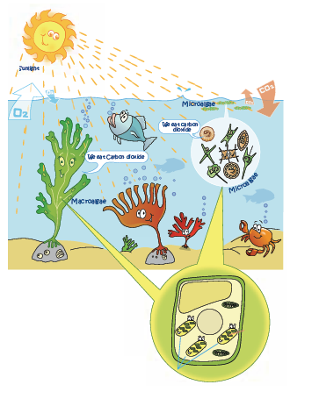
Algae make their own energy or food from the sun but they also need water, correct temperature and nutrients to grow. Algae generally live in water or damp environments.

Slide 4
Algae also need carbon dioxide to make sugars. Carbon dioxide is made from pollution such as smoke, fumes from cars and a little carbon dioxide is made when plants breathe at night when there is no sunlight. Algae are good for the environment as they absorb carbon dioxide from the atmosphere and use it to make energy. Algae also need nutrients to grow and they find the nutrients in water. Algae absorb the nutrients through their entire body. While algae is making energy for themselves they are also producing oxygen for humans.

Slide 5
What causes Algae to grow?
For algae to grow it needs light and nutrients. Both the aquarium and room light can cause algae to grow. If your tank is getting more than 10 hours of light a day you may notice green algae starting to grow. Warm water and ‘nitrates’ (which build up from not doing regular water changes) will cause algae to grow quickly.
Also if phosphates are present, they will promote algae growth.

Slide 6
The process of how algae make energy from the sun is called “ Photosynethesis”. It is like cooking, the main ingredients that algae need to make their energy and give us oxygen are:
Sunlight + Chlorophyll (in their cells) + Carbon Dioxide + Water = Glucose + Oxygen

Slide 8
1. Lag or induction phase
This phase during which little increase in cell density occurs is relatively long when an algal culture is transferred from a plate to liquid culture.
2. Log or exponential phase: the cell density increases as a function of time according to a logarithmic function.
3. Phase of declining growth rate; cell division slows down when nutrients, light, pH, carbon dioxide or other physical and chemical factors begin to limit growth.
4. Stationary plateau phase: the limiting factors and the growth rate are balanced, which results in a relatively constant cell density.
5. Death or "crash" phase: water quality deteriorates and nutrients are depleted to a level incapable of sustaining growth. Cell density decreases rapidly and the culture eventually collapses.

Slide 9
Oxygen is released into the environmet and both humans and animals can use it. Macroalgae contain air-bladders and some other types of macroalgae contain flexible stipes which bring the macroalgae to the surface of the water to catch the sunlight. In the case of microalgae, the tiny floating organisms are brought to the surface of the water by the movement of the currents and waves. This will help the microalgae to capture more sunlight.
Both macroalgae and microalgae absorb water, nutrients and gases from the water through their cell walls.
Important nutrients for the growth of macroalgae are carbon, nitrogen, phosphorus and oxygen.

Slide 10
Carbon is important for all living things. From the diagram we can see that carbon goes around in a cycle. That is why we call it a “Carbon Cycle”. Carbon is needed by the plants, rocks, animals and the soil. We return carbon to the atmosphere by buring, pollution from industry or when we use fuel in our cars. Other examples of putting carbon back into the atmosphere are humans and animals breathing out carbon dioxide into the air. This is called respiration.
Carbon enters the rivers, lakes and oceans from the atmosphere. Algae and plants use sunlight and carbon to make energy and release oxygen. Carbon is recycled when carbon enters the atmosphere and is used by algae and plants.

Slide 11
How can algae grow when there is no sun?
We know that throughout the world people live in different climates. This is the same for algae. Algae are found growing where there are suitable conditions for growth such as temperature, light and nutrients. Some algae grow in warm waters and others prefer cold waters.
Some macroalgae like to grow in very cold waters. These macroalgae are located in the Arctic and Antarctic. The waters of the Antarctic are covered by ice for the majority of the year. There are a few varieties of macroalgae found only in these cold waters. They do not grow anywhere else in the world. A tiny number grow in the Arctic but much more grow in the Antarctic. At certain times of the year they live in complete darkness. They are unable to use the sunlight to make their energy but survive on the energy stored in their cells.

Slide 12
uses of algae
Rich in nutrient
Oil production
Biodiesel production
Cosmetic products
Waste water biotreatment

Slide 13
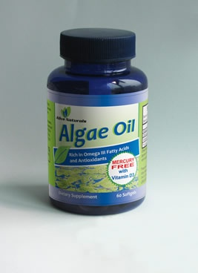
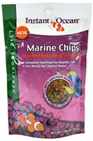
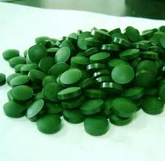
Rich in nutrients

Slide 14
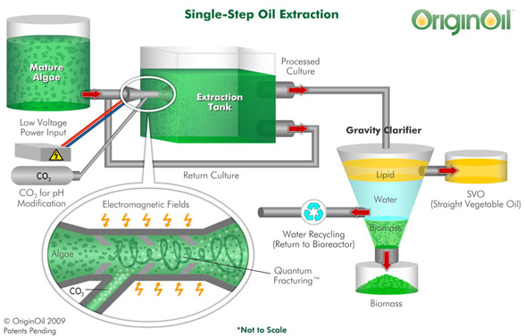
Oil production

Slide 15
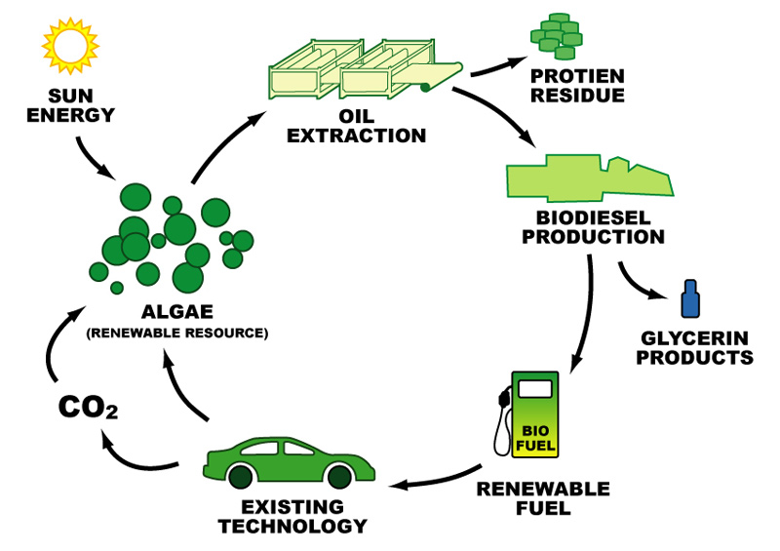
Biodiesel production

Slide 16
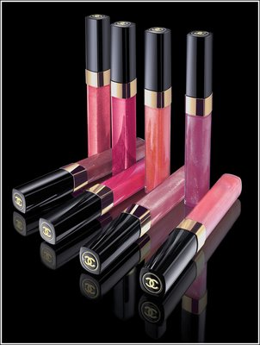
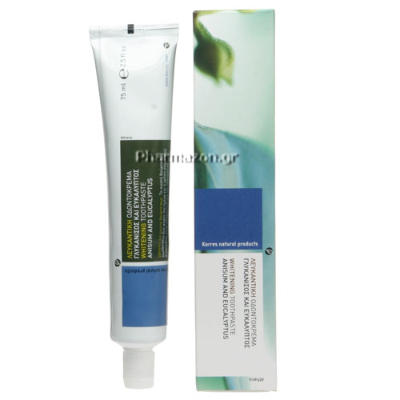
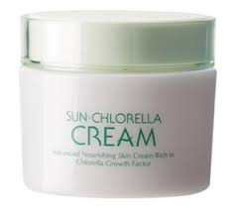
Cosmetic products

Slide 17
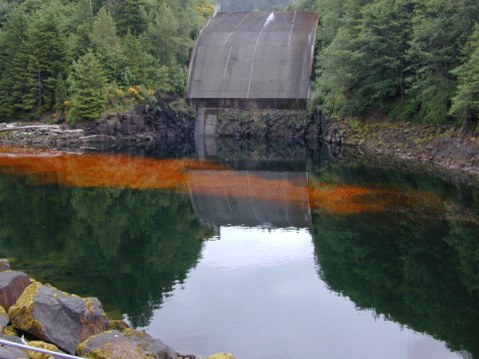
Wastewater biotreatment

Slide 18
How to control Algae:
1) Control the light received by the aquarium. The less light your tank gets, the less likely it is you will have algae. We suggest no more than 8-10 hours of light during the day. Be sure to turn the light off at night. Most hoods can be plugged into a light timer that makes controlling the light very easy.
2) Regular water changes. Algae uses excess fish food and fish waste for fertilizer. By doing regular water changes you will reduce the amount of “food” the algae has.
3) Live plants fight Algae. A densely planted aquarium will have fewer algae problems.

Slide 19
4) Certain fish are “Algae Eaters” and will naturally help to control algae growth.
5) Many chemicals are available to keep algae from growing. These chemicals are ”inhibitors” and will prevent some algae from starting to grow but will not get rid of algae after it has started.
6) Purchase a scraper or pad to remove algae from the sides of the aquarium. Don’t use anything from a supermarket to clean your tank, as it may contain soap deadly to fish!

Slide 20
Algae blooms or green water problems
An algae bloom is a suspended algae that makes the water green but does not grow on glass or ornaments. In some cases this appears overnight! If this happens to your tank the best way to get rid of it is by ‘starving” the algae. Cover the tank with newspaper so it is completely dark for 48 hours (during this time only feed every other day). This will cause the algae to die. We sell a product called “Velvet Guard” which works wonders on this condition as well. After 48 hours, do a 1/3-water change. If it is still a bit green or cloudy you can use a water clarifier such as “Acurel-F”. In some cases the water change may have to be repeated.

Slide 21
Cultivating Algae for Liquid Fuel Production (http://oakhavenpc.org/cultivating_algae.htm); NREL, 2005
Department of Energy, Office of Fuel Development. “Aquatic Species Program”. 1996.
Enhanced Biofuels & Technologies Ltd. 2007. Accessed: http://www.ebtplc.com/c4c.htm
Guiry, M.D. and Blunden, G. (Eds) 1991. Seaweed Resources in Europe: Uses and Potential. John Wiley & Sons. ISBN 0-471-92947-6
Mumford, T.F. and Miura, A. 1988. 4. Porphyra as food: cultivation and economics. p.87 — 117. In Lembi, C.A. and Waaland, J.R. (Ed.) Algae and Human Affairs. 1988. Cambridge University Press. ISBN 0 521 32115 8
John Sheehan, Terri Dunahay, John Benemann and Paul Roessler, "A Look Back at the U.S. Department of Energy's Aquatic Species Program-Bio-diesel from Algae, Closeout Report", July 1998, NREL/TP-580-24 190 http://www.nrel.gov/docs/legosti/fy98/24190.pdf
Michael Briggs, Widescale Biodiesel Production from Algae, University of New Hampshire, Physics Department, revised August 2004. http://www.unh.edu/p2/biodiesel/article_alge.html
Sheehan, J., T. Dunahay, J. Benemann, and P. Roessler. 1998. A look back at the U.S. Department of Energy’s aquatic species program - Biodiesel from algae. US Dept. Energy, Office of Fuels Development, Nat. Renewable Energy Lab., Golden, CO.
Solix BioFuels, 2006. accessed: http://www.solixbiofuels.com/index.php?option=com_content&task=view&id=12&Itemid=26
Websites:
http://www.ecology.com/dr-jacks-natural-world/most-important-organism/index.html
http://journeytoforever.org/biodiesel_yield.html

Slide 22
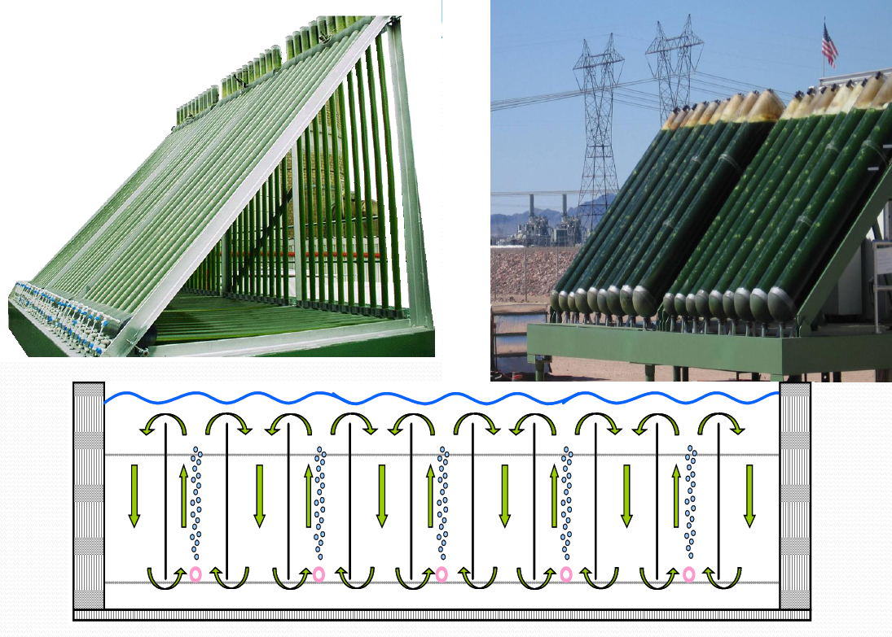
Thank you for your attention

