Slide 1
Action on water, climate and FSN – perspectives from GWP
Julienne Roux, GWPO

Slide 2
From global recommendations to the ground
Urgency to act: well demonstrated, not enough emphasized nor translated into action
Importance of global dialogues: CFS 2015, GFFA 2017 communique
  Uniqueness of CFS approach: knowledge based, multi-stakeholder platform
  GFFA 2017: call for action of the Ministers of agriculture on Enhancing access to water, Improving water quality, Reducing water scarcity risks, Managing surplus water
Taking the global recommendations to the country level:
  2015 – 2017: country multi stakeholder dialogues and regional exchanges in Sub-Saharan Africa, directly building on CFS recommendations
  Accompanying country dynamics: important drivers and dynamics around basin management, climate adaptation, drought management, support needed for water investments, water – energy – food nexus, on-the-ground demos...

Slide 3
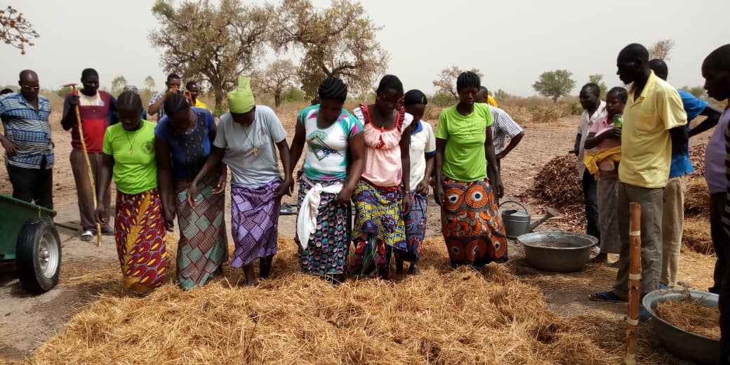
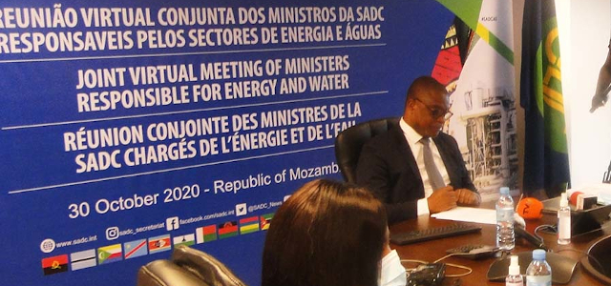
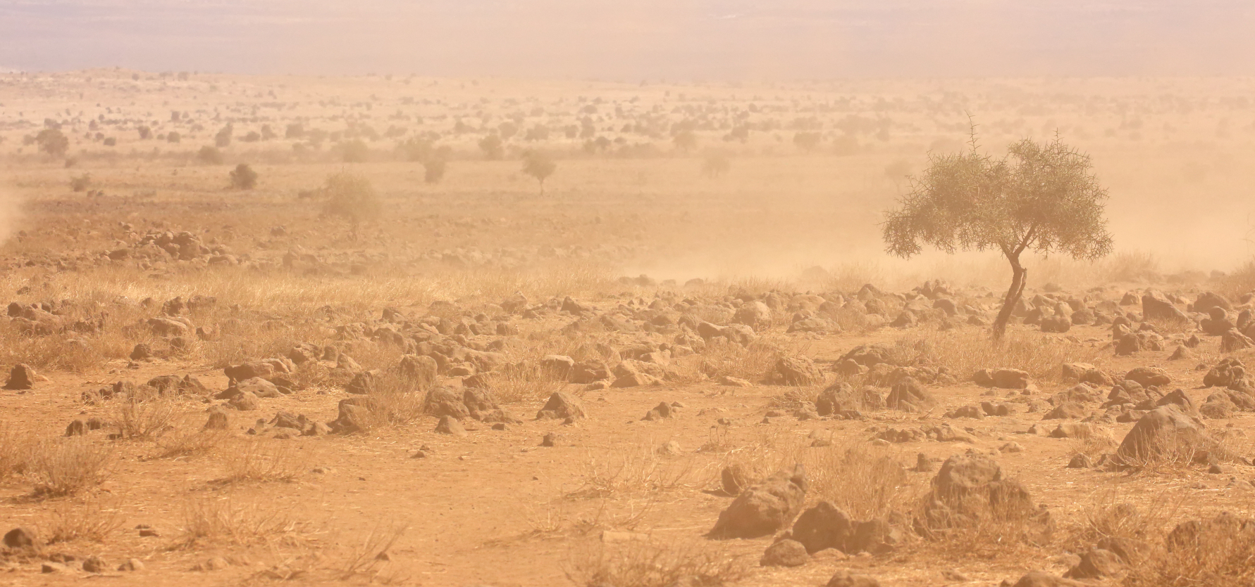
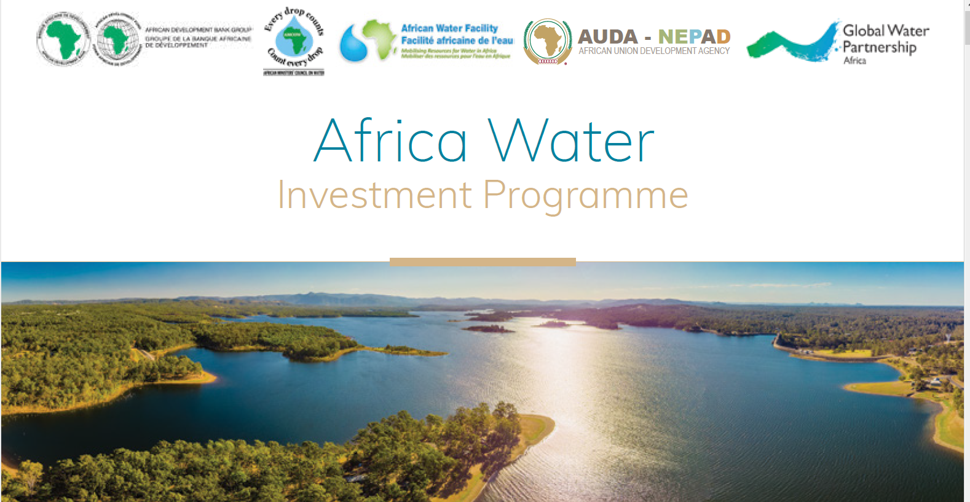
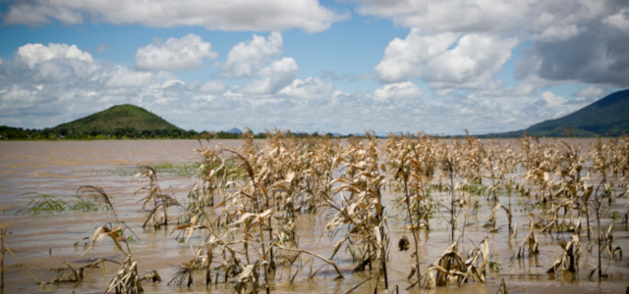
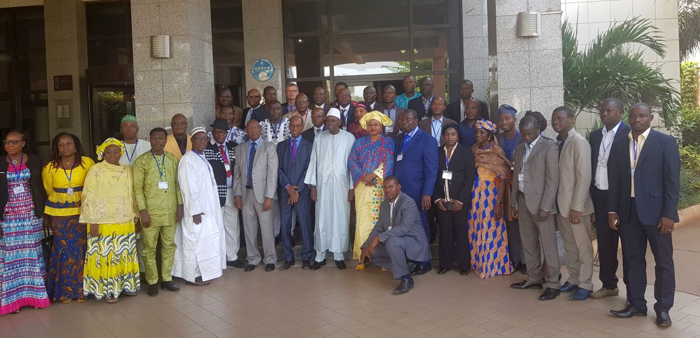
In practice – examples from Africa
DRESS – EA: Early warning systems and drought adaptation actions to enhance smallholder farmer and pastoralist resilience to climate change in IGAD region, with OSS
On the ground pilots focused on youth empowerment, agroecology and agroforestry in West Africa
SADC Water - Energy - Food Nexus Governance Framework, approved by Ministers
Dialogue on Investments for Food Security in Water - Energy – Food - Ecosystems Nexus in West Africa
Credits: GWP
Supporting Zambia to Integrate the Agriculture Sector into the National Adaptation Plan
Transforming the investment outlook on water in Africa

Slide 4
Accelerating action
Amplify water focus in global agricultural agendas
Increase global to national linkages
Mobilize leadership
Act before crisis point
Specific points of attention:
  Build shared understanding and acculturation water – agriculture
  Take a systems approach to food and water
  Knowledge & monitoring of water resources
  Promote economically, environmentally, socially performant agriculture
  Recognize trade-offs and promote transparent and inclusive decision-making
  Attention to the poor and most vulnerable, including women

