Slide 1

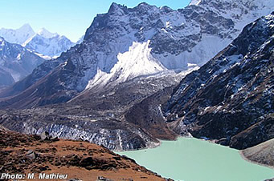
Wel Come from
Nepal

Slide 2
Using Population Census to improve Agriculture Statistics in Nepal
FAO-AFMA
Regional Workshop on Sampling for Agricultural Censuses and Surveys Bangkok, Thailand
14-18 May
2012
Ambika Bashyal
Central Bureau of Statistics
Hem Raj Regmi
Ministry of Agriculture and Cooperatives
Nepal

Slide 3
Inside This Report
General Background of the country.
Statistical System of Nepal
History of Population Censuses
History of Agriculture Censuses in Nepal
Use of Population Census in Ag Census
Details about latest Agriculture Census
Conclusions

Slide 4
General Background of the country
Situated in between India and China is a residence of 27 million people with more than 100 caste and ethnicity and languages
Share of agriculture in total GDP is about 35% and population engaged in Agriculture sector as their main occupation are 66%
GDP growth rate is only about 3% in average for last 5 years
Physically divided into three belts Mountains , hills and Terai (low land).
The elevation ranges from 80 m to 8848 m( highest peak of the world; the mount Everest)
Politically divided into 5 development regions, 14 zones and 75 districts.
Major Agriculture commodities are paddy, maize, wheat as cereal, sugarcane, cardamom, ginger, tea as cash and fruits and vegetables as well as livestocks.

Slide 5
Nepal; Physiographic and Administrative

Slide 6
Statistical System of Nepal
Central Bureau of Statistics (CBS), established under Statistics Act, 1958 is a sole agency for the collection, consolidation, publication and analysis of statistics.
Initially the statistical system of Nepal was highly centralized.
Gradually, statistical activities became decentralized as it was not possible to meet the growing demand by CBS alone.
Various ministries, departments, public corporations started to collect, process, and publish data as per their needs.

Slide 7
National Statistics Council
NSC coordinates the statistical activities with the following mandates
  to develop an Integrated Statistical System by formulating short term and long term Statistical Plans and policies and implementing them so as to ensure the availability of relevant, reliable and high quality data;
  to bring about co-ordination among all the governmental and non-governmental organizations that conduct economic and social data collection, processing, analysis and publication activities; and
  to develop a standardized statistical system

Slide 8
Agriculture Statistics System of Nepal
Ministry of Agriculture and Cooperatives (MoAC) and CBS are the two major agencies responsible for generating agriculture statistics.
MoAC is responsible for generating current agriculture statistics whereas CBS is undertaking Census of Agriculture (decennial) and other ad hoc agriculture surveys.

Slide 9
Agriculture Statistics System of Nepal ...
The MOAC that regularly publishes comprehensive statistics on agriculture sector.
The data published are advanced estimation of district level statistics on cereal crops, cash crops, pulses, livestock, poultry, fishery and horticulture.
These data are based on the field reports (of the extension workers), sample surveys and crop cutting experiments.

Slide 10
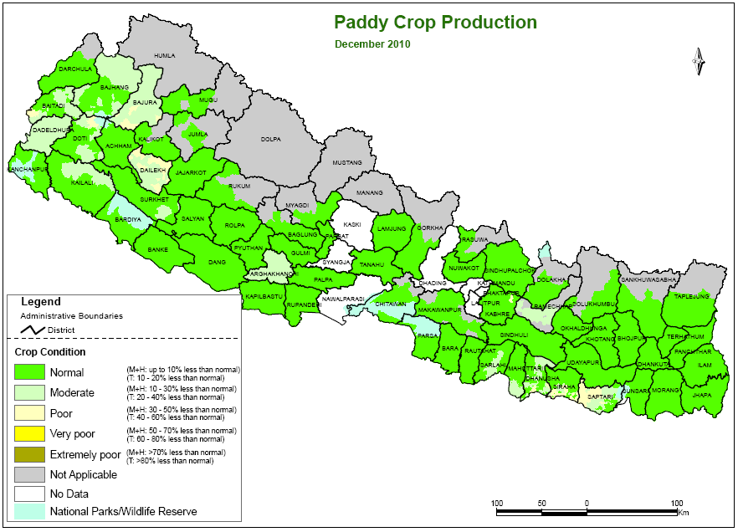
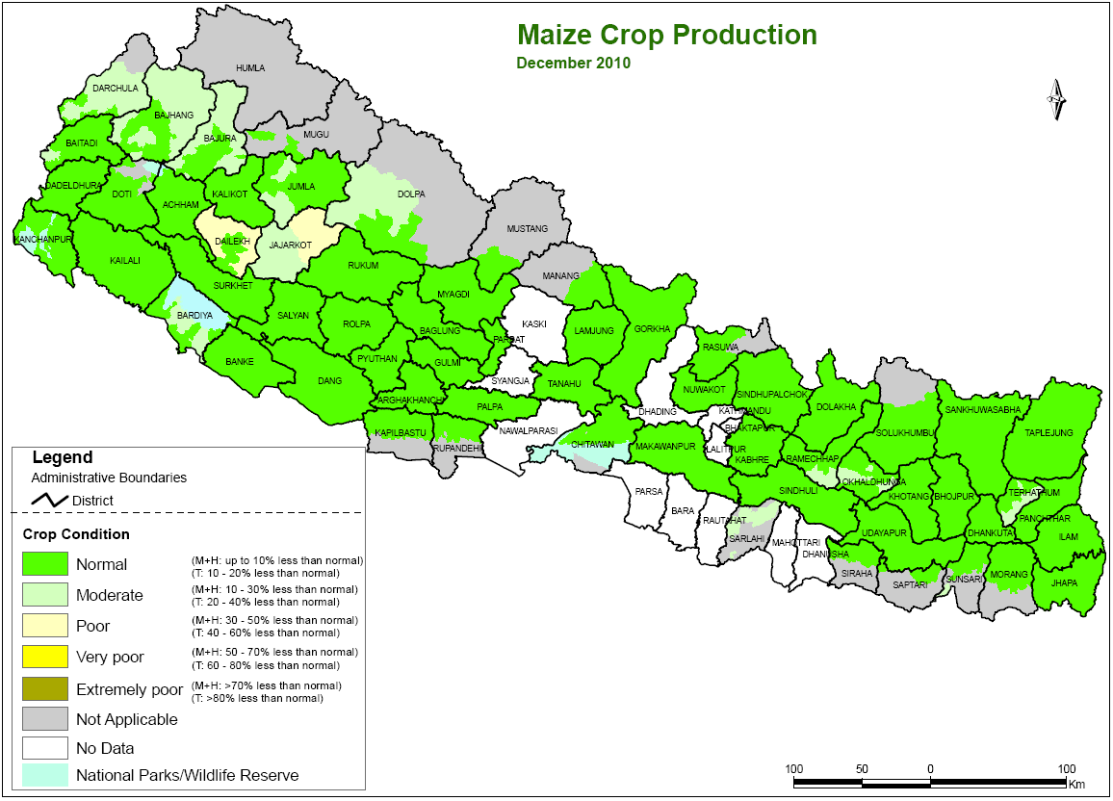
Major Crops of Nepal

Slide 11
Major Crops of Nepal

Slide 12
Integrated Agricultural Statistics System
Population Census (agricultural modules)
Agricultural Censuses within framework of integrated agricultural statistics system
Agricultural surveys

Slide 13
Population Censuses in Nepal
First Census 1911
Second, Third, Fourth
1951/52 Fifth with International Standard
Sixth, Seventh, Eighth, Ninth
Tenth in 2001
Eleventh in 2011; 100 years of census operation
Data processing still going on; Preliminary reports published

Slide 14
Census of agriculture
A statistical operation for collecting, processing and disseminating data on the structure of agriculture, covering the whole or a significant part of the country (WCA 2010)
Size of holding, land tenure, land use, crop area harvested, irrigation, livestock numbers, labour and other agricultural inputs.

Slide 15
Agricultural Censuses in Nepal
1961-62 First
1971-72 Second
1981-82 Third
1991-92 Fourth
2001-02 Fifth
2011-12 Sixth; 50 years of census operation
  A system of integrated agricultural censuses and surveys -- World Programme for the Census of Agriculture 2010
  Modular Approach

Slide 16
Agriculture related questions in Population Census, 2011
Following two questions with detail options were included in household listing questionnaire of country’s Population census 2011 for preparing the frame for Agriculture Census 2011/12.
hyperink

Slide 17
Agriculture related questions in Population Census, 2011 cont.
Does your household operate any land for agriculture purpose?
Yes/ No
If yes, the total area of the land in different local units
1) Bigha 2) Katha 3) Dhur ; Terai
4) Ropani 5) Ana 6) Paisa; Hills/mountains

Slide 18
Agriculture related questions (Contd.)
Does your household raise livestock/poultry for agriculture purpose?
Yes/ No
If yes, the total number of livestock/poultry for agriculture purpose (Detail livestock numbers first time)
Livestock
Cow/Ox b) Buffalo c) Yak/ Nak/ Chauri
d) Horse/Ass e) Sheep f) Goat g) Pig/pork h) Other
Poultry
a) Chicken b) Duck c) Other

Slide 19
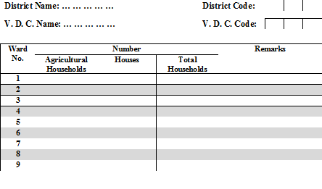
Format used for transcribing number of agricultural households in a VDC from the “House/Household Listing Form” of the 2011 Population Census

Slide 20
Detail Sampling Frame
A frame is the “keystone” of the sample design. The sampling design under consideration proposes to use the information from the following sources for the frames to be used at different stages of sample selection.
Number of agricultural households in each ward obtained from the “House/Household Listing Form” of the 2011 Population Census, and
Listing of agricultural holdings in the selected PSUs (to be carried out prior to the census enumeration of the NCA

Slide 21
Detail Sampling Frame, cont.
For the above mentioned sampling design, at least two types of frames are identified:
  Frame for selection of PSUs, and
  Frame for selection of holdings
  the sampling frame for PSUs was based on the data collected in the 2011 Population Census of Nepal. The frame contained listing of wards and blocks, along with the number of houses, households and agricultural households

Slide 22
Agricultural Household
Answers to questions regarding agriculture and /or livestock /Poultry must be “Yes”
Cut offs
  At least 4 Anna in Hill and mountain districts
  At least 8 dhur in Tarai districts
  Raising at least one big head (Cow, Buffalo)
  Raising at least 5 small heads (Goats, sheep etc.)
  Raising at least 20 poultry (birds, fowl, ducks.)

Slide 23
Sample Design Parameters
CV, Deff and Rate of Homogeneity are available for Agri. Census 1991/92 for all 75 districts for following parameters:
  Area of Holdings
  Area Under Paddy
  Area under Maize
  Number of Cattle
  Farm Population
  Holdings with Rice

Slide 24
Sampling Design - considerations
Objectives
Sampling frames
Stratified multistage designs
Stratification – explicit, implicit
Sampling units at different stages
Sample size
Methods of selection at different stages

Slide 25
Sampling Design
The sampling design is stratified multistage sampling with
  Districts as strata; Based on three years average area of 9 major crops published from MOAC
  Rural areas - Wards as PSUs
  Urban areas – EAs as PSUs
  Agricultural holdings as SSUs

Slide 26
Sampling Design (Contd.)
  Selection of PSUs following PPS systematic sampling with number of agricultural holdings in the PSUs as size measures
  Selected PSU’s were completely enumerated for listing of holdings for selecting SSU for collecting detailed information

Slide 27
Sampling Design (Contd.)
  Holdings to be grouped into four implicit strata based on holding sizes
  Less than 1 Bigha/10 Ropani
  1 to 3 Bigha/10 to 20 Ropani
  More than 3 Bigha/ 20 Ropani
  Only having livestock and poultry

Slide 28
Detail Sample Size
 | VDC/Mun | Wards | PSUs |  | Sample
NEPAL | 3,960 | 36,022 | 36,257 |  | 5,200
Ecological belt
Mountains | 532 | 4911 | 4,477 |  | 861
Hills | 2,034 | 18,443 | 18,502 |  | 2,503
Tarai | 1,394 | 12,668 | 13,278 |  | 1,836
Development region
Eastern | 907 | 8,216 | 8,438 |  | 1,199
Central | 1,219 | 11,097 | 11,351 |  | 1,379
Western | 864 | 7,945 | 7,792 |  | 1,134
Midwestern | 581 | 5,248 | 5,174 |  | 938
Far western | 389 | 3,516 | 3,502 |  | 550

Slide 29
Allocation Plan
It provides a better distribution of resources and also provides a balance between district and national level estimates
The size measure used for allocation was based on area under 9 important crops as obtained from Ministry of Agriculture
Minimum number of EAs was taken as 50 from each district (livestock was a prime consideration)

Slide 30
District wise Allocation of PSUs
In the present census compromise power allocation has been followed:
The size measure used for allocation of PSUs was based on area under 9 major crops as obtained from Ministry of Agriculture and Cooperatives
Minimum number of EAs was taken as 50 from each district (livestock was a prime consideration)
It provides a better distribution of resources and also provides a balance between district and national level estimates

Slide 31
Standard Errors
National Level less than 1%
Development 3 to 5% in Far West
Regions 2 to 3% in other regions
Ecological Belts: less than 2% in Hill & Tarai
around 3% in mountain belt
Districts: around 4 to 6 % for major aggregates in important districts

Slide 32
Census Questionnaire; WCA 2010 –a modular approach
Combination of
Core modules
  5 among 16 items (compete enumeration)
  and
Thematic Supplementary modules (sample based)
  12 themes
Questionnaires prepared in view of WCA 2010 document data items
Notes:
32

Slide 33
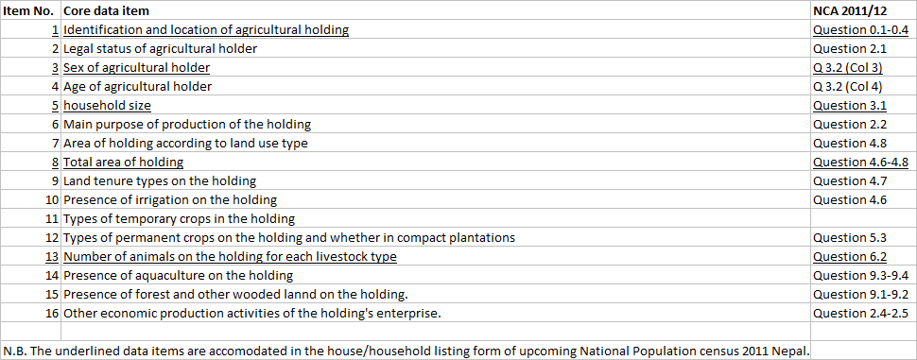
Ongoing Census Questionnaire

Slide 34
WCA 2010 –a modular approach, cont.
Among 16 recommended core data items in WCA 2010, Population Census consists following 5 core items
  Identification and location of agricultural holding
  Sex of agricultural holder
  household size
  Total area of holding
  Number of animals on the holding for each livestock type
  All above 16 items have been included in on going Agri Census for sample enumeration
  Which can be linked with each other

Slide 35
WCA 2010 –a modular approach, cont.
Among 12 thematic models, all 12 models have been covered by asking questions as per the country requirement

Slide 36
Conclusions
A list frame for large commercial and institution farms needs to be developed and updated
One of the major constraints in 2001-02 Agricultural Census was that no documentation of reliability of data was available; it is recommended to compute these indicator in the on going census
It is recommended that specific studies on qualitative aspects of NAC 2011-12 should be undertaken to facilitate planning of subsequent censuses and surveys

Slide 37
Conclusions (Contd.)
Special studies on emerging social data needs in agricultural sector are needed which can be undertaken utilizing the data from NAC 2011-12
Such studies should be preferably a part of Agricultural Census programme

Slide 38
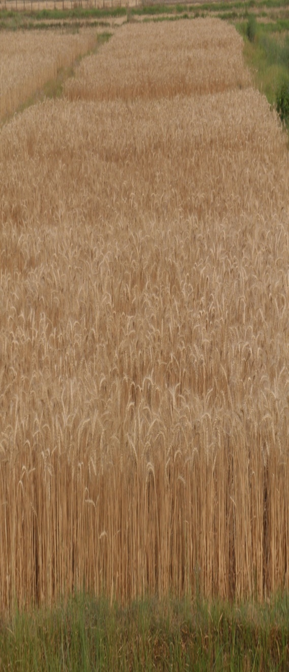
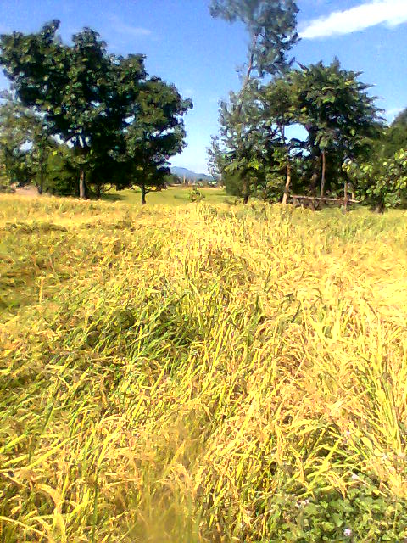
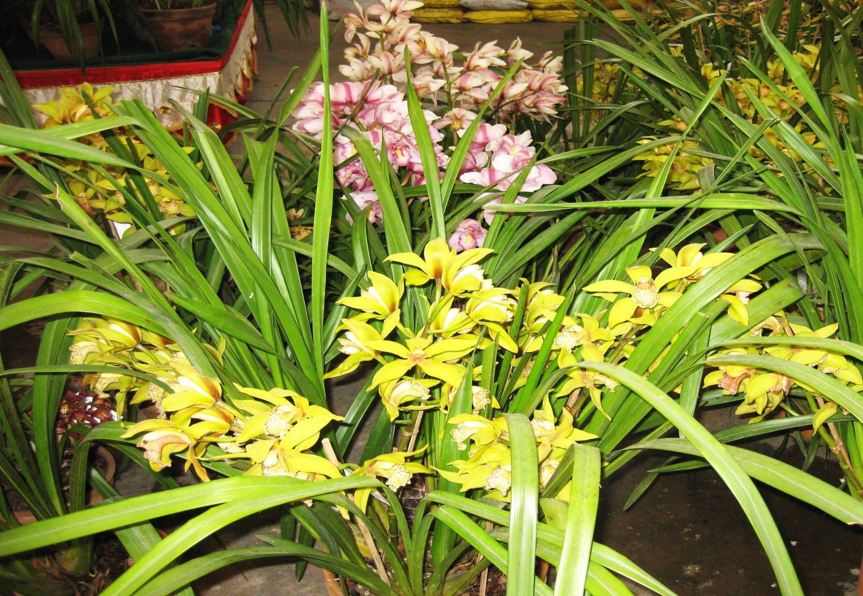
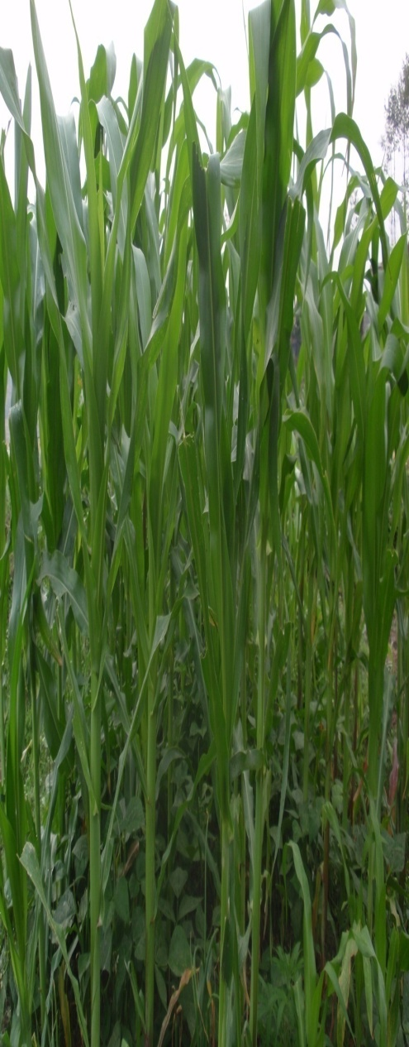
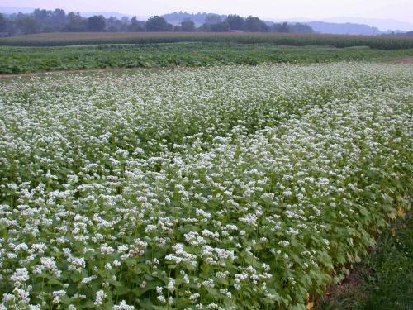
Any Questions, Comments, Suggestions?

Slide 39
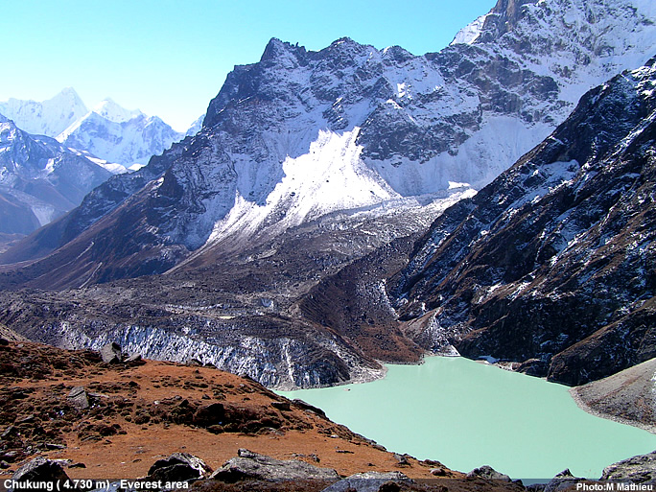
Thank You for your patience

