Slide 1
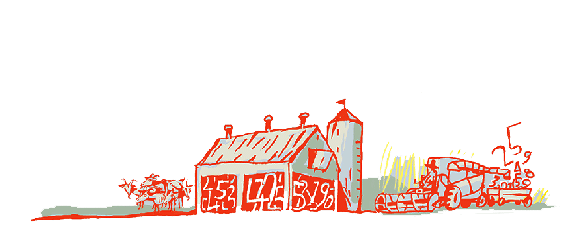
Regional Roundtable on
World Programme for the Census of Agriculture 2020 Port of Spain, Trinidad and Tobago
22-26 May 2017
Statistics Canada: Key Highlights from the 2016 Census and Vision for 2021
Technical Session 02
Etienne Saint-Pierre Statistics Canada
etienne.saint-pierre@canada.ca

Slide 2
Canadian Census of Agriculture 2016 – Key Highlights

Slide 3
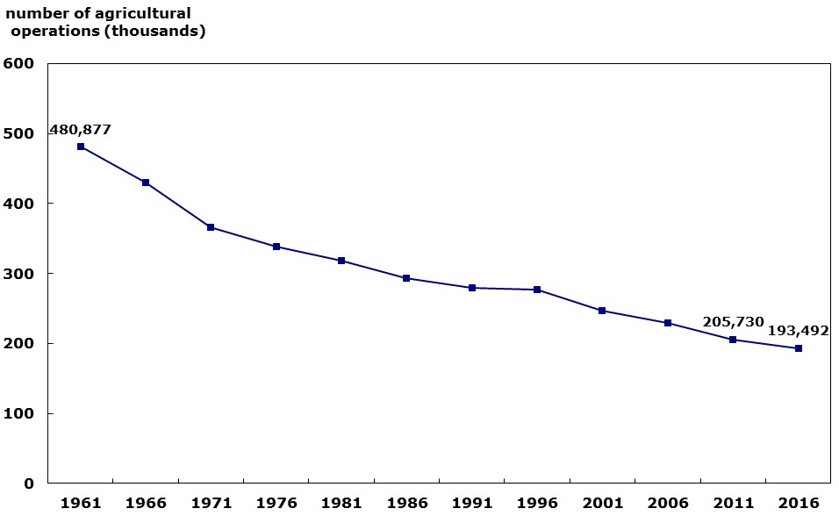
Number of agricultural operations in Canada
Source: Statistics Canada, Census of Agriculture 2016

Slide 4
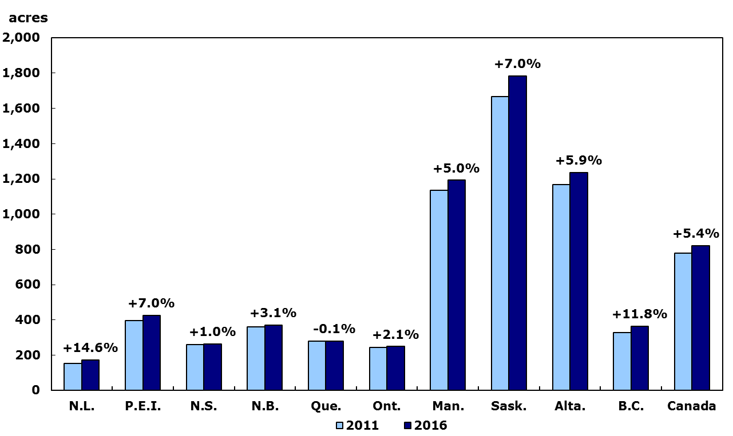
Average agricultural operation size, by province

Slide 5
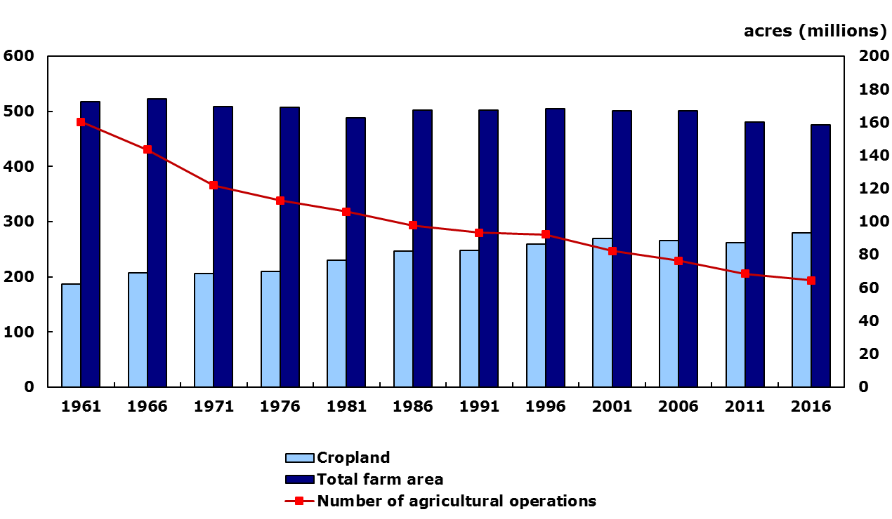
Crop area and number of agricultural operations - Canada
number of agricultural
operations (thousands)

Slide 6
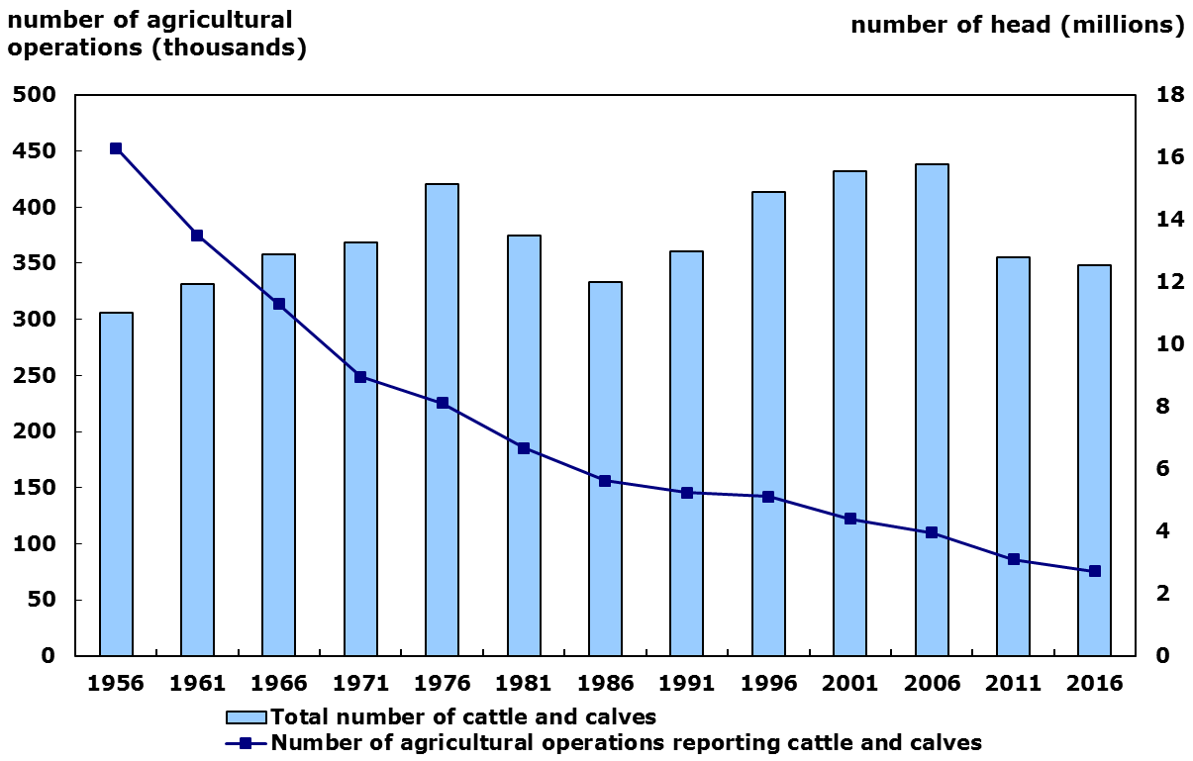
Total cattle and agricultural operations reporting cattle

Slide 7
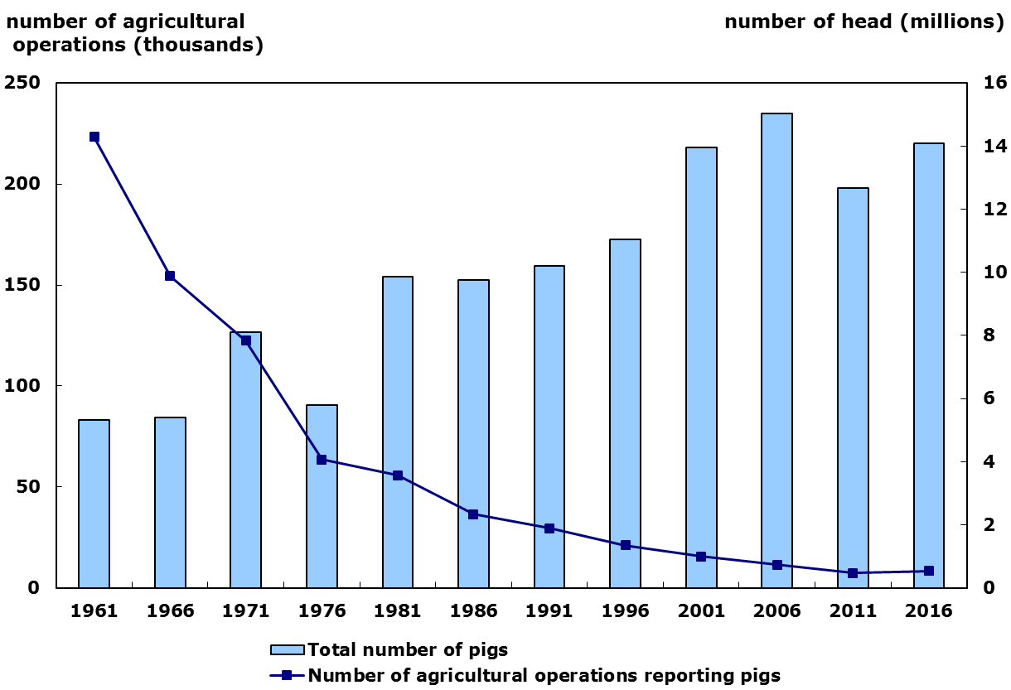
Total pigs and agricultural operations reporting pigs

Slide 8
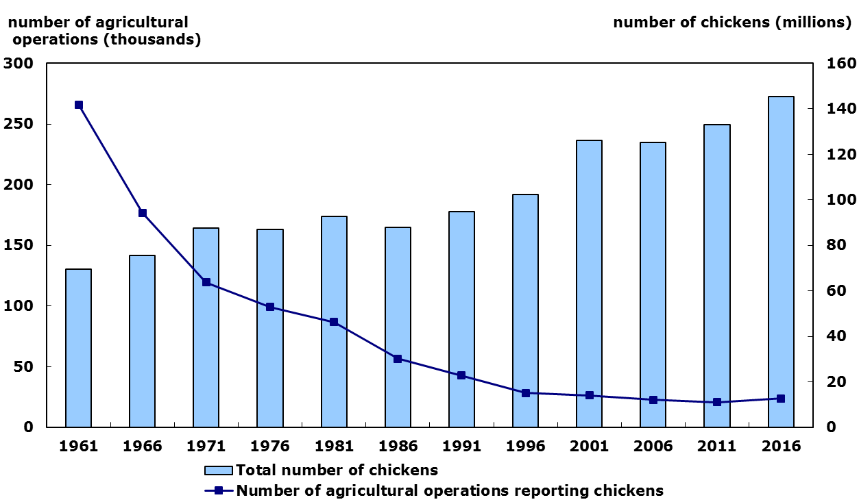
Total chickens and agricultural operations reporting chickens

Slide 9
Data Quality

Slide 10
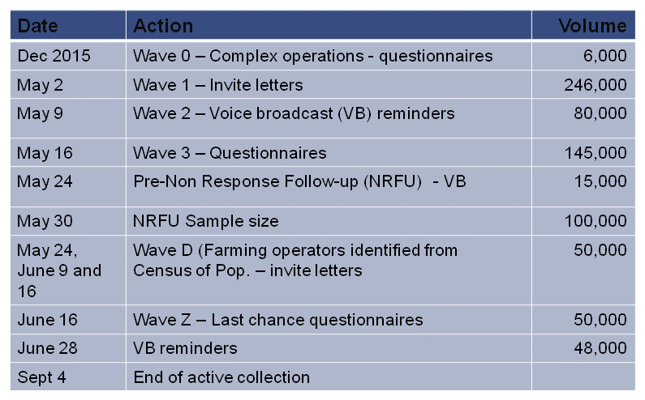
Multiple Collection Waves

Slide 11
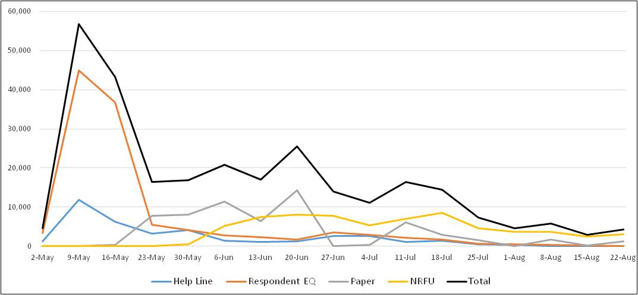
Weekly Response by Channel
Collection Modes

Slide 12
Dissemination Plan
Release date: May 10, 2017
Overall theme: Canadian agriculture continues to evolve and innovate. The popular depiction of agriculture as dominated by low-tech, small land-holdings is no longer valid.
7 thematic releases:
May 10: From the power of horses to the horsepower of tractors
May 17: A portrait of a 21st century farmer
May 24: Production efficiency and cyclical nature of livestock
May 31: Canadian farmers seeding decisions to harvest opportunities
June 7: Leveraging technology and market opportunities in a diverse horticulture industry
June 14: Innovation and investment pay off
June 21: Farmers innovate to get more from the market
June 30: 150 years of farming -infographic
“Road Shows” in provinces

Slide 13
Canadian Census of Agriculture 2021 – The Vision

Slide 14
Census 2021 – Key Pillars
The CEAG day will be in May 2021 – the same as Census of Population.
Not the optimal time for farmers – seeding season but...
...cost efficiencies for sharing communication, printing, postage, contracting, staffing with the Census of Population
Identification of new operators not yet on the Business Register
EQ will be considered as the primary collection mode; printing will be on demand only.
Planning assumption –65% to 70% EQ take-up rate
Maximize the use of EQ functionalities to reduce the time required to complete the questionnaire
Use interactive web mapping application for geo-coding

Slide 15
Census 2021 – Key Pillars (2)
CEAG will maximize its integration with existing platforms and tools used in the Economic Statistics Field (Governance, BR, Collection, IBSP, Disclosure Avoidance, IT support).
Use of corporate services / generalized systems
Better integration with other business statistics programs (e.g. Environment, Manufacturing, Trade)
Harmonized content between CEAG and other surveys / programs
CEAG program hooked to the BR
Annual Agriculture Frame Update Survey
Modular approach for the questionnaire
Common data repository and analytical tools
Rolling Estimates

Slide 16
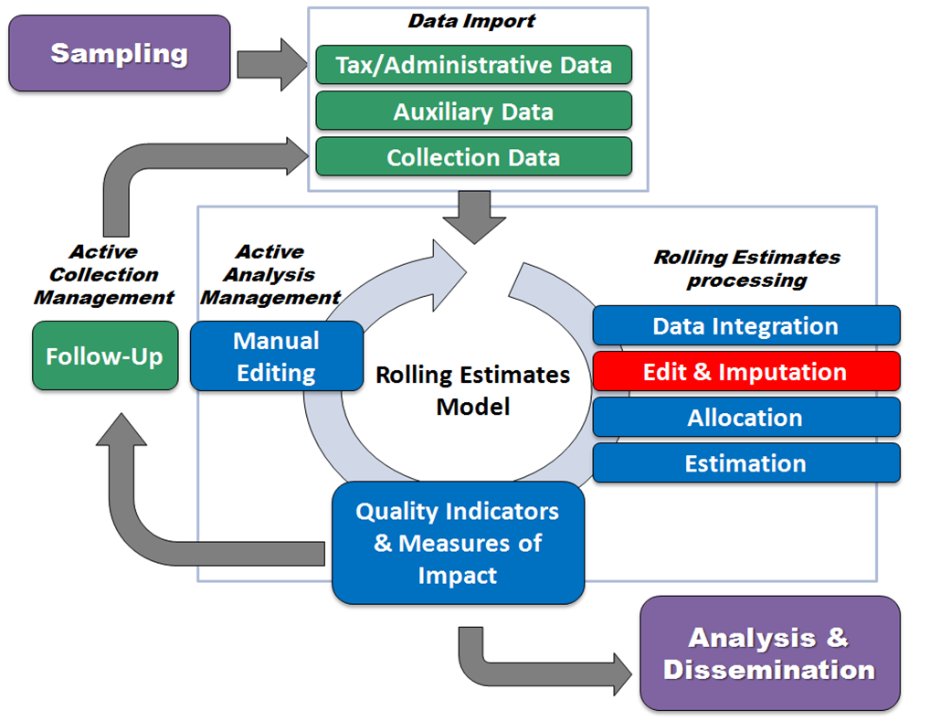
Census 2021 – Key Pillars (3)
Rolling Estimates

Slide 17
Census 2021 – Key Pillars (4)
“In Field” collection will be an option for the more complex farms.
Consolidation of farms / contracting
Visit to profile operations and collect the census information
Special skills – knowledge of the industry / business register /enumeration
There will be a review of the Disclosure Avoidance methodology.
Publish more data without compromising confidentiality of respondents
Perturbation methods
Decision tree

Slide 18
Census 2021 – Key Pillars (5)
CEAG will maximize the use of administrative data, Earth observation data and survey data in their processes.
Enhanced data integration in CEAG using administrative lists (quotas, crop insurance, traceability) and satellite images
Harmonisation and integration of the content with other survey programs
Exploration for new external sources for the 2026 cycle
Implement tax data replacement of detailed expenses and revenues
From a pure Classical Approach to the Use of Registers as a partial source of census data.
Frame information, Validation, Imputation, Data Replacement

Slide 19
Towards Census 2026
CEAG 2021: a transition for the major transformation expected in 2026
Decoupling from the Census of Population 2026
Moving from the Classical Approach to the Use of Registers (including Earth observation data) and / or the Integrated Census and Survey Modality (?)

Slide 20
Thank you

