Slide 1
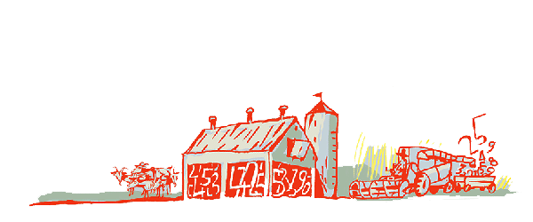
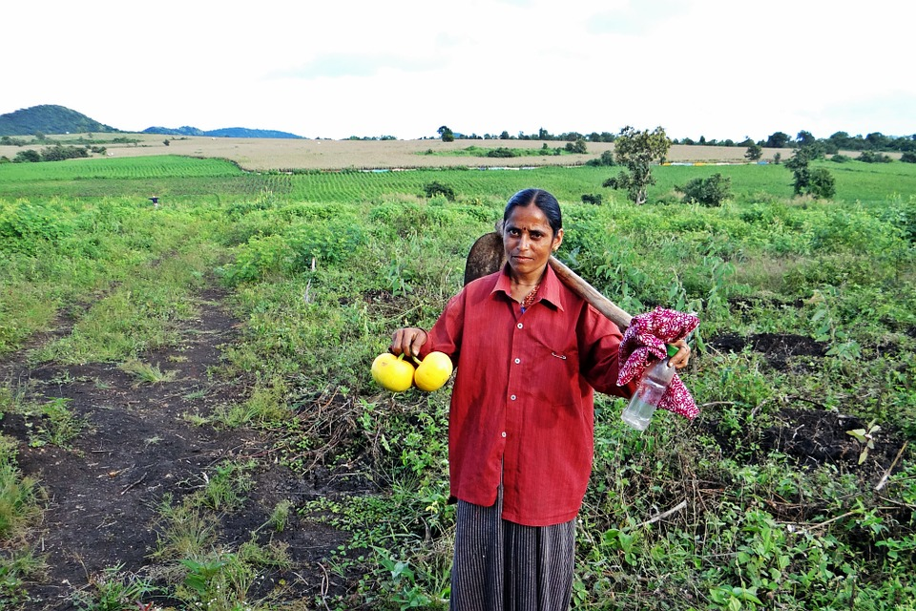
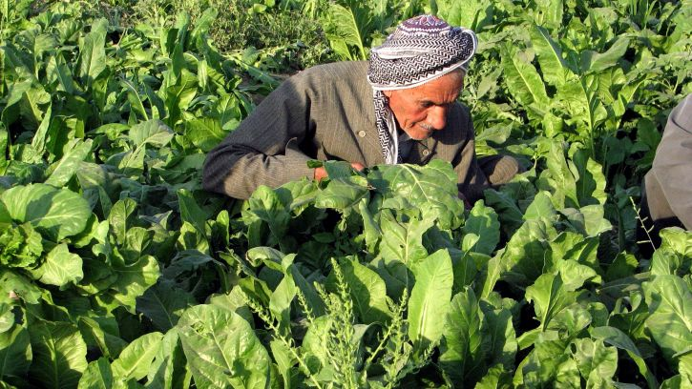
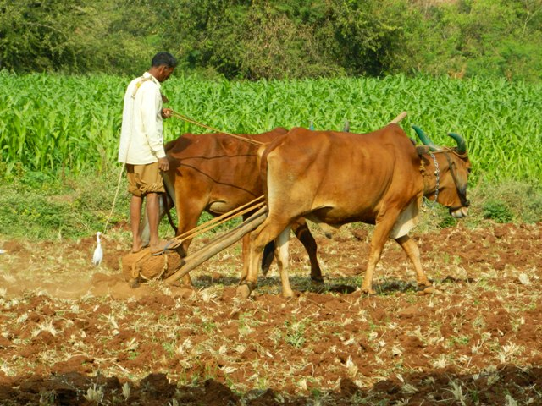
Regional Roundtable on
World Programme for the Census of Agriculture 2020
Port of Spain, Trinidad and Tobago
22-26 May 2017
Theme 9: Work on the holding
Technical Session 12
Oleg Cara
Agricultural Census and Survey Team
FAO Statistics Division

Slide 2
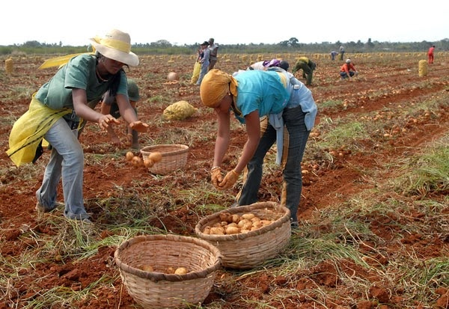
Contents
Background
General concepts and definitions
Items
Concepts and definitions of items
Country experiences

Slide 3
Background
In the WCA 2020 “work” concepts has been updated to be consistent with the resolution adopted by the International Labour Organization (ILO) in 2013.
The title of the theme “Farm Labour” of the WCA 2010 Programme has been changed to “Work on holding” in the present Programme to reflect the new concept of work after the above mentioned resolution.
As a consequence, several items of the previous Programme has been modified:
  “Activity status” was modified as “0904 Labour force status”
  “Time worked on the holding” was modified as “0902 Working time on the holding”
  “Number of employees on the holding: time worked and sex” as “0903 Number and working time of employees on the holding by sex”.

Slide 4
General concepts and definitions
Two types of work inputs are covered by the agricultural census:
  Work provided by household members
  Work provided by outside workers
The ILO resolution (2013) defines the basic concept of work as “any activity performed by persons of any sex and age to produce goods or to provide services for use by others or for own use”.
Work is defined irrespective of its formal or informal character or of the legality of the activity.
Work, as defined in the ILO resolution, can be performed in any type of economic unit as distinguished by the System of National Accounts (SNA) 2008, namely: (i) market units; (ii) non-market units; and (iii) households that produce goods or services for own final use.

Slide 5
General concepts and definitions (contd)
5. The ILO resolution identifies five mutually exclusive subsets of work activities or forms of work:
own-use production work, comprising production of goods and services for own final use (an unpaid form of work)
employment work, comprising work performed for others in exchange for pay or profit;
unpaid trainee work
volunteer work
other work activities (including such activities as unpaid community service and unpaid military or alternative civilian service).

Slide 6
General concepts and definitions (contd)
6. The theme collects information about the working age population. To
determine the working age population, the Resolution recommends that:
(i) the lower age limit should be set taking into consideration the minimum age for employment and exceptions specified in national laws or regulations, or the age of completion of compulsory schooling; and
(ii) no upper age limit should be set.
7. To facilitate international comparisons, tabulations should distinguish between persons aged less than 15 years and those aged 15 years and above. Where countries set the minimum age limit below ten years, tabulations should also distinguish children aged less than ten years.
Notes:
A minimum age limit lower than that used to define the working-age population may be appropriate in countries where children often participate in agricultural work. To facilitate international comparisons, tabulations should distinguish between persons aged less than 15 years and those aged 15 years and above. Where countries set the minimum age limit below ten years, tabulations should also distinguish children aged less than ten years.

Slide 7
General concepts and definitions (contd)
8. Operational definitions on relevant forms of work:
  Persons in employment are defined as all those of working age who, during a short reference period (that is, seven days or one week), were engaged in any activity to produce goods or provide services for pay or profit.
  Persons in own-use production work of goods are defined in the Resolution as all those of working age who, during a short reference period (that is, four weeks or one calendar month) performed any activity to produce goods for own final use for a cumulative total of at least one hour.
Notes:
For the purpose of this theme, the working-age members of the agricultural holding’s household that have worked on the holding will be considered as being in own-use production work if the holding’s intended destination of production during the census reference year has been primarily for own use and the person meets a minimum threshold number of hours worked, defined by countries according to national circumstances.

Slide 8
General concepts and definitions (contd)
9. Operational definitions related to labour force status:
  The labour force status of a person of working age may be in one of three mutually exclusive categories, namely:
    in employment
    in unemployment
    outside the labour force
  Persons in unemployment are defined as all those of working age who: (i) were not in employment; (ii) carried out activities to seek employment during a specified recent period; and (iii) were currently available to take up employment given a job opportunity.
  Persons outside the labour force are those of working age who were neither in employment nor in unemployment during the reference period.

Slide 9
Use of the agricultural census reference year and questionnaire design issues
The new work statistics framework uses short reference periods (such as one week or one month) for the operational definitions of the forms of work concepts. However, for the census items in the present theme, the reference period is the census reference year.
As for items in the agricultural census, countries need to carefully design questionnaires for the collection of data related to work on the holding, suitable to national circumstances to ensure that the report is as complete and accurate as possible.

Slide 10
Items
Theme 9 comprises the following items:
0901: Whether working on the holding is the main activity (for each household member of working age, identifying the sex) | 0904: Labour force status (for each household member of working age, identifying the sex)
0902: Working time on the holding (for each household member of working age, identifying the sex) | 0905: Status in employment of main job (for each household member in employment, identifying the sex)
0903: Number and working time of employees on the holding by sex (for the holding) | 0906: Form of payment for employees (for the holding)
0907: Use of contractors for work on the holding according to type (for the holding)

Slide 11
Item 0901: Whether working on the holding is the main activity (for each household member of working age, identifying the sex)
Type: Essential item
Reference period: Census reference year
Purpose of the item: The purpose of this item is to determine whether or not, during the census reference year, the household member spent more time working on the agricultural holding than outside the holding

Slide 12
Item 0902: Working time on the holding (for each household member of working age, identifying the sex)
Type: Essential item
Reference period: Census reference year
Purpose of the item: This item has two objectives:
  To collect information on the volume of work contributed by household members to the operation of the holding, both in paid and unpaid forms of work
  To obtain data on the number of household members working on the holding, disaggregated by sex.
Concept: Working time “comprises the time associated with productive activities and the arrangement of this time during a specified reference period”.
Notes:
The measurement of working time can be done based on the assessment of hours or days worked on the holding, or by using broad categories such as full-year/part-year or full-time/part-time, as feasible and relevant to national circumstances. Full-year/part-year work measures the number of months or weeks of work carried out during the year. Full-time/part-time work measures the number of hours worked per day or week, as assessed against a norm such as an eight-hour day or a 40-hour week.

Slide 13
Item 0902: Working time on the holding (for each household member of working age, identifying the sex) (contd)
Working time can be measured based on the assessment of hours or days worked on the holding, or by using broad categories, as feasible and relevant to national circumstances.
Based on a broad categories approach the following options can be considered:
    Present data according to specified weeks/months per year and hours per day/week groupings;
    To summarize working time according to the following six categories:
Full-time work during 1-3 months in the year
    Full-time work during 4-6 months in the year
    Full-time work during 7 or more months in the year
    Part-time work during 1-3 months in the year
    Part -time work during 4-6 months in the year
    Part -time work during 7 or more months in the year.
Notes:
The measurement of working time can be done based on the assessment of hours or days worked on the holding, or by using broad categories such as full-year/part-year or full-time/part-time, as feasible and relevant to national circumstances. Full-year/part-year work measures the number of months or weeks of work carried out during the year. Full-time/part-time work measures the number of hours worked per day or week, as assessed against a norm such as an eight-hour day or a 40-hour week.

Slide 14
Item 0902: Working time on the holding (for each household member of working age, identifying the sex) (contd)
It is recommended that the number of persons who worked on the holding during the census reference year as well as working time of such persons, be cross-tabulated:
according to whether the work is in:
      employment or
      own-use production work
by sex.
Notes:
The measurement of working time can be done based on the assessment of hours or days worked on the holding, or by using broad categories such as full-year/part-year or full-time/part-time, as feasible and relevant to national circumstances. Full-year/part-year work measures the number of months or weeks of work carried out during the year. Full-time/part-time work measures the number of hours worked per day or week, as assessed against a norm such as an eight-hour day or a 40-hour week.

Slide 15
Item 0903: Number and working time of employees on the holding by sex (for the holding)
Type: Essential item
Reference period: Census reference year
Concept: This item refers to the use of paid workers on the holding. It refers:
For holdings in the non-household sector - to all employees on the holding, while in
In the household sector - only to employees who are not members of the holding’s household.
An employee on the holding is a person who had a job on the holding at some time during the reference year, whose status in employment for that job was “employee”
Note: A distinction is made between hiring an employee to work on the holding for a defined remuneration and engaging a contractor to provide certain agricultural services for an agreed fee. Item 0903 covers only employees. Contract work is covered in item 0907.

Slide 16
Item 0904: Labour force status (for each household member of working age, identifying the sex)
Type: Additional item
Reference period: Census reference year
Concept: Labour force status refers to whether a person’s main status was within or outside the labour force during the census reference year .
Categories:
  Inside the labour force:
    in employment,
    in unemployment
  Outside the labour force
Notes:
For the purposes of this item, a person within the labour force is a person whose main status was either in employment or in unemployment according to the definitions in paragraphs 8.9.11 and 8.9.16 during the census reference year; otherwise the person is considered to be outside the labour force. A person within the labour force is considered to be mainly in employment if his/her time in employment is equal to or greater than the time during which he/she was in unemployment during the census reference year.

Slide 17
Item 0905: Status in employment of main job (for each household member in employment, identifying the sex)
Type: Additional item
Reference period: Census reference year
Concept: For the purposes of this item, the main job over the census reference year is defined as the job in which the person has spent most of his/her time during his/her period of employment during the reference year.

Slide 18
Item 0905: Status in employment of main job (for each household member in employment, identifying the sex) (contd)
Categories:
Employee: person who holds paid employment job.
Self-employed: Remuneration depends directly upon the profits (actual or potential) derived through market transactions from the goods and services produced:
  Employer (Person who working on his/her own account or with one or a few partners holds a self-employment job and has engaged employees)
  Own-account worker (Person who working on his/her own account or with one or a few partners holds a self-employment job in a market-oriented establishment and has not engaged any employee)
  Contributing family worker (Person who holds a self-employment job in a market-oriented establishment operated by a related person living in the same household and who cannot be regarded as a partner)
  Member of producers’ cooperative (Person who holds a self-employment job in an establishment organized as a cooperative)
Person not classifiable by status (those persons with jobs for which insufficient information is available and/or who cannot be included in any of the preceding categories)

Slide 19
Item 0906: Form of payment for employees (for the holding)
Type: Additional item
Reference period: Census reference year
Concept: This item refers to the form or forms of payment used on the holding during the reference year.
Typical categories (forms of payment groups):
  Money
  Farm produce
  Exchange of labour
  Other forms of in-kind payment
Note: If more than one form of payment is used on the holding, then all forms of payment practised by holdings should be reported.

Slide 20
Item 0907: Use of contractors for work on the holding according to type (for the holding)
Type: Additional item
Reference period: Census reference year
Concept: This item refers to whether agricultural service contractors were used for work on the holding during the census reference year. Contractors are workers who:
  have registered with the tax authorities (and/or other relevant bodies) as a separate business unit responsible for the relevant forms of taxes, and/or have made arrangements so that their employing organization is not responsible for relevant social security payments, and/or have a contractual relationship that is not subject to national labour legislation applicable to e.g. “regular employees”;
  hold explicit or implicit contracts which correspond to those of ”paid employment”.
Types of service provided: crop protection, crop harvesting, tree pruning, sheep shearing , farm administration, etc.

Slide 21
Country experiences
Antigua and Barbuda: Census of Agriculture 2007
Section C “Population and Employment” of the census questionnaire included the following questions:
For each member of the farmer’s household worked on holding (for persons aged 12 and over):
Sex
Age
Worked regularly or occasionally?
How many hours on average worked per week on the holding?
For non-household workers aged 16 years and over which worked on the holding for more than 6 months in 2007:
Number
Sex
Full-time/Part-time
Unpaid/Paid
For temporary workers in 2007:
How many days did the farm use temporary workers?
Average number of temporary workers employed on each of these days?

Slide 22
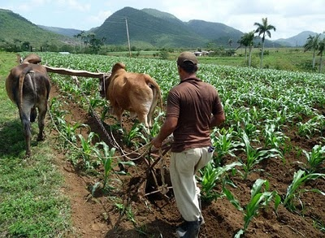
MANY THANKS

