Slide 1
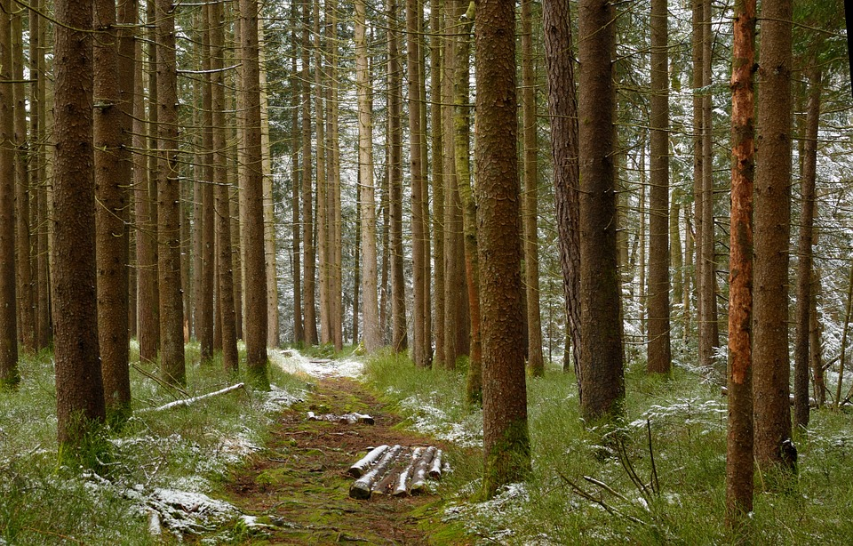
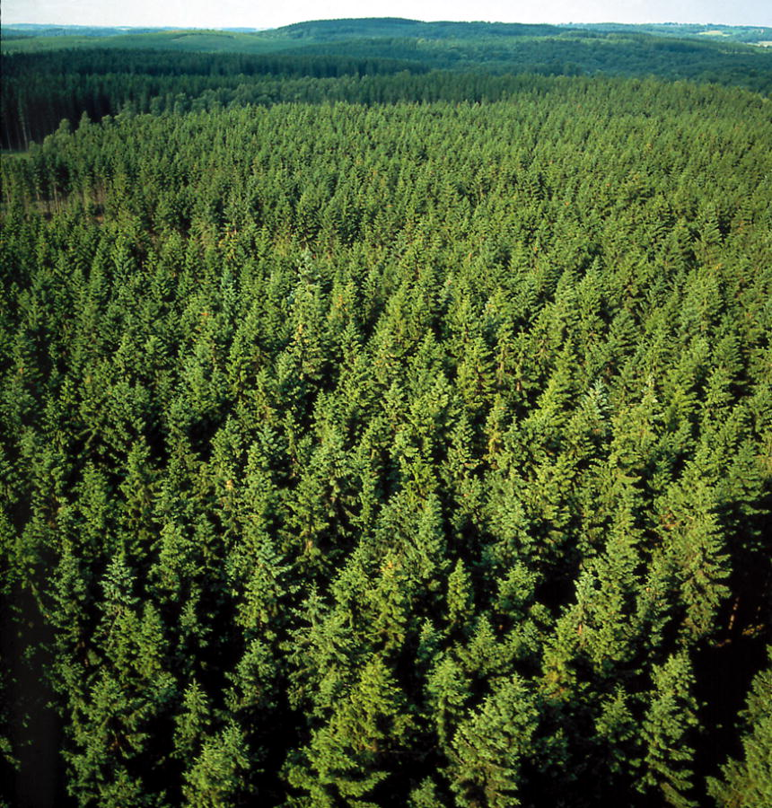
Regional Roundtable
World Programme for the Census of Agriculture 2020
Port of Spain, Trinidad and Tobago
22-26 May 2017
Theme 13 and 15: Forestry and Environment/greenhouse gas (GHG) emissions
Technical Session 14
Adriana Neciu
Agricultural Census and Survey Team
FAO Statistics Division

Slide 2
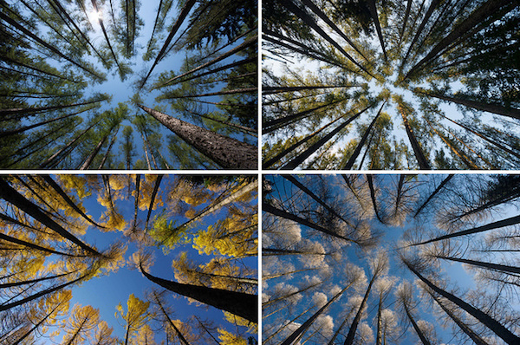
Outline
Background
Importance of the theme
Items
Concepts and definitions

Slide 3
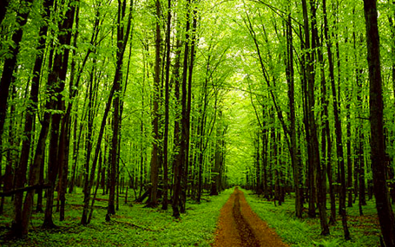
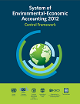
Background
Theme 13: Forestry refers to forest and other wooded areas on the agricultural holding.
In order to harmonize with the new concepts and classifications from the SEEA 2012*, some items from the WCA 2010 have changed as follow:
  The wording “forest and other wooded land” changed to: “woodland”.
Units engaged in forestry are not covered unless they also had some crop or livestock production activities. In order to have a complete picture of forestry activities in a country, all forestry holdings should be included and not just those associated with an agriculture holding: Forestry census.

Slide 4
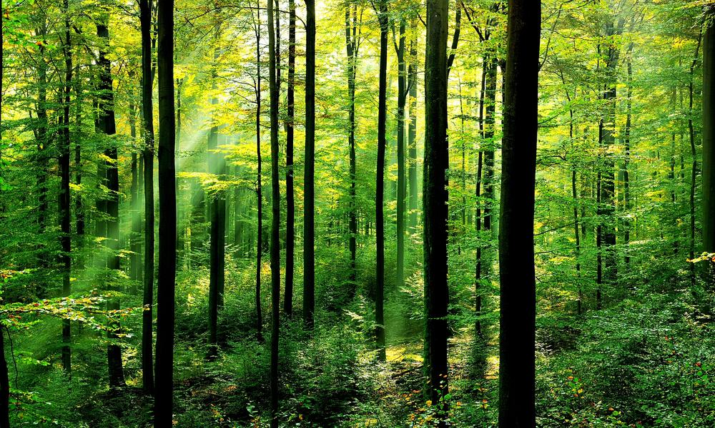

Importance of forestry
One-third of the world’s people depend on forest goods and services for the direct provision of food, wood fuel, building materials, medicines, employment and cash income.
Forests are not only important for the people who live in them, but also for those living in adjacent landscapes.*
Agro-forestry plays an important role in soil conservation, livestock production and environmental preservation.
Notes:
It is estimated that about one-third of the world’s people depend on forest goods and services for the direct provision of food, wood fuel, building materials, medicines, employment and cash income.

Slide 5
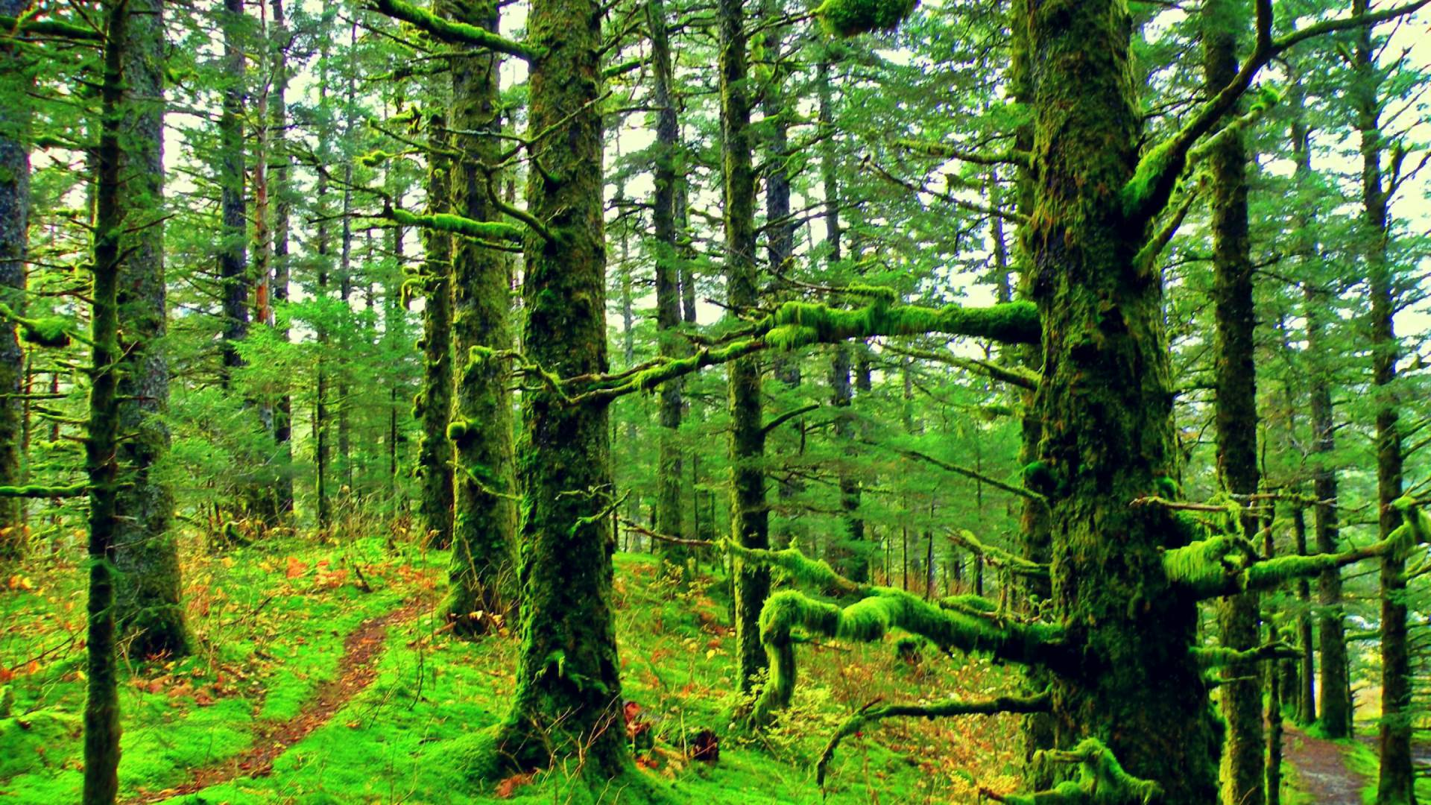
Items
Theme 13: Forestry comprises 4 items (for the holding)
1301 Presence of woodland on the holding; (frame item)
1302 Area of woodland;
1303 Purposes of the woodland;
1304 Whether agroforestry is practiced (frame item)

Slide 6
Item 1301: Presence of woodland on the holding
Type: Frame item.
Reference period: Census reference day
Concept:
If some area of the holding is classified as “forest and other wooded land” in Land item 0202, then the holding contains wooded areas. However, this may not be sufficient for identifying all holdings with wooded areas potentially usable for forestry activities or other purposes because:
      Land use classification is based on the concept of main use of the land.
      For example, “land under permanent meadows and pastures” may span over 0.5 ha, with higher than 5m and crown cover of more than 10%. To identify all holdings with forest and other wooded land, data on secondary land use are needed.
      The criterion of spanning over 0.5 ha limits capacity of the land-use approach for identifying all holdings with wooded areas potentially usable for forestry. In some countries, small wooded areas on holdings may play an important role in sustaining livelihoods.
    Because of the above considerations, the concept of woodland is introduced here. It refers to the area of land satisfying all criteria for either forest land or other wooded land except the criterion of spanning over 0.5 ha.
Notes:
..

Slide 7
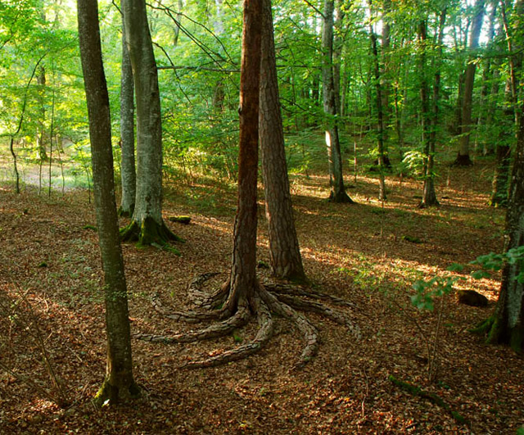
Item 1302: Area of woodland
(for the holding)
Type: Additional item
Reference period: Census reference day
Concept: This item collects data on the total area of woodland on the holding as defined in item 1301 further subdivided into various components:
  Forest land as primary land use;
  Other wooded land as primary land use;
  Forest land as secondary land use on agricultural land
  Other wooded land as secondary land use on agricultural land
  Other Woodland
  land classified as “forest land” and “other wooded land” in the land use classification (Item 0202);
  those areas on the holding that satisfy the criteria for forest land and other wooded land, but were classified as agricultural land according to their primary land use. (Agricultural land covers arable land, land under permanent crops, and permanent meadows and pastures.)
  those areas that span less than 0.5 ha and satisfy all other criteria for either forest land or other wooded land.

Slide 8
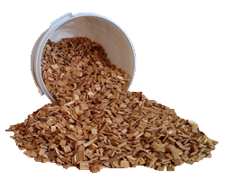
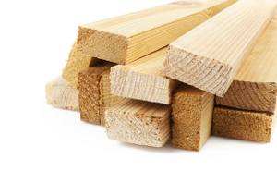
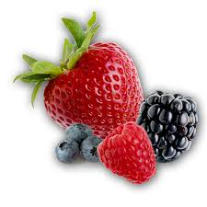
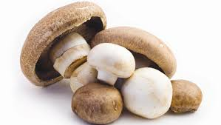
Item 1303: Purposes of woodland (for the holding)
Type: Additional item
Reference period: Census reference year
Concept: This item relates to all woodland on the holding, including all categories listed in Item 1302.
Purposes:
Production: Wood and non-wood
Soil and water protection: - protection of soils from wind and water erosion.
Improving agricultural production: - trees integrated into agricultural systems, providing a range of benefits in terms of restoring or sustaining soil fertility and boosting food production.
Social and cultural values: when forest area is primarily designated or managed for spiritual or cultural values or practices.
Recreation and ecotourism: Such as Agrotourism and ecotourism, which can conserve natural resources, provide employment opportunities and boost the rural economy
Other: with not specific function
Notes:
Wood (timber, firewood, wood chips) and non-wood (mushrooms, berries, nuts, oils, etc.).

Slide 9
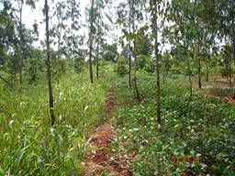
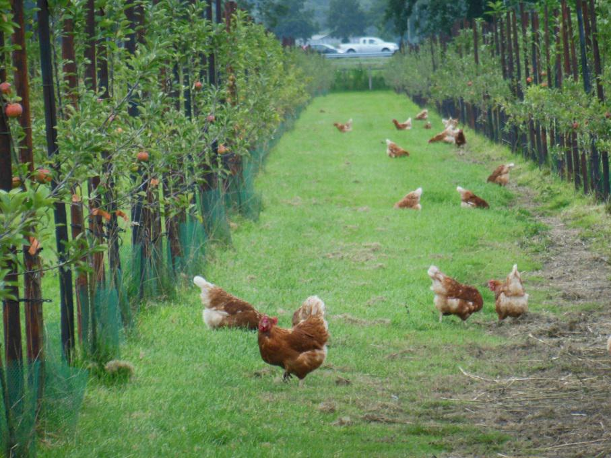
Item 1304: Whether agroforestry is practiced
(for the holding)
Type: Frame item
Reference period: Census reference year
Concept: Agroforestry is a sustainable land management system in which forest species of trees and other wooded plants are purposely grown on the same land as agricultural crops or livestock, either concurrently or in rotation. Agroforestry includes:
  agrosilvicultural (trees and crops)
  silvopastoral (trees and livestock),
  agrosilvipastoral (trees, crops and livestock) systems.
Notes:
  Agroforestry refers to specific forestry practices that complement agricultural activities, such as by improving soil fertility, reducing soil erosion, improving watershed management, or providing shade and food for livestock.
  Countries need to develop their own procedures to collect data on agroforestry systems. Some may wish to collect data on specific agroforestry activities.

Slide 10
Country experiences
Chile: VII Agriculture and Forestry Census 2007
Section IX of the census questionnaire is devoted to “Forest Area”.
  Cultivated forest - for each one of ten species of cultivated forest: aspen, mimosa, eucalyptus niplen eucalyptus globolus, pine radiatus, pine oregon, rauli, coigüe, oak, tamarugo the following information was recorded:
  planted area
  forests age
  whether forest management and/or irrigation were applied.
  Native forest – in the case of native forest the information collected were recorded for 12 native spices:
  area covered
  whether forest management was used
  In case that trees were used as windbreakers, the total linear meters involved were also recorded.
In Section XVI Other activities on holding, several forest produces were also investigated: carbon, firewood, wood for pulp; wood for sawmills and mushrooms.
In the Section Land use, it was recorded the type of uses for forests: livestock, wood, unexplored forests and rest of forest and wodland.

Slide 11
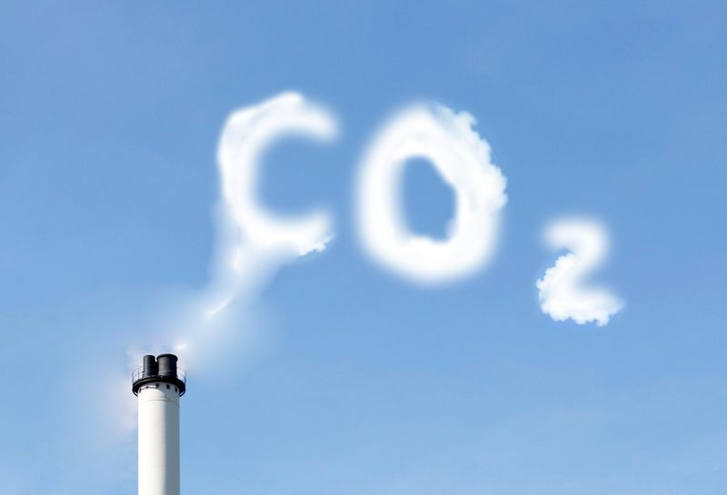
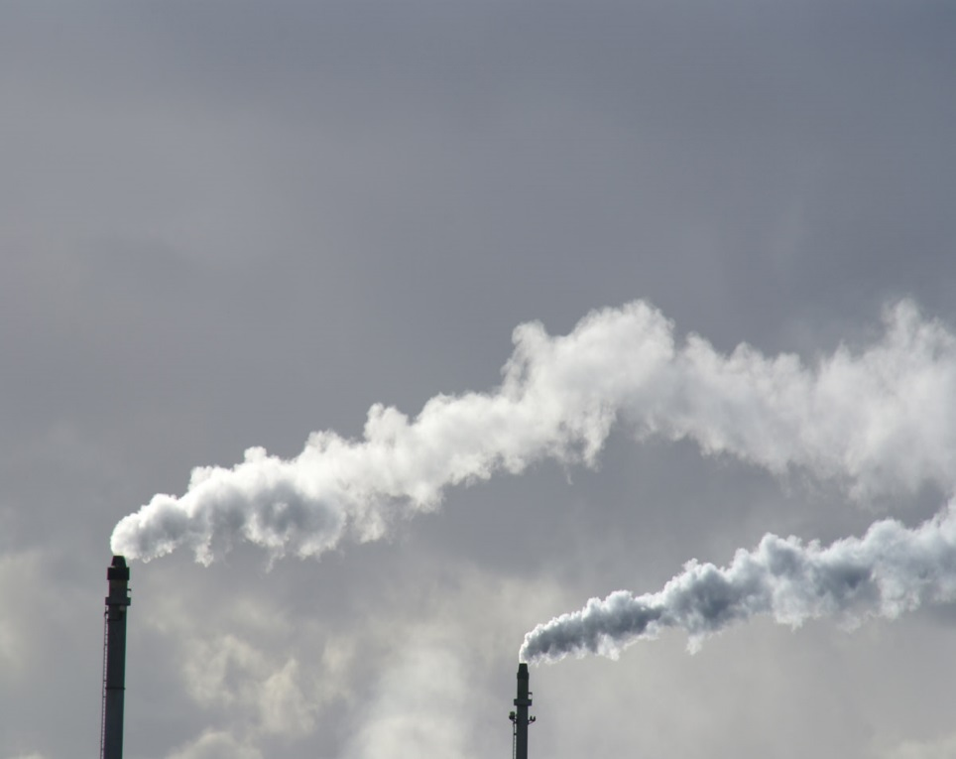
Theme 15: Environment/greenhouse gas (GHG) emissions
Contents
Background
Sources of GHG emissions
GHG items on crop and livestock production subsectors
Concepts and definitions
Country experiences

Slide 12
Background
Under the UN Framework Convention on Climate Change (UNFCCC), countries should produce and regularly report their GHG emissions from all sectors, including agriculture to monitor the achievement of their targets.
In response to the growing demand for basic agro-environmental data on GHG and ammonia emissions, the WCA 2020 introduced this new theme (theme 15) with items covering relevant crop and livestock production subsectors.
Theme 15 gives possibility for countries to establish the baseline for reports and provide a frame for periodic sample surveys. (Some of the items are already covered in other themes of the WCA 2020)
Notes:
In response to the growing demand for basic agro-environmental data on GHG and ammonia emissions, as well as for compilation of nitrogen balances, the WCA 2020 includes a new theme with a set of items that can help countries assess their emissions .
GS: “Agricultural censuses are sources of structural information that, through comparison at different points of time, contribute to the monitoring of environmental changes. In addition, data on the use of environmentally friendly practices and inputs, collected through the census of agriculture, helps decision- makers and planners when adopting measures to mitigate adverse effects.
Thus, the WCA 2020 introduces the possibility for countries to establish the baseline:
To eport GHG and other agro-environmental indicators and
can provide frame information for designing and
conducting periodic sample surveys to collect data necessary for estimation of GHG emissions from the agricultural sector and calculation of other agro-environmental indicators.
Another important use of census information to measure environmental impact is with reference to water management and irrigation. Methods of irrigation, sources of water and final disposal of water used for irrigation are important elements to analyse threats and actual risks to the environment.

Slide 13
Sources of GHG emissions in agriculture
Enteric Fermentation | Crop Residues
Manure Management | Cultivation of Organic Soils
Rice Cultivation | Burning – Savanna
Synthetic Fertilizers | Burning - Crop Residues
Manure applied to Soils | Energy Use in Agriculture
Manure left on Pasture

Slide 14
GHG items on livestock production subsector
Relevant existing items (explained in Theme 5):
  0501: Type of livestock system
  0504: Number of animals: age and sex (for each livestock type)
  0505: Number of animals according to purpose (for each livestock type).
New items (Theme 15):
  1501 Type of animal grazing practices
  1502 Manure application
  1503 Manure management system
  1504 Final use of the treated manure.
Notes:
The items is relevant for the calculation of agro-environmental indicators and particularly for GHG and ammonia emissions

Slide 15
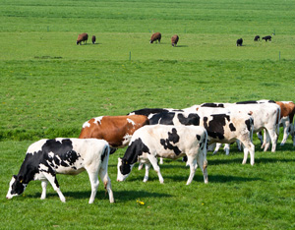
Item 1501: Type of animal grazing practices
Type: Additional item
Reference period: Census reference year
Concept: Animal grazing has a significant impact on the quality of pastures. Combining the information from the livestock theme with types grazing improves estimation of the status of pastures – non-degraded, moderately degraded or severely degraded. Importantly, this item allows for more accurate estimation of the area in which manure is left on pasture.
Notes:
The latter process represents the second largest source of GHG agriculture emissions globally.

Slide 16
Item 1501: Type of animal grazing practices (cont’d.)
Types of animal grazing:
    Grazing on the holding:
      Area grazed during the year
      Number of animals
      Fraction of the year with animals on pasture
    Common pasture grazing:
      Number of animals
      Fraction of the year with animals on pasture
      (e.g. <3; 3-6; 6-9; 9> months).

Slide 17
Item 1502: Manure application
Type: Additional item
Reference period: Census reference year
Note: This item is relevant for the calculation of agro-environmental indicators and particularly for GHG and ammonia emissions. Not applicable to holdings with a nomadic livestock system.
Categories for manure application:
Percentage of holding’s pastures on which the manure is left on pasture
Fraction of manure left on pasture that is removed for use as fuel (0; 50% or less; more than 50%; all manure removed)
Agricultural area on which solid/farmyard manure is applied (spread)
Agricultural area on which slurry is applied (spread)
Manure directly daily spread on the field.

Slide 18
Item 1503: Manure management system
Type: Additional item
Reference period: Census reference year
Note: This item is relevant for the calculation of agro-environmental indicators and particularly for GHG and ammonia emissions. Not applicable to holdings with a nomadic livestock system.
Notes:
Cases may exist in which there are both covered and open storage facilities of the same type for one holding. Where feasible, information on the percentage of the capacity of the covered facilities could be asked.
Definitions and notes:
Solid/farmyard manure is excrements (with or without litter) of domestic animals (may include a small amount of urine).
Liquid manure is urine from domestic animals (may include a small amount of excrement and/or water).
Slurry is manure in liquid form, a mixture of excrements and urine of domestic animals (possibly including water and/or a small amount of litter).
Manure removed for use as fuel is dried dung cakes created and burned for fuel.
Directly daily spread means the manure is routinely removed from the confinement facility and is applied to cropland or pasture within 24 hours of excretion; no storage is needed.
Storage facility for solid/farmyard manure usually means a structure with a concrete floor and reinforced concrete or timber walls.
Storage facility for liquid manure/slurry usually means a watertight tank, open or covered, or a lined lagoon for storage of liquid manure/slurry.
Slurry tank is a tank, usually made of impermeable material, used for the storage of slurry. Watertight pits or cellars beneath/integrated in the livestock houses are also included.
Anaerobic lagoon is a pit dug in the soil, usually lined, used for the storage of slurry.
Aerobic treatment is the biological oxidation of manure collected as a liquid with either forced or natural aeration.
Storage facilities for manure are considered covered when they are protected from rain or other precipitation and the cover can reduce ammonia emissions.
Digesters (biogas reactors) are reactors in which animal excreta, with or without straw and/or other materials such as wood shavings, sawdust, etc., are collected and anaerobically digested in a large containment vessel or covered lagoon.

Slide 19
Item 1503: Manure management system (cont’d.)
Categories:
Availability of storage facilities for:
Solid/farmyard manure
Liquid manure
Slurry
Type of storage facilities used:
For all manure: Digesters(biogas reactors)
For slurry: Slurry tank Anaerobic lagoon Aerobic treatment
Covered or open storage facilities:
Solid/farmyard manure
Liquid manure
Slurry
Notes:
Paragraph 8.15.19 of the WCA 2020 provides the relevant definitions.

Slide 20
Item 1504: Final use of the treated manure
Type: Additional item
Reference period: Census reference year
Concept: This item refers to percentage use of manure exiting the manure management system, and applicable to all holdings with a non-nomadic type of livestock system.
Categories:
  Applied as fertilizers
  Used for fuel (manure used for production of energy, it does not include manure left on pasture, collected and dried for dung cakes already reported in item 1502)
  Used for construction (used as component of construction materials)
  Used as feed
  Other uses (e.g. manure delivered to others for fertilizer).

Slide 21
GHG items on crop production subsector
Relevant existing items (explained in Themes 4 and 6):
  0411: Use of each type of fertilizer
  0412: Area fertilized for each type of fertilizer and major crop type
  0610: Type of tillage practices.
  New items (Theme 15):
  Submodule on rice cultivation (Rice cultivation accounts for 10% of global GHG emissions in agriculture, but is significantly higher in rice-producing countries).
    1505 Length of the growing period for rice cultivation
    1506 Rice cultivation – irrigation and water regimes
    1507 Organic amendments to soils used for rice cultivation
  1508 Crop residues
  1509 Permanent crops – age of plantations.
Notes:
1506 Rice cultivation - irrigation and water regimes
Water regimes before the growing period:
Flooded pre-season
Non-flooded pre-season
Water regimes during the growing period:
Irrigated – continuously flooded
Irrigated – intermittently flooded
Rice cultivation in rainfed and deep water area

Slide 22
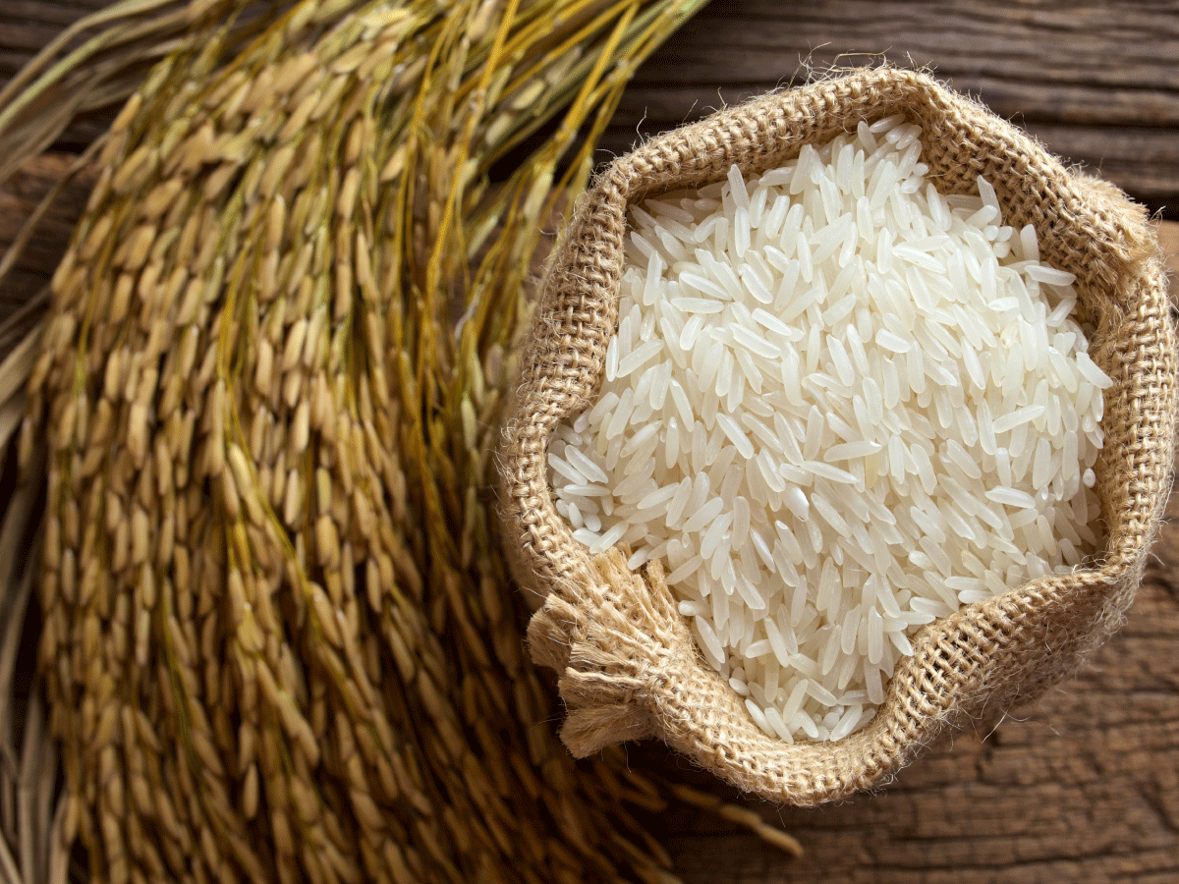
Item 1505: Length of the growing period of the rice cultivation
Type: Additional item
Reference period: Census reference year
Concept: Length of the growing period means number of months between crop planting and harvest.

Slide 23
Item 1506: Rice cultivation –irrigation and water regimes
Type: Additional item
Reference period: Census reference year
Concept: This item complements the information collected in Theme 3: Irrigation, specifically for rice irrigation and water regimes.
Water regimes before the growing period:
    Flooded pre-season: the land has been flooded for 30 consecutive days or more just prior to planting;
    Non-flooded pre-season: the land has been flooded for less than 30 consecutives days or has not been flooded prior to planting.
Water regimes during the growing period:
    Irrigated – continuously flooded: field with standing water throughout the rice growing period;
    Irrigated – intermittently flooded: field that has at least one aeration period of more than three days during the growing period;
    Rice cultivation in rainfed and deep-water area: rice grown of flooded surface, in areas depending entirely on rain for water supply.
Notes:
It is a holding-level item. However, for operational reasons, countries may find it easier to collect the data at field/plot level, as one holding could have different water regimes for different fields.

Slide 24
Item 1507: Organic amendments of soils used for rice cultivation
Type: Additional item
Reference period: Census reference year
Concept: Additionally to information on fertilizers (Theme 4 “Crops”), the following breakdown of organic fertilizers gives important information on rice cultivation practices:
  Straw incorporated shortly before cultivation (30 days or less)
  Straw incorporated long before cultivation (more than 30 days)
  Compost
  Farmyard manure
  Green manure
Notes:
Straw incorporated shortly before cultivation (30 days or less) means that straw is incorporated to soil no more than 30 days before the cultivation of rice.
Straw incorporated long before cultivation (more than 30 days) means that straw is incorporated to soil for longer than 30 days before the cultivation of rice.
Compost is a mixture of decaying organic substrates, such as from leaves and manure, used to improve soil structure and provide nutrients. Alternatively, it refers to organic substrates subjected to biological decomposition and stabilization and converted into a final product that is stable, free of pathogens and plant seeds, and can be beneficially applied to land.
Solid/farmyard manure is excrements (with or without litter) of domestic animals, possibly including a small amount of urine
Green manure/cover crops (GMCCs) are plants that are grown in order to provide soil cover and to improve the physical, chemical and biological characteristics of soil. GMCCs may be sown independently or in association with crops.

Slide 25
Item 1508: Crop residues
Type: Additional item
Reference period: Census reference year
Concept: Management and use of crop residues may affect the environment. This item is applicable to all holdings.
Handling of crop residues includes the following:
  Crop/pasture area burnt on the holding: refers to the area of crop/pasture where crop residues/grass are burned during the reference year.
  Crop residues removed from field: describes the fraction of crop residues (such as straw, stubble or other plant parts) which is not left on the field.
  Pastures on the holding renewed during the crop year: refers to the area of pasture that is ploughed and seeded to produce a new grass cover.

Slide 26
Item 1509: Permanent crops – age of plantations
Type: Additional item
Reference period: Day of enumeration
Note: In addition to information on permanent crops (Theme 4 “Crops”), for improving estimates of GHG emissions by sources or removals by sink, the following information from holdings with commercial orchards is needed:
    Age of plantations (productive and non-productive)
    Age at which the permanent crops are renewed.

Slide 27
Country experiences
Italy: General Agricultural Census (GAC) 2010
New queries useful for environment/climate change issues were included in the GAC 2010 questionnaire aimed in particular at improving the preparation of the national GHG inventory:
Q39:Type of animal grazing practices (with the specification of: i) total number of grazing animals; ii) utilized area and iii) number of months):
Grazing on the holding
Grazing on other holdings land
Common land grazing
Q.41: Storage method by type of animal manure generated in the holding ( three types of manure were specified: i) dung manure; ii) urine and iii) slurry):
Pit (covered; uncovered)
Tank (covered; uncovered)
Lagoon covered; uncovered).

Slide 28
Country experiences (cont’d.)
Italy: General Agricultural Census 2010
Q.42: Manure application:
A. Utilised agricultural area treated with manure:
1. Application of dung manure
of which with immediate incorporation (within 4 hours)
2. Application of urine and slurry (fertigation* included), of which:
2.1 Application and immediate incorporation of urine and slurry (within 4 hours) or injection
2.2 Incorporation of manure and slurry within 24 hours
2.3 Incorporation of manure or slurry in strips, or by injection, or fertigation.
Note: Fertigation is the application of fertilizer with irrigation water

Slide 29
Country experiences (cont’d.)
Italy: General Agricultural Census 2010
Q.42: B. The percentage of animal manure taken outside the holding in relation to the total produced by the holding (sold or removed for direct use as fertiliser or for treatment processes):
1. Percentage of solid dung taken off the holding in relation to the total dung produced
2. Percentage of slurry taken off the holding in relation to the manure produced.

Slide 30
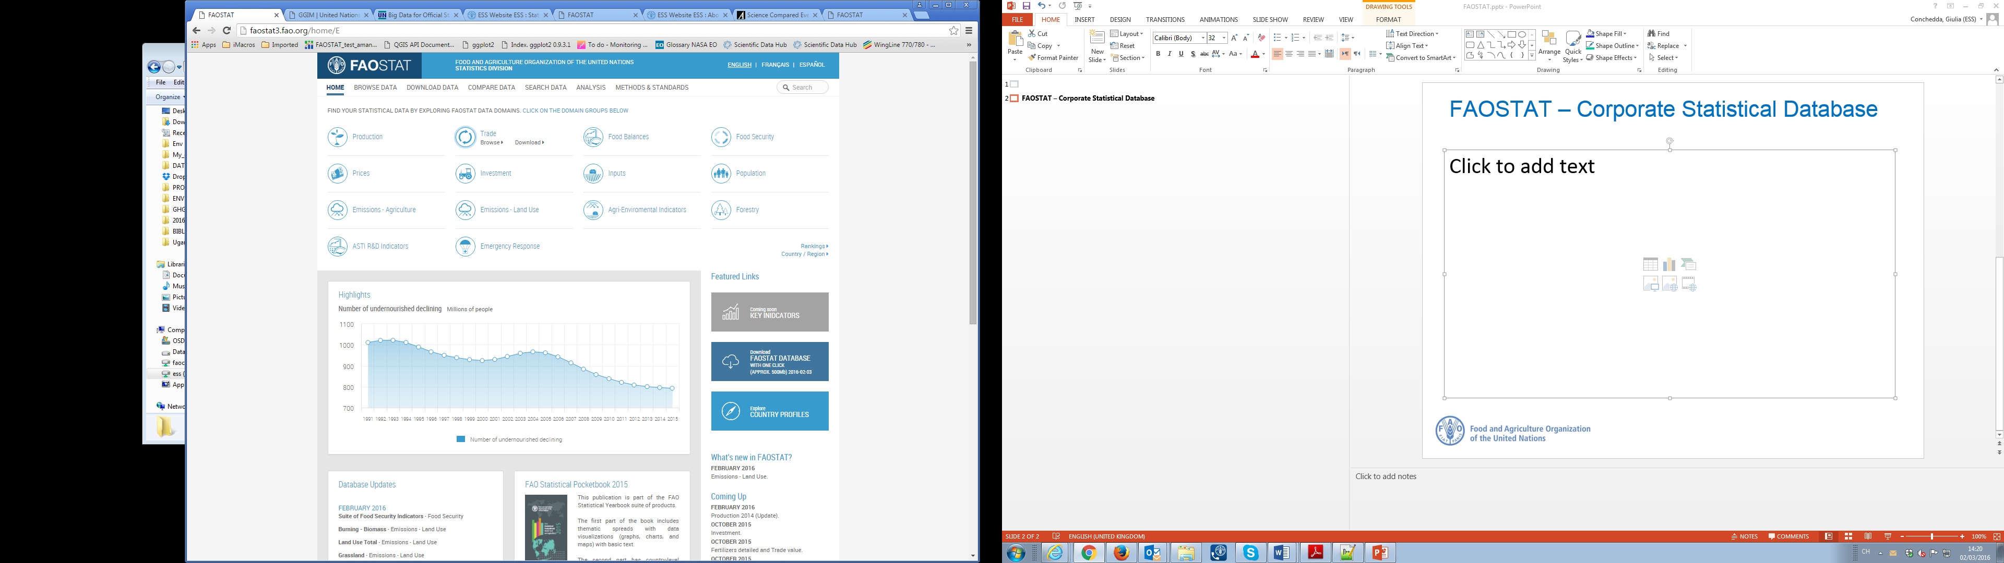
FAOSTAT – Corporate Statistical Database

Slide 31
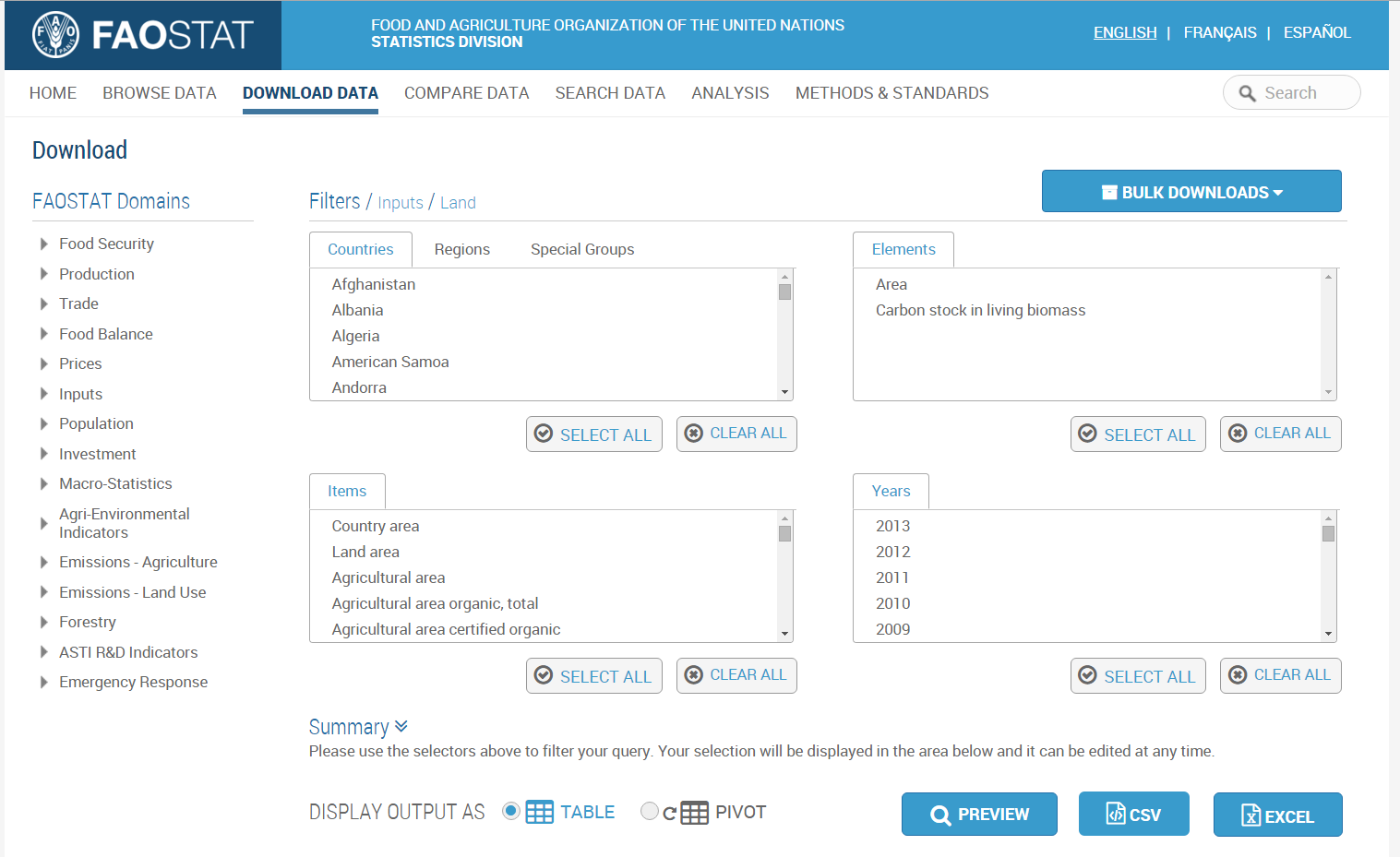
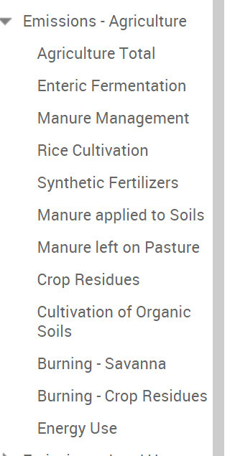
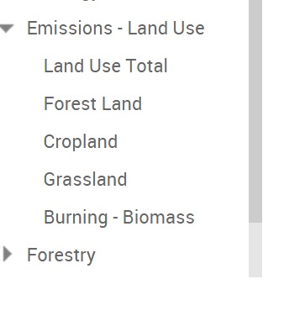
FAOSTAT database for AFOLU

Slide 32
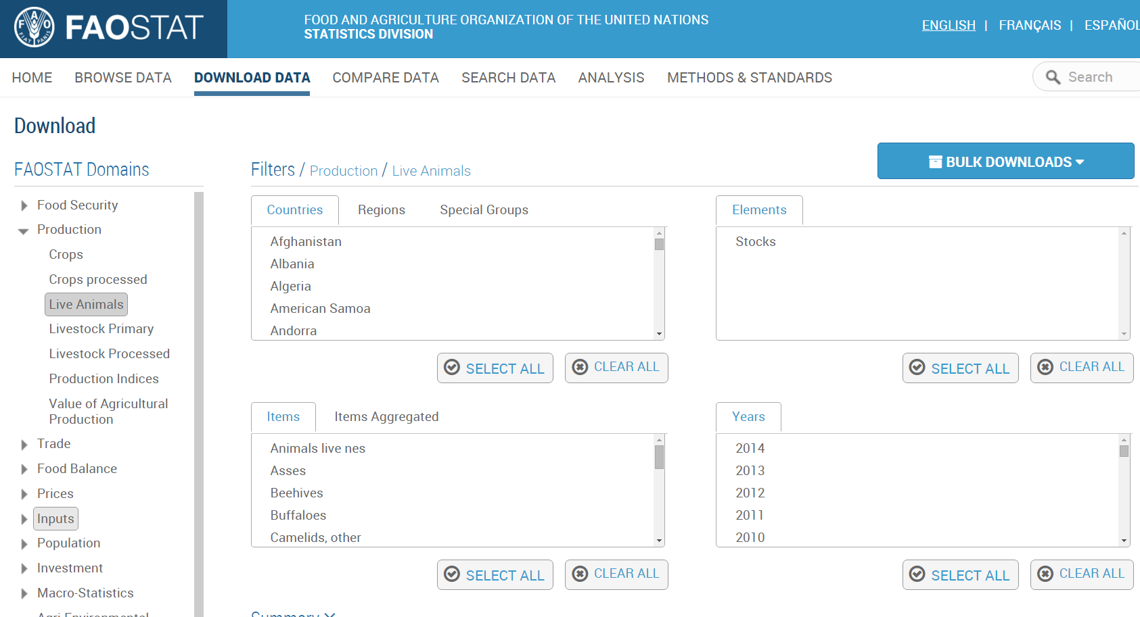
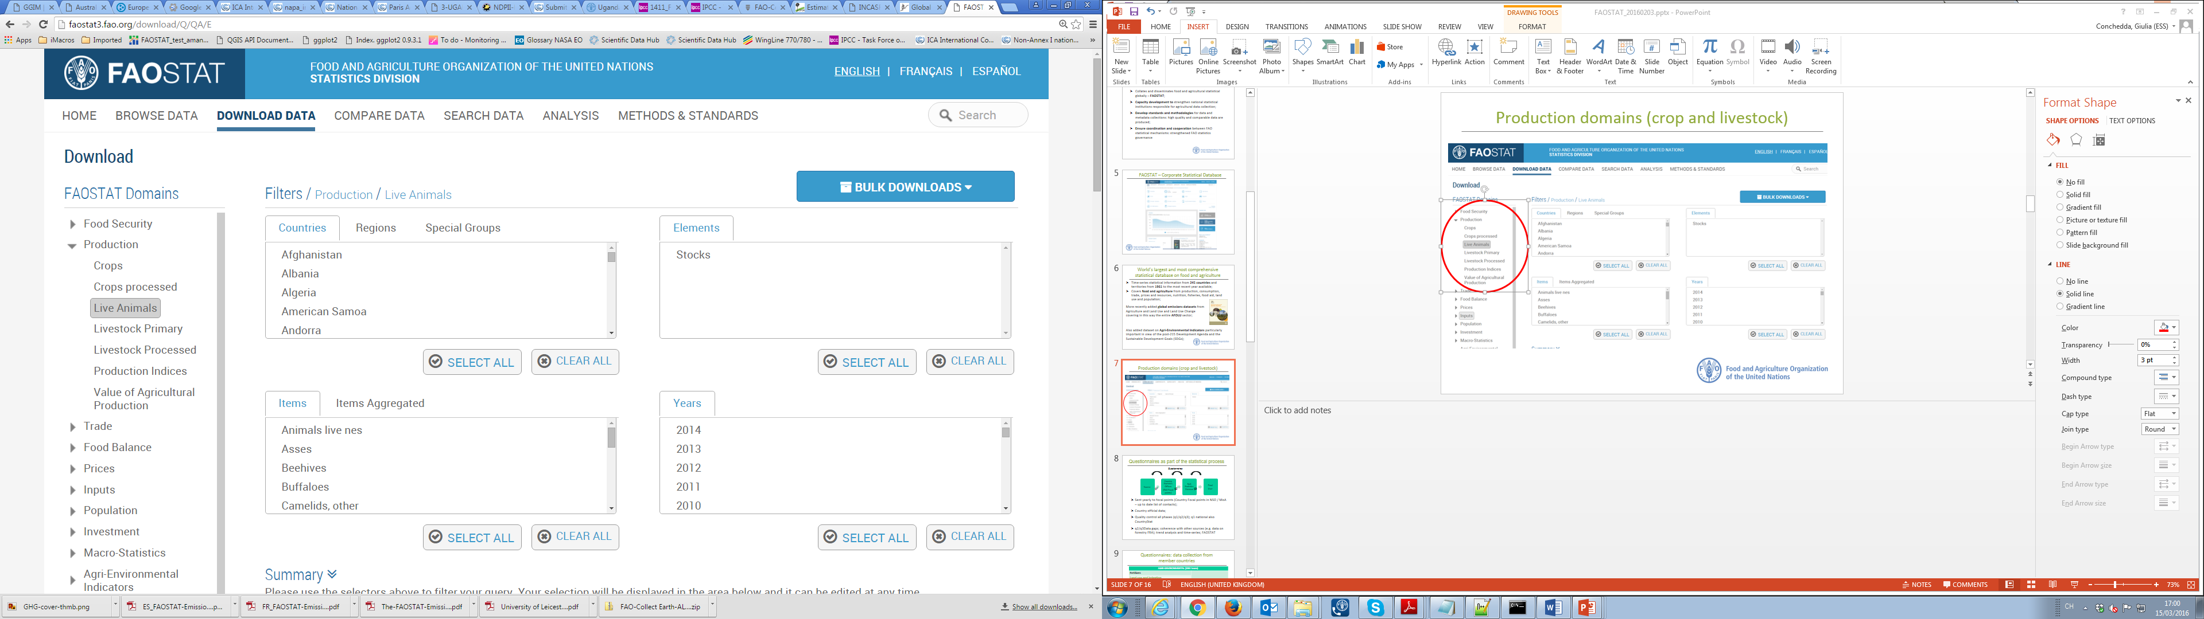
ACTIVITY DATA: Production domains
(crop and livestock)
ENVIRONMENT – TEAM; FAO STATISTICS DIVISION
Email: Environment-Statistics@fao.org
http://www.fao.org/economic/ess/environment/en/

Slide 33
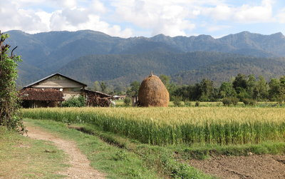
MANY THANKS

