Slide 1
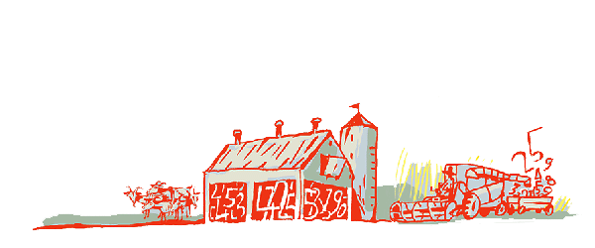


Regional Roundtable on
World Programme for the Census of Agriculture 2020
Port of Spain, Trinidad and Tobago
22-26 May 2017
Community level data
Technical session 15
Jairo Castano
Senior Statistician
Leader, Agricultural Census and Survey Team
FAO Statistics Division

Slide 2
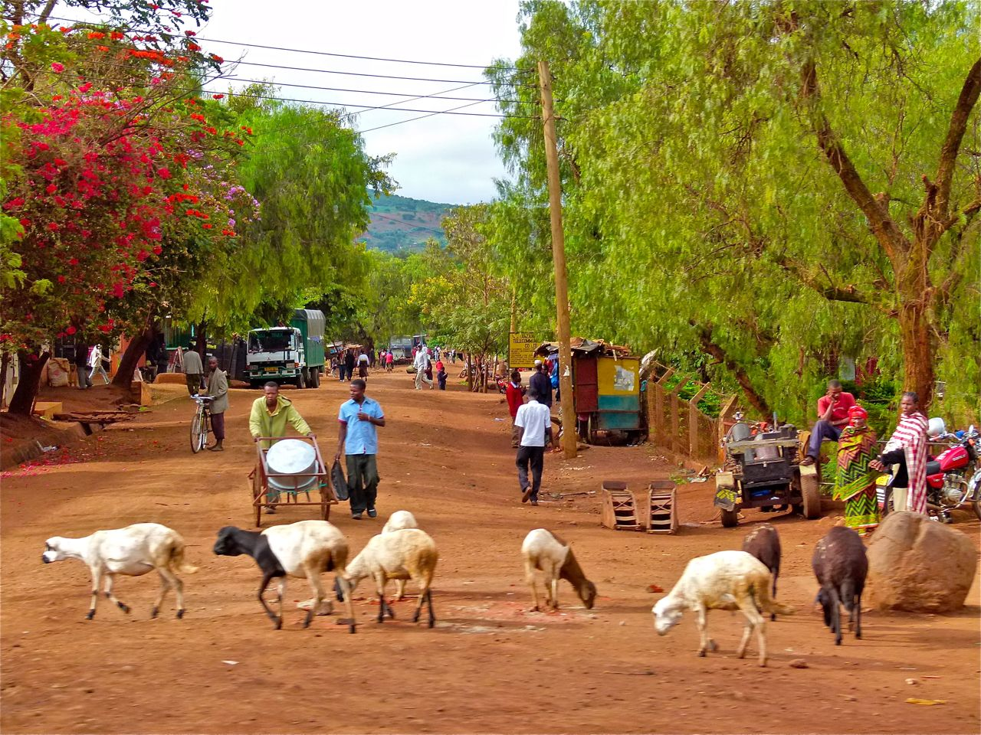
Contents
Background
Reasons for collecting and uses of community-level data
Methodological considerations
Items
Tabulation
Country experiences
Conclusions

Slide 3
Background
The collection of community-level data was first introduced in the WCA 2010.
Countries are encouraged to collect community-level data along with holding-level data in the census of agriculture.
The community survey is not part of the census enumeration, it is a separate operation: both exercises have different statistical units, data suppliers and specific objectives.
Chapter 9 of the WCA 2020 (Vol. I) is devoted to community-level data.

Slide 4
Reasons for collecting and uses of community-level data (CLD)
Community-level data are of interest for:
Planning, monitoring and evaluation of agricultural and rural development and of food security policy (e.g. to support the solution of problems related to food-shortages, infrastructure problems of farmers and communities in general);
Development partners to support rural development programs at national and subnational levels;
Businesses;
Identification of:
  areas where agricultural market or commercial network are needed;
  areas where agricultural services or processing facilities should be encouraged;
  vulnerable areas where there is a risk of food insecurity due to natural disasters;

Slide 5
Reasons for collecting and uses of community-level data (contd.)
They can be analysed in relation to holding-level data taken from the census of agriculture (e.g. No. of holdings participating in farmers associations);
They can be used to complement data collected at holding-level (e.g. agricultural land not belonging directly to any agricultural holding – such as common agricultural land used for grazing (communal grazing land));
User-friendly presentation of results on maps using GIS;
CLD can be collected at marginal cost as it involves mainly community administrations.

Slide 6
Methodological considerations
What is a community?
A community is a self-contained unit of social and economic activities.
What statistical units should be chosen for a community survey?
Unit chosen for community survey depends on:
  Data collected: sometimes, the lowest admin. unit has no substantial admin. function, and the community unit may need to be defined at a higher level.
  Cost: may influence whether to collect data at, for example, the commune or village level.
  Identifying community units: ready access to lists of community units needed.
  Stability of community units: difficulties when changes in admin. units are common and not well-coordinated.
  Census coverage: Countries should endeavour to cover the communities where census enumeration is conducted.

Slide 7
Community data collection
How to collect community-level data will depend on the organization of field work for the collection of holding-level data. Informants will be community officials or other relevant persons.
The most experienced of the supervisors or enumerators in charge of census data collection could be assigned in advance to administer the community questionnaire.
  Could take place when the community administration prepares the list of households or holdings for the agricultural census.
  Often, community officials help locate each household or help as translators. Community questionnaire can then be collected.
  Consideration should be given to the suitability of collecting community-level data by mail, rather than by interview.

Slide 8
Recommendations of WCA 2020 on Community Level Data
DOs
  Link agricultural census with existing community databases and other available reliable administrative and statistical data sources to avoid duplication.
  CLD should be limited to key admin. information that are well-known to people in the community such as weather conditions, economic activities, presence of infrastructure and services.
  The number of community-level items should be kept to a minimum, normally, 10-20 items.
  In designing the community survey, tabulation needs should always be considered. Community-level data are only useful if they can be presented in statistical summaries

Slide 9
Recommendations of WCA 2020 on Community Level Data (cont.)
DON’Ts
The community survey should not be used for collecting:
data available from other reliable statistical and administrative data sources;
that are better collected directly from holdings.
Communities should not be asked to report the same data as holdings. The only exception could be land use data from community records. If they are deemed to be of good quality and their concepts and definitions are compatible with those adopted for the agricultural census, they could be used for checking at the aggregate level the land use data reported by holdings.

Slide 10
Community-level items
Geography
Location, agro-ecological, climatic, topographical or soil types; land use; area of communal grazing land; area of communal forest; communal area under water used for aquaculture; travelling time and mode of travel to the major nearest urban centre; whether the community has a year-round access to the nearest urban centre; whether the community is prone to natural disasters.
Socio-economic conditions
Population according to population group; number of households; economic status, main economic activities; whether there are seasonal food shortages.

Slide 11
Community-level items (contd.)
Community infrastructure and services
Presence of (or travelling time to the nearest): fertilizer dealer; pesticide dealer; seed dealer; credit institution; agricultural produce market; food storage facilities; agricultural processing facilities; facilities for maintaining agricultural machinery; extension services; primary school, health facility
Presence of irrigation facilities & area equipped for irrigation
Availability of (or travelling time to the nearest) veterinary services.
Whether the community is covered by agricultural produce collection network
Existence of farmers’ associations, cooperatives and other supporting bodies.
Whether electricity is connected.
Presence of radio, telephone and internet services
Availability of public transport
Development programmes
Presence of specific development projects in the community, for example an irrigation or an rural electrification project.

Slide 12
TABULATION
Community level data can be tabulated in 2 ways:
Summarize the characteristics of communities;
To use as classification variables for tabulations of census holding-level data (crucial to be able to link each holding with its community).

Slide 13
TABULATION (contd.)
For the second case, typical community level classification variables are:
Access to urban centre
Risk of natural disasters
Economic status
Occurrence of seasonal food shortages
Presence of periodic or permanent agricultural produce market
Access to veterinary services
Access to farm input trading centre
Access to credit institutions
Access to farmers’ association
Presence of specific development projects.

Slide 14
Country experiences
Nicaragua- IV National Agricultural Census 2011
  Coverage: the community survey covered 5,440 “rural communities”, a unit below “comarca” (county).
  Items: The questionnaire covered 6 main sections.
              Geographical location of the community
              Respondent identification
              Road access and transport in the community
              Ethnicity and environment
              Availability of agricultural services
              Availability of health, education and communication services
Notes:
Thematic study on: Improving rural farmers ‘economy combining the raising of cattle /other livestock with crop cultivation;

Slide 15
Country experiences
Haiti – Census of agriculture 2008-2009
The “Enquête Communautaire” covered “communal sections”, a unit below “commune”. Main sections:
Location and respondent ID
Land use and main crops
Environment and natural risks
Roads, transport, water & electricity
Access to basic services (health, education)
Processing facilities
Main markets
Natural/cultural sights and festivities
Main economic activities
Availability of inputs, extension services and credit
Agricultural employment
Social cohesion, integration and conflicts
Food security
Development projects
Villages and residential areas

Slide 16
Conclusions
Advantageous to conduct community survey along with the agricultural census.
Limited additional cost, but results are much useful for planning of targeted development programmes at national and subnational levels and appreciated by development partners.
CLD are important for both short-term and long-term policies in food security and agricultural and rural development.
User-friendly presentation using GIS.

Slide 17
MANY THANKS

