Slide 1
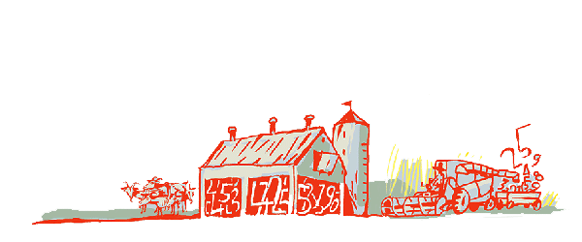
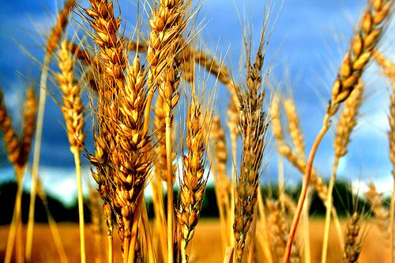
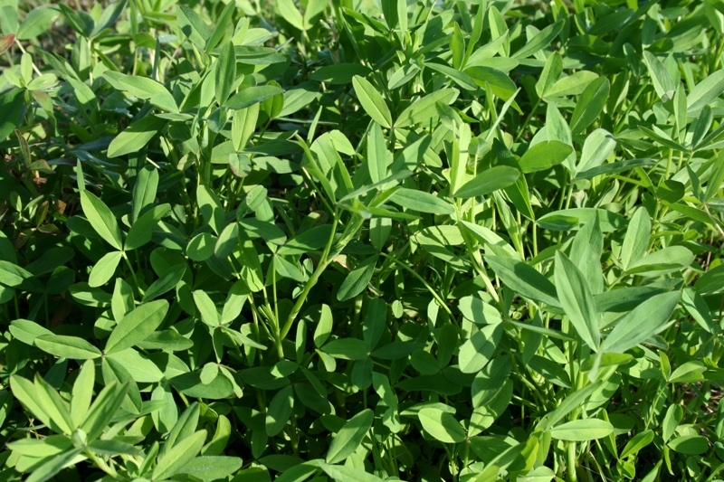
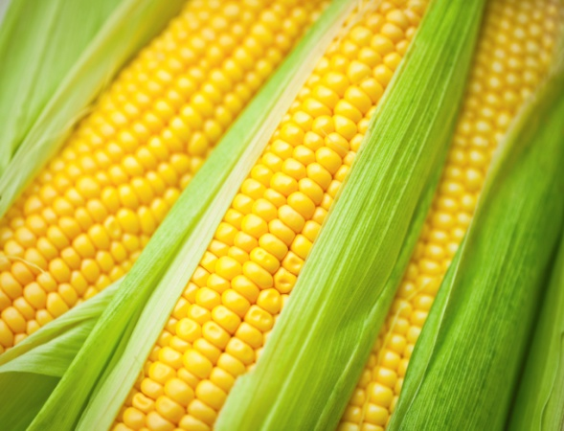
Regional Roundtable on
World Programme for the Census of Agriculture 2020
Port of Spain, Trinidad and Tobago
22-26 May 2017
Theme 4 – Crops
Technical Session 8
Adriana Neciu
Agricultural Census and Survey Team
FAO Statistics Division

Slide 2
Outline
Background
Importance of the theme
Main concepts and definitions
Items: type, reference periods, concepts and special characteristics
Country experience

Slide 3
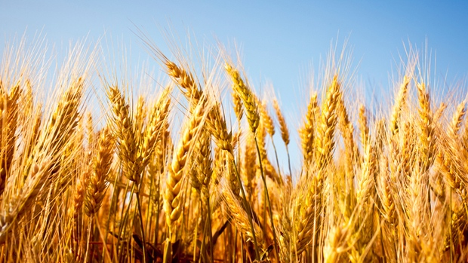
Background
Four (4) frame items:
Four (4) essential items:
    0413-presence of nurseries
    0415-presence of cropped land under protective cover
    0401-types of temporary crops on holding
    0405-types of permanent crops on holding and whether they are in compact plantation.
NEW ITEM
0402-area of temporary crops harvested
    0406-area of productive and non-productive permanent crops in compact plantations
    0407-number of permanent crop trees in scattered plantings
    0411-use of each type of fertilizer
NEW ITEM
Notes:
4 frame items - (two of them are new items). The frame items are directly relevant to frame construction for the supplementary modules for countries using the modular approach and for subsequent surveys.
For example,
-frame Item 0401 can be used for a supplementary module or specialized annual survey on “Production of temporary crops”;
frame Item 0405 can be used for a supplementary module or specialized annual survey on “Production of permanent crops”
Countries may include additional items for use in creating sampling frames for the census supplementary modules or the programme of agricultural surveys according to their needs.
Some frame items are a component of existing items for the purpose of building a frame (e.g. Item 0413 “Presence of nurseries”)
0413 - Presence of nurseries (for the holding) frame and new
0414 – Area of nurseries additional
0415 - Presence of cropped land under protective cover (for the holding); frame and new
0416 - Area of cropped land under protective cover (for the holding) additional
4 essential items -These items are part of the minimum data set that all countries should collect, regardless the methodological approach used.
They are important to compile a minimum set of national indicators on the agricultural sector needed for agricultural policy-making and planning. Data for these items are required for small administrative units such as districts or villages, or in the form of detailed cross-tabulations; these items are required for international comparison purposes.

Slide 4

Importance of the theme
Defining agriculture according to ISIC*
(Cultivation of crops and raising of livestock).
Paramount for understanding agriculture in a country (structural data on types of crops, area, their spatial distribution, their end-use and seasonality)
Extensive and intensive use of data about crops (Decision-makers, researchers and other stakeholders)
*International Standard Industrial Classification of all Economic Activities (ISIC Rev. 4)
Notes:
Theme Crops is important for many reasons:
Cultivation of crops and raising of livestock are the activities defining agriculture according to ISIC.
Structural data on types of crops, area, their spatial distribution, their end-use and seasonality are paramount for understanding agriculture in a country.
Decision-makers, researchers and other stakeholders make an extensive and intensive use of data about crops.
A decennial agricultural census cannot be used as a source of current agricultural statistics because it does not provide data frequently enough. However, the agricultural census can provide a reliable benchmark for improving current crop and livestock statistics.
Census data could, for example, help to identify comparative advantages of certain crops or livestock for export purposes and suggest the need for government or private investments to promote export-oriented production.
For crops, the agricultural census usually provides the most reliable data available on the area of each crop at each administrative level for the census reference year. This is especially the case for minor crops, for which the current statistics are often weak. The census data could provide a base for estimating crop area and production in the following years. For example, the current crop area could be obtained by estimating the change in the crop area since the census reference year. Census data can provide benchmark figures for current statistics on permanent crops, especially for trees not grown in plantations. Data on the number of productive and non-productive trees can be used to project future production trends.
The census by complete enumeration provides the frame for rare crops or livestock types.

Slide 5
Main concepts and defintions
Temporary crops: | crops with less than one-year growing cycle.
Permanent crops: | crops with a more than one-year growing cycle.
Successive crops: | temporary crops that grow more than once on the same land in the same agricultural year.
Inter-planted crop: | temporary crop planted between rows of another crop.
Mixed crops: | more than one temporary crop is grown unsystematically in a plot or field.
Notes:
The main concepts and definitions used in this theme are:….

Slide 6
Main concepts and defintions cont.d’
Permanent crops in compact plantation: | plants, trees and shrubs planted in a regular and systematic manner.
Scattered plants: | permanent crops planted in such a manner that it is not possible to estimate the area.
Associate crop: | a temporary crop grown in a compact plantation of permanent crops

Slide 7
Items
Theme 4 Crops, comprises 16 items:
Temporary crops (4)
    0401 - Types of temporary crops on holding;
    0402 - Area of temporary crops harvested (for each temporary crop type);
    0403 - Area of temporary crops harvested according to end use;
    0404 - Production of temporary crops harvested;
    Permanent crops (5)
    0405 -Types of permanent crops on holding and whether in compact plantations;
    0406 -Area of productive and non-productive permanent crops in compact plantations (for each permanent crop type);
    0407 - Number of permanent crop trees in scattering planting (for each tree crop);
    0408 - Area of productive permanent crops in compact plantations according to end use (for each selected permanent crop type);
    0409 - Production of permanent crops (for each selected permanent crop type);
Notes:
Theme 4 Crops comprises a total of 16 items:
4 items relates to temporary crops,
5 relates to permanent crops and
7 on the holding.

Slide 8
Items cont.d’
    For the holding (7)
    0410 - Area of land used to grow temporary crops as a secondary land use (for the holding);
    0411 - Use of each type of fertilizer (for the holding);
    0412 - Area fertilized for each type of fertilizer and major crop type;
    0413 - Presence of nurseries (for the holding)
    0414 – Area of nurseries
    0415 - Presence of cropped land under protective cover (for the holding);
    0416 - Area of cropped land under protective cover (for the holding)
NEW ITEM
NEW ITEM

Slide 9
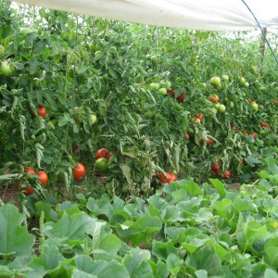
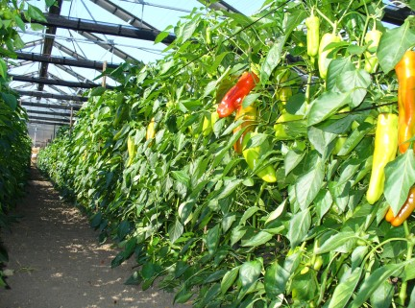
Item 0401: Types of temporary crops on holding
    Type: Frame item.
    Reference period: Census reference year.
    Concept: Whether the holding grew each specific type of crop. Area data would be collected as item 0402.
    Caveat: In a census conducted on sample enumeration basis data on minor crops are likely to be less reliable and so only the major crops should be canvassed.
    Notes:
    The list of crops can be expanded or abridged
    More details can be added, such as: season, land type, variety, end uses, etc.
Notes:
Concepts -The information in this item is limited to whether the holding grew each specific type of crop. Area data would be collected as item 0402.
Notes :
According to country characteristics, the list of crops can be expanded or abridged.
Countries may also wish to add more details such as: season, land type, variety, end uses, etc.

Slide 10
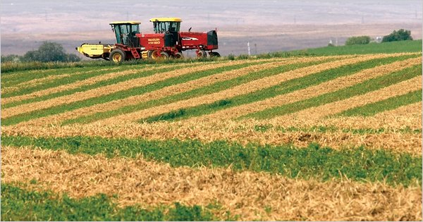
Item 0402: Area of temporary crops harvested (for each temporary crop type)
    Type: Essential item.
    Reference period: Census reference year.
    Concept: Area harvested refers to the total area from which the crop is gathered. Thus, area destroyed for any cause (drought, flooding, pest attack, etc.) is excluded. If the crop was damaged but not destroyed is included in the area harvested.
    Notes:
- covers crops grown to maturity;
        Area harvested
        - includes all crop harvested regardless end-use;
        If a crop is planted in one agricultural year and harvested in the next agricultural year, the recommended approach is to take the area harvested during the census reference year with special exceptions made for end-of-year crops.
Notes:
Notes:
Area harvested only covers crops grown to maturity;
Area harvested includes all crop harvested regardless end use;
If a crop is planted in one agricultural year and harvested in the next agricultural year, the recommended approach is to take the area harvested during the census reference year with special exceptions made for end-of-year crops.

Slide 11
Item 0402: Area of temporary crops harvested (for each temporary crop type) cont’d
      Successive crops - area should be reported for each crop each time the land is sown during the year.
      Inter-planted crops- area of inter-planted plot or field is assigned to individual area of crops in proportion to the area occupied by each crop.
      Mixed crops-some estimation is needed. The idea is to assign areas to individual crops on the basis of “What area the crop would have occupied if it were grown in pure stand?”.
      Associate crops (temporary and permanent crops in compact plantations together) the area of temporary crop is, usually, estimated by apportioning the land in a suitable manner.
      When temporary crops are grown scattered around the holding it is difficult to estimate the area unless crops are grown in some sort of systematic manner.
Notes:
For successive crops ……
For inter-planted crops, the area of inter-planted plot or field is assigned to individual area of crops in proportion to the area occupied by each crop. The sum of the areas of the individual inter-planted crops must be equal to the area of the plot or field.
For mixed crops, some estimation is needed. The idea is to assign areas to individual crops on the basis of “What area the crop would have occupied if it were grown in pure stand?”. The estimation may be based on quantities of seed used for crops in the mixture, plant density, eye estimates, etc. Sometimes countries report a crop mixture or inter-planting as a single crop unit because it is an important production system (for example when beans are mixed with corn taking advantage of the corn stalks to grow beans, it can be reported as “corn-bean crop”
In case of associate crops (temporary and permanent crops in compact plantations together) the area of temporary crop is, usually, estimated by apportioning the land in a suitable manner.
When temporary crops are grown scattered around the holding it is difficult to estimate the area unless crops are grown in some sort of systematic manner.

Slide 12
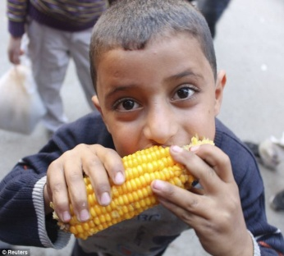
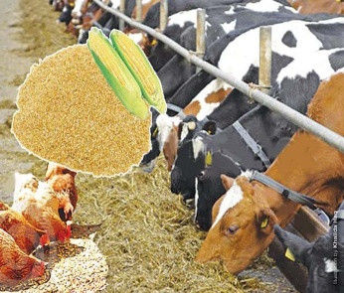
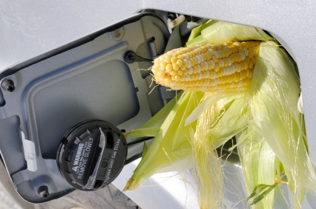
Item 0403: Area of temporary crops harvested according to end-use
(for each selected crop type)
    Type: Additional item.
    Reference period: Census reference year.
    Concept: End use - purpose of the crop.
    Types of end-use suggested:
      Food for human consumption;
      Feed for animals;
      Biofuels;
      Other uses.
A single crop may have more than one end-use.
i.e. maize being grown partly
human consumption
fodder crop
bio fuels
Notes:
End use refers to the purpose of the crop. A single crop may have more than one end-use (i.e. maize being grown partly for human consumption, partly as a fodder crop and partly for producing biofuels.

Slide 13
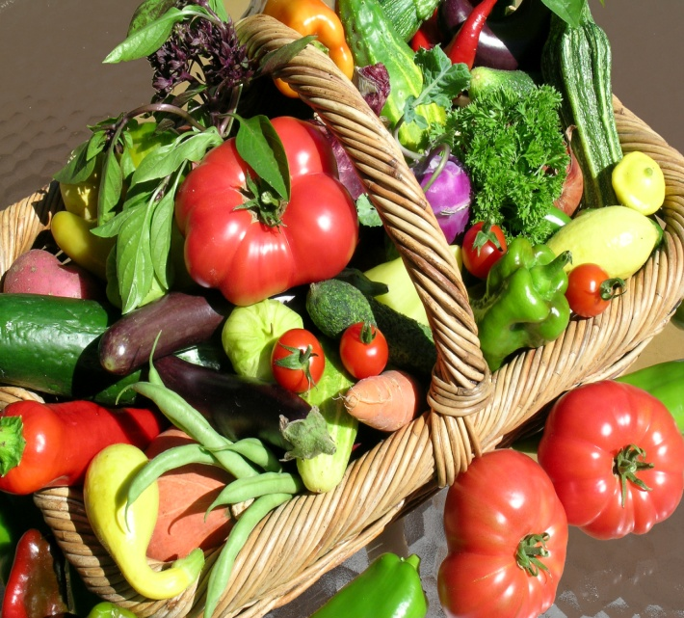
Item 0404: Production of temporary crops harvested (for each selected crop type)
    Type: Additional item.
    Reference period: Census reference year.
    Concept: Production refers to the actual quantity of produce after drying and processing, ready for sale or consumption and after deducting pre-harvest, harvest and post-harvest losses.
    Notes:
      Countries should select the crops according to their needs.
      Production data in an agricultural census are useful as benchmarks for current crop production statistics.

Slide 14
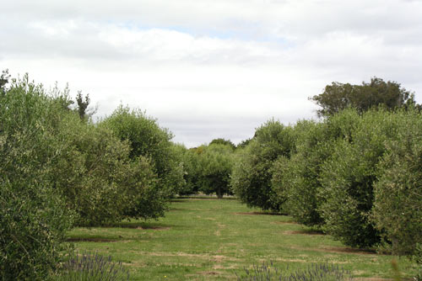
Item 0405: Types of permanent crops on the holding and whether in compact plantation
    Type: Frame item
    Reference period: Census reference day
    Concept: This item refers to whether each specific permanent crop is present on holding and which crops are grown in compact plantation.
    Note: Countries should expand or abridge the crop list as appropriate taking into account their circumstances and data needs.

Slide 15
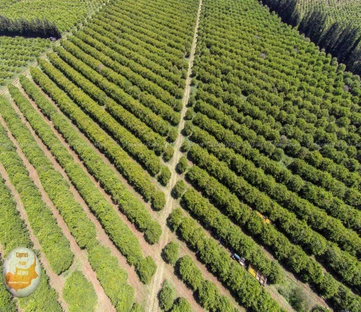
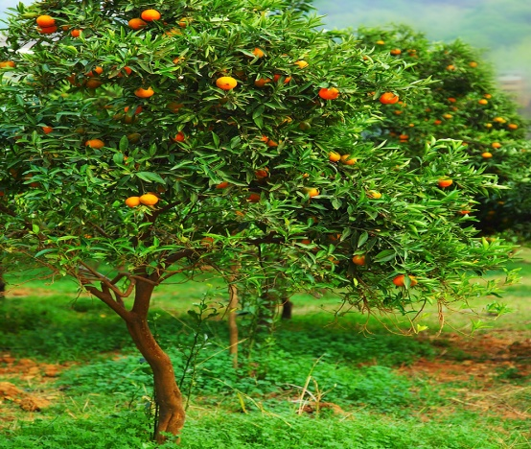
Item 0406: Area of productive and non-productive permanent crops in compact plantations (for each permanent crop type)
    Type: Essential item
    Reference period: Census reference day
    Concept: This item refers to the area of the crop at a single point of time.
    (does not include nurseries)
    Notes:
      Permanent crops of productive age - already bearing fruit or otherwise productive;
      Two or more permanent crops grown together in a compact plantation should be treated as in the previous case of temporary crops inter-planted or mixed: area is assigned to a particular crop proportionately to the area occupied by each crop;
      When permanent crops in compact plantation are in association with temporary crops (i.e. “growing in the compact plantation of permanent crops”), the area assigned to permanent crops usually is the whole area of the compact plantation.
Notes:
Number of permanent crops trees in compact plantation may also be collected;
Some countries may also wish to collect the number of permanent crops trees in compact plantation;
Permanent crops of productive age refers to permanent crops already bearing fruit or otherwise productive;
Two or more permanent crops grown together in a compact plantation should be treated as in the previous case of temporary crops inter-planted or mixed: area is assigned to a particular crop proportionately to the area occupied by each crop;
When permanent crops in compact plantation are in association with temporary crops (i.e. “growing in the compact plantation of permanent crops”), the area assigned to permanent crops usually is the whole area of the compact plantation because the density of trees is normally not affected by the presence of the temporary crop associated. In other cases, countries will need to develop procedures for a different allocation.

Slide 16
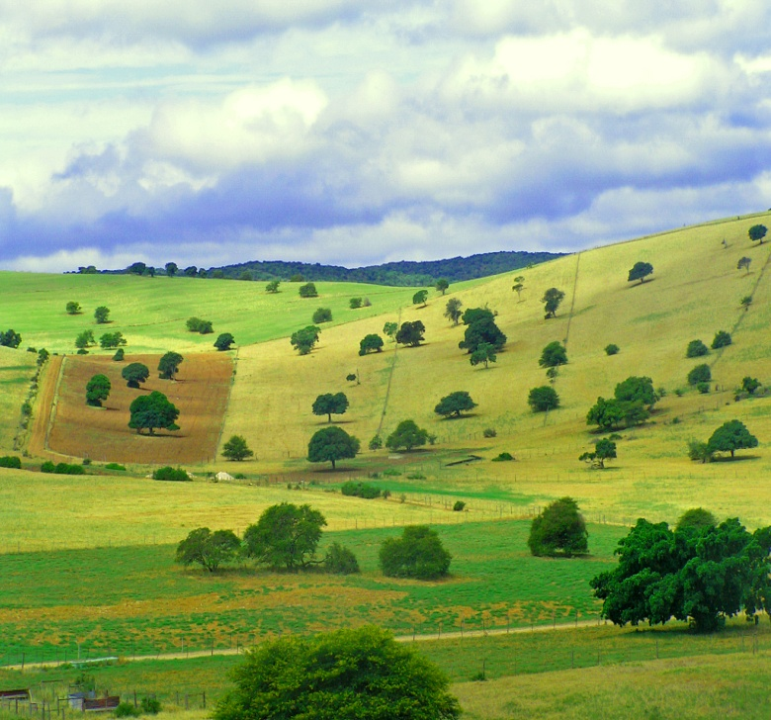
Item 0407: Number of crops trees in scattered planting (for each tree crop)
    Type: essential item.
    Reference period: census reference day.
    Concept: number of trees crops in scattered planting at a single point of time (nurseries are excluded).
    Note: Plants scattered around the holding.
Notes:
Notes: Usually these plants are scattered around the holding

Slide 17
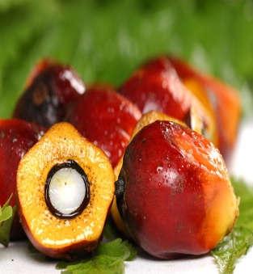
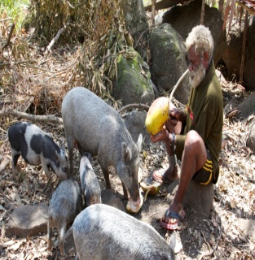

Item 0408: Area of productive permanent crops in compact plantations according to end use (for each selected permanent crop type)
    Type: Additional item.
    Reference period: Census reference day.
    Concept: End use-purpose of the crop.
    Countries should collect these data specific to their national conditions and data requirements focusing on those crops with multiple uses.
    Types of end-use suggested:
      Food for human consumption;
      Feed for animals;
      Biofuels;
      Other uses.
A single permanent crop may have multiple uses
human consumption
fodder crop
bio fuels

Slide 18
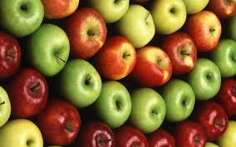
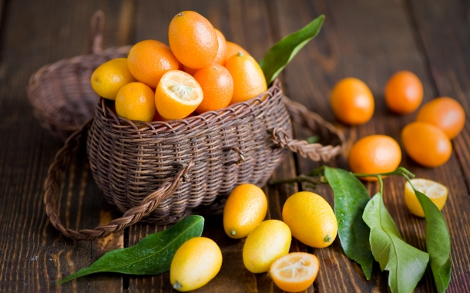
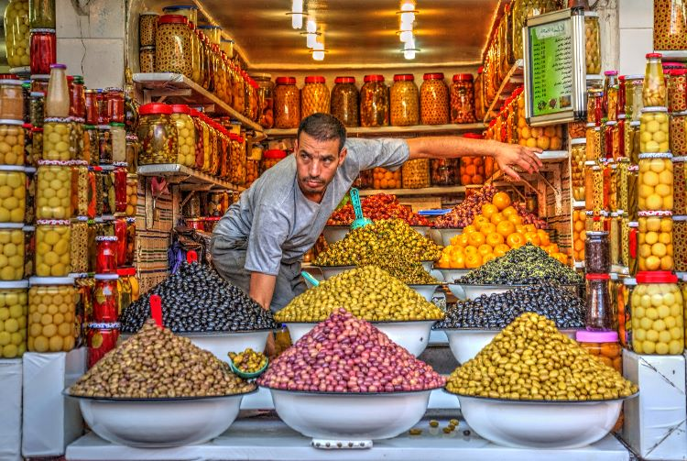
Item 0409: Production of permanent crops (for each selected permanent crop type)
    Type: Additional item.
    Reference period: Census reference year.
    Concept: Production - actual quantity of produce ready for sale or consumption and after deducting the losses.
    (pre-harvest, harvest and post-harvest losses)
    Notes:
      Countries should select the crops according to their needs.
      Production data in an agricultural census are useful as benchmarks for current crop production statistics.
Notes:
- Highest number of trees are of olives trees in Libyan Arab according to the last census 2001. (grapes, dates, citrus fuits and almonds)
- Highest number of trees are of olives tress in Jordan acording to the agricultural census 1997 (apples, vines, bananas, clementines)
- Highest number of trees are of olive trees in Tunisia according to the agricultural census 2004/2005 (grapes for raising, apples, pears etc)

Slide 19
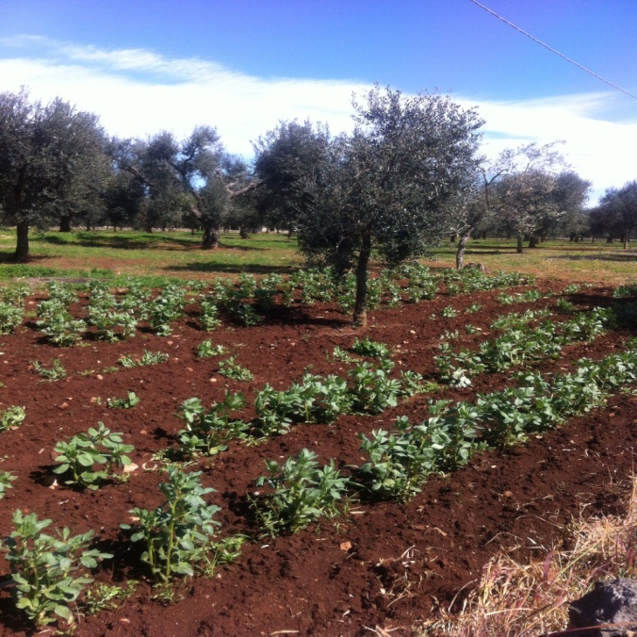
Item 0410: Area of land used to grow temporary crops as a secondary land use (for the holding)
    Type: Additional item.
    Reference period: Census reference year.
    Concept: temporary crops are grown on land classed as “other land uses type” and no under “land under temporary crops” in the land uses classification. It relates to area on the census reference day according to its main use during the census reference year.
    Examples:
      Temporary crops grown in association with permanent tree crops in compact plantation. It means temporary crops planted in “land under permanent crops”
      Temporary crops planted in “forest or wooded land”.
Notes:
Tunisia between the Olives trees there are crops cultivated such as soyabeans, grasses or also some cereals.
This item refers to the case when temporary crops are grown on land classed as “other land uses type” and no under “land under temporary crops” in the land uses classification. It relates to area on the census reference day according to its main use during the census reference year.
(because the categories of land use refer to the census reference year).

Slide 20
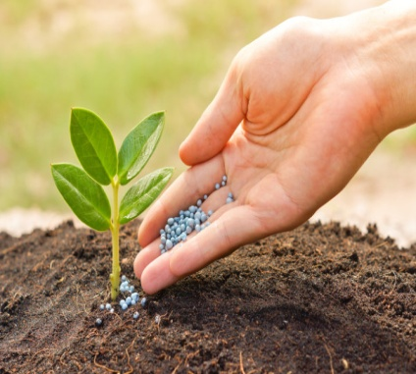
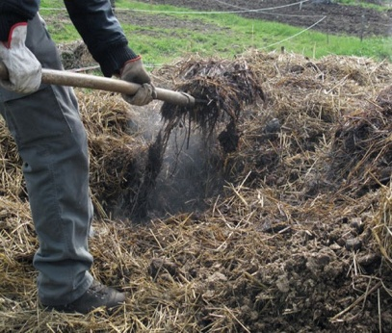
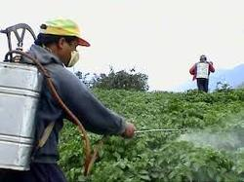
Item 0411: Use of each type of fertilizer (for the holding)
    Type: Essential item
    Reference period: Census reference year.
    Concept: Fertilizers refers to mineral or organic substances, natural or manufactured, which are applied to soil, irrigation water or hydroponic medium, to supply plants with nutrients or to enhance plant growth.
    Types:
      Fertilizers:
        Mineral fertilizers
        Organo-mineral fertilizers
        Organic fertilizers
        Biofertilizers
        Manure
      Other organic materials to enhance plant growth

Slide 21
Item 0412: Area fertilized for each type of fertilizer and major crop type (for the holding)
    Type: Additional item.
    Reference period: Census reference year.
    Concept: This item refers to the area of crops fertilized.
      For temporary crops - the part of the area harvested to which fertilizers were applied some time during the census reference year.
      For permanent crops- the part of the current area of permanent crops (i.e. the area with permanent crops at the census reference day) fertilized at some time during the census reference year.
    Caveat: This item relates to crops fertilized not to the land fertilized, therefore if fertilizer is used in two crops grown successively on the same land in two seasons, the fertilized area should be counted twice.
    Note: Countries will wish to limit this item to the most important national crops.
Notes:
For temporary crops, it is the part of the area harvested to which fertilizers were applied some time during the census reference year.
For permanent crops, it refers to the part of the current area of permanent crops (i.e. the area with permanent crops at the census reference day) fertilized at some time during the census reference year.

Slide 22
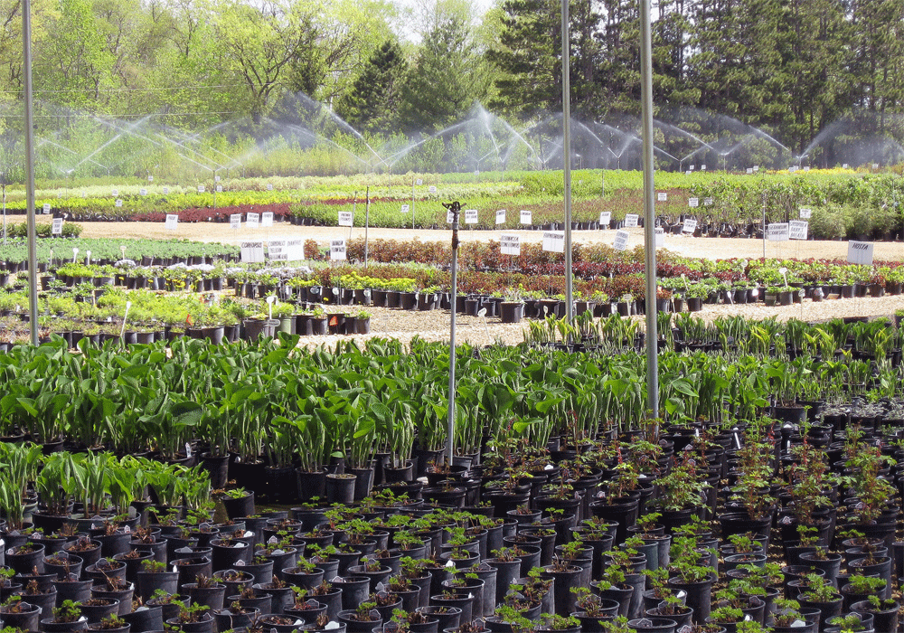
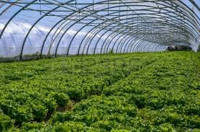
Item 0413:Presence of nurseries(for the holding)
Item 0414:Area of nurseries(for the holding)
Nursery in:
    Types:
    0413 :Frame item
    0414: Additional item
    Reference period: census reference year.
    Concept: area where young plants, trees or vines are propagated for the purpose of transplanting.
NEW ITEM
open
under protected cover
    Notes:
      Nurseries do not include seedfields.
      Plants in a nursery are not harvested
      (so its area is not included in the area of temporary crops or permanent crops)
      0414 - the area of land used for nurseries and no the total area of the nursery crops
      (if piece of land was used during the census reference year for nurseries of two crops should be counted only once)
PLANTS FOR:
Holding or Sale
Notes:
Concept: Nursery is an area where young plants, trees or vines are propagated for the purpose of transplanting.
A nursery may be in the open or under protective cover and may be used for the development of plants for the holding itself or for sale;
Item 0414 relates to the area of land used for nurseries and no the total area of the nursery crops, therefore if piece of land was used during the census reference year for nurseries of two crops should be counted only once.

Slide 23
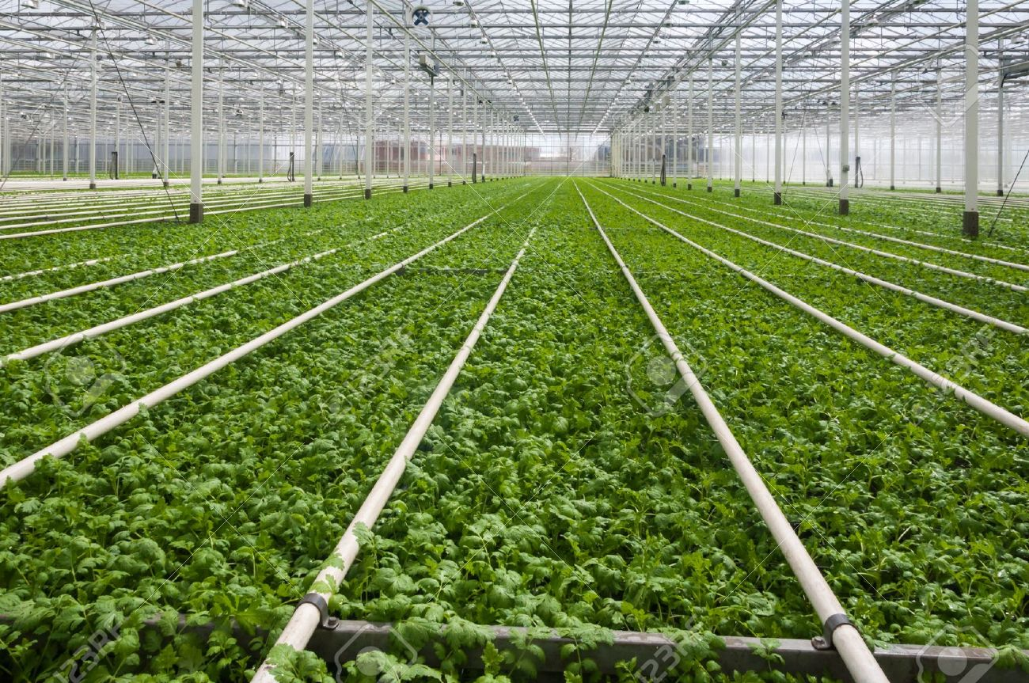
Item 0415 and Item 0416: Presence and area of cropped land under protective cover (for the holding)
    Types:
      0415: Frame item.
      0416: Additional item
    Reference period: census reference year.
    Concept: Cropped land under protective cover is land under permanent structure with a roof of glass, plastic or other material (“greenhouse”) used for protecting crops against the weather, pest or diseases.
NEW ITEM
    Notes:
      Temporary devices for short-term protection and netting to protect against insect and animals should not be included;
      0416 - the area of land used for growing crops under protective cover
Notes:
Item 0416 refers to the area of land used for growing crops under protective cover
therefore if piece of land under protective cover was used for growing different crops during the census reference year, it should be counted only once.

Slide 24
Country experience
Saint Lucia, 2007 Agricultural Census:
SECTION D: Land
Q 21. For each parcel the following Information were collected:
Total area of each parcel
Area under permanent/médium term crops (pure stand or interplanted with temporary crops)
Area under temporary crops only
Area under permanent meadows and pastures
Area under temporary meadows
SECTION E: PERMANENT CROPS
Q 24. For each parcel, the following information for coconut, banana and plantain in compact plantation, were collected:
area under production
crop status (in use/abandoned)
interplanted
Q 25. For other permanent crops at holding level the following information were collected:
number of trees/plants (of which bearing/abandoned)
interplanted
SECTION F: TEMPORARY CROPS
Q26. The following Information were collected:
is this crop growing today
if not growing today, was it grown during 2006?
end-use of the crop (for home use, for home and sale, and for sale)
Q27. If there are greenhouses on holding, for each please state the area.

Slide 25
THANK YOU!
http://www.fao.org/economic/ess/ess-wca/en/

