Slide 1
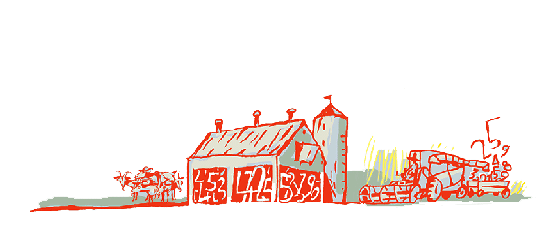
Regional Roundtable on
World Programme for the Census of Agriculture 2020 Port of Spain, Trinidad and Tobago 22-26 May 2017
Theme 05 – Livestock
Technical Session 9
Adriana Neciu
Agricultural Census and Survey Team
FAO Statistics Division

Slide 2
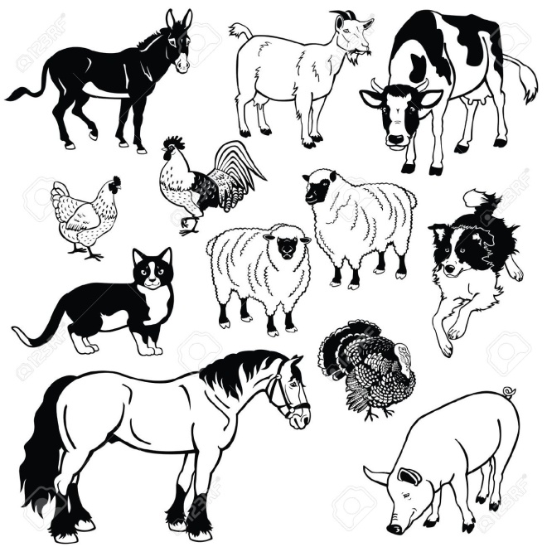
Outline
Concept and Definition
Importance of livestock statistics
Methodology on livestock numbers and characteristics
Items: type, reference periods and concepts
Country experiences

Slide 3
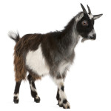
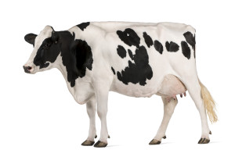
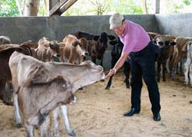
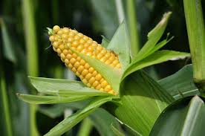
Concept & Definition
Livestock - all animals kept or reared in captivity mainly for agricultural purpose including cattle, sheep, goats, etc.
Livestock farming - an economic activity distinct from crop production (According to the Int’l Standard Industrial Classification -ISIC)
Livestock farming combined with growing of crops is treated as a Group (015), separate from farming livestock alone (Group 014).
Notes:
The term livestock covers all animals, birds and insect kept or reared in captivity mainly for agricultural purpose including cattle, (buffaloes) horses and other equine animals, camels, sheep, goats and pigs, as well as poultry, bees, silkworms, etc. – except aquatic animals (see Annex 6).
Domestic animals, such as cats and dogs, are excluded unless they are being raised for food or other agricultural purposes.
For further details on livestock please refer to the explanatory notes of Central Product Classification (CPC), Version 2.1.
Livestock farming is recognized as an economic activities distinct from crop production (According to the Int’l Standard Industrial Classification -ISIC)
Livestock farming combined with growing of crops is treated as a Group (015), separate from farming livestock alone (Group 014).

Slide 4
Importance of Statistics of Livestock & Livestock Products
Importance of livestock & livestock products is increasing. For example, according to FAO’s Agricultural and Consumers Protection Department, “annual per capita consumption of meat has doubled since 1980 in developing countries”.*
Livestock products in the form of meat, milk, and eggs, supply much needed protein thus contributing to improvement of nutritional status of under-nourished population;
Draught animals provide power for cultivation (in developing countries).
Livestock provide manure for enrichment of soil.
It’s a mode of transport.
Contributes cash income, employment and earnings of exchange through export.
Notes:
Importance of livestock & livestock products is increasing. For example, according to FAO’s Agricultural and Consumers Protection Department, “annual per capita consumption of meat has doubled since 1980 in developing countries”.*
Livestock products in the form of meat, milk, and eggs, supply much needed protein thus contributing to improvement of nutritional status of under-nourished population;
In developing countries draught animals provide power for cultivation.
Livestock provide manure for enrichment of soil.
It’s a mode of transport.
Contributes cash income, employment and earnings of exchange through export.

Slide 5
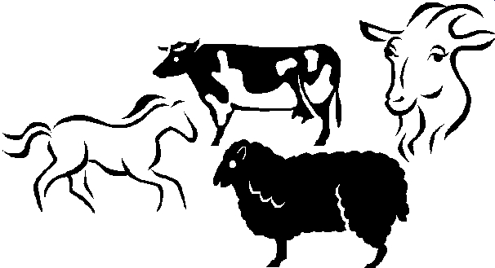
Methodology on livestock numbers and livestock characteristics
Data on livestock numbers need special techniques due to their nature.
Livestock census is costly and it is carried out every five years but some countries do yearly.
Notes:
Djibuti - Livestock census 2015/2016

Slide 6
Items
Theme 5 comprises 13 items:
For holdings (2):
0501 Type of livestock system (essential item);
0513 Use of veterinary services.
0506 Number of milking animals according to milk status;
0507 Number of animals born;
0508 Number of animals acquired;
0509 Number of animals slaughtered;
0510 Number of animals disposed of;
0511 Number of animals that have died from natural causes;
0512 Types of feed.
For each livestock type (11):
0502 Number of animals (essential and frame item);
0503 Number of female breeding animals (essential and new);
0504 Number of animals: age and sex;
0505 Number of animals according to purpose;
NEW ITEM

Slide 7
Item 0501: Type of livestock system
Type: Essential item
Reference period: census reference day
Concept: The livestock system refers to the general characteristics and practices of raising livestock on the holding.
Livestock systems: WCA 2020 distinguishes the following:
Grazing system
(˃90% of the dry matter feed animals comes from grazed grass or other herbaceous plants)
Nomadic or totally pastoral
Semi-nomadic, semi-pastoral or transhumant
Sedentary pastoral or ranching
Mixed system
(˃ 10% of the dry matter fed to animals come from crop or crop by-products
or stubble and ˂ 90% of the dry matter feed is off-farm produced)
Industrial system
(at least 90% of the dry matter of the animal feed is off-farm produced, e.g. feedlots or other in-house systems of feeding.)
Notes:
The livestock system refers to the general characteristics and practices of raising livestock on the holding. There are large variations in scale and intensity of livestock systems and it is difficult for a classification system to capture all of this diversity. For the purpose of the agricultural census the following livestock systems are identified:
Grazing system is characterized by ruminants grazing mainly on grasses and other herbaceous plants, often on communal or open access areas. In this system, more than 90% of the dry matter fed to animals comes from grazed grass or other herbaceous plants.
The following categories can be considered:
Nomadic or totally pastoral refers to livestock raised where the agricultural holder has no permanent place of residence and does not practice regular cultivation, the animals move from place to place with the agricultural holder;
Semi-nomadic, semi-pastoral or transhumant refers to livestock raises by holders who live a semi-nomadic life (the holder establishes a semi-permanent home for several months or years and herds are moved on transhumance to assure forage and water;
Sedentary pastoral refers to livestock raised by holders who have a permanent residence; Ranching is a category of large-scale livestock activities carried out on large areas of land set aside for extensive grazing.
Mixed system is the largest and most heterogeneous livestock system where grazing may be largely practiced but more than 10% of the dry matter fed to animals come from crop or crop by-products or stubble and less than 90% of the dry matter feed is off-farm produced.
Industrial system refers to intensive livestock-raising methods in which at least 90% of the dry matter of the animal feed is off-farm produced (e.g. feedlots or other in-house systems of feeding.)

Slide 8
Item 0502: Number of animals (for each livestock type)
Type: Essential and frame item
Reference period: census reference day
Concept: The number of animals is the animal population on the holding at the reference date regardless of ownership. A holding is raising an animal if it has primary responsibility of looking after it on a long-term basis and making day-to-day decisions about its use.
Caveat: A distinction must be made between raising an animal and being employed by an animal owner to look after the animal where the animal owner is decision-maker.
Notes:
The number of livestock is one of the essential items of the agricultural census, and is especially useful as a means of providing sampling frames for livestock surveys.

Slide 9
Item 0503: Number of female breeding animals (for each livestock type)
Type: Essential item
Reference period: census reference day
Concept: Breeding animals refers to the number of female animals that are kept mainly for reproduction purposes rather than food production.

Slide 10
Item 0504: Number of animals: age and sex (for each livestock type)
Type: Additional item
Reference period: census reference day
Way of collecting data: Age of livestock data are
collected in suitable age groupings, depending on livestock type and sometimes the breed of the animal:
Livestock type | Age group
Cattle, buffaloes | calf (< 1 year); young stock ( 1-2 years) adult (2 years or more);
Sheep, goats | lamb/kid (<1 year), adult sheep/goat (1 year or more);
Pigs | piglet (< 3 months); young pig (3-9 months), adult pig (over 9 months);
Horses, camels, mules, hinnies, asses | foal (< 1 year); yearling (1-2 years); young stock (2-4 years); adult stock (more than 4 years);
Poultry | young birds (for example, aged less than 3 weeks); adult birds;
Other animals | according to circumstances.
Notes:
Often these data are collected only for the major livestock types.
For poultry, it is often not necessary to distinguish between male and female young birds.

Slide 11
Item 0505: Number of animals according to purpose (for each livestock type)
Type: Additional item
Reference period: census reference day
Concept: Purpose refers to the main reason for the animals to be kept.
Main purposes:
Cattle, buffaloes: milk, meat, draught power, breeding;
Sheep, goats: milk, meat, wool, breeding;
Pigs: meat, breeding;
Horses, camels, mules/hinnies, asses: milk, meat, draught power, breeding;
Poultry: meat, eggs, breeding;
Other animals: according to circumstances
Notes:
To asses the main purpose, reference should be made to the main use of the animals during the census reference year or the intended main use in the future. Countries usually collect these data for the major types only.

Slide 12
Item 0506: Number of milking animals according to milk status (for each livestock type)
Type: Additional item
Reference period: census reference day
Concept: This item relates to the livestock types raised for milking as identified in the previous item. A milking animal is defined as an animal present on the reference day that has been milked at some time during the census reference year.
Milking status: Milking animals can be:
In milk
Dry.
Notes:
Milk status refers to whether the milking animal is in milk or dry on the day of enumeration

Slide 13
Items: 0507: Number of animals born 0508: Number of animals acquired 0509: Number of animals slaughtered 0510: Number of animals disposed of 0511: Number of animals that have died from natural causes
Items: 0507; 0508; 0509; 0510 and 0511
(for each livestock type)
Type: Additional items.
Reference periods:
Large animals (cattle, buffaloes and other large animals): census reference year;
Small animals (sheep, goats, pigs): 6-months reference period is often used;
Poultry: one-month reference period is often most suitable.
Concept: This 5 items provide information on the population dynamics of livestock herds, such as measures of reproductive rates and take-off rates. The five items refer to the number of events (births, deaths, etc.) during the reference period
Note: Countries should decide on the livestock types to be covered.
Notes:
For cattle, buffaloes and other large animals, normally the census reference year is taken.
For smaller animals, such as sheep, goats and pigs, a six-month reference period is often used.
For poultry, a one-month reference period is often most suitable.

Slide 14
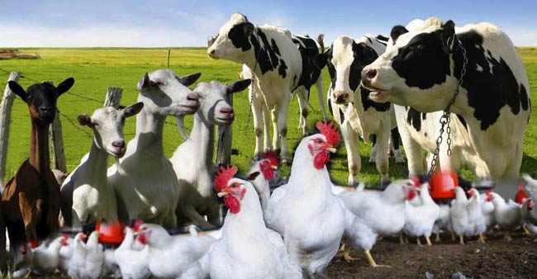
Items: 0507; 0508; 0509; 0510 and 0511 (contd.).
Concepts:
0507 Number of animals born - the live births during the reference period to animals that were part of the holding at the time of the birth.
0508 Number of animals acquired - purchases and other livestock acquisitions by the holding during the reference period;
0509 Number of animals slaughtered - number of slaughtering's during the reference period of animals that were being raised on the holding.
0510 Number of animals disposed of - sales or other disposals during the reference period of animals being raised on the holding. Two types of disposal are shown:
Sold or otherwise disposed for slaughter;
Other disposals
0511 Number of animals that have died for natural causes during the reference period for animals that were being raised on the holding at the time of the death.
Notes:
0507- Number of animals born refers to live births during the reference period to animals that were part of the holding at the time of the birth. Births to animals belonging to another holding that are temporarily on the holding should not be included.
0508 -Number of animals acquired refers to purchases or other livestock acquisitions by the holding during the reference period. This includes animals received as gifts or as payment for work.
0509 Number of animals slaughtered - number of slaughtering's during the reference period of animals that were being raised on the holding. It includes slaughtering's carried out on the holding as well as slaughtering's carried out by someone else on behalf of the holding.

Slide 15
Item 0512: Types of Feed (for each livestock type)
Type: Additional item
Reference period: census reference year.
Concept: Type of feed refers to the source of feed for the livestock type. More than one type of feed may be used; for example, animals may graze during the summer but be hand-fed during the winter.
Types of feed:
Forages/roughages: fresh grass or grass-legume mixture grazed or cut and distributed; silage grass or grass-legume mixture; hay; whole plant silage; crop residues; tree leaves.
Agro-industrial by-products/concentrate components, including crops: grain, beans, corn gluten meal and feed; oilseeds; oilseed and cotton seed cakes; brans and middling; by-products from breweries and destiller’s grains; molasses; fishmeal; cassava, banana.
Swill/household wastes: organic household residues;
Supplement additives: vitamins, amino acids, minerals
Notes:
Countries should decide on the livestock types to be covered by this item, according to national conditions.
Type of feed refers to the source of feed for the livestock type for a given reference period, usually the census reference year. More than one type of feed may be used for a specific livestock type during the reference year; for example, animals may be grazed during the summer but need to be hand-fed during the winter.
There are two types of feed.
Primary products include green fodder such as pasture grasses, forage crops, other crops and tree leaves, as well as harvested by-products and hay.
This is sub-divided into whether it was produced on the holding or purchased.
Processed products include concentrates and compound feeds.

Slide 16
Item 0513: Use of Veterinary Services (for holding)
Type: Additional item
Reference period: census reference year
Concept: Veterinary services cover all professional veterinary services used to protect animal health for the livestock kept on the holding. It includes services provided by both the public and private sectors.
Data collection - Data on the use of veterinary services may be collected in two ways (suited to country’s needs):
for the holding as a whole: can be useful as an indicator of whether such services are generally available to the holding.
for each major livestock type: can help in assessing the animal health situation of each livestock type.
data to collect:
i) the number of visits by an extension officer/veterinary;
ii) type of services received (diseases treatment; surgical procedures, artificial insemination, breeding, vaccination, etc.)
Notes:
Veterinary services cover all professional veterinary services used to protect animal health for the livestock kept on the holding, including treatment of diseases, artificial insemination, vaccination, and surgical procedures.
It includes services provided by government organizations, such as through veterinary field workers, as well as by the private sector.
Data on the use of veterinary services may be collected in two ways.
First, data for the holding can be useful as an indicator of whether such services are generally available to the holding.
Second, data for each major livestock type can help in assessing the animal health situation of each livestock type. Countries collect data in the form suited to their needs.
As far as the type of data to collect, it is suggested to record:
The number of visits by an extension officer
Type of services received

Slide 17
Country experiences
Grenada– Agricultural Census 2012
Period of reference for recording livestock number was day of enumeration
For each type of livestock, three variables have been recorded: the total number of animals (as at the day of enumeration), type (cattle, sheep, goat, pig, poultry) and sex.
Sheep (for example)
Number of male lambs
Number of female lambs
Number of rams
Number of ewes
For horses, donkeys, rabbits and beehives the total number has been recorded.
Number of animal disposed of (sold alive, slaughtered, lost/other disposal) during the census year, for each type of livestock (cattle, goats, sheep, pigs, chickens)

Slide 18
Thank you.
Thank you

