Slide 1
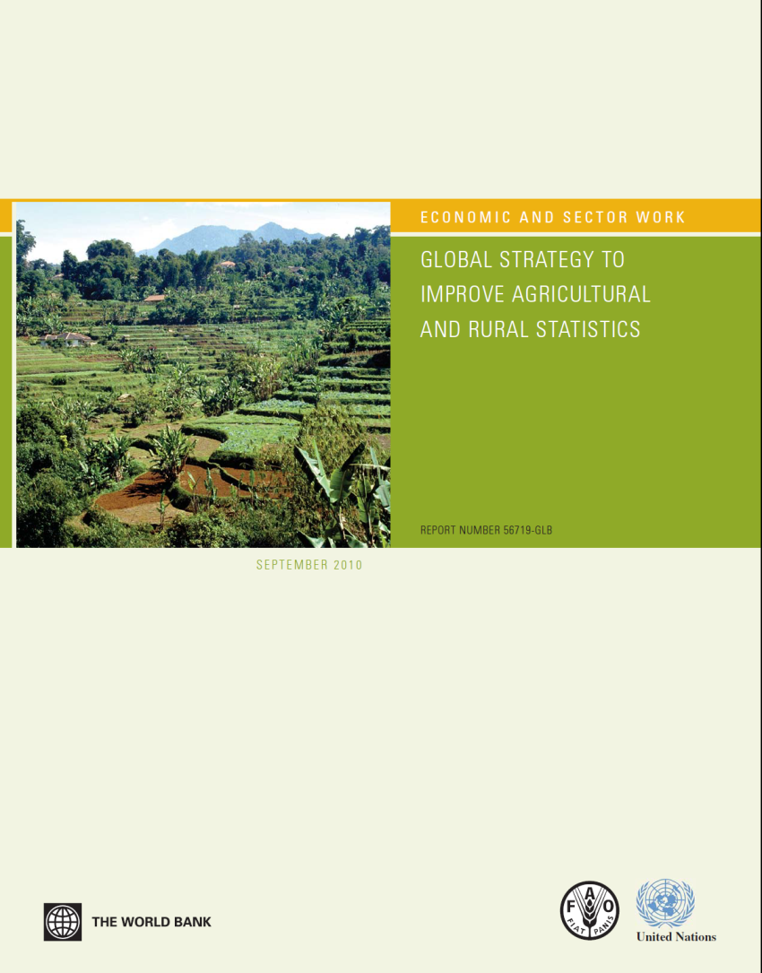
Global Strategy to Improve Agricultural and Rural Statistics
Implementation in the Pacific Region

Slide 2
Outline
Global Strategy to Improve Agricultural and Rural Statistics
Action Plan to Implement the Global Strategy
Implementation in the Pacific Region

Slide 3
Poverty reduction
2.5 billion people depend directly on agriculture
Global extreme poverty 2002 (millions)
1.5 billion live in small farm households ( 85% less than 2ha)
75% of poor are rural.
Majority will be rural to about 2040

Slide 4
Agriculture reemerging on the global policy agenda
2008 food price spike
Devastating impact on the poor
Highlighted need for further agricultural data
Data on crop production, consumption, stocks and trade flows, often not available
Price monitoring is limited in scope
Results are not timely
Most recent data are for 2009
Lack of timeliness of production data contributed to food price crisis

Slide 5
Inadequate scope of agricultural statistics
Emerging needs food security, bio fuels etc.
Data is production oriented
No coverage of environment or rural development
Numbers of farms, agricultural households, rural households, and their characteristics
Unable to link the welfare of rural and agricultural households with agricultural production and land use
Quality of data is not sufficient
Data for maize and cattle for many countries imputed for around half

Slide 6
Global Strategy Development
Global Strategy -UNSC 40th session, February 2009 – Friends of the Chair Working Group – country led approach. Endorsed UNSC Feb 2010 41st session
FAO and WB developed with Friends of Chair Working Group, consultations with stakeholders
UNSC urged FAO to lead the preparation of an implementation plan for the GS.
Implementation Plan includes :
a comprehensive technical assistance programme
training programme: regional and national levels
research agenda: including new technologies
Global Action Plan and Regional Implementation Plans
Notes:
Australia, Brazil (head), China, Cuba, Ethiopia, Italy, Morocco, the Philippines, the Russian federation, Trinidad and Tobago, Uganda, the United States, FAO, UNSD (secretariat and observer), Eurostat and WB (observers)
ISI Satellite Meeting on Agricultural Statistics, Maputo, Mozambique, August 2009 (more than 200 participants from over 45 countries and regional and international organizations)
FAO biannual conference in November 2009 (ministers of agriculture of all member countries)
Sessions of Regional Commissions on Agricultural Statistics (attended by directors of National Statistical Offices)
The PARIS21 Consortium meeting in Dakar, Senegal in November 2009 (around 100 participants representing governments, private businesses, intermediate organizations and statisticians)

Slide 7
Global Strategy – Purpose
Coordinated and long-term initiative to address the decline in agricultural statistics systems
Framework for national and international statistical systems
Implemented in partnership with regions and adapted to suit regional specificities
To produce and to apply the basic data and information
To guide decision making in the twenty-first century

Slide 8
Global Strategy - Conceptual framework
Brings together economic, social and environmental dimensions of agriculture
Agricultural production - incorporates forestry, fisheries, and land and water
In addition to traditional definition of production
Linkages between rural and agricultural holdings
Their use and impact of land and other natural resources
Notes:
A thorough assessment of users’ data needs

Slide 9
Global Strategy -Three pillars
The First Pillar - minimum set of core data and determining national priorities
The Second Pillar —integration of agriculture into national statistical systems
The Third Pillar — sustainability of agricultural statistics by governance and statistical capacity building

Slide 10
Minimum Core Data Set
Georeferenced data
Production, area harvested and planted, Yield, exports and imports of:
Core crops
Core fishery and aquaculture products
Core livestock
Core forestry products
Stocks
Land area
People of working age by sex
Number of live animals
Equipment – no of tractors, harversters etc
Quantity of water for irrigation
Core fertilizers
Core pesticides
Seeds, feed by core crops
Volume of core crops/fishery/livestock used in processing food by industry and values of output
Producer and consumer prices for core crops/fishery/livestock

Slide 11
Minimum Core Data Set
Public investment and subsidies on agriculture and rural development
Private investments in agriculture
Household consumption of core crops/ fisheries etc
Areas for irrigation/roads/ etc
ODA for agriculture and rural development
SOCIAL
Age and sex of urban /rural population
Country of birth
Highest education level completed
Labor status – employed, unemployed, inactive
Status in employment – self employment and employee by sex
Economic sector in employment
Occupation in employment
Total household income
Household composition
No of family/hired workers
Housing conditions

Slide 12
Minimum Core Data Set
ENVIRONMENTAL
Soil degradation
Pollution due to agriculture
Emissions due to agriculture

Slide 13
Action Plan – Elements
Country Assessment
Identifies priority needs for TA and training
Three technical components:
Research
Training
Technical assistance
Governance mechanism

Slide 14
Action Plan – Global, Regional and Country levels (3 technical components)
 | Global level | Regional level | Country level
TA | Developing cross-regional standards and guidelines | Providing TA and coordinating regional technical assistance | Implementing technical assistance
Training | Developing cross-regional training materials | Adapt to regional specificities, organize training in regional training centers and support countries training activities | Implementing training activities through, on-job, e-learning, training in regional centers
Research | Organizing research on new cost-effective methods in agricultural statistics | Collaborate with Global level to ensure that special research needs of the region are taken into account and organizing region-specific research | Validate methods at local level, contribute to field test, adopt and implement methods
Notes:
21/05/2012
14

Slide 15
Research Component
Improve agricultural data collection and manageemnt
Guidelines and handbooks on advanced methodologies, standards and tools.
Priority areas:
Reference framework: mainstreaming agriculture into the National Strategy for the Development of Statistics (NSDS); implementation of an Integrated Survey Framework.
Master frame for integrated survey: Use of technology such as GPS, linking area frames with list frames; use of remote sensing.
Data collection methods: Estimation of crop area, yield and production; cost of production; enumerating nomadic livestock; Adoption of new technologies; forestry and deforestation; crop forecasting; Inland fishery, aquaculture;
Food security: estimation of supply utilization account, food balance sheets, food stocks and edible forest products, nutrition indicators, use of households surveys/LSMS for food security indicators.
Market information: estimation of farm gate prices, collecting rural and border market prices,
Data analysis: reconciliation of census and survey data, use of small area estimation methods for improving agricultural statistics.
Administrative data: improvement and use of administrative data

Slide 16
Technical Assistance and Training
TRAINING
Staff of National Statistical Agencies – on the job & formal training
Training regional training centres
TECHNICAL ASSISTANCE
Institutional and organisational strengthening
Legal framework
Coordination among statistical producers
Advocacy
Mainstreaming agriculture into NSDS
Agriculture Census
Capacity Development on methods for collection of Minimum Core Data
Use of PDA/CAPI/GPS
Development and use of master sample frame
Etc.
Notes:
Institutional – legal, coordination, staff conditions of service; Organisational – management skills
improve institutional and organizational aspects of the agricultural statistical systems
undertake advocacy and policy dialogue between government and development partners to mainstream agricultural statistics in sector development programmes
promote and enhance coordination for agricultural data production and use

Slide 17
Implementation Pacific Region
Tailored to current activities in the region
Integrated with the TYPSS Ten-Year Pacific Statistical Strategy
MAIN ACTIVITIES
Minimum core data set tailored to Pacific
Already developed under the TYPSS
Linking population and agricultural censuses
Collection of minimum core agricultural data
Developing core modules for household surveys
Food Security Module
Mainstreaming agriculture into the NSDS

Slide 18
Lack of knowledge is darker than night

