Slide 1
2011 pilot census
(CENSUS PREPARATORY WORK)
28nd May, 2012
Integrating Agricultural Questions with 2020 Census Programmes

Slide 2
outline
BACKGROUND
QUESTIONNAIRE
TARGETED OUTCOME
OUTCOME

Slide 3
BACKGROUND
SURVEYS / CENSUS
Employment status
  Occupations & Industries
Consumptions of Home Produces
  Cash & non-cash income of agricultural commodities
  Home produces
    Subsistence fishing
    Crops & vegetables produces
    Subsistence farming (pigs, chicken, ducks)
  Participation of hholds in agricultural activities

Slide 4
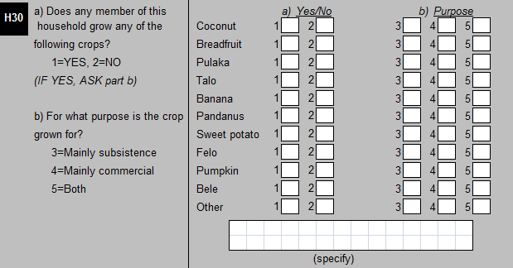
QUESTIONNAIRE

Slide 5
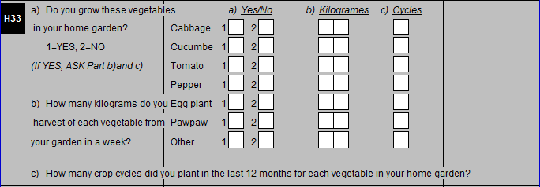
QUESTIONNAIRE

Slide 6
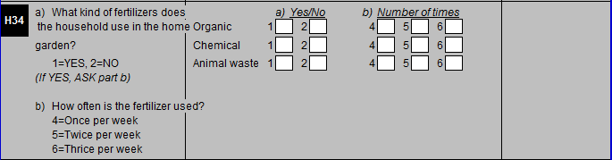
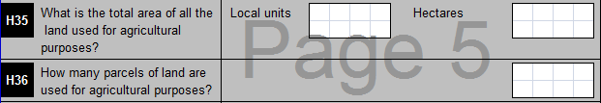
QUESTIONNAIRE

Slide 7
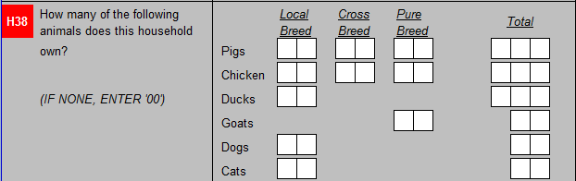
QUESTIONNAIRE

Slide 8
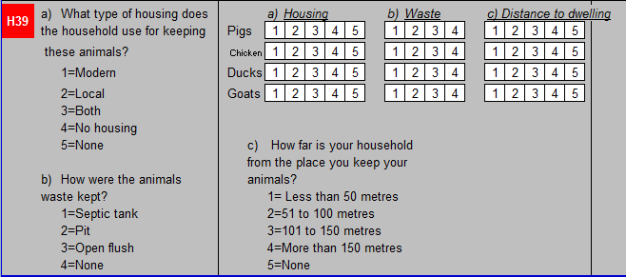
QUESTIONNAIRE

Slide 9
OUTCOME
Table H30. Crops grown and purpose of growing them by the households
Crops | Total | Mainly subsistence | Mainly commercial | Both
Coconut | 87 | 86 | 0 | 1
Breadfruit | 66 | 66 | 0 | 0
Pulaka | 18 | 18 | 0 | 0
Talo | 15 | 15 | 0 | 0
Banana | 87 | 86 | 0 | 1
Pandanus | 51 | 50 | 0 | 1
S/ potato | 8 | 8 | 0 | 0
Felo | 10 | 10 | 0 | 0
Pumpkin | 13 | 13 | 0 | 0
Bele | 15 | 15 | 0 | 0
Other | 10 | 10 | 0 | 0

Slide 10
OUTCOME
Table H32. Size of home garden
Village | Total | 10 sqr metres or less | 11-15 sqr metres | 16-20 sqr metres | 21-25 sqr metres | 26-30 sqr metres | More than 30 sqr metres
Total | 36 | 30 | 3 | 0 | 2 | 1 | 0
SENALA | 3 | 2 | 0 | 0 | 1 | 0 | 0
ALAPI | 8 | 8 | 0 | 0 | 0 | 0 | 0
VAIAKU | 25 | 20 | 3 | 0 | 1 | 1 | 0

Slide 11
OUTCOME
Table H33. Weights harvested and cycles of vegetables grow by the households
Vegetables |  | Total households | Weights (kg) harvested weekly | Cycles for planting annually | Average weights (kg) | Average no. of cycles
Cabbage |  | 19 | 103 | 39 | 5.42 | 2.05
Cucumber |  | 13 | 76 | 28 | 5.85 | 2.15
Tomato |  | 13 | 51 | 29 | 3.92 | 2.23
Pepper |  | 7 | 29 | 13 | 4.14 | 1.86
Egg plant |  | 5 | 36 | 10 | 7.20 | 2.00
Pawpaw |  | 27 | 257 | 51 | 9.52 | 1.89
Other |  | 11 | 66 | 20 | 6.00 | 1.82

Slide 12
OUTCOME
Table H34. Usage of fertilizers by households
Fertilizers |  | Total households | Once a week | Twice a week | Thrice a week
Organic |  | 25 | 20 | 5 | 0
Chemical |  | 3 | 2 | 1 | 0
Animal waste |  | 26 | 22 | 3 | 1
Table H38. Number of animals, chicken and ducks
Vegetables |  | Total | Local Breed | Cross Breed | Pure Breed
Pigs |  | 731 | 122 | 477 | 132
Chicken |  | 143 | 93 | 0 | 50
Duck |  | 0 | 0 | 0 | 0
Goats |  | 0 | 0 | 0 | 0
Dogs |  | 35 | 35 | 0 | 0
Cats |  | 75 | 75 | 0 | 0

Slide 13
OUTCOME
Table H39a. Types of housing used to keep the animals
Types of housing |  | Pigs | Chicken | Goats | Ducks
Total |  | 113 | 113 | 113 | 113
Modern |  | 101 | 0 | 0 | 0
Local |  | 4 | 4 | 0 | 0
Both |  | 6 | 0 | 0 | 0
No housing |  | 0 | 4 | 0 | 0
Not Applicable |  | 2 | 105 | 113 | 113
Table H39b. Method used to keep the animal waste
Types of waste disposal |  | Pigs | Chicken | Goats | Ducks
Total |  | 113 | 113 | 113 | 113
Septic tank |  | 18 | 1 | 0 | 0
Pit |  | 4 | 0 | 0 | 0
Open flush |  | 89 | 7 | 0 | 0
Not Applicable |  | 2 | 105 | 113 | 113

Slide 14
OUTCOME
Table H39c. Distance of places that keep the animals to the respective households
Types of waste disposal |  | Pigs | Chicken | Goats | Ducks
Total |  | 113 | 113 | 113 | 113
Less than 50m |  | 10 | 5 | 0 | 0
51 to 100m |  | 18 | 1 | 0 | 0
101 to 150m |  | 21 | 0 | 0 | 0
More than 150m |  | 62 | 2 | 0 | 0
Not Applicable |  | 2 | 105 | 113 | 113

