Slide 1
Status Report
Regional Training Workshop on Linking Population and Housing Censuses with Agricultural Censuses
Noumea, 28 – 1 June 2012, SPC Headquarters
Federated States of Micronesia
Office of SBOC - Division of Statistics
FSM National Government
Palikir, Pohnpei
FSM 96941

Slide 2
Status and Calendar
Census/Survey | Conducted(Year) | Plan(Year)
Agricultural Census |  | 2013
Food Security | 2010
HIES | 2005 | 2012
Population Census | 2010 | 2020
DHS |  | 2014
Child Protection | 2012
Disability Survey |  | 2012
Tobacco Survey | 2012

Slide 3
Work in Progress
Agriculture policy being drafted before Population Census and Agriculture Census/survey ?????????
Contents (yet to be shared widely)

Slide 4
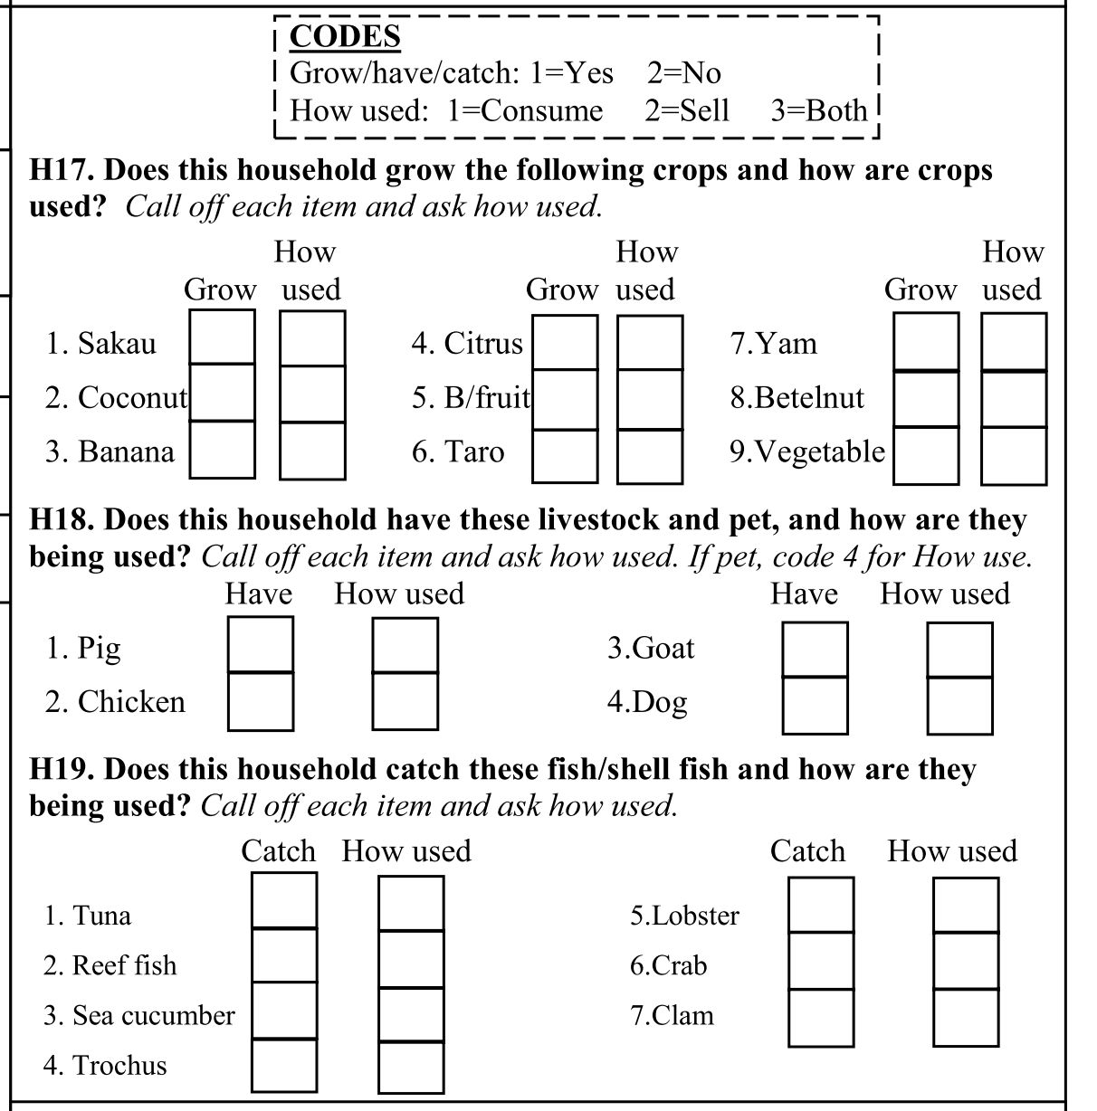
Pop Census – HH Questions

Slide 5
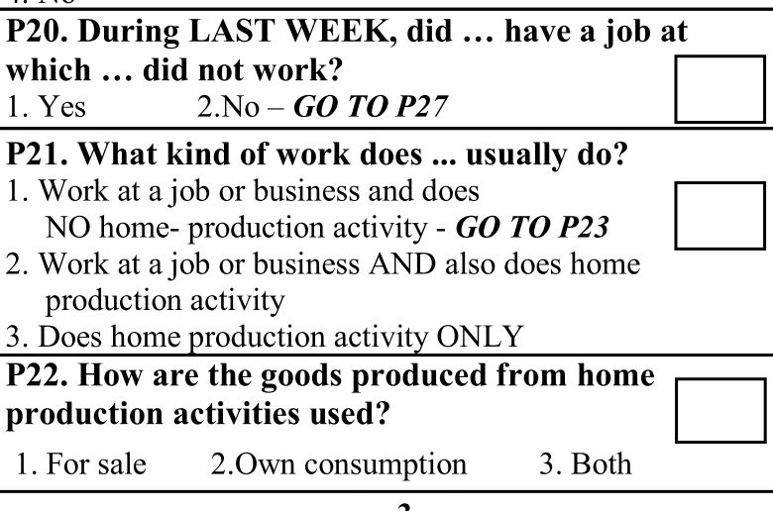
Pop Census – Person Questions

Slide 6
What is NEXT …
Conduct an Agriculture Census in 2013
Decide on the approach to take …

Slide 7
THANK YOU

