Slide 1

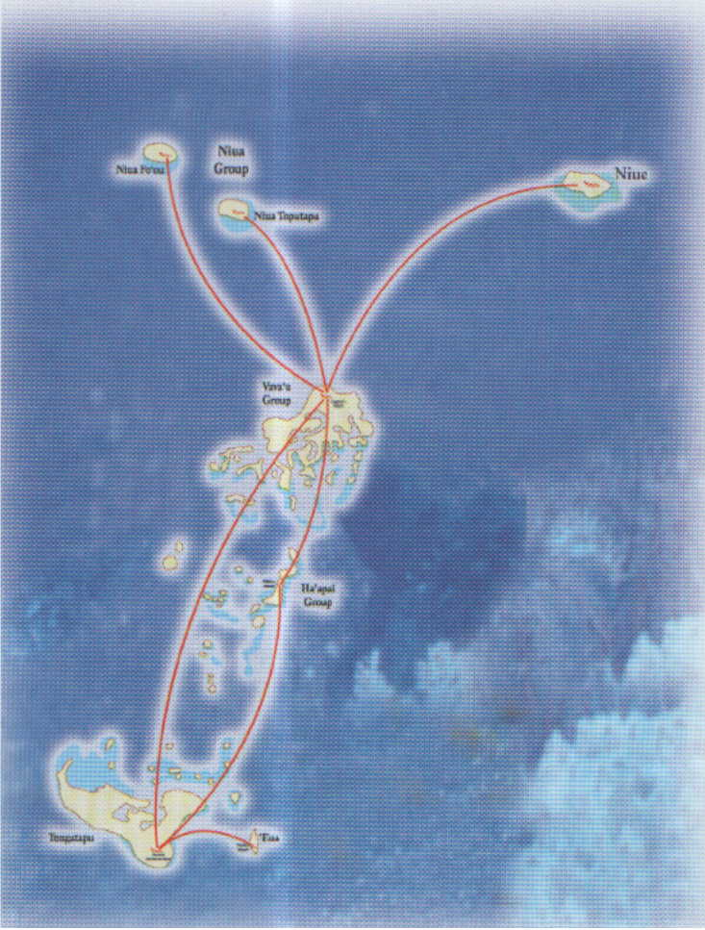
-
In the beginning, God created the heaven and earth, He also created the friendly Isles, and called the
KINGDOM OF TONGA

Slide 2
TONGA: PRESENTATION
Regional Training Workshop on Linking
Population and Housing Censuses with
Agricultural Censuses,
Noumea, New Caledonia,
28 May – 1 June 2011.

Slide 3
Contents:
Background Information
Background of Censuses in Tonga
Importance of Agriculture in Tonga
Current Agriculture Statistics
Important Agr Surveys before AC 2001
Visions for Agriculture 2001
Agr Census 2001 Operations
Results

Slide 4
Kingdom of Tonga
Background Information
It covers an area of some 360,000 square kilometers between the latitudes 15 and 23.5 degrees south and longitudes 173 and 177 degrees west.
Its total land area is about 670 sq. km. which is made up of 171 islands of which only 36 are inhabited.
It has five main groups of islands, namely, Tongatapu, Vava’u, Ha’apai, Eua and Niuas.
It is located near the international dateline, hence, this is where the time begins

Slide 5
Background of Censuses in Tonga
The First Censuses;
Population Census/Count 1891
Agriculture Census, by SD 1985
The Last;
Population Census, by SD 2011
Agr. Census (& 2nd), by MAFF & SD 2001
The Next;
Agriculture Census 2013
Population Census 2016

Slide 6
Importance of Agriculture in Tonga
No Agriculture, No Future!!
Tonga last annual Foreign Trade Surplus was in early 1970s, dominated by Agriculture’s only 2 commodities, Copra and Banana,
Agriculture is currently the major contributor (industry) to Tonga economy, vis a vis, the GDP, just under 20%,
Sustainable food security

Slide 7
Current Agriculture Statistics
In addition to the last 2 Agricultural Censuses;
Quarterly Market Report (Agr produce) compiled by the MAFF, price collection shared by the MAFF and SD (for CPI),
Agriculture Export Statistics, SD Quarterly and Annual FTS,
SD’s Agriculture’s VA estimates for GDP (benchmarked from HIES and other indicators)

Slide 8
Some of the important surveys in the agricultural sector undertaken before the Agr. Census 2001:
Surveys of Household Consumption and Production of Crops, Livestock and Fish in Tonga in 1970 and 1980
Survey of Coconut Palms - 1979
Coconut Age Distribution and Productivity Survey in1980
Agricultural Inputs Survey in 1982/83
Land Utilization Survey in Tongatapu in 1982
Market Surveys in
Animal Health Survey in the Kingdom of Tonga - 1994
The 1991-1992 Annual Crops Survey
Land Use and Crop Survey in 1993
Inventory of Coconut Palm Resources - 1996

Slide 9
Visions for Agriculture 2001, to:
provide benchmark or basic data on the structure of agricultural holdings and their main characteristics;
use this information to develop a regular system of agricultural statistics;
build up some important village level statistics;
establish a technical and organizational foundation on which to build up a comprehensive and integrated system of food and agricultural statistics; and
provide a frame from which samples can be drawn to study certain aspects of agricultural activities in greater depth.

Slide 10
Agr Census 2001 Operation, to mention a few
Like the AC 1985, the Government of Tonga approached the FAO for technical and financial assistance
Census Training
Field Enumeration
Data Processing
Results

Slide 11
Training
Done in two levels:
First level, training of supervisors – Sept. 18-20, 2001
Second level, training of enumerators – Sept. 21 to October 1, 2001
For each level, physical inspection of holdings, parcels and plots was done.

Slide 12
Field Enumeration started Oct. 3, 2001 until end of Dec. 2001…
Enumerators
interviewed the
knowledgeable
respondents using
the census
questionnaires

Slide 13
Data Processing
1. Manual Processing
Further manual processing
was done for the accomplished
questionnaires for almost two months from January to February 2002.

Slide 14
Data Processing
Machine Processing
Data encoding began in the third week of February 2002 until April 2002.
Then followed by editing of the encoded data and tabulation of census results which lasted until May 2002.

Slide 15
Result (3 slides);
1. Number and Percentage of Agriculturally Active Households
Division
Number
%
Tonga
10,102
100.0
Tongatapu
5,735
56.7
Vava’u
2,183
21.6
Ha’apai
1,076
10.7
Eua
774
7.7
Niuas
334
3.3

Slide 16
Result;
2. Number and Percentage of Households engaged in Fishing
Division
Number
%
Tonga
5,130
100.0
Tongatapu
2,393
46.6
Vava’u
1,337
26.1
Ha’apai
937
18.3
‘Eua
211
4.1
Niuas
252
4.9

Slide 17
Result;
3. Number and Percentage of Households keeping Livestock
Division
Number
%
Tonga
12,585
80.0
T/tapu
7,893
74.6
Vava’u
2,356
89.8
Ha’apai
1,204
92.8
Eua
789
91.4
Niuas
343
93.0

Slide 18
For more information, please contact
Statistics Department
or
Ministry of Agriculture and Forestry

Slide 19
MALO AUPITO!

