Slide 1
AGRICULTURE CENSUS 2011 Cook Islands NSO Experience
Statistics Office, MFEM
Rarotonga, Cook Islands
UNFPA/FAO/Paris21/SPC Workshop on
Integrating Agricultural Census with 2020 round of Population Censuses
Noumea, NEW CALEDONIA, 28 May-1 Jun 2012

Slide 2
Joint Venture
Statistics Office, MFEM
Rarotonga, Cook Islands
Questionnaire Design
Management of the field operation
Recruitment and Training of field workers
Sharing of resources
Data processing

Slide 3
Questionnaire Design
Statistics Office, MFEM
Rarotonga, Cook Islands
Consultation with MoA (as users of information)
Determining the content and format of the Census Questionnaire
AgricultureCensus 2000 CookIslands.doc
Pre Testing

Slide 4
Concepts and Definitions
Statistics Office, MFEM
Rarotonga, Cook Islands
Household vs Holding
Parcel, Plot, Piece of land
Crops, fruit names, variable specifications
Census Districts vs Location of Holding, farms,

Slide 5
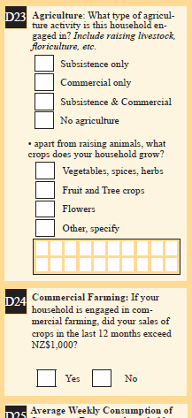
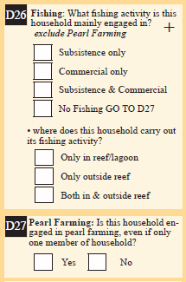
Link or Integrate
Statistics Office, MFEM
Rarotonga, Cook Islands

Slide 6
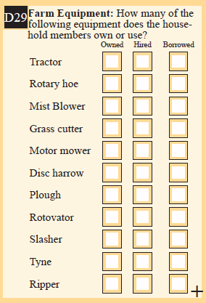
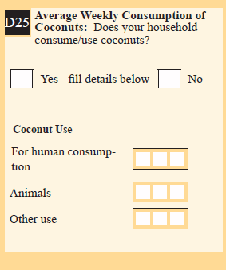
Link or Integrate
Statistics Office, MFEM
Rarotonga, Cook Islands

Slide 7
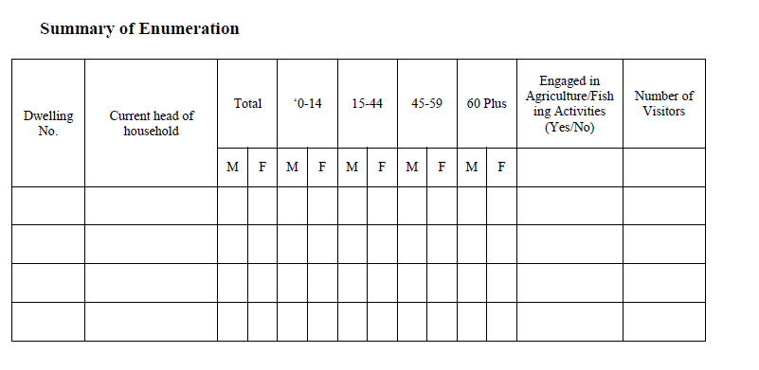
Population Census
Field book

Slide 8
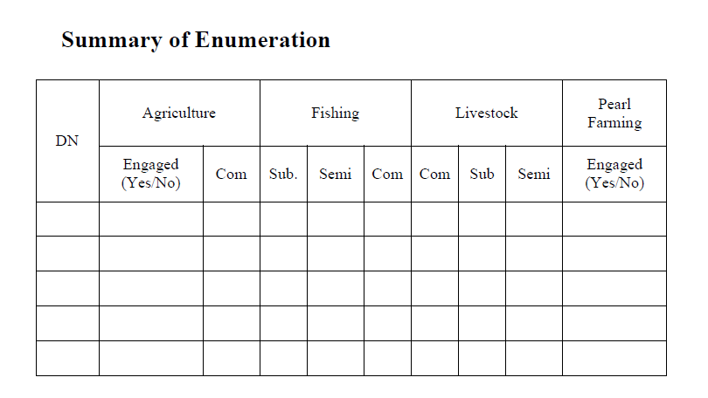
Agriculture Census
Field book

Slide 9
Field Operation
Statistics Office, MFEM
Rarotonga, Cook Islands
Logistics – transport, communication
Recruitment of field workers
Training of Enumerator
Sharing of resources

Slide 10
Recommendation
Statistics Office, MFEM
Rarotonga, Cook Islands
There is avenue for integration but it has to be managed carefully to avoid jeopardizing the Population Census
Early planning
Early identification of the requirement of the Agriculture Census

