Slide 1
Status and Prospect of Production and Market of Kenaf in China
Dr. Defang Li
Institute of Bast Fiber Crops, Chinese Academy of Agricultural Sciences, Changsha, China

Slide 2
Nowadays, kenaf not only acts as an economical crop which supplies fiber and industrial material, but also is used for animal feed and other purpose in China.
Kenaf cultivation enhances soil environment, renovates heavy metal pollution and produces more oxygen than trees. New multipurpose exploitation promotes kenaf industry rapidly.

Slide 3
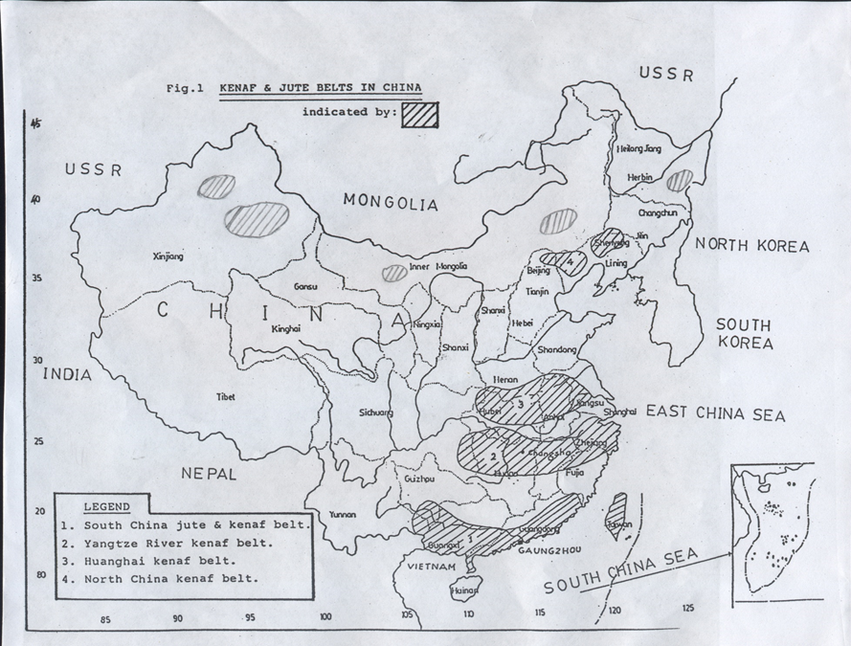
Major agro-ecological regions of kenaf in China
(1) The South China Kenaf Belt: including Guandong, Fujiang, Guangxi provinces.
(2) The Yangtze River Kenaf Belt : Sichuan, Hunan, Hubei provinces.
(3) The Yellow and Huaihe River Kenaf Belt: Henan, Shandong, Hebei, Anhui provinces.
(4) The North China Kenaf Belt (Northwest and Northeast) : including Xinjiang, Inner Mongolia, Liaoning, Jining provinces.

Slide 4
Planting area of kenaf
From 1974 to 1984, rapid growth of kenaf planting area, the highest peak planting area were about 900,000ha in 1985, mainly due to the wide adaptation of the high-yielding, disease-resistant kenaf variety.
After 1985, the planting area decreased rapidly and remained at a low level after 1995, but the planting area is relatively stable ((ahout 20000-30000 hectares/year) ).

Slide 5
Price of Kenaf
Before 2010, kenaf fiber price is stable and keep it at about 400 dollar per ton. it is remarkably increasing after 2012 and up to 850 dollar per ton at 2018. The rising price of kenaf will promote the development of kenaf industry and the increase of planting area in China

Slide 6
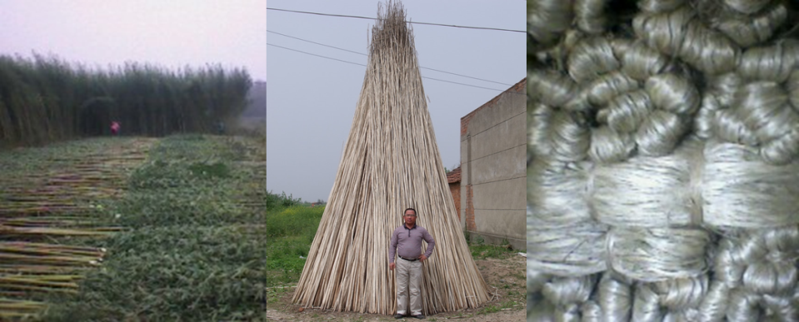
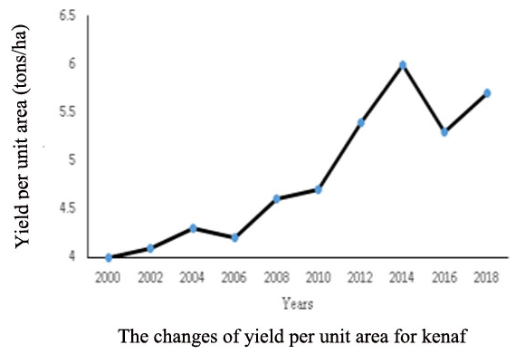
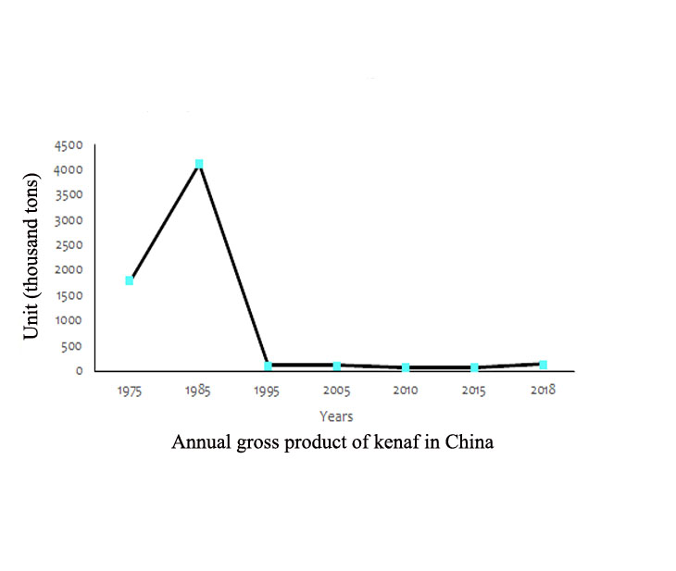
Yield of kenaf
On average, kenaf fiber yield is about 3.0-4.0T/ha (15T/ha stalk) for growing 120-150 days.The highest fiber yield can be up to 5-6 T/ha, because some new varieties with high yield, good resistance and later mature have been bred in China. Its fiber basically maintain 50000 tons gross production for each year in recent years.

Slide 7
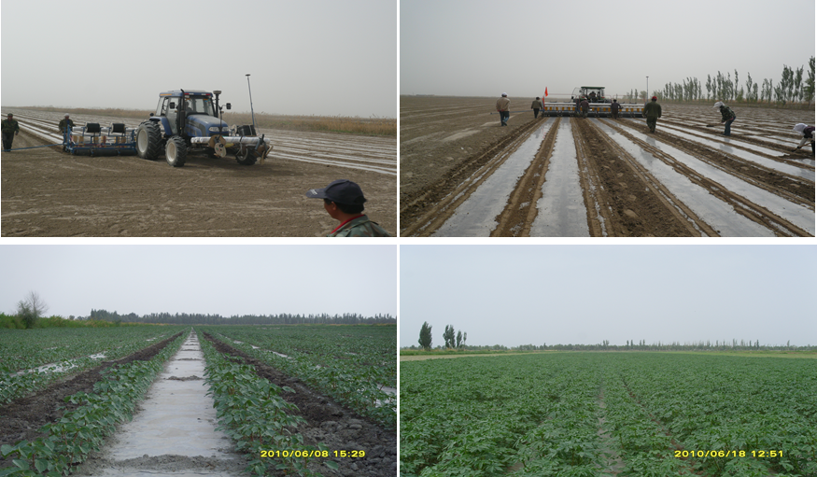
Modern agriculture on kenaf
China has realized large-area mechanized planting of kenaf, and the mechanized harvesting technology is developing rapidly.

Slide 8
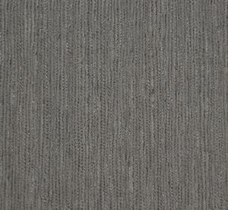
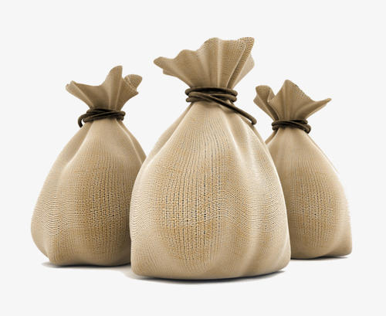
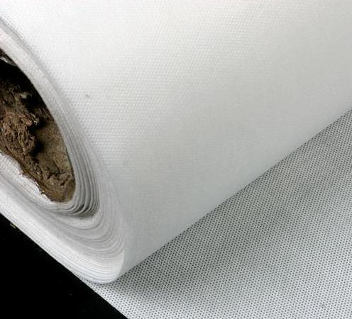
Traditional purpose for kenaf fiber
Degummed kenaf
Wallpaper
Bag
Non-woven fabrics
It generates about $100000000 on traditional products every years in China.

Slide 9
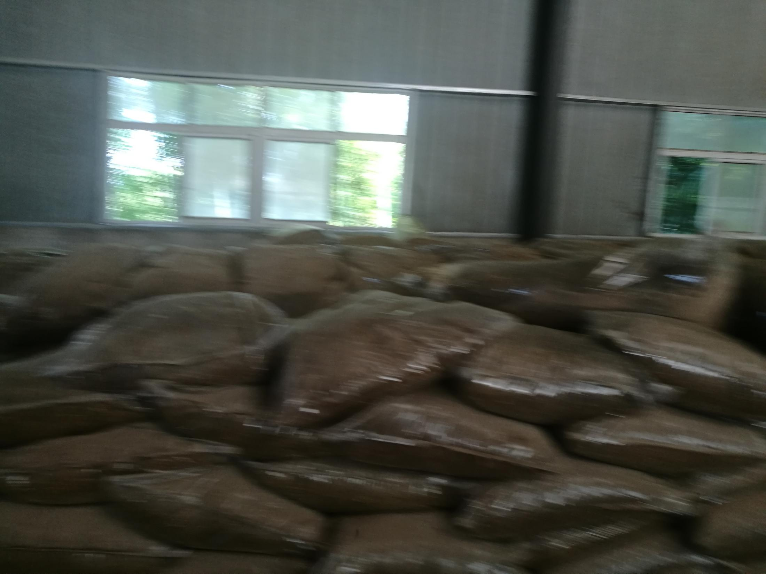
Silage for Livestock and Fish/livestock
Multiple utilization of kenaf
Fodder made of dry young stem and leaves for fish and poultry
Silage by spraying microbial inoculum for livestock and herbivorous animal
Kenaf can be used as animal feed, which will be a new growth point of kenaf market in near future.

Slide 10
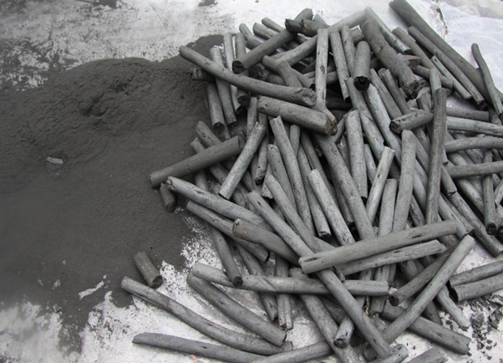
Multiple utilization of kenaf
Fine fireworks materials
Fine fireworks carbon production on sustainable development
1. Kenaf can be used for produce the best biochar for fireworks without smog and small particle.
2. Fireworks have a big market, with an annual output value of 20 billion RMB and an export revenue of 3 billion RMB in 2018, in China.
3. So, It can promote the development of kenaf industry and reduce environmental pollution.

Slide 11
Many companies make a lot of decoration materials and industrial products using kenaf in China which export to Europe and American. In addition, we export $450000000 firework to the world. Almost all advanced fireworks use kenaf carbon as an element ingredient which makes firework no smoky, more environmental friendly and gorgeous.
Trade of kenaf
At present, the cultivation of kenaf in China is only not enough for the domestic market, and there is almost no export of kenaf.
Because domestic kenaf can not meet the industrial production needs, it is possible to increase the import of kenaf in the future for China.

Slide 12
The prospect
● The kenaf market for traditional textile showed declining, but the tendency is becoming better and better for kenaf as low carbon crop, and because kenaf is versatile and environmentally friendly.
● In recent years, the price of kenaf continues to rise, and the production of kenaf cannot meet the market demand of our country. In the future, the planting area of kenaf will further increase, and the import of kenaf will also increase in China.
● A number of high-yield and disease resistant kenaf varieties have been bred in China. Kenaf breeding is in the leading position in the world for China. It is of great significance to export kenaf breeding technology and strengthen international cooperation to promote the development of kenaf industry in the future.
● Kenaf can be used for many purposes. For example, expanding the consumption of Kenaf fireworks will greatly promote the development of kenaf industry
● It is of great significance for the recovery of natural fiber industry such as kenaf to reduce the use of chemical fiber and increase the use of environmental friendly natural fiber in the world.

Slide 13
Thank You !

