Slide 1
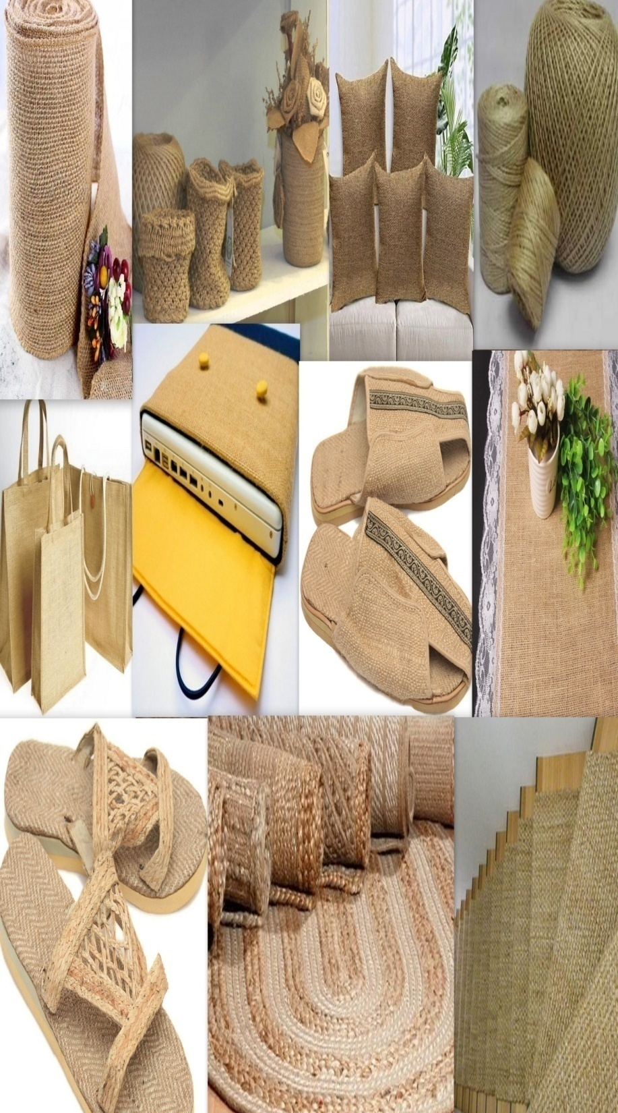


Study
Assessment of Indian Jute Industry & its linkages with Global Value Chain
Textiles Committee
Govt. of India, Ministry of Textiles

Slide 2
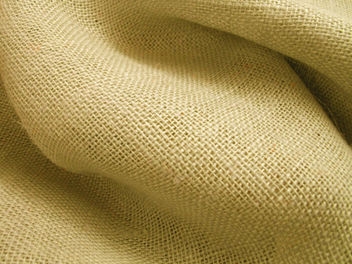
Structure
Introduction, Objectives and Methodology
Jute Industry in the Global Trade
Jute Industry in India
Value Chain of the Jute industry of India and its linkage
Conclusion and Suggestive measures for strengthening the jute Textile industry

Slide 3
Introduction
Jute textile industry plays an important role in India’s economy in terms of generation of employment and income and augmenting national output of the sector.
The industry provides direct employment to 0.37 million workers in organized mills and in diversified units including tertiary sector and allied activities and supports the livelihood of around 4.0 million farm families.
In addition, large number of persons are engaged in trading of jute and jute products and other service activities.
India is the largest manufacturers of jute textiles followed by Bangladesh and Bangladesh out of the global production of about 3.30 Million Tonnes per Annum.

Slide 4
Objectives & ToRs Of the Study
Main Objectives of the Study are :
Map different players involved in the Indian Jute Industry, their roles and issues and challenges they face, using a value chain approach.
Provide an overview of current situation and future directions of Jute natural fibre in India with special reference to agro-textiles industry linkages.
Discuss effective participation of Indian jute industry in Global Value Chain (GVC) and highlight challenges, constraints and barriers faced in connecting, moving up and establishing production and service value chains and analyze how these constraints are being addressed.
Identify public and private actions along value chain that can promote sustainability (economic/social/environmental) within Jute value chain.
Make policy recommendations on the way forward to sustain product and market diversification in the industry and strengthen linkages with the GVC.

Slide 5


Methodology
Secondary Research
Comprehensive database on Jute mills, JDP manufacturing units, jute traders, farmers or farmers’ association, input suppliers, exporters, importers, buying agents etc of jute and jute products prepared based on secondary data.
Global Trade in Jute was collected from various sources including existing data bases of WITs, ITC Trade Map, FAO, O/o Jute Commissioner, NJB, etc.
Appropriate econometric tools like Export Similarity Index (ESI), Revealed Comparative Advantage (RCA) and Export Potential Indicator have been used to ascertain the Competitiveness of the jute textile products at 6 digit HS line basis keeping the global trade and competing countries position in mind.
  RCA: The RCA is used in international economics for calculating the relative advantage or disadvantage of a certain country in certain class of goods or services as evidenced by trade flows.
  where X represents exports, i is a country, j is a commodity (or industry), t is a set of commodities (or industries), and n is a set of countries.
  ESI : ESI is intended to measure the similarity of exports among the countries in the destination market (Finger and Kreinin (1979) and is given by,
  where ESI(ab,c) refers the ESI of countries a and b in the common market (c); Xj(a,c) refers the exports of product j from country a to country c, and Xj(b,c) refers the exports of product j from country b to country c. ΣX(a,c) and ΣX(b,c) are total exports of country a and b to country c, respectively.

Slide 6
Methodology
Primary Survey:
Development of Study Instruments: Taking cue from desk research the structured questionnaires, in-depth discussion guides, etc. were developed in consultation of the National Jute Board and other key actors of the sector.
Different Questionnaires are developed for collection of data from :
  Input suppliers and Farmers.
  Traders and intermediaries of Jute Fibres
  Jute manufacturers like Yarns, Hessian Cloths, etc
  Trades of Jute products
  Manufacturers of Jute diversified products including Agro Textiles
The questionnaires were also pretested at unit level and appropriate modification were also made keeping the objectives in mind.

Slide 7
Methodology
Primary Survey: Sample size enumerated for the purpose
Stakeholders in Value Chain | Units Covered
Input Suppliers/farmers | 72
Jute Textiles manufacturers in organised sector | 25
Grading & Trading | 47
Jute Diversified Product (JDP) manufacturers | 51
Buying Agents | 04
Retailers/ Wholesalers | 18
Jute Textile Exporters/Importers | 06
Jute textile producing states covered for the purpose are
East Zone: West Bengal, Assam, Odisha
South Zone: Andhra Pradesh, Telengana, Tamil Nadu, Kerala, Pondicherry, Karnataka.
North Zone: Haryana, Rajasthan, New Delhi, Uttar Pradesh
West Zone: Gujarat and Maharashtra

Slide 8
Key Stakeholders Covered
Input Suppliers & farmers
Jute textile manufacturers including spinning, weaving, processing, manufacturers of the diversified products, etc
Grading & Trading Mechanism
Jute Textile Exporters/importers
Buying Agents/retailers
Developmental agencies including state and central govt. organisations working for the development of the sector.
The Centre of Excellence of the Govt. for Agro-textiles and Geo-textiles.

Slide 9
Value Chain Approach for GVC
Value Chain Analyses (VCA) Consists of two inter-linked components
  Chain Analyses (Use information from key actors and firm-level data to map the value-chain and analyse systematic constraints in the chain to competing in high potential market)
    The analyses has been carried out for the key actors in the jute textile value chain starting from input suppliers & farmers to the domestic and international market.
    The existing and potential international Market for the jute textiles have taken into consideration.

Slide 10
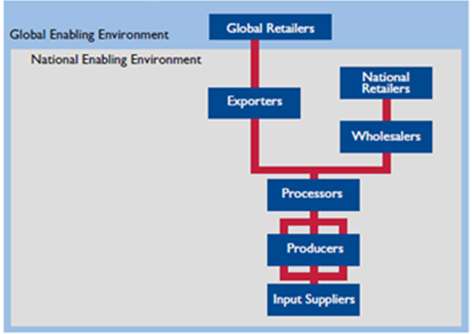
Value Chain Approach-II

Slide 11
Mapping Global Value Chain & Competitiveness of Jute

Slide 12
Global Production of Raw Jute
Raw Jute cultivation is mostly concentrated in South Asian region mainly India, Bangladesh, Nepal besides China, Uzbekistan etc
Global production of raw jute has recorded a moderate growth of 2.76% during the last ten years.
India is the top producer of Jute in the world with 55.69 % share followed by Bangladesh with 42.38 %, China with 0.85%, Uzbekistan with 0.46% and Nepal with 0.33%.
The production has recorded a positive trend during 2016 and 2017.

Slide 13
Area and Productivity of Raw Jute
Around 52% of the world area under cultivation is in India followed by Bangladesh with 42%.
The production of jute in India and Bangladesh is 97% as compared to 94% of the cultivable area.
Yield per hectare is increasing at a CAGR of 0.81% during the last five years

Slide 14
Global Export of Jute Textiles
Global export in Jute textiles has recorded CAGR of 6.29% during last 10 years
The global export of jute textiles is US$ 1.43 Bn in 2017 as compared to US$ 0.78 Bn in 2008.
Bangladesh has dominated the export market with export of US$ 941.36 million of jute textiles in 2017 with share of 65.71%, followed by India with US$ 243.55 million with share of 17%.
The countries like UK, Myanmar are also making their presence felt. While UK’s export is guided by value added product, other countries are mostly presence in both traditional and value added products.

Slide 15
Global Export of Jute
Top Exporter in Jute ($ Mn)
Exporters | 2008 | 2011 | 2014 | 2017 | Share | CAGR (2008-17)
Bangladesh | 423.70 | 935.51 | 722.74 | 941.36 | 65.71 | 8.31
India | 226.62 | 380.17 | 225.16 | 243.55 | 17.00 | 0.72
Nepal | 0.11 | 42.48 | 36.20 | 45.14 | 3.15 | 82.15
Myanmar | 0.49 | 0.73 | 0.54 | 30.78 | 2.15 | 51.21
UK | 3.45 | 5.74 | 13.51 | 27.29 | 1.90 | 22.99
Tanzania | 0.92 | 12.73 | 28.23 | 20.91 | 1.46 | 36.72
RoW | 99.72 | 116.32 | 136.82 | 110.04 | 7.68 | 0.99
World | 778.48 | 1509.87 | 1179.88 | 1432.62 | 100.0 | 6.29
In growth term, major gainer is Nepal (82.15%), whose export share has increased substantially followed by Myanmar (51.21%), Tanzania (36.72%) and UK (22.99%).
The surge in export of these countries may be one of reason for decline in India’s export to world.

Slide 16
Global Import of Jute
Among the top importers, Turkey is major importer of Jute and import about $272.67 million with share of 19.18% followed by India $170.44 million (11.98%), China $131.66 million (9.26%), Sudan $ 82.57 (5.81%) and USA $64.42 million (4.53%) during 2017.
India is largest Jute producer and second largest importer.
The Unit Value Realisation (UVR) is highest in Iran, USA, India, Ghana and Sudan. These markets are providing better realisation than others and have high potential for higher value addition and greater realisation.
Top Importer in Jute ($ Mn)
Importers | 2008 | 2011 | 2014 | 2017 | Share | CAGR (2008-17) | UVR (US$/Kg)
Turkey | 121.92 | 201.70 | 212.21 | 272.67 | 19.18 | 8.38 | 1.20
India | 114.80 | 229.33 | 152.20 | 170.44 | 11.98 | 4.04 | 1.80
China | 49.40 | 122.58 | 112.06 | 131.66 | 9.26 | 10.30 | 0.54
Sudan | 0.71 | 39.15 | 0.00 | 82.57 | 5.81 | 60.88 | 1.41
USA | 47.61 | 59.02 | 64.70 | 64.42 | 4.53 | 3.07 | 2.27
Iran | 49.09 | 70.20 | 44.33 | 55.61 | 3.91 | 1.25 | 2.63
Pakistan | 63.85 | 70.85 | 42.90 | 55.53 | 3.91 | -1.39 | 1.23
Ghana | 12.15 | 36.53 | 0.00 | 38.81 | 2.73 | 12.32 | 1.71
Côte d'Ivoire | 10.42 | 9.57 | 17.58 | 38.19 | 2.69 | 13.87 | 1.32
Indonesia | 19.99 | 30.03 | 28.83 | 32.90 | 2.31 | 5.11 | 1.05
RoW | 542.00 | 708.99 | 483.60 | 478.85 | 33.68 | -1.23 | -
World | 1031.23 | 1538.80 | 1158.40 | 1421.66 | 100.0 | 3.26 | 1.77

Slide 17
Product wise Jute Export
Following 7 products at 6-digit HS level are mostly exported Jute products in the global market:
  Single Yarn (530710),
  Sacks & bags, for packing of goods, of jute or of other textile bast fibres (630510)
  Yarn of jute or of other textile bast fibres, multiple (folded) or cabled (530720)
  Woven fabrics of jute or of other textile bast fibres, unbleached (531010)
  Jute and other textile bast fibres, raw or retted (530310)
  Woven fabrics of jute or of other textile bast fibres, other unbleached (531090)
  Jute and other textile bast fib, not spun, nes; tow and waste of these fibres (530390)
There are about 54 products at 8-digit HS level. As information for all the nations is available at 6 digit, the analysis in this section is done at 6-digit.

Slide 18
Top Products of Exports
Yarn of jute or of other textile bast fibres, single (530710) is the top exported product of jute in world with share of 29.82%.
Bangladesh is top exporter of this product and contributed about 97.97% share of total global export in product. India is at 4th position with share of 0.27%.
Similarly the second most exported product is Sacks & bags, for packing of goods, of jute or of other textile bast fibres (630510) with share of 26.18% in world.
India is top exporter of this product with share of 32.51% followed by Bangladesh with share of 31.77%.

Slide 19
Global Trade Scenario of Jute
Bangladesh is the largest exporter with share of 66.34%
India is the second largest exporter with share of 17.16%
Turkey is the major importer with a share of 19.18%
India is the second major importer with a share of 11.99%
EU has also emerged as a significant market during last five years and its import is growing due to demand for eco friendly products.

Slide 20
Comparative Advantage of Major Players in Global Market
RCA indicates the product level strength of exporting country on global market.
Major Players | Products having Comparative Advantage in Global Market
Bangladesh | Yarn of jute or of other textile bast fibres, single (530710) Jute and other textile bast fibres, raw or retted (530310) Yarn of jute or of other textile bast fibres, multiple (folded) or cabled (530720)
India | Woven fabrics of jute or of other textile bast fibres, unbleached (531010) Sacks & bags, for packing of goods, of jute or other textile bast fibres (630510)
Nepal | Woven fabrics of jute or of other textile bast fibres, o/t bleached, dyed (531090), Sacks & bags, for packing of goods, of jute or of other textile bast fibres (630510)
Myanmar | 1) Sacks & bags, for packing of goods, of jute or of other textile bast fibres (630510)
UK | 1) Woven fabrics of jute or of other textile bast fibres, dyed (531090) 2) Sacks & bags, for packing of goods, of jute or of other textile bast fibres (630510)
Tanzania | 1) Jute and other textile bast fibres, raw or retted (530310)
China | Woven fabrics of jute or of other textile bast fibres, unbleached (531010), Woven fabrics of jute or of other textile bast fibres, o/t unbleached (531090), Sacks & bags, for packing of goods, of jute or other textile bast fibres (630510)
Belgium | 1) Jute and other textile bast fibres, processed but not spun; tow and waste of such fibres (530390) 2) Multiple "folded" or cabled yarn of jute or of other textile bast fibres (530720) 3) Woven fabrics of jute or of other textile bast fibres, o/t unbleached (531090)
Bangladesh is enjoying comparative advantage in three products, while India maintains advantage in 2 products.
China is also emerging as competitor to India on woven fabrics and sacks & bags for packing goods
Nepal’s presence in the same products in the global market is also equally good.

Slide 21
Export Similarity Index of Major Players in Jute Exports to world
Export Similarity index used to find product level competing interests of countries.
India is competing with all countries in almost all product lines, Bangladesh’s product lines are mostly experiencing competition from Belgium (57.85%), China & India. The diverse product matrix of Bangladesh may be one of the reason for it.
Major Players | B’desh | India | Nepal | Myanmar | UK | Tanzania | Kenya | Côte d'Ivoire | China | Belgium
Bangladesh |  | 32.63 | 19.31 | 10.49 | 18.16 | 18.65 | 30.66 | 14.03 | 37.16 | 57.85
India | 32.63 |  | 50.92 | 37.44 | 52.28 | 5.1 | 16.71 | 48.22 | 75.19 | 57.52
Nepal | 19.31 | 50.92 |  | 41.87 | 60.28 | 2.67 | 12.89 | 54.78 | 64.83 | 42.41
Myanmar | 10.49 | 37.44 | 41.87 |  | 72.7 | 5.83 | 25.36 | 75.09 | 37.19 | 33.21
UK | 18.16 | 52.28 | 60.28 | 72.7 |  | 1.58 | 12.92 | 91.79 | 51.46 | 42.12
Tanzania | 18.65 | 5.1 | 2.67 | 5.83 | 1.58 |  | 43.47 | 0.17 | 3.81 | 24.44
Kenya | 30.66 | 16.71 | 12.89 | 25.36 | 12.92 | 43.47 |  | 11.84 | 14.03 | 38.53
Côte d'Ivoire | 14.03 | 48.22 | 54.78 | 75.09 | 91.79 | 0.17 | 11.84 |  | 43.83 | 36.46
China | 37.16 | 75.19 | 64.83 | 37.19 | 51.46 | 3.81 | 14.03 | 43.83 |  | 58.35
Belgium | 57.85 | 57.52 | 42.41 | 33.21 | 42.12 | 24.44 | 38.53 | 36.46 | 58.35

Slide 22
India and Global Jute Value Chain

Slide 23
Production of Raw Jute in India
India’s production of raw jute experienced 1.27% growth during last 10 years.
Bangladesh has experienced growth of 5.38%
Area under Jute cultivation has experienced negative growth in India with CAGR of 0.20% during last 10 years.
The decline in the area of cultivation is a matter of concern for the Indian jute industry

Slide 24
Production of Jute Goods in India
Decline in Production of Jute goods is higher as compared to jute fibre
The consistently declined production of jute goods as compared to production of raw jute may undermine the value addition in the production chain
Sacking is the major product category with 76.62% share in 2017-18
The second major production category is Hessian cloth followed by yarn

Slide 25
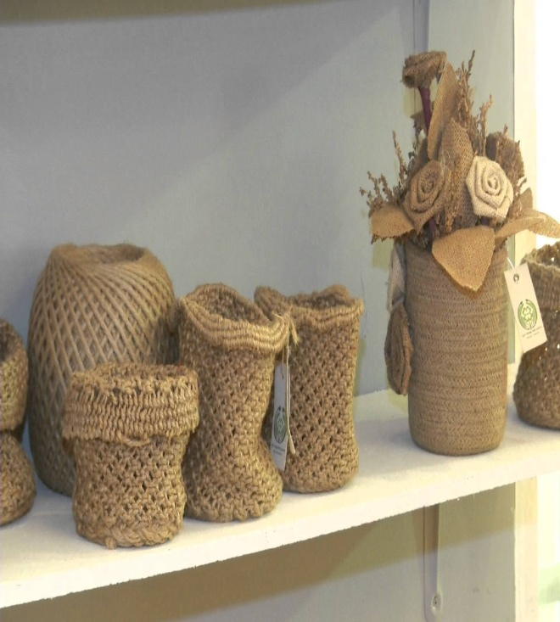
Production of Jute Goods in India
India is leading jute goods producing country in the world, counting for about 70% of estimated world production. Bulk of the manufactured jute goods is predominantly being used in packaging purpose in domestic market.
Trend in production of jute goods of India (‘000 tonnes)
Year | Hessian | Sacking | Carpet backing cloths (CBC) | Others | Total
2013-14 | 202.5 | 1150.4 | 3.3 | 171.5 | 1527.7
2014-15 | 211.3 | 901.8 | 3 | 151.2 | 1267.3
2015-16 | 196.5 | 891.9 | 0 | 128.9 | 1217.3
2016-17 | 178.6 | 871.6 | 0 | 92.3 | 1142.5
2017-18 | 173.3 | 902.7 | 0 | 102.1 | 1178.1
CAGR (%) | -3.07 | -4.73 | -100.00 | -9.85 | -5.06
Source: Jute Commissioner
Indian jute mills recorded a total production of jute goods of 1.178 million Tonnes in 2017-18 which recorded an increase of 3.12% as compared to previous season.

Slide 26
India’s Trade in Jute Textiles
India’s jute export was US $ 342 Million in 2017, which has increased with CAGR of 1.36% during last ten years.
Hessian is the top product exported by India with a share of 43% followed by JDP (33%) and Sacking (19%) in 2017.
India’s jute import was US$ 170.44 Mn in 2017, which has increased with CAGR of 4.04% during last ten years.
Sacking is the top product imported by India with a share of 33% followed by JDP (30%) and Yarn (26%) in 2017.

Slide 27
India’s Trade Partners in Jute
EU is top export destination for India with share of 18.08% followed by USA with 12.33% and Ghana with 8.52% share, etc.
Export to Côte d'Ivoire in terms of the CAGR (2008-17) has been impressive with 24.87%.
Bangladesh is top import partner for India with share of 76.39% followed by Nepal with 21.31% share.
Import from Nepal in terms of the CAGR (2013-17) has been impressive with 27.46% as against the growth rate of about (-)2.92% of Bangladesh.

Slide 28
India’s Export t 8 digit HS Level
Chapters | No. of Products | 2008 | 2017 | 2018 (E) | 2025 (E) | CAGR% (2008-17) | CAGR% (2017-25)
Chapter-42 | 1 | 39.04 | 47.89 | 57.59 | 72.44 | 2.06 | 3.83
Chapter-44 | 2 | 0 | 0 | 0 | 0 | Na | na
Chapter-53 | 20 | 141.92 | 121.42 | 101.35 | 126 | -1.55 | 0.34
Chapter-56 | 3 | 0.43 | 3.09 | 2.94 | 4.5 | 21.80 | 3.48
Chapter-57 | 3 | 30.67 | 43.29 | 51.32 | 48.24 | 3.51 | 0.99
Chapter-58 | 3 | 0.41 | 1.38 | 1.67 | 2.49 | 12.90 | 5.51
Chapter-59 | 5 | 0.52 | 1.81 | 1.82 | 2.49 | 13.28 | 2.94
Chapter-63 | 14 | 85.52 | 122.64 | 120.07 | 192.11 | 3.67 | 4.16
Chapter-67 | 1 | 0 | 0.002 | 0.02 | 0.04 | na | 31.30
Total | 52 | 298.51 | 341.53 | 336.78 | 448.31 | 1.36 | 2.50
India has a presence in 52 products in the global market with $341.53Mn in 2017
Most of the products experienced negative growth during last ten years
If the same trend continue, India export will be $448.31 Mn by 2025.
Amongst the products, knotted netting of twine, ropes has experienced growth 43%, used or new rags, scrap twine, cordage, rope and cables; gunny cuttings with 39% followed by sacks and bags with 28%, have experienced promising growth.
The JDPs like hand bags has also experienced 3.10% growth in the international market.
Most of other products have experienced 0.74% growth during the period.

Slide 29
India’s import in Jute ($ Mn) at 8-digits
Chapters | No. of Products | 2008 | 2017 | 2018 (E) | 2025 (E) | CAGR% (2013-17) | CAGR% (2017-25)
Chapter-42 | 1 | 0.06 | 0.22 | 0.19 | 0.29 | 14.00 | 2.66
Chapter-44 | 2 | 0.00 | 0.06 | 0.01 | 0.08 | Na | 2.05
Chapter-53 | 20 | 38.46 | 142.76 | 138.14 | 262.35 | 14.01 | 5.69
Chapter-56 | 3 | 1.19 | 1.11 | 0.10 | -1.55 | -0.69 | -203.08
Chapter-57 | 3 | 0.27 | 0.97 | 0.94 | 2.19 | 13.64 | 7.68
Chapter-58 | 3 | 0.03 | 0.32 | 0.05 | 0.86 | 26.71 | 9.40
Chapter-59 | 5 | 1.99 | 0.19 | 0.62 | -0.31 | -20.93 | -204.55
Chapter-63 | 14 | 72.76 | 24.78 | 33.06 | 17.05 | -10.21 | -3.34
Chapter-67 | 1 | 0.01 | 0.03 | 0.15 | 0.02 | 11.61 | -3.62
Total | 52 | 114.77 | 170.44 | 173.26 | 280.98 | 4.03 | 4.65
India imports $170.44 Mn of jute textiles from RoW mostly from Bangladesh.
Even if, the import is mostly raw-material focused, the import of products like hand woven tapestries and jute hand bag which have grown at 26.31% and 14% respectively may be a matter of concern for the industry.
If the current trend continues, India may import about $280.98 Mn of import by 2025.
The product like carpet and other floor coverings & narrow woven fabrics have registered a robust growth in import during last ten years.

Slide 30
Export Potential for Indian Jute products
It is estimated that an additional export potential for Indian jute was US$ 132.43 Mn during 2019.
Composition of the export potential in terms of product groups is 3.62% of jute fibre, 5.60% of jute yarn, 9.00% of jute fabrics and 81.79% of jute made-ups (sacking, hessian, etc.)
Ghana with 13.50% is top market for additional export followed by Sudan (7.64%), Indonesia (7.02%), Cote D'Ivoire (5.03%), Pakistan (4.46%), Viet Nam (4.14%), Uganda (3.82%), China (3.65%), Tanzania (3.33%), Iran (3.18%), Kenya (3.12%), USA (2.57%), Turkey (2.53%) and Thailand (2.43%), etc.
Pakistan with 52.20% share is top market for jute fibre followed by Nigeria (9.98%), China (6.08%), Cote D'Ivoire (5.50%), Libya (4.31%) and Saudi Arabia (3.78%), etc.
Turkey with 40.49% share, is major potential market for yarn followed by China (14.85%), Algeria (6.65%), Iran (6.15%), Russian Federation (4.37%) and Tajikistan (4.36%), etc.
Iran with 31.33% share is major potential market for fabric followed by China (16.31%), Egypt (15.46%), Korea, republic of (7.04%), Indonesia (3.70%) and Turkmenistan (3.08%), etc.
Ghana with 16.43% share is major potential market for sackings/bags followed by Sudan (9.33%), Indonesia (8.12%), Cote D'Ivoire (5.91%), Viet Nam (4.89%) and Uganda (4.52%), etc.

Slide 31
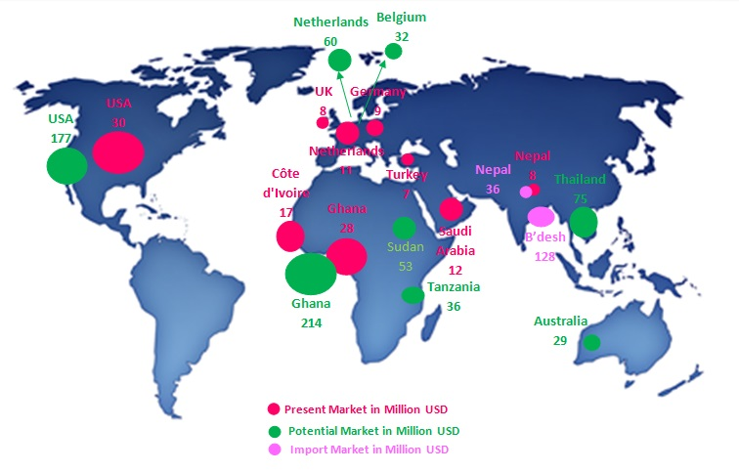
India in Global Value Chain & its potential

Slide 32
Product level Value Addition – A case of EU
Country | Value Addition (%)
 | Fibre | Fabric | Twine | Twine (measuring >100,000 decitex)
France | 76.18 | 39.67 | 53.25 | 79.56
Germany | 69.01 | 6.95 | 26.99 | 37.20
Italy | 60.43 | 77.41 | 42.41 | 79.50
United Kingdom | 77.11 | 82.82 | 57.75 | 81.30
Denmark | 1.34 | 43.84 | 17.47 | 76.79
Greece | 86.68 | 82.16 | 36.03 | 44.73
Spain | 44.39 | 79.04 | 9.88 | 19.16
Sweden | 60.14 | 60.07 | 13.83 | 13.03
Finland | NA | 94.54 | 33.83 | 26.20
Latvia | NA | 79.58 | 58.01 | 33.33
Lithuania | 67.50 | 35.81 | 70.01 | NA
Czech Republic | 89.41 | 61.84 | 41.66 | 60.54
Slovenia | 73.80 | 52.48 | 27.62 | 18.30
Most of these value additions have been affected due to the activities involved in manufacturing/processing of fibre, fabric and twine are related to Processing, Dyeing of fibre, Bleaching/Dyeing/Printing/Finishing of woven fabrics, production of twine, cordage, rope or cables of jute and Twine, cordage, rope or cables of jute, measuring >100,000 decitex.

Slide 33
Agro textiles & Future Trend
Agrotextiles is one of the important categories of technical textiles, with consumption accounting for around 8.2% by volume and 6.4% by value of the global technical textiles market in 2013 and is growing at more than 12 %.
The sector has very strong growth predictions based on projected increase in global population and demand for higher quality food.
The market in developing countries like India, China and Brazil is expected to grow at 8-10 % for next 15 years.
By value, Asia already accounts for around 60 % of the total agrotextiles market by volume and 55 % by value.
Aquaculture is projected to emerge as the fastest application segment growing at a CAGR of 5% in terms of revenue from 2017 to 2025
Demand for agro tech products for animal husbandry in the Middle East & Africa was 3.8 kilo tons in 2016 and is anticipated to grow at a CAGR of 2.4% over the upcoming years

Slide 34
.DOMESTIC MARKET SIZE & PROJECTION SEGMENT WISE.
Domestic Market Size of Agro-textiles
MARKET SIZE ( PRODUCTION ) Figures in INR.Cores .
SR. NO | PRODUCT | CURRENT POSITION | CURRENT CAPACITY | PROJECTION (11 % GROWTH RATE )
 |  | 2017 - 2018 | 2017 - 2018 | CAPACITY CAN BE UTILIZED ( 2018 - 2019 )
 |  |  |  | ( 2018 - 2019 ) |  | ( 2019 - 2020 )
 |  |  |  | AT 25 % UTILIZATION | AT 50 % UTILIZATION | AT 25 % UTILIZATION | AT 50 % UTILIZATION
1 | SHADE NETS | 177.69 | 40868.7 | 11341.06 | 22682.13 | 12588.58 | 25177.16
2 | MULCH MAT | 23.6 | 5428 | 1506.27 | 3012.54 | 1671.96 | 3343.92
3 | CROP COVER | 3.4 | 782 | 217 | 434.01 | 240.88 | 481.75
4 | ANTI HAIL & ANTI BIRD NET | 16.45 | 3783.5 | 1049.92 | 2099.84 | 1165.41 | 2330.83
5 | TOTAL | 221.14 | 50862.2 | 14114.25 | 28228.52 | 15666.83 | 31333.66
Out of the total production and demand, Jute fibre based agrotex contribute about 3 % of the total production .
It is expected to grow further with product diversification and with the better awareness towards ecology.

Slide 35
Demand Estimates of Indian Jute products
Mn US $
Sl. No. | Description | Present Market (2017) | Potential market (2025)
1 | International Market | 341.53 | 448.31
2 | Domestic Market Size
(i) | Traditional Jute Textiles | 1330.98 | 1768.06
(ii) | Jute Diversified products | 593.71 | 971.83
(iii) | Jute based Agro Textiles | 6.76 | 10.02
(iv) | Additional Market to be created due to ban in plastic | - | 135.00
 | Total | 2272.98 | 3333.22

Slide 36
Value Chain Analyses for Jute Textile Industry of India

Slide 37
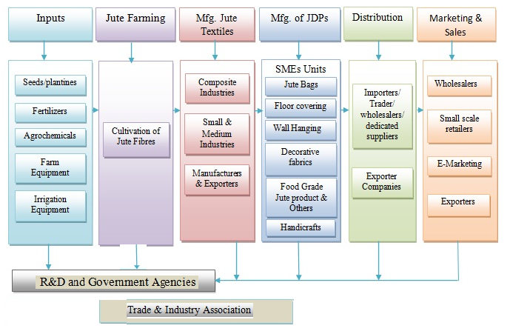
Mapping of Jute Value Chain

Slide 38
Jute Value Chain In India
Keeping functional activities of production in mind , the Value chain has been classified into two important components:
Stage-I : Manufacturing of traditional goods including Raw jute to Fabrics/ Sacks
Stage-II : Value Chain of Jute Diversified Products (JDP).
Key production/value chain activities of traditional goods including jute farming are as follows:
  Jute Crop Chain
    Jute farming
    Baling
  Jute Manufacturing
    Spinning
    Weaving and stitching of sacks.
  Trade
Jute Diversified Product activities starts with the procurement of fabrics and other raw-materials.

Slide 39
Jute Crop Chain :
Cost of Cultivation
Being labor intensive, most of the expenditure is incurred towards labor cost.
Wages paid towards hiring of labor contributes 58.97% of expenditure but varies from state to state with highest in West Bengal and lowest in Bihar.
Cost of retting considered as a tedious job contributes 14.92% of the total cost.
Inclusion of the rent of owned land cultivated for the crop may increase the cost component.
Labor cost is one the key attributes in the total cost of production of raw jute with a contribution of about 50 %

Slide 40
Value Addition in Farming
Average income from Jute farming has been estimated at US$ 864.15/ha.
The expenditure incurred per hectare is estimated at US$ 534.39/ha.
The average value addition at farming level is estimated at US$ 329.76/ha, excluding profit of US $ 62.91/ha, which gives the value addition at US$ 184.02/MT.

Slide 41
Jute Mills:
Component wise Expenditure
Raw Material with 43.41%, is major component of expenditure(operating costs) involved in Jute textile manufacturing.
Average manpower cost is 14.94% followed by electricity & fuel with 11.01%.

Slide 42
Value Addition in Traditional Jute Sector
On an average, jute manufacturers procurement cost for fibre is US $ 605.60/MT. An estimated operation cost of US $ 247.20 is incurred for production of 1 MT
On an average, jute manufacturers cost of yarn for production of a MT of sacking is US $ 852.80 and an estimated operation cost of US $ 181.10 is incurred for production of 1 MT . Further an additional operation cost of US $ 168.01 for production of a MT of sacking bags
In case of hessian, an estimated average operation cost of US $ 255.80 is incurred for production of 1 MT of hessian cloth and additional operating cost of US $ 68.64 will yield in production of a MT hessian bags.
Value Addition in Traditional Jute Sector (US $/MT)
End Product | Production Cost | Raw Material & other consumables cost | Operation cost | Value Addition %
Yarn | 605.60 | 247.20 | 852.80 | 28.99
Sacking Cloth | 852.80 | 181.10 | 1033.90 | 17.52
Sacking Bag | 1033.90 | 168.01 | 1201.91 | 13.98
Hessian Cloth | 852.80 | 255.80 | 1108.60 | 23.07
Hessian Bag | 1108.60 | 68.64 | 1177.24 | 5.83
Source: Textiles Committee

Slide 43
Value Chain of Traditional Jute Textiles
Value Addition in Traditional Jute Textiles
Stage in Value Chain | Main Products | Gross value addition (%) for
 |  | Sacking Cloth/Bag | Hessian Cloth/Bag
Farming, harvesting, retting by farmers | Jute Fibre | 13.01% | 12.86%
Traders/Brokers | Jute Fibre | 14.26% | 14.09%
Mills | Yarn | 20.08% | 19.85%
 | Sacking Cloth/Bag | 52.65% | -
 | Hessian Cloth/Bag | - | 53.20%
Total |  | 100% | 100%

Slide 44
JDP Units - Operational Cost

Slide 45
Value Added in JDP
S. No | Product | % Value Addition
1 | Yarn | 39.28
2 | Jute Decorative fabrics | 10.48
3 | Jute Bags | 50.95
4 | Jute Carpets | 60.51
5 | Jute Made-ups | 80.84
6 | Laminated Hessian Cloth | 78.25
7 | Other Jute Products | 44.98
8 | Fine Fabric | 23.11
Source: Textiles Committee

Slide 46
Major Findings & Suggestive Measures

Slide 47
Key Constraints
The non-availability of good quality seeds at affordable prices to cultivators affecting productivity and quality of jute fibre.
Fragmented landholding and SMEs based production activities adversely affecting in realizing scale economies.
Inability to scale up and provide consistent quality and timely supply results into loss of markets & low integration to GVC.
The technological gap in cultivation of jute particularly in retting & limited knowhow on technology is also creates hindrances. Adoption of modern technology by the industry is slow and hence affects productivity and quality of the product.
The Post Harvesting Management compounded with poor production practices deprives farmers/manufacturers in rural areas from effective participation in GVC.
The technology for packaging, grading is inadequate and many graders have no formal training on grading and proper handling of the produce. Hence, the post-harvest scenario creates difficulties in ensuring quality of fibre.

Slide 48
Key Constraints Contd…
The organised industries based in Kolkata are mostly inclined towards procedures laid down in the JPM Act for marketing their products.
Industry linkage with other actors in both backward and forward linkages is limited.
As the industry plays a crucial role in value addition to jute fibre procured from farmers/producers on one hand and supplying raw material to JDP units on the other, lack of coordination among these players is severely affecting GVC of jute.
The presence of intermediaries and low price realisation for jute is also adversely affecting cultivation leading to decline in cultivable areas.
The skilling process including up-skilling and re-skilling of the existing manpower is also inadequate.
The concentration of jute mills in a specific region creates difficulties in procurement of raw material for MSMEs in other parts of the country.
The potential of geo textiles is yet to be explored appropriately.

Slide 49
Key Constraints Contd…
Better policy initiatives with more focus on use of geo textiles for infrastructures developments, construction of roads, protection of against soil erosion and protection of coastal regions would be helpful for further strengthening jute.
The lack of integration of service providers with industry is also adversely affecting the sector.
The global trade in jute and jute textiles has been experiencing key constraints in the form of Tariffs and Non-Tariff Measures (NTMs).

Slide 50
Suggestive Measures
Creating mechanism for strengthening linkage with GVC by addressing issues on Tariffs and NTMs.
Cooperation on product development, technology and quality between India and Bangladesh and collaborative effort with countries like the Netherland, UK, Belgium, France would be helpful in development and transfer of existing technology for product development and quality improvement.
India should also try to explore the potential market identified under the study for enhancing export of jute.
Strengthening input supply mechanism for farmers and facilitating adoption of modern technology in the cultivation including better retting technology is need of the hour.
Rationalisation of tax structure including increased duty drawbacks to the exporters of this eco-friendly product, focus on market and product development for JDPs would be helpful.

Slide 51
Suggestive Measures Contd…
Strengthening of Jute Product Development and Export Promotion Council with a focus on export from SMEs including JDPs would help in export promotion initiatives.
Modernisation & product diversification in organised jute mills would be helpful to increase the product basket for jute. The participation of organised jute mills in the skill development process and ensuring the quality of the products would be helpful. The models being adopted by cotton spinning mills in India for supporting the farmers could be helpful for the purpose.
Institutionalising quality assurance of products including grading would help in realising better price for key actors in GVC and inculcating quality culture.
Skill development need to be addressed systematically for enhancing quality and productivity.
A dedicated policy for the development of Jute Diversified Products (JDPs) with focus on product and market development would be helpful for strengthening GVC.

Slide 52
Suggestive Measures Contd…
Dedicated government policy for popularising use of geotextiles can enhance market size of jute geotextiles. The linking geotex to flagship scheme of government Pradhan Mantri Gram Sadak Yojana, construction of highways, Schemes for Development of North Eastern States would be helpful for strengthening GVC.
Specific mechanism for promotion of eco-friendly jute goods for packaging would help industry as most of the states in India have banned use of plastics.
The cluster approach for JDPs development should be adopted for strengthening manufacturing base of JDPs

Slide 53
Thank You

Slide 54
Traditional Jute Products
Estimates of the production of Jute Goods in India (Value in million US$)
Product | 2017-18 | 2024-25 | 2029-30 | 2034-35
Hessian | 240.28 | 258.20 | 280.10 | 303.85
Sacking | 965.21 | 1381.29 | 1838.71 | 2447.61
Others | 125.49 | 128.57 | 134.80 | 141.34
Total | 1330.98 | 1768.06 | 2253.61 | 2892.80

Slide 55
JDP Products
Estimates of the production of Jute Goods in India (Value in million US$)
Product Group | 2017-18 | 2024-25 | 2029-30 | 2034-35
Shopping & Carry Bags | 36.85 | 60.33 | 88.40 | 129.52
Handicrafts & gift Items | 34.45 | 56.39 | 82.62 | 121.06
Wall Hangings | 2.16 | 3.53 | 5.18 | 7.59
Floor Covering | 22.65 | 37.08 | 54.33 | 79.60
Decorative Fabrics | 223.19 | 365.34 | 535.31 | 784.37
Yarn | 147.13 | 240.84 | 352.89 | 517.07
Food and Food Grade Jute Products | 63.13 | 103.34 | 151.41 | 221.86
Fashion & Garment Accessories | 2.68 | 4.39 | 6.43 | 9.42
Shoe Slipper | 0.48 | 0.79 | 1.16 | 1.70
Composite Board | 0.53 | 0.87 | 1.27 | 1.86
Soft Luggage | 0.23 | 0.38 | 0.55 | 0.81
Others | 60.22 | 98.57 | 144.43 | 211.63
Total | 593.71 | 971.83 | 1423.98 | 2086.48

Slide 56
Tariffs for India & Bangladesh
Country | India | Bangladesh | Country | India | Bangladesh
Indonesia | 0-5 | 0-10 | Spain | 0-4 | 0
Viet Nam | 0-5 | 0 | Guinea | 0-20 | 0
China | 0-10 | 0 | Greece | 0-4 | 0
Tanzania | 0-25 | 0 | Russian Federation | 0-4 | 0
Turkey | 0-3 | 0 | Malawi | 0-3 | 0
Thailand | 0-6 | 0-10 | United Kingdom | 0-4 | 0
Belgium | 0-4 | 0 | Jordan | 0-0 | 0-13
Saudi Arabia | 0-5 | 5-5 | Hungary | 0-4 | 0
UAE | 0-5 | 5-5 | Kazakhstan | 0-4 | 0
France | 0-4 | 0 | Togo | 0-5 | 0
Zimbabwe | 0-15 | 0 | New Zealand | 0-2 | 0
Malaysia | 0-5 | 0-10 | Austria | 0-4 | 0
Nigeria | 0-20 | 0-5 | Belarus | 0-4 | 0
Bangladesh | 0-5 | 0 | Poland | 0-4 | 0
Germany | 0-4 | 0 | Canada | 0-5 | 0
Guatemala | 0-15 | 0-10 | Chile | 0-6 | 0
Zambia | 0-25 | 0-15 | Moldova, Rep. | 0-0 | 0-8
Mozambique | 0-8 | 0 | Colombia | 0-5 | 0
Italy | 0-4 | 0 | Niger | 0-5 | 0
Madagascar | 0-20 | 0 | Philippines | 0-1 | 0-3
Botswana | 0-10 | 0 | Sweden | 0-4 | 0
Gambia | 0-20 | 0 | Netherlands | 0-4 | 0

Slide 57
Non Tariff Measures
Country | NTMs
China | Consumer Protection, Human Health and Safety, Regulating Market and Trade Facilitation
Ghana | Human Health & Safety, Environmental Protection
Indonesia | Consumer Safety
Kenya | Quality Standards, Consumer Safety and Environmental Protection
Tanzania | Human Health & Safety, Consumer & Environmental Protection
United States | Consumer Protection
Viet Nam | Human Safety and Environmental Protection
Armenia | Technical Regulations/Standards
Australia | Consumer Protection
Brazil | Labelling and Consumer Protection
Canada | Consumer Protection
Costa Rica | Consumer Protection
Dominica | Consumer Protection and Safety
Dominican Republic | Labelling
Egypt | Harmonisation and Consumer Protection Labelling
El Salvador | Consumer Protection, Technical Regulations/standards
European Communities | Consumer safety & protection, conformity assessment procedures
Guyana | Labelling
Honduras | Consumer Protection
Italy | Consumer Protection
Jamaica | Labelling
Japan | Harmonisation with International Standards and Labelling
Kyrgyz Republic | Consumer Protection, Human Health & Safety
Latvia | Human Health and Safety
Mexico | Consumer Protection and Labelling
Netherlands | Human health, safety and environmental protection
Nicaragua | Consumer Protection
Panama | Consumer Protection
Romania | Consumer Health and Protection
Slovak Republic | Consumer health and certification
Slovenia | Consumer Protection and Trade facilitation
South Africa | Consumer Protection
Switzerland | Human Health & Harmonisation with Regional Standards
Thailand | Consumer Protection

Slide 58
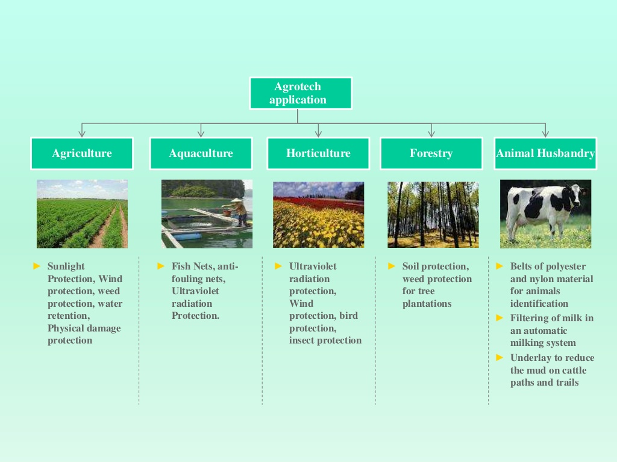
Application Agro-textiles
Application area of AGRO textiles
Even if most of the Agro textiles are Man Made Fibre (MMF) based , the demand for natural fibre based products like jute, Coir, would have a robust growth in future in lieu of the
environmental concerns and high performance parameters for some specific products.

Slide 59
Pattern of Raw-material Use in Agro-Textiles
Products | Fiber type | Products | Fiber type
Sunscreen | Polyethylene | Root ball net | Cotton, Polyester, Cotton polyester blend
Packing material | Jute, plastic, polypropylene FIBC | Soil protection fabric | Polypropylene, Jute
Insect meshes | Polyethylene mono filament & multi filament, Nylon | Nets for covering pallets | Polyethylene, Nylon, Polyester
Cold and frost control fabrics | Polypropylene | Anti fouling nets | Nylon
Weed control fabric | Polyethylene | Mosquito protection nets | Nylon
Tape nets | Polypropylene | Monofil nets | Nylon, HDPE
Mulch mat | HDPE, LDPE, Polypropylene, Wool,jute | Filter for milking | Cellulose, viscose, cotton, polyester
Anti hailstone nets | Polyethylene mono filament | Plant net | Polyolefin type fiber
Harvesting nets | HDPE, Nylon, Cotton | Bird protection net | Co-polymer nylon, Polyethylene, Polypropylene
Support nets | Nylon | Shade cloth | Polyethylene
Baler twine | 100% Polypropylene, Sisal fiber | Udder protection nets | Cotton, Cotton-poly blend
Aquaculture nets | Nylon mono filament, multi filament, HDPE | Fishing nets | Nylon mono filament, multi filament, HDPE
Ground cover | 100% Polypropylene | Fishing line | HMPE (e.g. Dyneema and Spectra), HDPE, PP, Nylon
Cherry cover | Polypropylene, Polyethylene | Belt | Nylon, Polyester
Rain protection fabric | Polyethylene | Ultraviolet radiation protection sheets | Cotton, Cotton-poly blend, Polypropylene
Greenhouse cover | Polyethylene | Porous tube for localized irrigation | Recycled vehicle tire
Usage of natural fibres

Slide 60
Global Market Size of Agro-textiles and Future Direction
Global Agro Textile Market, 2015-2025 (US$ Mn)
The global agro textiles market is expected to reach USD 12.77 billion by 2025, (Grand View Research, Inc). Increasing demand for food with growing population has put a lot of pressure on agricultural productivity. Limited availability of land coupled with various natural disasters further reduces the total yield.
The global agro textiles demand was 1,489.9 kilo tons in 2016 and is estimated to grow at a CAGR of 4.4% from 2017 to 2025
The global mulch mats demand was over 185 kilo tons in 2016 and is projected to witness moderate growth over the next eight years
The fishing nets segment in India is anticipated to reach net worth exceeding USD 1.54 billion by 2025
Agriculture application segment in China accounted for 15% in 2016 and is expected to witness the same trend over the forecast period

Slide 61
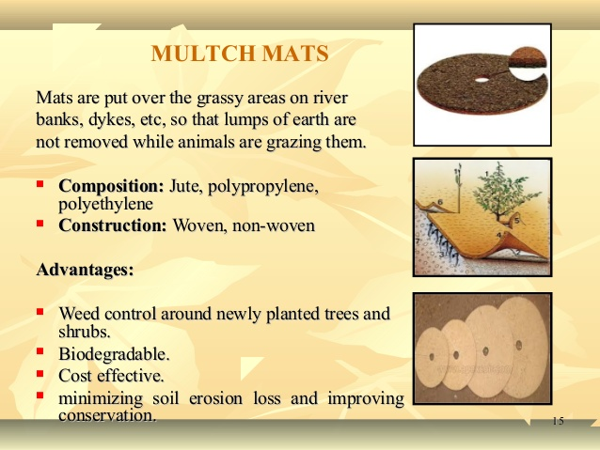
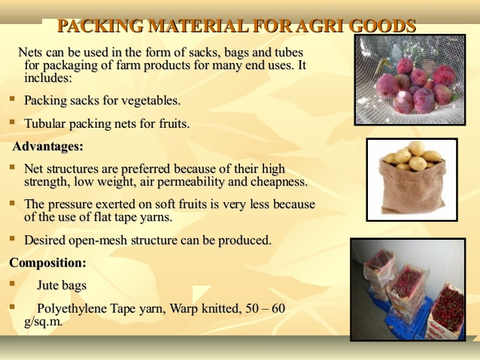
Application of Jute Geotextiles

Slide 62
Jute Crop Chain
Jute is a rainy season crop, sown from March to May according to rainfall and type of land and is harvested from June to September.
These plants take nearly 3 months, to grow to an height of 12 to 15 ft, during season.
Jute is harvested any time between 120 days to 150 days when the flowers have been shed, early harvesting gives good healthy fibers.
The plant from 8 to 12 feet high are cut with stickles at or close to the ground level.
In flooded land, plants are up rooted. The harvested plants are left in field for 3 days for the leaves to shed.
The stems are then made up into bundles for steeping in water. Steeping is carried out immediately after harvest.
The jute plant's fibers lie beneath the bark and surrounded the woody central part of the stem.
Sowing
Cutting of Plants
Bundle Stalk
Retting
Strepping
Washing
Squeezing excess
Sundry
bailing
Kutcha Packing
Storage/Transport

Slide 63
Jute Crop Chain
Retting
Retting is a process in which the tied bundles of jute stalks are steeped in water at least 60 cm to 100 cm depth through which fibres get loosened and separated from the woody stalk and the process is completed in 8 to 30 days.
Stripping:
Stripping is the process of removing the fibres from the stalk after the completion of retting.
Washing and Drying:
Extracted fibres are washed in clean water.
The dark colour of fibres can be removed by dipping them in tamarind water for 15 to 20 minutes and again washed in clean water.
After squeezing excess water, the fibres are hung on bamboo railing for sun drying for 2-3 days.
Bailing and Packing:
Jute fibers after extraction are graded by Kutcha Balers into tops, middles, B, C and X-bottoms:
After grading Packing into Kutcha bales about 250 pounds for use in the home trade. They are transported to jute market or direct to jute mills, for getting converted to Jute yarn and Hessian /Sacking Fabrics/ bags.

Slide 64
Value Chain for Jute Textile Manufacturers
Jute Issue
Beaming
Selection Department
Warp Put On Beams
Weaving
Batching Department
Cloth Woven on Looms
Preparing Carding, Silver Rolls
Finishing & Dumping
Softner Processing & Jute Piles
Bag Sewing & Cloth Calendaring & Lapping
Drawing
1st Drawing, 2nd Drawing & 3rd Drawing
Press
Spinning
Packing of Bags & Cloth into Bales
Warp Spools & Weft Cop Bundles
Shipment

Slide 65
Value Chain for Jute Textile Manufacturers
Selection of Raw Jute:
Raw jute bales are opened to find out any defect and to remove the defective portion from the morah by experienced workers. The bales are assorted according to spin like Hessian weft, Sacking wrap, Sacking weft etc.
Softening/Batching & Piling:
Process of adding oil and water emulsion on jute batches is called as batching. The stack of fibre blends from jute fibres for a particular class of yarn is called a batch.
During its passage through softener or spreader machines, oil and water emulsion is applied on jute for its moistening or lubrication.
In this softening process jute becomes soft and pile-able and suitable for carding.

Slide 66
Value Chain for Jute Textile Manufacturers
Carding:
Carding is a combining operation where jute reeds are split and extraneous matters are removed. Jute fibres are formed into ribbon called "sliver". There are three different carding sections:
  Breaker carding: The Rolls made in Breaker Carding are of different qualities.
  Inter carding: These rolls are brought together to inter carding machine for re-processing. This will also enhance the regularity.
  Finisher carding: Finisher carding machine make the sliver more uniform and regular in length and weight obtained from the Breaker carding machine.
Drawing (1st, 2nd & 3rd):
The first drawing machines makes blending, equalising the sliver and doubling two or more slivers, level and provide quality and colour.
The Second Drawing machine makes more uniform sliver and reduce the jute into a suitable size for third drawing.
The Third Drawing machine is of high speed makes the sliver more crimpled and suitable for spinning.

Slide 67
Value Chain for Jute Textile Manufacturers
Spinning:
In the spinning process slivers are elongated and fibres are twisted into yarn to impart strength.
Spun yarns in the spinning process are wound onto Bobbins.
Winding:
Winding is a process which provides yarn as spools and cops for the requirement of beaming and weaving operations. There are two types of winding
  Spool Winding and
  Cop Winding
Beaming:
Beaming process follows after spool winding. In Beaming operation yarn from spool is wounded over a beam of proper width and correct number of ends to weave jute cloth.

Slide 68
Value Chain for Jute Textile Manufacturers
Weaving:
Weaving is a process of interlacement of two series of threads called "wrap" and "weft" yarns to produce the fabric of desired quality. There are separate looms for hessian and sacking in weaving section.
The Hessian looms, shuttle which contents cops (weft yarn) is manually/ automatically changed. The sacking looms are equipped with eco-loader to load a cop automatically into the shuttle.
Damping & Calendaring:
Damping is the process in which the rolled woven cloth is unrolled and water is sprinkled on it continuously to provide desired moisture.
Calendaring is a process similar to ironing of fabric. After damping the damped fabric passes through pairs of heavy rollers rendering threads in fabric flattened and improve the quality and appearance.

Slide 69
Value Chain of Jute Textile Manufacturers(Contd…)
Lapping and Cutting:
Lapping is the process in which Hessian fabrics are folded into the required size used in "Bale press" operation on the lapping machine.
Cutting is the process where the sacking cloth is cut to the required length for making bags for different size such as A-Twill bags ,B-twill bags ,etc
Hemming, Herackle Sewing & Safety Sewing:
In Hemming process, the raw edges of sacking cloth cut pieces are sown by folding it with sewing machine.
In Herackele sewing the sides of sacking cloth cut pieces are sown to make a complete bag.
In Safety sewing, the sides of sacking which was sown at the time of Herackle Sewing is again stitched to enhance the strength of the Bags edge. This kind of stitching is generally done on FCI bags.
Bailing:
Bags or Bale processing cloths are pressed compactly according to buyers need. After this Sacking bags in bale form and Hessian cloth in bale form are ready for use/export.

Slide 70
JDP Value Chain
Input Suppliers
The primary input suppliers are composite and spinning mills, local accessories suppliers.
Most of the fabrics and yarn suppliers are based in West Bengal, while the accessories suppliers are spread across the country.
The product design and defining specifications are generally carried by JDP units of their own.
JDP Enterprises
JDP enterprise owners are the actors, who convert the fabrics, yarns and other related products to Jute Diversified Products.
In JDP value chain, the enterprises makes maximum value addition.
The entire processing includes designing, pattern making, cutting, sewing, quality assurance, packaging and marketing of the product..
Buyers/Traders/Exporters
Domestic individual and institutional buyers plays a crucial role for domestic market and exporters and foreign buyers for international market.
Input suppliers
JDP Enterprises
Buyers/Exporters/Traders
Consumers
The NGOs, MNCs and large industries are also supporting the JDP units in setting up of enterprise and also marketing the products

