Slide 1
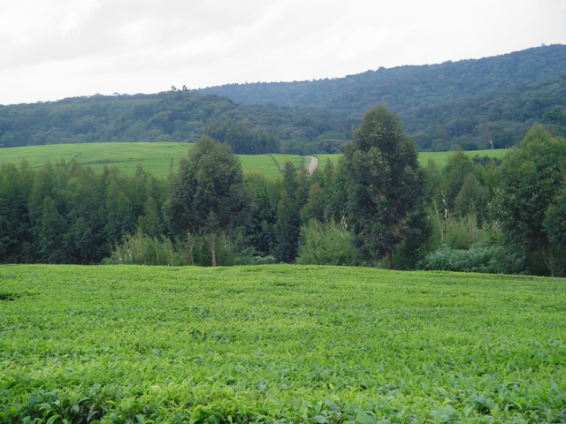

Climate Change:
Effects on the Kenyan Tea Industry
TEA RESEARCH FOUNDATION

Slide 2

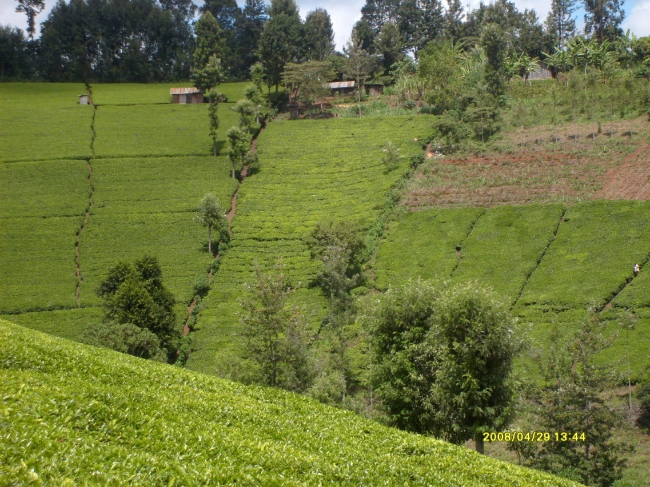
TEA IN KENYA: AN IMPORTANT CASH CROP
Source of livelihood to about 3million Kenyans and their families
A rural based enterprise & contributes to rural poverty alleviation
Contributes to the national economy (export earnings >1 billion $ in 2010, 4% of GDP)
Contributes to Environmental conservation / Carbon sink/ water infiltration
Kenya has the highest productivity efficiency in tea

Slide 3

Tea Enterprises are Threatened by Climate Change
Climate Change-A change in the state of the climate that persists for an extended period, typically decades or longer
Is there evidence of climate change in tea growing areas in Kenya?
TRFK is responsible for R & D in the tea sector
    Collection and collation of weather data;
    Climate change detection, monitoring, prediction and early warning;
    Information sharing with the Tea Industry;
Notes:
3

Slide 4
Significance of climate change
Considered to be one of the most serious threats to agriculture.
Impacts are expected on: Environment, Human health and pest and disease dynamics, Food security, Economic activities, Natural resources and Physical Infrastructure.
Adaptation will be necessary

Slide 5
Global Disaster Trends: 1990 – 2006
  Most of the Global Disasters are Hydro-meteorological (Climate-related).
    The frequency and intensity of disasters have increased in the last decade
El nino/La nina related Droughts, Frost, Hail
400
300
200
100
0
‘90
‘91
‘92
‘93
‘94
‘95
‘96
‘97
‘98
‘99
‘00
‘01
‘02
‘03
‘04
‘05
‘06
Geo Physical
Hydro
Meteorological
Epidemics &
Insect Infestation
Source: CRED

Slide 6
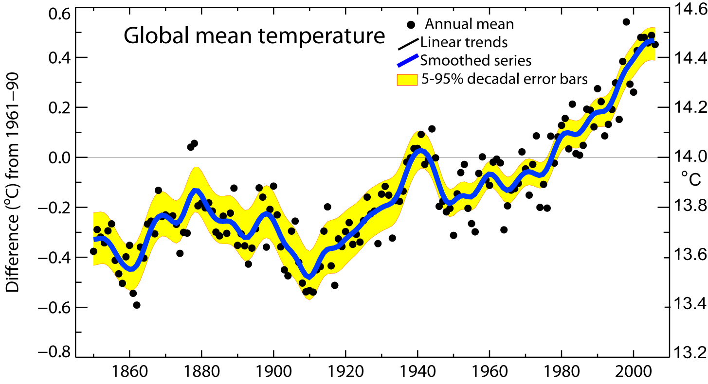
Global mean temperatures are rising faster with time
Warmest 12 years:
1998,2005,2003,2002,2004,2006, 2001,1997,1995,1999,1990,2000
Period Rate
Years °/decade
50 0.128±0.026
100 0.074±0.018

Slide 7
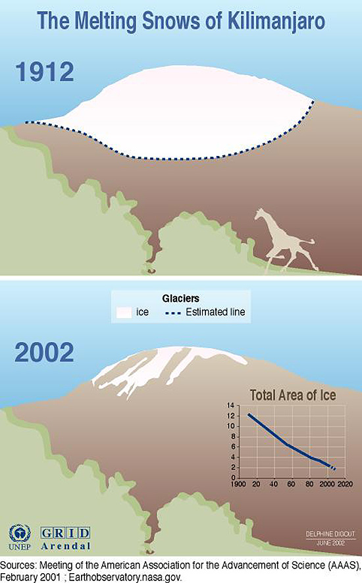
EVIDENCE OF GLOBAL WARMING
Declining Mountain Glaciers in East Africa e.g. Melting of Mt. Kilimanjaro glaciers
82 % of the icecap that crowned the mountain Kilimanjaro when it was first thoroughly surveyed in 1912 is now gone, and the ice is thinning as well - by as much as a meter in one area. According to projections, if recession continues at the present rate, the majority of the glaciers on Kilimanjaro could vanish in the next 15 years
Same observed for Mt Kenya

Slide 8
INDICATORS OF CLIMATE CHANGE IN KENYA
Climate change signals are now apparent in the Kenya.
The change signals observed include:
    temperature rises;
    Decreasing rainfall and irregular trends;
    melting and retreat of the mountain glacier at Mt Kenya;
    increasing frequency of extreme climate events eg droughts, frost, hail etc

Slide 9
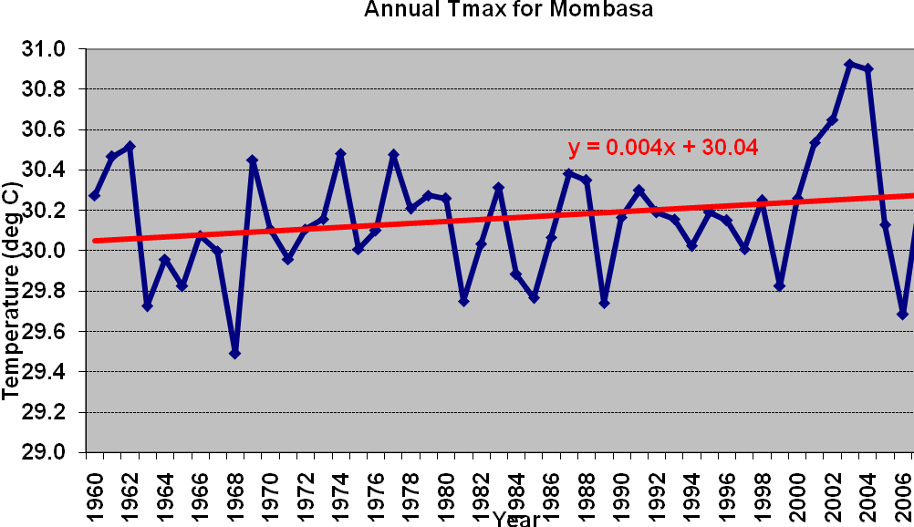
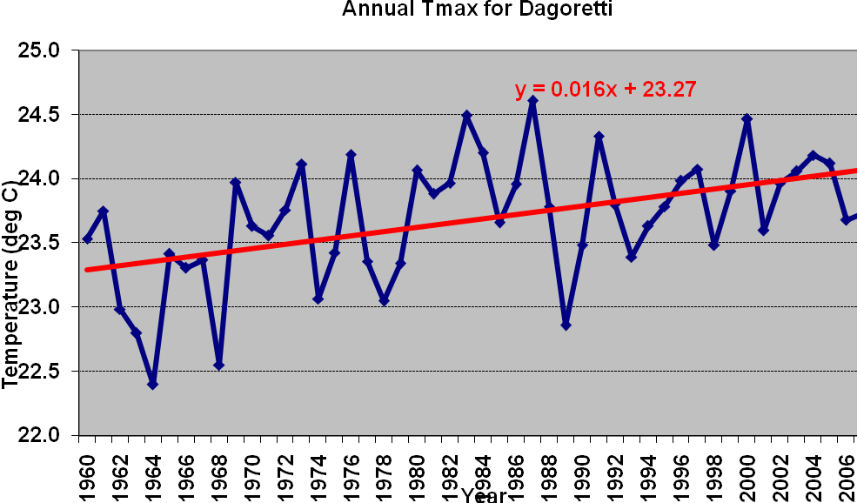
Annual maximum temperature trends in Kenya
-non tea areas

Slide 10

OND Rainfall Trends In Kenya
Marsabit
Nyahururu
Narok

Slide 11

Annual Rainfall Trends in a Tea Area- TRFK Kericho
There is an annual decrease of 4.82mm over a 52 year period.
This is a rainfall decrease of slightly more than 250mm over the period.
Notes:
11

Slide 12
Rainfall Trends in a tea area (Kericho)
  There is an average rainfall decrease of 65mm (R² = 0.803) for every ten-year period.

Slide 13
Linear increase in soil water deficits in a tea area (Kericho)

Slide 14

Temperature Trends in a Tea Area- TRFK, Kericho
There is an annual rise of 0.016⁰C (R² = 0.331) over a 52 year period.
Notes:
14

Slide 15
Mean Air Temperature Trends over a four Decade period in a tea growing area- TRFK, Kericho
There has been an average rise of 0.2⁰C (R² = 0.852) for every ten-year.
This is a temperature increase of 1⁰C over the years.
Notes:
15

Slide 16
Magnitude of change of Tmax. in Kenya
REGION TREND MAGNITUDE
Western Increase 0.5 - 2.1°C
Central Increase 0.1- 0.7°C
Northern Increase 0.1- 1.3°C
Northeastern Increase 0.1- 1.3°C
South Eastern Increase 0.2- 0.6°C
Coastal strip Increase 0.2 - 2.0°C
TEA AREAS

Slide 17
Magnitude of change in Tmin. in Kenya
REGION TREND MAGNITUDE
Western Increase 0.8 - 2.9°C
Central Increase 0.8 - 2.0°C
Northern Increase 0.7 - 1.8°C
Northeastern Increase 0.7 - 1.8°C
South Eastern Increase 0.7 - 1.0°C
Coastal strip Decrease 0.3 - 1.0°C
TEA AREAS

Slide 18
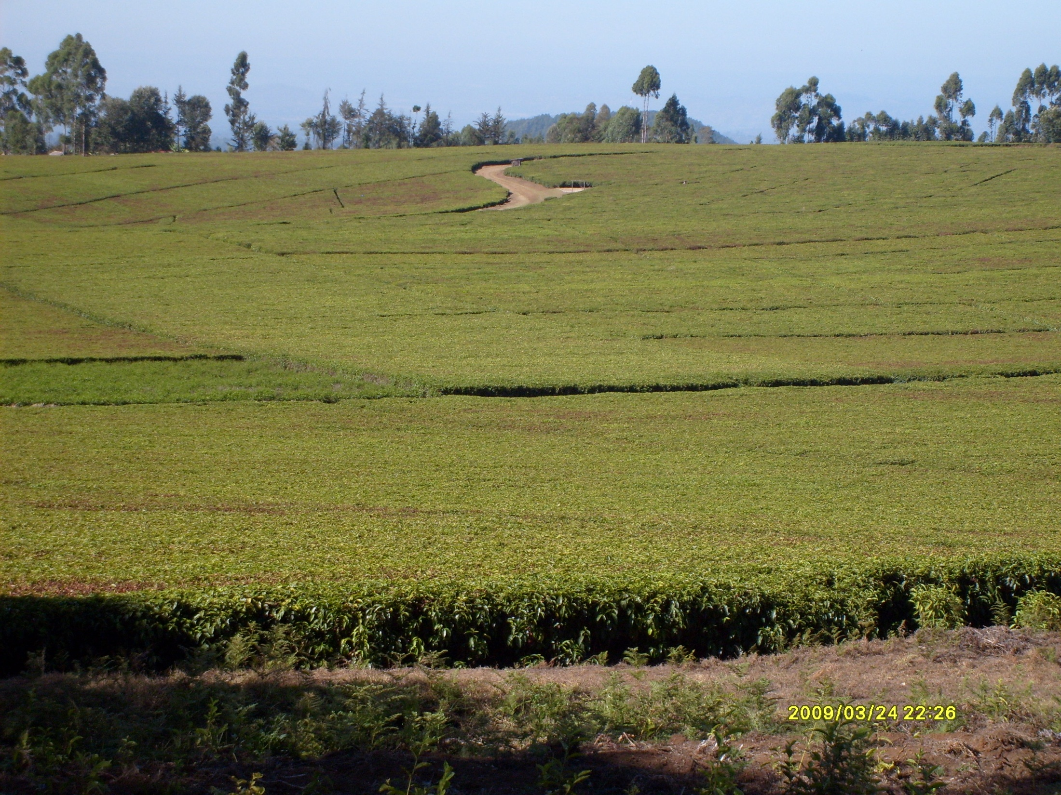
RISK FROM FROST DAMAGE

Slide 19
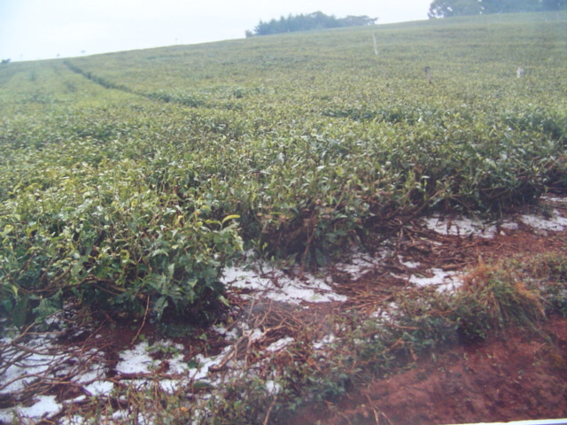
RISK FROM HAIL DAMAGE

Slide 20
Hail incidences in tea areas West of Rift Valley- Unpredictable

Slide 21
Hail Hit Areas and Crop Losses

Slide 22
Effects of climate change on Tea enterprises.
Shifts in crop distribution.
Yield decline or increase in some catchments.
Quality decline in some catchments.
Harvest losses due to Unpredictable risks due to increasing extreme weather events e.g. Frosts, Hail, droughts.
Soil fertility decline and degradation/landslides due to erosion.
Shift in disease and pest dynamics- e.g.Increase of pest infestation in some catchments (Helopeltis, Mites) and resurgence of some diseases like highland malaria
Loss of biodiversity and desertification
Human Conflicts over limited resources like water and pasture
Some cultural exacerbate the impacts of global warming.

Slide 23

Effect of fertilizer rates on soil moisture content
Water content decreases with increased fertilizer rates and soil depth.

Slide 24
Effects of Nitrogen rates on porosity
Porosity of the soil increases with increase in N rates. Control had the lowest porosity value
Implication of high fertilizer rates- affects the water relations and gas diffusion in the soil

Slide 25
Plant mortality increases with N rate during drought

Slide 26

Adaptation measures undertaken by Tea Sector in Kenya
Efficient management of soil and water resources- (Precision farming and Judicious use of inputs eg Fertilizer).
Catchment protection (planting of Bamboo).
Environmental conservation and Control of deforestation.
Riverbank protection.
Sustainable management of forests- Planting of hedges and natural barriers to forests.
Soil Water Conservation measures and Mulching.
Water harvesting structures (Micro-catchments).
Growing of low water demand (drought resistant) tea clones/varieties.
Identification of alternate sources of energy (wind, solar, hydro).
Consideration of crop insurances.
Delineation of tea areas, crop diversification and farmer education.

Slide 27
Education of farmers on Fertilizer Utilization

Slide 28
What steps has Kenya taken to address the climate change challenges?
1.) Climate Change Legislation
Kenya has no specific law or policy touching on climate change. However, the multi-sectoral nature of the climate issues implies that a broad range of sector policies and regulations such as environmental conservation, energy, manufacturing, natural resources are of relevance
The “Energy Act 2006” and the “Kenya Forest Policy” specifically provide for carbon finance activities
Several key documents address environmental and energy concerns. These include, inter alia, Environmental Management and Coordination Act of 1999 (EMCA, 1999), Energy Policy, Energy Act 2006, as well as the Forest Act 2005

Slide 29
National Climate Change Focal Point (NCCFP)
Coordination of climate change activities is undertaken by the National Climate Change Focal Point, The Focal Point is physically located in the Ministry of Environment and Mineral Resources.
Roles:
  Coordinate national climate change activities;
  Liaison with the UNFCCC Secretariat;
  Act as the secretariat to the National Climate Change Activities Coordination Committee and the four technical working groups
CDM Designated National Authority (DNA)
NEMA (National Environment Management Authority) is the Designated National Authority (DNA) for CDM projects in Kenya.
  The principal role of the DNA is to give a Letter of Approval for proposed CDM projects and confirm that they contribute to country’s sustainable development

Slide 30
The National Climate Change Activities Coordination Committee (NCCACC)
A technical, multi-sectoral, multi-stakeholder group, that coordinates the activities of the Government of Kenya on climate change.
Parliamentary Network on Renewable Energy and Climate Change (PANERECC)
A follow up to the COP12 in 2006 was the formulation of a (PANERECC) for purposes of creating awareness and influencing policy making relevant for both renewable energy and climate
National Communication to the UNFCC
Kenya completed and submitted the First National Communication to the UNFCCC in 2002 and is currently working on the Second

Slide 31
The Way Forward
Global warming will persist. Adaptation is therefore the only option. There is thus need for:
Preparation of sector based climate change programmes, strategies, policies and projects.
Closer collaboration between stakeholders in resource mobilisation to support climate change adaptation activities within the sector.
Awareness creation and public education.
Intensification of data and information collection and forecasting
  Review of various climate change scenarios.
  Analysis and/or review of available data (while referencing to current Kenyan tea /soil map).
  Analysis of current weather patterns in Tea growing Zones.

Slide 32


THANK YOU

