Slide 1
INTERGOVERNMENTAL GROUP ON TEA
INTERSESSIONAL MEETING
Mombasa, Kenya, 18-19 July 2011
Interactive Electronic Forum
Notes:
To insert this slide into your presentation
Save this template as a presentation (.ppt file) on your computer.
Open the presentation that will contain the image slide.
On the Slides tab, place your insertion point after the slide that will precede the image slide. (Make sure you don't select a slide. Your insertion point should be between the slides.)
On the Insert menu, click Slides from Files.
In the Slide Finder dialog box, click the Find Presentation tab.
Click Browse, locate and select the presentation that contains the image slide, and then click Open.
In the Slides from Files dialog box, select the image slide.
Select the Keep source formatting check box. If you do not select this check box, the copied slide will inherit the design of the slide that precedes it in the presentation.
Click Insert.
Click Close.

Slide 2
INTRODUCTION
The Forum of the Intergovernmental Group on Tea
Scope of the Forum
Why become a member?
Guidelines
Demonstration of the components of Forum
Feedback from the Members

Slide 3
BACKGROUND
User-to-user tool
A community of members who are interested in the tea industry.
Two components
The Forum is facilitated by the Secretariat of the IGG/Tea

Slide 4
SCOPE
Bring the community of the tea industry together
FAO's mission of putting information within the reach of the international community
A corner where members may discuss, interact and exchange knowledge on tea

Slide 5
COMPONENTS
Public Room
Open to all registered users, including members of the Private Room
General questions and comments such as
“Does anybody know the Mombasa tea auction prices...?”
“How climate change is affecting my tea plantation”

Slide 6
COMPONENTS
Private room
Open only to those registered users who are members of the Panel of Experts
Pre-screening of potential project proposals for submission to the Common Fund for Commodities
IGG-specific issues

Slide 7
WHY?
Participation
Dissemination information
Obtaining of information

Slide 8
FORUM GUIDELINES
“Common sense” principles for posting, such as
No profanity
No obscenity
No defamatory posts
No discriminatory posts
Members who repeatedly breach the guidelines will be banned

Slide 9
DEMONSTRATION
URL address: http://www.fao.org/economic/est/commodity-markets-monitoring-and-outlook/tea/tea-meetings/teaforum/en/
Panel of experts page
How to register

Slide 11
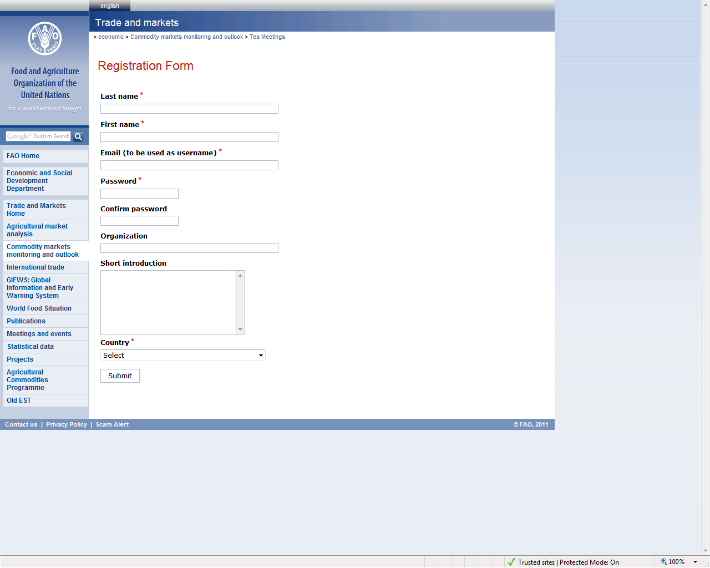

Slide 12
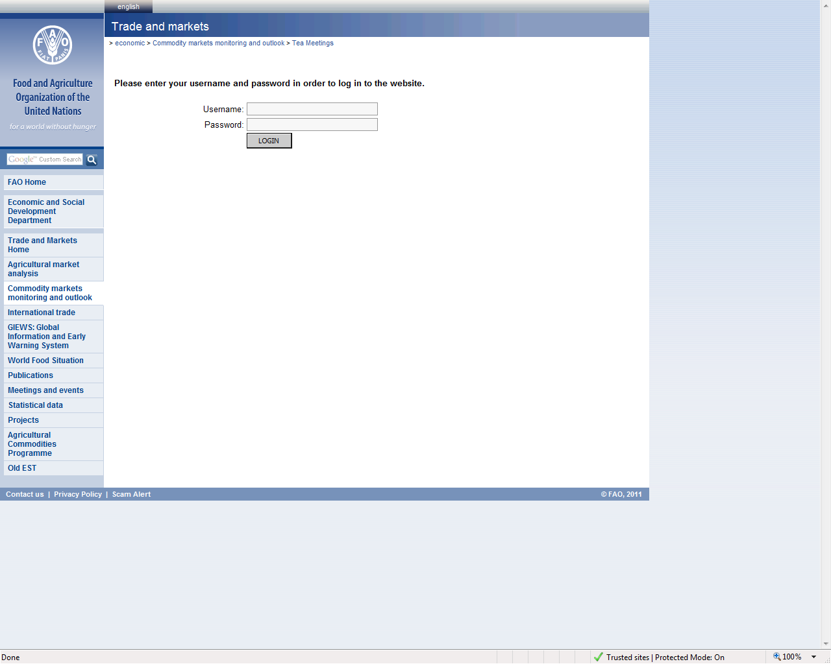

Slide 13
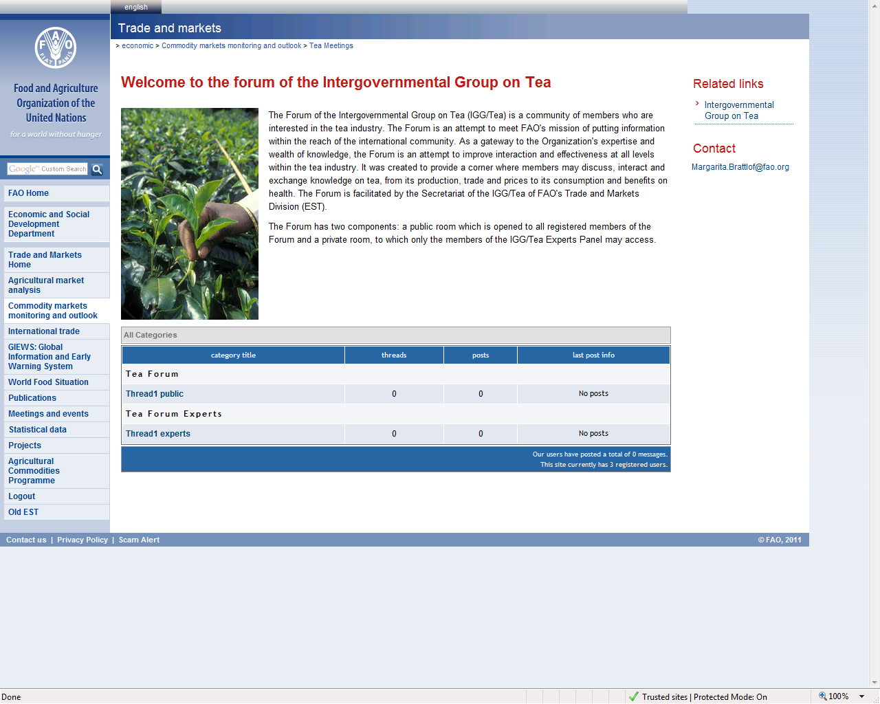
Open to all members (public and private)
Open to private members only

Slide 14
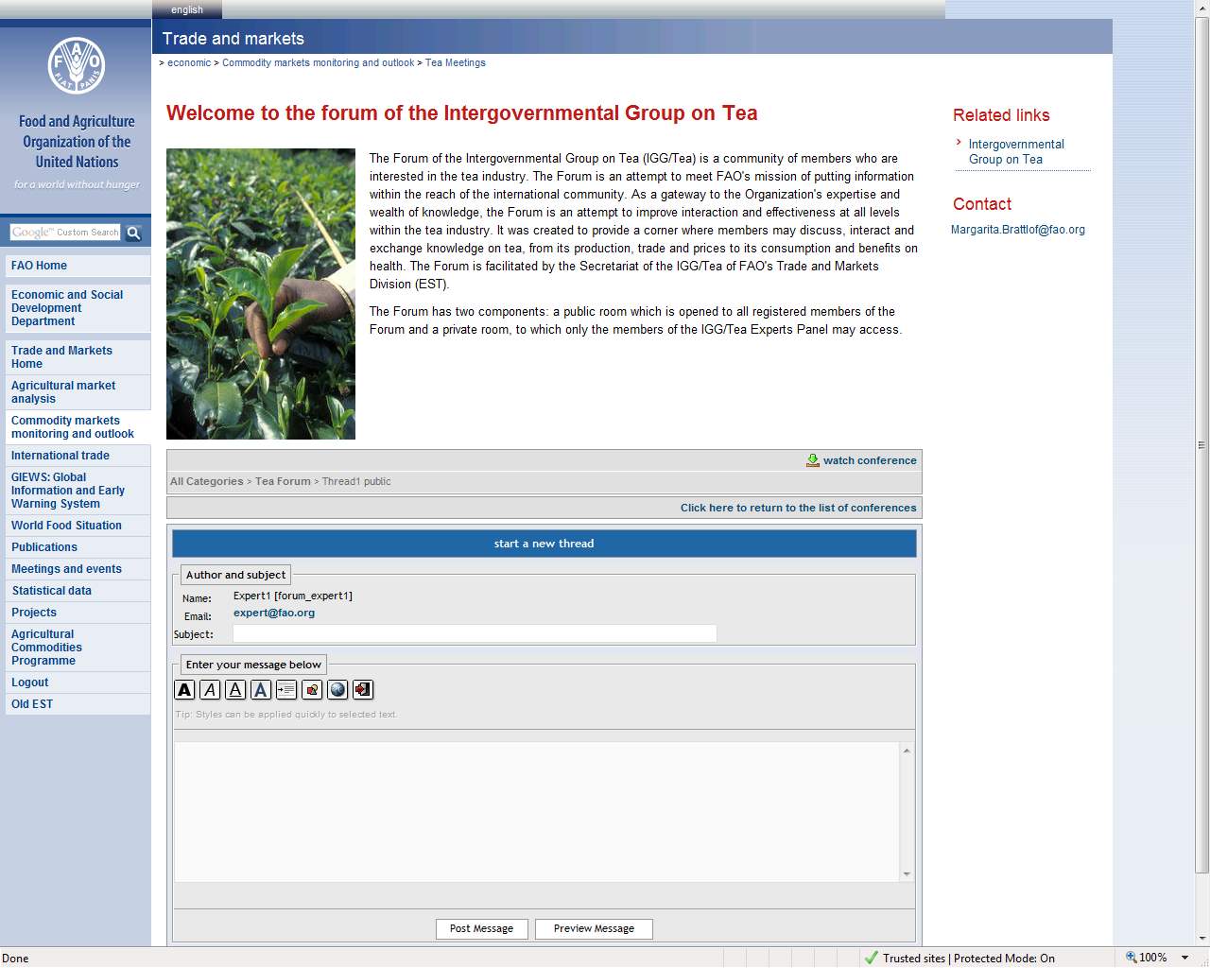

Slide 15
FEEDBACK AND PARTICIPATION
Assessment
Feedback
Participation

Slide 16
THANK YOU!

