Slide 1
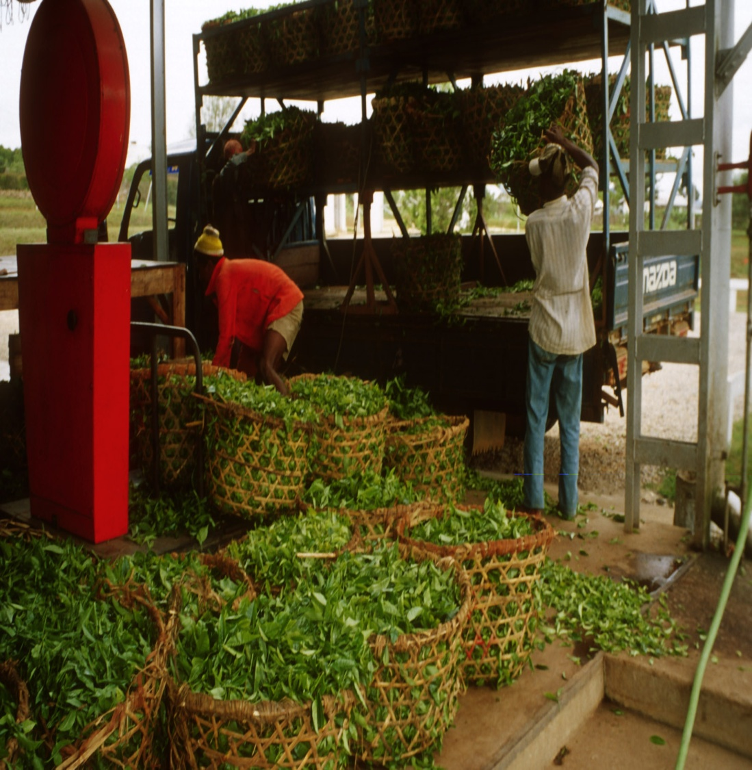

CONTRIBUTION OF TEA PRODUCTION AND EXPORTS TO FOOD SECURITY, RURAL DEVELOPMENT AND SMALLHOLDER WELLFARE IN SELECTED PRODUCING COUNTRIES

Slide 2
Outline of presentation
Introduction;
The role of tea export earnings in food security;
Institutional set-up and support for smallholders in:
  India;
  Kenya; and
  Sri Lanka
Conclusions

Slide 3
Introduction
Background
Objective of study
Low response rate to the questionnaire
Issues with responses
Requirements for improvement

Slide 4
Introduction (cont’d)
Emphasis of document CCP:TE 14/5:
  The role of export earnings on food security;
  The growing prominence of smallholders in the global tea economy;
  The institutions supporting tea smallholder development in India, Kenya and Sri Lanka.

Slide 5
Role of tea export earnings in food security
Trade contributes to income growth
Tea, production and exports
  Foreign exchange/employment;
  National economic growth;
  Help cover food import bills:
    51 percent (Kenya) and 71 percent (Sri Lanka) in 2011.

Slide 6
Role of tea export earnings in food security (cont’d)

Slide 7
Institutional set up & support for smallholders
Tea production by smallholders is growing worldwide
Governments that have created policies to promote smallholders
  India
  Kenya
  Sri Lanka

Slide 8
Institutional set up & support for smallholders in India
  India tea production in thousand tonnes
  Source: Tea Board of India.
Year | Small garden | Big garden | Total
2011 | 316.73 | 798.99 | 1 115.72
2012 | 363.09 | 763.24 | 1 126.33
2013 | 374.91 | 825.5 | 1 200.41

Slide 9
Institutional set up & support for smallholders in India (cont’d)
Share of small and big gardens in total production (percent)
Year | Small garden | Big garden
2011 | 28.39 | 71.61
2012 | 32.24 | 67.76
2013 | 31.23 | 68.77
  Source: Tea Board of India.

Slide 10
Institutional set up & support for smallholders in India (cont’d)
Smallholder in India = tea growers holding up to 10.12 hectares
Average size = < 1 hectare
More than 200 000 smallholders in India
  Green leaves supplied to private, stand-alone bought leaf factories (BLFs) directly or through middlemen

Slide 11
Institutional set up & support for smallholders in India (cont’d)
Tea Board of India set up a new Small Grower Directorate (SGD) in 2013
  Technical field offices posted throughout tea smallholder areas
Average productivity of small and big gardens (yield kg made tea/hectare)
Year | Small gardens | Big gardens
2011 | 2 000 | 1 970
2012 | 2 292 | 1 882
2013 | 2 367 | 2 035
  Source: Tea Board of India.

Slide 12
Institutional set up & support for smallholders in India (cont’d)
SGD objective:
  Facilitate the collectivization of smallholder tea growers through Primary Producer Societies/ SHGs business entities which produce quality leaf for better price realization
Capacity building
Technical assistance and financial support

Slide 13
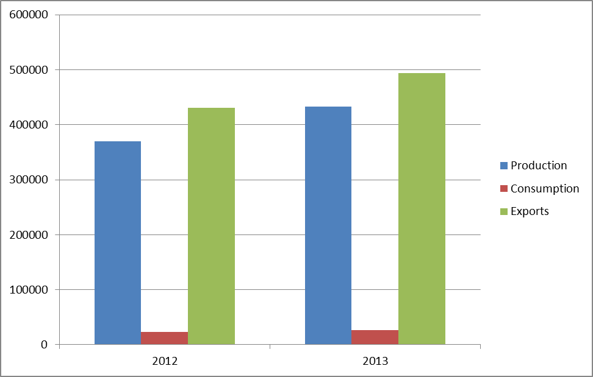
Institutional set up & support for smallholders in Kenya
Kenya: production, consumption and exports of tea (tonnes)

Slide 14
Institutional set up & support for smallholders in Kenya (cont’d)
Kenya: tea export values (million USD)

Slide 15
Institutional set up & support for smallholders in Kenya (cont’d)
60% of tea grown by smallholders
Kenyan smallholders almost exclusively belong to the Kenya Tea Development Agency (KTDA)
Services provided by KTDA:
  Farm inputs, materials and extension services;
  Inspection and collection of green leaf tea; and
  Processing and marketing.

Slide 16
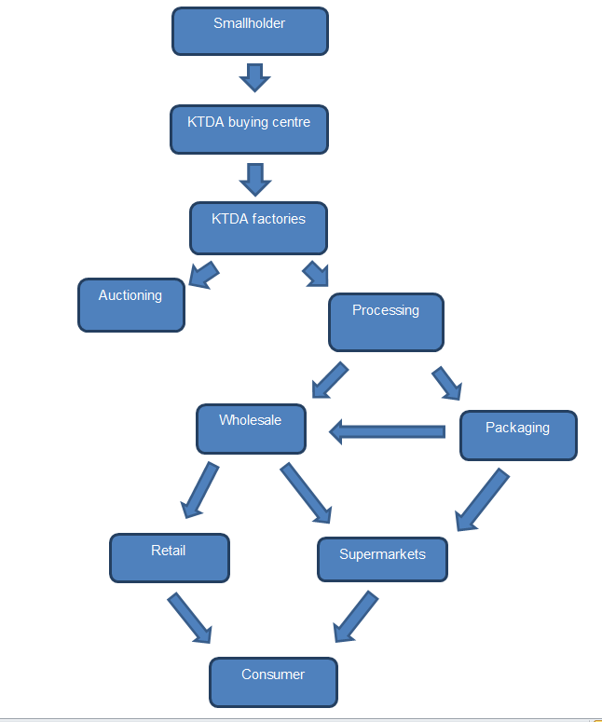
KTDA Value Chain

Slide 17
Institutional set up & support for smallholders in Kenya (cont’d)
Kenya Tea Packers Limited (Kepeta) is
  A private company
  Owned inter alia by Kenyan tea smallholders through the KTDA and the Kenya Tea Growers Association.
  Objective: increase returns to its shareholders through packed value added tea.

Slide 18
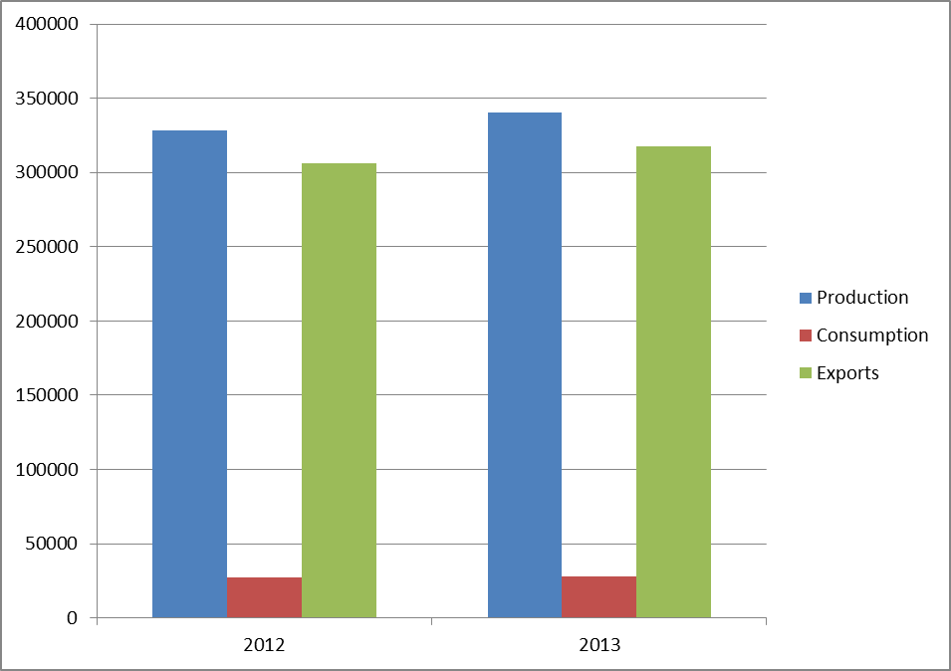
Institutional set up & support for smallholders in Sri Lanka
Sri Lanka production, consumption and exports of tea (tonnes)

Slide 19
Institutional set up & support for smallholders in Sri Lanka (cont’d)
Sri Lanka: tea export values (million USD)

Slide 20
Institutional set up & support for smallholders in Sri Lanka (cont’d)
There are over 400 000 tea smallholders in Sri Lanka
76% of Sri Lankan tea is grown smallholders
Smallholders organized into tea smallholder development societies (TSDS).

Slide 21
Institutional set up & support for smallholders in Sri Lanka (cont’d)
The Tea Small Holdings Development Authority (TSHDA)
  Promotes and develops the tea smallholdings in Sri Lanka
  Assigned to increase tea production, marketing activities and improve productivity,
  Aim: to improve the livelihood of Sri Lankan tea smallholders.
  Functions: extension interventions; land development interventions; and social development interventions.

Slide 22
Conclusions
The situation of tea smallholders continues to be problematic
Governments of most tea producing countries have formulated policies
Member countries are requested to complete the questionnaire senty by the Secretariat
India, Indonesia and Kenya requested to complete the questionnaire in its entirety
Countries which did not respond are requested to do so

Slide 23
THANK YOU!

