Slide 1
Current Situation of Tea Production and Marketing in China
The 21 Session of FAO-IGG on Tea
Prof. Lin Zhi
Tea Research Institute, CAAS

Slide 2
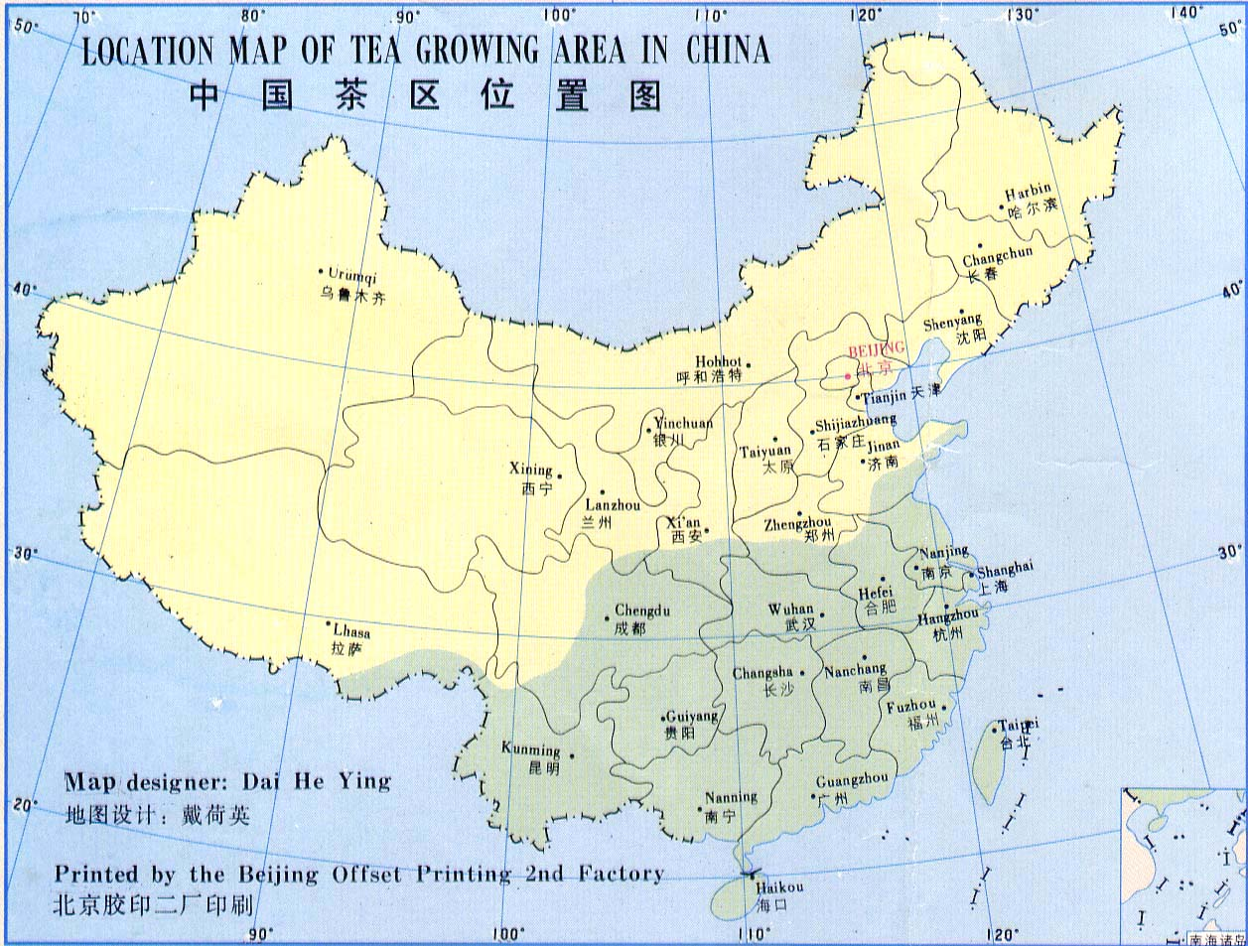
1. Tea Production in China
(1) Production concentrated in the advantageous areas

Slide 3
The Distribution of Chinese Tea Production in 2013
15.80%
17.46%
In 2013, the cultivated area and the production of tea in these 11 provinces together accounted for 88.04% and 88.32% of the national total, respectively.

Slide 4
1. Tea Production in China
(2) Increasing area, production and profits
With an average annual growth rate 6.6% and 7%
258
197
189
149

Slide 5
Gross output value of Chinese tea industry and its share in total agricultural gross output value
With an average annual growth rate 14.4% and 13.1%
1.94%
1106
1.83%

Slide 6
1. Tea Production in China
(3) The integral growth of six major teas
While the total production continues growing, the proportions of green tea and oolong tea have stayed at the same level or slightly declined. By contrast, the proportions of brick tea, black tea, white tea and yellow tea are continually on the rise, taking on a look of six major teas developing integrally.

Slide 7
The structural change of Chinese teas (Yield ratio): 2010-2013
70%
66%
In 2013, the productions of green tea, black tea, brick tea, oolong tea, white tea and yellow tea were 1.249 million tons, 0.198 million tons, 0.197 million tons, 0.229 million tons, 0.011 million tons and 2.253 thousand tons, respectively, with year-on-year growth rates of 5%, 14.2%, 16%, 3.6%, 19.8% and 10.5% respectively.
5%
12%
10%

Slide 8
1. Tea Production in China
(4) Improving product quality
Chinese government takes great efforts to invest in the standardization of tea plantation, pest control and green prevention-control technology. In the procedure of tea processing, marketing threshold was raised for tea firms to improve production conditions according to the QS standard criteria.

Slide 9
The proportions of clonal tea area, organic tea area and pollution-free tea in 2013
5.91%
0.152 million hectares, growth rate 6.4%
1.64 million hectares, annual growth rate 8.6%
63.63%

Slide 10
2. Tea Marketing in China
Exploring urban and rural market to increase domestic sales
China’s consumption quantity of tea reached 1.235 million tons in 2013 with an annual average tea consumption growth rate of 5%(FAO data).
The population of Chinese tea consumers was 4.68 billion, 36% of the total. Among them, the population of urban consumers and rural consumers were 2.54 billion and 2.14 billion, respectively (Guan Xi , 2011).

Slide 11
Per capita consumption of tea in selected countries
Ranking only the 20th in the world
China still has lots of space to enhance its domestic consumption quantity of tea.

Slide 12
2. Tea Marketing in China
(2) Consolidating international market to increase export quantity
In recent years, the export quantity of Chinese tea has been growing slightly with fluctuations, and the export value and price have continued rising too.

Slide 13
China’s export quantity and value of tea: 2010-2013

Slide 14
World exports of tea: 2003 VS. 2012
The share of Chinese tea export quantity wasn’t high compared with the total world export, the number in 2012 (i.e., 18%) was even lower than that of 2003.

Slide 15
3. Tea Marketing in China
(3) The balancing of production and marketing
From 2001 to 2011, the annual average growth rate of tea consumption in China was 8.86%; on the other hand, the annual average growth rate of tea production was 8.77%.

Slide 16
China’s tea production and marketing: 2010-2013
 | 2010 | 2011 | 2012 | 2013
Total Yield (10 thousand tons) | 147.51 | 162.32 | 177.43 | 189.00
Total Sales (10 thousand tons) | 146.36 | 155.51 | 161.85 | 171.08
Since 2010, along with the increase of new tea plantations, China’s tea production has been growing rapidly, even more than tea consumption. Considering consumption inventory, processing losses and other factors, production and marketing keep in balance basically.

Slide 17
Thank you!

