Slide 1

21st SESSION OF FAO IGG ON TEA
- WG ON CLIMATE CHANGE
Chair: India – Dr. R.M. Bhagat
Co-Chairs: Sri Lanka - Dr. M.A. Wijeratne
Kenya – Dr. J.K. Bore
Members: China
Japan
Tanzania
Malawi
Bangladesh
Rwanda
FAO Economist
Indonesia
5-7 November, 2014
Bandung, Indonesia

Slide 2
“The WG on climate change was formed at the 20th session of FAO-IGG on tea held at Colombo, Sri Lanka, Jan 30-Feb 1, 2012”
Objective of the Working Group
Development of climate databases, identifying models and impact assessment.
Support analysis on interaction on GxExM
Adaptation strategies and agronomic practices –development of a decision support system framework.

Slide 3
ACTION PLAN
Work plan
1. Database Development
Spatio-temporal data
Biophysical (meteorological, soil, crop, management etc.)
Socio-economic (demographic, costs, income etc.)
(Data quality check, bridging missing data gaps, fairly good resolution for both spatial and temporal data for bio-physical database)
2. Impact Analysis –Methodology
Trend analysis
Meteorological data
Long term trends and comparison with long term normals
Frequency of extreme events
Crop data (production & quality)
(Tea quality data on long term basis from the same area/cultivar- if available TF, TR to start with)
Future scenarios development
Using appropriate model or consortium of models (preferably 1km grid)
Long term future climate (For IPCC, A1B scenario)
Immediate future weather
Socio-Economic analysis
(Potential partners FAO -e.g. for Global Agro-ecological zones)
3. Work out interaction between Genotype (G) x Environment (E) x Management (M) which is the prime driver of productivity
Test existing and emerging cultivars for future climate scenarios (in OTC to begin with)
Use GIS to identify vulnerable regions and suitable areas
4. Identify adaptation strategies/Agronomic practices - via developing decision support system framework
Combine surface, satellite and simulation data (model outputs) -nowcasts/forecast and future climate scenarios

Slide 4
Action Area 1: Database development
All countries - India, Sri Lanka, China, Malawi and Kenya
Data on meteorology, soil, crop and management have been collected
Quality checks have/are being done.
Current database is being refined and updated.
The socio – economic data collection is in progress.

Slide 5
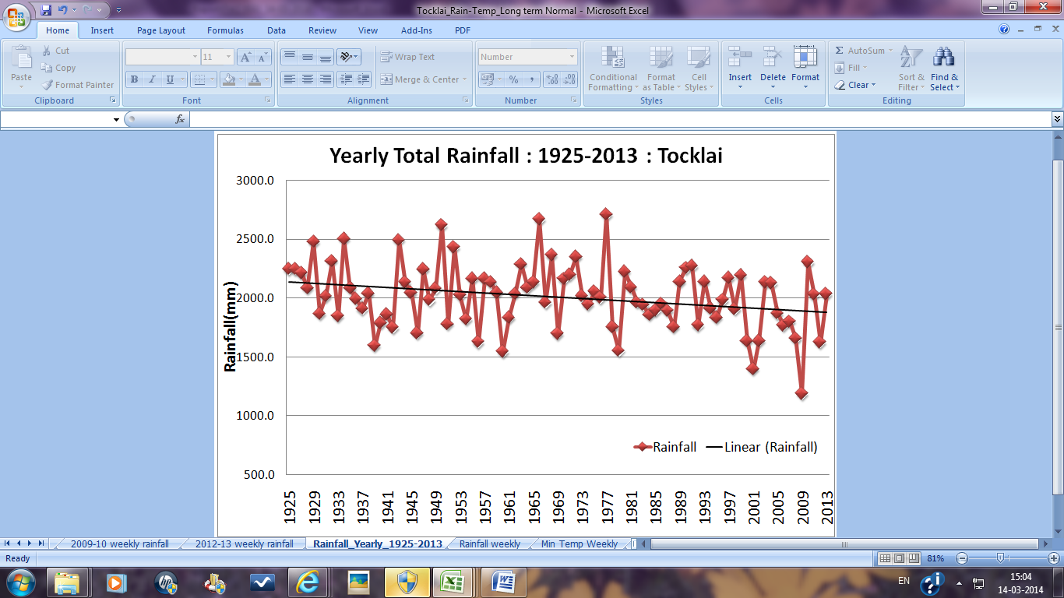
Action Area 2
Impact Analysis of time series data: Climate trends, frequency of extreme events
RAINFALL
India
Rainfall in north eastern India declined by more than 200 mm in last 90 years.
Sudden drop in annual rain after 1979 and thereafter it had never risen beyond 2299.7mm (2011) and has even gone down to 1184.4 mm (2009).
Contrasting rainfall pattern between 2009 – 2013 with alternate low and high annual rainfall.

Slide 6
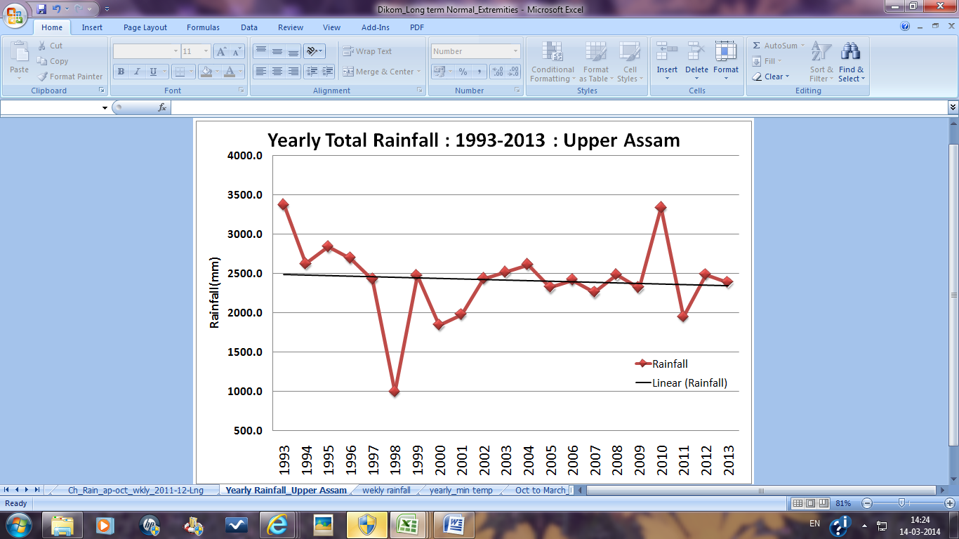
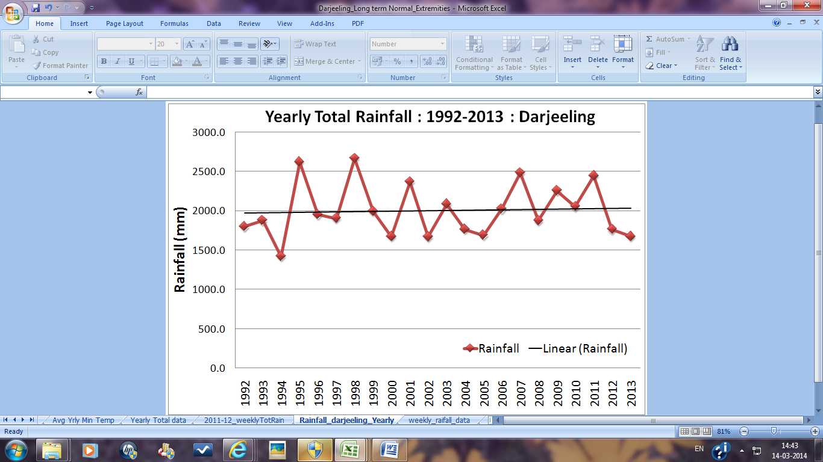
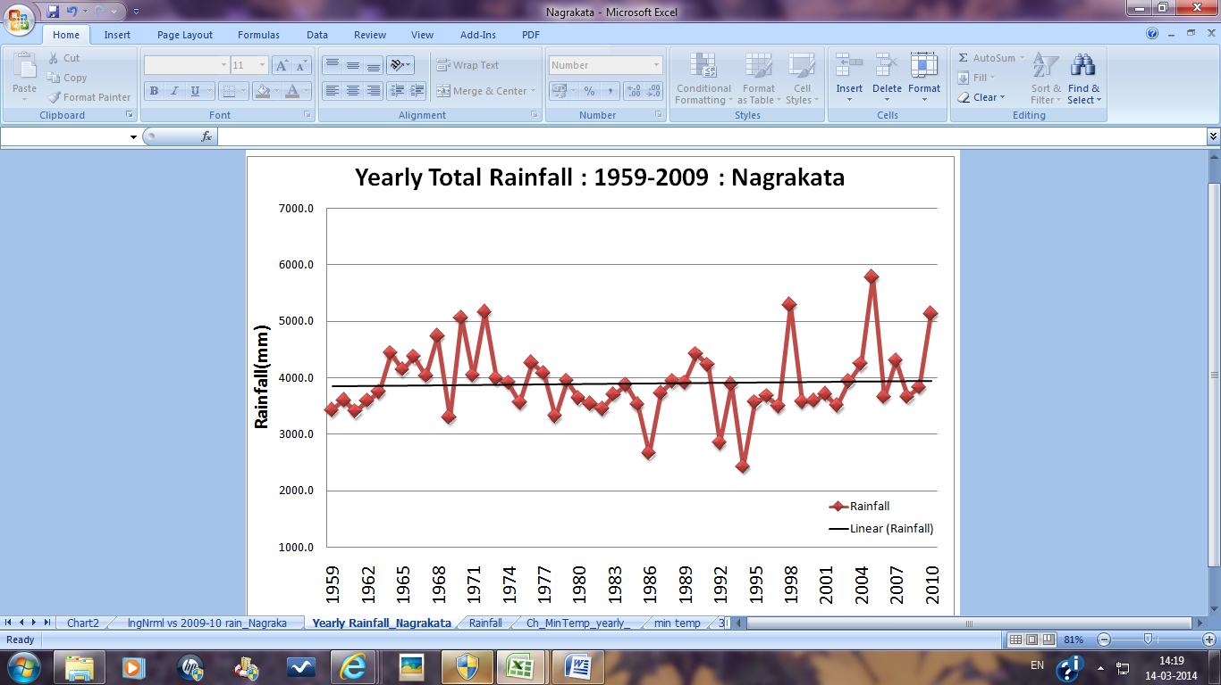
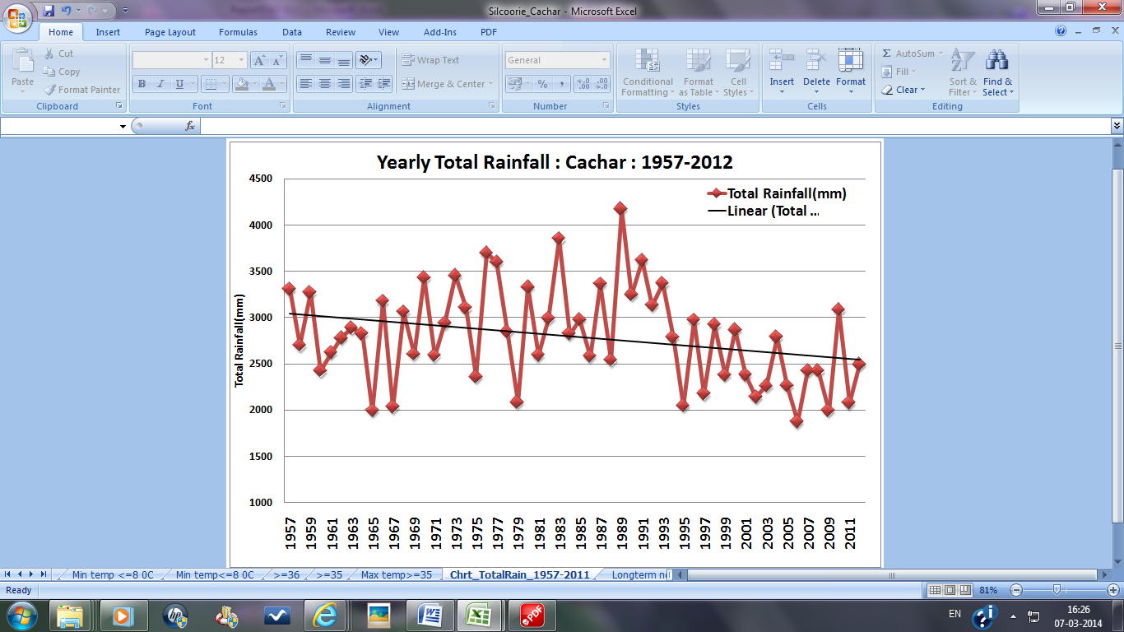
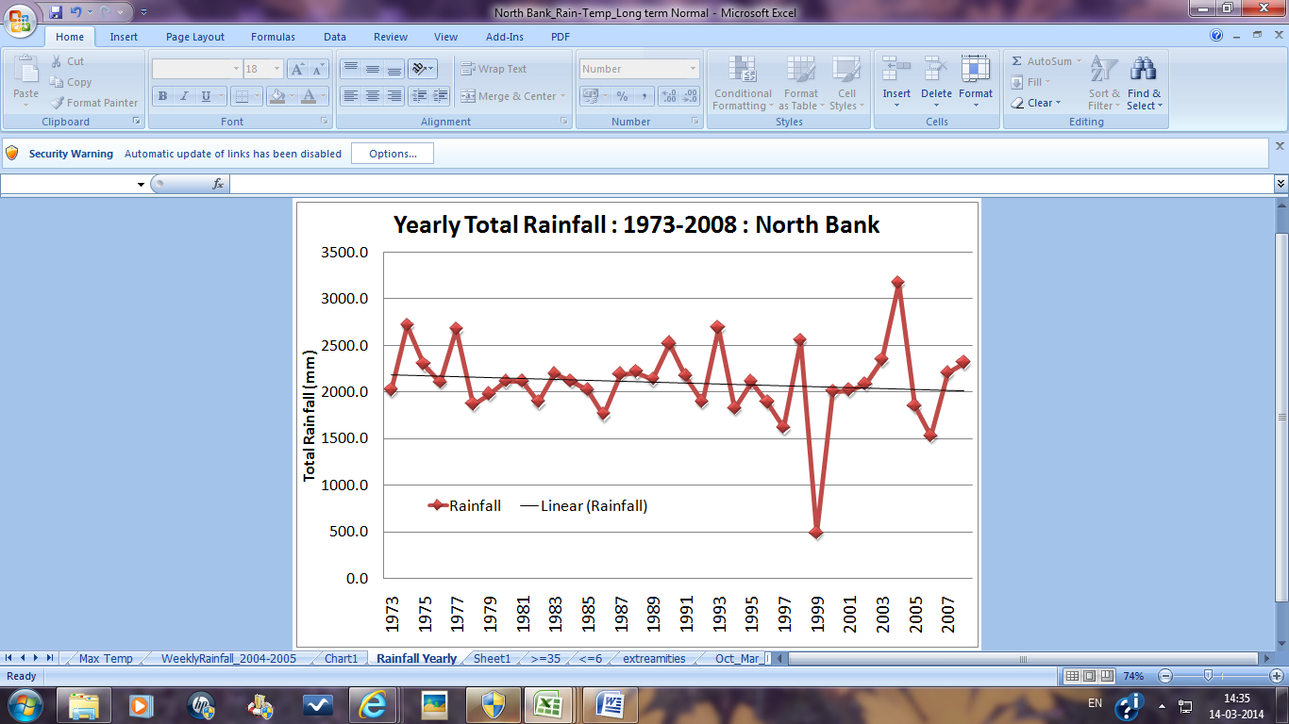
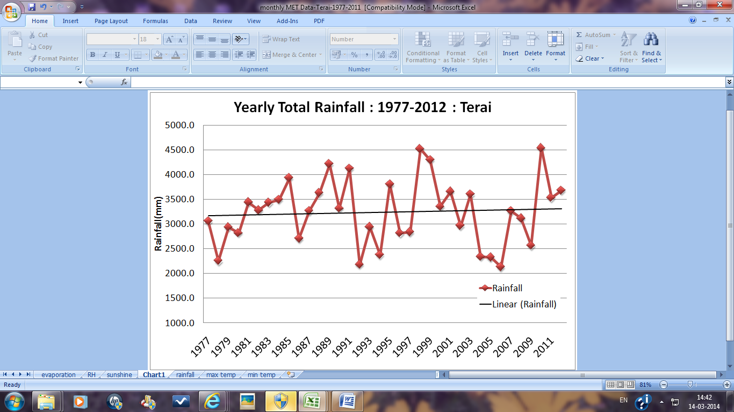
Rainfall scenario in different tea growing regions of NE India
Decrease in rainfall observed with varying magnitude

Slide 7
Sri Lanka
Mean annual rainfall of tea growing AERs for the 50 year period (1961-2010)

Slide 8
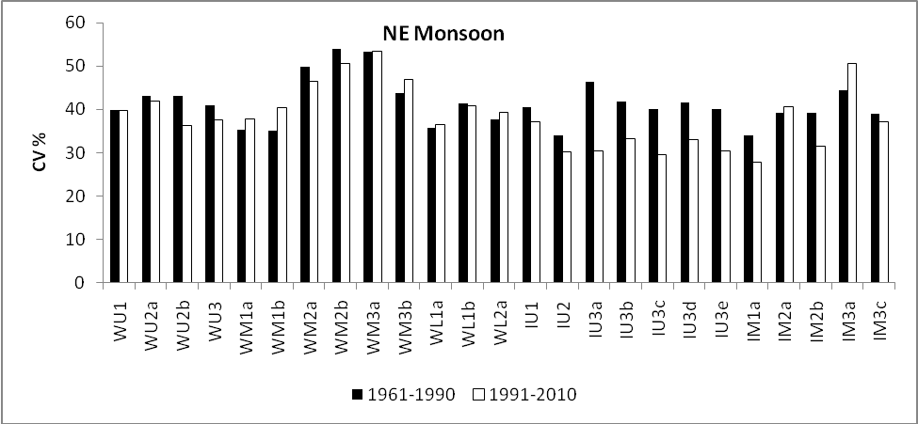
Comparison of rainfall variability of the North east monsoon
between the base period and the recent two decades –Sri Lanka.
Large variability in NE monsoonal rainfall has been observed

Slide 9
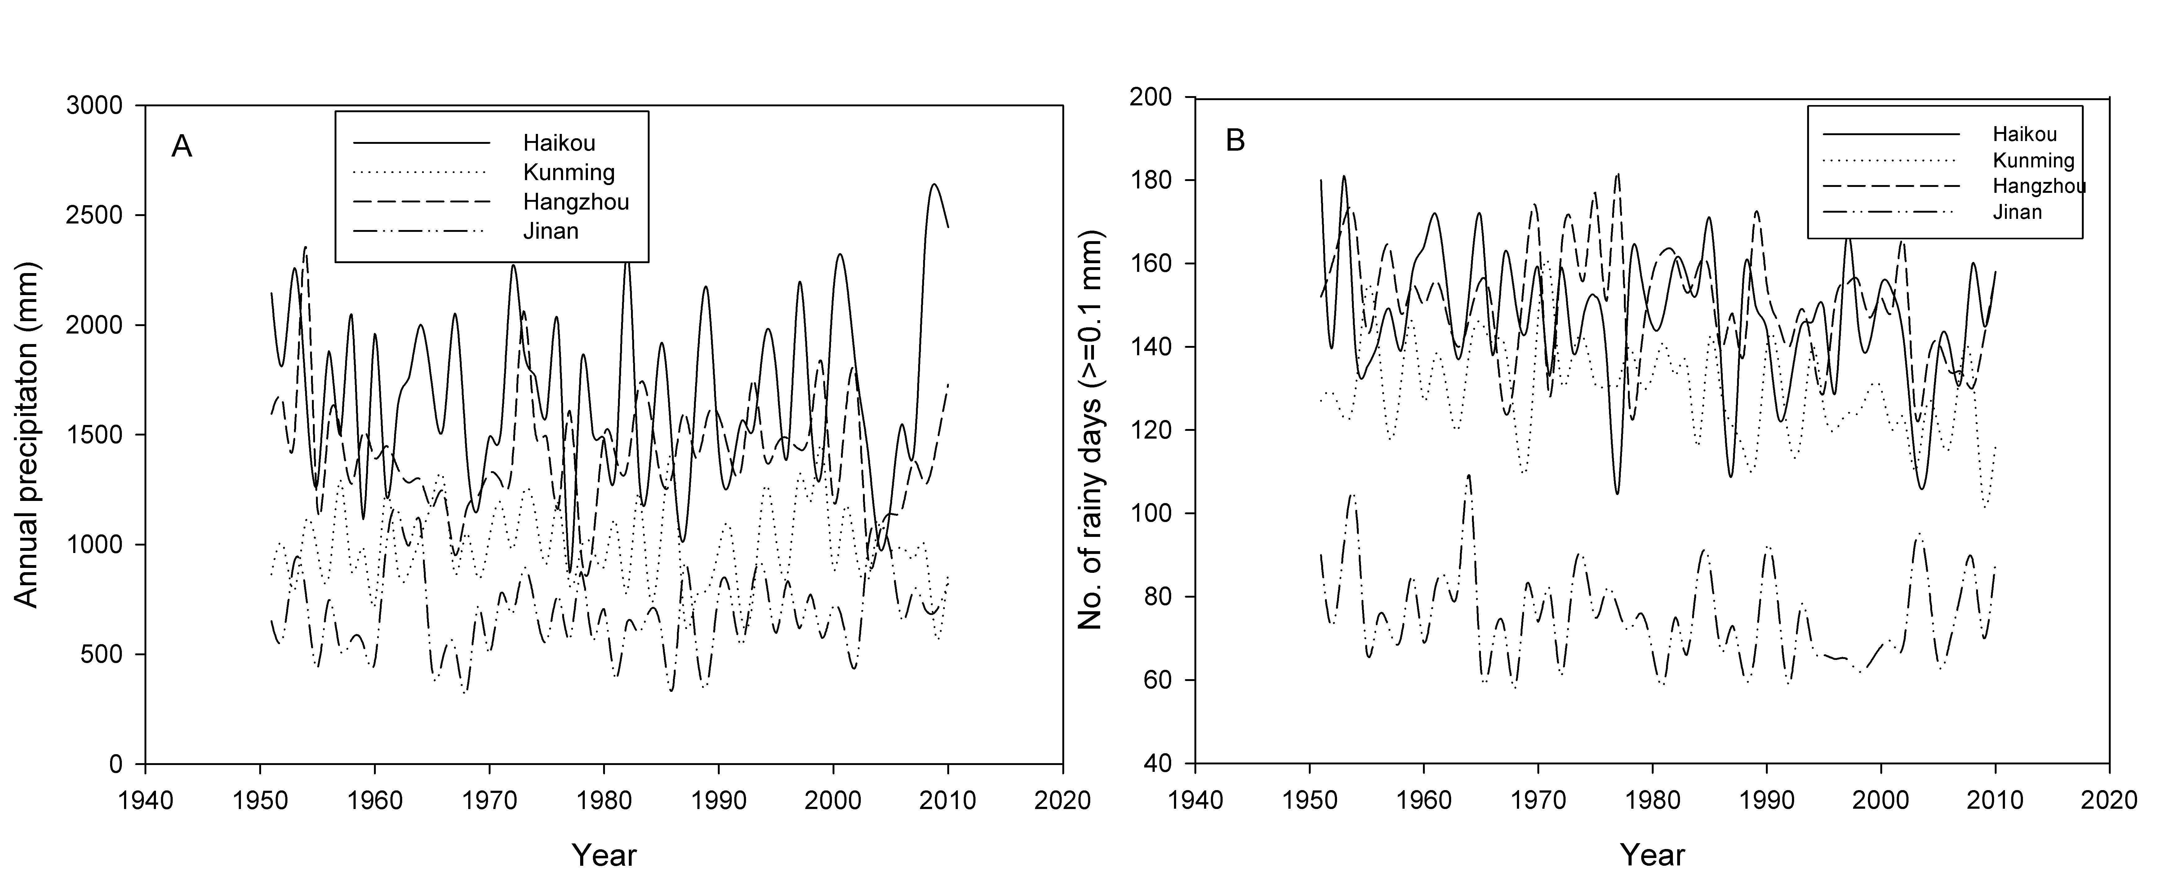
China
Changes of annual precipitation (A) and No. of rainy days (≥0.1mm)
(B) in 4 sites during the last 60 years.
Annual precipitation decreasing and no of rainy days falling with time

Slide 10
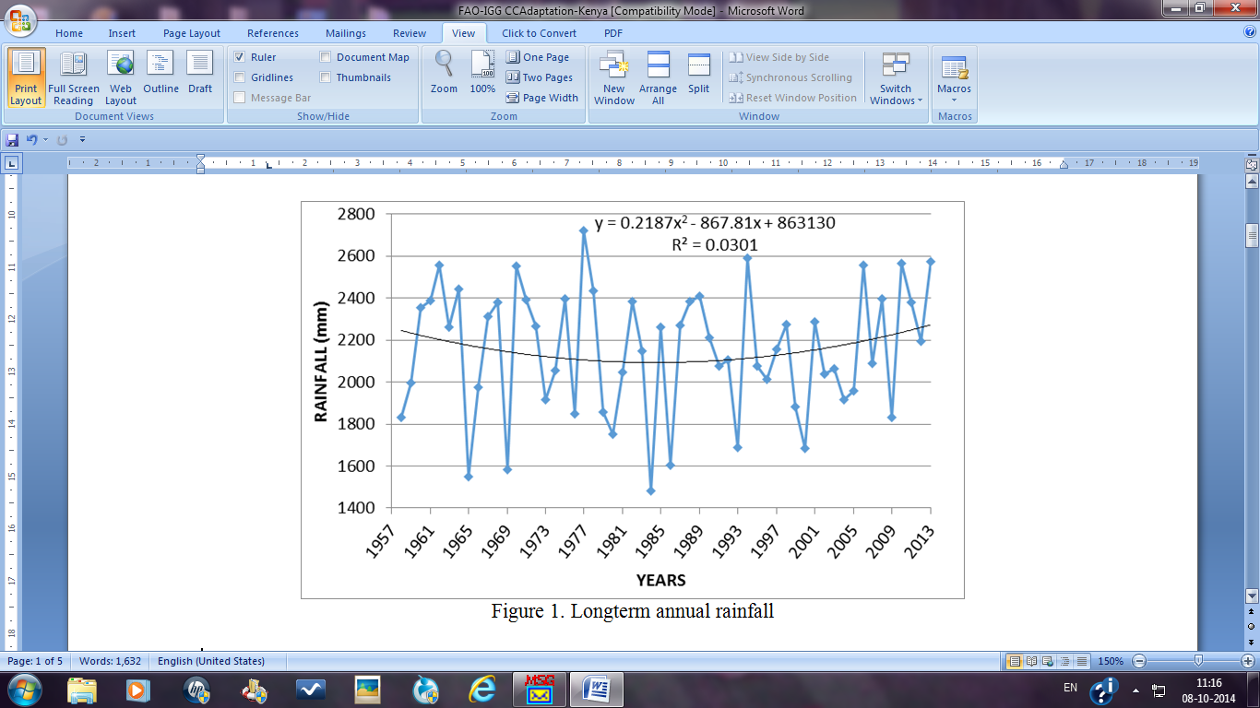
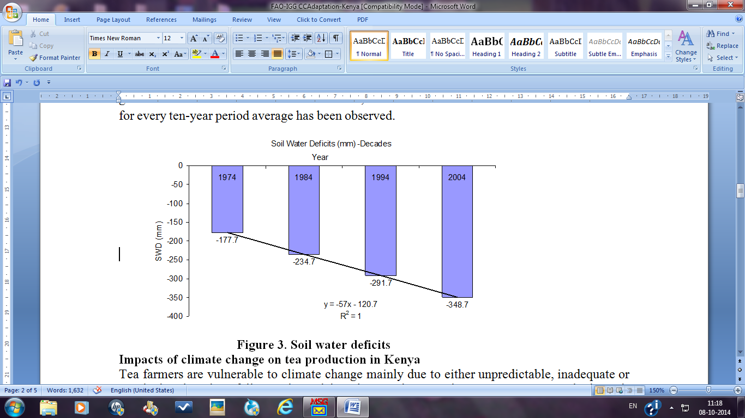
Kenya
Rainfall decrease accompanied by soil water deficit in profile

Slide 11
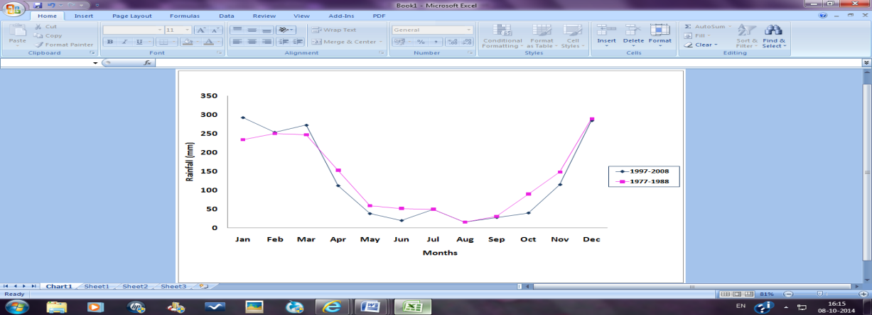
Malawi
Rainfall has decreased in the recent decade 1997-2008 compared to earlier

Slide 12
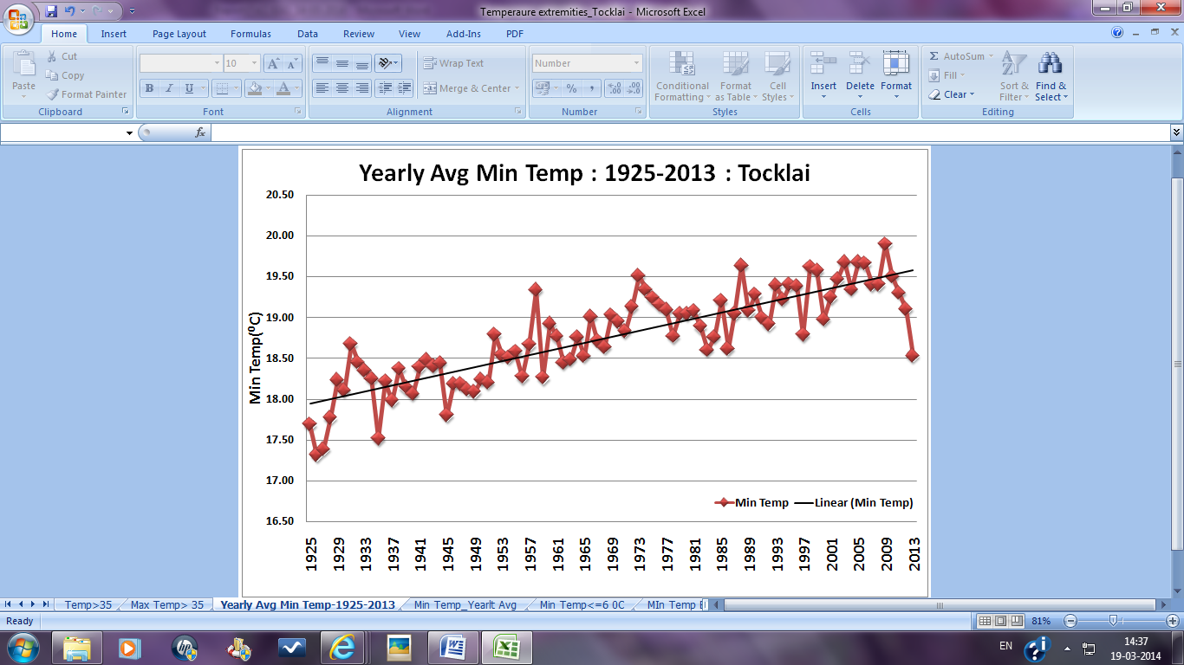
Temperature
India
Yearly Average Minimum Temperature (1925-2013) at Tocklai, Jorhat, Assam
Minimum Temp increased by 1.4 deg C in about 90 years

Slide 13
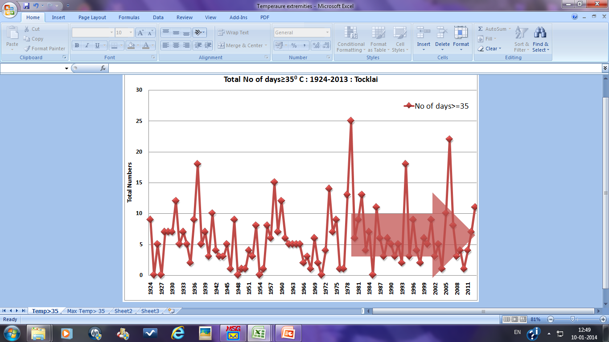
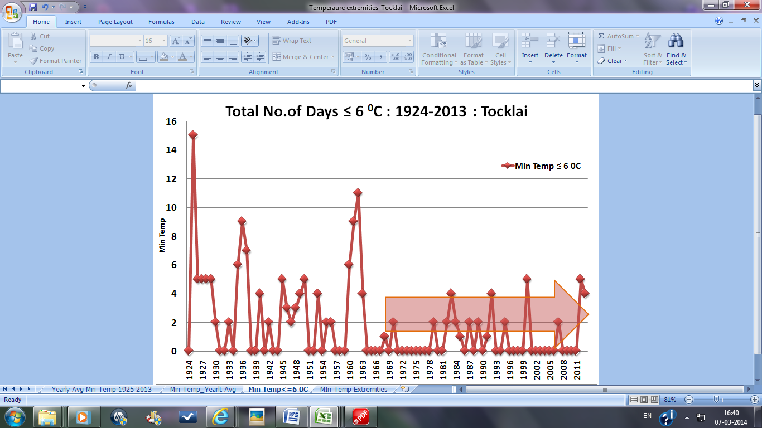
Total number of days having > 35°C temperature and total number of days having ≤ 6°C temperature at Tocklai, Jorhat, Assam, India

Slide 14
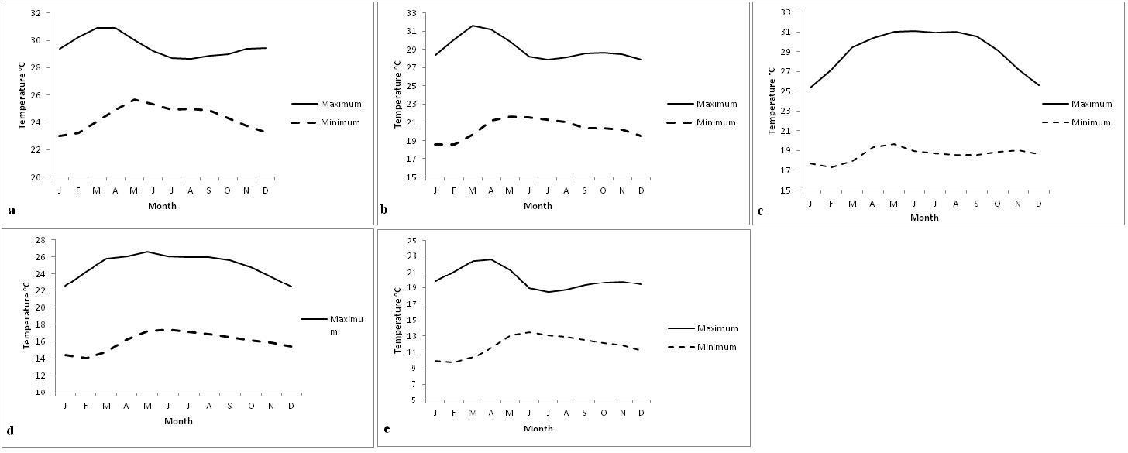
Sri Lanka
Monthly temperaure variation at different AERs (a)WL2a, Galle (b) M3b, Katugastota (c) IM1a, Badulla (d) IU3c, Bandarawela and (e) WU3, Nuwara Eliya.
If optimum temperature for tea growth is considered 22ºC, then rising temperature above this will impact tea growth and yield
Increase in temperature is 0.5 to 2 deg C 1961-2010

Slide 15
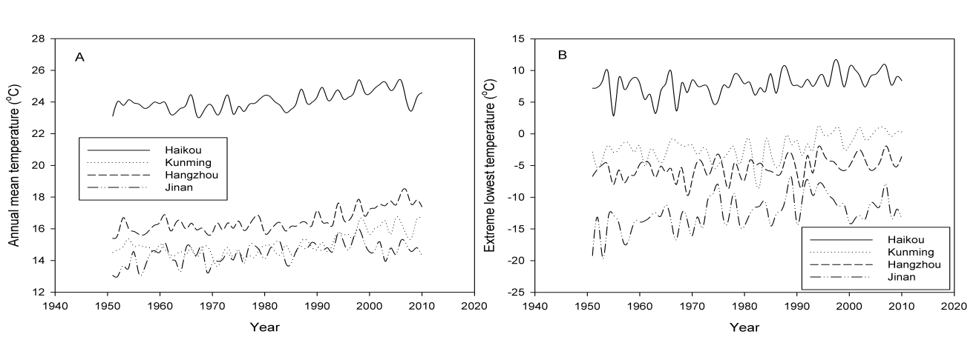
China
Changes of annual mean (A) and extreme lowest (B) temperature in 4 cities during the last 60 years
Linear regression equations fitted with the change of annual mean temperature in the last 60 years.
City | Linear regression equation (Y: annual mean temperature, X: year). | R² (Sig.) | Annual mean temperature increase in every 50 years (℃)
Haikou | Y=0.021X-16.721 | 0.378 (p<0.001) | 1.0
Kunming | Y=0.030X-43.380 | 0.480 (p<0.001) | 1.5
Hangzhou | Y=0.032X-46.149 | 0.591 (p<0.001) | 1.6
Jinan | Y=0.021X-27.401 | 0.323 (p<0.001) | 1.1

Slide 16
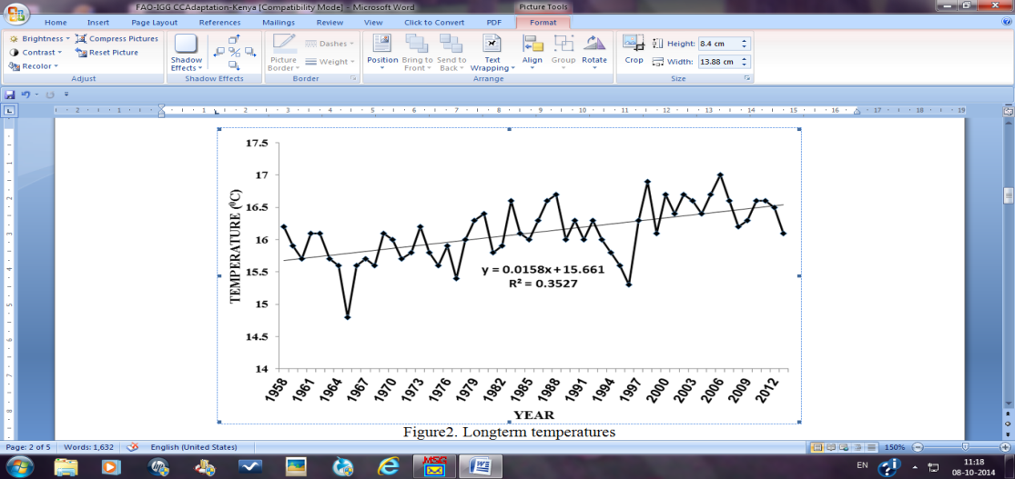
Kenya
Temperature has risen by 0.1 deg C in 54 yrs at a rate of 0.002 deg C annually

Slide 17
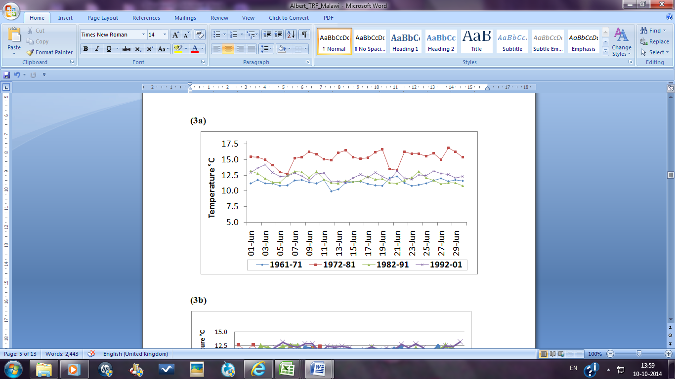
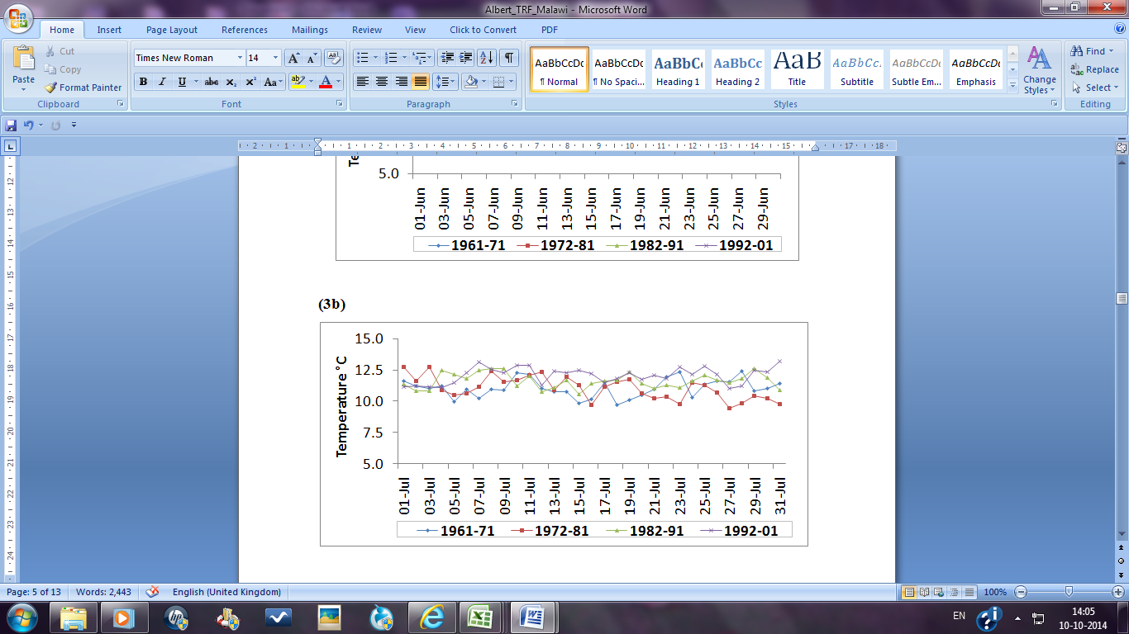
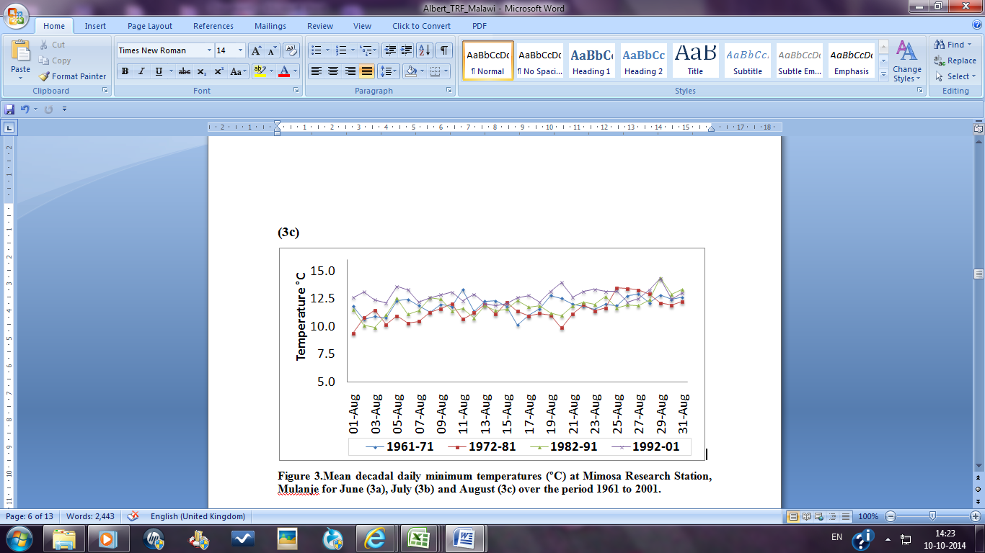
Malawi
Mean decadal daily minimum temperatures
JUNE
JULY
AUGUST
Continuous rise for last decade

Slide 18
Impact on yield…….

Slide 19
Yield decline of ageing teas – North East India

Slide 20
Yield decline of aging tea fields – Sri Lanka
Low country
Up country

Slide 21
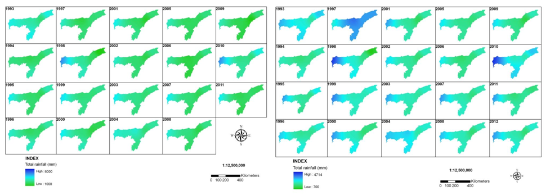
B. Spatial analysis of trends
India
Distribution of total annual precipitation (mm) and in production season (April – October), Assam, India for (1993-2011).
Overall a slow decreasing trend

Slide 22
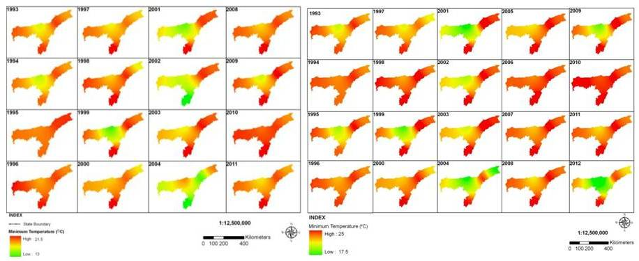
Distribution of average annual minimum temperature (°C) and in production season (April – October), Assam, India (1993-2012).
The minimum temperature shows a very clear increasing trend

Slide 23
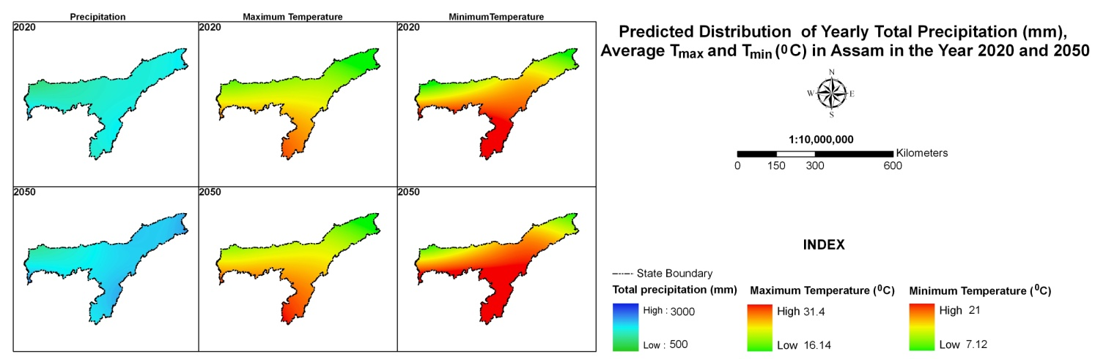
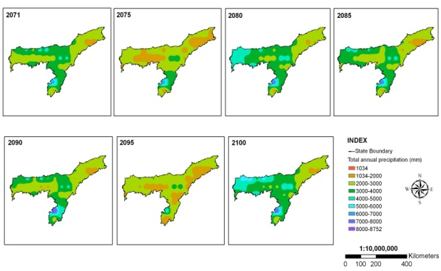
C. Future scenario development
Immediate future
The absolute values of temperature and precipitation for 2020 and 2050 which indicates precipitation to fall below the current levels and has a decreased rainfall.
Long-term future
The long term scenarios mapped using spatial analysis showed that on long term basis the annual total precipitation is likely to decrease in almost all over Assam except in some areas in the Cachar region where the annual total precipitation may increase

Slide 24
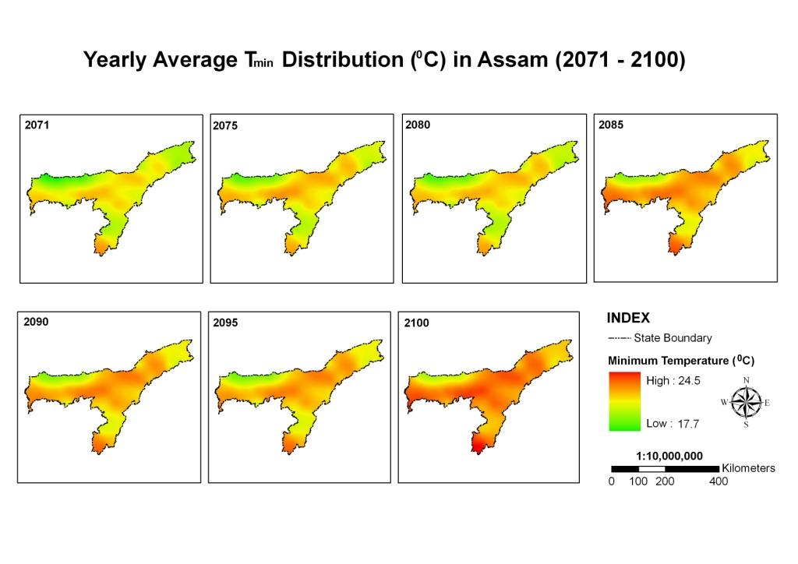
Distribution of average annual minimum temperature (°C) in Assam under IPCC A2 climate scenario for the time period of 2071-2100
The average annual minimum temperature shows a consistent increasing trend. The rate of increase is likely to be faster post 2080.

Slide 25
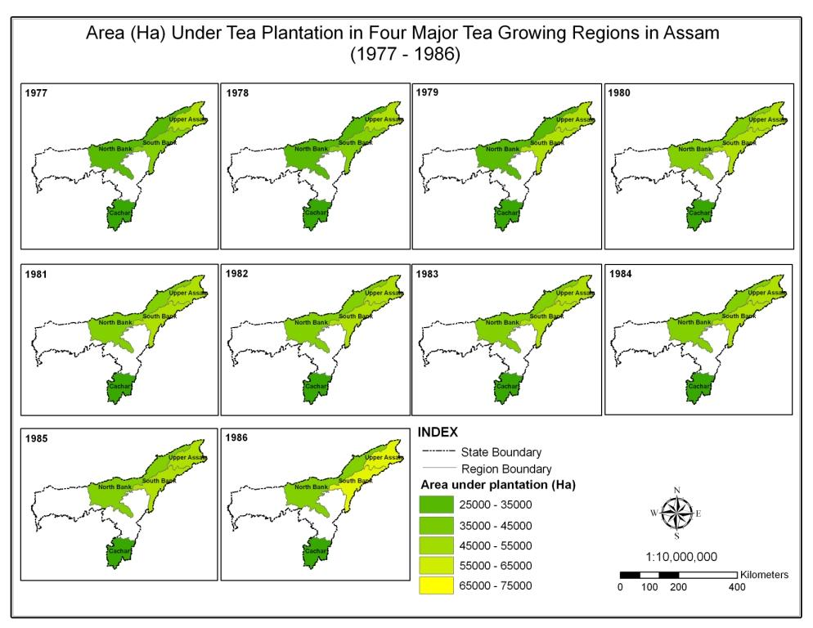
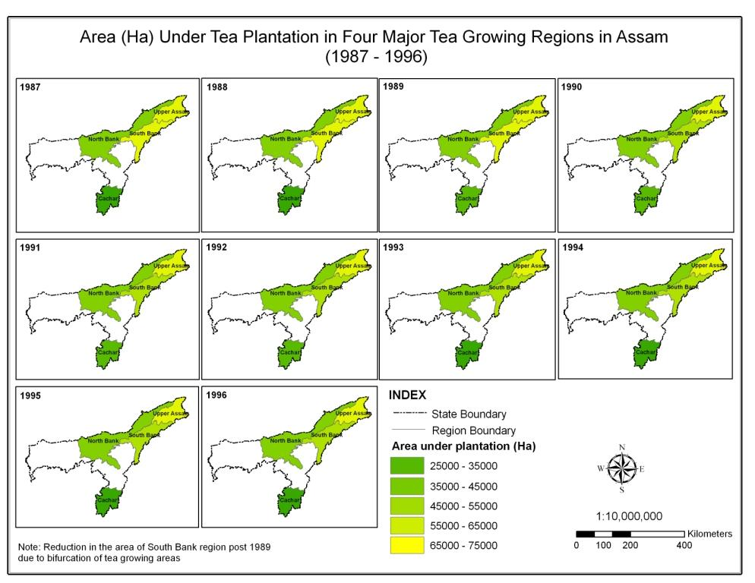
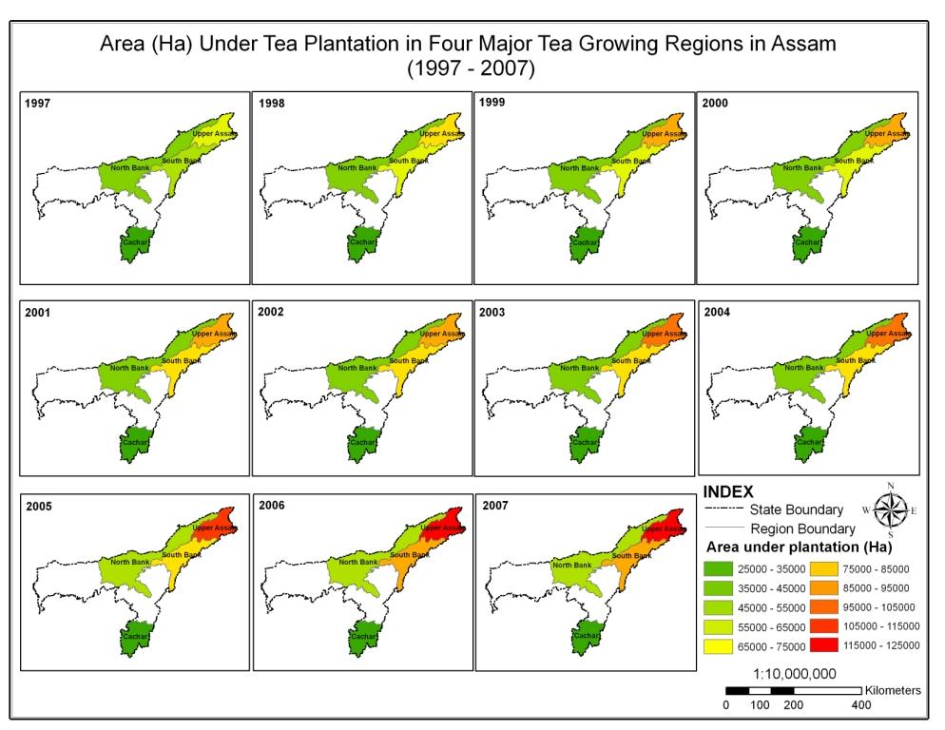
Analysis of Crop data: Area and Production
Area (in Ha) under tea plantation in four major tea growing areas of Assam 1977-1986, 1987-1996 and 1997-2007
Tea plantation area has consistently increased in all the tea plantation regions

Slide 26
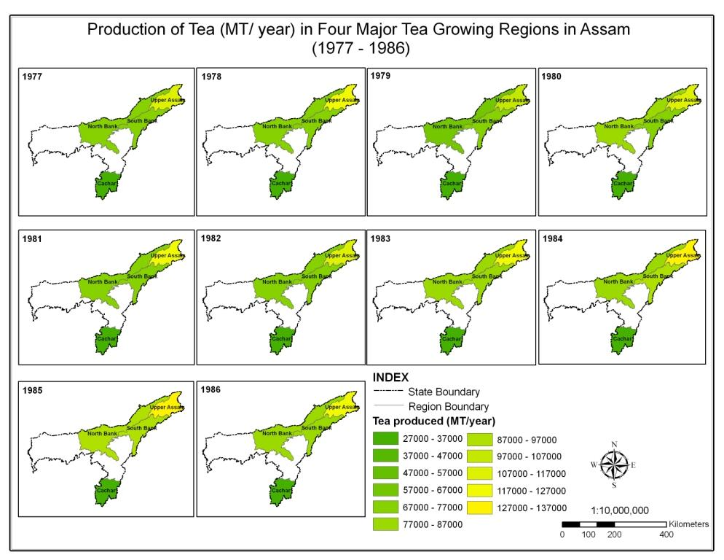
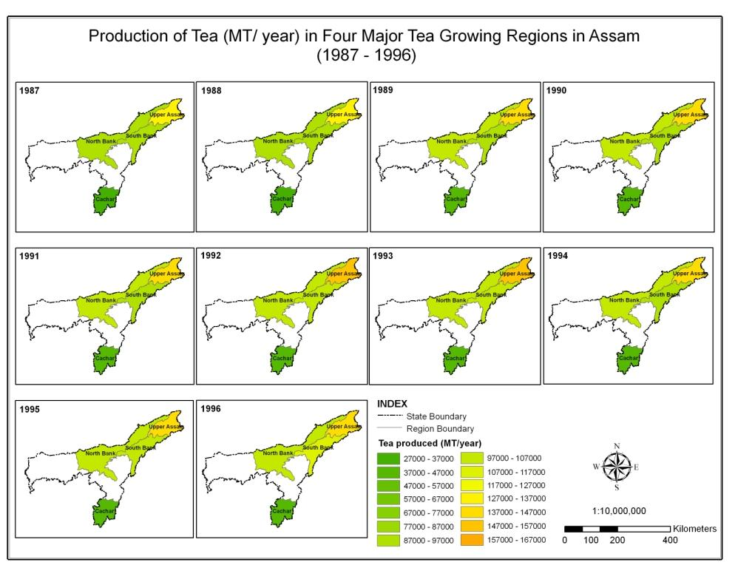
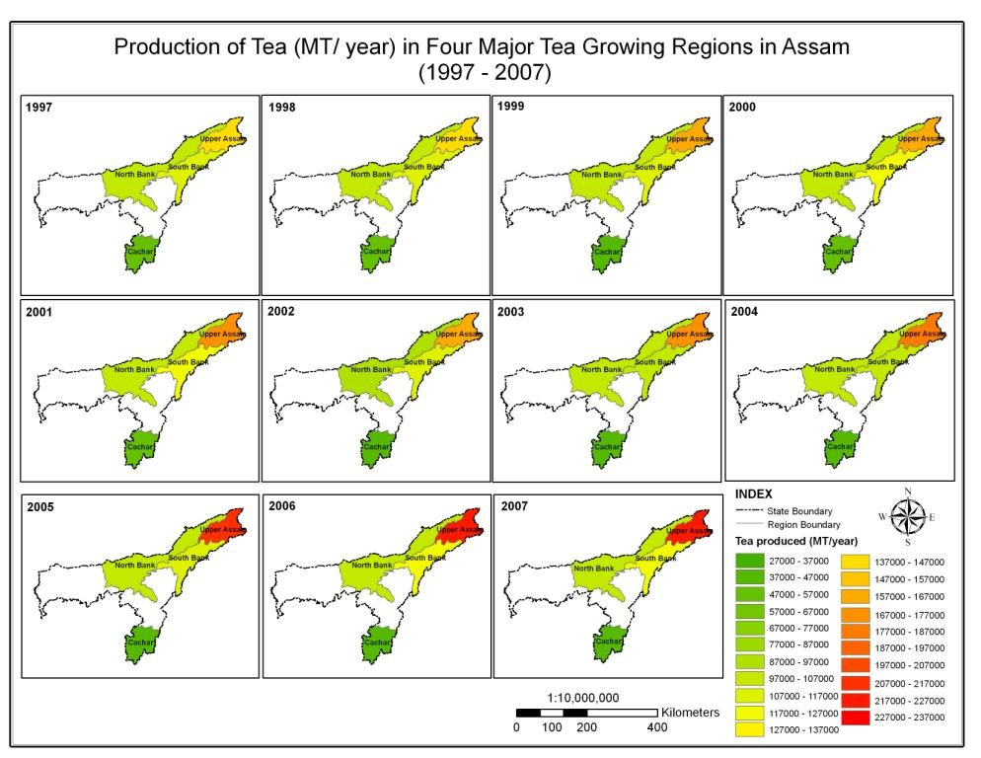
Production of tea (in MT/Year) in four major tea growing areas of Assam (a) 1977-1986,
(b) 1987-1996 and (c) 1997-2007.
The production of tea follows the same trend as the plantation area i.e. production increased.

Slide 27
Sri Lanka
Projected tea yields for 2050 at different elevations in Sri Lanka
GCM Model & Scenario | Yield (kg/ha/yr)
 | Low elevation Ratnapura (WL1a) | Mid elevation Kandy (WM3b) | High elevation N’Eliya (WU3)
Baseline | 2489 | 2217 | 2454
HadCM3-A1F1 | 2348 | 2174 | 3130
HadCM3-B1 | 2419 | 2189 | 3115
CISIRO-A1F1 | 2401 | 2246 | 3167
CISIRO-B1 | 2472 | 2245 | 3137
CGCM-A1F1 | 2314 | 2217 | 3108
CGCM-B1 | 2380 | 2228 | 3072
Appears a positive effect on yield at high elevation

Slide 28
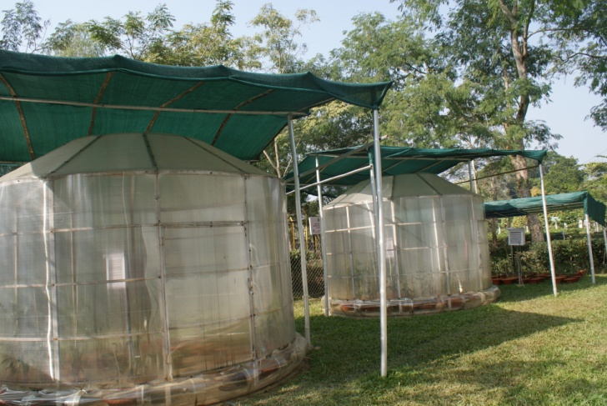
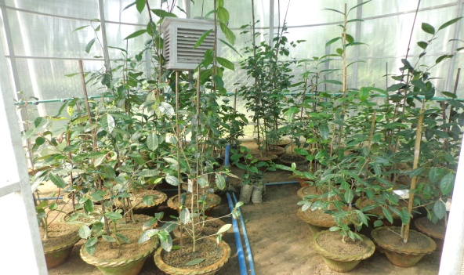
Action Area 3: Work out interaction between Genotype (G) x Environment (E) x Management (M)
Test existing and emerging cultivars for future climate scenarios (OTC studies)
India
Open Top Chamber facility at TTRI
Outside view
Inside view

Slide 29
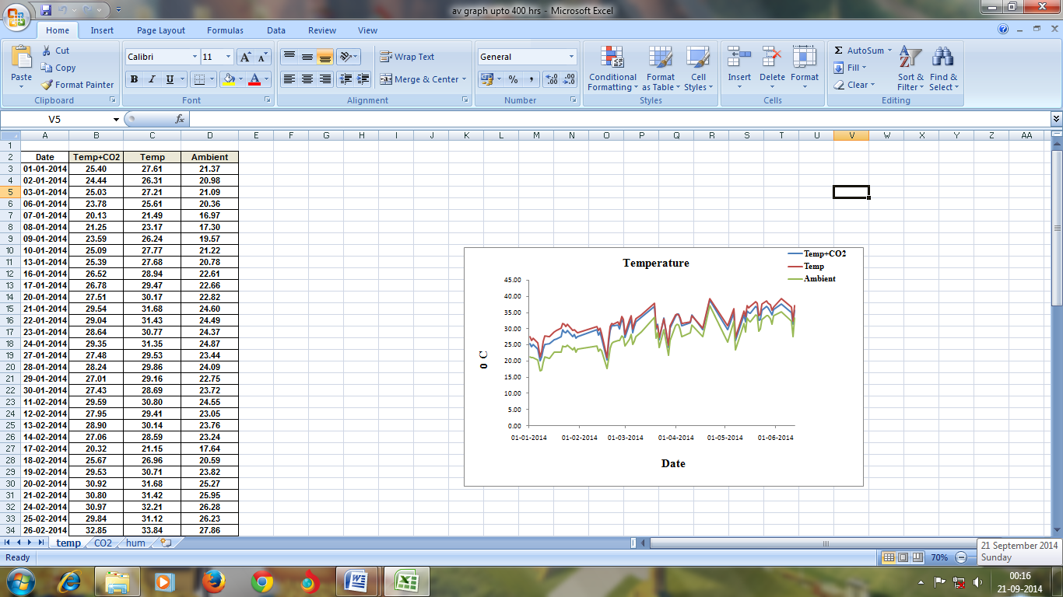
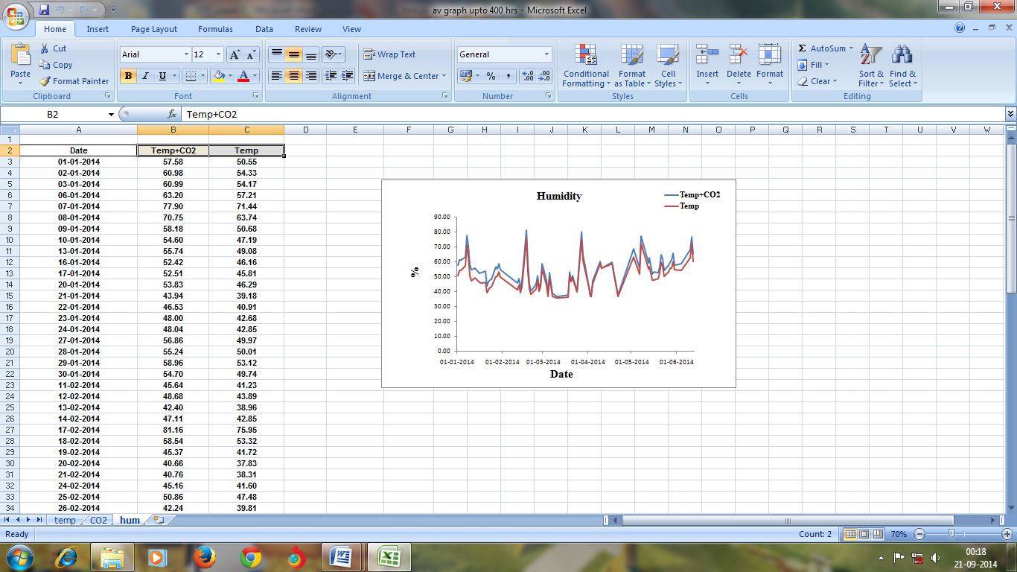
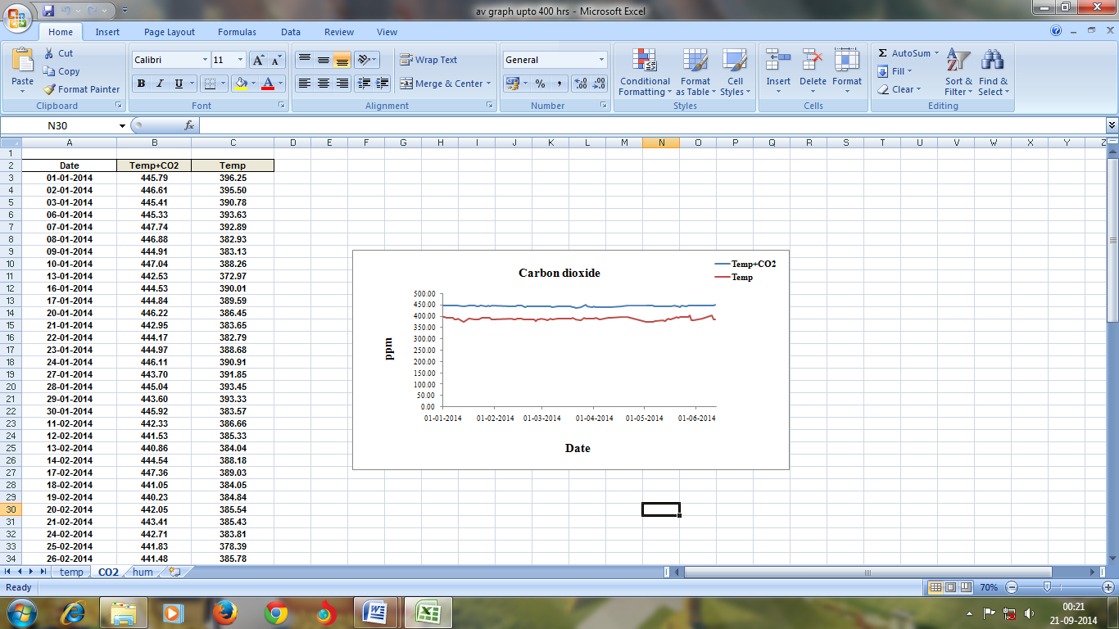
Comparison of sensor data of temperature, humidity and carbon dioxide after 1st phase

Slide 30
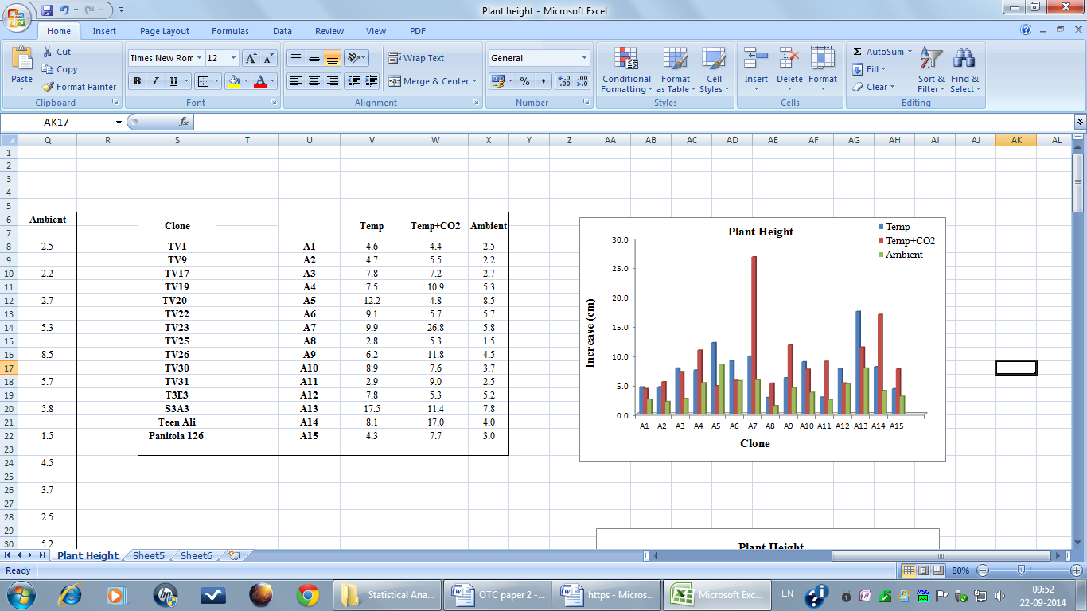
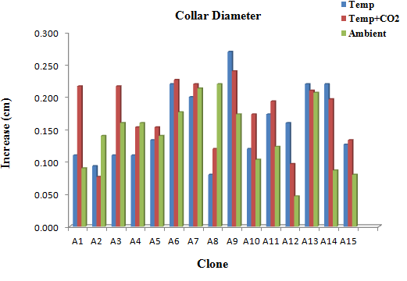
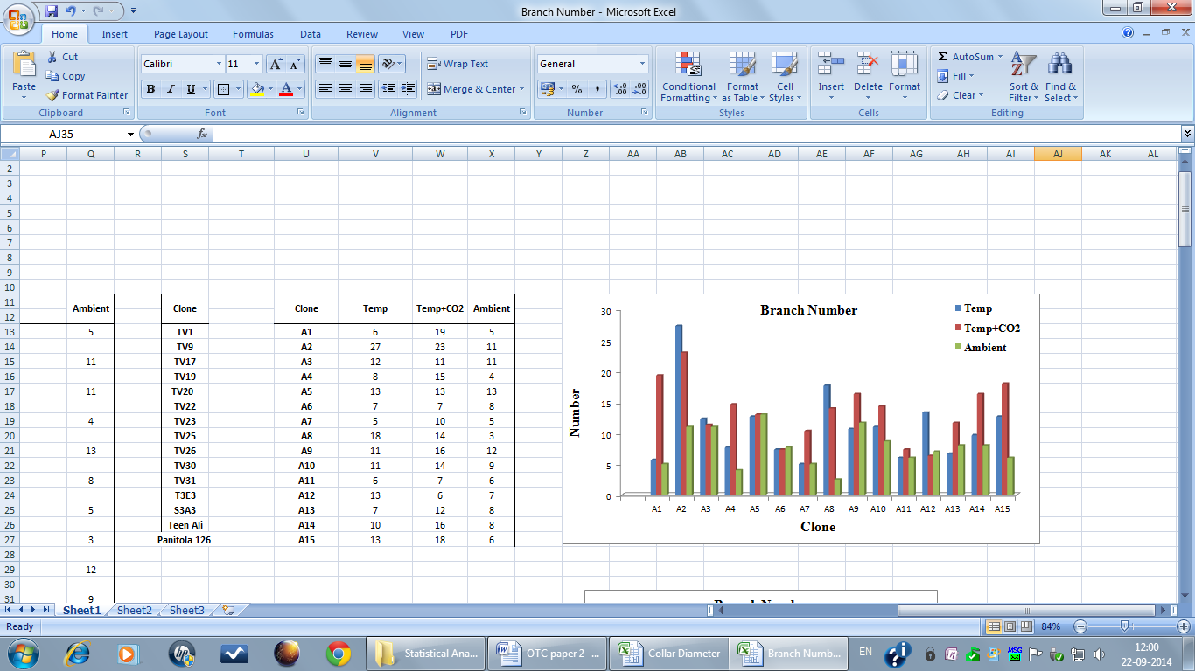
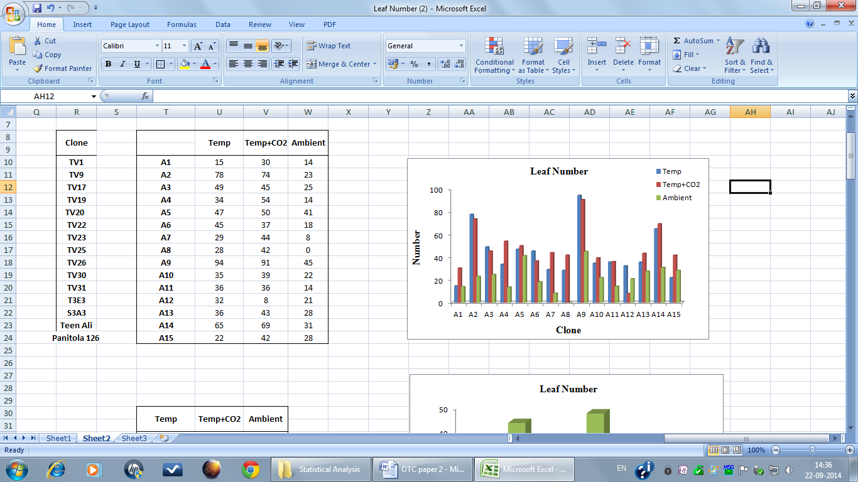
Impact of growing environment on morphological character after 1st phase

Slide 31
Sri Lanka
The effect of ambient temperature on tea yield.

Slide 32
The effect of CO₂ concentration on the total shoot density (TSD), harvested shoot density (HSD), shoot weight (SW), shoot growth rate (SGR), time taken for bud break, net photosynthesis rate (NPR), transpiration rate (TR) and water use efficiency (WUE)
CO₂ Concentration | TSD No/m² | HSD No/bush | SW g/shoot | SGR mm/day | Bud Break days | NPR mol/m²/s | TR mol/m²/s | WUE (NPR/TR)
600 ppm | 362 ± 11.9 | 64.1 ± 2.3 | 0.831 ± 0.017 | 2.8 ± 0.16 | 16.8 ± 0.79 | 12.1 ± 0.58 | 3.6 ± 0.08 | 3.36
360 ppm | 312 ± 16.3 | 42.1 ± 3.9 | 0.698 ± 0.028 | 2.1 ± 0.23 | 20.6 ± 0.56 | 10.2 ± 0.37 | 6.2 ± 0.52 | 1.64

Slide 33
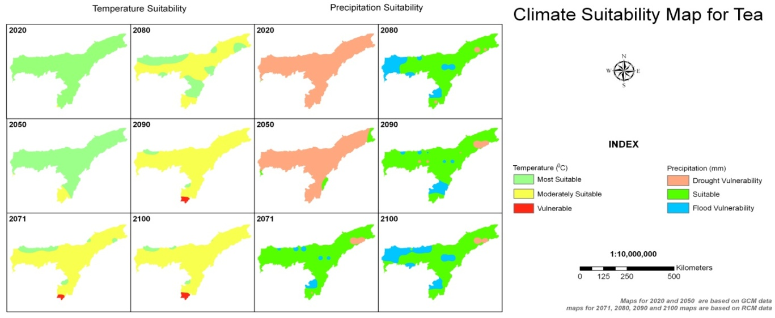
B. Vulnerable regions -assessment
India
Future climatically vulnerable/suitable regions for growing tea in Assam – GIS outputs

Slide 34
Sri Lanka
Individual vulnerability indices developed for rainfall, temperature and soil, for each AER showed that WL1a, WL1b, WL2a, WM2a, WM2b, WM3a, IM2b, IM3a and IM3c regions are highly vulnerable and WM1a, WM1b, WM3b, IM1a, IM2a, IU3a, IU3d and IU3e regions are vulnerable for climate change.

Slide 35
Current suitability of tea production areas
Kenya
1 km resolution data

Slide 36
Suitability-2020
Slight decrease in tea areas –western Kenya

Slide 37
Suitability-2050
More decrease in tea area in west Kenya and slight increase in East Kenya - More high altitude areas becoming suitable for tea production

Slide 38
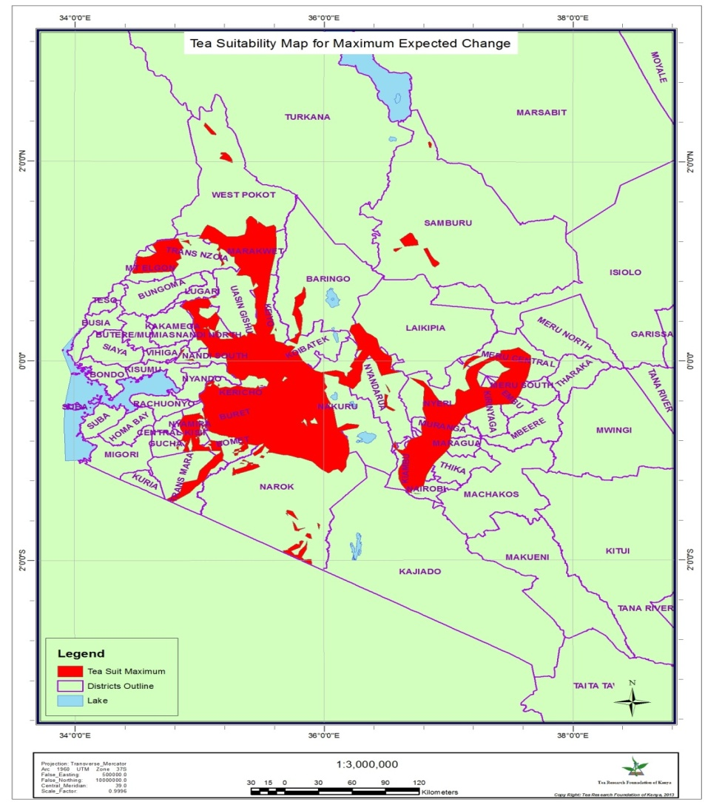
2075
Temp increase: 4.3deg C
Rainfall increase: 25%
Maximum expected change in Kenya

Slide 39
Action Area 4
Identify ADAPTATION strategies
Agronomic practices
Identify safe spaces/hot spots
Information exchange
Combine surface, satellite and simulation data (model outputs) –nowcasts/ forecasts and future climate scenarios

Slide 40
Climate change is a cause not an effect
It triggers
Biotic –
(mainly disease and pests)
Abiotic –
(mainly Floods, Droughts & hailstorms)
This is not something NEW
Only Frequency changed
Accurate forecasts and Decision support system /Early Warning System (EWS)
Team Efforts: Scientists of all disciplines to come together to Combat Climate change

Slide 41
Approach for practices to cope with climate change
Combined approach (Not Climatologists alone)
Crop improvement (Plant Breeding/Biotechnology/Plant Physiology)
Establishment and management of shade trees (Agronomy)
Maintaining humid conditions in a tea gardens
Water harvesting (water Management)
Soil and Soil moisture Conservation (Soil Science)
Efficient planning on artificial irrigation (Irrigation Agronomy)
Efficient drainage system (Engineering)
Multiple cropping (Agronomy/Horticulture)
Organic cultivation (Soil Science)
Weather forecasting (Crop Modelling/Information Technology)
Disease/ Pest incidence forecasts (Plant Pathology and Entomology)
Crop advisories based on forecasts (Extension, Advisory system)
Affordable practices (Economics)

Slide 42
Identifying safe spaces/hot spots
Research efforts must be directed towards identifying hot spots and relatively safe spaces
Identify highly vulnerable regions
Identify vulnerable regions
Identify Most suitable regions
Identify suitable regions
Research already started by WG (CC) members
Continuous flow of information and information exchange (e.g. www.teaclimate.com)

Slide 43
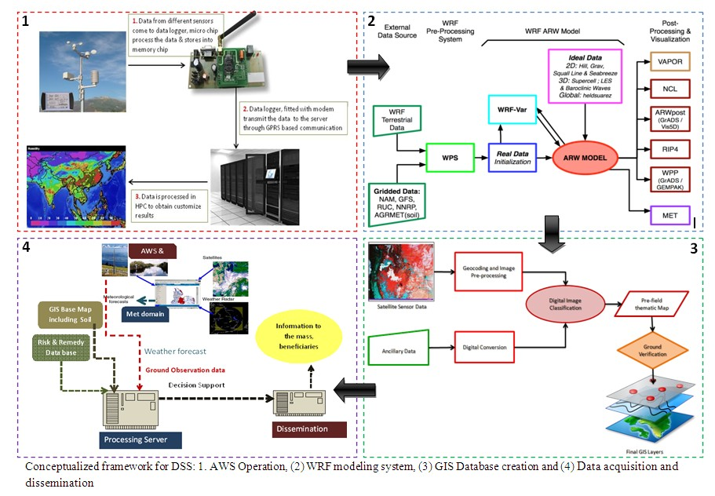
Conceptualized framework for DSS: 1. AWS operation, 2. WRF model, 3. GIS database creation and 4. data acquisition and dissemination
WRF: weather research and forecasting model

Slide 45
Future plan of action
Action area 1: Database development: All WG members to continue work to further strengthen (bridging data gaps) databases.
Action area 2: All members: IPCC A1B Scenario data will be taken for SPATIAL trend analysis. Efforts will be made to use IPCC AR 5 scenarios
Action area 3: GxExM: Studies to continue on locally released clones/cultivars for elevated Carbon dioxide and temperature under different moisture regimes. Strategy to be adopted to popularise only those clones which will be producing economically in future climate scenarios/projections. Vulnerability analysis (regional suitability using a GIS platform) to be performed by all WG members including any new areas becoming available for cultivation of tea in respective countries
Action area 4: Agronomic adaptations strategies will be further fine tuned and Decision Support System (DSS) work to be lined accordingly by all members of WG on conceptualized framework. Mechanism for regional weather forecast/disease forecasts and advisories based on the forecasts to be developed.
The working group has decided to write and explain in a booklet form the country specific adaptation strategies to combat climate change and how to use different forecasts and decision support system

Slide 46

Thank You

