Slide 1
Eastern Africa Comparison: policies, price incentives and policy coherence for the rice sector in United Republic of Tanzania, Kenya and Uganda

Slide 2
Production, Yield and Area Harvested
 | Yield (t/ha) | Area (ha) | Production (t) | Growth rate, 2005-10 (%)
 |  |  |  | Yield | Area | Production
Tanzania | 1.8 | 697,153 | 1,250,153 | -3.8% | 3.9% | 0.1%
Kenya | 2.8 | 19,041 | 53,150 | -5.3% | 2.9% | -2.4%
Uganda | 1.4 | 123,333 | 178,456 | 1.4% | 6.4% | 7.8%

Slide 3
Tanzania’s Main Import Partners, 2005-2010

Slide 4
Kenya’s Main Import Partners, 2005-2010

Slide 5
Uganda’s Main Import Partners, 2005-2010

Slide 6
Strategic Policies by Country
Tanzania
2009 Kilimo Kwanza
2008 National Rice Development Strategy (NRDS)
Kenya
2008 National Rice Development Strategy (NRDS) 2008-2018
Uganda
Uganda National Rice Development Strategy (NRDS) 2009/10-2017/2018
National Irrigation Board’s Long-term Irrigation Plan
2009 Cereals and Other Produce Act

Slide 7
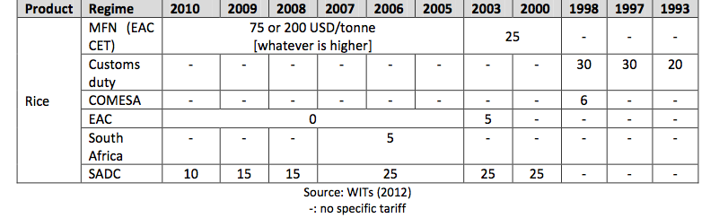
Market and Trade Policies by Country
Kenya obtained an exemption for rice imports from Pakistan throughout the period, applying only a 35% import tariff

Slide 8
Price Incentives at Farm Gate

Slide 9
Main Findings
Little trade within the East Africa region, possibly due to consumer preferences
Import tariffs in place do result in effective price premiums for farmers
The policy to prevent cheap imports is actually delivering the expected outcomes; however the costs for consumers is high
In 2010, Tanzania became a net exporter, but the existence of an export ban prevented farmers from receiving higher prices

Slide 10
Composition of Agriculture-specific Public Expenditure in Tanzania: Support to Commodity Groups

Slide 11
Composition of Agriculture-specific Public Expenditure in Uganda: Support to Individual Commodities

Slide 12
Relative Price Incentives at Wholesale

