Slide 1
MAFAP project overview

Slide 2
Outline
Highlights of the MAFAP project
  Operational aspects
  The three components of the MAFAP methodology: price incentives and disincentives, public expenditure and policy coherence
Today’s panel discussion

Slide 3
MAFAP rationale
- increased attention to food security in recent years due to price increases and volatility
- to achieve agricultural development and food security, there is a need for better information and analysis to know how policies are affecting farmers – does an enabling environment exist?
- the availability of and capacity to provide quantitative evidence is limited in developing countries

Slide 4
FAO’s response: MAFAP
- a system to measure, monitor and evaluate the effect of policies on agricultural producers in Africa
- implemented by FAO through structural collaboration with national teams to develop institutional capacity and ensure sustainability
- provides evidence to support more effective policy making, investment decisions and dialogue at national, regional and pan-African levels

Slide 5
Building on OECD experience
OECD measures countries’ support to agricultural sector through Producer Support Estimates (PSE)
Important input for dialogue on agricultural policy in OECD member countries
FAO partnered with OECD to develop the MAFAP methodology

Slide 6
The MAFAP Monitoring System
- Looks at price incentives and disincentives in countries’ key agricultural value chains
- Analyzes public expenditure in support of agriculture and rural development
- Assesses policy coherence:
public expenditure vs. price support
policy effects vs. policy objectives

Slide 7
What is MAFAP doing?
- building the technical capacities of about 20 government and research partners in ten African countries (possibly 60 partners in the next phase)
- identifying key areas for policy reform and developing concrete recommendations for policymakers
- identifying where inefficiencies in commodity value chains can be reduced or eliminated through targeted investment
- monitoring progress towards CAADP and national policy objectives

Slide 8
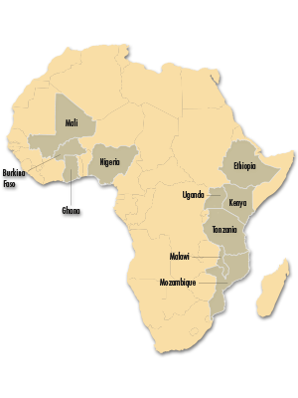
Where we work
Burkina Faso
Kenya
Mali
Tanzania
Uganda
Ghana
Ethiopia
Malawi
Mozambique
Nigeria
http://www.fao.org/mafap

Slide 9
How are price incentives/disincentives measured?
By comparing the domestic farm gate price to a reference price (the world market price, adjusted for marketing costs to the farm gate, quantity and quality differences)
The difference between the domestic price and the reference price is an indicator of price incentives or disincentives for producers – Price Gap
Notes:
The reference price represents the value of the commodity in the world market valued at the farm gate

Slide 10
To illustrate…
Price (LCU/tonne)
Price incentives
Positive price gap
Reference Price
Price disincentives
Negative price gap
The vertical distance between the domestic price and reference price is the price gap
Notes:
Interpretation of indicators
Price gap and nominal rate of protection equals zero: agricultural commodity producers receive the reference price (world market price that account to spatial and quality differences) which is the situation reflecting neutral policy impact on commodity price and characterizing allocation of resources consistent with comparative advantage.
Positive price gap and nominal rate of protection: agricultural commodity producers receive a higher price than the reference price (price incentives). In this case, more resources would be allocated to production of the commodity relative to optimal allocation. With fixed resources (e.g., land), more of the commodity and less of other competitive commodities may be produced.
Negative price gap and nominal rate of protection: producers of the commodity are penalized while consumers of the commodity and/or taxpayers would receive a transfer from producers. As a result, some resources would be shifted away from the commodity and allocated to other commodities. With fixed resources, less of the commodity will be produced and more of other commodities may be produced.

Slide 11
Indicators of Incentives/Disincentives
Nominal Rate of Protection (NRP): Price Gap in relative terms
It measures the deviation between the domestic farm gate price and the price producers would receive in an efficient market without government intervention (the reference price)
It measures the impact of three factors:
  Government policies (if any): tariffs, export subsidies, price floors and ceilings
  Market structure: non-competitive behavior, monopsony
  Inefficiencies: excessive profit margins, taxes, bribes, excessive marketing costs

Slide 12
Public Expenditure methodology
- Broad scope: rural development spending, revenue foregone, administrative cost vs. policy transfers, share of aid
- Comparable across countries; COFOG compatible
- Allocation to commodities to estimate commodity support
- Combination with price analysis provides comprehensive analysis of support to agricultural sector
Notes:
Definition of 'Foregone Earnings'
The difference in earnings or performance between what is actually achieved and what could have been achieved with the absence of specific fees, expenses or lost time. Foregone earnings represent the investment capital that the investor spent on investment fees. The assumption is that if the investor had been exposed to lower fees, he or she would have generated a better return. This term is often used when referring to management fees or other expenses paid to mutual funds, exchange-traded funds, or other pooled investment vehicles.
COFOG
Classification of the Functions of Government (COFOG)
First- and second-level COFOG
Developed by the OECD, the Classification of the Functions of Government (COFOG) classifies government expenditure data from the System of National Accounts by the purpose for which the funds are used. As Table B.1 illustrates, first-level COFOG splits expenditure data into ten “functional” groups or sub-sectors of expenditures (such as defence, education and social protection), and second-level COFOG further splits each first-level group into up to nine sub-groups. While first-level COFOG data are available for 31 out of the 34 OECD member countries, second-level COFOG data are currently only available for 21 OECD European member countries.*

Slide 13
Notes:
Comparison of World Bank, MAFAP and ReSAKSS Public Expenditure Analyses
Over the recent years, there are been three exercises of public expenditure analysis in Africa : the World Bank Public Expenditure Reviews, the Regional Strategic Analysis and Knowledge Support System (ReSAKSS) reviews, and MAFAP.
The three exercises differ in the approach, scope and methodology, and they are complementary, especially the World Bank PER and MAFAP.
MAFAP approach consists in a country-level monitoring system for the level and composition of public expenditure for food and agriculture, established within the Ministry of Agriculture or related research institutes. FAO provides technical assistance in the early stages and will ultimately phase out. World Bank PERs and ReSAKSS analysis are one-off reviews conducted by staff of World Bank and IFPRI in association with local consultants.
The objective of MAFAP is to develop a sustainable country-based monitoring system to inform policy-makers on public expenditure, and to compare the composition of agricultural spending with policies affecting prices in the country and policy objectives to assess policy coherence. The indicators generated by MAFAP are also comparable in all MAFAP countries. The objective of the World Bank is to promote more efficient budgetary processes (expenditure frameworks especially), and formulate evidence-based recommendations to improve technical and allocative efficiency of public expenditure for agriculture in the countries. ReSAKSS’s objective is to follow the implementation of the CAADP commitments through public expenditure in member countries of the African Union.
In terms of scope, ReSAKSS has carried out a deep analysis for three countries, going up to 2007, the World Bank has analysed over ten countries from up to 2012, and MAFAP public expenditure monitoring system was set up in 10 countries, with data going up to 2012. ReSAKSS and the World Bank use the Classification of Functions of Government (COFOG) which corresponds to agriculture-specific measures, and MAFAP uses the Organisation of Economic Cooperation and Development (OECD) classification that is compatible with COFOG but more disaggregated. The World Bank and ReSAKSS complement their COFOG analysis with more disaggregated data classified according to each country’s budgetary specificities.
As far as the methodology is concerned, the main difference is that MAFAP analysis goes down to the program level, and classifies each programme or project according to the economic characteristics of their activities rather than to the reported objectives. World Bank and ReSAKSS analyses typically classify public expenditure according to the policy objectives. All three exercises take into account budgeted and actual expenditure, recurrent and development, and the share of donor expenditure

Slide 14
How is policy coherence measured?
Assessing the consistency between public expenditure and price incentives for producers
Difficult to measure the degree of consistency among policies within and across different policy areas or priorities
  This is highly subjective and requires a large amount of discretion
Given this difficulty, an analytical framework was developed…

Slide 15
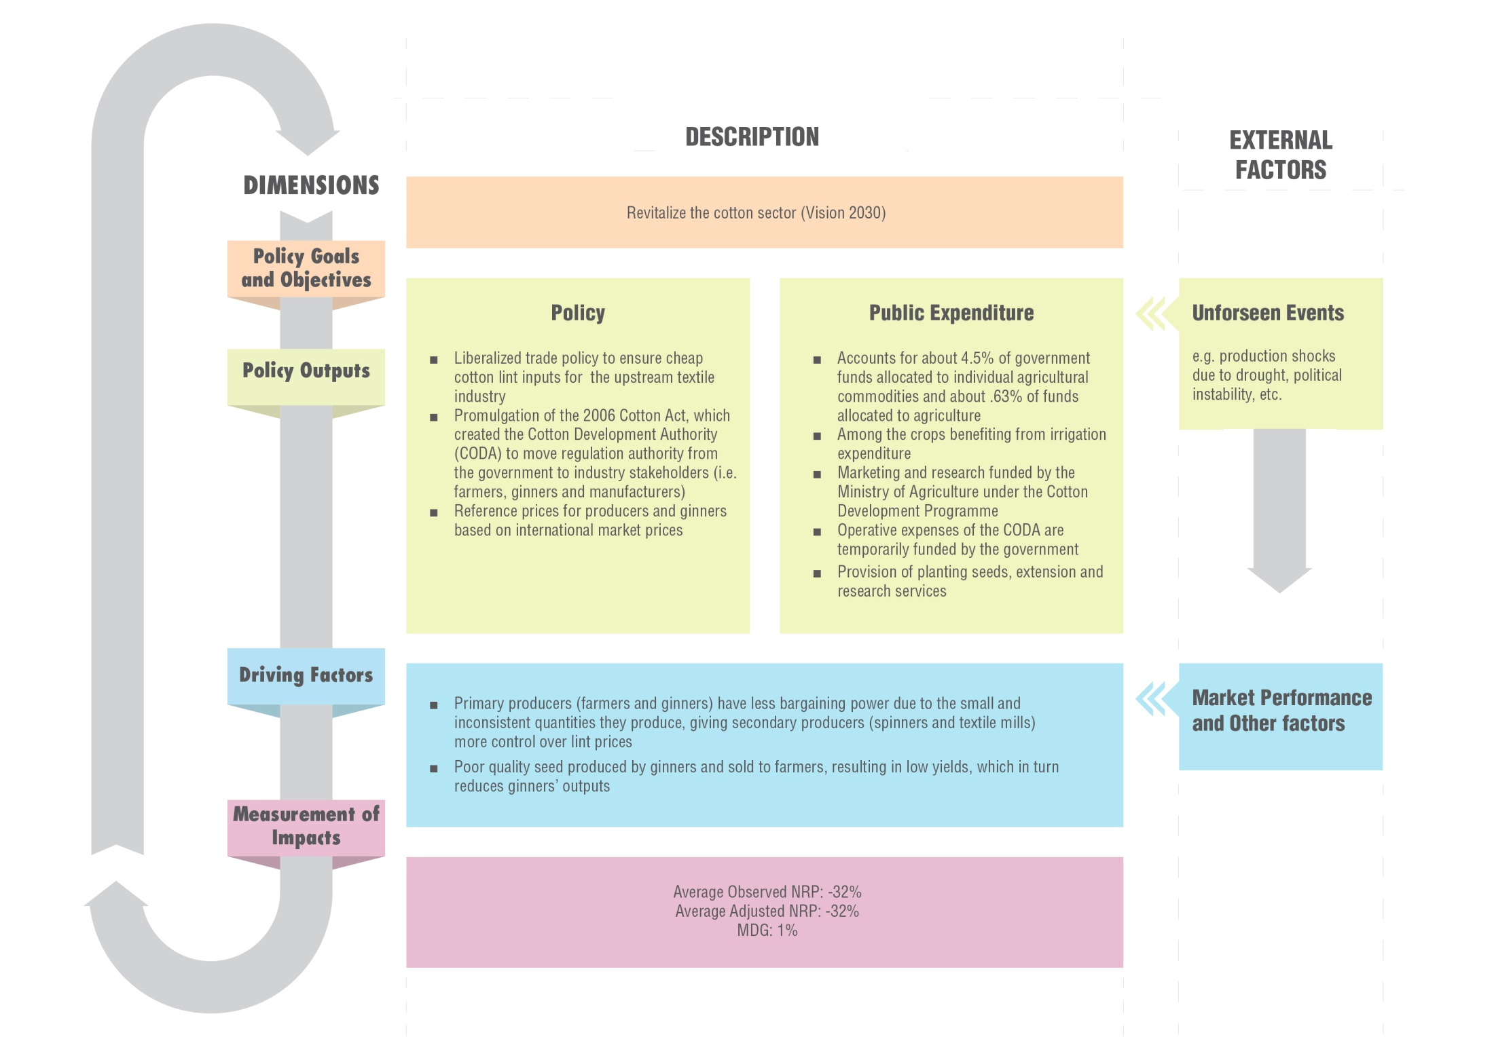
Notes:
This section identifies trends across countries by assessing the degree of alignment between policy objectives, policy outputs (policy measures and public expenditure) and their effect on the factors or issues driving price incentives or disincentives for producers. This approach for policy coherence analysis is defined in the MAFAP Methodology Guidelines (2013) and summarized in Figure 57. Analytical framework for the MAFAP policy coherence analysis” below. As illustrated, policy dimension “A” represents all the policy goals and objectives related to the particular commodity being analyzed, while dimensions “B” and “C” refer to specific policy outputs (measures and related public spending, respectively). As indicated by the external factors shown in the diagram, policy outputs are not only determined by long-term goals and objectives of the government, but also by unforeseen events such as the production shortages from drought or other natural disasters, which may require temporary policy measures to address immediate needs. Dimension “D” represents those factors driving price incentives or disincentives for producers. This dimension takes into account all direct and indirect effects of policy measures and overall market performance. Finally, dimension “E” includes MAFAP’s price incentives and disincentives indicators, which reveal how policies and market performance affect producers and traders in the commodity value chain, and hence if policy measures and public expenditure are achieving stated objectives and goals.

Slide 16
Today’s Presentations
Results for RICE in the
following countries/regions:
  Uganda
  Ghana
  Selected countries in Eastern Africa
  Selected countries in Western Africa
  8 countries in Africa
Key results covered:
  Background information
  Policy environment
  Indicators of price
  incentives/disincentives
  Main messages

Slide 17
THANK YOU

Slide 18
ANNEX - Examples

Slide 19
Policy coherence

Slide 20
Government spending on rice in Mali high…
Increasing rice production a key policy objective of government
Input subsidies in place to support producers
Rice sector also supported through targeted investments in irrigation infrastructure
Total expenditure to rice represents at least 24% of total
Share of agricultural specific expenditure targeted to the rice sector (2005 – 2010)

Slide 21
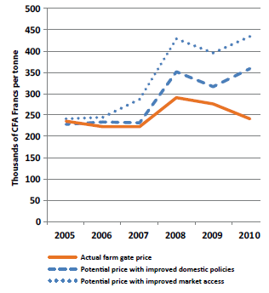
...but not consistent with other policy effects
Farmers did not benefit from high international prices during food crisis
And faced strong price disincentives
Government signals are inconsistent
Low prices and inconsistent policies reduce investment potential of farmers

Slide 22
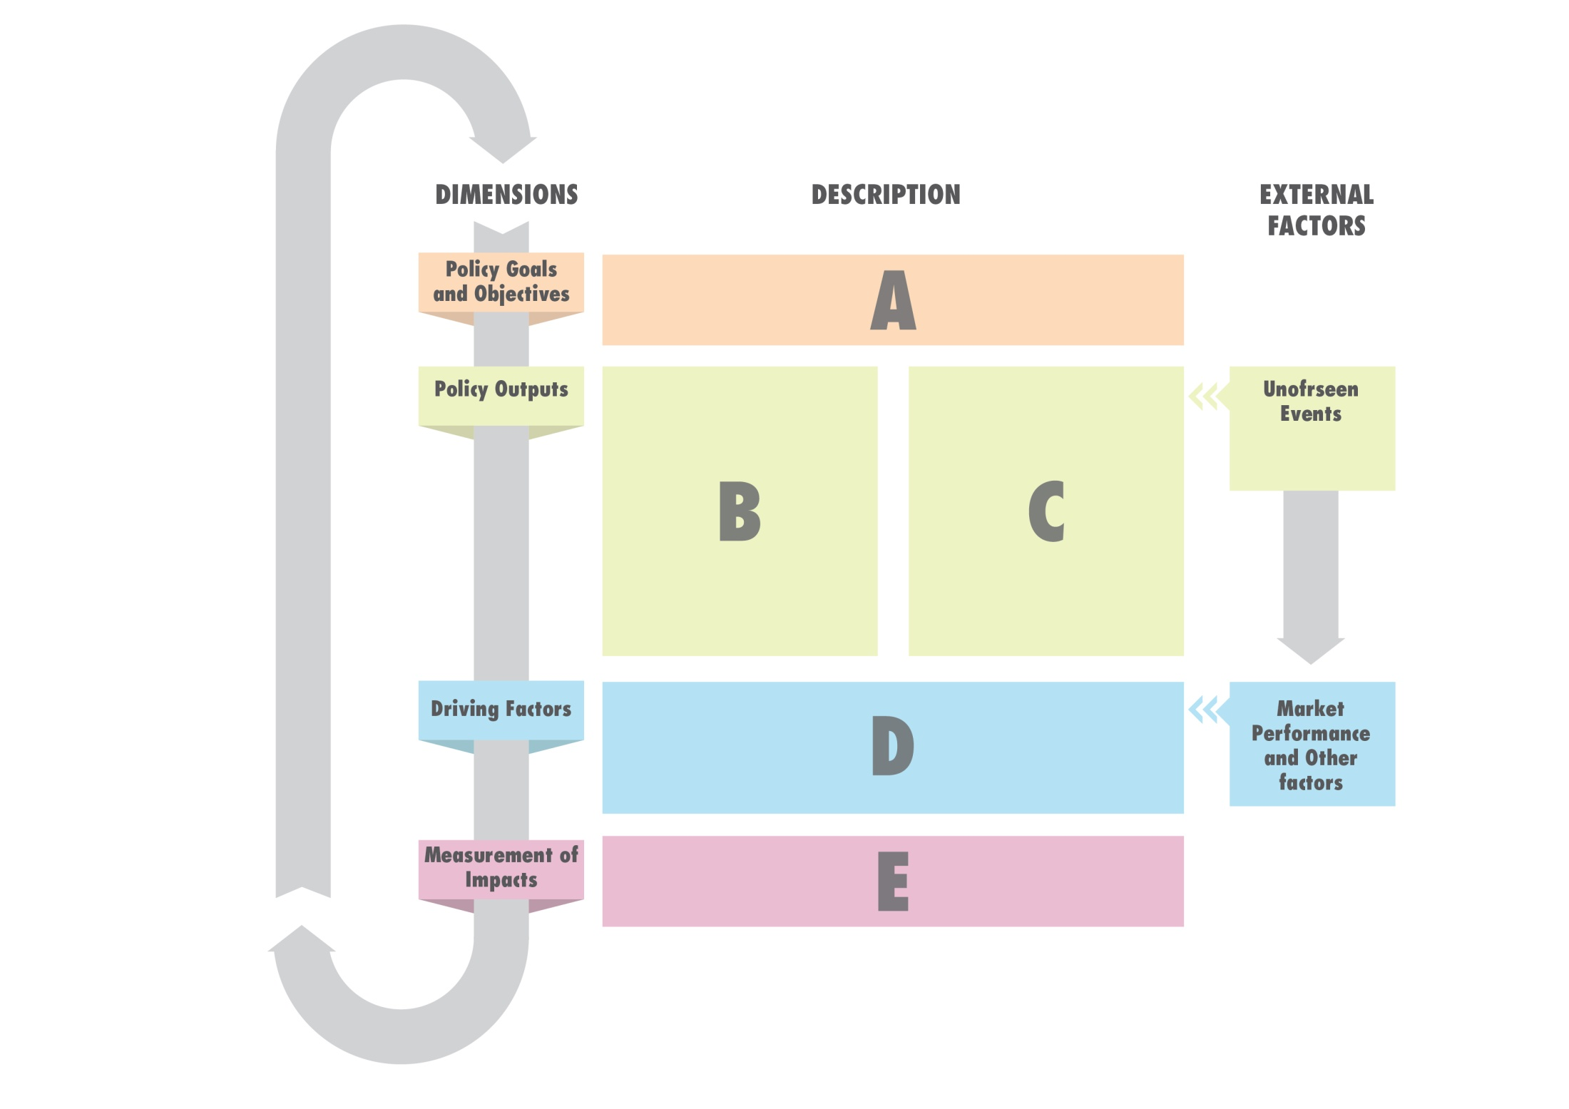
Notes:
This section identifies trends across countries by assessing the degree of alignment between policy objectives, policy outputs (policy measures and public expenditure) and their effect on the factors or issues driving price incentives or disincentives for producers. This approach for policy coherence analysis is defined in the MAFAP Methodology Guidelines (2013) and summarized in Figure 57. Analytical framework for the MAFAP policy coherence analysis” below. As illustrated, policy dimension “A” represents all the policy goals and objectives related to the particular commodity being analyzed, while dimensions “B” and “C” refer to specific policy outputs (measures and related public spending, respectively). As indicated by the external factors shown in the diagram, policy outputs are not only determined by long-term goals and objectives of the government, but also by unforeseen events such as the production shortages from drought or other natural disasters, which may require temporary policy measures to address immediate needs. Dimension “D” represents those factors driving price incentives or disincentives for producers. This dimension takes into account all direct and indirect effects of policy measures and overall market performance. Finally, dimension “E” includes MAFAP’s price incentives and disincentives indicators, which reveal how policies and market performance affect producers and traders in the commodity value chain, and hence if policy measures and public expenditure are achieving stated objectives and goals.

