Slide 1



Biodiversity assessment tools for
Papua New Guinea’s
Multipurpose National Forest Inventory
Workshop: Technical support to PNGFA to implement a multipurpose NFI
Port Moresby, 30th April 2015
Presented by:
Giorgio Grussu
Project Coordinator
FAO
www.fao.org/forestry

Slide 2
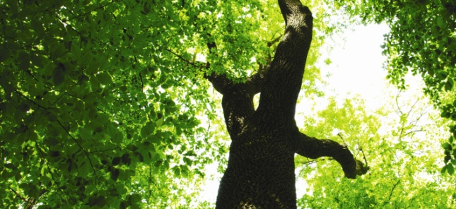

z
A project of the Mountain Partnership
an overview
Aim:
To support the development of a methodology for biodiversity assessment to integrate the design of PNG’s Multipurpose National Forest Inventory
It’s part of a project called “Climate Change and Mountain Forests” financially supported by the Italian Development Agency and implemented by FAO in the framework of the activities of the Mountain Partnership, in cooperation with the Global Island Partnership (glispa.org)
The Mountain Partnership is a United Nations voluntary alliance that brings members together to work towards a common goal: improving the lives of mountain peoples and protecting mountain environments around the world. The Mountain Partnership has over 200 members from governments, intergovernmental organizations, civil society, research institutions and the private sector.
MP Secretariat is hosted by FAO HQ in Rome.
mountainpartnership.org

Slide 3
Background
PNG’s first multipurpose National Forest Inventory (NFI)
a key element for the National Forest Monitoring System that PNG is required to establish in order to participate in the expected REDD+ mechanism under UNFCCC
Potential negative effects of REDD activities on biodiversity of forest ecosystems
REDD+
Reducing Emissions from Deforestation
and forest Degradation
+ Conservation of forest carbon stocks
Sustainable management of forests
Enhancement of forest carbon stocks
Cancun Agreements
UNFCCC COP16 2010
REDD+ safeguards and co-benefits
principles to be respected by actors undertaking REDD+ activities so as to prevent harm to and support conservation of biodiversity
In addition to the traditional inventory activities for carbon and greenhouse gas measurement, PNG’s multipurpose NFI aims to incorporate the multiple values (products and services) that forests provide, including biodiversity

Slide 4
z
Background
Working with PNG FA, in synergy with the other FAO projects
objective analysis of the trade-off between
reducing emissions
and
protecting biodiversity
informed decisions on REDD+ activities and funding, aiming to maximize both objectives
Central role in mitigating the impacts of climate change by removing from the atmosphere the carbon dioxide that is responsible for global warming. Illegal logging, deforestation and unsustainable land use practices reduce the capacity of forests to function as “buffers” in the global carbon cycle, with the effect of accelerating the climate change itself and, in turn, of weakening the capacity of local populations to adapt.
Due to their exceptional biodiversity PNG forests provide resources and ecosystem services of vital importance for the subsistence and adaptation to climate change of local communities. Protecting biodiversity reduces the risk of unsustainable use of forest resources, which undermines the resilience of forests and, consequently, their capacity to provide such goods and services.

Slide 5
z
Issues and constraints
summary
Geographical scope of investigation
National scale investigation.
Worldwide, practical REDD+ experience on biodiversity is still limited to sub-national pilot initiatives
High Biodiversity richness and knowledge gaps
Third largest expanse of tropical rainforest on the planet
A megadiverse country: estimated 200,000 species of plant + animals (26,318 reported by IUCN)
Wide areas of the country yet to be surveyed
Logistics constraints
A biodiversity assessment methodology needs to be integrated in that of a traditional forest inventory and to deal with all constraints related to the establishment of a forest inventory: restricted time for sampling, difficult access, security issues, limited national expertise, etc.
It would not be feasible to evaluate the entire biodiversity in a tropical forest, in terms of time and people needed, as well as costs (Lawton et al. 1998, Nature)
SMART indicators

Slide 6
z
Biodiversity assessment tools for PNG NFI
Partners
FAO invited two MP members to work with PNG Forest Authority to design a methodology for biodiversity assessment that could integrate the planned NFI
Floral diversity assessment
methodology
(Sapienza University of Rome)
Port Moresby, 20-22 May 2014
3rd PNGFA workshop on “development of methodologies for the first multipurpose NFI in PNG”
Faunal assessment
methodology
(University of Queensland)
Brisbane, 8-10 October 2014
Workshop on “development of a biodiversity assessment methodology for PNG NFI”

Slide 7

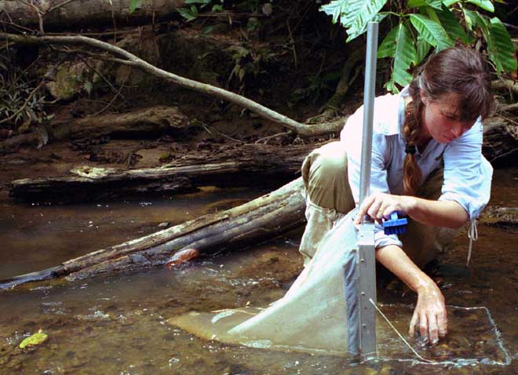
z
Floral diversity assessment - summary
Selection of indicators 1/4
Selection as a trade-off process
indicators that reflect some useful measures of ecological integrity or biodiversity vs. indicators that can be feasibly sampled (Gardner et al. 2008)
Critical literature review
SELECTION OF
INDICATORS
Expert-based evaluation
A first larger set of indicators to be further assessed in terms of their performance with respect to REDD+ goals
No certainty to select the best indicators a priori
Notes:
7

Slide 8
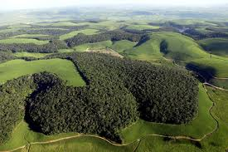

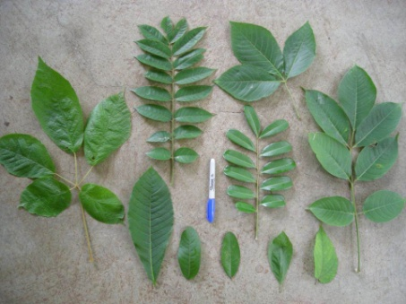
z
Floral diversity assessment - summary
Selection of indicators 2/4
Focus on 3 typologies of indicators, as proposed by Lindenmayer (1999)
Structure based indicators
Landscape level: connectivity, heterogeneity
Stand level: stand structural complexity
(eg. horizontal and vertical arrangement, age, and size of trees)
Taxon based indicators
Group of taxa whose richness is highly correlated with that of unrelated groups
Indicators of functional diversity
Based on plant functional traits (Dìaz & Cabido 2001)
Notes:
8

Slide 9
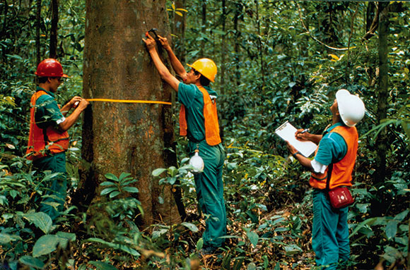
z
Floral diversity assessment - summary
Selection of indicators 3/4
TREE data from National Forest Inventory
Structure based indicators
Taxon based indicators
Stand level: stand structural complexity
(eg. horizontal and vertical arrangement, age, and size of trees)
Tree composition
Promising indicators for biodiversity in REDD+ (Imai et al. 2014):
Easy sampling (Gardner et al. 2008)
Taxonomy is generally well described
It shows high cross-taxon congruence
(Barlow et al. 2007; Howard et al. 1998; Kati et al. 2004)
Sufficient data from NFI to evaluate biodiversity or conservation status of PNG forests?
Notes:
9

Slide 10
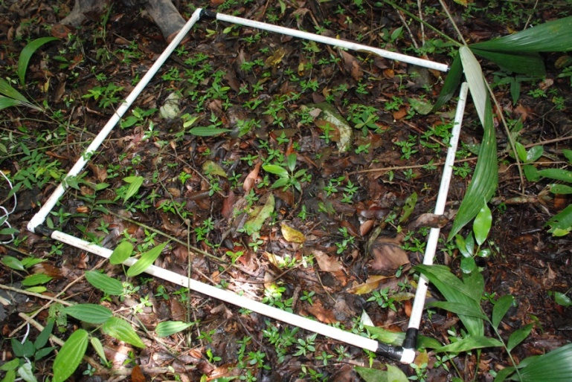
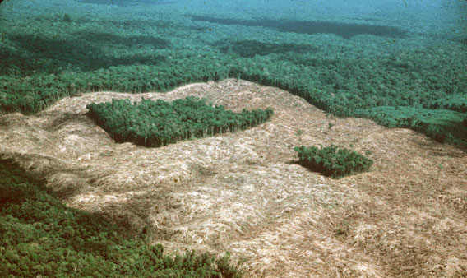
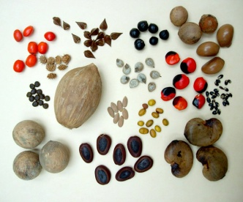
z
Floral diversity assessment - summary
Selection of indicators 4/4
Biodiversity Surrogacy
remains a highly contentious issue
(Lawton et al. 1998; Hess et al. 2006)
Richness of one group is often highly correlated with that of unrelated groups (Blair 1999; Swengel & Swengel 1999), even though the richness of any particular group is a notoriously unreliable surrogate of the richness of all groups combined (Hess et al. 2006)
A range of taxa is required for reliable surrogacy of total species richness (Inara et al. 2010)
it is proposed to integrate the planned NFI data with a number of additional biodiversity indicators
Surrogate taxa are likely to be biome-specific (Larsen et al. 2009)
Notes:
10

Slide 11
z
Floral diversity assessment - summary
Suggested stratification
Parameters |  |  |  | Number of plots | Required precision (95% CI) | Required number of clusters* | 1000 clusters to be visited | First 6 months trial
Low altitude forest on plains & fans | Primary |  |  | 2,276 | 5% | 130 | 150 | 10
 | Degraded |  | Logged | 1,306 | 10% | 30 | 50 | 10
 |  |  | Other disturbance | 1,078 | 10% | 30 | 50 | 10
Low altitude forest on uplands | Primary |  |  | 3,732 | 5% | 130 | 150 | 10
 | Degraded |  | Logging | 1,229 | 10% | 30 | 50 | 10
 |  |  | Other disturbance | 1,528 | 10% | 30 | 50 | 10
Lower montane forest | Primary (including 21 montane coniferous forest) |  |  | 3,452 | 5% | 130 | 150 | 10
 | Degraded (including 14 montane coniferous forest) |  |  | 1,344 | 10% | 30 | 50 | 10
Swamp forest |  |  |  | 1,141 | 10% | 30 | 50 | 5
Woodland |  |  |  | 815 | 10% | 30 | 50 | 5
Dry seasonal forest |  |  |  | 750 | 10% | 30 | 50 | 5
Savannah & Shrub |  |  |  | 592 | 10% | 30 | 50 | 5
Littoral & Seral |  |  |  | 274 | 20% | 8 | 25 | 5
Montane (including 8 M/coniferous above 3000m ) |  |  |  | 242 | 20% | 8 | 25 | 5
Mangrove |  |  |  | 179 | 20% | 8 | 25 | 5
 |  |  |  |  |  | 684 | 975+25 (M/conif. forest) | 115
* in the case of 0.1ha circular plots with 4 plots per cluster
Notes:
Parametri di tipologia forestale secondo la loro estensione
11

Slide 12
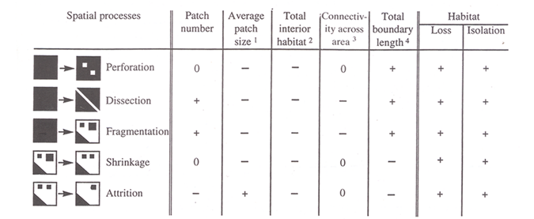
z
Floral diversity assessment - summary
Indicators – (1) structure based
landscape structure
habitat fragmentation
Affects biodiversity, total carbon storage and other ecosystems processes (e.g., Fahrig 2003, Fisher and Lindenmayer 2007). An increase of fragmentation over expected natural levels is generally indicative of degradation
Methods
Remote Sensing, GIS software, soil and vegetation maps...
Indicators
Metric | Calculation | Unit | Relation to degradation | Caveats and constraints
Mean Patch Size | Total forest area divided by the total number of patches | Hectares | Increasing: degradation due to area effects | Mean patch size can increase as a result of elimination of small forest patches
Mean Perimeter-Area Ratio | The mean ratio of the patch perimeter to area across all patches | Dimension-less | Increasing: degradation via edge effects | Ratio can decline through the elimination of smaller and more complex patch shapes
Patch density | The number of patch divided by total landscape area | N/100ha | Increasing: degradation via edge effects | Limited interpretative value by itself: it conveys no information about the size and spatial distribution
Incidence function model | The mean distance between all landscape patches, based on shortest edge-to-edge distance | Metres | Increasing: degradation due to isolation effects | Loss of individual isolated patches can cause a decrease in the mean nearest neighbor distance
Forest Integrity Index | Combined metrics of patch size, connectivity, and edge effects | Dimension-less | Declining: reduced ability to produce goods and services, and therefore increasing degradation | Relationship to specific goods and services not established – complexity may obscure more understandable trends
Notes:
A fronte di un processo di frammentazione, ogni gruppo tassonomico reagisce in maniera differente.
La quantificazione dei processi di frammentazione si basa su tecnologie RS, GIS, mappe suolo e vegetazione e software in grado di calcolare tutta una serie di indicatori.
Mappa vegetazione JICA ottenuta attraverso la classificazione assistita da operatore, di immagini satellitari Rapideye ad alta risoluzione (5m)
12

Slide 13
z
Floral diversity assessment - summary
Indicators – (1) structure based
stand structure 1/2
Within-stand distribution of trees and other plants attributes (size, age, vertical/horizontal arrangement, species composition)
(Powelson & Martin 2001)
structural complexity can be an effective biodiversity proximate if measured with an appropriate suite of structural attributes (Mc Elhinny et al. 2005)
Non Tree Plant Diversity (NTPD)
Lianas, Shrubs, Herbs, Epiphytes
Useful to characterize levels of disturbance (Gillison et al. 2013)
Trees
Tree data will be collected within NFI according to the methodology of PNG Forest Authority
(canopy, diameter, height, biomass, species, dead wood, saplings)
We only add evaluation of regenerative capacity of forest as a whole and\or for target tree species
Open Foris Collect BIODIVERSITY
software interface
(PNG first case)
Notes:
SPECIE NON ARBOREE
DISPOSIZIONE DEL FOGLIAME
13

Slide 14
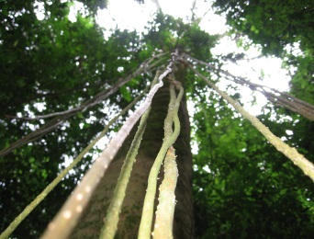
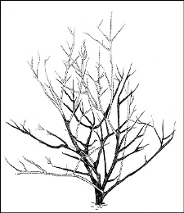
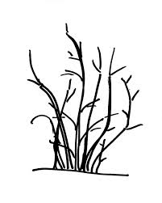
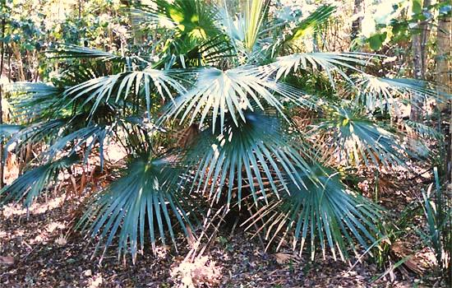
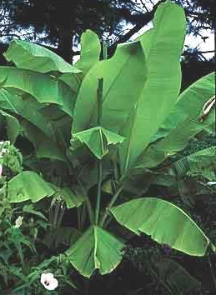
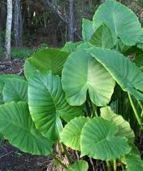
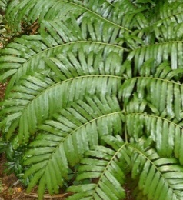
z
Floral diversity assessment - summary
Indicators – (1) structure based
stand structure 2/2
Field collection for stand structural diversity (NTDP)
1.000 clusters
attributes:
Lianas
Number of stems (rooted in the plot)
Number of trees with lianas attached at their trunk
Measure of stems (>5cm; 1,30m)
Number of stems (classified as multi-stemmed or single-stemmed)
Cover of three layers (High: 2-3m, Middle: 1-2m, Low: 0-1m) : (1)<10% (2)10-40% (3)40-70% (4)70-100% (Cover Index: CI)
Shrubs (plant <3m)
Palms (plant <3m)
Cover Index for each morpho-species identified
Herbs
Cover Index for each species or morphospecies
Cover Index of tall (>1m) herbs plants (e.g. Musa, Araceae, tree ferns, Marattiaceae, Zingiberaceae)
Notes:
14

Slide 15
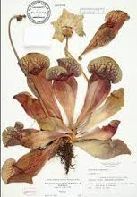
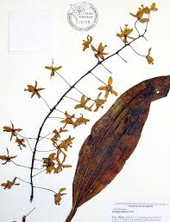
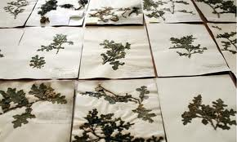
z
Floral diversity assessment - summary
Indicators – (2) taxon based
comprehensive floral survey
Measure and estimate species richness
200 superplots
6÷7k samples
Diversity of a range of taxa as surrogate of total species richness
Indices
α, Simpson, Shannon (Magurrann 2004)
Estimated Richness using non-parametric estimators (Chao et al. 2005)
Trees
Taxonomic identification by NFI, based on PNGFA methodology available for all 1000 plots
Non Tree Plant Diversity (NTPD)
Sampling method:
Collection of three individuals (with taxonomic traits) for each presumed species located in the plot
Storage of samples
Shipment to Herbaria: Lae, Sydney, Rome?
+ Network of tropical forest experts
Notes:
Superplots identificati mediante stratificazione utilizzando gli stessi parametri definiti per I 1000 cluster
Campioni con tutte le caratteristiche necessarie per la loro identificazione: fiori, frutti e fogliame.
Indici non parametrici: stima del numero di specie totale è basato sulla frequenza delle specie rar
15

Slide 16
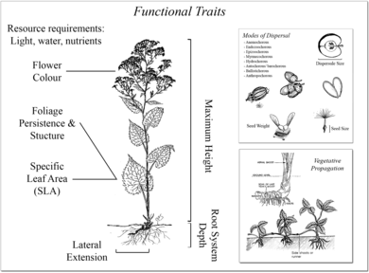
z
Floral diversity assessment - summary
Indicators – (3) functional traits based
methodology background
Plant Functional Traits (PFTs) have been proved to be a useful surrogate of a complete floristic inventory, and in some cases as biodiversity indicators (Gillison et al. 2013)
They can be used to predict response of organisms to environmental variation:
among different forest management
along climatic gradients (Lavorel et al. 2007)
grazing disturbance (Adler et al. 2005)
nutrient availability (Dyer et al. 2001)
Notes:
Metodologia di campionamento sviluppata in contesti tropicali dove non c’è una conoscenza tassonomica completa: non richiede la definizione di specie quanto di morfospecie cioè individui riconosciuti come simili anche se non riconosciuti dal punto di vista tassonomico
16

Slide 17
z
Floral diversity assessment - summary
Indicators – (3) functional traits based
field data collection
Field collection for functional diversity indicators
1000 plots
time consuming and expensive: only a subset of PFTs to be recorded
Non Tree Plant Diversity (NTPD)
Growth form: life form¹, plant height¹, regeneration¹ (clonality properties) and spinescence¹
Leaf traits: Leaf inclination¹, Leaf chlorotype², Leaf morphotype², Specific Leaf Area², Specific Leaf Mass² and Specific Leaf Weight²
¹ data obtained from the NTPD protocol (in the field);
² data obtained subsequently from herbaria
Collection of three individuals for each identified morpho-species (taxonomic traits not needed)
Leaf inclination
Vertical: >30° above horizontal
Lateral: + or - >30°
Pendulous: >30° below horizontal
Composite: variety of inclinations
Rosulate
Succulent
Parallel veined
Filicoid
Carnivorous
Leaf chlorotype
Dorsiventral: chlorophyll mainly on upper side of a flat leaf
Isobilateral: chlorophyll equally distributed on both sides of leaf
Achlorophyllous : without chlorophyllous
Life morphotype
No spines, thorns or prickles; (a simple tick on the field protocol)
Annotate if there are soft spines; and the plant hurts when hit carelessly
Presence of spines for one of the following categories:
Intermediate or high density of hard, sharp spine equivalents >5mm
Intermediate or high density of hard, sharp spine equivalents >20 mm
Intermediate or high density of hard, sharp spine equivalents >100 mm
Spinescence
Notes:
17

Slide 18
z
Floral diversity assessment - summary
Conclusion
summary table
Notes:
18

Slide 19
z
Timeline and scope
Biodiversity assessment activities during NFI implementation
biodiversity assessment methodology
PNGFA, Sapienza, UQ, Binatang
Regional field tests and training on-the-job
5-10 NFI field teams of 6 people
5 regions (1-2 teams per region)
1 month training (approx. 5 days in each region)
pilot phase impl.
(115 cluster plots)
6 months approx.
total number of plots to reach desired accuracy will be decided on the basis of experience from pilot phase
second phase impl. (estimated total number of plots 435-1000)
2014
2015
2016
2017

Slide 20
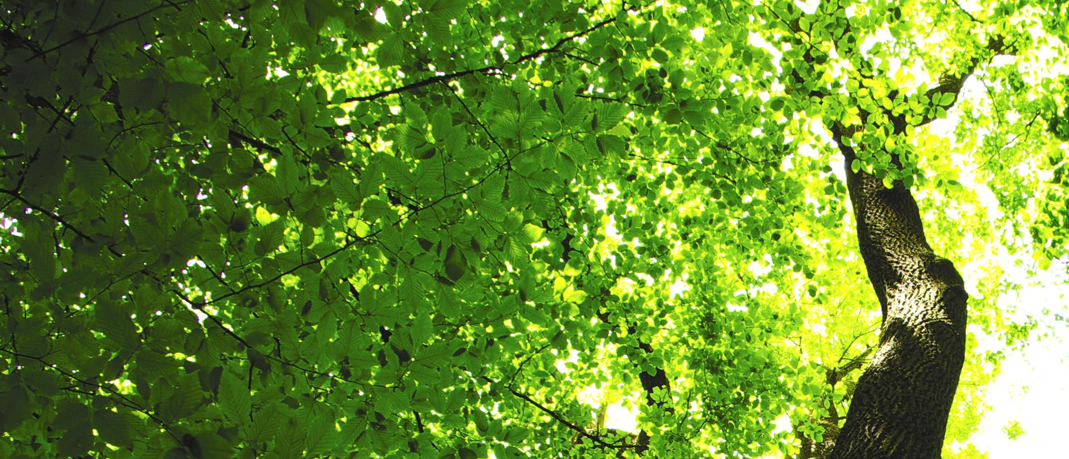

thank you

