Slide 1
Building resilience through sustainable management of mountain water resources and closing the gap between policy and implementation

Slide 2
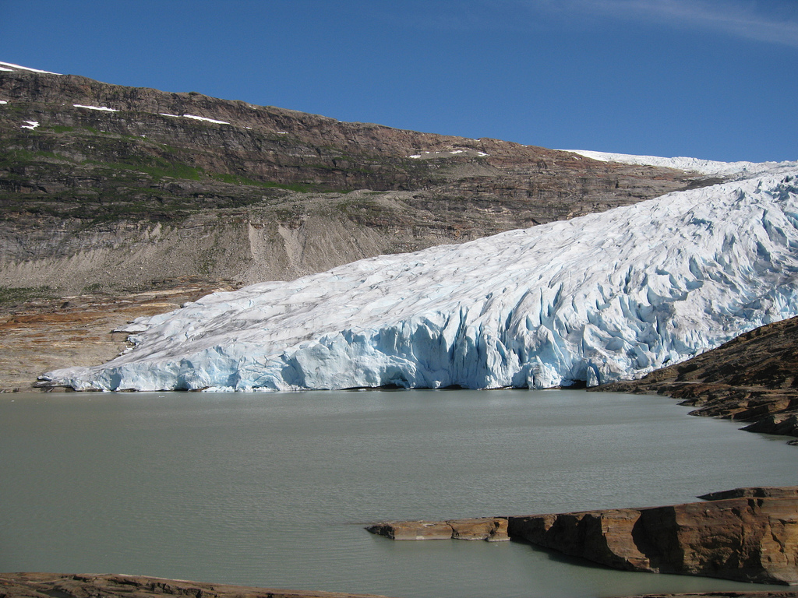

Slide 3
The Water and Climate Coalition…
Brings together stakeholders from the global water community - to promote progressive and integrated water and climate change policy
Targeted global advocacy, collaboration to develop policy recommendations, statements, interventions, events, seminars and workshops - Cap-Net, CIWEM, CI, Instituto Ipanema, IUCN, IWA, FAN, GCI, Progressio, SF, SIWI, TNC, UNC, WWF, Udyama - Collaborative Partners: GWP, CONAGUA

Slide 4
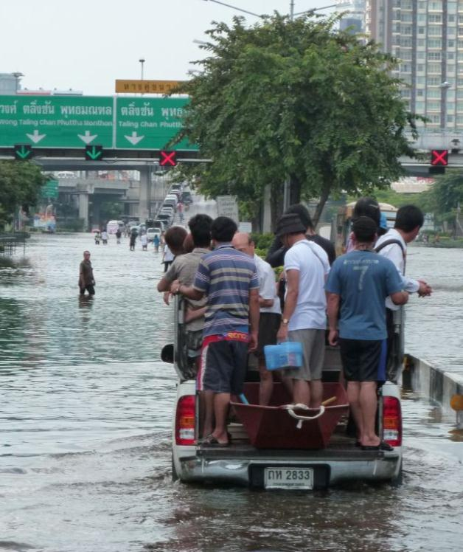
Key messages
The cross-cutting nature of water must be fully recognised
Climate change is water change – water resources management must be fully integrated in climate adaptation and mitigation at all levels
Gaps between policy and implementation must be overarched
Water expertise needs to be represented where decisions are made
Water must be integrated more effectively into programmes and mechanisms under UNFCCC

Slide 5
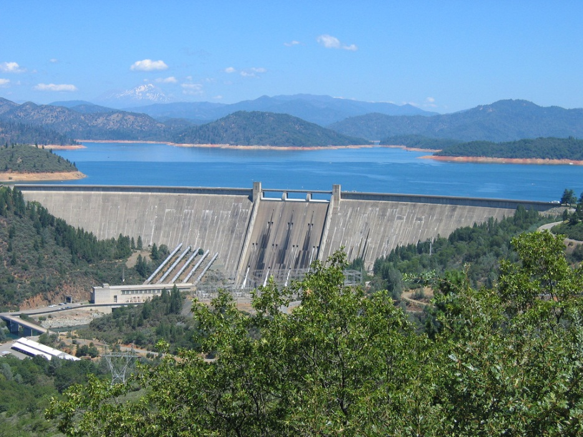
Suggestions by the Water and Climate Coalition
UNFCCC programmes and mechanisms must promote mitigation and adaptation coherence – there is an urgent need for bridging the divide! Water can serve as an example on the linkages
Establish a water programme under the UNFCCC to enhance a comprehensive approach – long term
Establish water as a priority under the Green Climate Fund and other financial mechanisms

Slide 6
Suggestions by the Water and Climate Coalition
Water knowledge must inform the Adaptation Committee
Establish a thematic focus area on water resources in the next phase of the Nairobi Work Programme
Water Resources Management must be integrated in NAPs and NAMAs
Water as a resource AND a hazard should be explicitly recognised in the Programme on Loss and Damage
Water resources management must be integrated in a possible programme on agriculture under UNFCCC/SBSTA

Slide 7
Karin Lexén, Director, World Water Week & Prizes, SIWI karin.lexen@siwi.org

Slide 8
Green Climate Fund (GCF) under the Convention
Financial mechanism to assist the developing countries with adaptation and mitigation;
Cancun agreements: GCF will support projects, programmes, policies and other activities in developing country Parties (such as NAMAs, NAPAs, NAPs);
Objective to raise $100 billion a year by 2020;
Fast Start Funding of the GCF was agreed, encompassing $30 billion for the period 2010-2012.

Slide 9
Adaptation Committee
To promote the implementation of enhanced action on adaptation in a coherent manner under the Convention;
Following functions, inter alia:
Providing technical support and guidance to the Parties;
Sharing of relevant info, knowledge, experience and good practices;
Promoting synergy and strengthening engagement with national, regional and international organizations, centres and networks;
Providing information and recommendations, drawing on adaptation good practices, for consideration by the COP when providing guidance on means to incentivize the implementation of adaptation actions, including finance, technology and capacity-building;
Considering information communicated by Parties on their monitoring and review of adaptation actions, support provided and received.

Slide 10
Nairobi work programme
Objective is to assist all Parties, in particular developing countries, including the least developed countries and small island developing States to:
Improve their understanding and assessment of impacts, vulnerability and adaptation to climate change; and
Make informed decisions on practical adaptation actions and measures to respond to climate change on a sound scientific, technical and socio-economic basis, taking into account current and future climate change and variability.
Durban outcome
requested the SBSTA to reconsider, at its session at SBSTA 38 (May/June 2013), work areas of the NWP with a view to making recommendations to COP 19 (December 2013) on how best to support the objectives of the work programme, and support work of the Cancun Adaptation Framework;
The COP invited Parties and relevant organizations to submit, by 17 September 2012, their views on potential future areas of work under the NWP for consideration by SBSTA 38.

Slide 11
National Adaptation Plans (NAPs)
Under the Cancun Adaptation Framework, a process established to enable LDCs to formulate and implement NAPs:
Will build upon their experience in preparing and implementing NAPAs,
A means of identifying medium- and long-term adaptation needs
A means of developing and implementing strategies and programmes to address those needs.
Other developing country Parties are also invited to employ the modalities formulated to support the NAPs in the elaboration of their planning efforts
.

Slide 12
National Adaptation Plans (NAPs)
Call for Submissions from Parties and organizations
On how they have responded to the invitation to support the NAP process in the LDCs and, where possible, to consider establishing support programmes for the NAP process within their mandates, as appropriate, which could facilitate financial and technical support to LDCs. (by 13 Feb 2012)
On their experiences with the application of the guidelines for the NAP process for LDCs. (13 Feb next year)

Slide 13
Programme on Loss and Damage
Cancun Outcome (COP 16)
A work programme in order to consider approaches to address loss and damage associated with climate change impacts in developing countries that are particularly vulnerable to the adverse effects of climate change, including impacts related to extreme weather events and slow onset events
Three thematic areas:
Assessment of risk of Loss and Damage
A range of options to address Loss and Damage
The role of the Convention in enhancing the implementation

