Slide 1
Climate, Water and Adaptation in the eyes of Pakistan - a country heavily dependent on mountain water resources
By Pervaiz Amir (GWP)
Building Resilience through sustainable management of Mountain Water Resources and closing the gap between policy and implementation.
Monday 3 December, 14.15 – 16.00 Hours, Doha Exhibition Center

Slide 2
Story Line
Mountains main source of water-glaciers in trouble
Projections scary
Science vs. ground realities
Adaptation challenge-180 million
Climate change –A flooding Case
New trends in CC
COP’S—HOPE WITHIN FRUSRATIONS
NEGOTIATIONS FOR PARTICULARLY VULNERABLE
MAKE OR BREAK-POCESS IN JEOPARDY

Slide 3
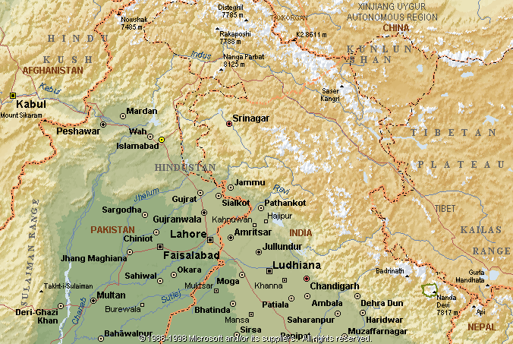
Indus
Chenab
Jhelum
Ravi
Beas
Sutlej

Slide 4
Distribution of Water in Main Rivers of Pakistan
 | % of IRS Inflows | % Seasonal Distribution |  | Dominant Source in Summer | Dominant Source in Winter
 |  | Summer Winter (Apr-Sep)(Oct-Mar)
Indus | 44 | 86 | 14 | Snow/Glacial melt | Winter Rainfall + Baseflow
Chenab | 19 | 83 | 17 | Snow/Glacial melt + Monsoon | Winter Rainfall + Baseflow
Jhelum | 16 | 78 | 22 | Mainly Snow melt + Monsoon | Winter Rainfall + Baseflow
Kabul | 16 | 82 | 18 | Snow/Glacial melt | Winter Rainfall + Baseflow
Others | 5

Slide 6
CC and the Water challenge

Slide 7
Messages

Slide 8
Adaptation Strategy
Storage
Regulation of Water
Approaching crisis 40% or more water will be lost
Pakistan’s dependence in over 80% in some cases
Implications for Conflict and governance
Community Based Adaptation

Slide 9
Brakes on Development-energy nexus
Expectations from COP’s in Question
Frustration within Governments
Agriculture, Water, Food security– everyone is impacted
Fast track domestic resource mobilization
Debt swaps with ME
Thinking ahead

