Slide 1
Climate change, water and infrastructure - the importance of good governance when climate proofing society
Mats Eriksson, Programme Director
Stockholm International Water Institute

Slide 2
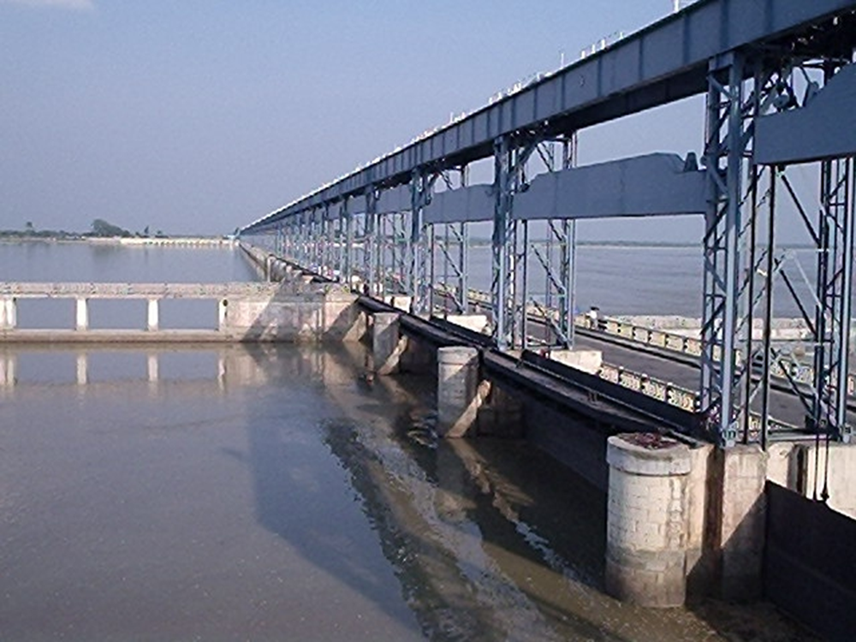
Main message
Infrastructure development and governance, particularly for flood mitigation, is overlooked leading to faulty constructions and poor governance systems with disasters and loss of human lives and livelihoods as a result.
Decision-making, governance, transparency and accountability needs to be improved for better planning, construction and maintenance of flood mitigation infrastructure.

Slide 3
Conclusions
Infrastructure development and governance, particularly for flood mitigation, is overlooked leading to faulty constructions and poor governance systems with disasters and loss of human lives and livelihoods as a result.
Decision-making and governance needs to be improved for better planning, construction and maintenance of flood mitigation infrastructure

Slide 4
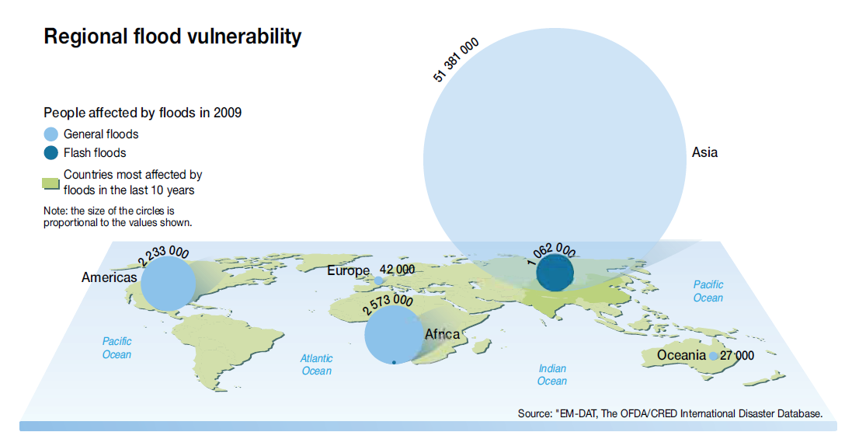
The majority of all hazards are water-induced (= climate-determined)
2009

Slide 5
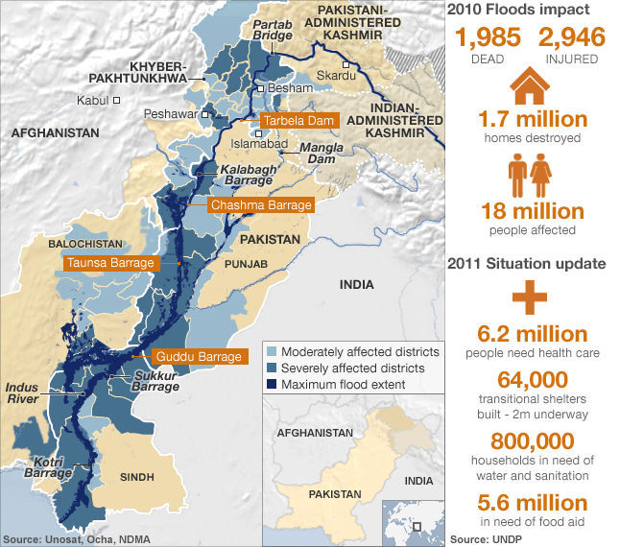
Some figures: 2010 Flood impact in Indus

Slide 6
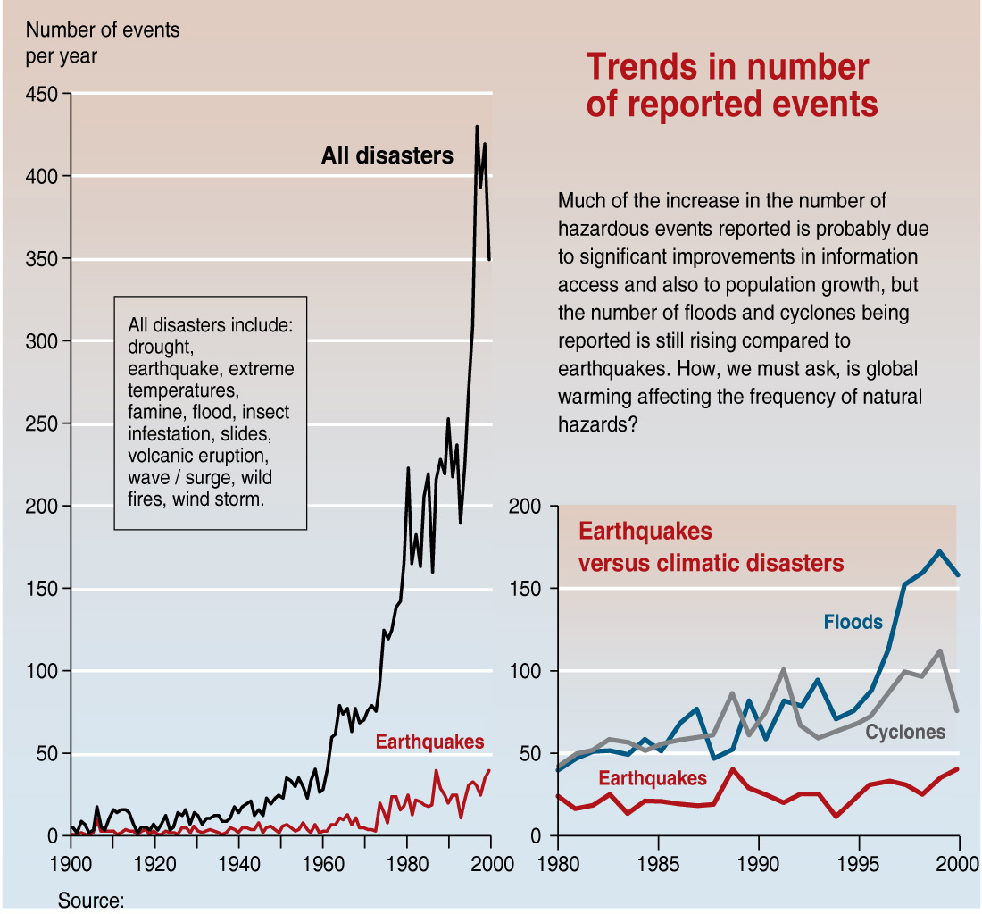
Trends in number of reported events
Climate and water-induced disasters increase in number
Trends in number of reported events
Source: UNEP

Slide 7
Dams are well monitored and governed
BURKINA FASO:
Following destructive floods in 2007, dams for irrigation are re-constructed in a climate proof way

Slide 8
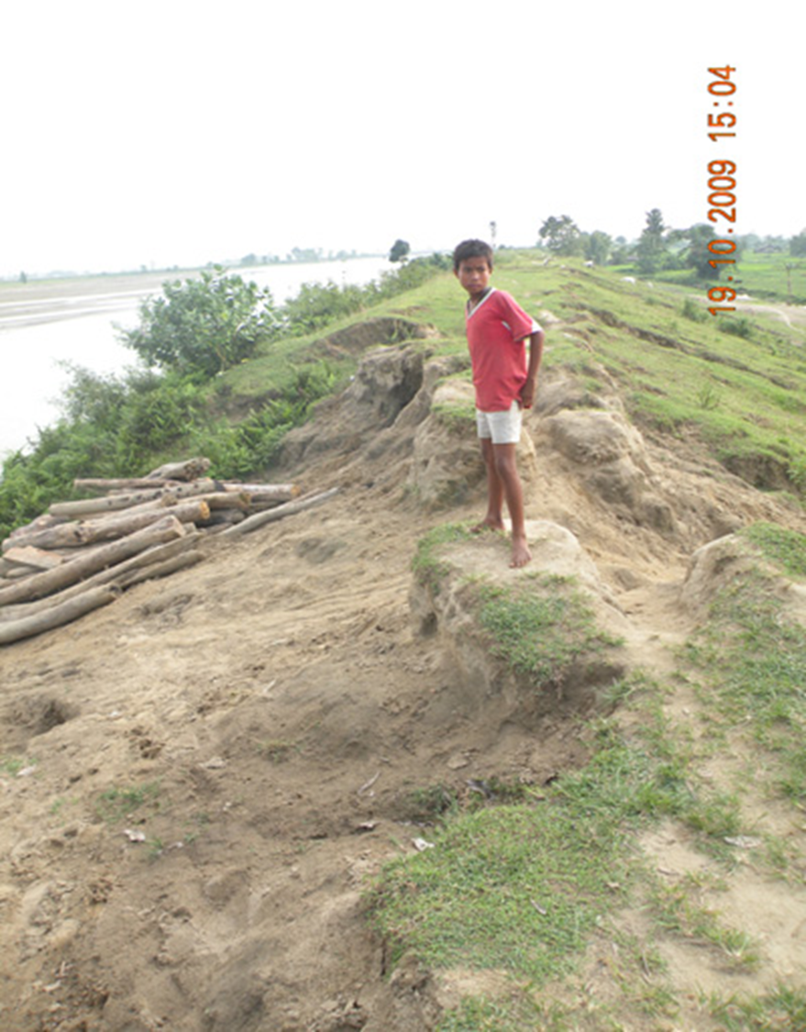
Embankments
Poor governance
Inadequate monitoring and maintenance
One of the highest destructive potential among infrastructures
Subject to un-ethical governance and management

Slide 9
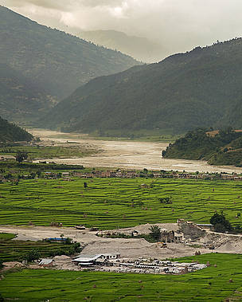
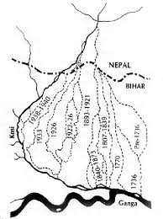
Example 1: Koshi Basin, Nepal/India

Slide 10
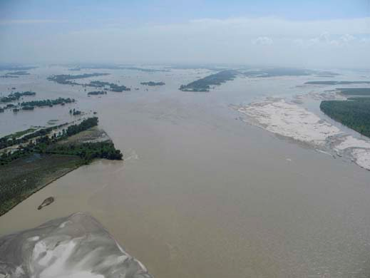
Koshi Basin disaster Nepal/India 2008
Breach of an embankment in a transboundary setting
A man-made disaster due to poor governance setup, leading to neglected monitoring and maintenance

Slide 11
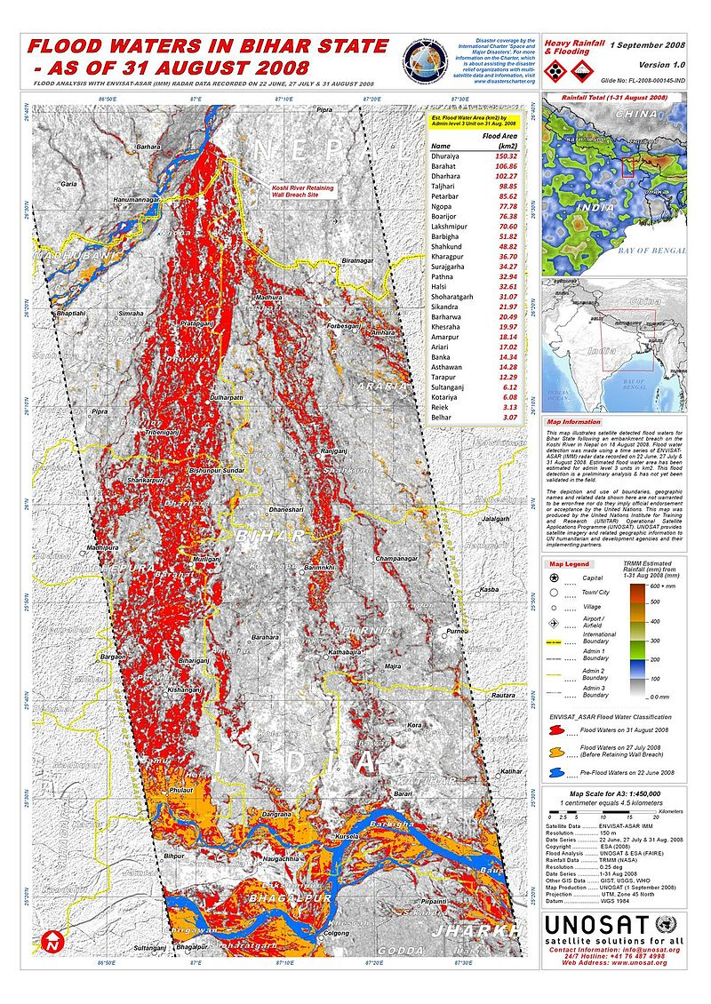
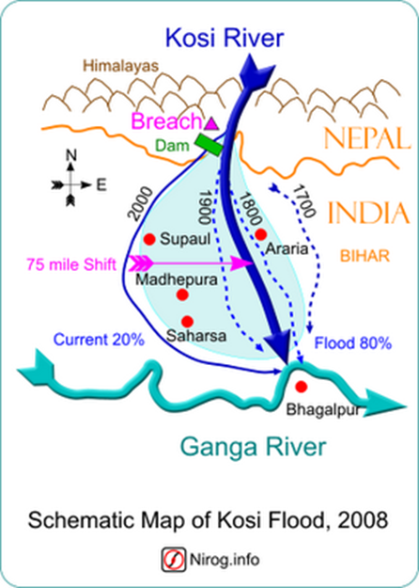

Slide 12
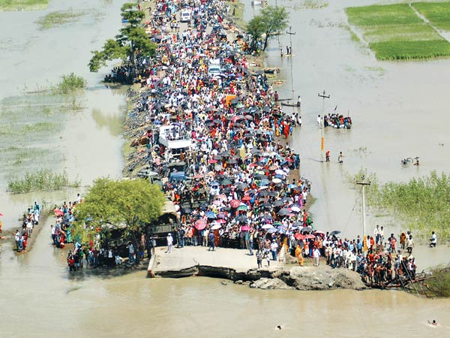
Koshi: disaster due to poor governance
Breach of the embankment happened at 1/3 of average river flow
7000 people dead
3,650,000 displaced
Breach have happened 8 times since 1954!
Governance and maintenance = Indian authorities on Nepalese territory

Slide 13
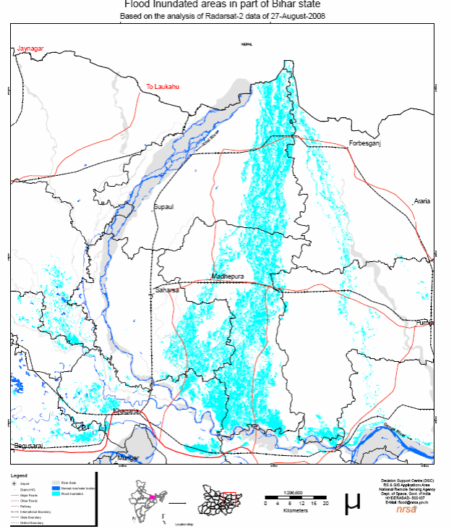
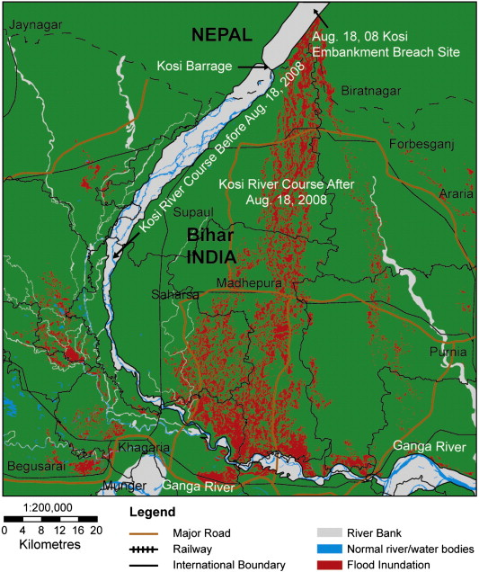
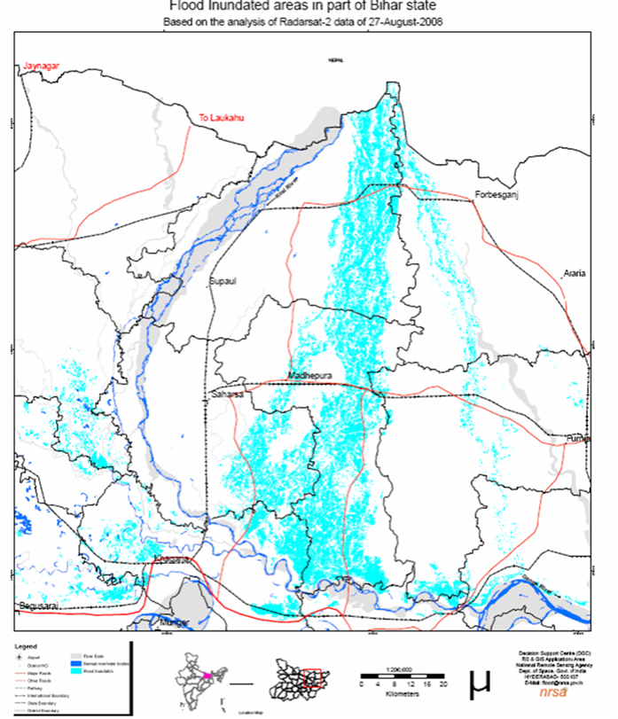
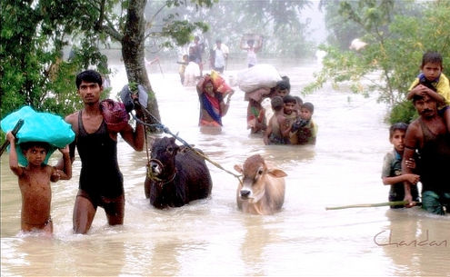
Koshi basin disaster (Nepal/India) August 2008 Breach of an embankment in a transboundary setting

Slide 14
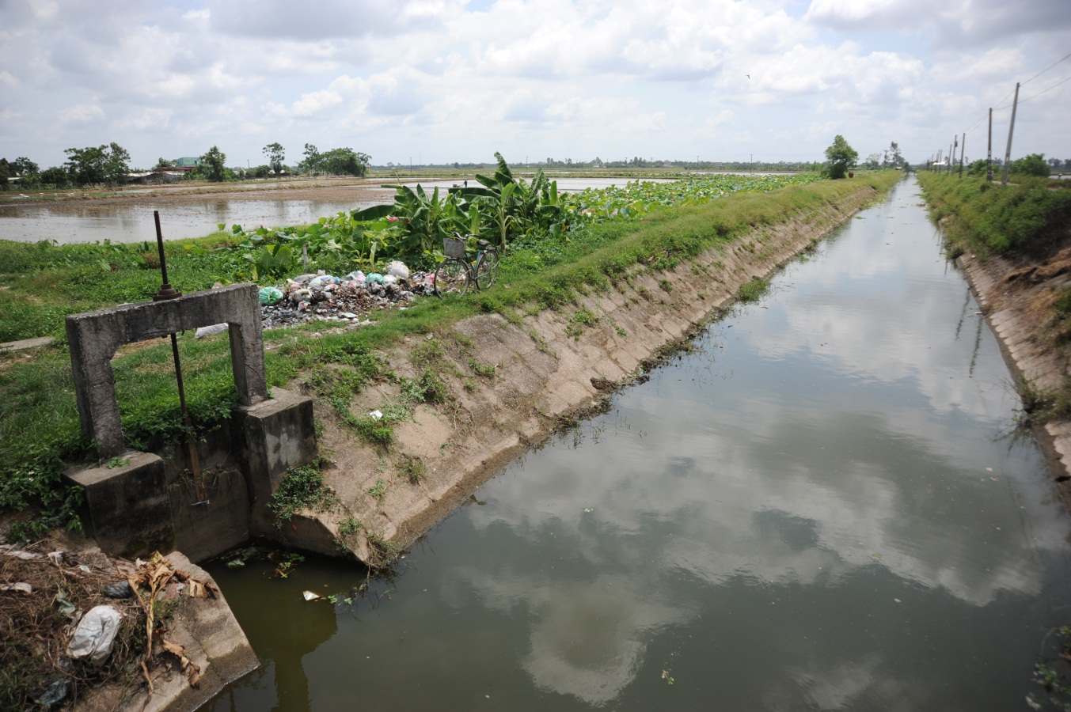
Example 2: Red River Delta, Vietnam – which is appropriate governance level?
Canal systems in low-lying paddy fields
drain water away during floods
Lead water to fields during droughts
-----
Canals are centrally governed
Is more local governance desirable?

Slide 15
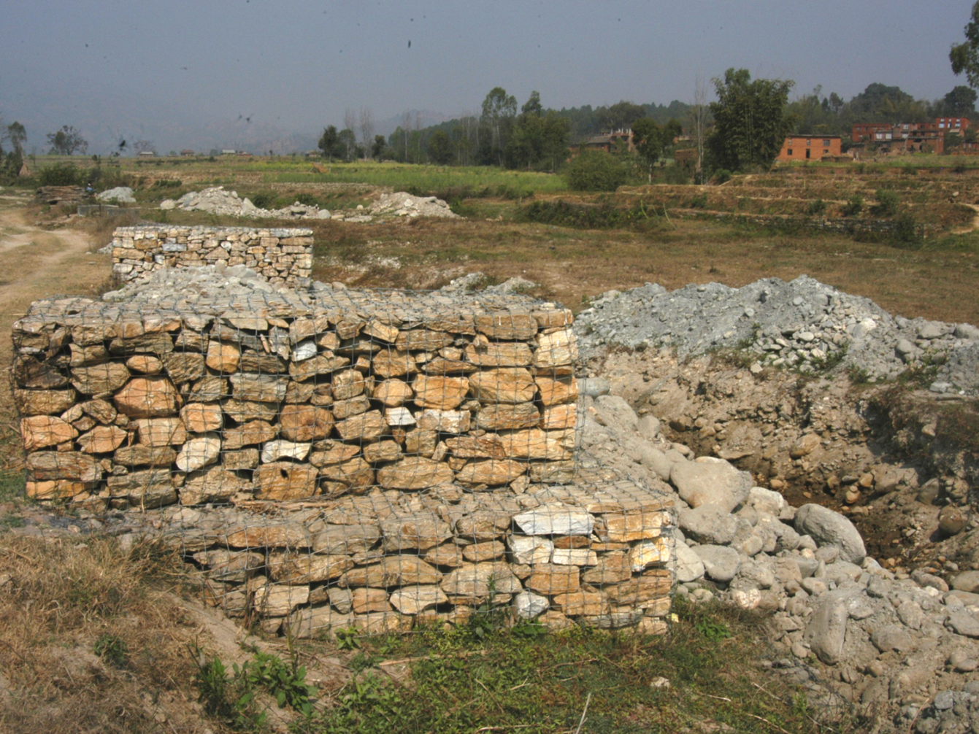
Example 3: Central Nepal – mismatch between central and local level
Flood protection being built when drought is a problem
Mismatch between central governance decisions and local needs

Slide 16
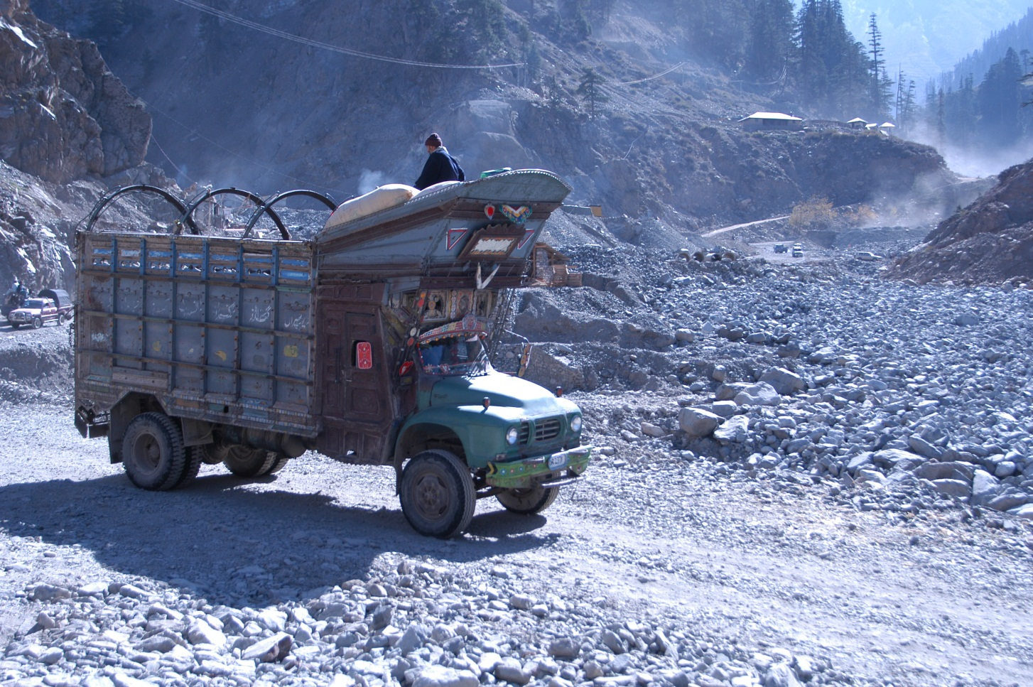
Example 4: Chitral, NW Pakistan
Extremely challenging areas for infrastructure development

Slide 17
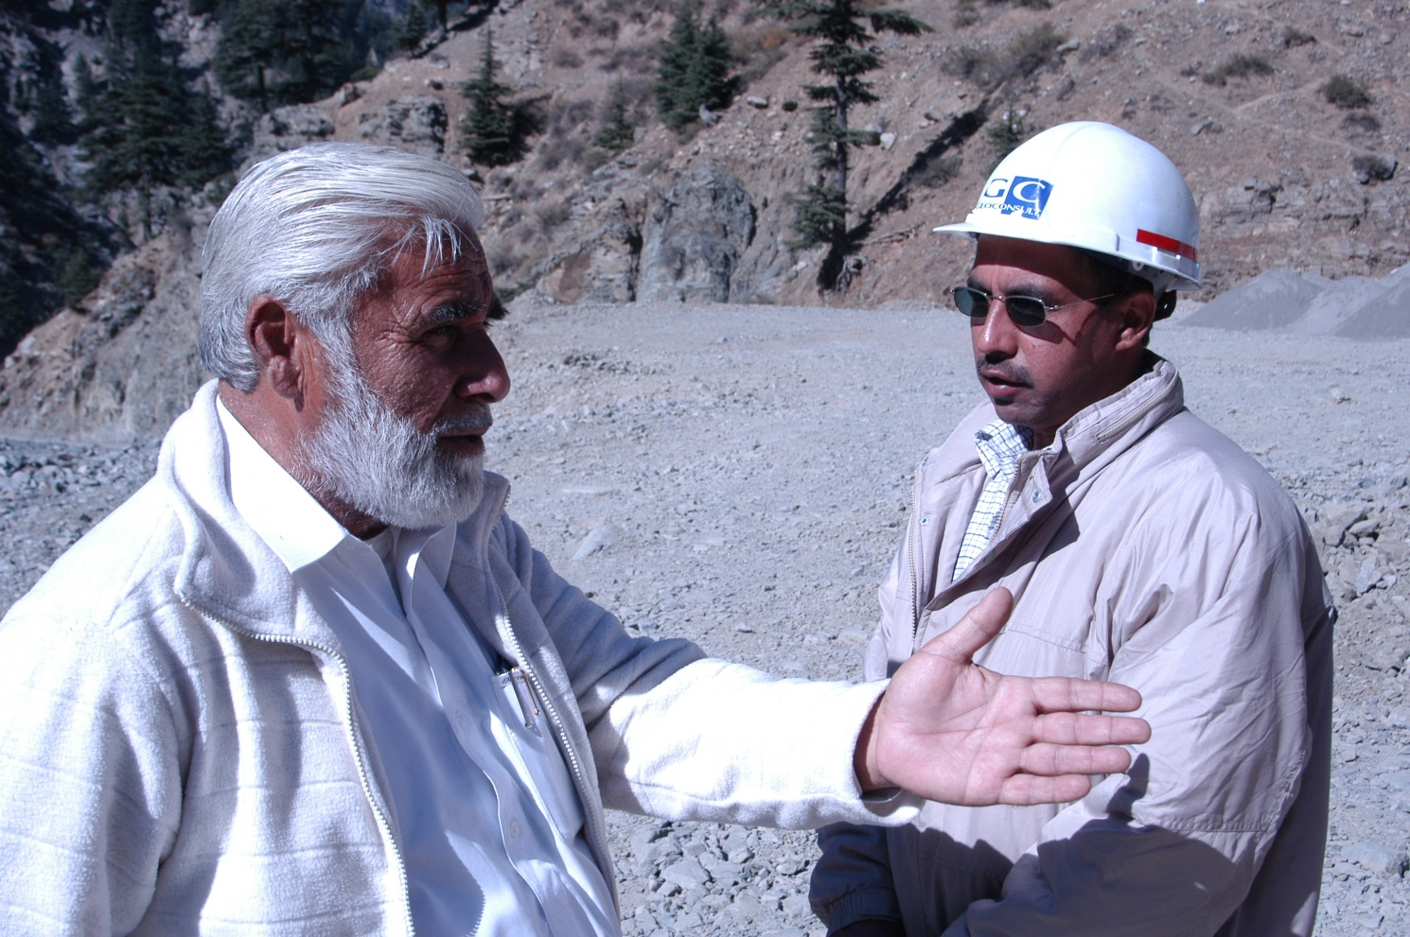
Example 4: Chitral, NW Pakistan – local knowledge disregarded
Foreign contractors have limited understanding of local conditions
Warnings from local community disregarded
Result: houses, equipment and people washed away

Slide 18
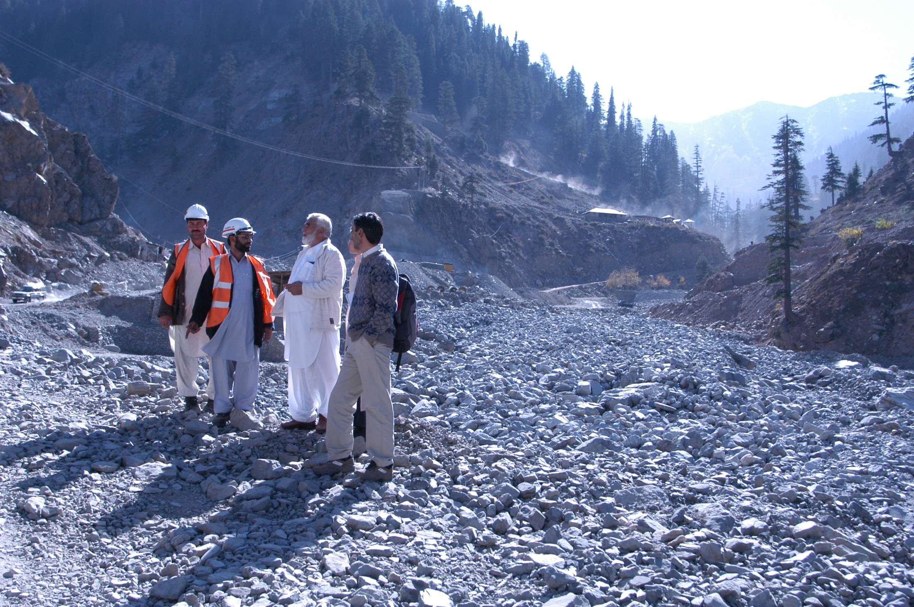

Slide 19
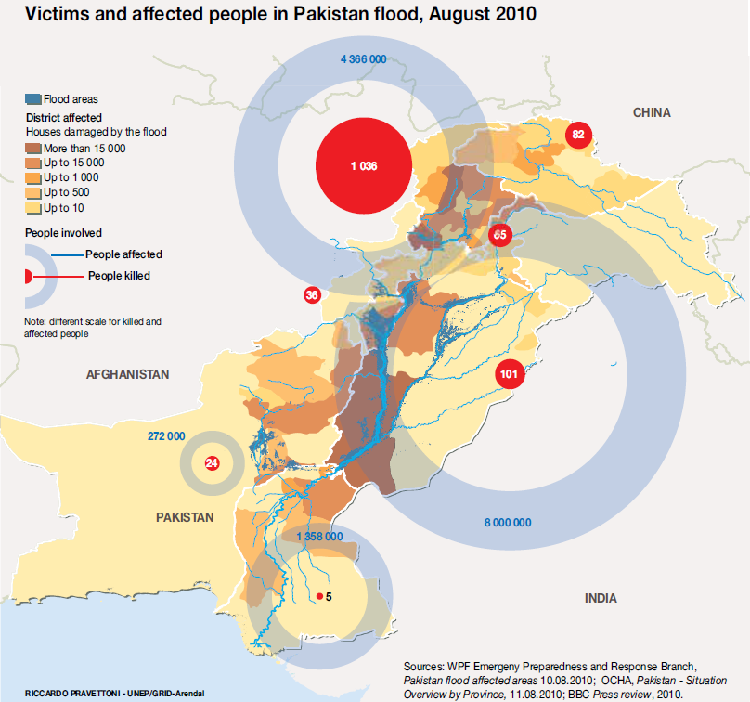

Slide 20
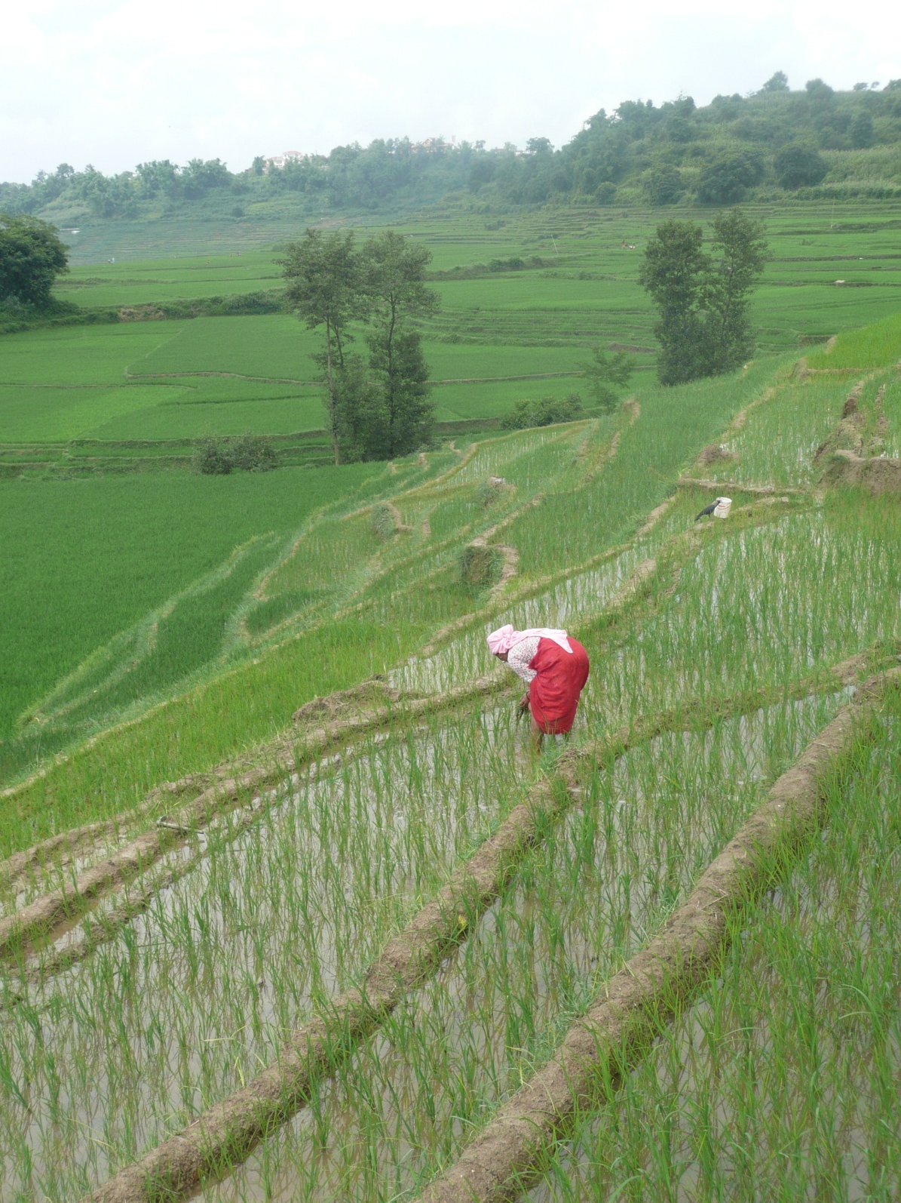
Local water management as a solution

Slide 21
Mishing Community, Brahmaputra floodplain, Assam, India
Notes:
‘Ghang Ghar’ house on stilts of the Mishing communities

Slide 22
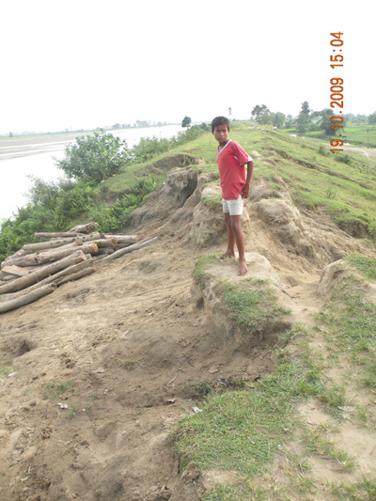
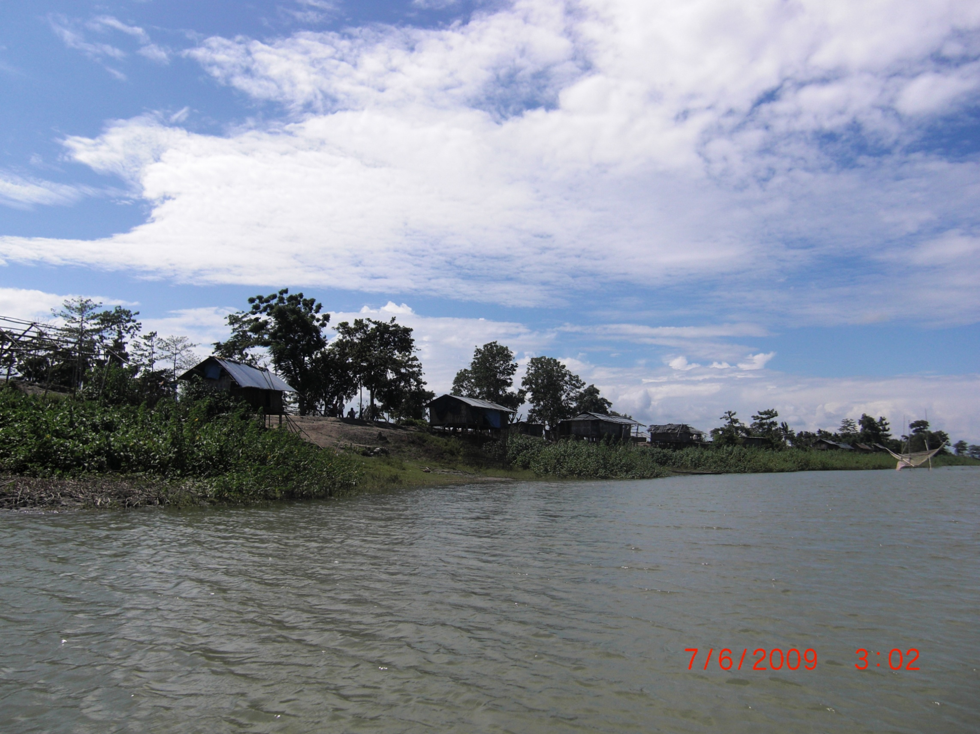
Lack of maintenance of embankments
Who governs our flood mitigation structures?

Slide 23
Matters of importance
Urgent need to improve infrastructure for management of water hazards and resources.
Infrastructure development particularly vulnerable to corruption. Currently 5-20% of construction costs are lost to corruption (18 billion USD/year ).
Same channels for implementation (same bottlenecks) = mismatch between financial flows and the capacity for financial management = risk for un-ethical practices.

Slide 24
How to minimize corruption risks?
Improve water adaptation measure selection:
Open and transparent cost-benefit analyses (including social benefits) of investment options
Improve governance systems
Mutual accountability - Build in better accountability systems between and within governments as well as the private sector
Ensure transparency in flows of funding
Need for oversight bodies with technical expertise, free from conflict of interest
Public engagement and involvement

Slide 25
Recommendations: There is a need…
to improve governance systems of embankments and similar flood mitigation infrastructure.
to build capacity in governments on national and local level to take informed decisions when planning for new infrastructure.
to involve the local level in all parts of the process (planning, construction, governance, maintenance).
to fight corruption in all parts of the process when planning for and constructing new infrastructure.
to support watch dogs keeping track on infrastructure development.

Slide 26
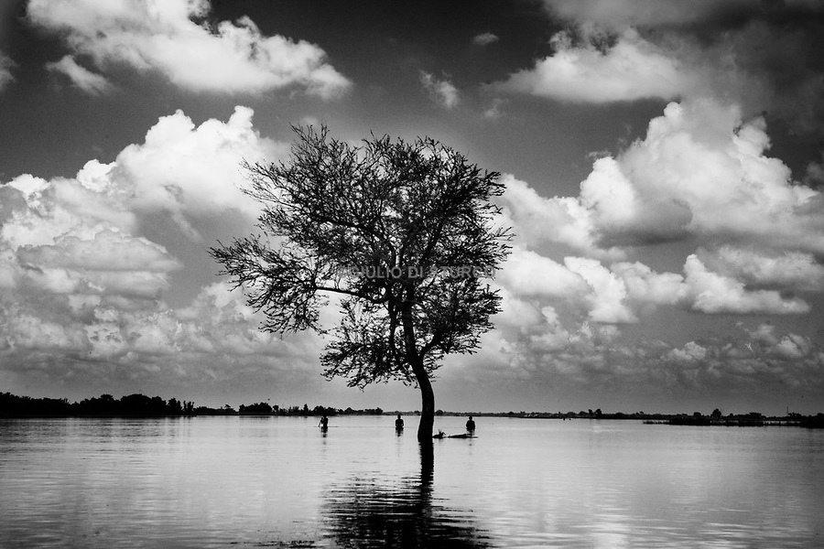
Thank You!
mats.eriksson@siwi.org

