Slide 1
hydrological trends in small watersheds in the fouta djallon highlands
Thomas Hofer, FAO / MPS, 3.12.2012
Research work: Veerle Verschoren

Slide 2
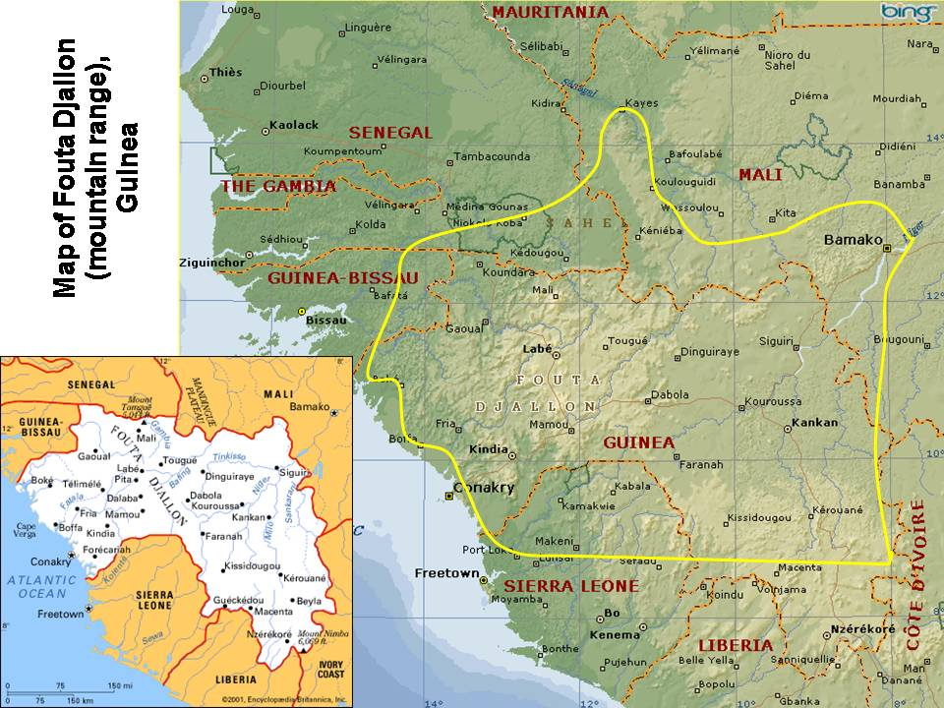

Slide 3
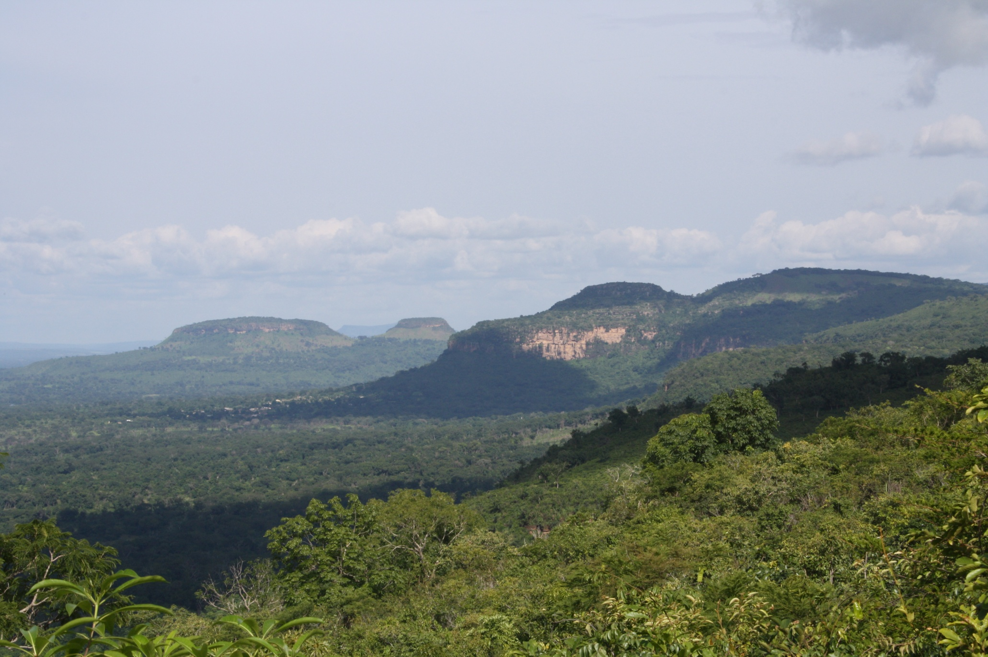
Fouta Djallon entre Pita et Dalaba (photo Marketta Juppi)

Slide 4
Introduction
Study area: Fouta Djallon Highlands (FDH)
Shifting cultivation!
Water tower of West-Africa,
High precipitation gradient (<650 mm NE and >2000 mm SW)
Field observations
Increased seasonal dry out of small rivers, disappearance of springs
Faster drain during the rainy season
Research
Many natural and human induced influencing factors
Limited data
→ Focus on small watersheds

Slide 5
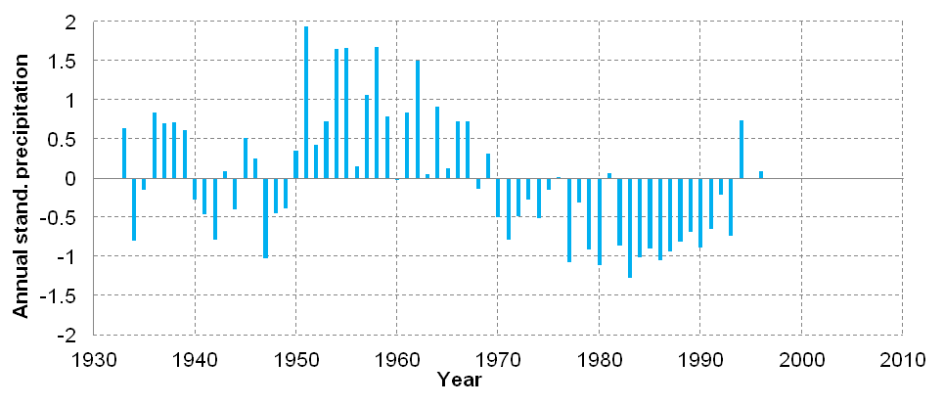
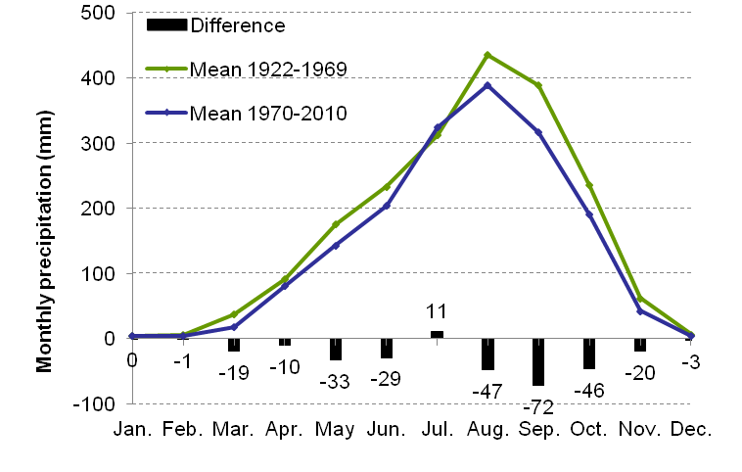
Annual precipitation
High inter-annual variation
Drastic decline after 1970
Before 1970: 1975 mm
After 1970: 1719 mm
→ Decrease of 13%
Reduction in rainfall in every
month except July
The rainy season is shorter
Lower peak values in the rainy
season, which mainly
contribute to the discharge
Data derived from Global Surface Summary of the Day, National Climate data centre.

Slide 6
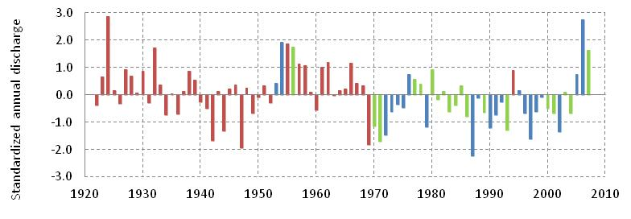
Annual discharge
Red: Calculated discharges
Green: Calculated and measured discharges
Blue: Measured discharges
No long term data series of discharge are available.
Similar as the precipitation, a change around 1970
Before 1970: 1287 mm
After 1970: 1065 mm
→ Decrease of 17%
Data derived from Governmental Hydrological Service Guinea

Slide 7
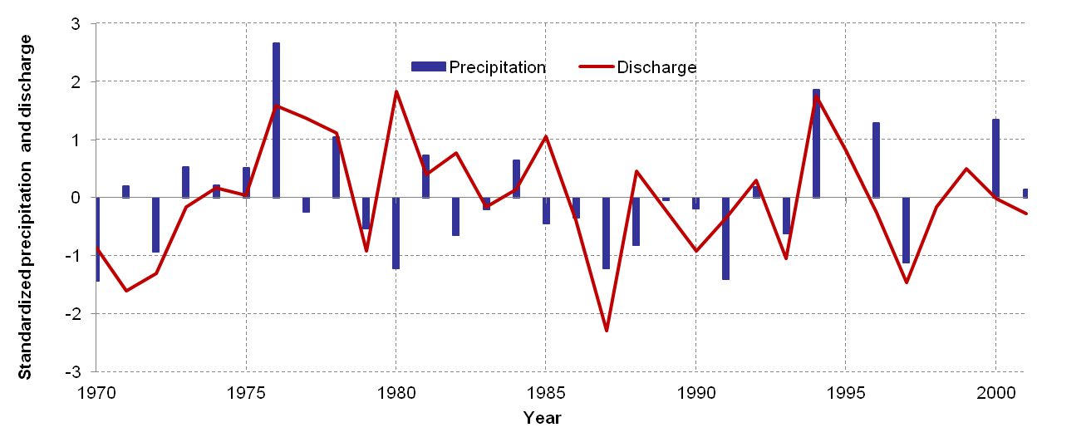
Annual trends 1970-2001
No long term trends in precipitation and in discharge.
The annual variation of discharge can only be partly explained by
the variation in precipitation, the influence of land use in unclear.

Slide 8
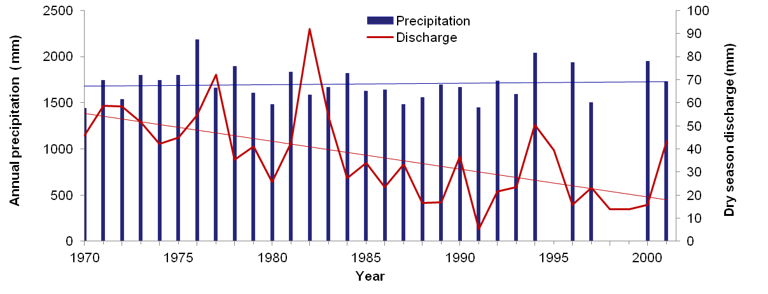
Dry season 1970-2001
Discharge of the dry season (Jan-May)
Annual precipitation of the year before
The dry season discharge (Jan.-May) decreased exponentially.
No link between the precipitation and the discharge is found.
Notes:
Note different axes in first graph.

Slide 9
Take home messages (I)
A strong reduction in annual precipitation took place around 1970 (-13%), which resulted in a discharge decrease of 17% after 1970.
In the period 1970-2001 no significant trends are found in the annual precipitation and in the annual discharge.
The discharge during the dry season declined between 1970-2001, the explanations are currently unknown.
The frequency of complete dry out of the river started and increased after 1970.

Slide 10
Take home messages (II)
Difficult to differentiate between climate variability and climate change
Hydrological trends: result of climate change or land use patterns / intensification?
Differentiated mountain terrain: difficult to identify overarching trends

Slide 11
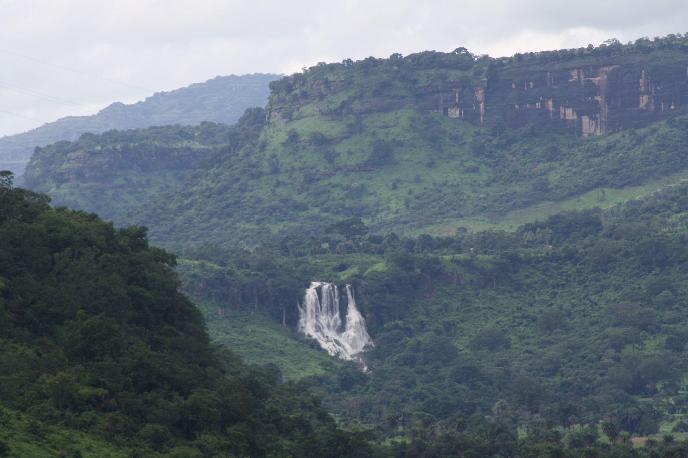
Thank you for your attention!
Photo Marketta Juppi)

