Slide 1
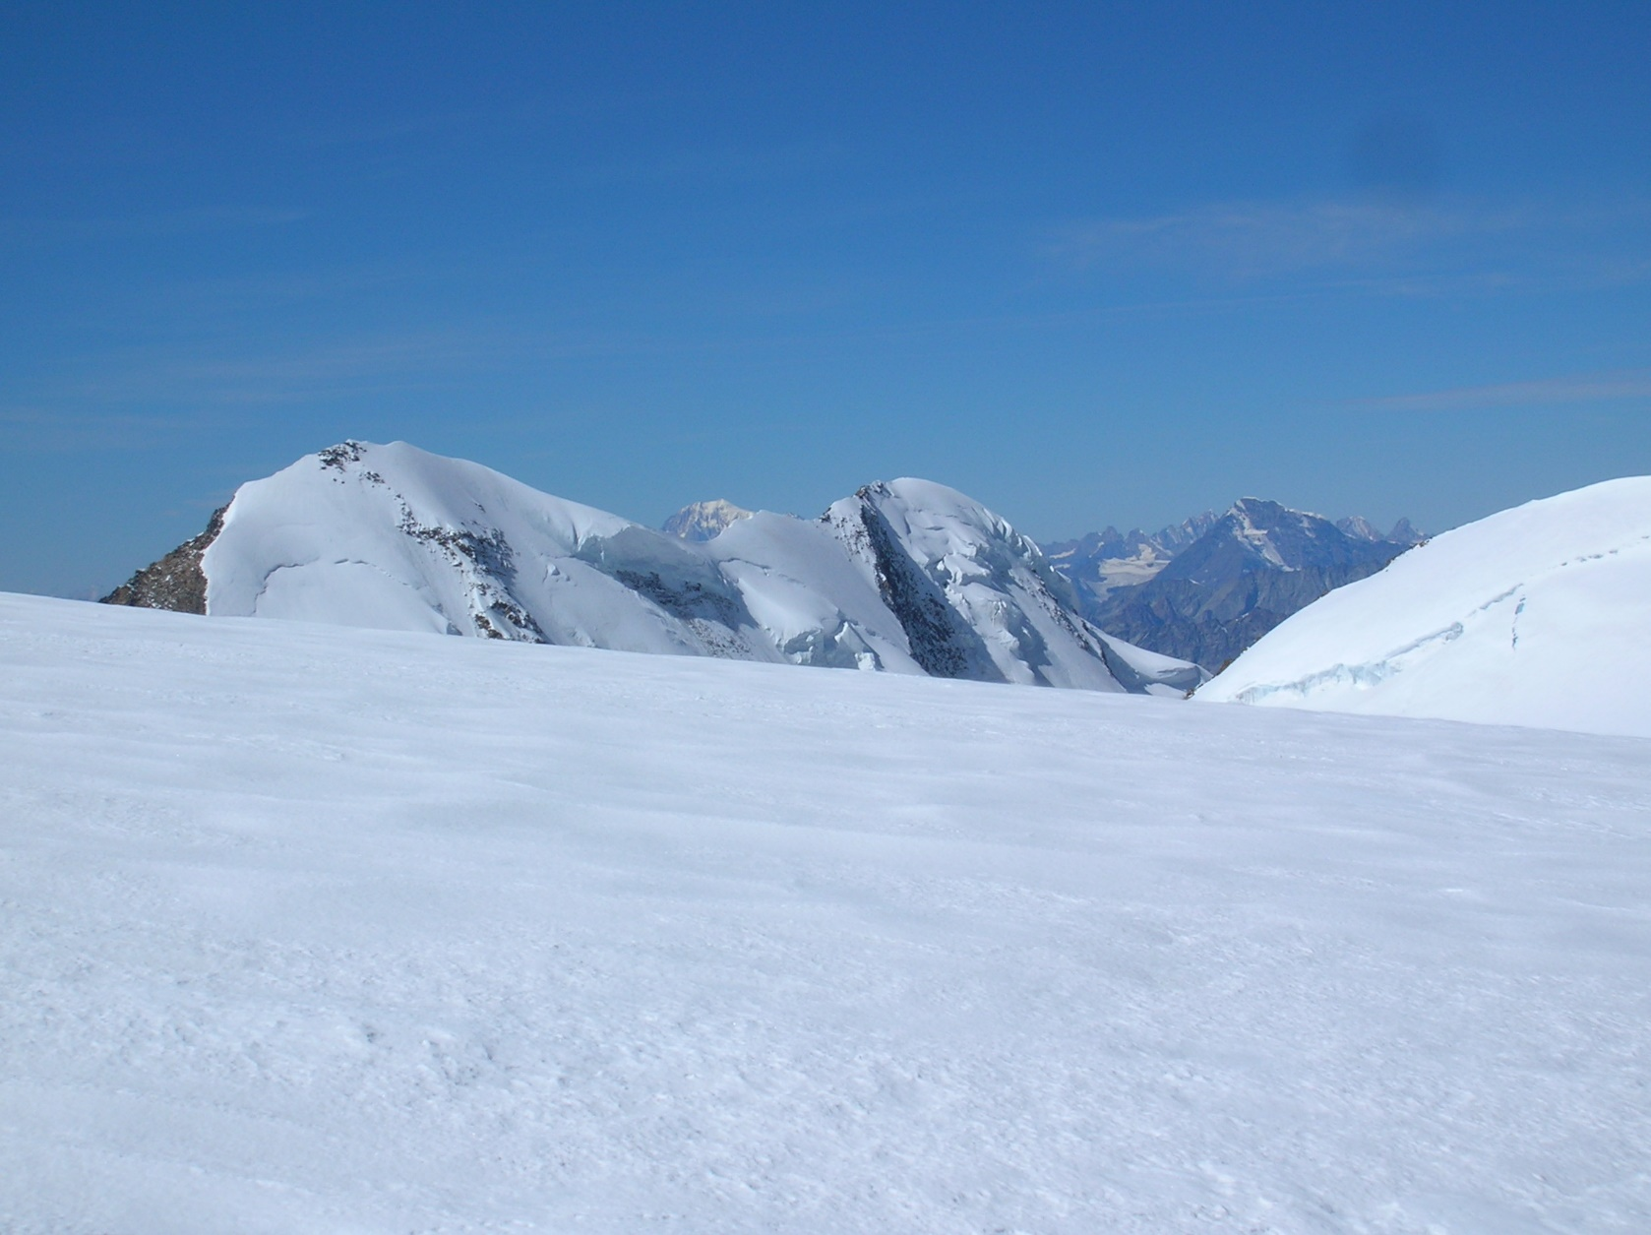
The experience of IPROMO
in building capacity for mountains
Michele Freppaz
Università degli Studi di Torino
Notes:
Ladies and gentlemen, thanks a lot for the kind invitation to participate to this side event concerning Mountain Education. My name is Michele Freppaz, and I’m professor in mountain soil science and snow science at the University of Torino, NW Italy. In my talk I’d like to share with you the experience of IPROMO - The International Program for Mountain - in building capacity for mountains.

Slide 2
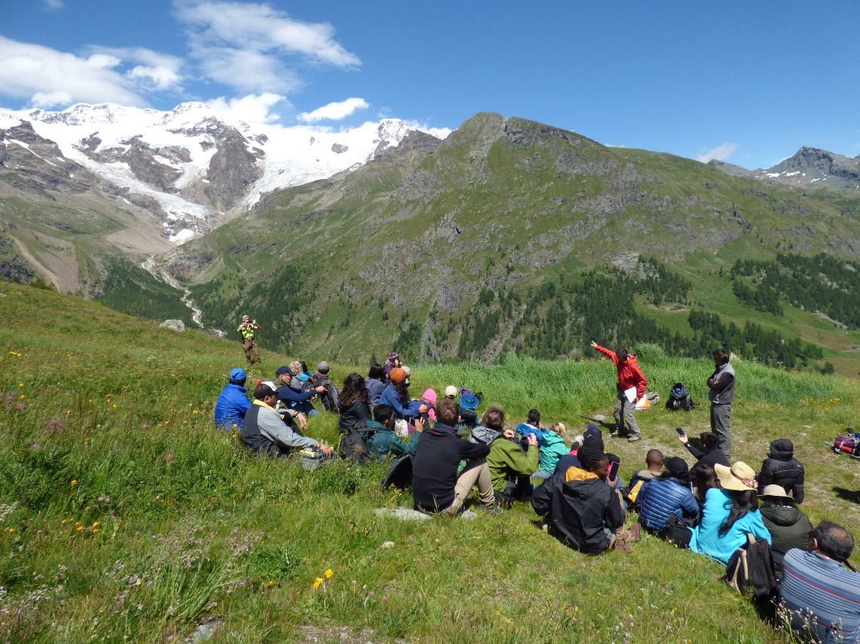
The need
The programme on research and training on sustainable management of mountain areas (IPROMO) was created in 2006 at the request of several Mountain Partnership members who had identified the lack of mountain related capacity development programmes as a concrete obstacle to the sustainable development of mountains around the world.
IPROMO 2017
Notes:
The IPROMO programme was launched by FAO – Mountain Partnership in 2006, to face the request of several members who had identified the lack of mountain related capacity development programmes as a concrete obstacle to the sustainable development of mountains around the world.

Slide 3
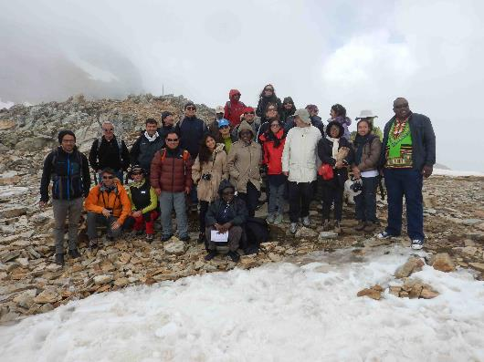
The idea
The idea was to periodically organize a full-immersion course on topics concerning the sustainable mountain development.
Target: technicians, planners and decision-makers from mountain regions of the world, particularly from areas with severe overexploitation and degradation, i.e. regions that are potentially more sensitive to global change impacts.
Subjects: activities in the fields of natural sciences, forestry, and socio-economics.
IPROMO 2014
Notes:
The idea was to periodically organize an intensive course on topics concerning the sustainable mountan development, dedicated to technicians, planners and decision-makers from mountain regions of the world, particularly from areas with severe degradation and potentially more sensitive to global change impacts. The subjects should cover a wide spectra, in the field of natural sciences, forestry and socio-economics.

Slide 4
The designers
FAO - Mountain Partnership and University of Torino-DISAFA-NatRisk shared their ideas on mountain education and in 2007 signed a MOU with the aim to support the IPROMO Course.
Venues: small villages in the NW Italian Alps.
Beneficiaries: technicians, planners, decision-makers from mountain regions of the World.
Structure: 2 weeks of intensive course. Individual and working groups coordinated by a chairman.
Notes:
In 2007 the dream come true.FAO-Mountain Partnership and University of Torino shared their ideas on mountan education and in 2007 signed a MOU with the aim to support the IPROMO course. The course should be organized in the mountain, in small mountain villages in NW Italian Alps, for technicians, planners and decision-makers from mountain regions of the world. The course should be intense, 2 weeks, with individual and working groups coordinated by a chairman.

Slide 5
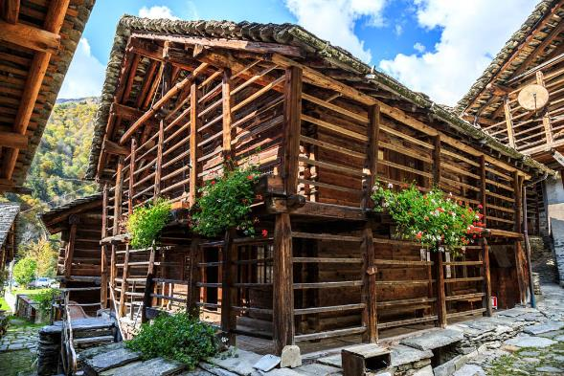
2008: The 1st Edition
Mountain Environment and Global Change
Venue: Alagna Valsesia, small Walser village close to the Monte Rosa Massif (NW Italy).
Local Donors
15 Instructors (5 countries)
25 Participants (19 countries)
Notes:
In 2008 the first edition of IPROMO was organized, in a small walser mountain village, Alagna Valsesia, close to the Monte Rosa Massif, NW Italy. The funding was guarantee by local donors and 25 participants were hosted, form 19 different countries. 15 teachers were involved.

Slide 6
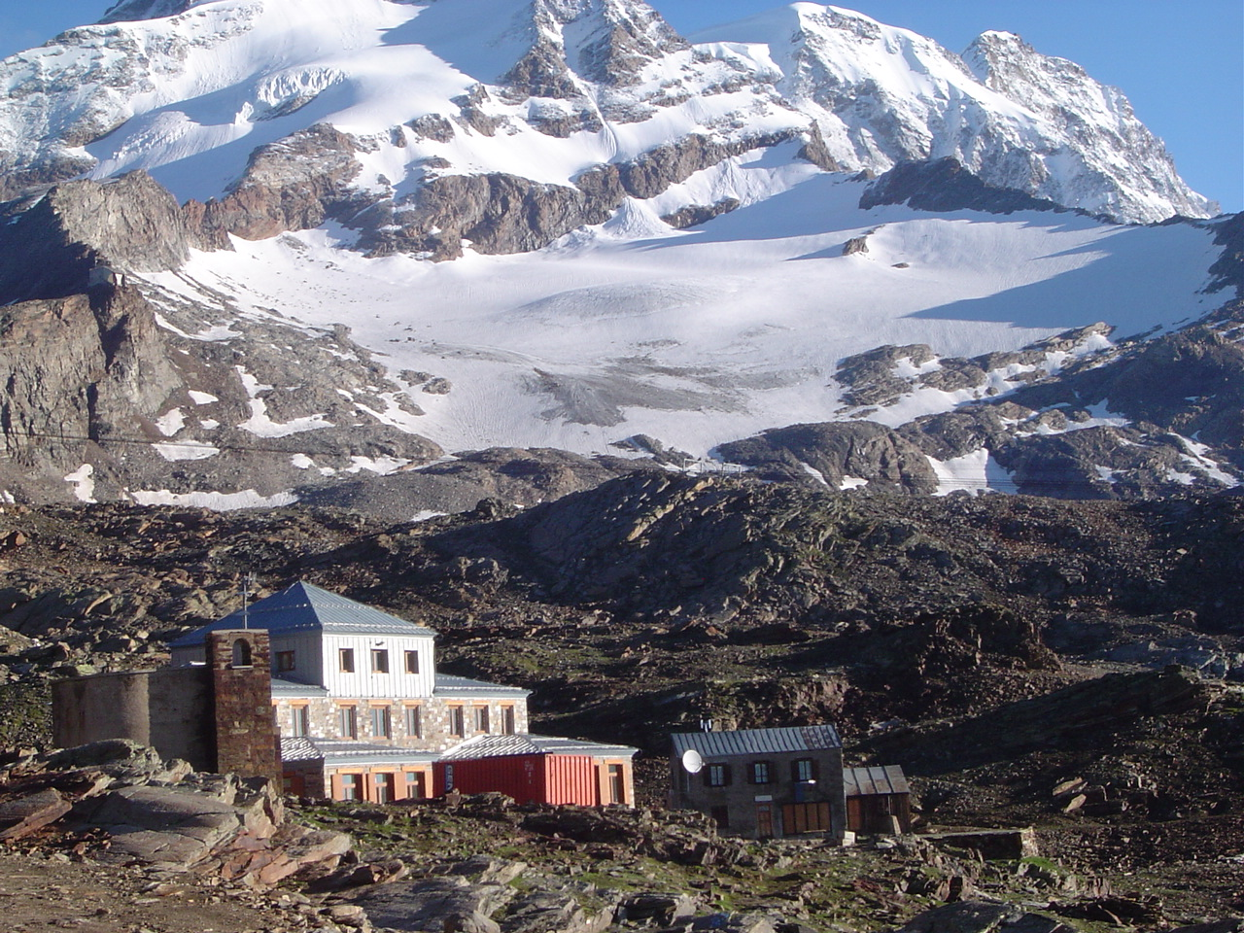
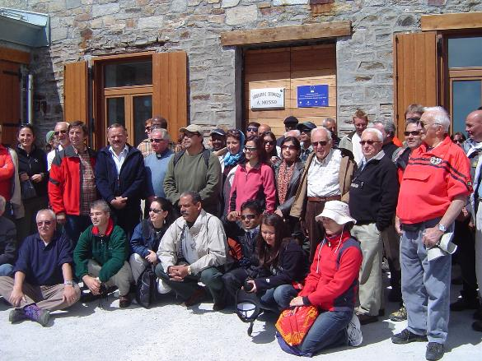
2008: The 1st Edition
Mountain Environment and Global Change
Mountain Research Station Istituto Scientifico Angelo Mosso, 2901 m asl
Notes:
The participants were hosted in the main village, but also in our high-elevation mountain research station, the Istituto Scientifico Angelo Mosso. The Istitute was built in 1907, thanks to the Queen Regina Margherita, and represents the base camp for the scientists who carried out their research activity at the top of Monte Rosa Massif, in the Capanna Regina Margherita Hut (4559 m asl), built in 1902.

Slide 7
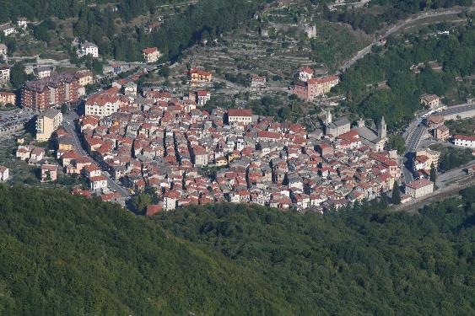
2017: The 10th Edition
International Summer School
Environmental and economic issues to enhance mountain sustainability
Venue: Ormea, a small town in the Ligurian Alps (NW Italy) and Pieve Tesino
Local Donors
21 Instructors (4 countries)
32 Participants (22 countries)
Notes:
Time goes very fast and last year we organized the 10 th edition, in a small town in south Piemonte, Ormea, in the Ligurian Alps. We had 32 participants coming from 22 countries and 21 teachers. The IPROMO inititive offcially become an International Summer Scholl.hosted by the University of Torino.

Slide 8
10 years: The themes
Understanding Upland Watershed Management
Promoting Sustainable Farming in Mountain Regions
Food security in mountain areas
Managing mountain resources and diversities - the role of protected areas
Environmental and economic issues to enhance mountain sustainability
Mountain Environment and Global Change
Developing economic opportunities for mountain areas
Protecting Mountain Biodiversity
Natural Hazards and Disaster Risk Management in Mountain Areas
Understanding and Adapting to Climate Change in Mountain Areas
Notes:
Here a list of the topics of the last and first 10 years of IPROMO. As you can see, the subjects deal with global change, biodiversity, natural hazards and food security in mountain areas.

Slide 9
10 years: The beneficiaries
257 beneficiaries
70 countries
Notes:
Globally, IPROMO reached more than 250 technicians from 70 different mountain regions.

Slide 10
10 years: The teaching staff
80 instructors
16 countries
Notes:
In 10 years 80 teachers have been involved, coming from 16 different countries and different institutions, of course from the University of Torino, but also from other universities and resercg centres.

Slide 11
IPROMO 9 years impact assessment
Nationality
78 Questionnaires were filled
Age
Notes:
After 10 years it’s time to make an assessment, a budget of our activities. A questionnaire was sent to all the IPROMO participants. 78 participants filled the questionnaire, mainly form Southern Asia and South America, most of them with an average age ranging between 30 and 35 years.

Slide 12
Welcome to the IPROMO Community
An ever-expanding virtual network of IPROMO alumni…
Notes:
While more than 80% are still in contact with other participants, revealing the importance of the ever-expanding virtual network of IPROMO alumni.

Slide 13
2018: The 11th Edition
International Summer School
Bioeconomy in mountain areas – an opportunity for local development

Slide 14
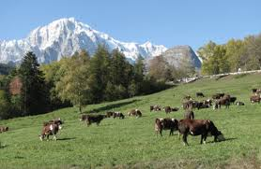
June 24-26
Field Trip to Aosta Valley

Slide 15
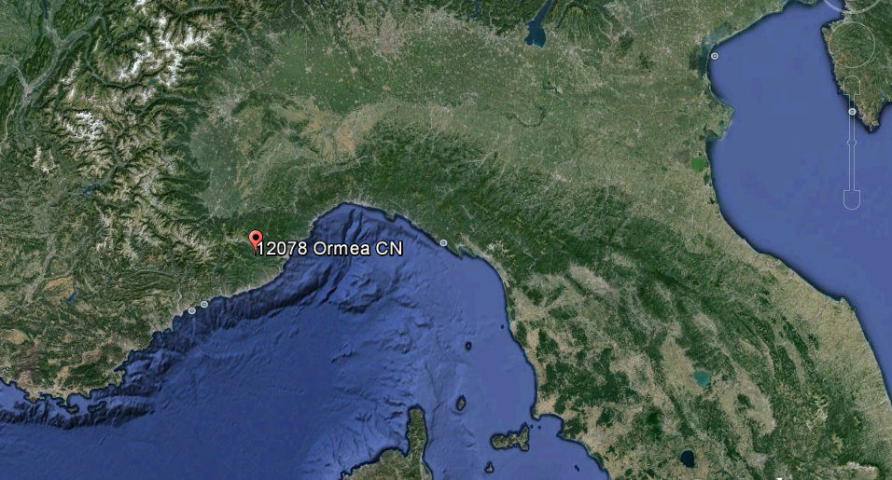
June 26 – July 2
Ormea

Slide 16
June 26 – July 2
Ormea

Slide 17
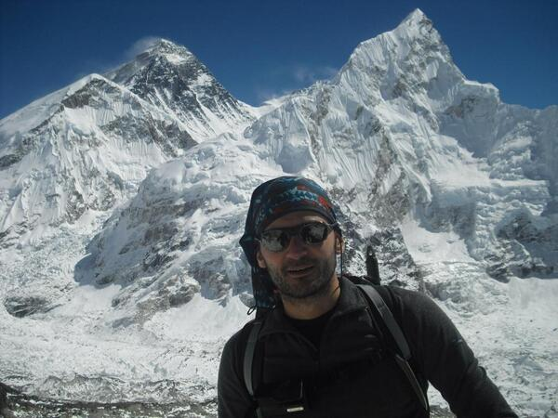
Danilo Godone, chairman

Slide 18
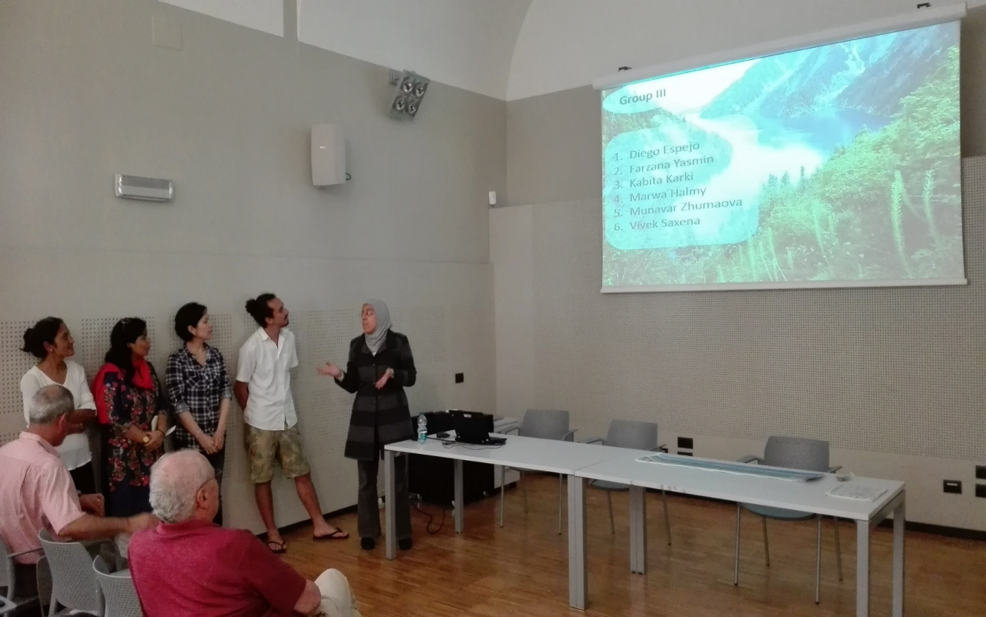
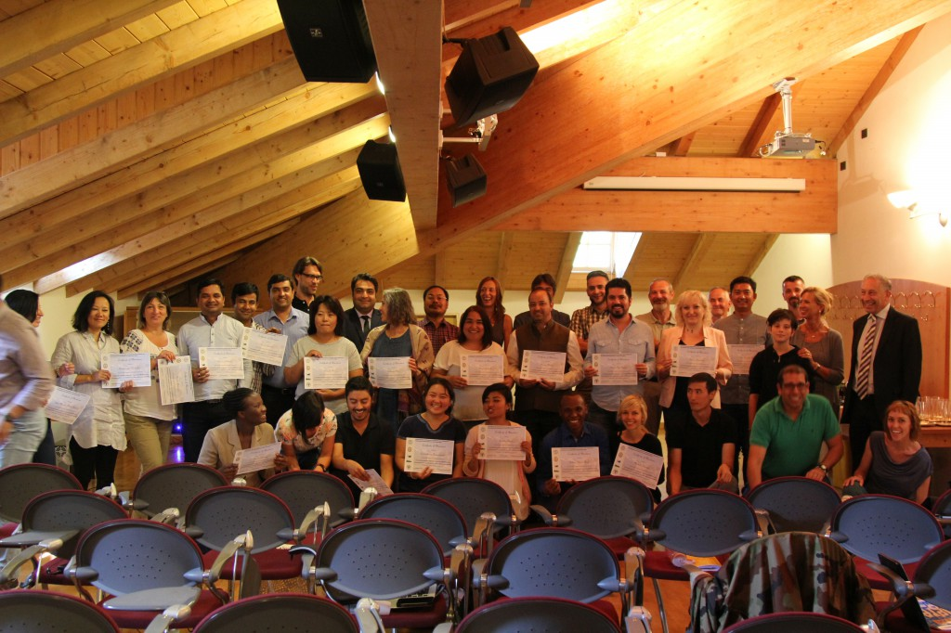
Working Groups Presentation
IPROMO 2016
IPROMO 2017
Notes:
As I mentioned before in every course the participants were organized in working groups, which develop specific subjects under the supervision of the chairman. At the end of the course, each group presents their activities during an official event.

Slide 19
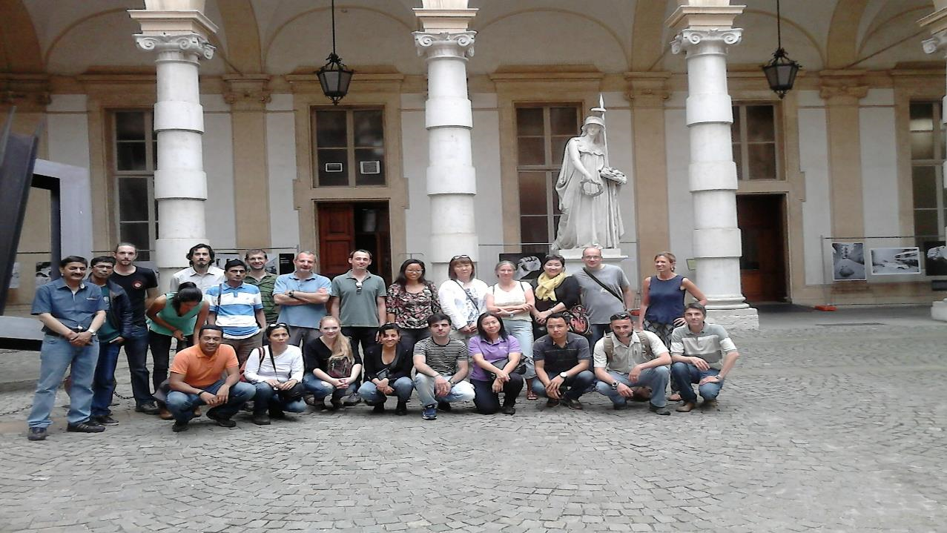
IPROMO, 2015
michele.freppaz@unito.it
http://www.fao.org/mountain-partnership/our-work/capacitydevelopment/ipromo/en/
Notes:
A picture of the IPROMO class in 2015, in the Rectorate Courtyard of the University of Torino, below Minerva, goddess of wisdom and knowledge. I hope that Minerva will help us in going on with IPROMO, at least for other 10 years. Thanks for your attention.

