Slide 1


IPROMO 2018
Bioeconomy in mountain areas
an opportunity for local development
MOUNTAIN PARTNERSHIP SECRETARIAT
Pieve Tesino – 19 June

Slide 2
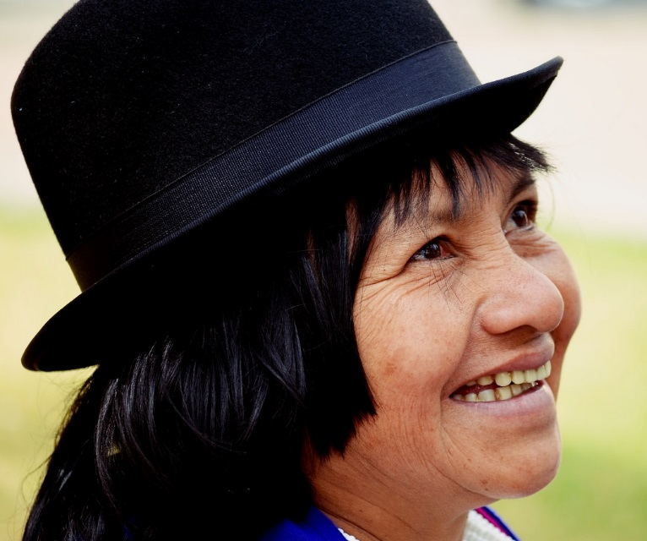
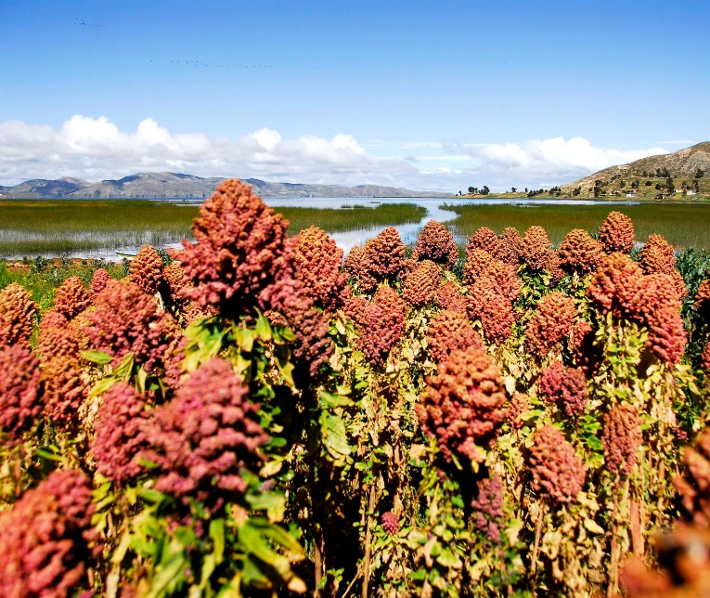
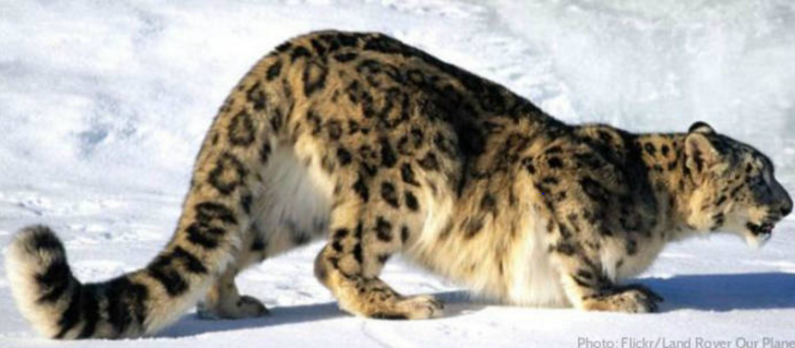
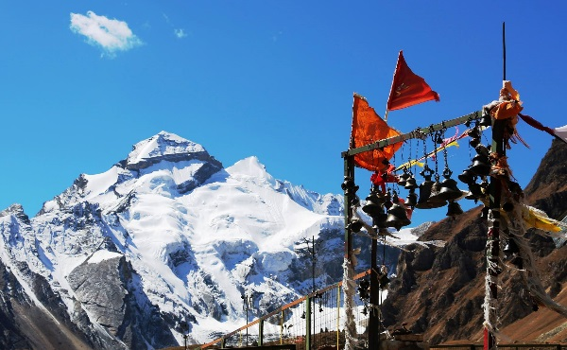
Mountains in figures
22% of the earth land surface
13% of global population
60 - 80% of global freshwater
25% of terrestrial biodiversity
60% of all Biosphere Reserves
15-20% of global tourism

Slide 3









The Mountain agenda
2015 Sustainable Development Goals
Target 6.6, 15.1, 15.4, indicator 15.4.2
2012 Rio+20 – The Future We Want
2002 WSSD – IYM – IMD - MP
1992
Rio Earth Summit
chapter 13

Slide 4
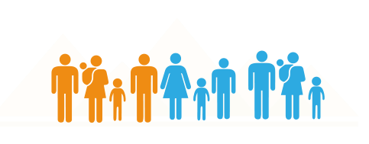
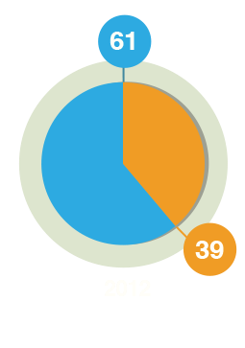
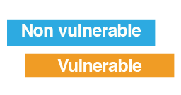
Mountains are under pressure
Mountains are under pressure for climate changes, hunger, poverty, migration, etc
Mountain peoples are among the poorest and most malnourished in the world
In developing countries, a great majority lives below the poverty line and 1 in 3 people faces food insecurity (in rural areas 1 in 2)

Slide 5
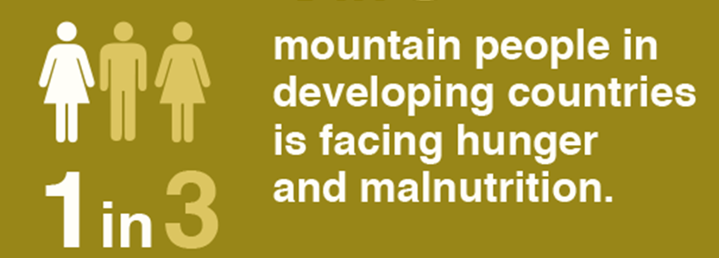
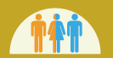
Mountains under pressure climate, hunger, migration
One of every two people on the planet depends on mountain ecosystem services
60-80% of all water comes from mountains
Hunger among mountain populations increased by 30% in 12 years
Mountain population ≈ 1,000,000,000
in rural areas:
1 in 2
Climate change, land degradation and natural disasters
put natural resources and communities under increasing pressure, pushing people to migrate
Notes:
The global importance of mountains is known. For they provide resources and ecosystem services to upstream and downstream communities and economies
Climate change, land degradation and natural disasters put an increasing pressure on natural resources and communities that are already vulnerable
And this will eventually affect the rest of the planet.
However...
Continental mountainous countries are often huge countries. It is not easy to coordinate their joint actions towards a common cause such as sustainable mountain development. Also because they do not necessarily identify in one single ecosystem. Even if, as in our case, that ecosystem might be crucial for the well being of an entire nation.

Slide 6
The Mountain Partnership is a United Nations voluntary alliance of more than 300 members (governments, intergovernmental organizations, civil societies, NGOs and private sector) to improve the lives of mountain peoples and protect mountain environments
Founded in 2002 to address the environmental and socio-economic challenges of mountain regions and stimulate concrete initiatives to improve quality of life and preserve ecosystems

Slide 7
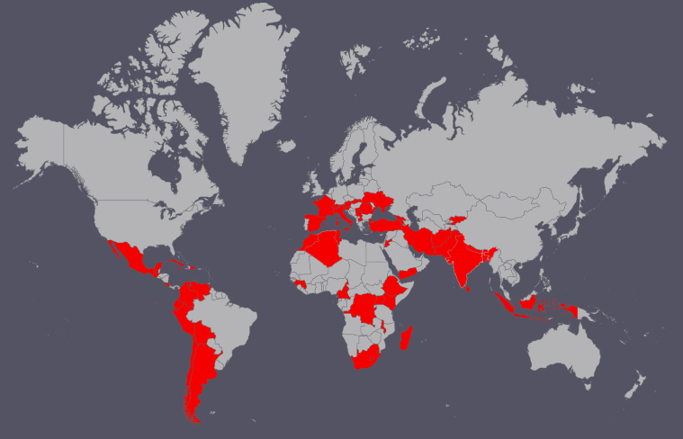
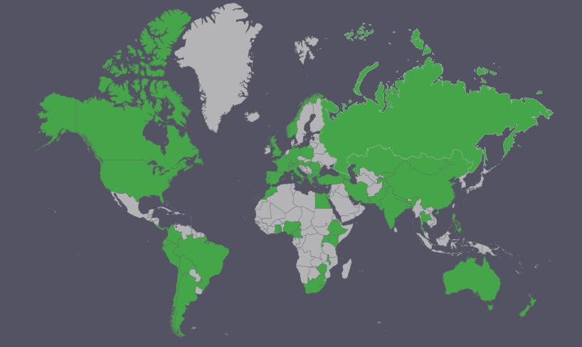
The Mountain Partnership
in figures
59 Gov.ts
7 Sub-national auth.
253 Civil society Organizations
16 INGOs
Notes:
Global issues need global solutions: that’s why the MP was born 15 years ago
MP is present in more than 80 countries
If we look at the figures, the MP has never stopped growing, either in terms of governments and, particularly, in terms of civil society org.
Both graphics show that in the last few years the attention to the MP has even increased. We are ripping the benefits of the huge work that’s been done over the years.
(governments + major groups): 62 developing countries (7 DGCS priority countries: Afghanistan, Bolivia, Cuba, Ethiopia, Kenya, Pakistan, Tunisia)

Slide 8

Programme of Work of the MP Secretariat
Commitment to achieving Sustainable Mountain Development
A.1
Advocating for mountains
    International advocacy of SMD in the framework of the 2030 Agenda
A.2
    Green Cover Index, studies on migration and on indigenous people
Sharing knowledge
A.3
Building capacities
    IPROMO XI, support to MP Products and Biodiversity/REDD+ trainings
A.4
Joining forces to work on initiatives
    Technical cooperation with all members making request
A.5
Mobilizing resources
    Supporting members’ fundraising: GCF, GEF, IKI, FAO, ...

Slide 9
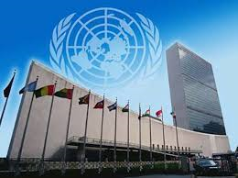
ADVOCACY
    UNSG/UNGA Triennial Resolutions
    Events at the three RIO Conventions
    Global campaigns
  Rio outcome: 3 paragraphs
  SDG process:
    3 mountain related targets achieved
    Green cover index developed to monitor SDG mountain targets
    High Level Political Forum – events planned
    AGENDA 2030 – FRAMEWORK FOR ACTION approved by MP governments

Slide 10
FACEBOOK, FLICKR, MP, WEBSITE, PEAK TO PEAK
Facebook (March 2017 – March 2018):
707 new followers acquired
244 people engaged weekly on average
1–2 posts daily
Flickr:
22,441 Photos of mountain ecosystems, peoples and events, taken by the MPS and members
97 followers
MP website:
24,290 visitors to the website – 84.6% new visitors, 15.4% returning visitors (March 2017 – March 2018)
54 mountain-related event announcements published in 2017
126 news stories about sustainable mountain development published in 2017
Peak to Peak:
Monthly Mountain Partnership newsletter, Peak to Peak, distributed to 2,000 + people
Average open rate March 2017 – March 2018: Members = 28.6%; Friends = 21.2%

Slide 11
SDG INDICATOR 15.4.2:
MOUNTAIN GREEN COVER INDEX
TARGET 15.4 By 2030, ensure the conservation of mountain ecosystems, including their biodiversity, to enhance their capacity to provide benefits essential for sustainable development
Mountain green cover index: measures the changes of green vegetation and land cover in mountain areas - i.e. trees, shrubs, grassland, cropland, wetland, settlements, other land (IPCC) – to monitor progress on the mountain target (developed by FAO Mountain Partnership Secretariat and endorsed by the UN)

Slide 12
MAP OF MOUNTAIN AREAS –
UNEP/WCMC CLASSIFICATION
32 million km² = 22% of earth’s land surface

Slide 13

sharING knowledge
Producing technical publications, brochures,
videos and newsletters
Maintaining a website and social media channels
Fostering communication among members

Slide 14
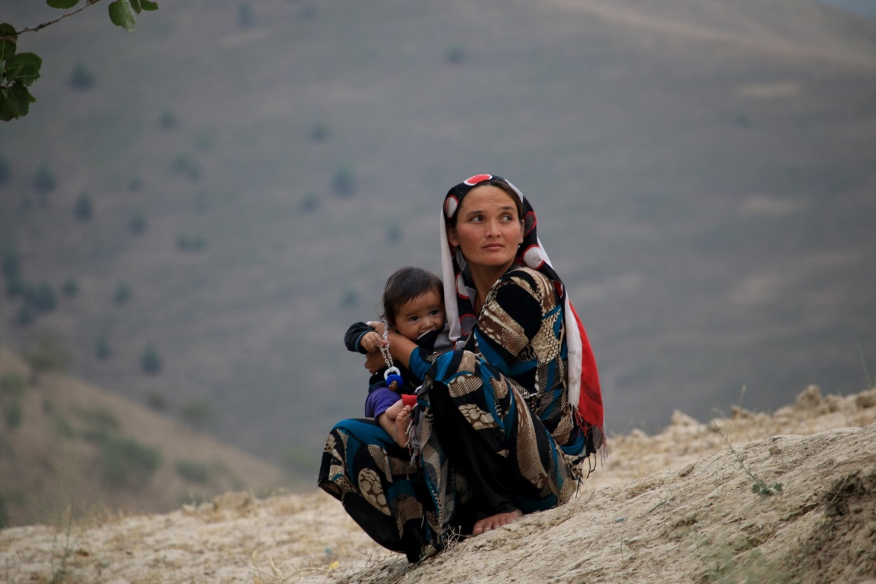
International Mountain Day
More than 200 events organized by governments
and civil society organizations in 44 countries
Fact sheets and posters produced in the six UN languages, IMD website, events reported on the IMD website and in Peak to Peak
# Mountains Matter Photo contest and Video contest

Slide 15
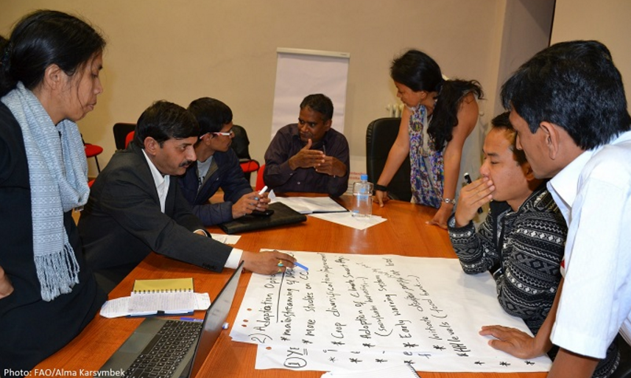
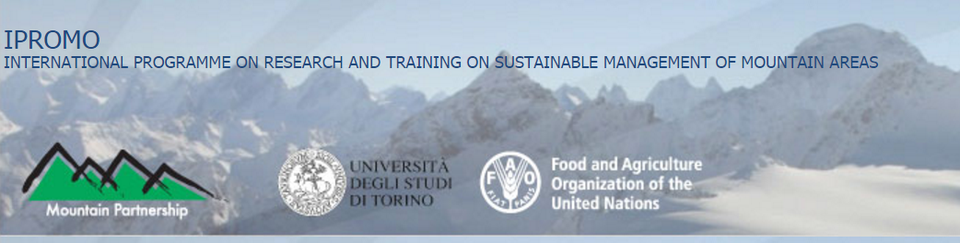
Capacity development
11 years of IPROMO
IPROMO Impact
Assessment
Launch of Mountain
Education Portal
Notes:
In 2016, in order to assess the impact IPROMO has had on its participants’ career development and networking and to improve the programme for the next courses, the Mountain Partnership Secretariat circulated a survey to all past IPROMO participants. The results showed that 92 percent said their careers benefitted from attending IPROMO, 94 percent shared knowledge gained at IPROMO with other colleagues and 84 percent are still in contact with other IPROMO participants.
In 2017, the MPS launched the Mountain Education Portal: connecting students and professionals with academic institutions offering mountain courses.

Slide 16
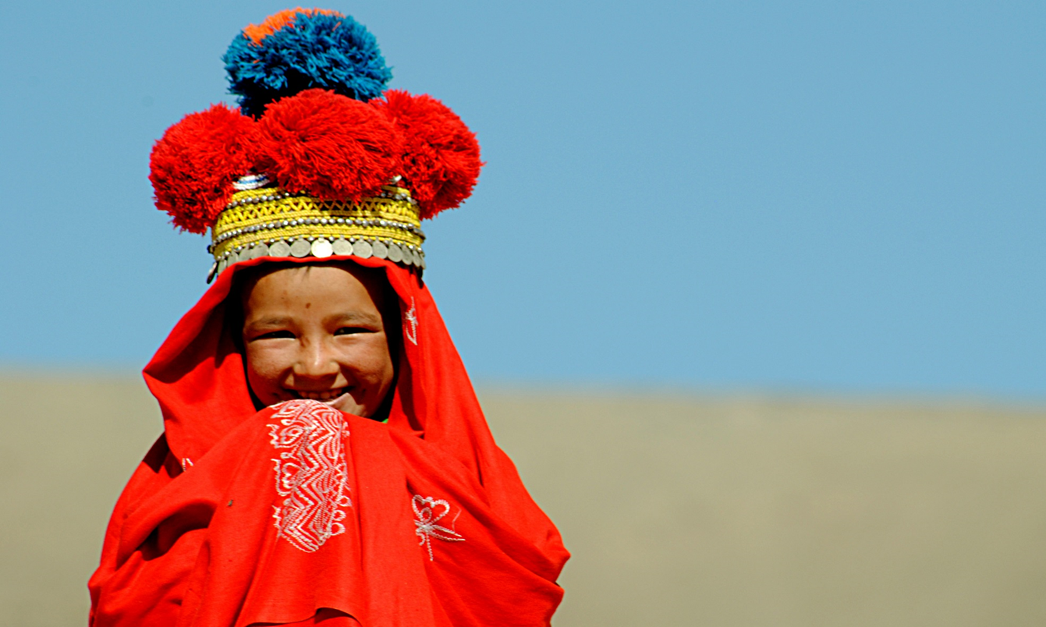
MOBILISING RESOURCES
      Green Climate Fund (GCF)
Global Environment Facility (GEF)
Technical Cooperation Projects (TCP)
Donor agencies
Databases of funding sources
The MP supports members in developing joint proposals and projects
Notes:
La Alianza para las Montañas es una plataforma para ejercer una acción conjunta y ejecutar programas. Los miembros unen sus fuerzas para promover, facilitar y llevar a cabo iniciativas en los ámbitos nacional, regional e internacional, mientras promueven la concienciación acerca de los retos que enfrentan los pueblos de las montañas y su entorno.
Abogar por la atención mundial
dirección de campañas internacionales y realización de eventos para destacar las cuestiones de la montaña globalmente
promoción de la inclusión del desarrollo sostenible de las montañas en las negociaciones y políticas globales, regionales y nacionales
elaboración de políticas y publicación de informes, mensajes claves e informes de la ONU
Promover proyectos conjuntos
compartir información sobre las convocatorias de proyectos y oportunidades de financiación
crear un ambiente favorable para promover la colaboración entre los miembros
apoyar a los miembros en el desarrollo de propuestas conjuntas y proyectos
Compartir conocimientos
producir publicaciones técnicas, folletos, videos y boletines
investigar y analizar datos para generar evidencia empírica
alentar la comunicación entre los miembros
Fortalecer la capacidad
organizar el curso anual Programa Internacional de Investigación y Formación sobre la Gestión Sostenible de la Áreas Montañosas (IPROMO)
promover la transferencia de tecnología entre los miembros
realizar talleres y sesiones de capacitación

Slide 17

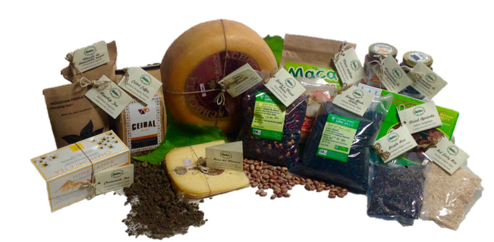
Launch of a global Mountain label
The Mountain Partnership Product logo designates a voluntary labelling scheme for high value Mountain products from developing countries
Its use is intended to support smallholder Mountain producers in maintaining sustainable production processes and better ensure fair compensation for their products
Notes:
Los miembros de la Alianza para las Montañas unen sus fuerzas para desarrollar una certificación voluntaria para marcar “productos de montaña de alto valor”, como estrategia para impulsar las economías locales.
La iniciativa forma parte del proyecto Cambio Climático y Bosques de Montaña, a cargo de la Alianza para las Montañas. Este proyecto está financiado por el Gobierno de Italia, y se concentrará en el análisis de la cadena de valor y desarrollo de la capacidad en áreas de montaña diferentes.

Slide 18
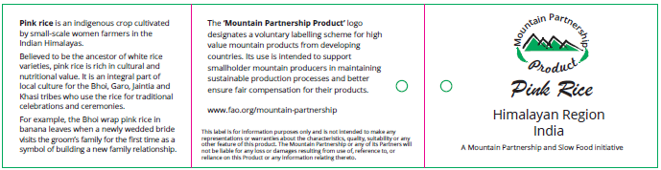
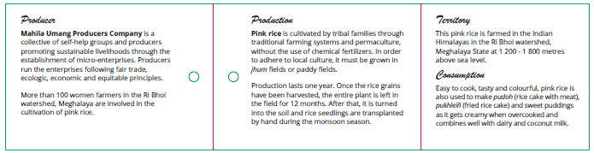
The MounTAIN PARTNERSHIP PRODUCT LABEL
The label tells the story of a specific product and highlights what makes it unique, complementing the information that is already included in a typical commercial label to help customers make a more informed purchase

Slide 19
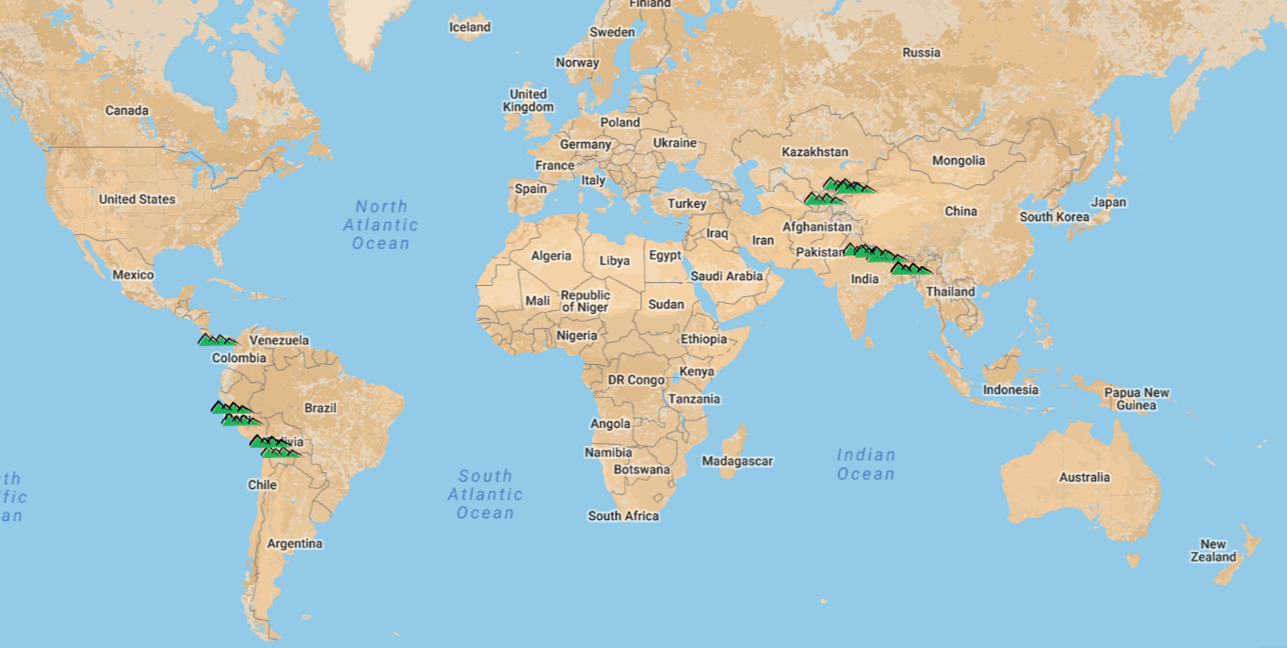
Pilot implementation
Notes:
Fourteen additional food products were selected from 6 countries (Bolivia, Kyrgyzstan, Peru, Nepal, India, and Panama) and 2 handicraft products from Kyrgyzstan and Mongolia, which were granted the label and were promoted by the Mountain Partnership Secretariat and Slow Food through the respective communication networks. Such products include: Bolivian cheeses, Peruvian jams, Nepalese lentils and beans, Indian chamomile tea and rice, Panama’s coffee, Kyrgyz teas, as well as Kyrgyz silk-and-felt scarves and felt toys from Mongolia.
Plus preliminary activities in Cuba.

Slide 20
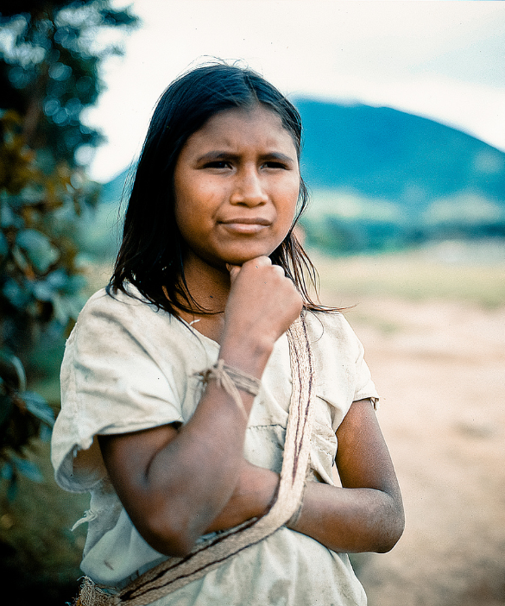
MAPping Indigenous mountain peoples
Mountain peoples are defined as groups that:
Live or spend at least part of the year on a mountain or highland area
Structure their traditional food systems around mountain ecosystems
Have a clear connection between their collective identity and a mountain or range

Slide 21
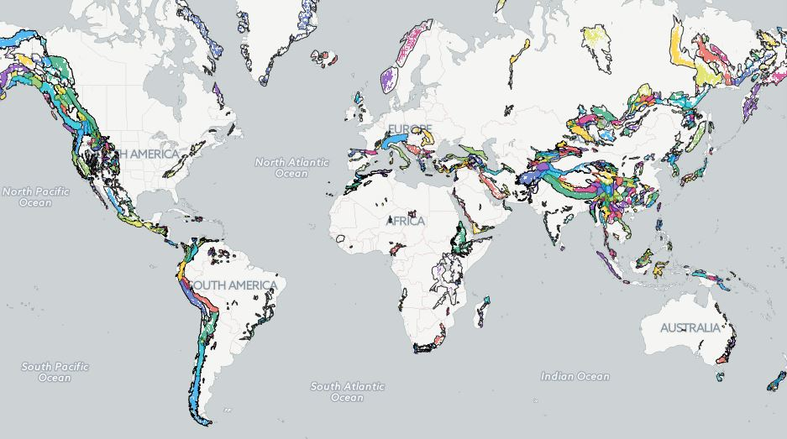
11
12
13
14
15
6
1
2
7
3
8
4
10
9
5
1. St'at'imc people, Canada
2. Goshute people, USA
3. Zapotec people, Mexico
4. Aymara people, Bolivia
5. Pewenche people, Chile
6. Sami people, Norway
7. Berber peoples, Algeria
8. Amhara people, Ethiopia
9. Xhosa people, South Africa
10. Tsimihety people, Madagascar
11. Yakut people, Russia
12. Karadaghi people
13. Rai people, India/Nepal
14. Degar people, Vietnam
15. Palawa people, Tasmania

Slide 22

SDG indicator 15.4.2:
Mountain Green Cover Index
TARGET 15.4: By 2030, ensure the conservation of mountain ecosystems, including their biodiversity, to enhance their capacity to provide benefits essential for sustainable development
The MPS/FAO is the responsible organization for the Mountain green cover index: measures the changes of green vegetation and land cover in mountain areas - i.e. trees, shrubs, grassland, cropland, wetland, settlements, other land (IPCC) – to monitor progress on achievement of the mountain target
Notes:
In mountain areas, below the permanent nival area, reduction or absence of green coverage is linked to land degradation and depletion of natural resources due to overgrazing, forest exploitation, timber extraction, fuel wood collection, or land clearing, urbanization, and fire. Green cover increase could stem from vegetation growth possibly linked to direct investments, such as forest or rangeland restoration, agroforestry, reforestation or afforestation practices.
Mountain development encompasses multiple areas that the SDGs focus on – poverty eradication; water and sanitation; sustainable agriculture, food security and nutrition; energy; climate change; and ecosystems and biodiversity. These strategically important themes are all connected. For example, mountain ecosystems cannot continue to provide a wide range of universally important ecosystem services if poverty and food insecurity in mountains are not specifically addressed.
The scientific mountain community recognizes that there is a direct correlation between the green coverage of mountain areas and their state of health, and as a consequence their capacity of fulfilling their ecosystem roles. Monitoring mountain vegetation changes over time provides an adequate measure of the status of conservation of mountain ecosystems. Monitoring the mountain “Green Cover Index” over time can provide information on the forest, woody and vegetal cover in general. For instance, its reduction will be generally linked to overgrazing, land clearing, urbanization, forest exploitation, timber extraction, fuelwood collection, fire. Its increase will be due to vegetation growth possibly linked to land restoration, reforestation or afforestation programmes.
The indicator results from the juxtaposition of land cover data extracted from FAO Collect Earth tool and the global map of mountains produced by FAO/MPS in 2015 based on the UNEP-WMCM mountain classification.
The indicator is based on Collect Earth, the most modern technology available. Its user friendliness and smooth learning curve make it a perfect tool for performing fast, accurate and cost-effective assessments. It is free, open source and highly customizable for the specific data collection needs and methodologies. It builds upon very high resolution multi-temporal images from Google Earth and Bing Maps and Landsat 7 and 8 datasets from Google Earth Engine. Data and images are stored and globally available for any year from 2000, making possible the monitoring of the change over time.
The indicator has a global accuracy of 99%, but at national level for small countries the degree of accuracy is lower. This will be improved over time as more countries expand the data collection within their territory.
Data on mountain coverage are provided by the 2015 FAO/MPS global map of mountains.

Slide 23

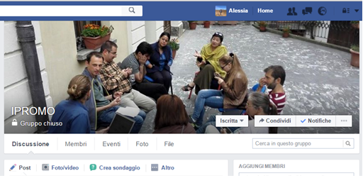
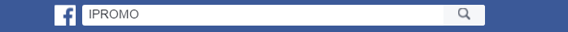
IPROMO ALUMNI
Alumni network
Presentations all on line
You are an agent for change
Join the community !

Slide 24
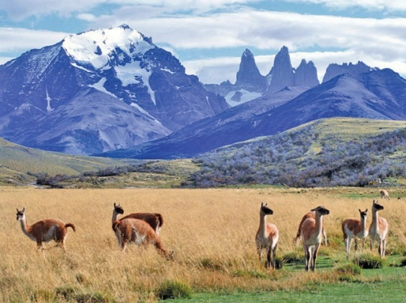
Thank you!

