Slide 1
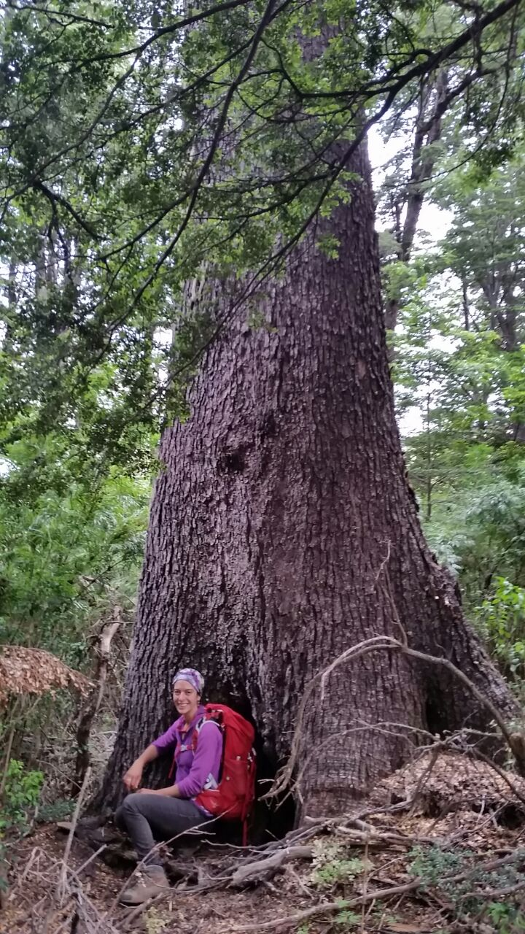
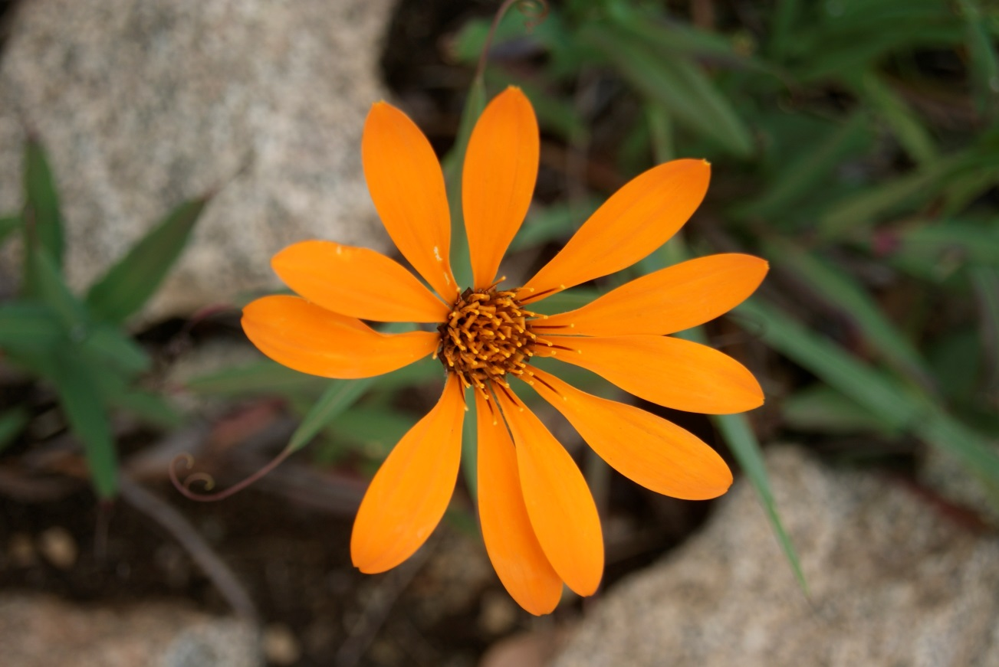
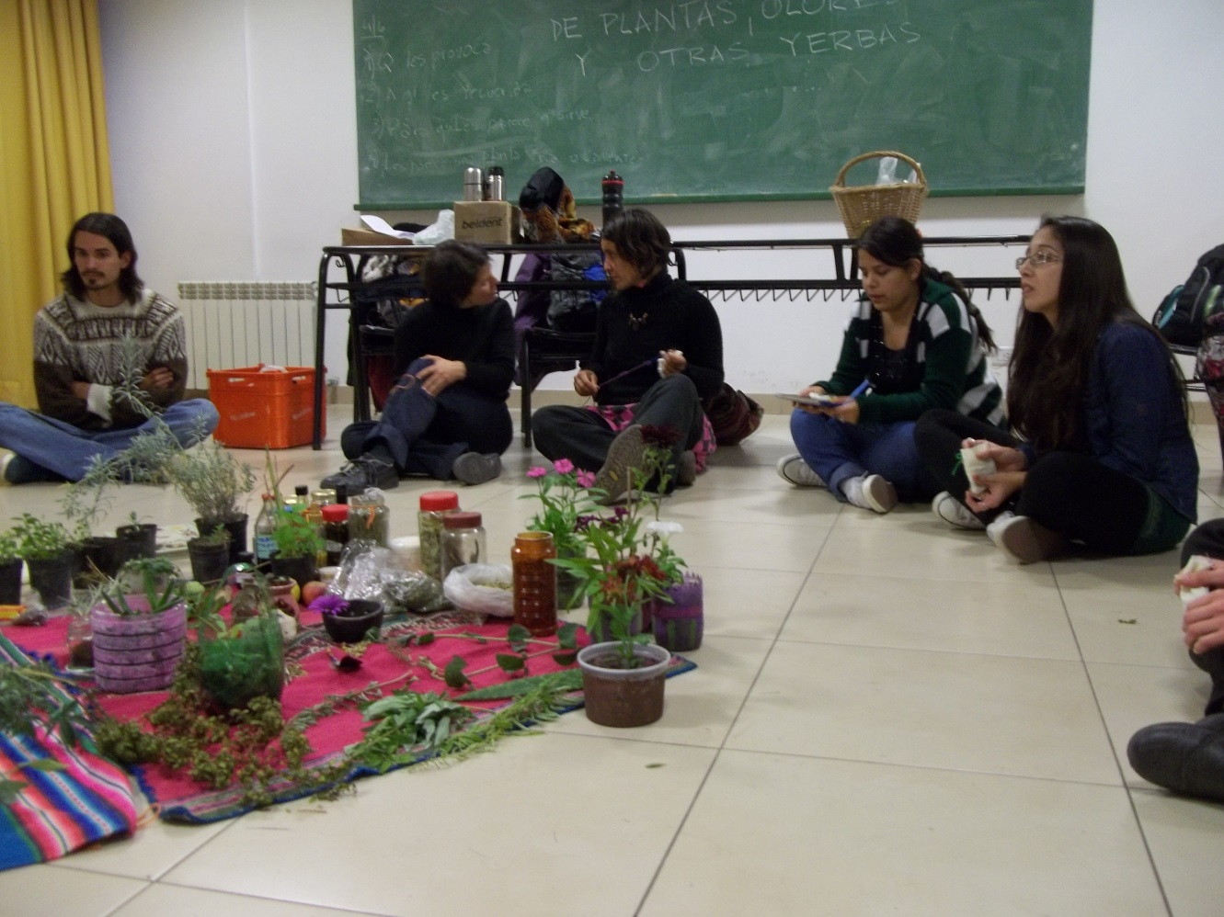
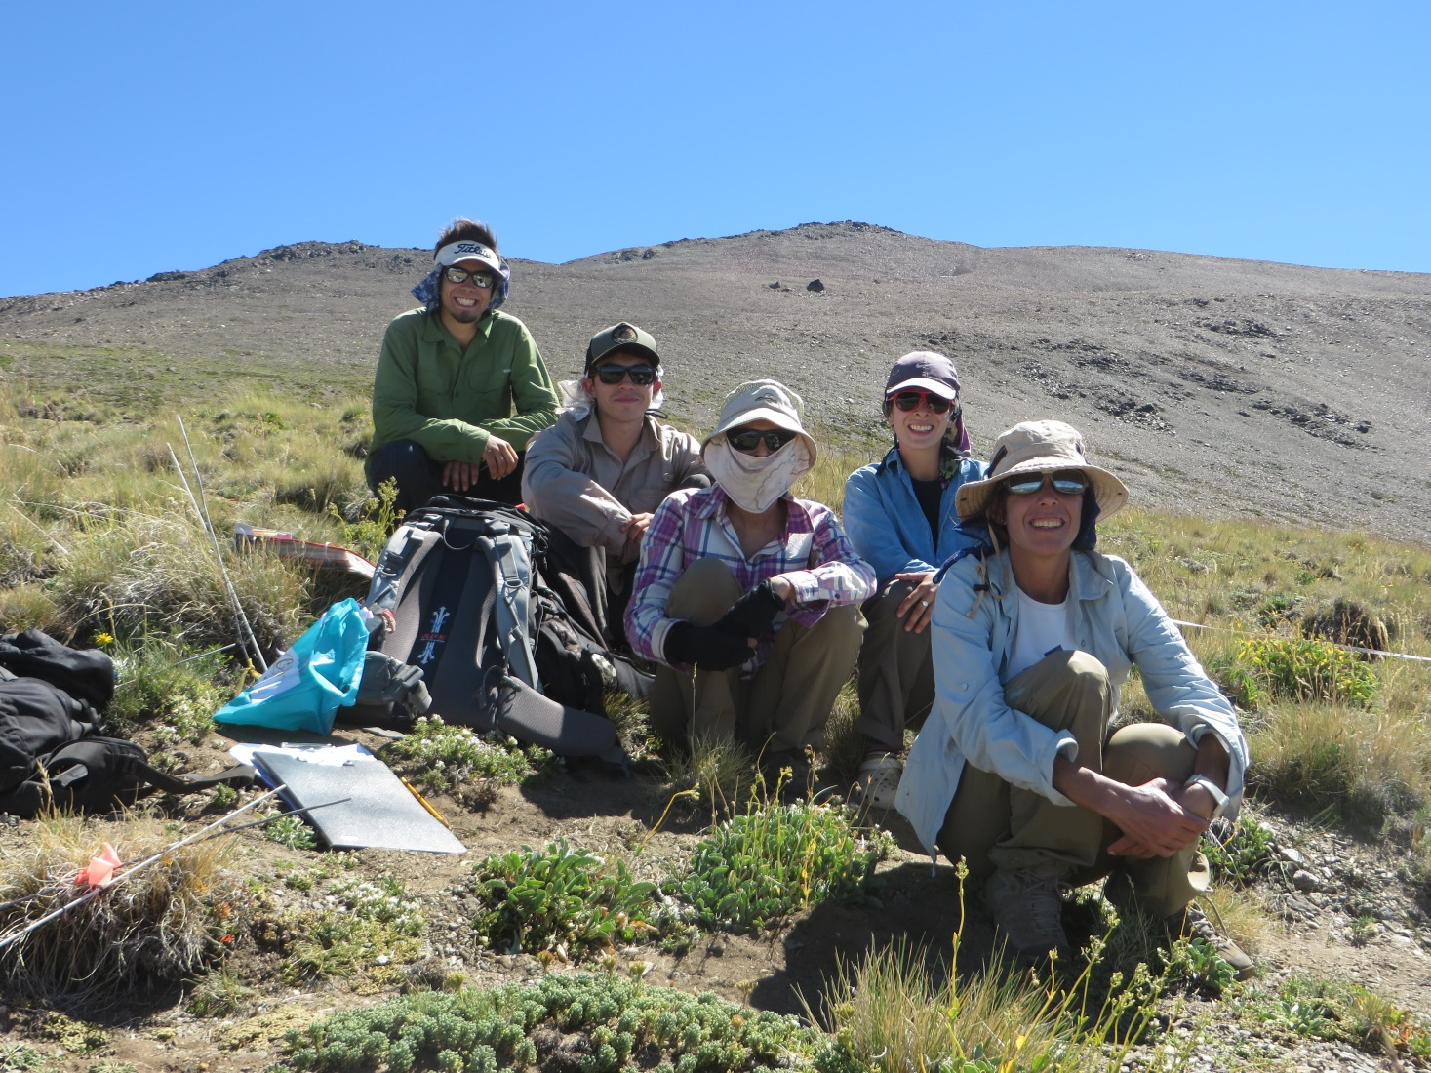
Clara Pissolito
Universidad Nacional de Río Negro-CONICET
cpissolito@unrn.edu.ar
IPROMO
Bioeconomy in mountain areas – an opportunity for local development
Pieve Tesino /Ormea 18 June -02 July 2018

Slide 2
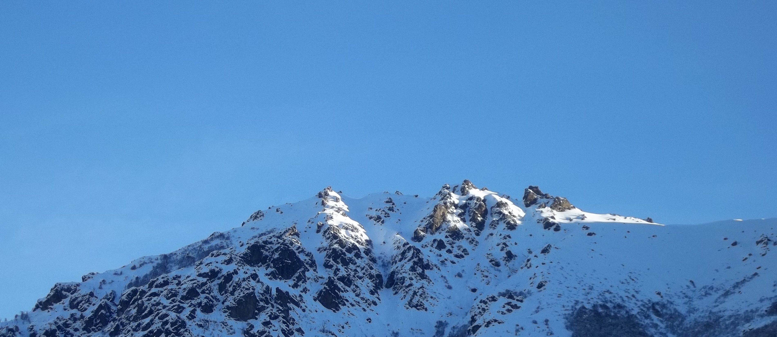
Education
Natural Resources Engineer
Doctorate in Biology
Employment and main activities
Researh in forest restoration and the impact of tourism on high mountain vegetation
Teaching «Climatology for Agriculture»

Slide 3
Practice
and teach yoga
Medicinal
plants
Hiking

Slide 4
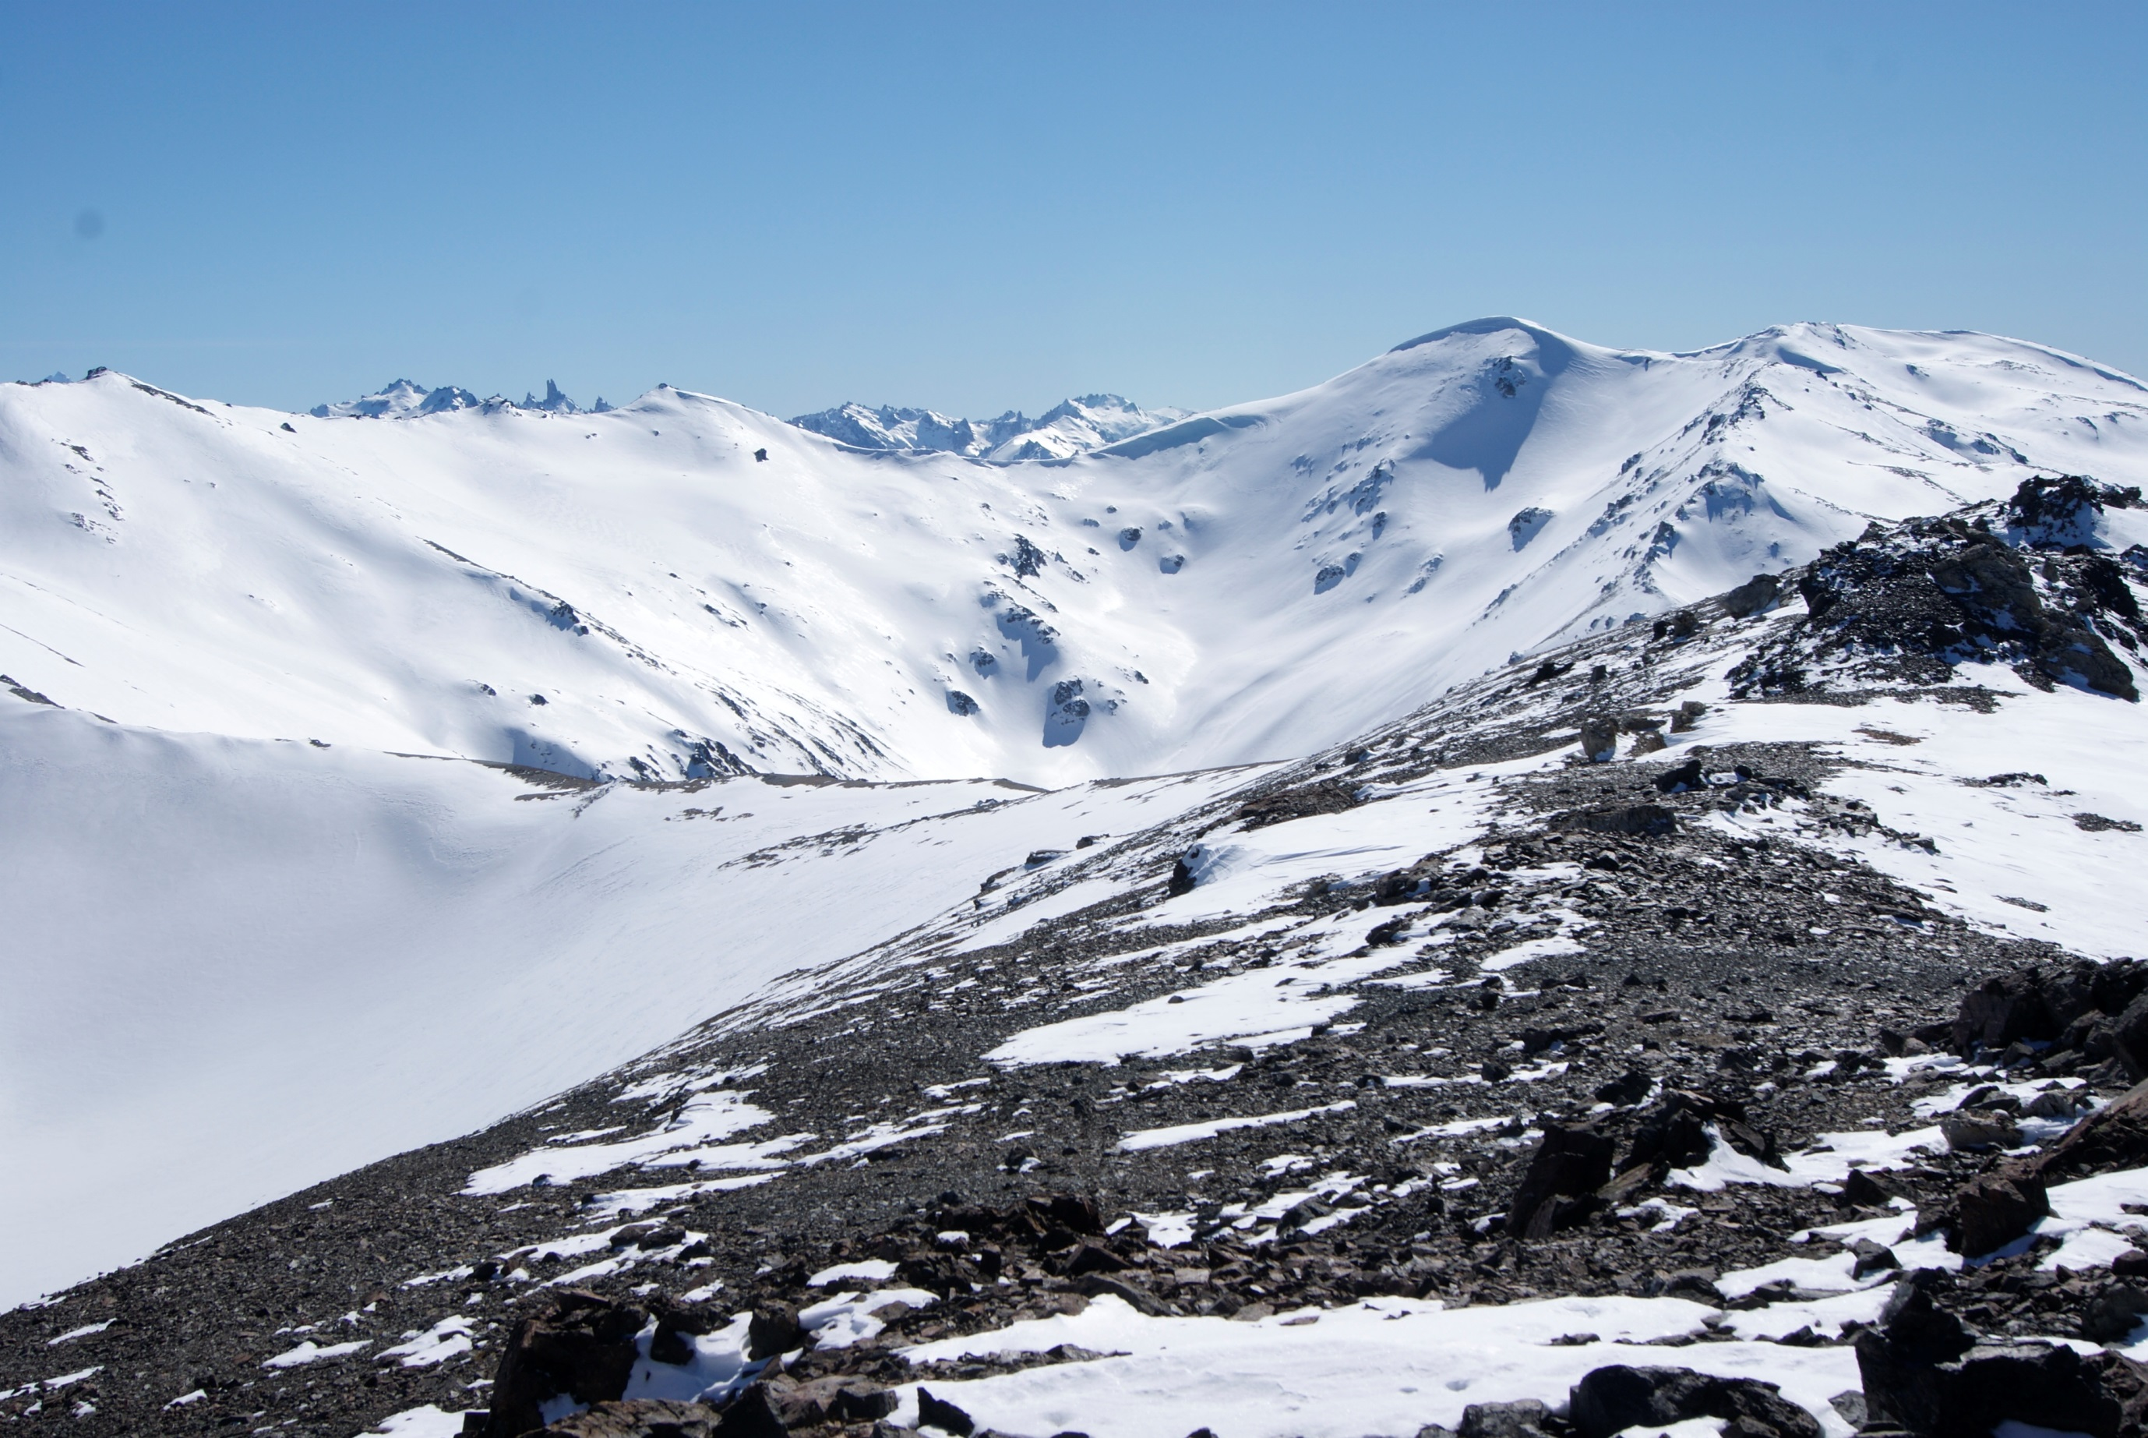
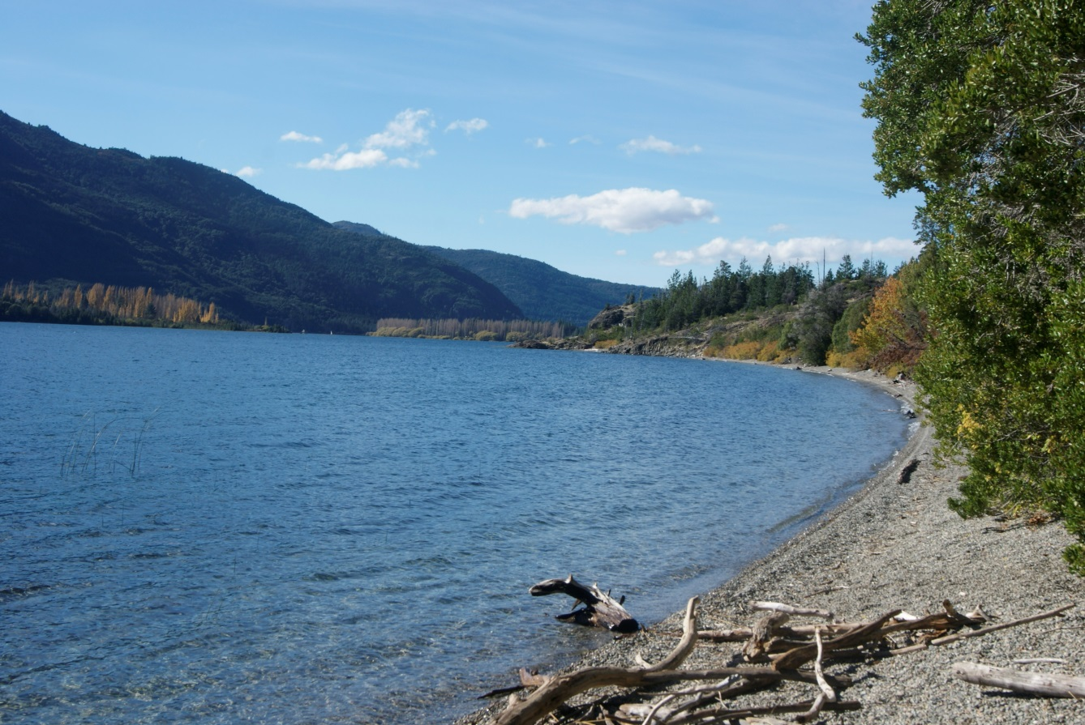
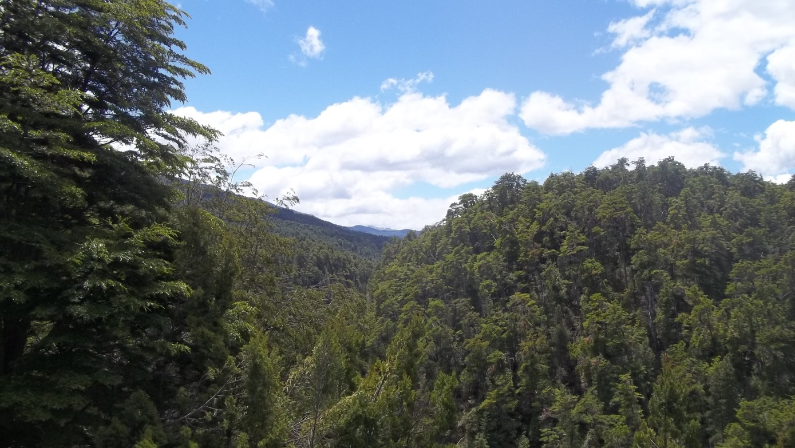

Slide 5
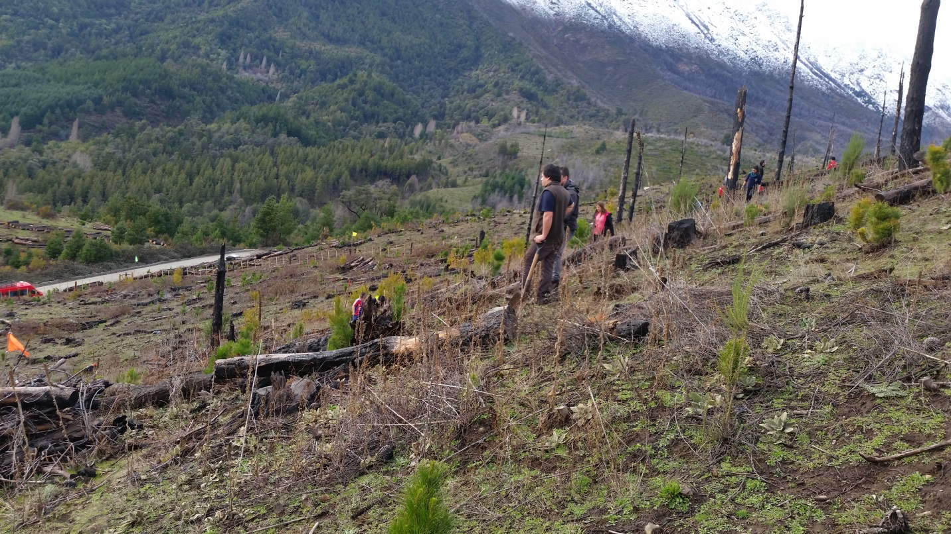

Slide 6
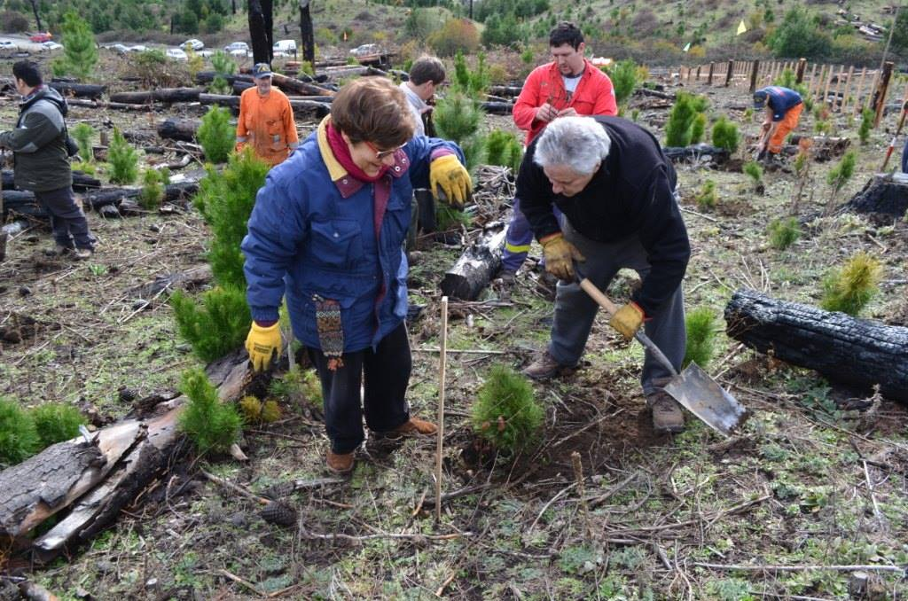
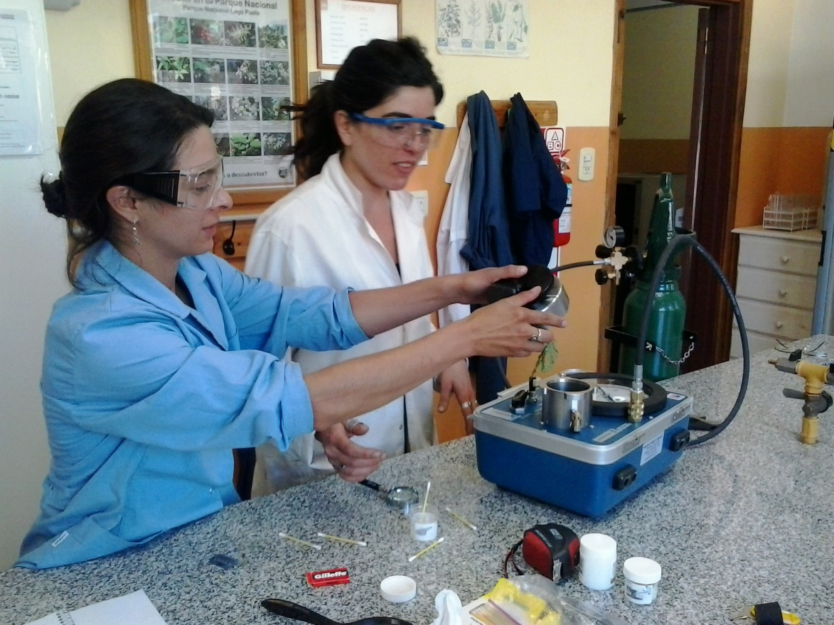
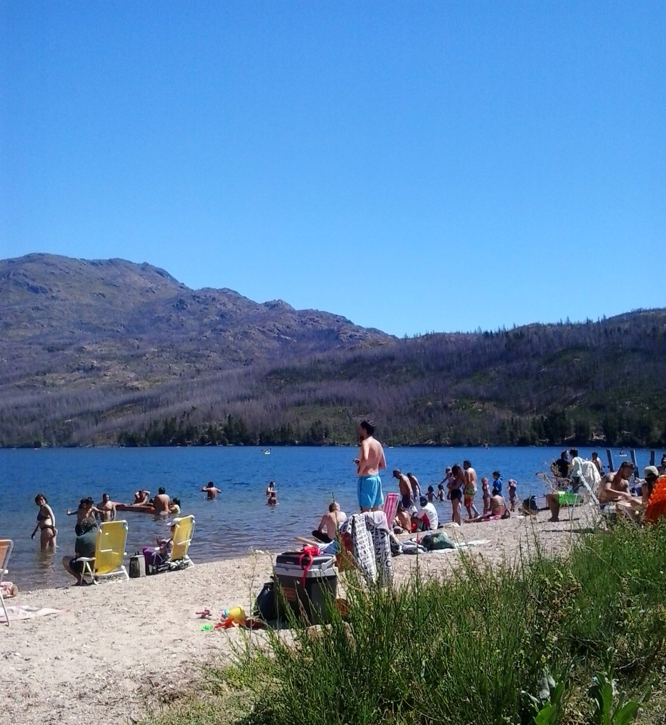
Gracias!!
Volunteer opportunities available!!!

