Slide 1


Jaymee Silva Balarin
The Mountain Institute
OIKOS
jsilva@oikos.pe
IPROMO
Bioeconomy in mountain areas – an opportunity for local development
Pieve Tesino /Ormea 18 June -02 July 2018

Slide 2
Education
The University of Melbourne - Australia
2015-2017| Master of Environment (Climate Change stream)
Universidad Nacional Mayor de San Marcos (UNMSM) - Peru
2009-2010| Diploma in Biodiversity Management
Universidad Peruana Cayetano Heredia (UPCH) - Peru
2003-2008| Doctor in Veterinary Medicine & Animal Husbandry
Employment and main activities
Program Officer in TMI Global Team
Technical Assistant in OIKOS
Coordinator of Climate Change Diploma for UNMSM

Slide 3
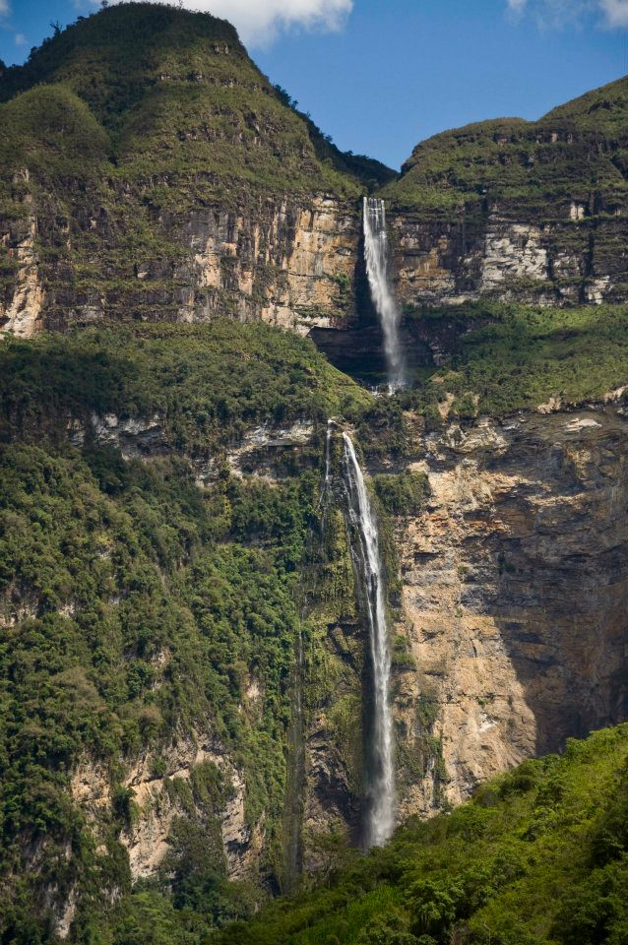
Other interests (volunteer work, hobbies etc.)
Photography
Yoga
Rock Climbing
Dancing

Slide 4
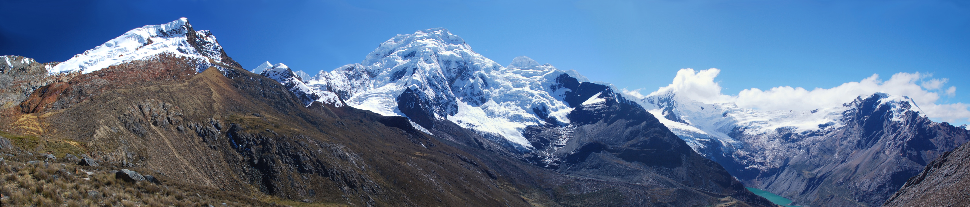
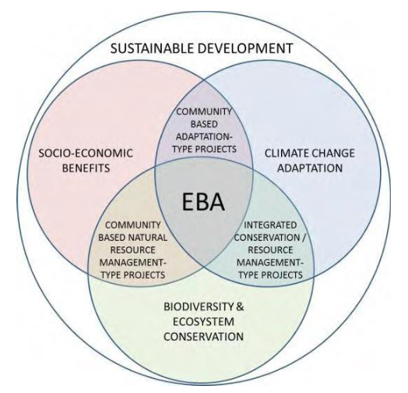
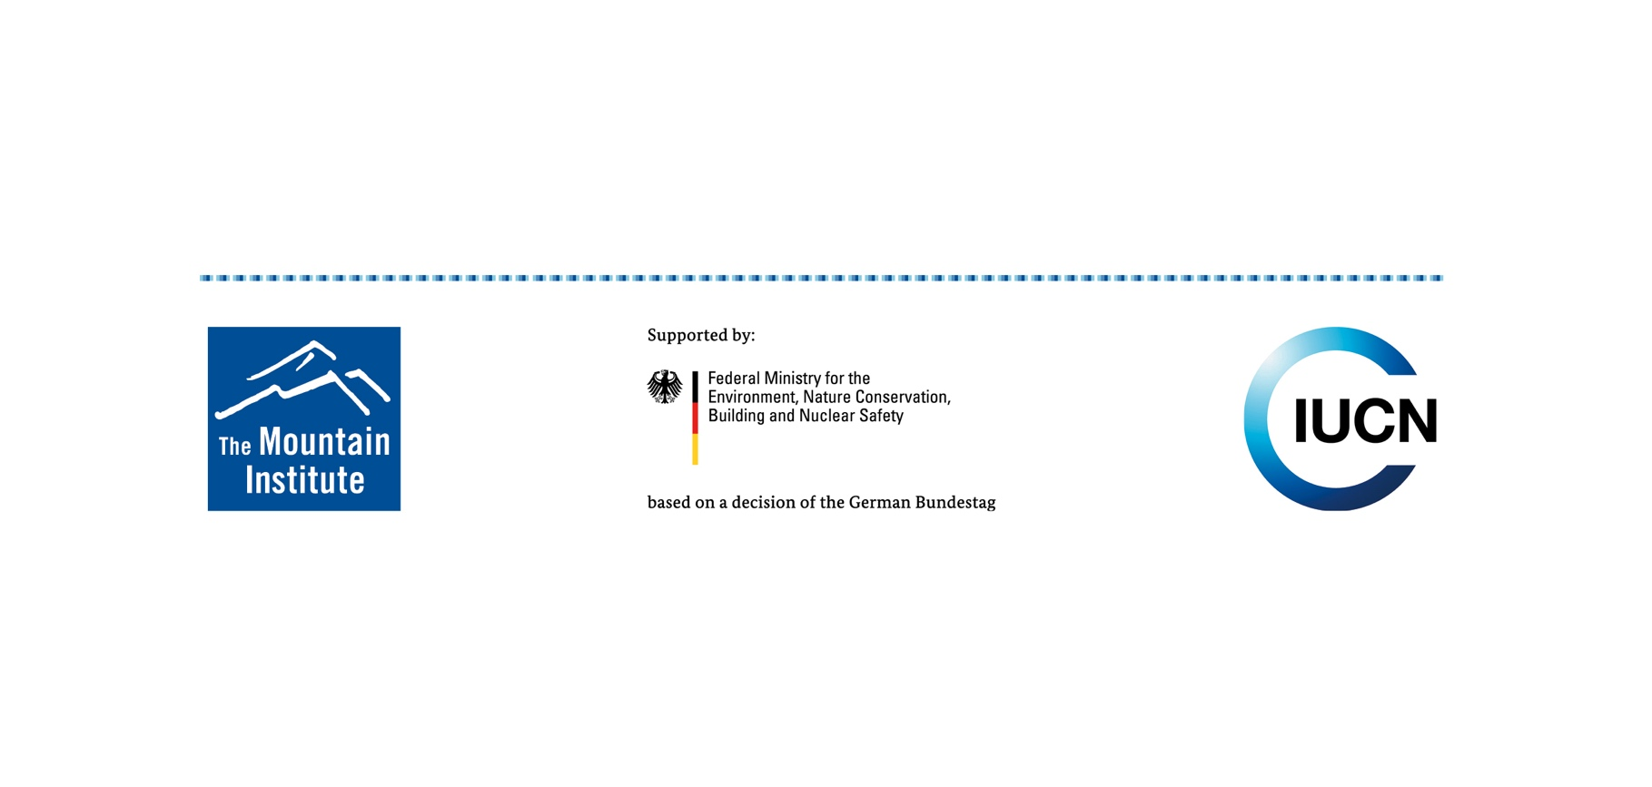
Mountain EbA Program
Scaling Up Mountain Ecosystem-Based Adaptation: Building evidence, replicating success, and informing policy

Slide 5
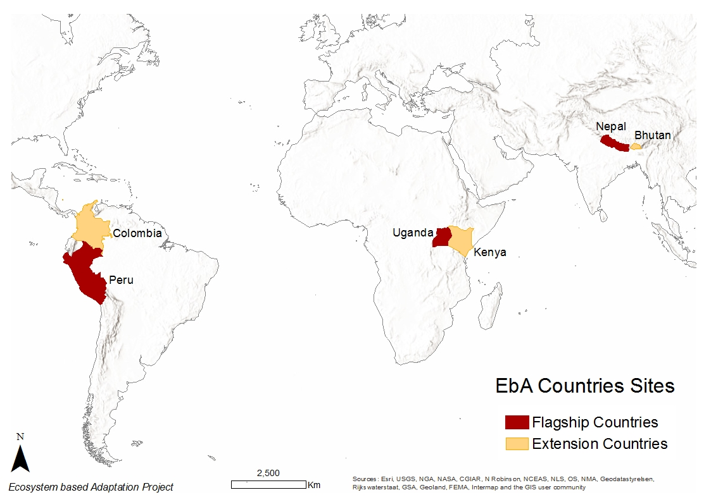
Goal: To scale up EbA as a means to build climate-change resilience and promote adaptation in mountains
Flagship countries: Nepal, Peru, Uganda
Expansion countries: Bhutan, Colombia, Kenya
Timeframe: July 2017– June 2020
Partners: TMI, IUCN, and country partners

Slide 6
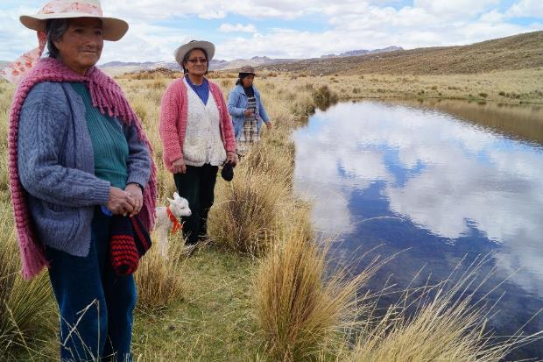
Scaling up Mountain EbA in PERU
Implementation of 4 EbA measures to reduce people and ecosystem vulnerabilities:
Recovery of upper micro-watersheds, wetlands and water-courses through restoration of ancient water channels and reservoir dam
Wetland fencing
Improving water distribution in communal grazing areas
Sustainable management of grasslands through enhanced vicuña and livestock management

