Slide 1
Marat ASANALIEV
German Federal Enterprise for International Cooperation (GIZ)
Regional Programme for Sustainable and Climate Sensitive
Land-Use for Economic Development in Central Asia
Bishkek, Kyrgyzstan
marat.asanaliev@giz.de
IPROMO
Bioeconomy in mountain areas – an opportunity for local development
Pieve Tesino /Ormea 18 June -02 July 2018

Slide 2
Kyrgyzstan: Geographic Location

Slide 3
Education
Master in Public Policy, The National Graduate Institute for Policy Studies. Tokyo, Japan. 2009
Employment and Main Activities
Coordinator – Piloting of the Forest Sector Reform Project
manage project activities on forest sector reform and related land-use issues;
maintain policy dialogue with national counterpart;
coordination with development partners active in forest sector;
ensure up/out-scaling of the forest piloting lessons learnt to facilitate 12 mio investment project;

Slide 4
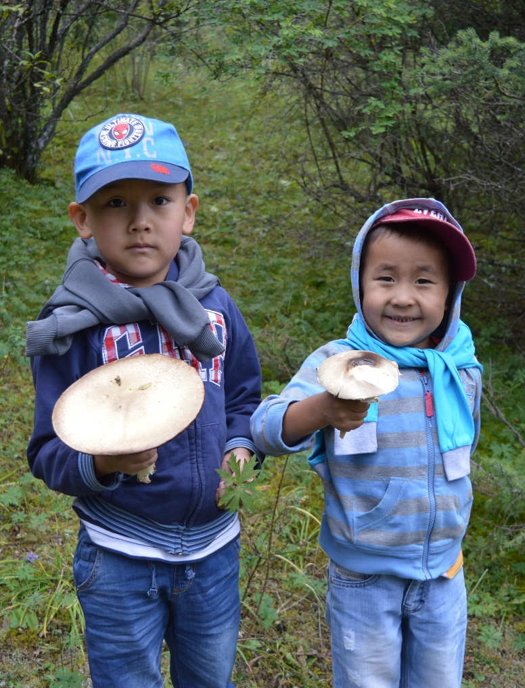
Volunteer Activity, Hobbies
«Kyrgyz People» public foundation
Fishing, Mushroom Picking, Traditional bow

Slide 5
Forest Sector Reform – Why?
population dependent on forests & pastures resources;
sustainable use of resources under great threat:
- population & livestock numbers increase
- ineffective management and
- climate change challenges.
So, there is a need for reform:
gradual transition to innovative and adapted principles; to
increase total forest area;
foster ecological functions and economic benefits;
Key elements of the reform: decentralization and partnership

Slide 6
Piloting of Forest Sector Reform is Process of:
testing innovative mechanisms of decentralized and participatory management followed by comprehensive analysis
involving local communities, authorities and private sector;
joint development of forestry reform policy document at national level based on piloting experiences;
Government - lead,
Development partners - support;

Slide 7
Piloting - Levels
National: Coordination and Consultative Council
Local: Joint Forest Management Councils of 6 pilot forest management units (FMU)
Roles:
CCC : coordination, monitoring and evaluation of FMU plans, documentation of lessons learnt.
FMUs: focus on management functions, promote partnership and cooperation, transfer of economic functions, elaborate participatory operational mgmt plans.
JFMCs: exchange of information, discussion, monitoring of activities; grievance mechanism, ensuring transparency and accountability of forest management decisions.

