Slide 1
Personal presentation
Zhumashev Murat
Kyrgyzstan
CAMP Alatoo PF
murat@camp.kg
IPROMO
Bioeconomy in mountain areas – an opportunity for local development
Pieve Tesino /Ormea 18 June -02 July 2018

Slide 2
Education
2014 – 2017 | Kyrgyz State Law Academy under the Government of Kyrgyz Republic (Bishkek) Faculty of Magistracy “Administrative law; financial right; information law” (Magistracy)
2007 – 2012 | Kyrgyz National University named after Jusup Balasagyn (Bishkek) Institute of Economics and Finance “Finance and Credit” (Specialty)
Employment and main activities
January 2017 – to present | PF CAMP Alatoo Bishkek, - Energy efficiency project’s specialist, coordinator
July 2012 – January 2017 | The State Service of Regulation and Supervision of Financial Market under the Government of Kyrgyz Republic Bishkek, Specialist of the Department for Supervision of the Securities Market Leading Specialist of the Securities Market Development Department

Slide 3
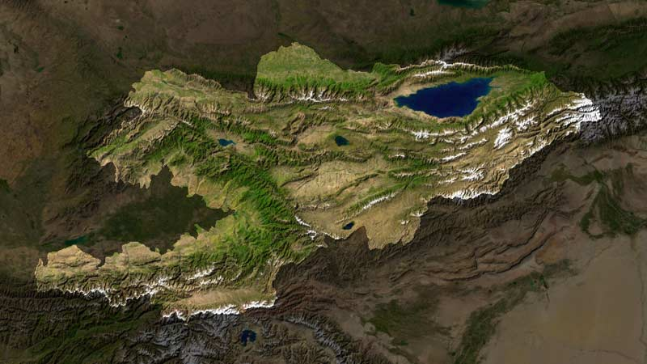
Other interests (volunteer work, hobbies etc.)
I love mountains. In my spare time I always try to go to the mountains. I’m lucky that 93% of Kyrgyzstan is a mountainous area.
I also like to ride a bicycle.

Slide 4
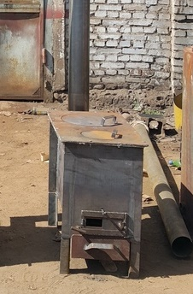
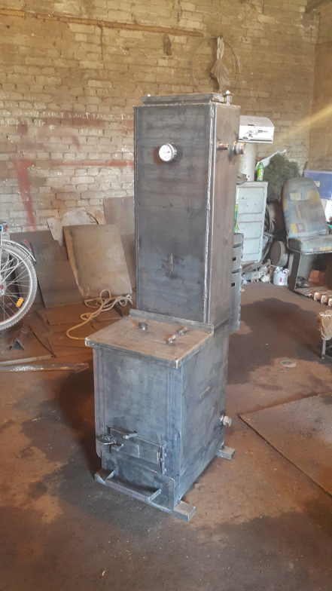
Energy efficient stoves project in Kyrgyzstan
Objectives of the Pilot Project
Identifying and selecting efficient heating stoves
Selecting households for stove installation and monitoring of results
Support development of a stove testing protocol
Monitoring results during heating seasons 2016/2017 and 2017/2018

Slide 5
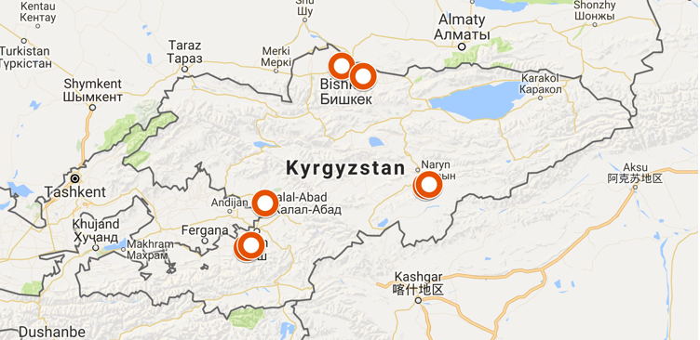
Project area and households
Oblast | Households | Type of stove | Monitoring status
Jalal-Abad and Osh | 20 | 19 coal stoves (KG4) 1 low pressure boiler (KG5); | Stove and health condition monitoring.
Naryn | 45 | 20 biomass stoves (KG1, KG2 and KG2.5) 20 coal stoves (KG4 and KG4.4) 5 low pressure boilers (KG5.2) | Stove and health monitoring. Before and after stove installation.
Chui | 11 | 10 low pressure boilers (KG5) 1 coal stove (KG4) | Stove and health condition monitoring.

Slide 6
Combustion efficiency
CO/CO2 - : the system efficiency, expressed as the ratio of the energy delivered into the living space divided by the energy available from the fuel, and the combustion efficiency expressed as a completeness of the combustion of carbon.

