Slide 1
IPROMO 2019 Summer School
Brief Intro
Danilo Godone – chairman

Slide 2
Daily agenda
9:00 - 13:00 Lectures (coffee break included!!!)
13:00 - 14:00 Lunch
14:00 – 17:00 Lectures (coffee break included!!!)
17:00 – 19:00 Working Groups

Slide 3
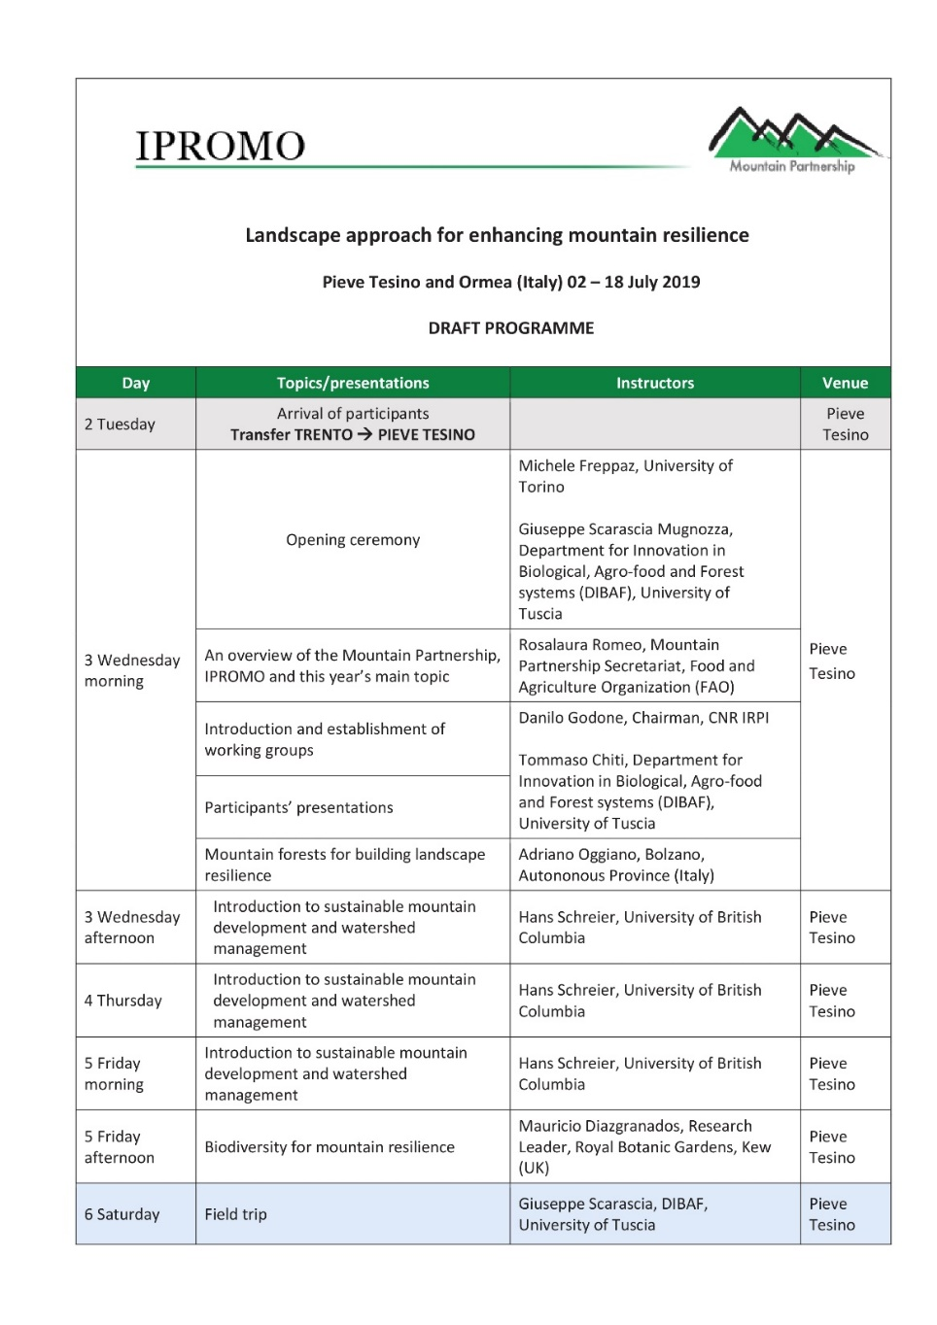
Programme – week 1

Slide 4
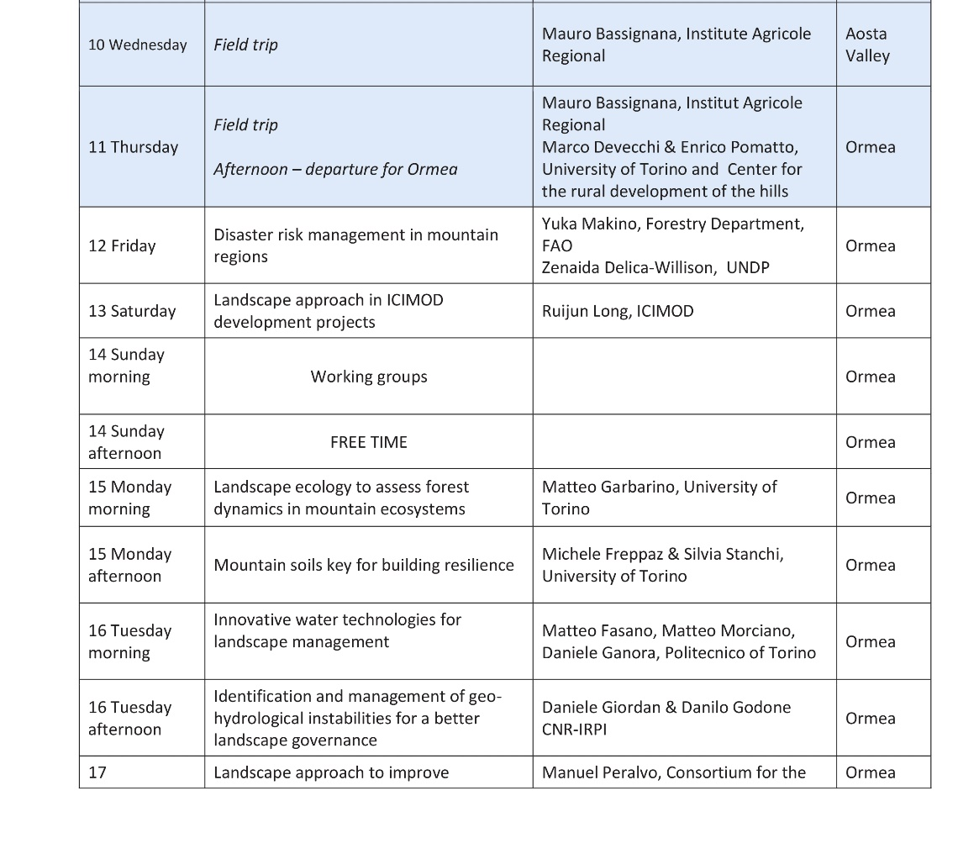
Programme – week 2

Slide 5
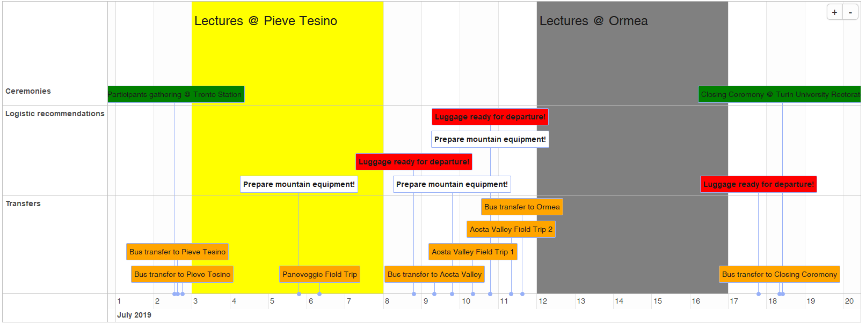
Schedule of the course

Slide 6
Topic
Landscape approach for enhancing mountain resilience
©Wageningen Centre for Development Innovation

Slide 7
Landscape…what other people see
https://www.facebook.com/trust.biologist/?tn-str=k%2AF

Slide 8
Landscape…what we see!
https://www.facebook.com/trust.biologist/?tn-str=k%2AF

Slide 9
Ten Principles of a Landscape Approach
Ten Principles of a Landscape Approach
Jeffrey Sayer,
Centre for Tropical Environmental and Sustainability Science – James Cook University
Louise Buck,
EcoAgriculture Partners , Cornell University

Slide 10
Principle 1: Continual learning and adaptive management; learning from outcomes can improve management.
Principle 2: Shared interest in an issue or problem; build solutions – even to wicked problems where parties have divergent views on possible solutions – around perceptions of common interest.
Principle 3: Multiple scales; awareness of numerous system influences and feedbacks that affect management is essential.
Principle 4: Multifunctionality; landscapes and their components have multiple uses and purposes that require tradeoffs be reconciled.
Principle 5: Multiple stakeholders; engaging them in an equitable manner is needed to ensure optimal and ethical outcomes.

Slide 11
Principle 6: Negotiated and transparent change logic; transparency is the basis of trust needed to avoid or overcome conflict and is helped by good governance.
Principle 7: Clarification of rights and responsibilities; rules on resource access and land use need to be clear to ensure good management and good outcomes.
Principle 8: Participatory and user-friendly monitoring; it is valuable to derive information from multiple sources.
Principle 9: Resilience; increase system-level resilience through recognition of threats and vulnerabilities and actions to reduce them.
Principle 10: Strengthened stakeholder capacity; people require the ability to participate effectively and to accept various roles and responsibilities.

Slide 12
The course will…
focus on several aspects, tools and skills that contribute to an integrated management of mountain areas through a landscape approach:
environmental conservation and water supply;
income generation;
food security;
participatory approach;
mountain resources management;
interrelations between climate change (and other global challenges) and mountain.
form working groups:
knowledge sharing ;
experts’ network buiilding.

Slide 13
Working groups 1/2
Task:
Prepare a presentation showing how the landscape approach could be used to improve the local development.
Tips:
Use an already existing project as starting point (participants’ contribution);
Take advantage of group discussion (participants’ contribution);
Exploit lessons learned from lectures & field trips (lecturers’ contribution);

Slide 14
Working groups 2/2
Task:
Prepare a presentation showing 4 iconic pictures of a country to show during the welcome ceremony at Gressoney la Trinitè (Aosta Valley)
Tips:
Each group should select a representative (and its country)

Slide 15
Group 1
Alejandra Huaman
Badri Baral
Ghanshyam Pande
Mabari Lebamang
Myriam Yumi Matsuno Remigio
Sonam Tashi

Slide 16
Group 2
Alexey Kim
Chkirni Malika
Gilbert Muvunankiko
Maher Melaouhia
Nicholas Ngece
Rusudan-Tata Chochua
Wu Xuemei

Slide 17
Group 3
Anara Alymkulova
Dang Xuan Truong
Goytom Berhe Hadera
Marilyn Calvo Méndez
Nirajan Bhattarai
Zahra Najarzadeh

Slide 18
Group 4
Eak Narayan Dhakal
Haider Lamya
Martine Francis Btaich
Oscar Ivan Galvis Mora
Sebastián Seisdedos Morales
Zhyldyz Shigaeva

Slide 19
Group 5
Apurva Rai
Gabriel Tripura
Hung Ling
Mirlan Joldoshbaev
Fabio Parisi
Angela Mendoza Ato

Slide 20
Personal presentation
Danilo Godone, PhD
National Research Council CNR-IRPI Research Institute for Hydrogeological Prevention and Protection Geohazard Monitoring Group
danilo.godone@irpi.cnr.it
IPROMO
Landscape approach for enhancing mountain resilience
Pieve Tesino / Ormea 02-18 July 2019

Slide 21
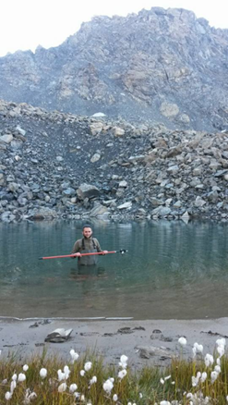
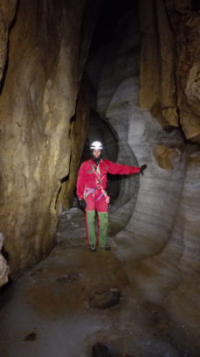
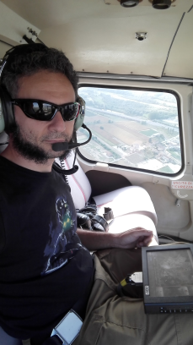
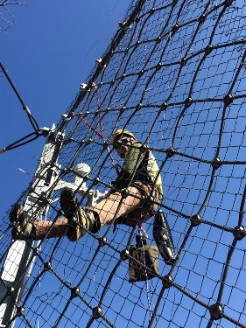
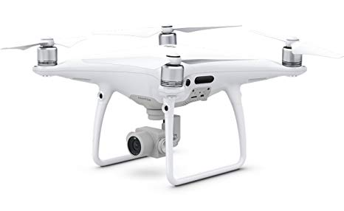
Education
PhD in Forestry – «Cryosphere Dynamics Monitoring by Innovative Geomatic Methodologies»
Employment and main activities
PostDoc @ CNR-IRPI
Ice cave monitoring;
Landslide monitoring by robotized systems;
Land monitoring by geomatic techniques (GPS, LiDAR, UAVs);
IPROMO!!!

Slide 22
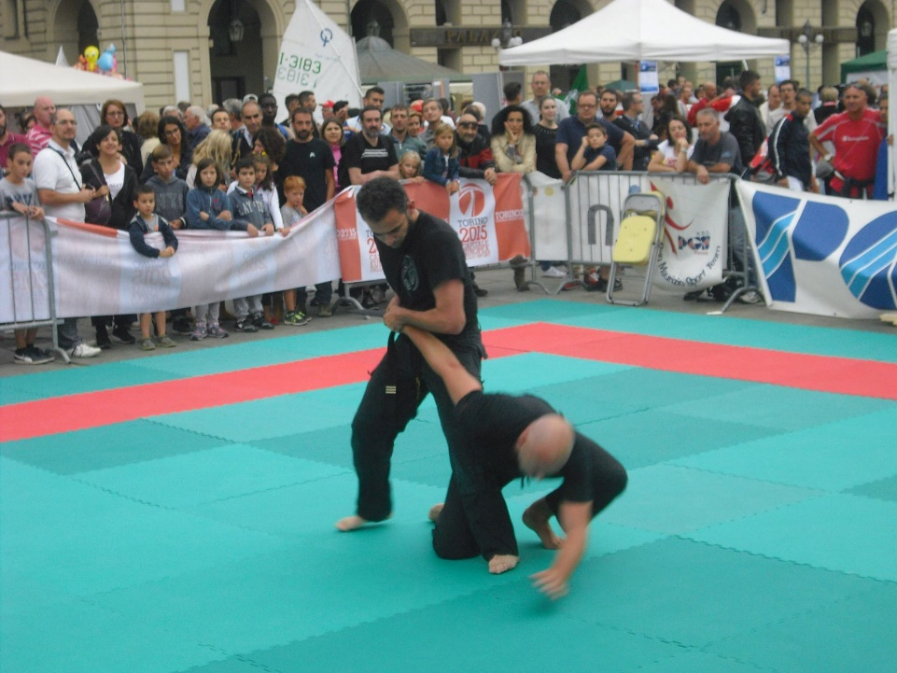
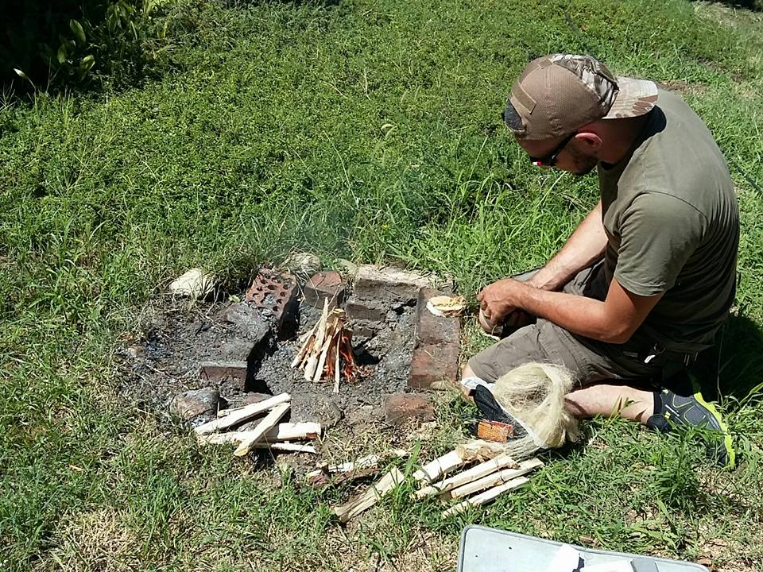
Other interests (volunteer work, hobbies etc.)
Hiking/climbing, self-defense, survival
Supporting rhino (and not only) poaching prevention (www.poachingpreventionacademy.org)

Slide 23
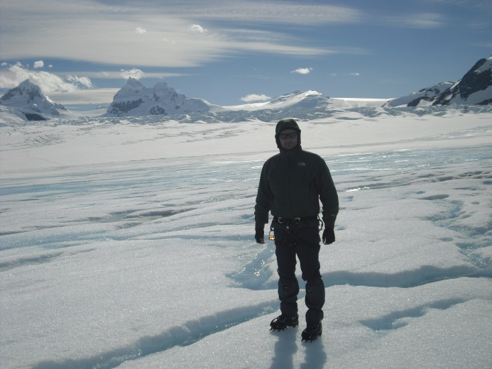
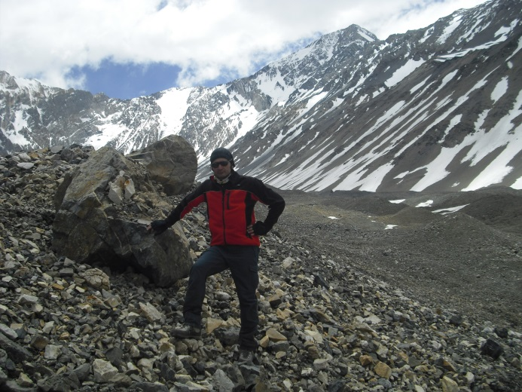
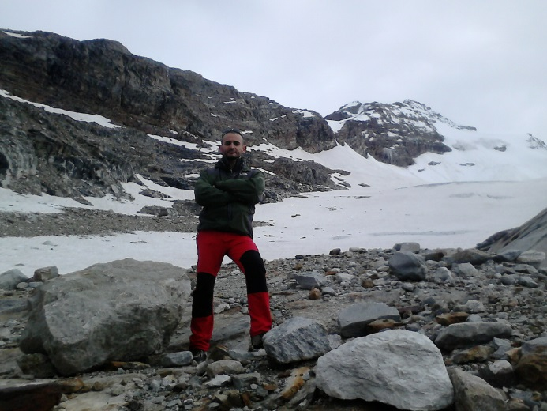
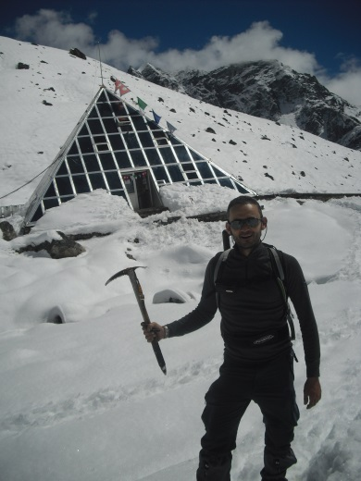
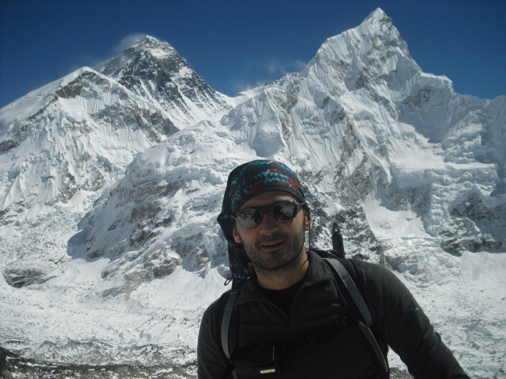
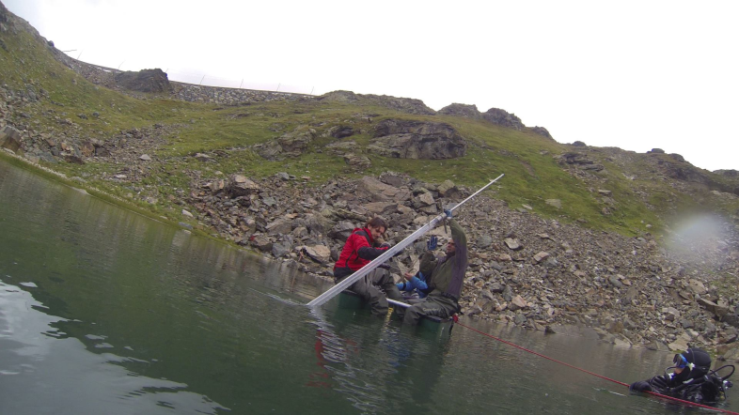
Presentation of a project you are working on 1/3
Cryosphere monitoring: glacier ablation, soil temperature, water chemistry
Rainfall as primary driver of discharge and solute export from rock glaciers: The Col d'Olen Rock Glacier in the NW Italian Alps Nicola Colombo, Stephan Gruber, Maria Martin, Mery Malandrino, Andrea Magnani, Danilo Godone, Michele Freppaz, Simona Fratianni, Franco Salerno Science of The Total Environment 2018 639, 316-330
Glacier Melting Increases the Solute Concentrations of Himalayan Glacial Lakes Franco Salerno, Michela Rogora, Raffaella Balestrini, Andrea Lami, Gabriele A. Tartari, Sudeep Thakuri, Danilo Godone, Michele Freppaz, and Gianni Tartari Environmental Science & Technology 2016 50 (17), 9150-9160 10.1021/acs.est.6b02735

Slide 24
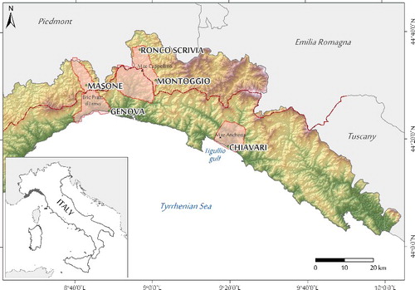
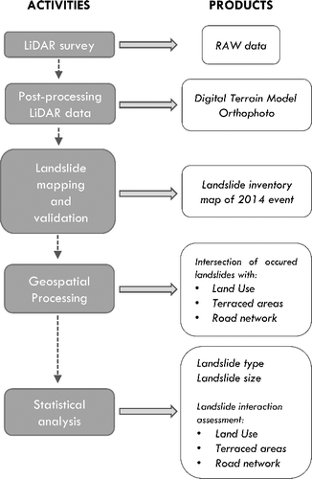
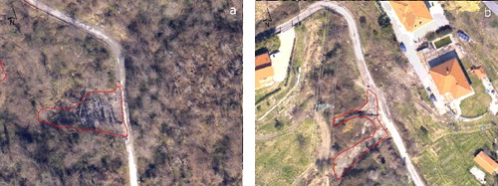
Presentation of a project you are working on 2/3
Relationship between anthropic landscapes and landslides
D. Giordan, M. Cignetti, M. Baldo & D. Godone (2017) Relationship between man-made environment and slope stability: the case of 2014 rainfall events in the terraced landscape of the Liguria region (northwestern Italy), Geomatics, Natural Hazards and Risk, 8:2, 1833-1852, DOI: 10.1080/19475705.2017.1391129
D. Godone, D. Giordan & M. Baldo (2018) Rapid mapping application of vegetated terraces based on high resolution airborne LiDAR, ), Geomatics, Natural Hazards and Risk, 10.1080/19475705.2018.1478893

Slide 25
Presentation of a project you are working on 3/3
Cryosphere monitoring: ice cave monitoring
3 Cardioshock
4
External
1 Entrance
2
Glacier

Slide 26
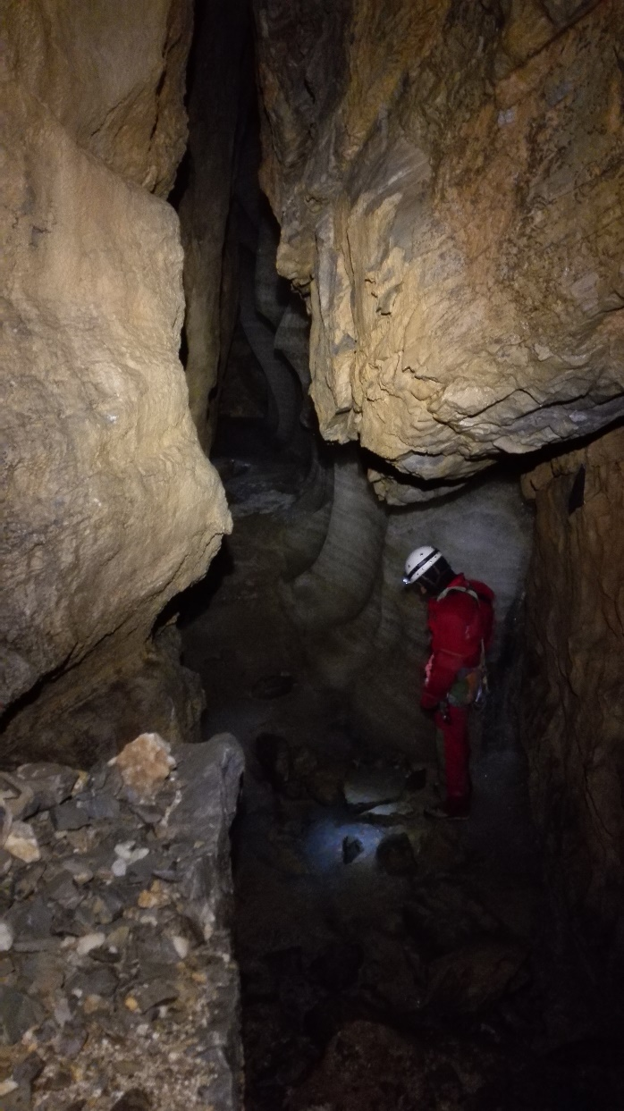
Presentation of a project you are working on 3/3
Cryosphere monitoring: ice cave monitoring
3 Cardioshock
4
External
1 Entrance
2
Glacier

Slide 27
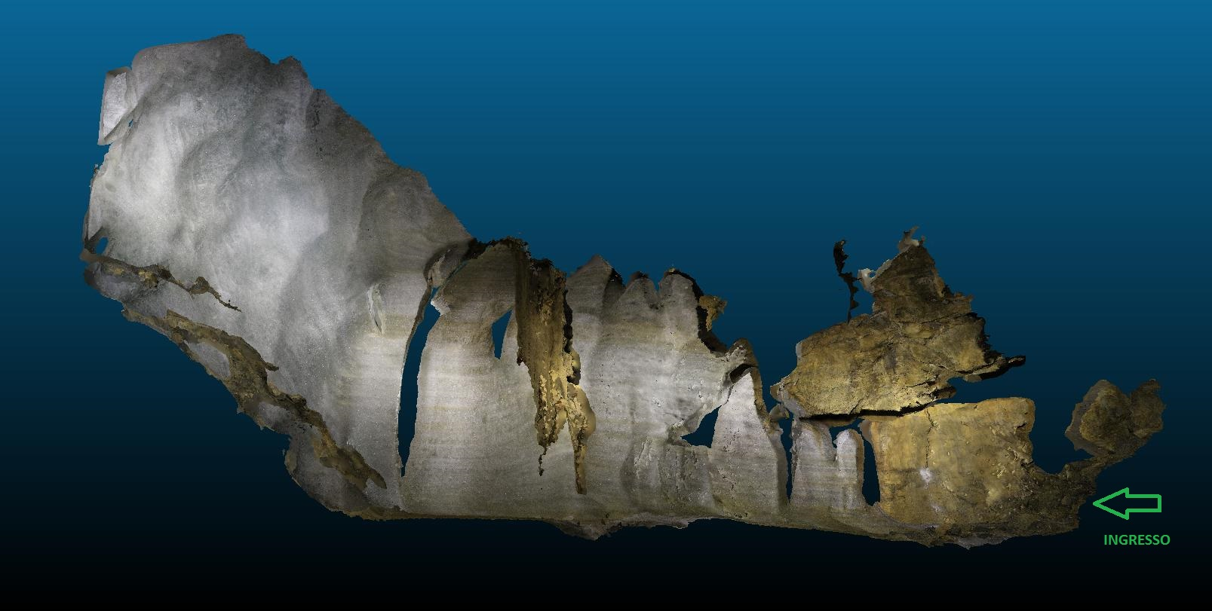
Presentation of a project you are working on 3/3
Cryosphere monitoring: ice cave monitoring
3 Cardioshock
4
External
1 Entrance
2
Glacier

Slide 28
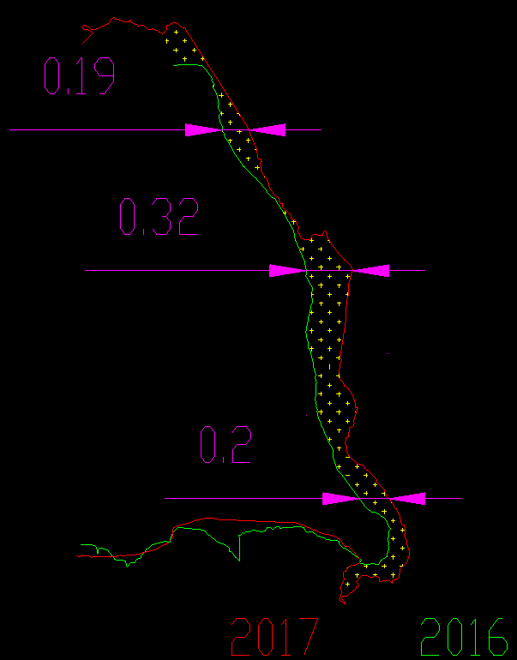
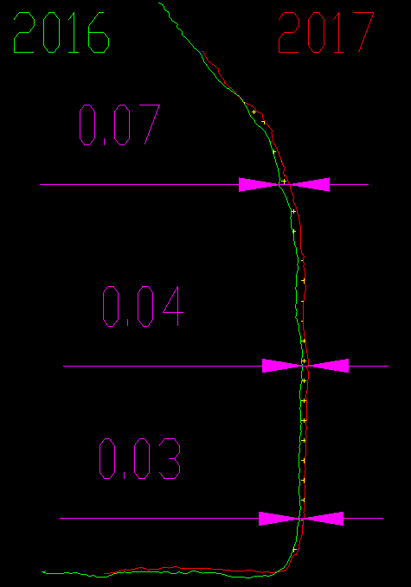
Presentation of a project you are working on 3/3
Cryosphere monitoring: ice cave monitoring
3 Cardioshock
4
External
1 Entrance
2
Glacier

Slide 29
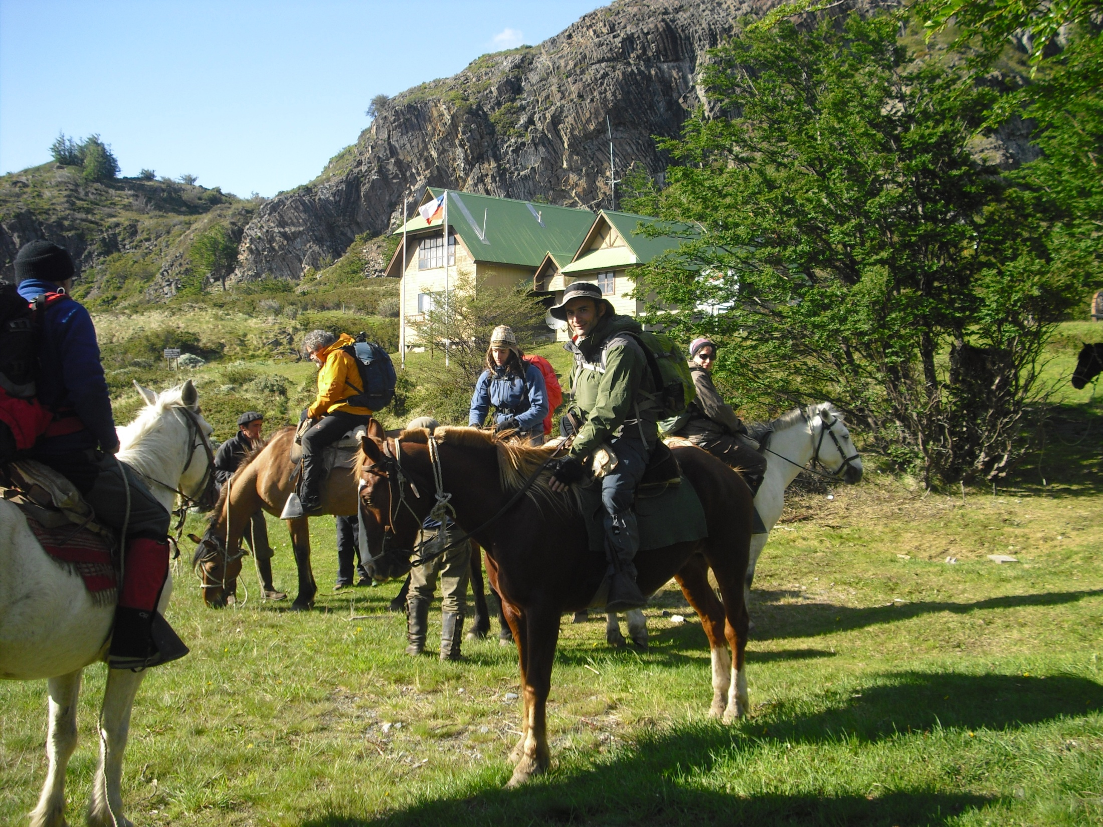
And many more…
Thank for your attention!!!
Danilo Godone, PhD
danilo.godone@irpi.cnr.it – d.godone@gmail.com

