Slide 1
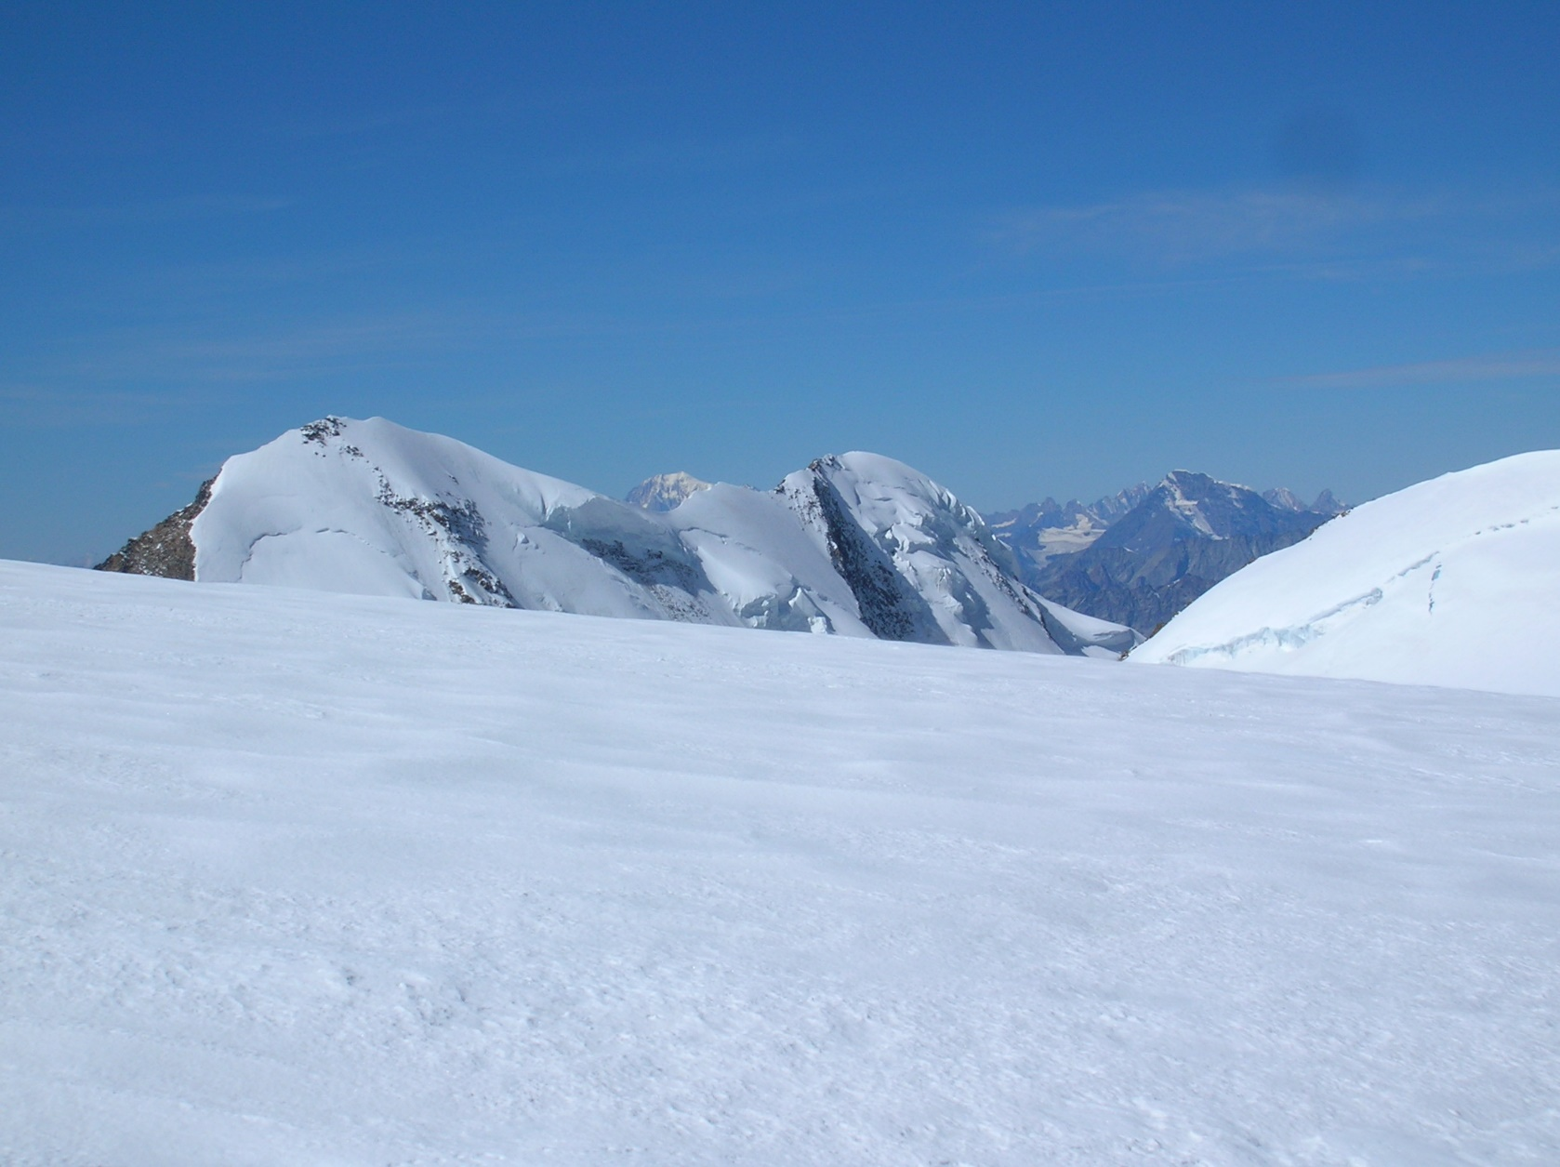
The experience of IPROMO
in building capacity for mountains
Michele Freppaz
Università degli Studi di Torino
Notes:
Ladies and gentlemen, thanks a lot for the kind invitation to participate to this side event concerning Mountain Education. My name is Michele Freppaz, and I’m professor in mountain soil science and snow science at the University of Torino, NW Italy. In my talk I’d like to share with you the experience of IPROMO - The International Program for Mountain - in building capacity for mountains.

Slide 2
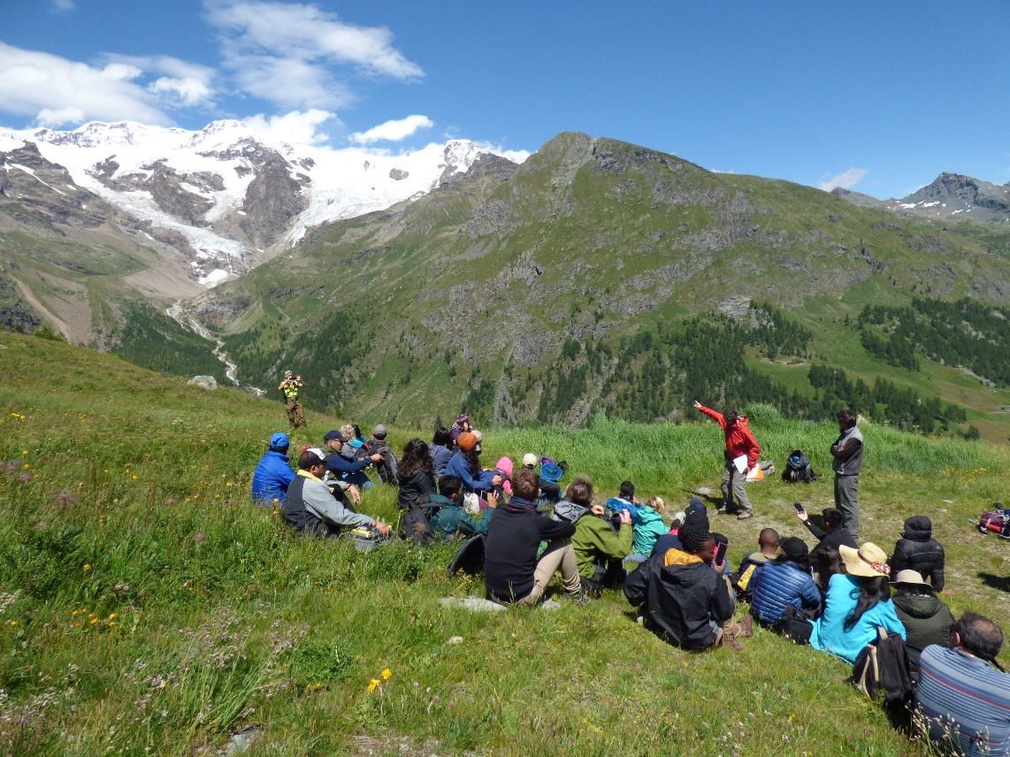
The need
The programme on research and training on sustainable management of mountain areas (IPROMO) was created in 2006 at the request of several Mountain Partnership members.
IPROMO 2017
Notes:
The IPROMO programme was launched by FAO – Mountain Partnership in 2006, to face the request of several members who had identified the lack of mountain related capacity development programmes as a concrete obstacle to the sustainable development of mountains around the world.

Slide 3
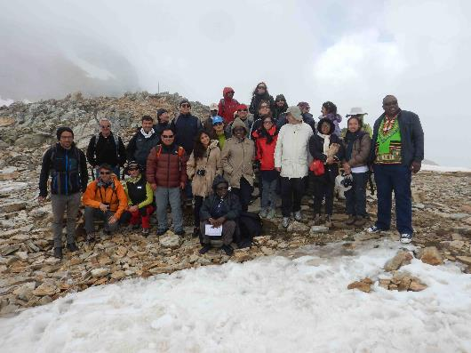
The idea
The idea was to periodically organize a full-immersion course on topics concerning the sustainable mountain development.
Target: technicians, planners and decision-makers from mountain regions of the world, particularly from areas with severe overexploitation and degradation, i.e. regions that are potentially more sensitive to global change impacts.
Subjects: activities in the fields of natural sciences, forestry, and socio-economics.
IPROMO 2014
Notes:
The idea was to periodically organize an intensive course on topics concerning the sustainable mountan development, dedicated to technicians, planners and decision-makers from mountain regions of the world, particularly from areas with severe degradation and potentially more sensitive to global change impacts. The subjects should cover a wide spectra, in the field of natural sciences, forestry and socio-economics.

Slide 4
The designers
FAO - Mountain Partnership and University of Torino-DISAFA-NatRisk shared their ideas on mountain education and in 2007 signed a MOU with the aim to support the IPROMO Course.
Venues: small villages in the NW Italian Alps.
Beneficiaries: technicians, planners, decision-makers from mountain regions of the World.
Structure: 2 weeks of intensive course. Individual and working groups coordinated by a chairman.
2017
Notes:
In 2007 the dream come true.FAO-Mountain Partnership and University of Torino shared their ideas on mountan education and in 2007 signed a MOU with the aim to support the IPROMO course. The course should be organized in the mountain, in small mountain villages in NW Italian Alps, for technicians, planners and decision-makers from mountain regions of the world. The course should be intense, 2 weeks, with individual and working groups coordinated by a chairman.

Slide 5
Mountain Environment and Global Change
Developing economic opportunities for mountain areas
Protecting Mountain Biodiversity
Natural Hazards and Disaster Risk Management in Mountain Areas
Understanding and Adapting to Climate Change in Mountain Areas
Bioeconomy in mountain areas – an opportunity for local development
12 years: The themes
Understanding Upland Watershed Management
Promoting Sustainable Farming in Mountain Regions
Food security in mountain areas
Managing mountain resources and diversities - the role of protected areas
Environmental and economic issues to enhance mountain sustainability
Landscape approach for enhancing mountain resilience
Notes:
Here a list of the topics of the last and first 10 years of IPROMO. As you can see, the subjects deal with global change, biodiversity, natural hazards and food security in mountain areas.

Slide 6
The beneficiaries
318 beneficiaries
70 countries
Notes:
Globally, IPROMO reached more than 250 technicians from 70 different mountain regions.

Slide 7
The teaching staff
93 instructors
16 countries
Notes:
In 10 years 80 teachers have been involved, coming from 16 different countries and different institutions, of course from the University of Torino, but also from other universities and resercg centres.

Slide 8
Welcome to the IPROMO Community
An ever-expanding virtual network of IPROMO alumni…
Notes:
While more than 80% are still in contact with other participants, revealing the importance of the ever-expanding virtual network of IPROMO alumni.

Slide 9
2019: The 12th Edition
International Summer School
Landscape approach for enhancing mountain resilience
2-8 July: Pieve Tesino
9-11 July: Field Trip Aosta Valley

Slide 10
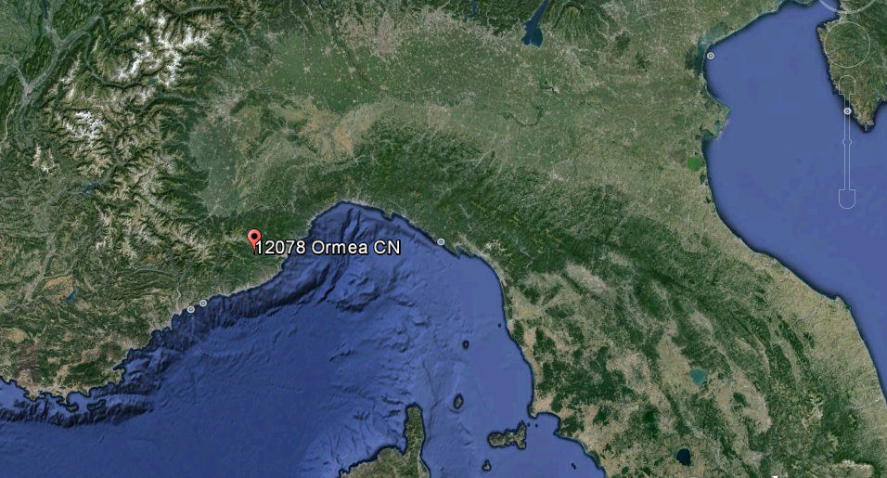
12-18 July: Ormea

Slide 11
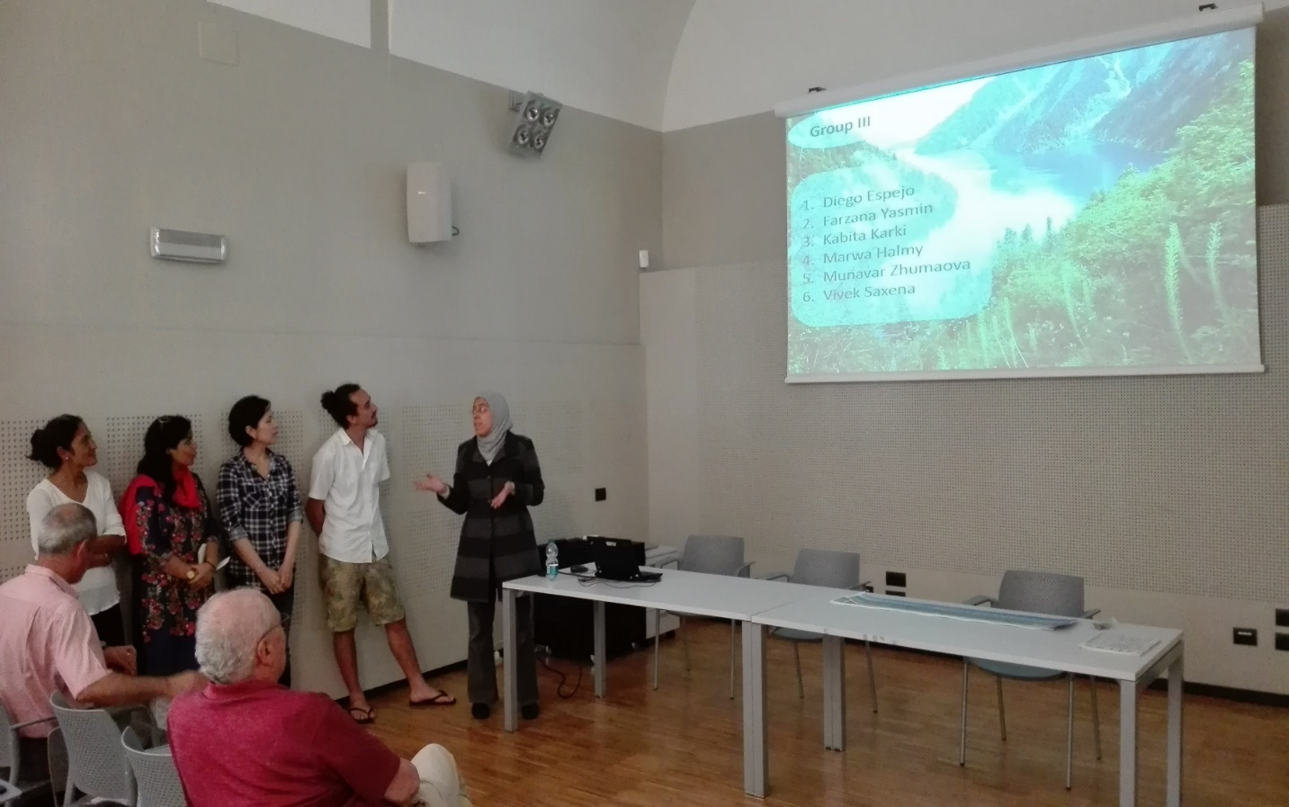
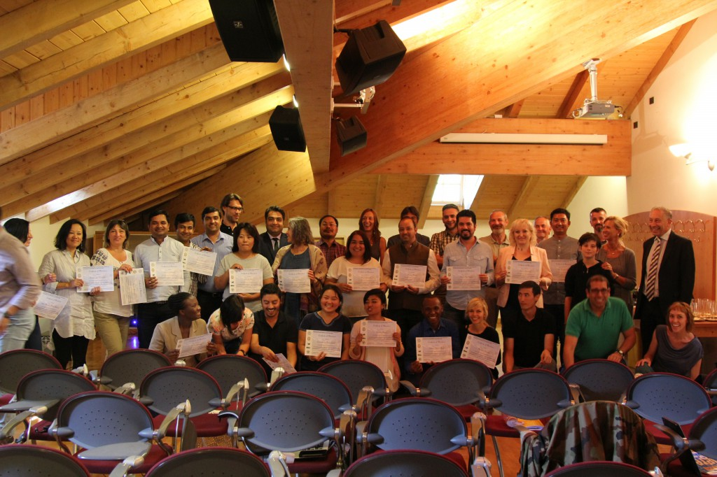
Working Groups Presentation
July 18
IPROMO 2016
IPROMO 2017
Notes:
As I mentioned before in every course the participants were organized in working groups, which develop specific subjects under the supervision of the chairman. At the end of the course, each group presents their activities during an official event.

Slide 12
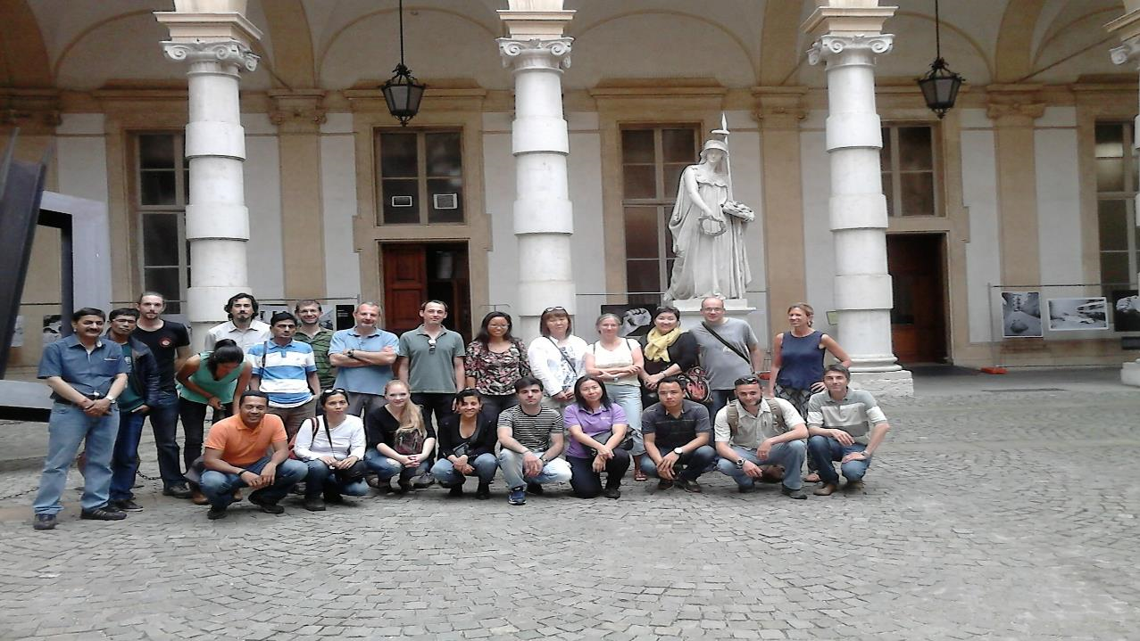
IPROMO, 2015
michele.freppaz@unito.it
Notes:
A picture of the IPROMO class in 2015, in the Rectorate Courtyard of the University of Torino, below Minerva, goddess of wisdom and knowledge. I hope that Minerva will help us in going on with IPROMO, at least for other 10 years. Thanks for your attention.

