Slide 1

Mountain soils key for building resilience
Silvia Stanchi, Michele Freppaz
Ormea, 15 July 2019

Slide 2
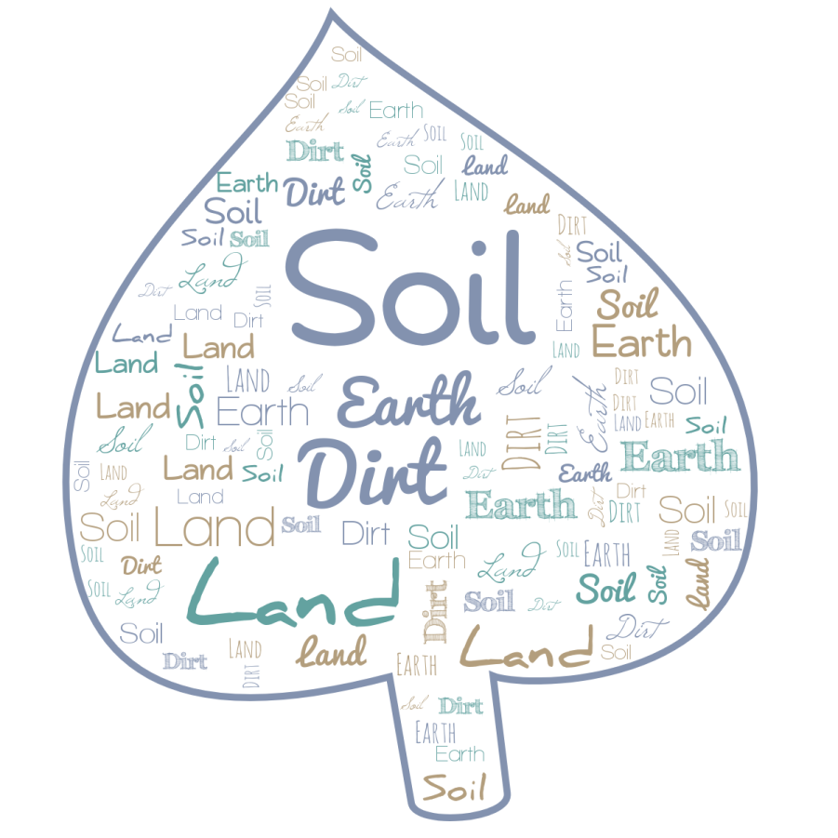
What is soil?
An “official” definition….
soil - The unconsolidated mineral or organic matter on the surface of the Earth that has been subjected to and shows effects of genetic and environmental factors of: climate (including water and temperature effects), and macro- and microorganisms, conditioned by relief, acting on parent material over a period of time. A product-soil differs from the material from which it is derived in many physical, chemical, biological, and morphological properties and characteristics
https://www.nrcs.usda.gov/wps/portal/nrcs/detail/soils/edu/?cid=nrcs142p2_054280

Slide 3
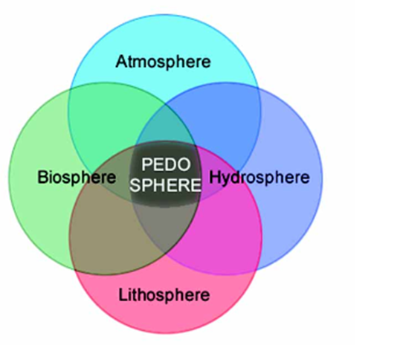
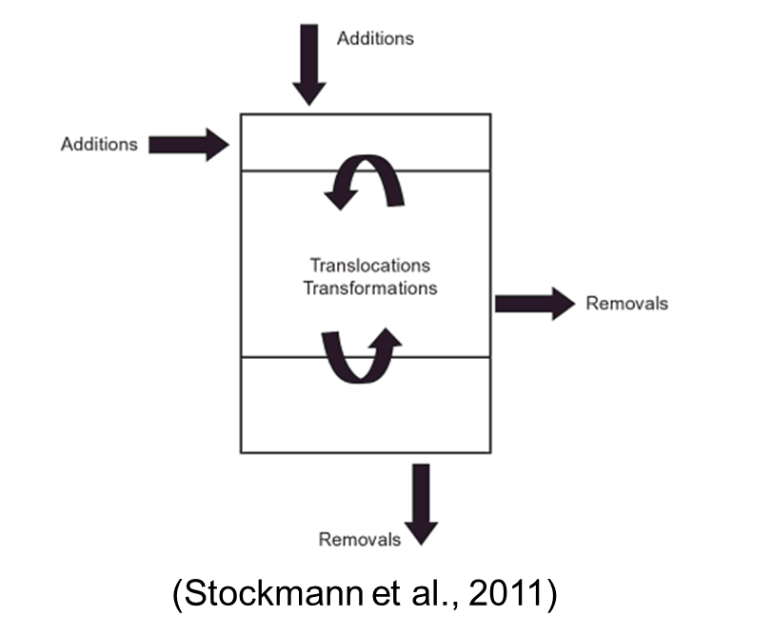
Soils and the environment
(Lal et al., 1998)

Slide 4
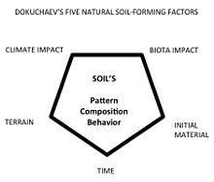
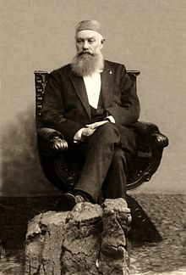

Soil science

Slide 5
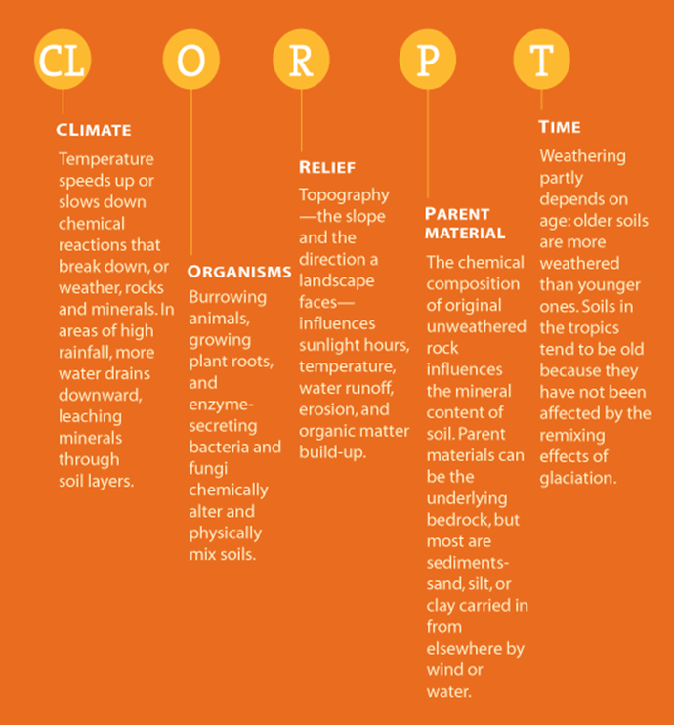
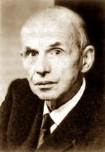
The «clorpt» model
CL
O
R
P
T
SOIL
Hans Jenny (1900-1992)
Born in Switzerland, professor
at Berkeley (CA-USA)

Slide 6
The «clorpt» model
CLIMATE
ORGANISMS
b
g
h
i
c
d
S= clorpt
j
e
RELIEF
PARENT MATERIAL
f

Slide 7
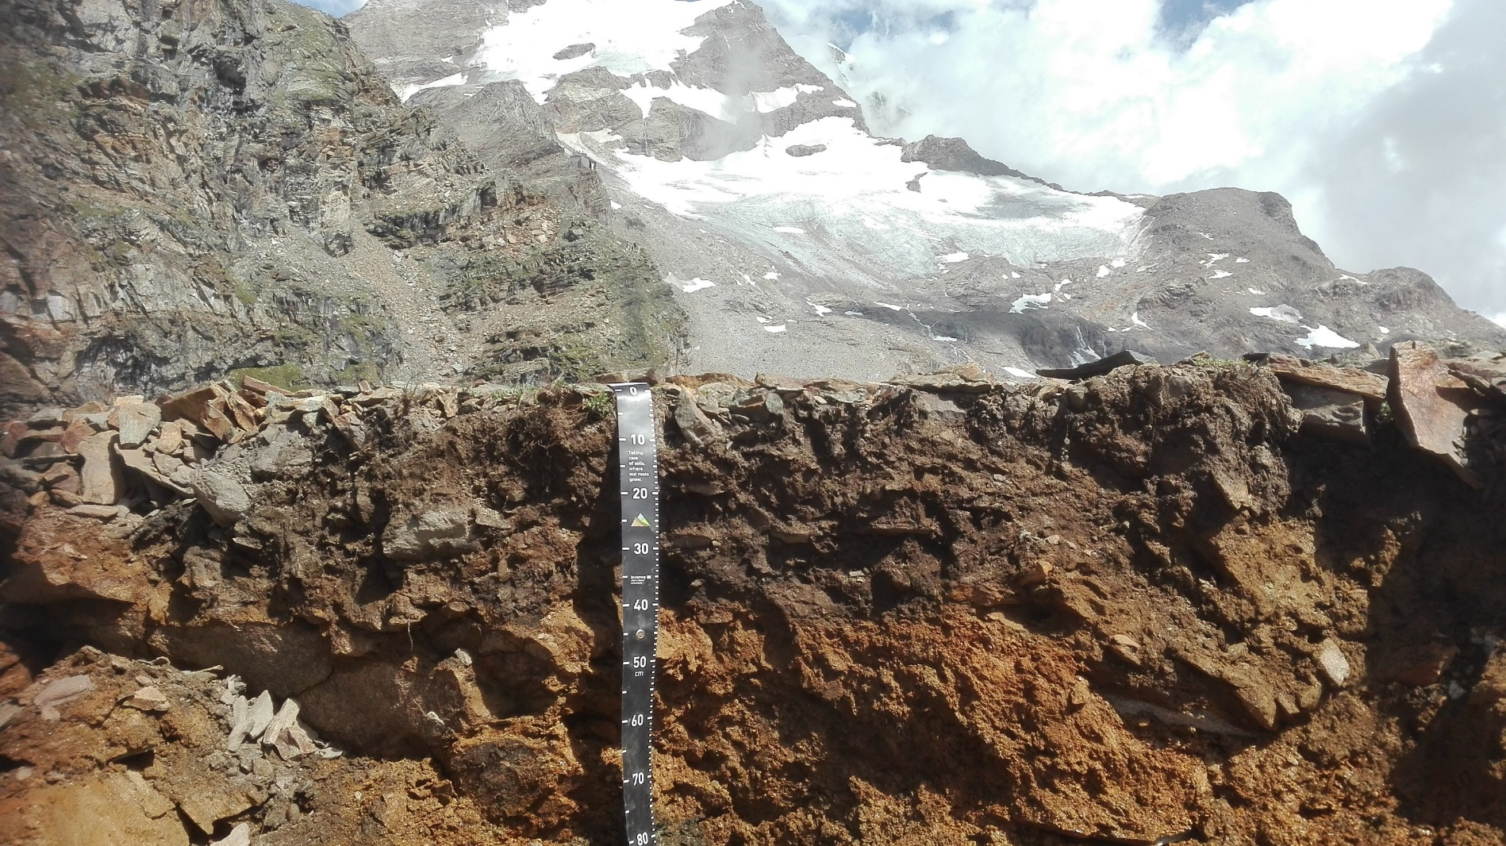
Mountain soils

Slide 8
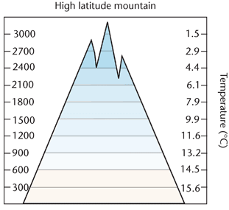
The soil forming factors in mountain areas: climate

Slide 9
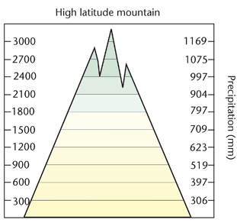
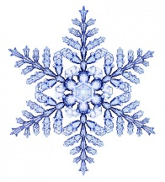
The soil forming factors in mountain areas: climate

Slide 10
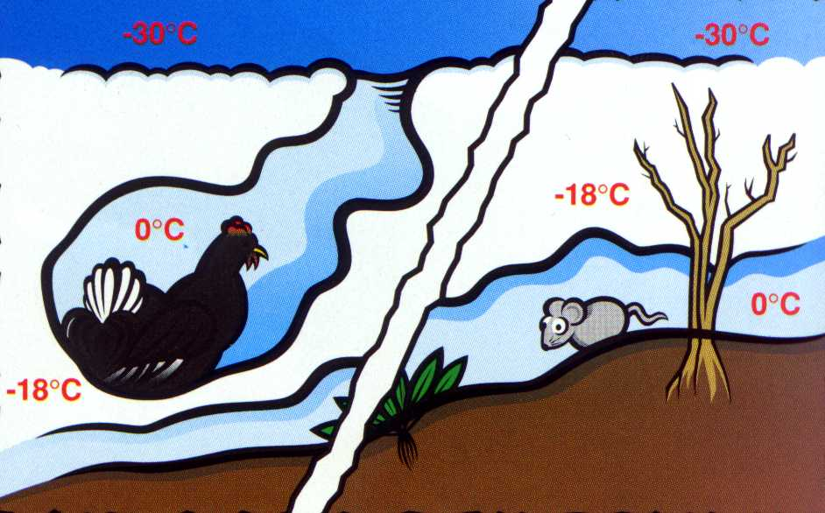
The soil forming factors in mountain areas: climate
Snow: a good insulator

Slide 11
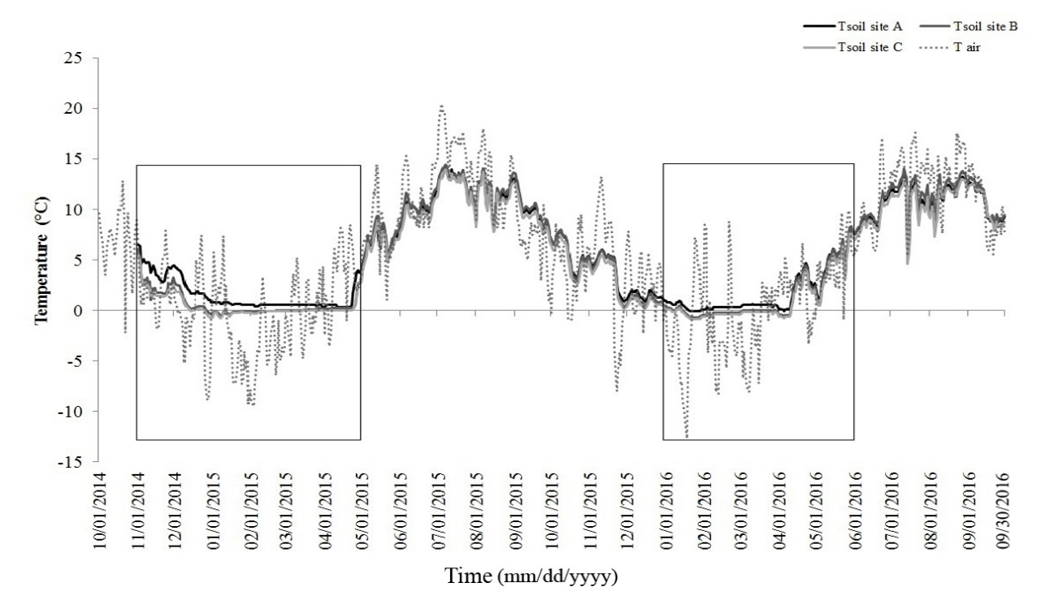
The soil forming factors in mountain areas: climate
Soil Climate:
temperature
Soil climate has two major components: moisture (precipitation) and temperature, influencing evaporation. When exceeds evaporation, leaching of the soil will occur.

Slide 12
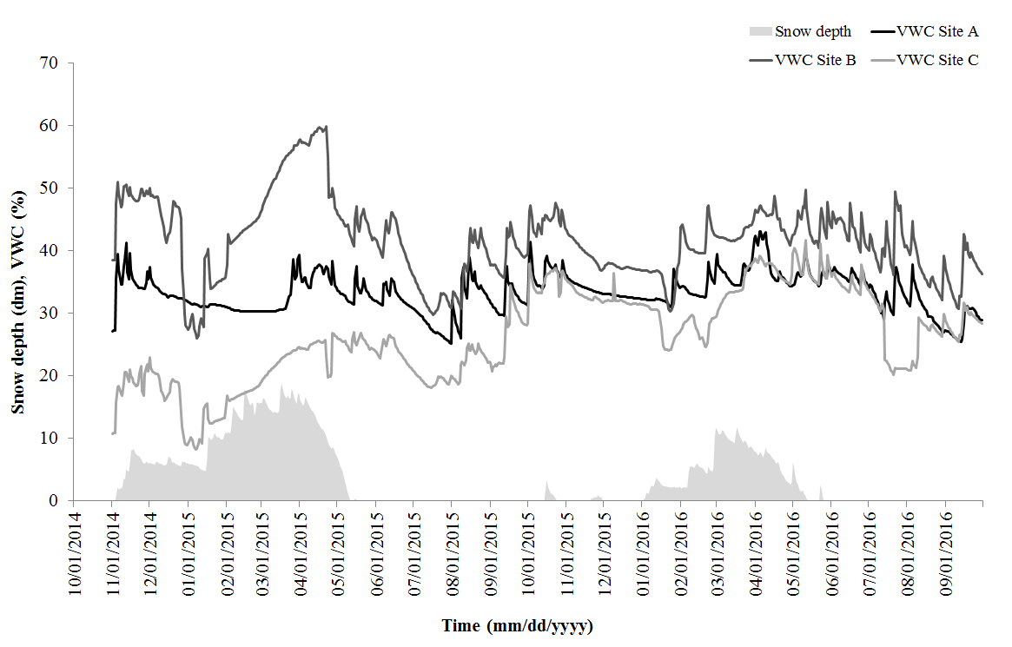
The soil forming factors in mountain areas: climate
Soil Climate:
water content
Soil climate has two major components: moisture (precipitation) and temperature, influencing evaporation. When exceeds evaporation, leaching of the soil will occur.

Slide 13
The soil forming factors in mountain areas: climate
Snow and climate change

Slide 14
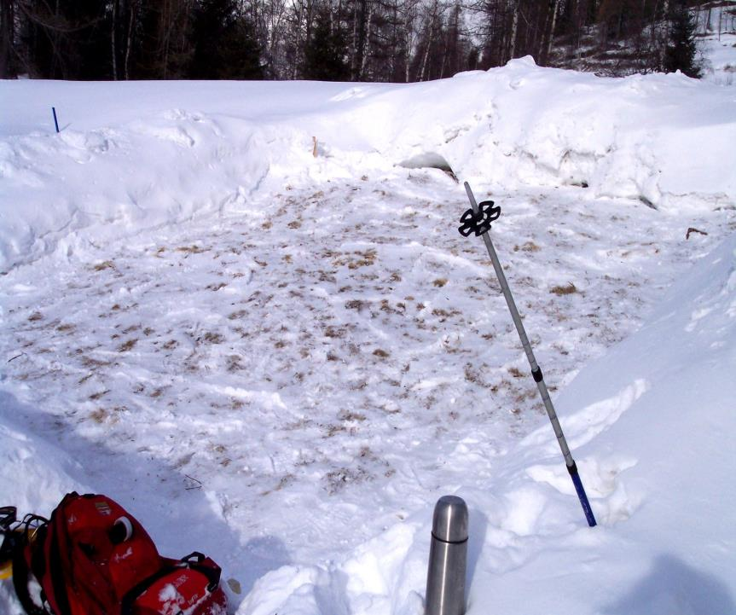
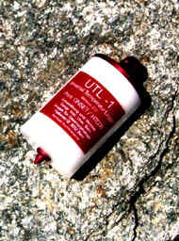
The soil forming factors in mountain areas: climate
Snow manipulation

Slide 15
The soil forming factors in mountain areas: climate
10
1450 m asl
8
t with snow
6
t without snow
t air
4
2
°C
0
-2
-4
-6
-8
February 1-9, 2004

Slide 16
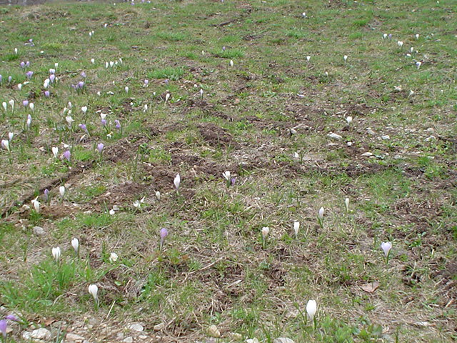
The soil forming factors in mountain areas: climate
The same day in spring:
With snow

Slide 17
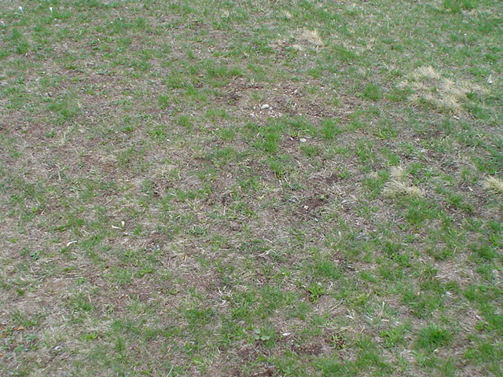
The soil forming factors in mountain areas: climate
The same day in spring:
Without snow

Slide 18
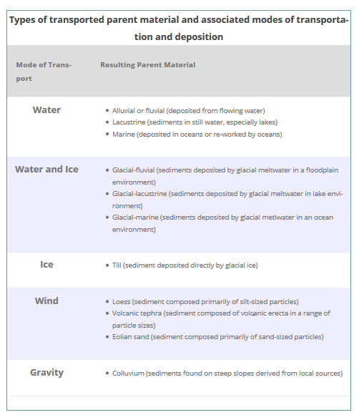
The soil forming factors in mountain areas: parent material
This is the material from which the soil has developed and can vary from solid rock to
deposits like alluvium. It has been defined as ‘the initial state of the soil system’.
The parent material can influence the soil in a number of ways:
colour
texture
structure
mineral composition
permeability/drainage

Slide 19
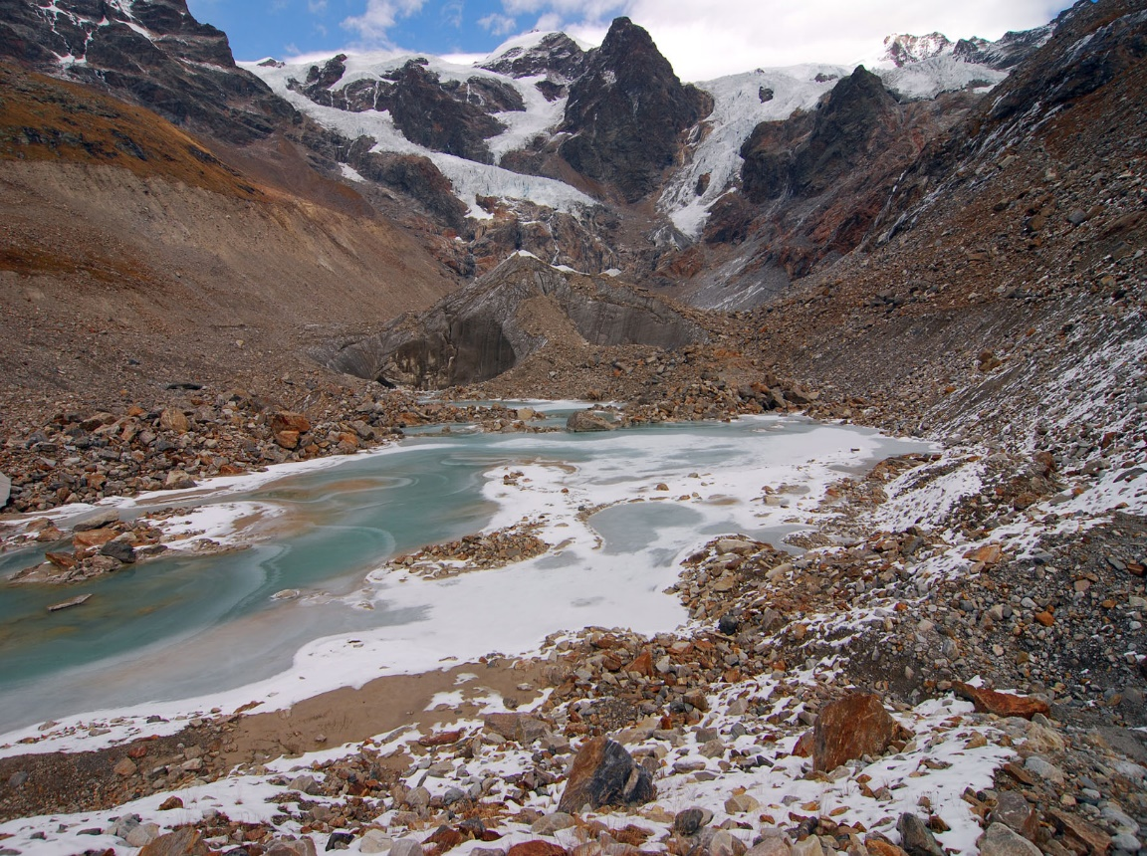
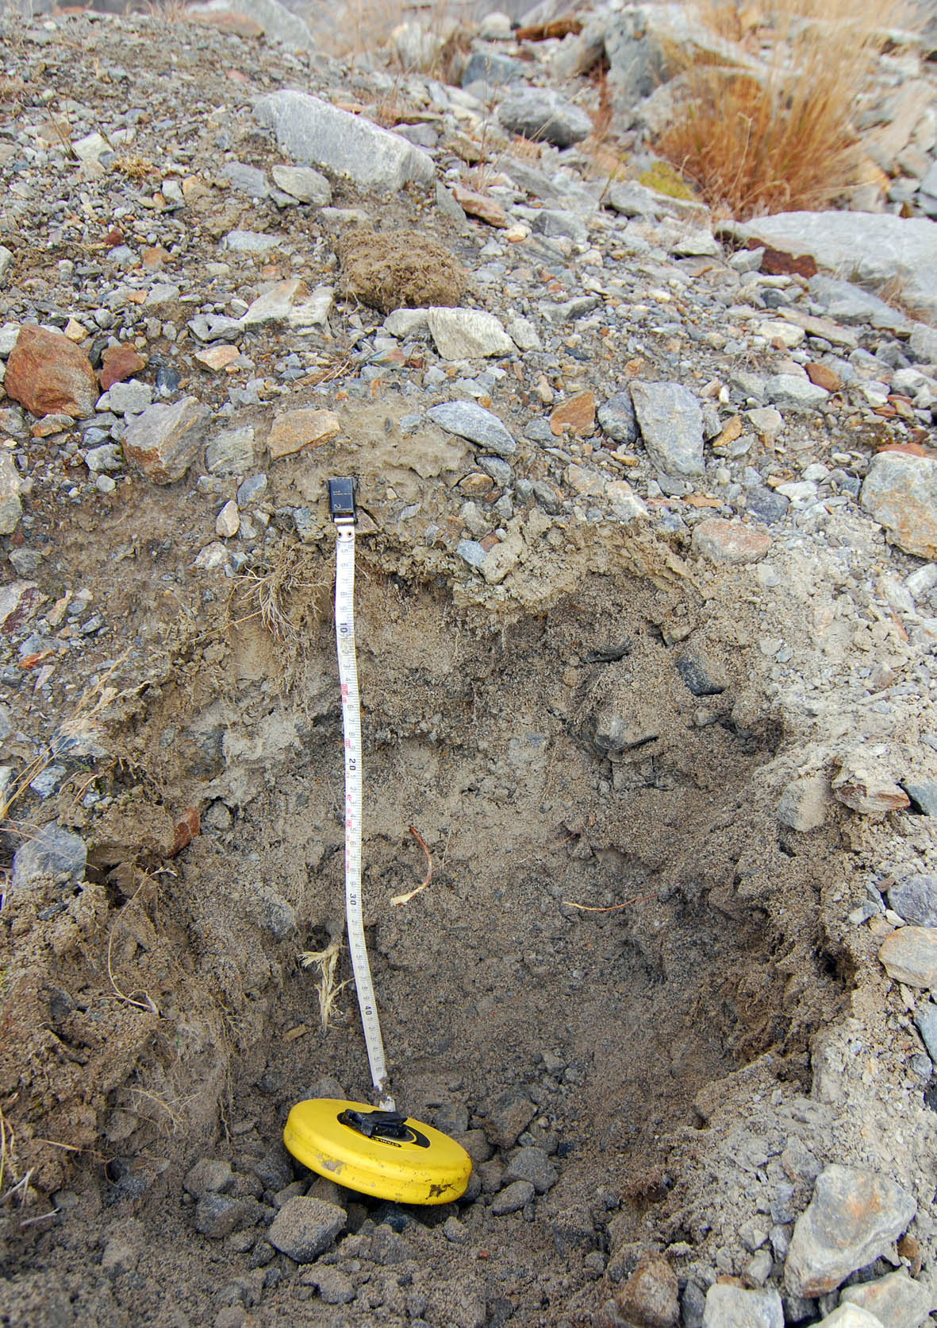
The soil forming factors in mountain areas: parent material
This young soil has developed on glacial till

Slide 20
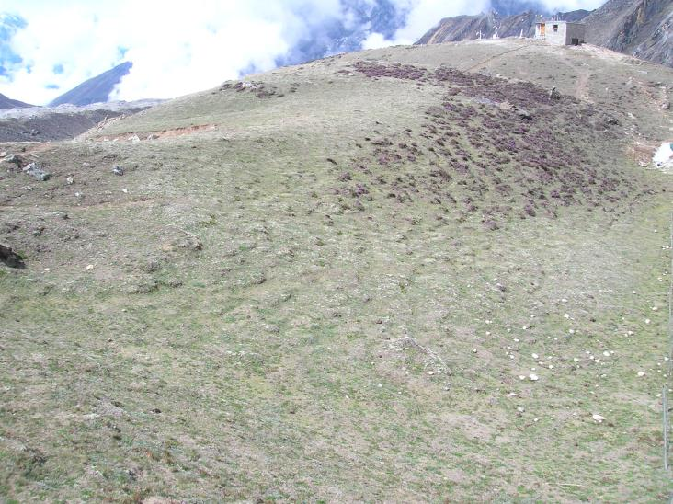
The soil forming factors in mountain areas: relief
Relief is not static; it is a dynamic system (its study is called geomorphology).
Relief influences soil formation in several ways:
it influences soil profile thickness i.e. slope angle increases so does the erosion hazard
gradient affects run-off, percolation and mass movement
it influences aspect which creates microclimatic conditions
Ridge site
Slope site
Sagarmatha National Park, ~5100 m slm

Slide 21
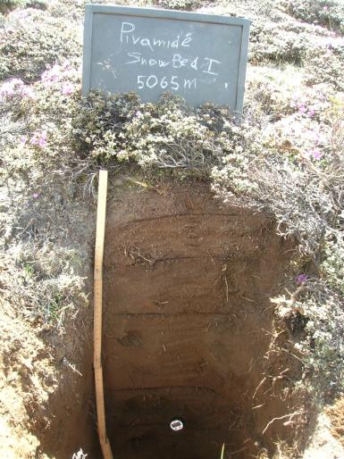
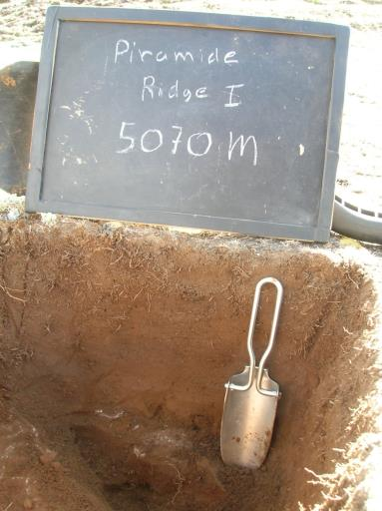
The soil forming factors in mountain areas: relief
Slope site
Ridge site

Slide 22
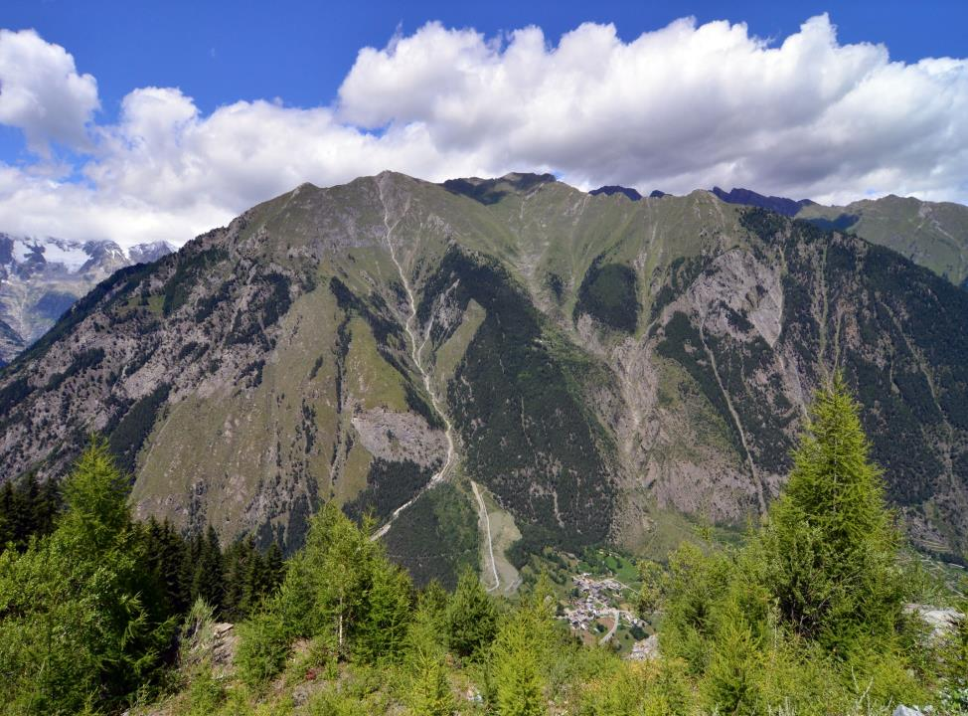
The soil forming factors in mountain areas: organisms
Altitudinal zonation

Slide 23
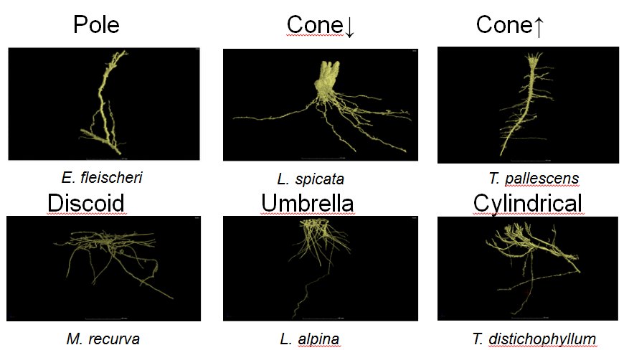
The soil forming factors in mountain areas: organisms

Slide 24
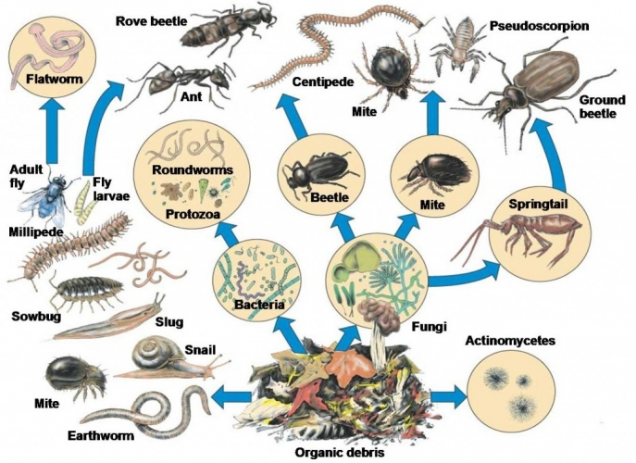
The soil forming factors in mountain areas: organisms

Slide 25
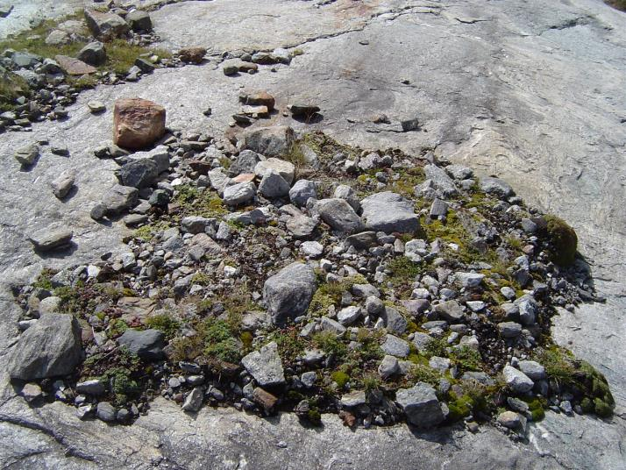
The soil forming factors in mountain areas: time

Slide 26
The soil forming factors in mountain areas: time
Lys glacier: 1915

Slide 27
The soil forming factors in mountain areas: time
Lys glacier: 2017

Slide 28
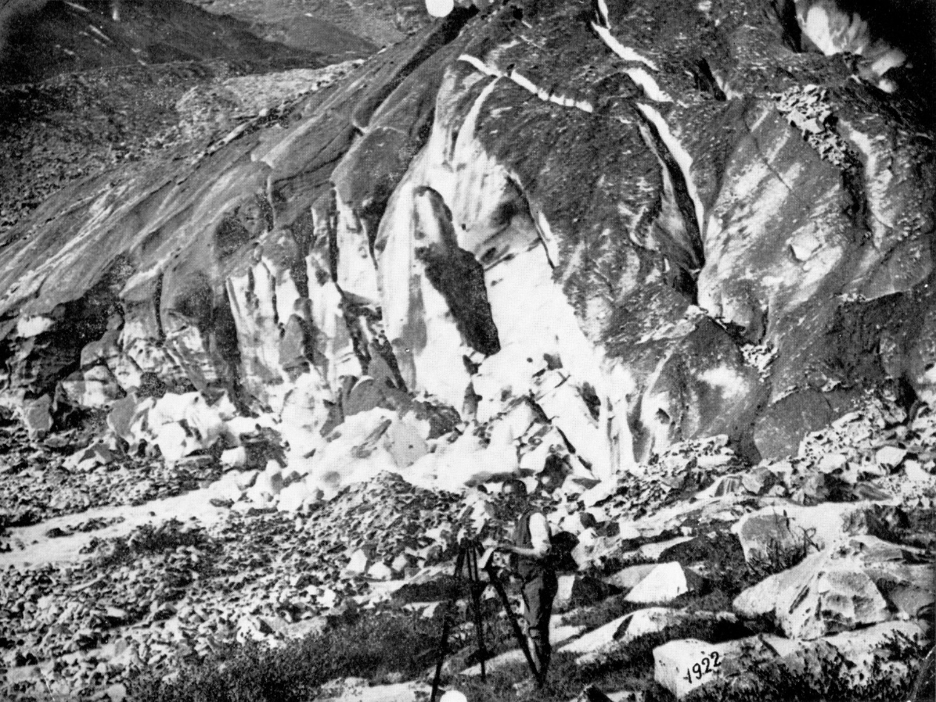
The soil forming factors in mountain areas: time

Slide 29
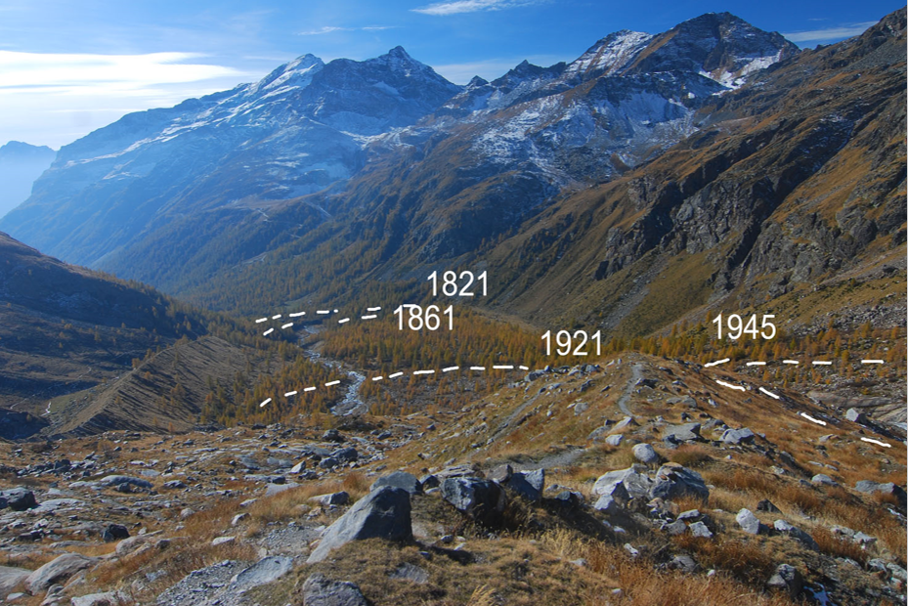
The soil forming factors in mountain areas: time

Slide 30

The soil forming factors in mountain areas: time
15 years

Slide 31
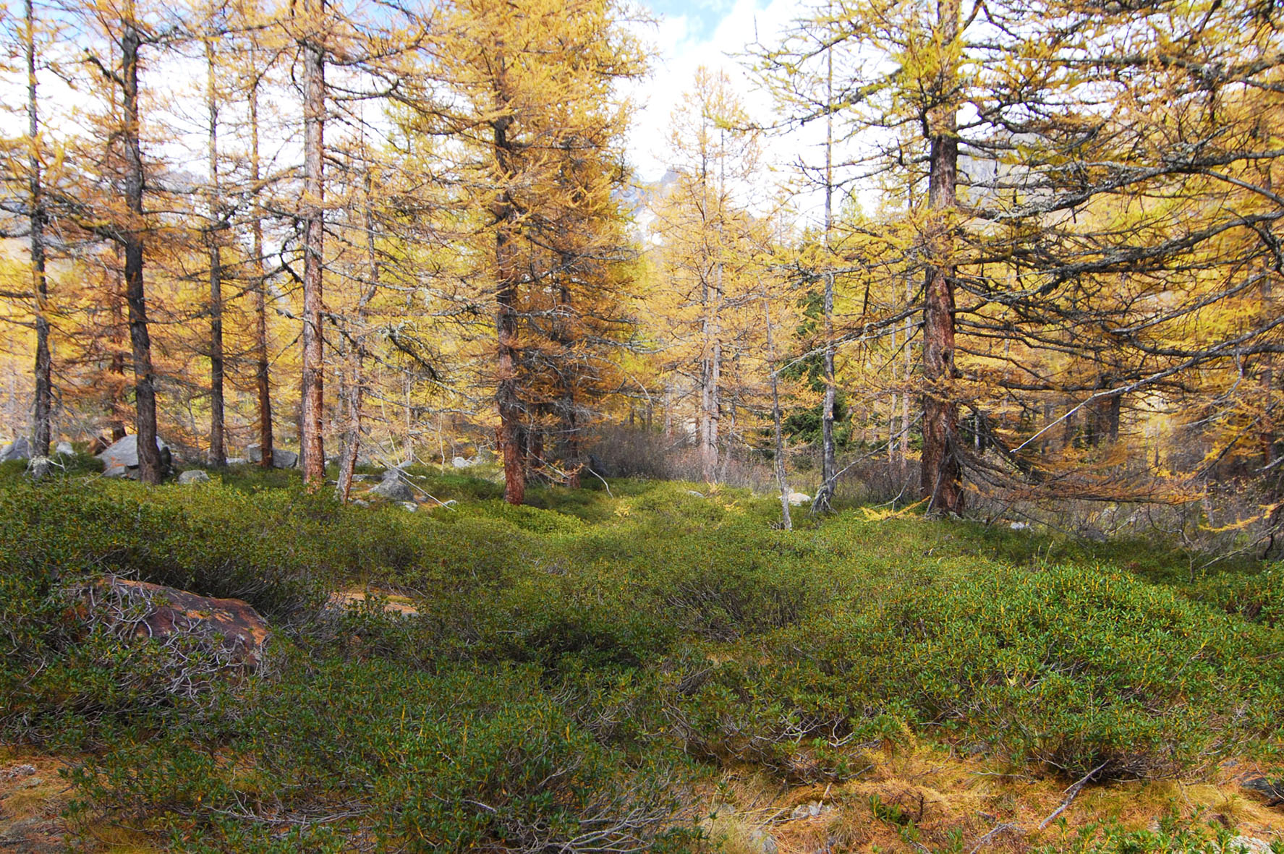
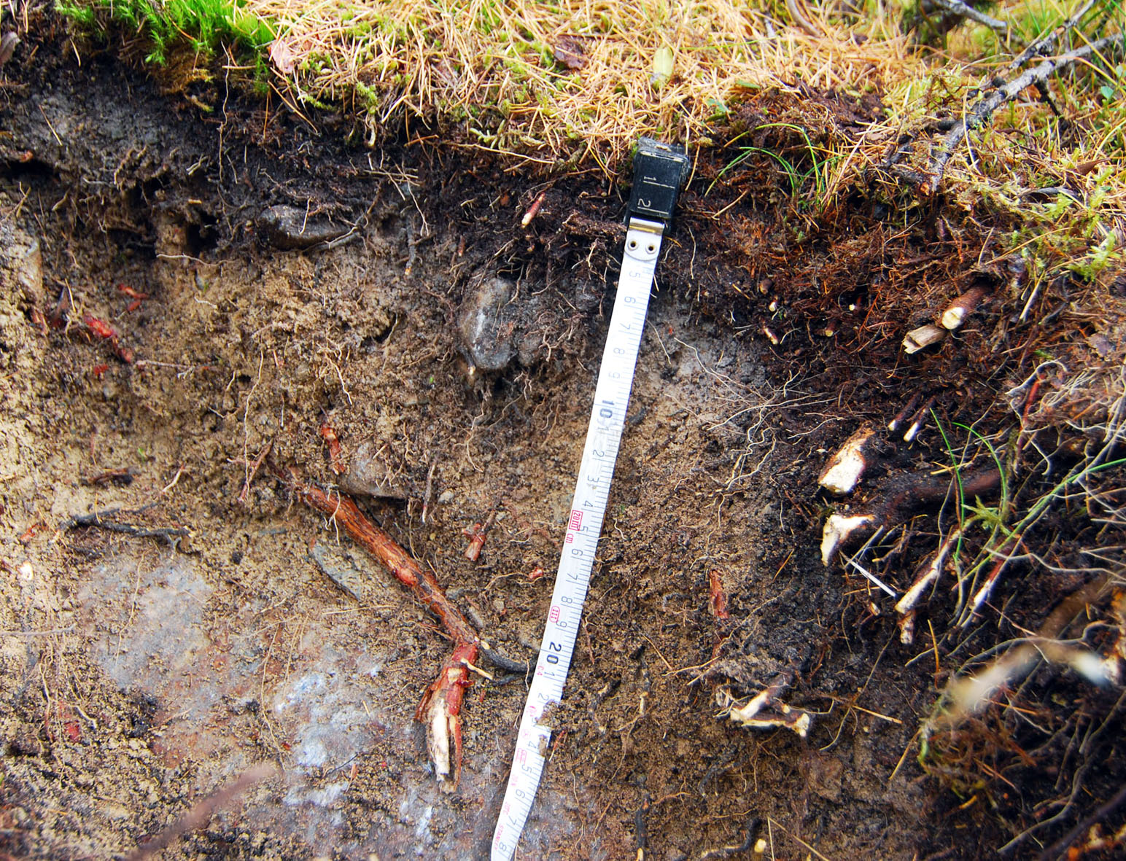
The soil forming factors in mountain areas: time
135 years

Slide 32
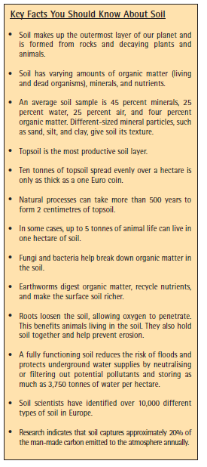
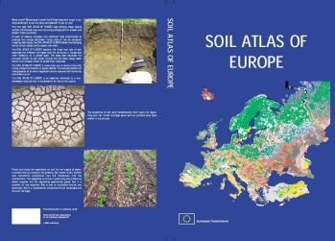
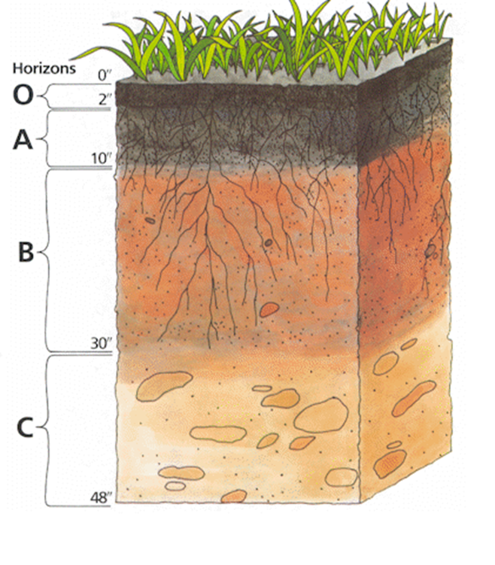
Some soil facts
https://esdac.jrc.ec.europa.eu/content/soil-atlas-europe

Slide 33
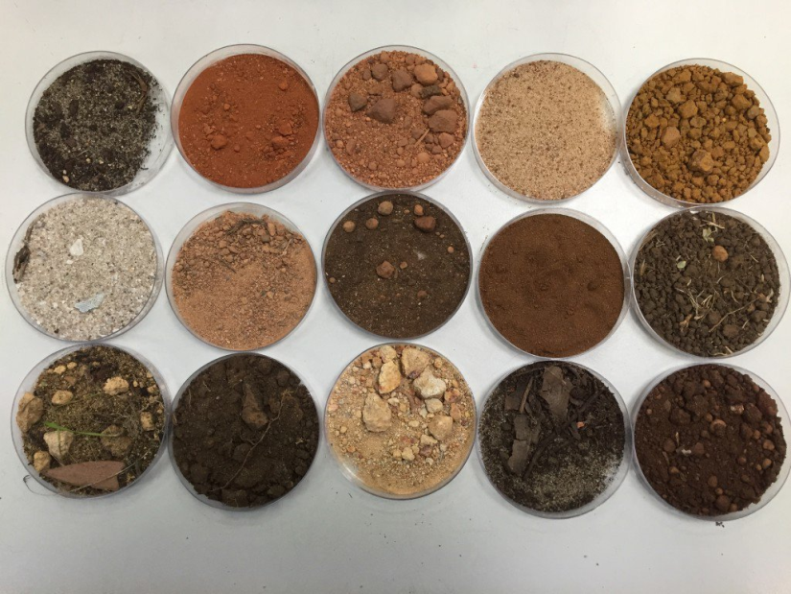
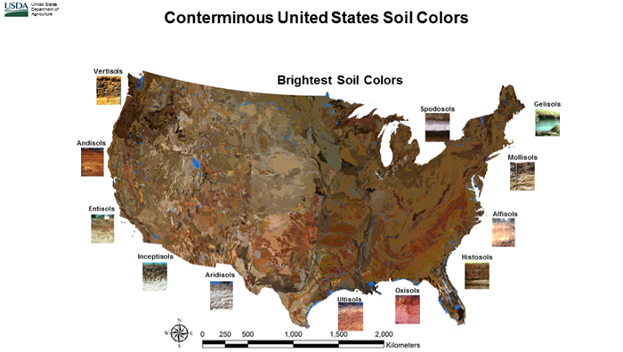
Soil colors
http://munsell.com/wp-content/uploads/2016/08/color-slices.gif

Slide 34
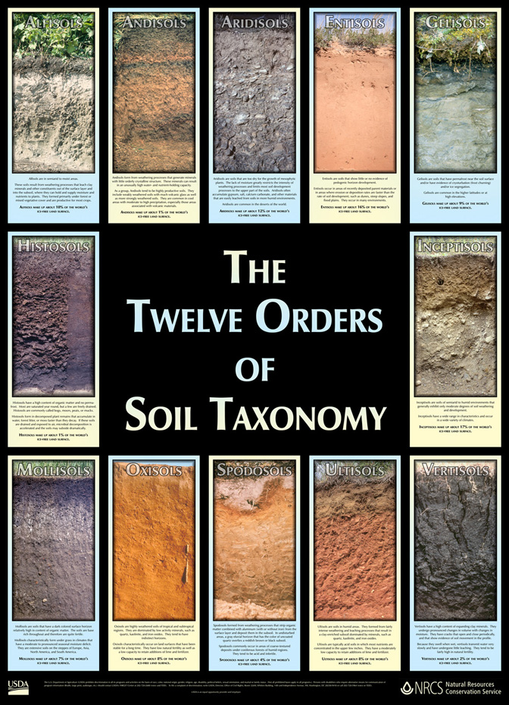
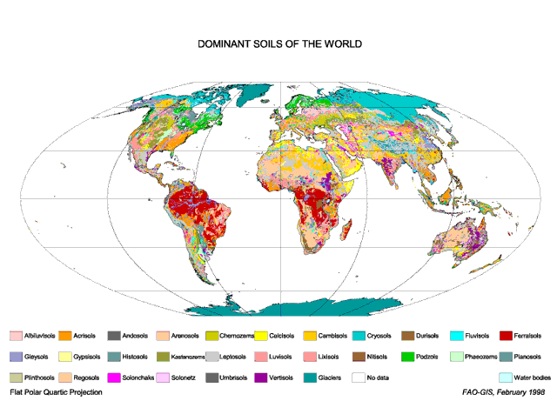
Soil types and classification systems

Slide 35
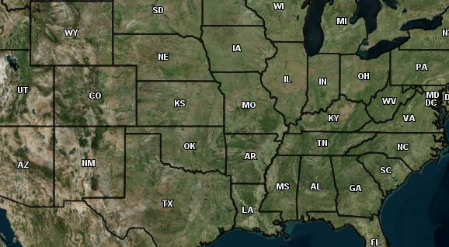
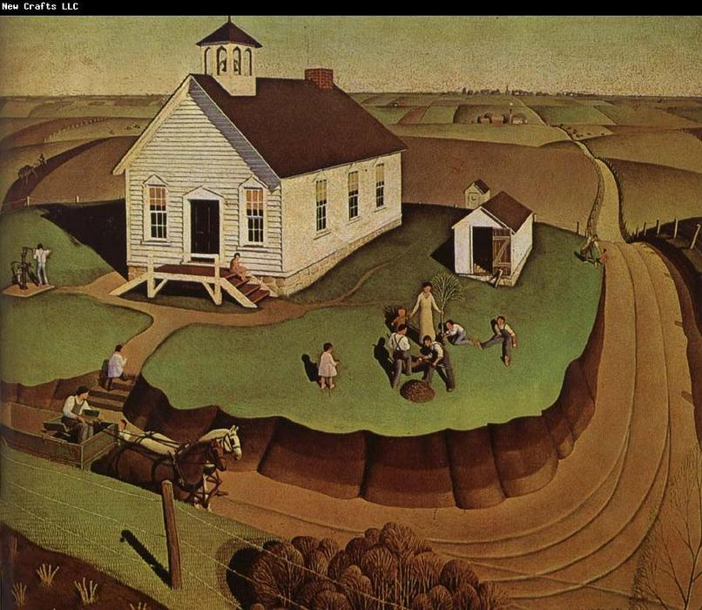
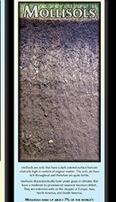
Soil types
Here for more soil types!
https://www.nrcs.usda.gov/Internet/FSE_MEDIA/nrcs142p2_050473.jpg

Slide 36
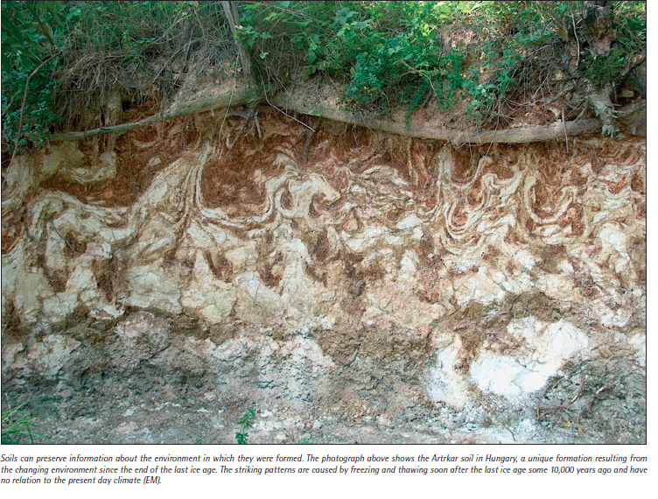
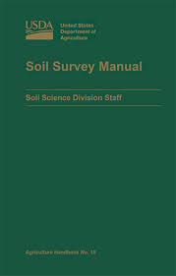
Soils and complexity
Ph Soil Atlas of Europe - JRC

Slide 37
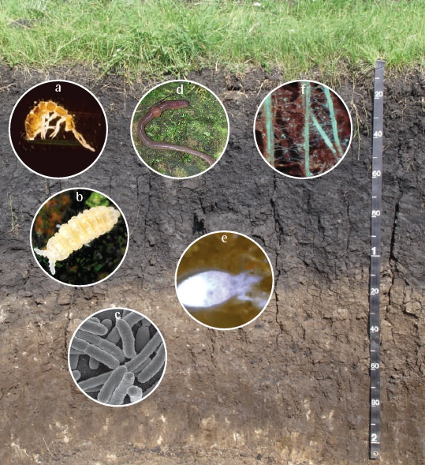
Soils and biodiversity
http://eusoils.jrc.ec.europa.eu/library/maps/biodiversity_atlas/

Slide 38
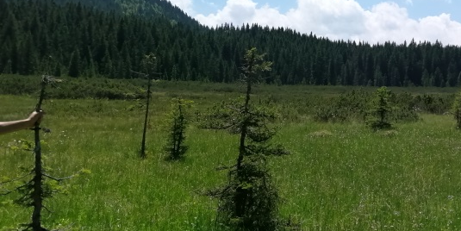
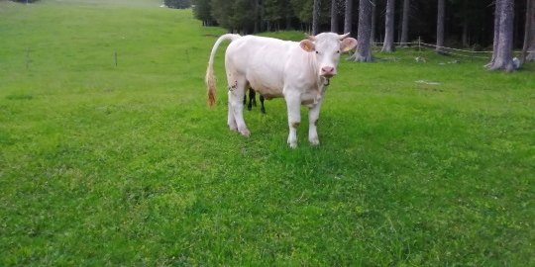
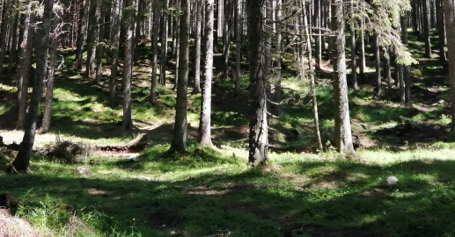
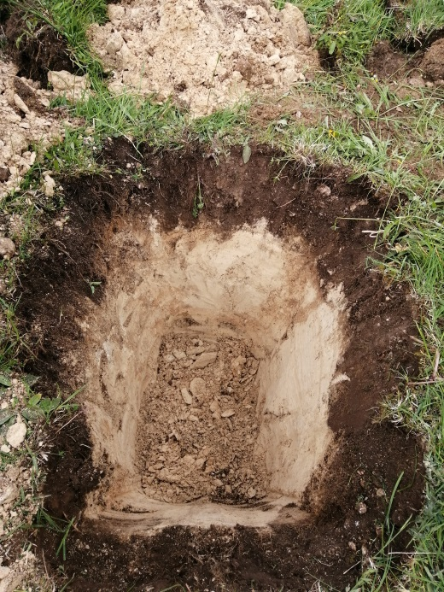
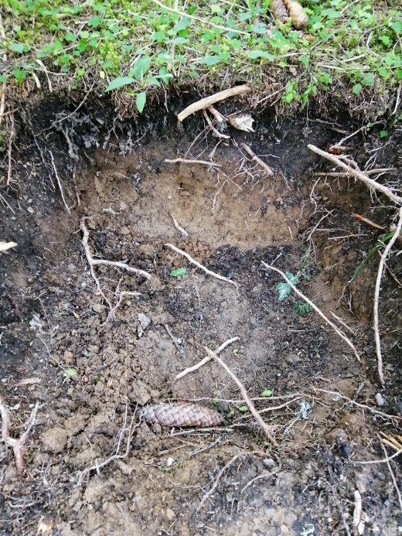

Soils and landscapes

Slide 39

Soils and landscapes
Soils and landscapes evolve in tandem. Landscape position is a strong determinant of vertical soil development, which has often been formalized in the catena concept*.
At the same time, soil properties are strong determinants of geomorphic processes such as overland erosion, landslides and creep, which significantly affect the landscape (Temme, 2015).
*A "Catena" in soil science is a sequence of types of soil down a hill slope

Slide 40

Soils and landscapes

Slide 41

Soil functions

Slide 42

Functions or services?

Slide 43
Watch
Let’s talk about soils

Slide 44

Soil threats

Slide 45
Group activity
Form the same groups of the activity on «Disaster risk management in mountain regions” (Friday)
Have a look at the 2 following slides on soil functions and threats
Now you will have 15 min to:
1) Individuate, for your geographical area, the 3 more relevant soil functions (1 is the most important)
2)Individuate, for your geographical area, the 3 more relevant soil threats, i.e. types of soil degradation
3)Discuss
Finally: give a short presentation the outcomes (3 min)

Slide 48

Soil erosion

Slide 49

Erosion mitigation in mountain agriculture

Slide 50

Erosion modelling

Slide 51


Grazing and land degradation

Slide 52

Soil erosion by snow avalanches
Avalanche tracks contribute largely to the landscape complexity of the European Alps
They are preferred habitats for animal species and have a characteristic vegetation (Rixen et al., 2007)

Slide 53


Soil erosion by snow avalanches
When avalanches involve the whole depth of snow or run onto snow-free areas they may incorporate large amounts of soil, organic and rock debris

Slide 54

Soil erosion by snow avalanches
The track area
Due to the great elevational gradient (2000 m) the avalanches often run onto snow-free areas

Slide 55


Lavancher
The runout area
Regione Valle d’Aosta, Avalanche Warning Service

Slide 56


The runout area
Sediment characteristics (2006-2007-2008)
March, 2007
Sampling on the avalanche deposit using a gridded design (n=105)
Snow was collected at different times from the upper 10 cm of the avalanche deposit (coring device: 200 mL)
Freppaz M., Godone G., Filippa G., Maggioni M., Lunardi S., Williams M.W., Zanini E. (2010) Soil Erosion Caused by Snow Avalanches: a Case Study in the Aosta Valley (NW Italy). Arctic, Antarctic, and Alpine Research, Vol. 42, No. 4: 412–421

Slide 57

The runout area
Sediment characteristics (2006-2007-2008)
The volume of the avalanche deposit ranged between 2500 m³ and 70000 m³
The total sediment load in the runout zone ranged between 2323 and 27115 kg
The average mass removal ranged between 0.07 and 0.8 Mg ha⁻¹ event⁻¹

Slide 58

The runout area
Sediment characteristics
rocks (> 2 mm) (black)
organic debris (> 2 mm) (grey)
fine earth (< 2 mm) (white).
Freppaz M., Godone G., Filippa G., Maggioni M., Lunardi S., Williams M.W., Zanini E. (2010) Soil Erosion Caused by Snow Avalanches: a Case Study in the Aosta Valley (NW Italy). Arctic, Antarctic, and Alpine Research, Vol. 42, No. 4: 412–421

Slide 59



The runout area
Avalanche snow characteristics

Slide 60

Snow bridges site
Glide Avalanche site
Photo Renzino Cosson

Slide 61

Glide avalanche site (Release area)
soil surface features
May, 2011

Slide 62

Glide avalanche site (Release area)
soil characteristics
Soil I
Truncated soil profiles

Slide 63


Soil erosion due to snow gliding
(and glide avalanches)
Adapted from:
Alexander Stahr, Ewald Langenscheidt 2014. Landforms of
High Mountains. Springer
Grass rolls

Slide 64

Soil erosion due to snow gliding
(and glide avalanches)

Slide 65

The snow bridges area
soil characteristics
Soil III

Slide 66

Resilience in ecosystems
Definition of «resilience»: How fast the variables return towards their
equilibrium following a perturbation.
Ludwig et al. (2018): the potential to recover functional and structural
integrity after disturbance. Resilience is a product of the past and present
soil management, and at the same time prospect of possible soil
responses to future disturbances.

Slide 67


Resilience as a component of sustainability
Resilience can be seen as a
part of sustainability or even
equated with the term
sustainability.

Slide 68

Resilience concept applied to soils
Soils are multi-functional, complex systems with no single equilibrium
state.
Sustainabilty <-> how much disturbance can be sustained before a
significant change in soil functions occurs?

Slide 69
Soil Science Challenges for 2050
Food security->feeding increasing population
Nutrients-> preservation of fertility and nutrients
Fresh water-> supply, pollution
Energy-> sustainable land management, biomass production…
Climate change -> coping with CC, mitigation, adaptation, resilience
Biodiversity-> resilience, gene pool
Recicling «wastes»-> circular economy concept
Global perspective-> global vs. local perspective
(Janzen et al., 2011, mod.)

Slide 70

Soil resilience
->Soil biota is an important driver of the
Interplay of soil properties and processes
-> F1..F6 are soil functions that derive from
the interaction between properties and
Processes
-> Soil functioning affects the response to
Disturbances (incl. antropogenic) and
therefore is a measure of the resilience
of the entire soil system
(Ludwig et al., 2018)

Slide 71

Application to agroecosystems
High potential for plant growth, abundant and diverse biota
Crops develop and ripen. Then they are ready for harvest (climax of the ecosystem)
Soil is a dynamic system in
constant change.
Endless loop:
Exploitation(r)-> conservation
(k)-> structural collapse and
release (Ω)-> reorganization
(α)->r
Harvest and tillage are two pulse disturbances that lead the system to an initial state (collapse)
The farmer controls the crop development by applying agrochemicals
Notes:
Inserire immagini

Slide 72

Resilience at different scales
Notes:
Inserire immagini

Slide 73




Post-fire resilience in soils
www.nature .com

Slide 74

Post-fire soil threats

Slide 75
Post-disturbance resilience in soils
SKI RUNS CONSTRUCTION

Slide 76
SKI RUNS CONSTRUCTION (1)

Slide 77
SKI RUNS CONSTRUCTION (2)

Slide 78
SKI RUNS CONSTRUCTION (3)

Slide 79

SKI RUNS CONSTRUCTION (4)

Slide 80
Post-disturbance resilience in soils

Slide 81


Post-disturbance resilience in soils
IT TAKES A LONG TIME……..

Slide 82
Watch…
Soils and climate
Soils and forests
https://www.alpine-space.eu/projects/links4soils/en/project-results

Slide 83


References

Slide 84

References
Alpine soil platform
https://alpinesoils.eu/
Alpine soil partnership
https://www.alpine-space.eu/projects/links4soils/en/project-results/alpine-soil-partnership-and-platform

