Slide 1
IPROMO 2019
SUSTAINABLE LANDSCAPE MANAGEMENT
GROUP #2
Maher MELAOUHIA - TUNISIA
Malika CHKIRNI - MOROCCO
Rusudan-TATA Chochua - GEORGIA
WU Xuemei - CHINA
GILBERT MUVUNANKIKO - RWANDA
ALEXEY KIM - KAZAKHSTAN
NICOLAS NGECE - KENYA

Slide 2
Outline:
Map;
Community based participatory approach;
Challenges;
Main Objectives;
Goal & Long-term vision;
Specific Objectives & Measures;
Future Management Plan.

Slide 3
IPROMO Valley

Slide 4
COMMUNITY BASED MANAGEMENT USING PARTICIPATORY APPROACH
Identify communities willing and commitied to cooperate
Discussion with local communities
Identify problems and challenges
Identify and agree measures and actions
Notes:
It ensures that the intervention will have more credibility in all segments of the community.
Bringing a broader range of people to the planning process provides access to a broader range of perspectives and ideas.
It can provide an opportunity for often-disenfranchised groups to be heard.
A participatory planning process builds trust, both between your organization and the community and among the individuals involved. This trust can serve as a foundation for future community development and community action. -> it is more sustainable
https://ctb.ku.edu/en/table-of-contents/analyze/where-to-start/participatory-approaches/main

Slide 5
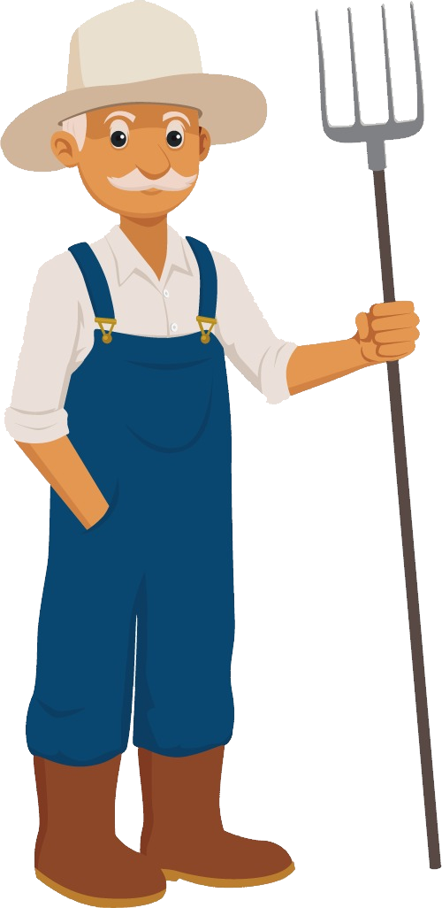
IPROMO Valley
Notes:
Livestock grazing is taking place in forest (free grazing)
Deforestation
Detoriated grassland
Forest fires

Slide 6
IPROMO Valley
Notes:
Lack of agricultural production due to lack of machienaries and other equipment
Migration of people

Slide 7
CHALLENGES
Unsustainable pasture and hay meadows management
Unsustainable forest management
Unsustainable Agriculture
Habitat fragmentation
Lack of suitable habitats of wildlife species and isolated populations
Disturbance of wildlife species
Unemployment and low income
Low livelihood conditions and poverty

Slide 8
MAIN OBJECTIVES
Ensure availability of ecosystem Benefits (Services)
Social
Ecological
Economic
Conservation of wildlife species and their habitats
WIN-WIN SOLUTION
People-Nature
Improve livelihood conditions

Slide 9
LONG-TERM VISION
GOAL
To improve living conditions of IPROMO Valley community and achieve environmental sustainability.
The entire landscape is managed in an environmental friendly way;
Natural resources are used in a sustainable way;
Livelihood conditions are improved and income per family is increased by 20% till 2025.
Notes:
entire landscape: forest; pastures; agriculture land; wetlands; and river basins.

Slide 10
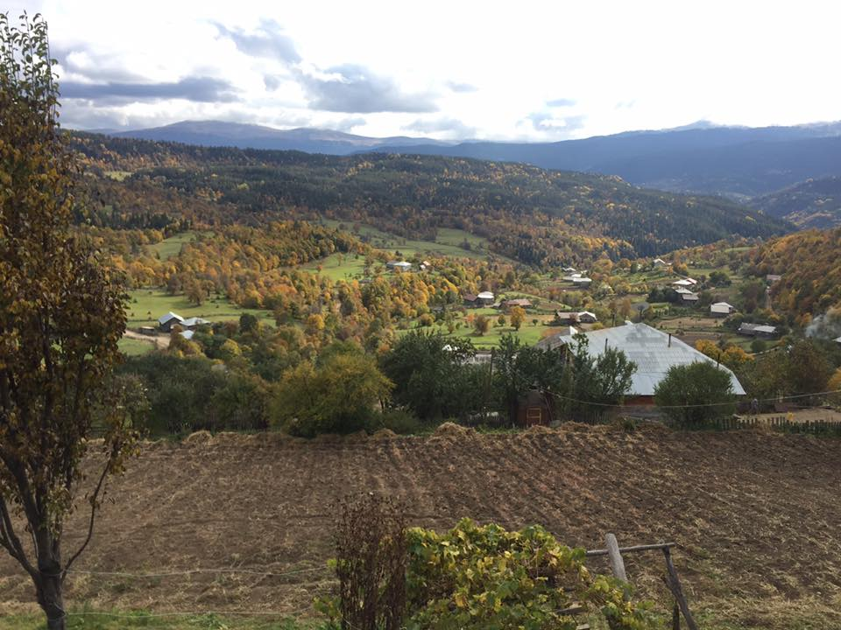
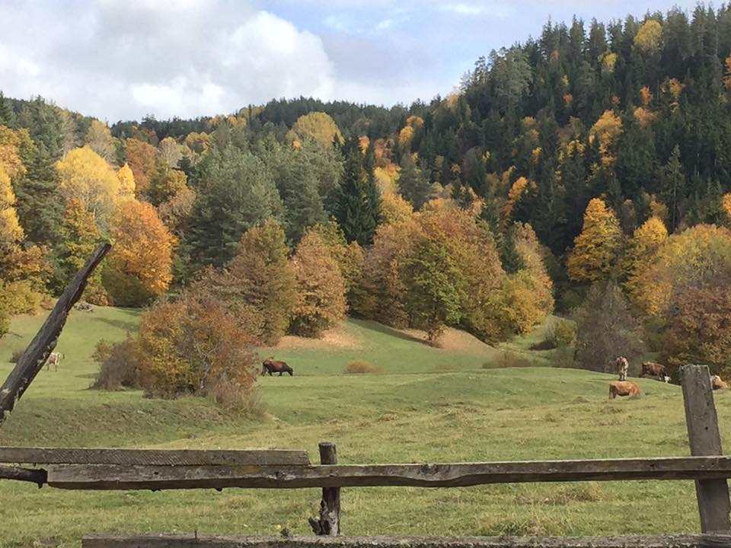
SUSTAINABLE PASTURE & HAY MEADOWS MANAGEMENT
OBJECTIVES
Maintain the pastures and meadows
Keep forests free from livestock and hay making
Increase productivity of cattle
Mitigate forest fires
Maintain high plant diversity

Slide 11
SUSTAINABLE PASTURE & HAY MEADOWS MANAGEMENT
MEASURES
Restoration of pastures and increase livestock productivity
Hay making to ensure grass for winter
Rotational grazing
Herding animals for controlled grazing

Slide 12
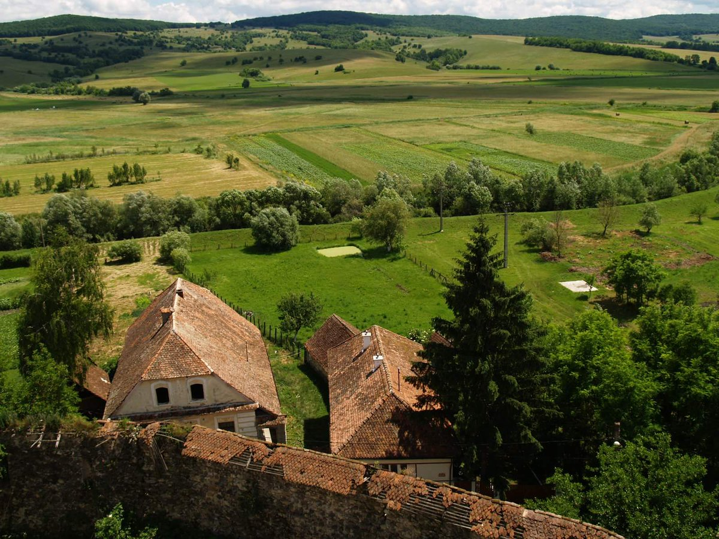
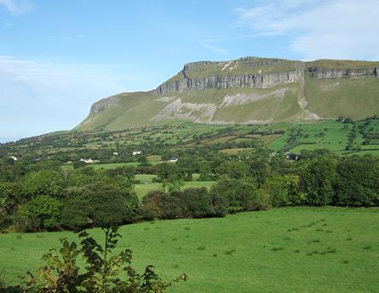
Conservation of high value landscape elements and secure ecosystem services in long-term perspective
Forest landscape restoration/management
Sustainable river basin management
Restoration and maintenance of wetlands
Protection of different habitats and stepping stones
Preserve cultural and historical heritage
Notes:
To preserve cultural

Slide 13
Framework Measures:
Establishment of Nature Community Fund through project support, which will include as grant support as well as loans
Preparation of IPROMO Valley Landscape Management Plan, including community based monitoring system

Slide 14
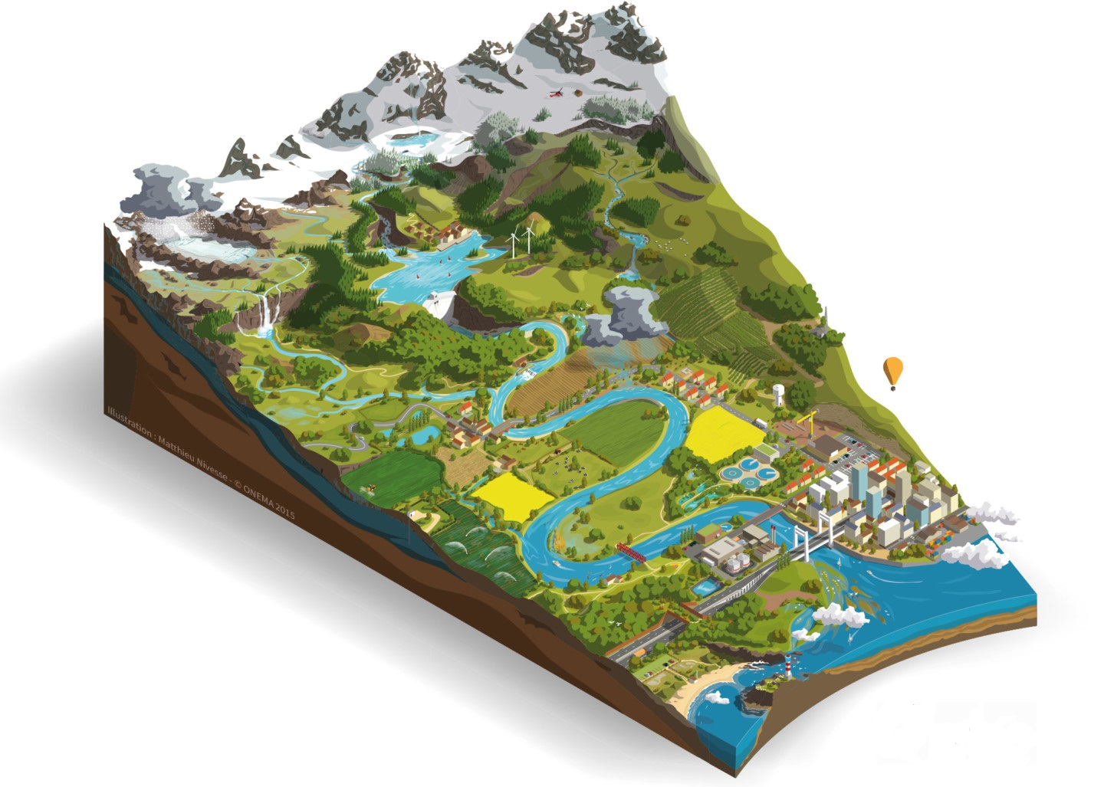
Using bottom-up approach:
Strong communication and planning with people;
Insured community ownership;
Integration of all stakeholders (local government;
Creation of Nature Community Fund
Protected zones
Pasture
Hay meadows
Agricultural land
Notes:
Future Management Plan

Slide 15
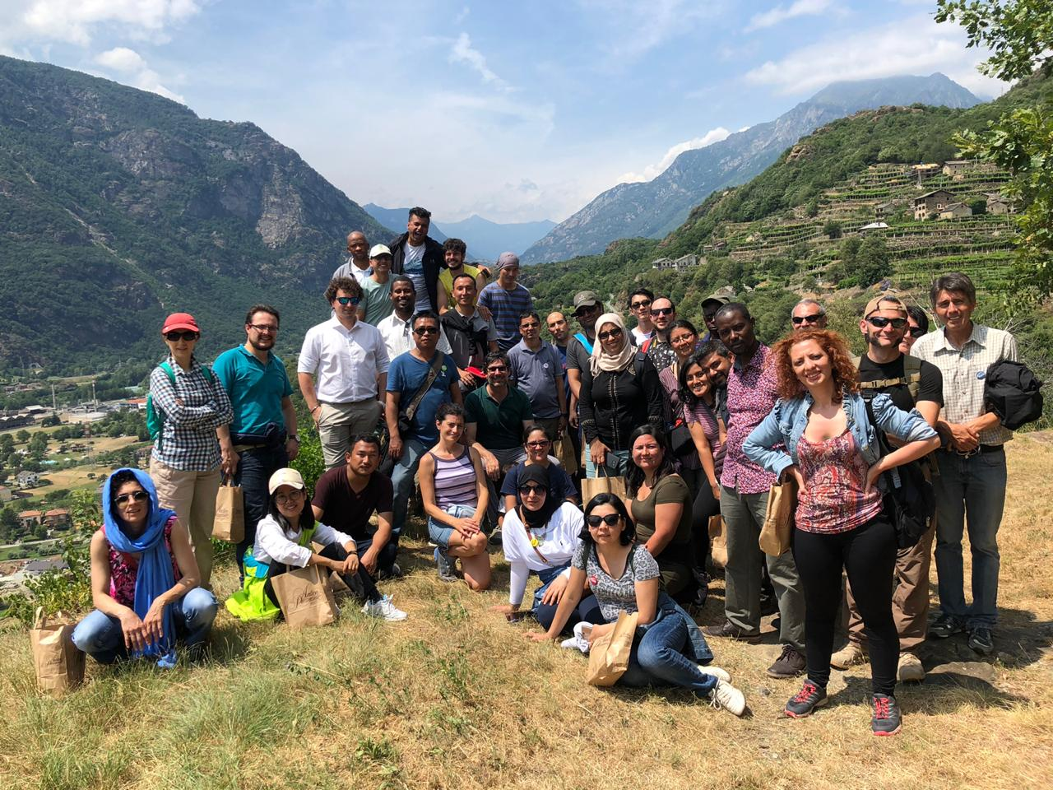
Grazie per l'attenzione!
IPROMO Valley Community

