Slide 1
A community based initiative to cope with land use challenges in mountain areas
sustainable development to face climate change in mediterranean regions
IPROMO SUMMER COURSE 2019 | TORINO
Eak Narayan Dhakal (Nepal) | Martine Francis Btaich (Lebanon) | Oscar Iván Galvis Mora (Colombia) | Lamya Haider (Algeria) | Sebastián Seisdedos Morales (Chile) | Zhyldyz Shigaeva (Kyrgystan)

Slide 3
¿What are we facing?

Slide 4
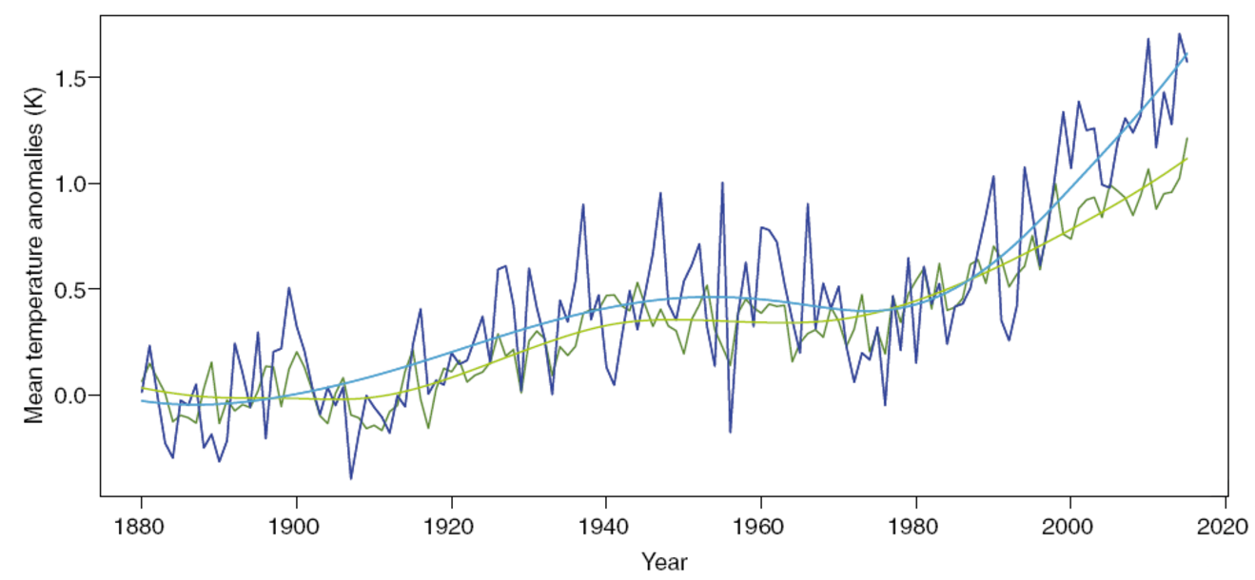
¿Why mediterranean climate zones are important?
Historic warming of the Atmosphere globally and in the Mediterranean Basin.
+ 0,5°C

Slide 5
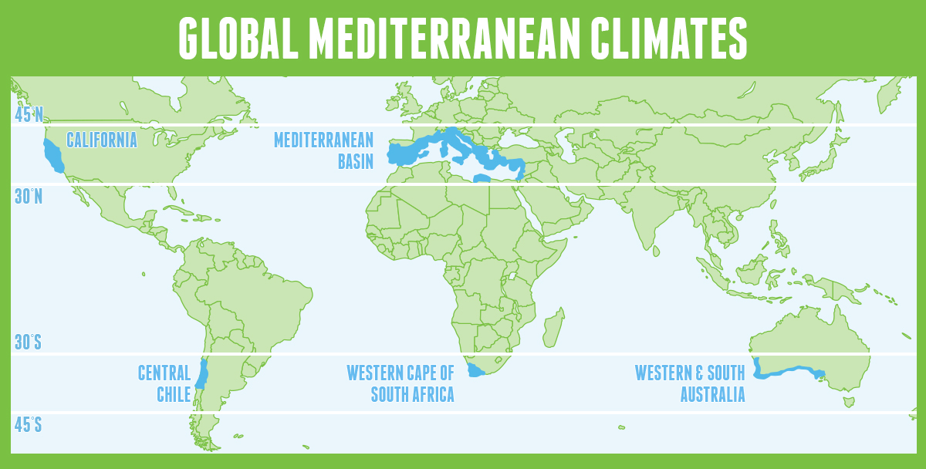

Slide 6
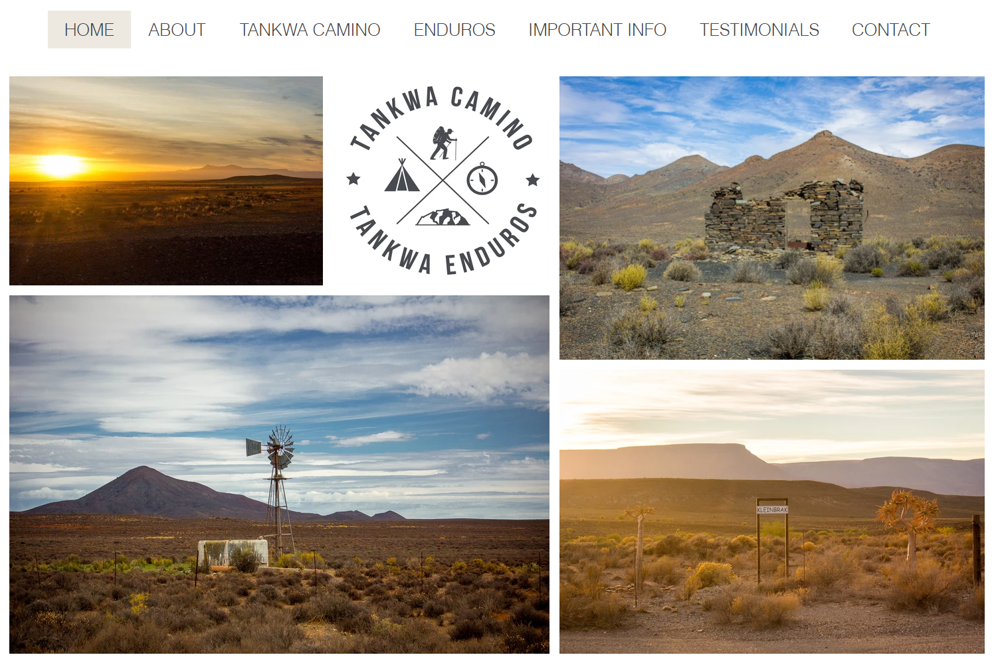
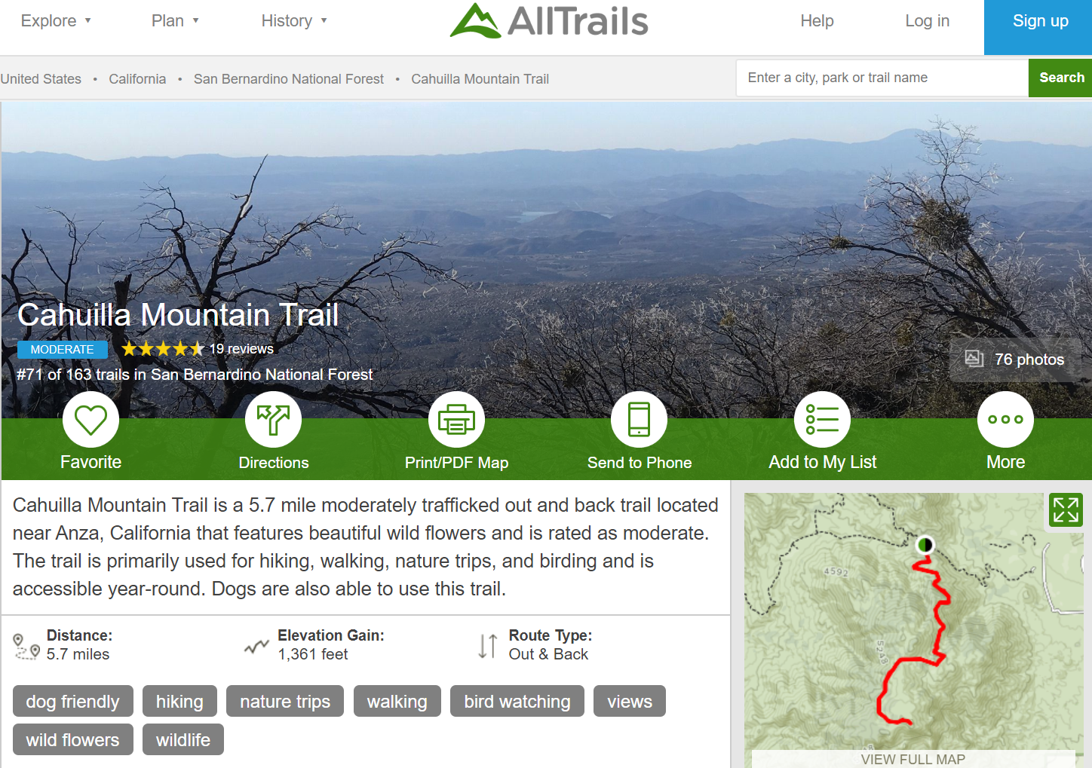
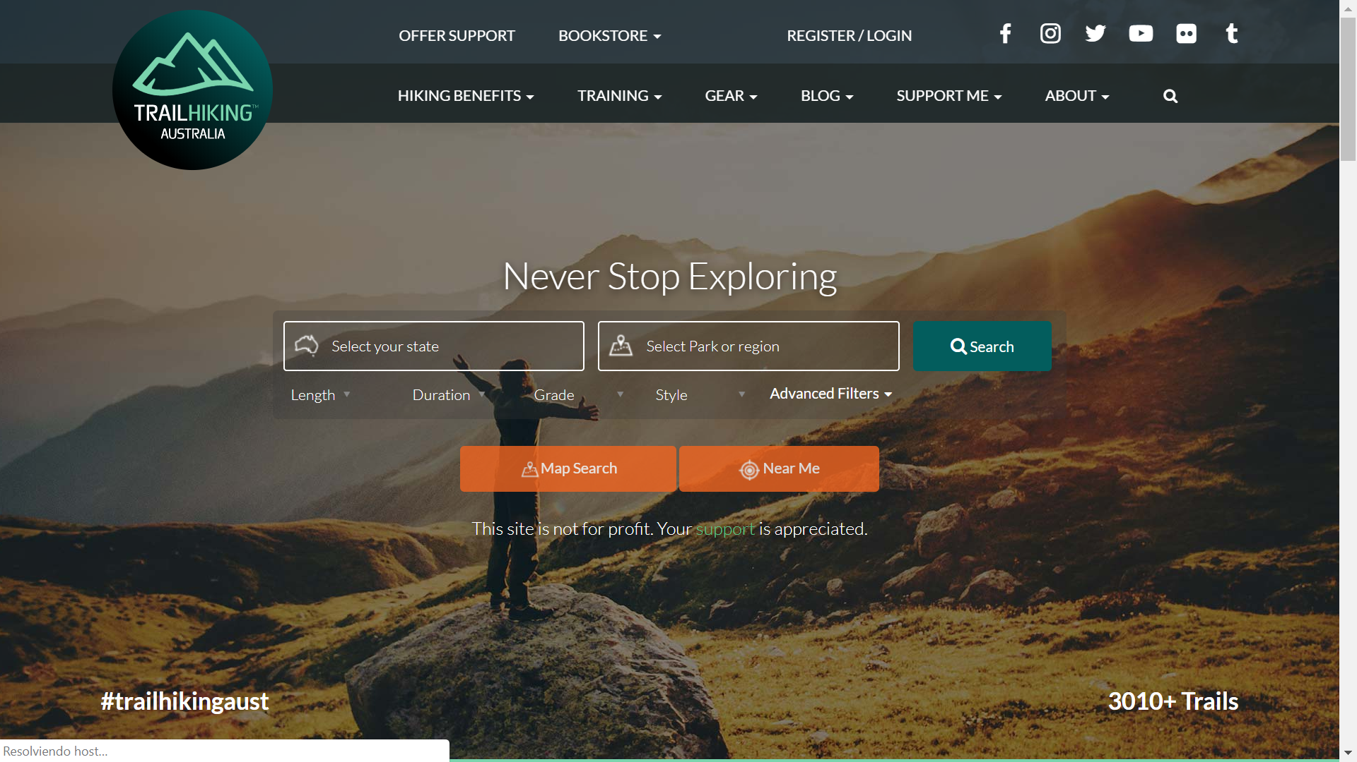
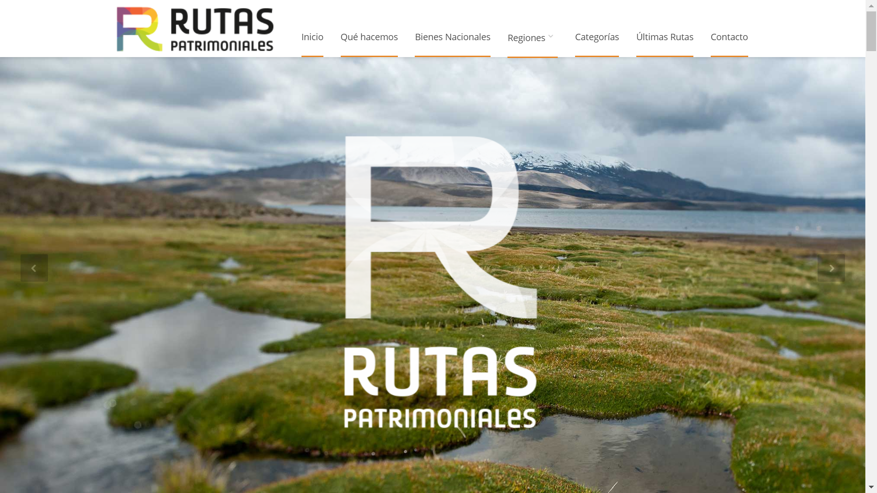
Case study
California
Italy
South Africa
Chile
Australia

Slide 7
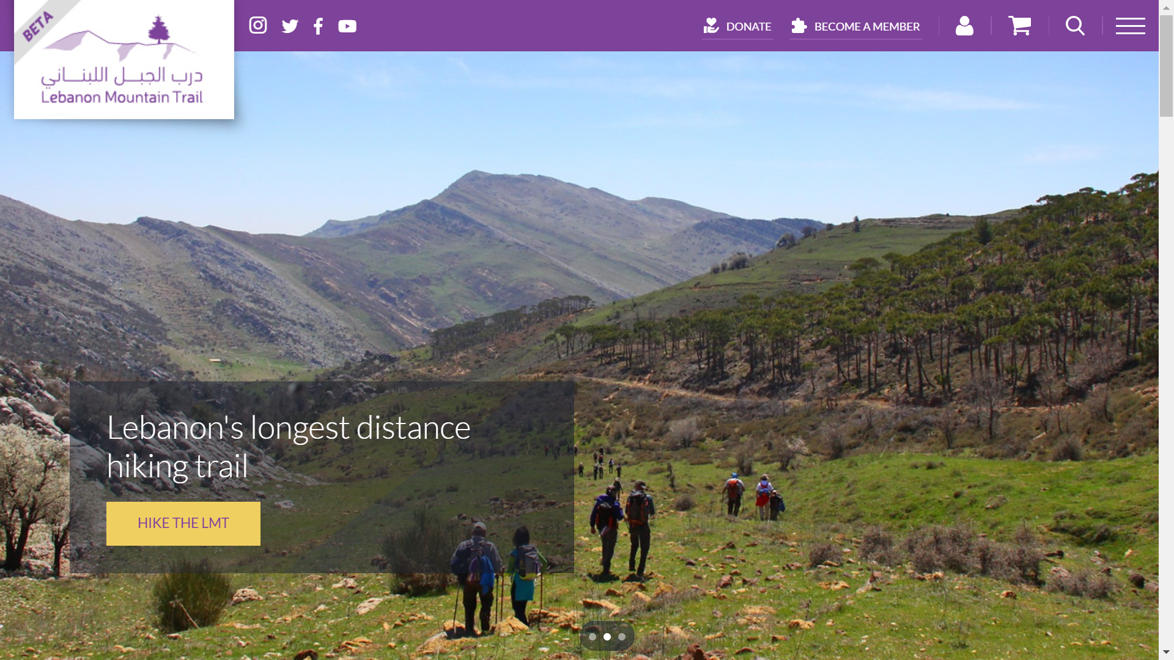
Lebanon

Slide 8
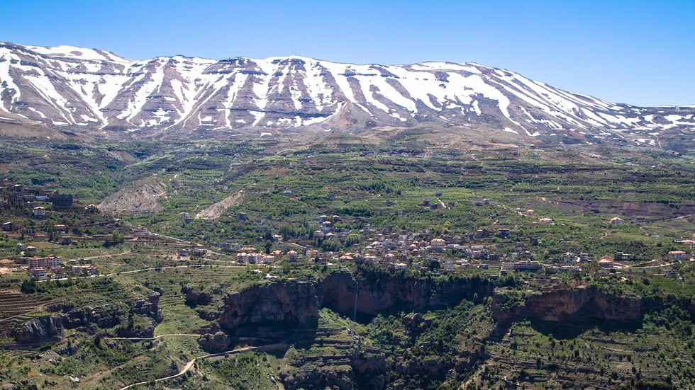
mountain landscape
6.898 sqKm
66% mountain territory
1/3 of mountain population are exposed to climate change effects

Slide 9
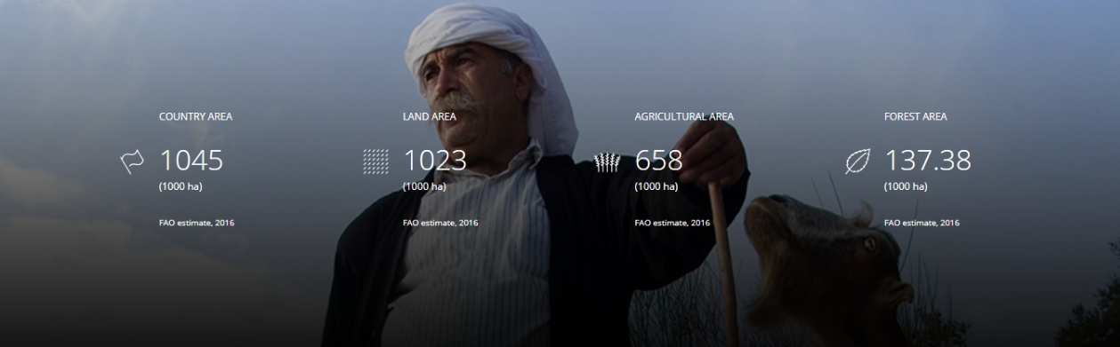
total area and land use
Crecimiento población
Lebanon Context

Slide 10
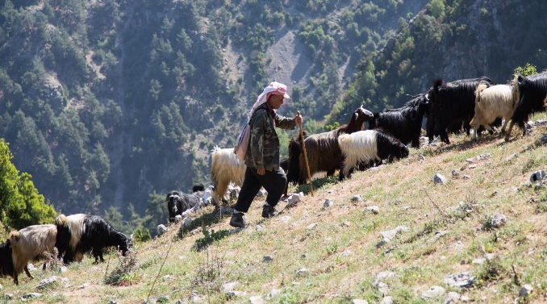
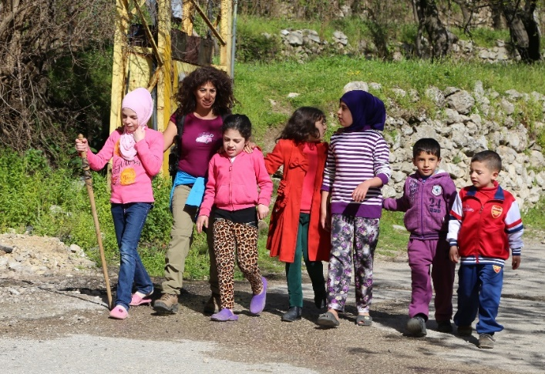
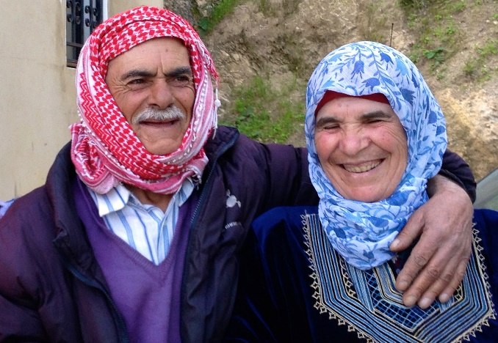
population

Slide 11
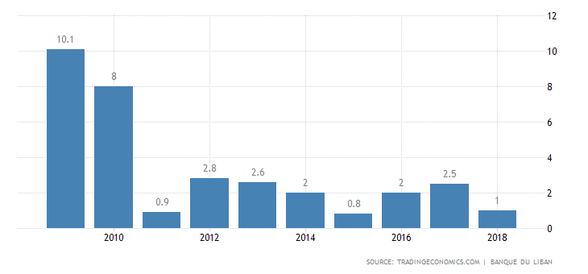
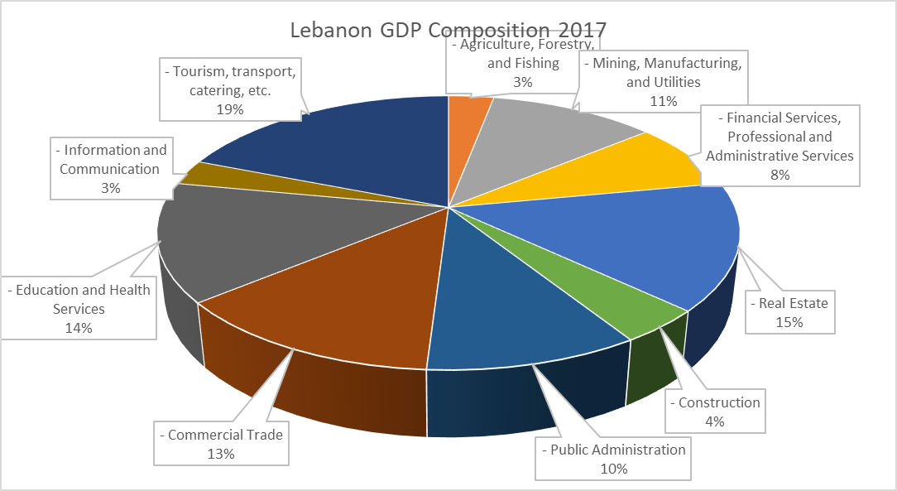
economy
30% (or 1.5M individuals) of the Lebanese population live on less than 4$/day or 120$/month
Lebanon Annual GDP Evolution
About 2% are considered extremely poor and live on less than 2.5$/day (unable to meet their basic food needs)*
*UNDP Rapid Poverty Assessment in Lebanon (2017)

Slide 12
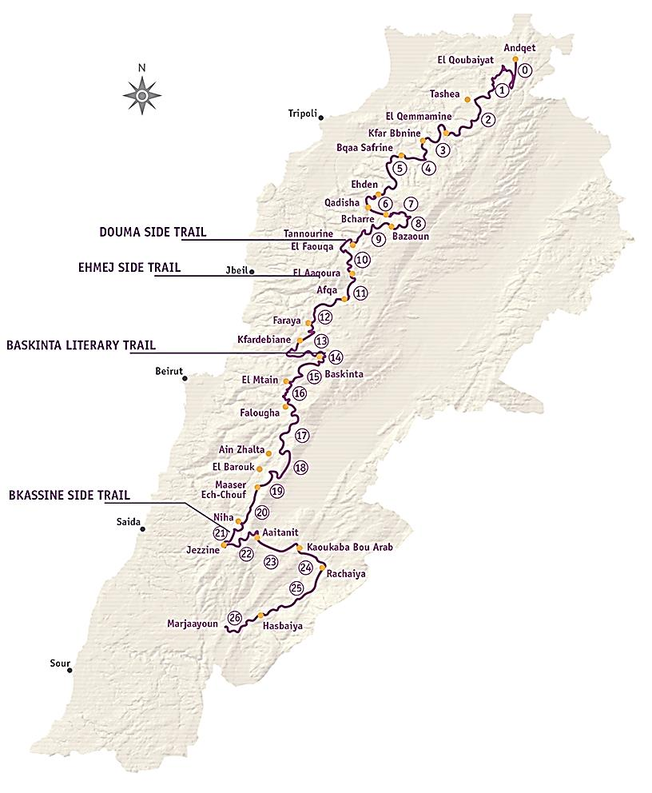
Celebrating a Shared Heritage!
Lebanon Mountain Trail
470 km (293 mi.)
570-2,011 m (1,870-6.600ft)
27 sections (27 days)
4 side trails
75 towns and villages
50 municipalities
1 World Heritage Site
3 Nature Reserves
2 Biosphere Reserves
Protected Areas and Sites
Important Bird Areas
50% foot/ historic paths
40% dirt/ agricultural roads
10% paved

Slide 13
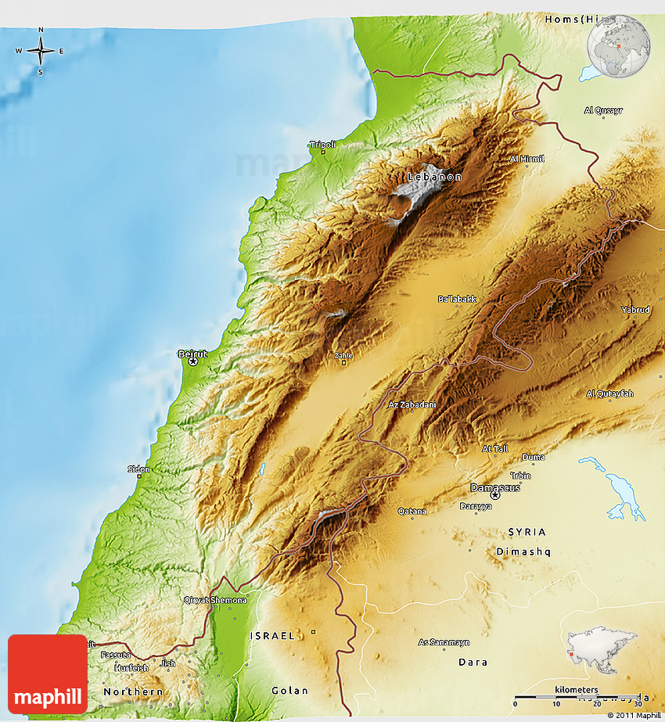
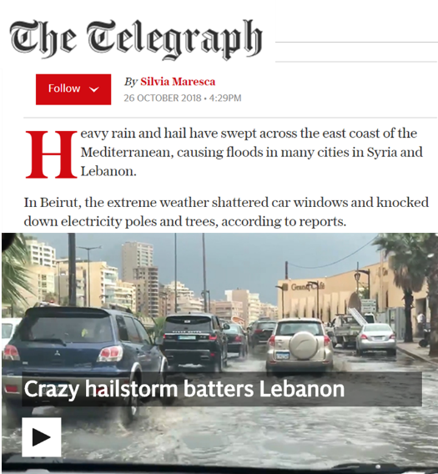
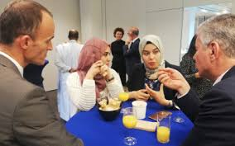
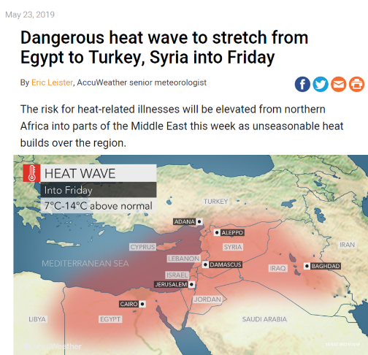
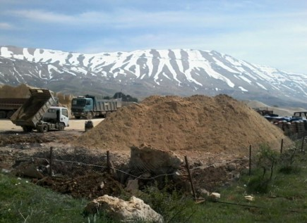
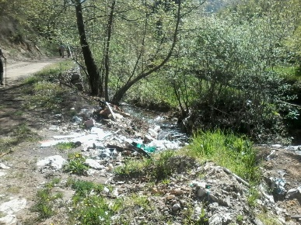
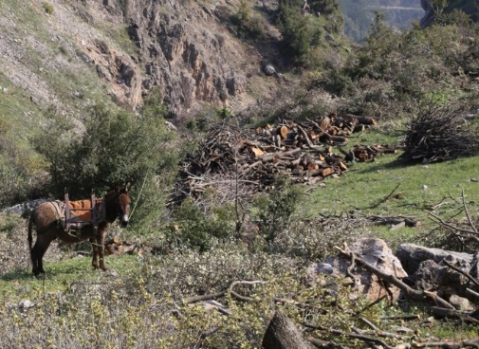
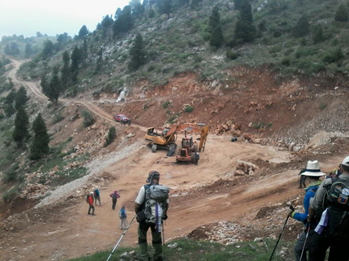
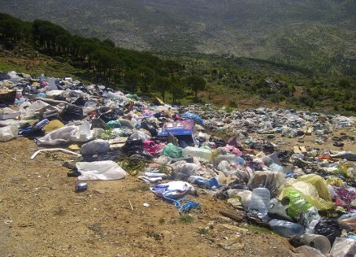
Danniyeh region´s challenges
``
Extreme Variability
Poor local
governance
Climate Change
Pollution
Quarries
Unsustainable
construction
deforestation
Solid waste
CRISIS

Slide 14
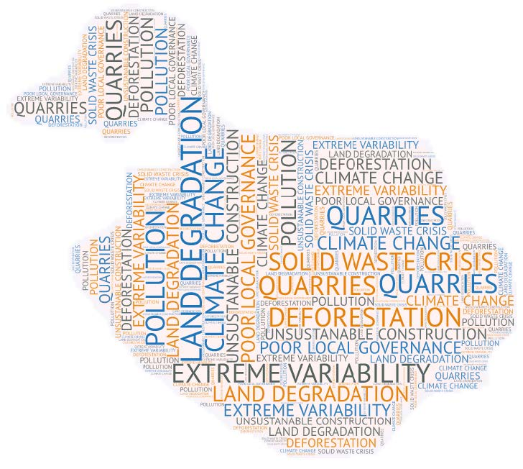
Danniyeh region´s problems
``

Slide 15
goal
Local communities are able to develop their economy and protect environment through sustainable land management.

Slide 16
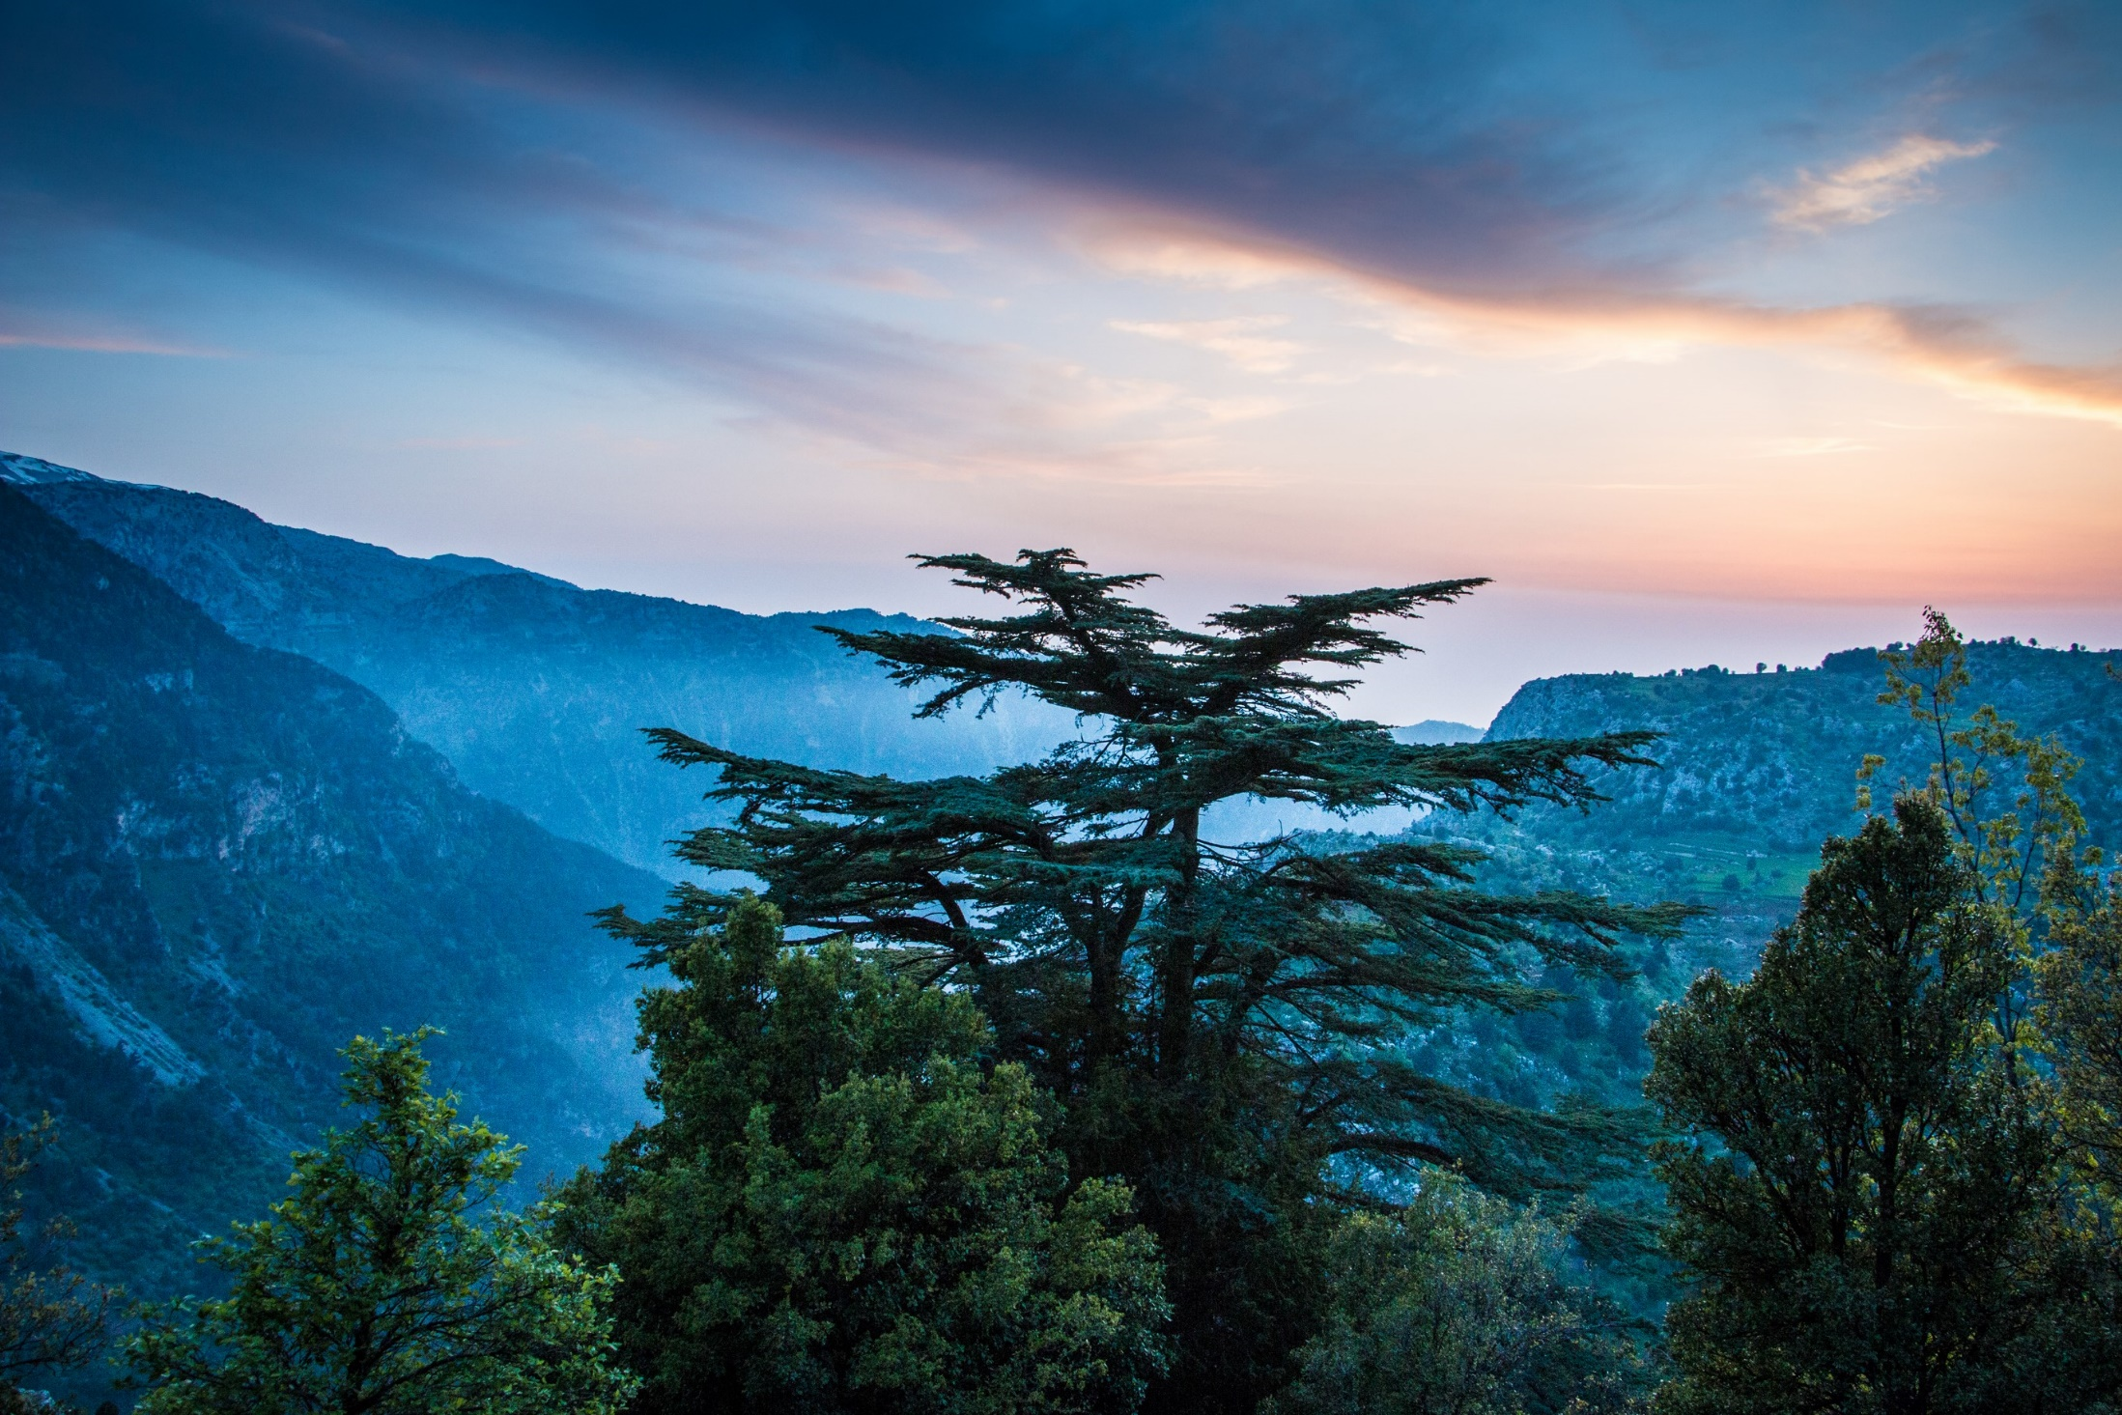
pre-project activities
Need assessment of the Project area applying Participatory workshops
Stakeholder mapping and discussing, social mapping, resource mapping
Survey about functions and perceptions of landscape (historical, present and future)
Trend Analysis
Wellbeing Ranking
Vulnerability/ risk assessment
Remote sensing survey

Slide 17
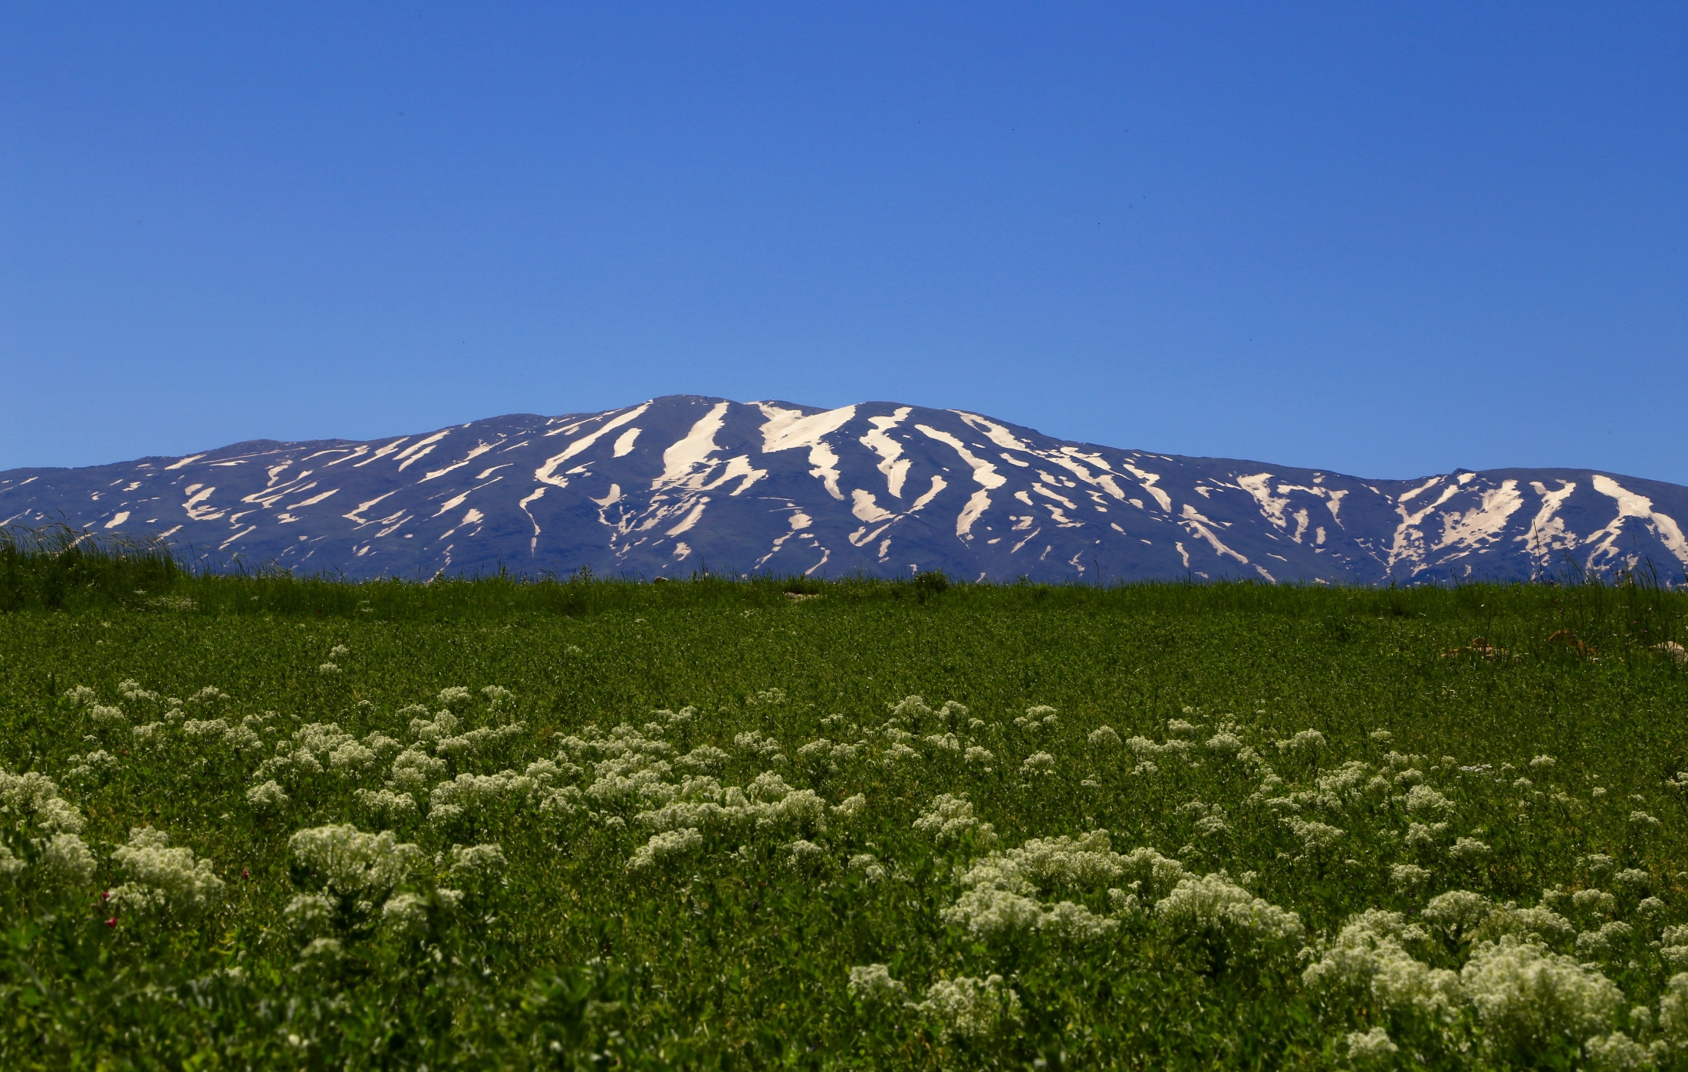
strategy
Strengthening community groups, civil society, local institutions and stakeholders.
Create a commonwealth group to implement the project.
Implement project through local community and local authorities.
community based development initiatives

Slide 18
objectives
To contribute to a sustainable land use management in the Danniyeh Region, through local communities development by 2030.
Empower local community to enhance sustainable land use and climate change management

Slide 19
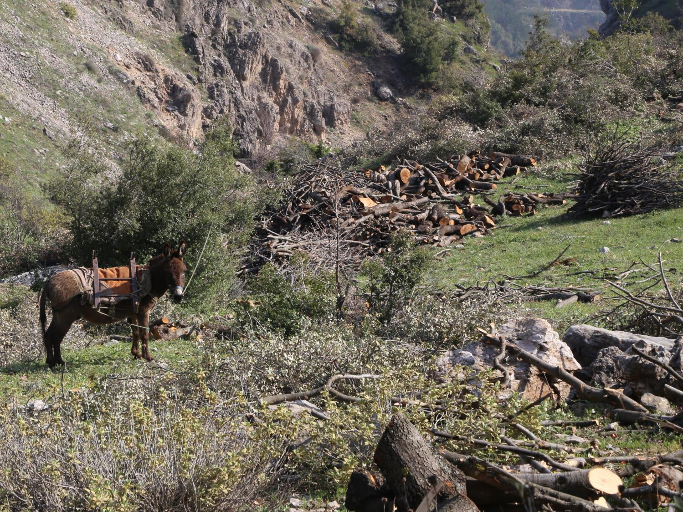
deforestation
actions
Reforestation (tree cropping).
Identify and implement new economic alternatives (ecoturism, bee keeping, agroforestry, crafts, livestock, rural tourism, etc.)
9,2%
7,4%
7,2%

Slide 20
climate
actions
Introduction of a new crops resistant to climate change.
Use of a renewable energy (solar, micro hydropower)
Set up a solid waste management
Build the capacity of the municipality
Set up a construction code of the area considering the extreme weather variability in the new infrastructures building
Notes:
Source:
https://weatherspark.com/y/99217/Average-Weather-in-Beirut-Lebanon-Year-Round
https://weatherspark.com/y/99217/Average-Weather-in-Beirut-Lebanon-Year-Round

Slide 21
unsustainable construction
actions
Consultation with stakeholders of quarries to identify more sustainable management of the quarries
Socioeconomic impact assessment of the quarries
Build the capacity of the municipality
Environmental impact assessment of the quarries
Set up a construction code of the area considering the extreme weather variability in the new infrastructures building
Set up a code of conduct of construction

Slide 22
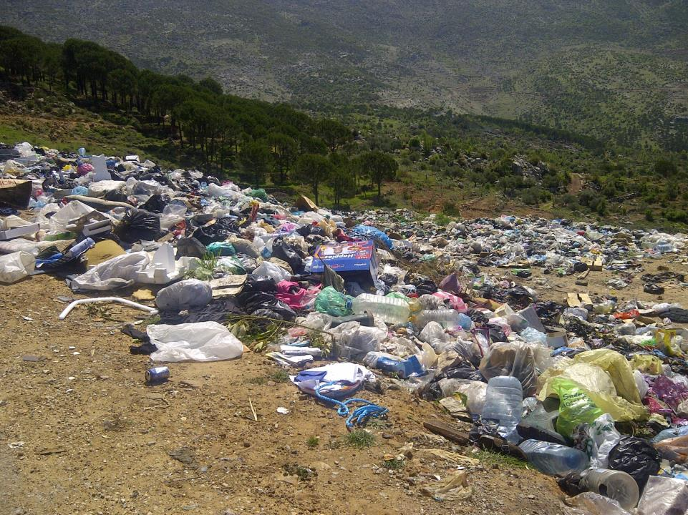
solid waste &
pollution crisis
actions
Set up a solid waste management
Build the capacity of the municipality
Identify new economic alternatives such as ecoturism, bee keeping, agroforestry, crafts, livestock, rural tourism
Reforestation (tree cropping)
Local water management

Slide 23
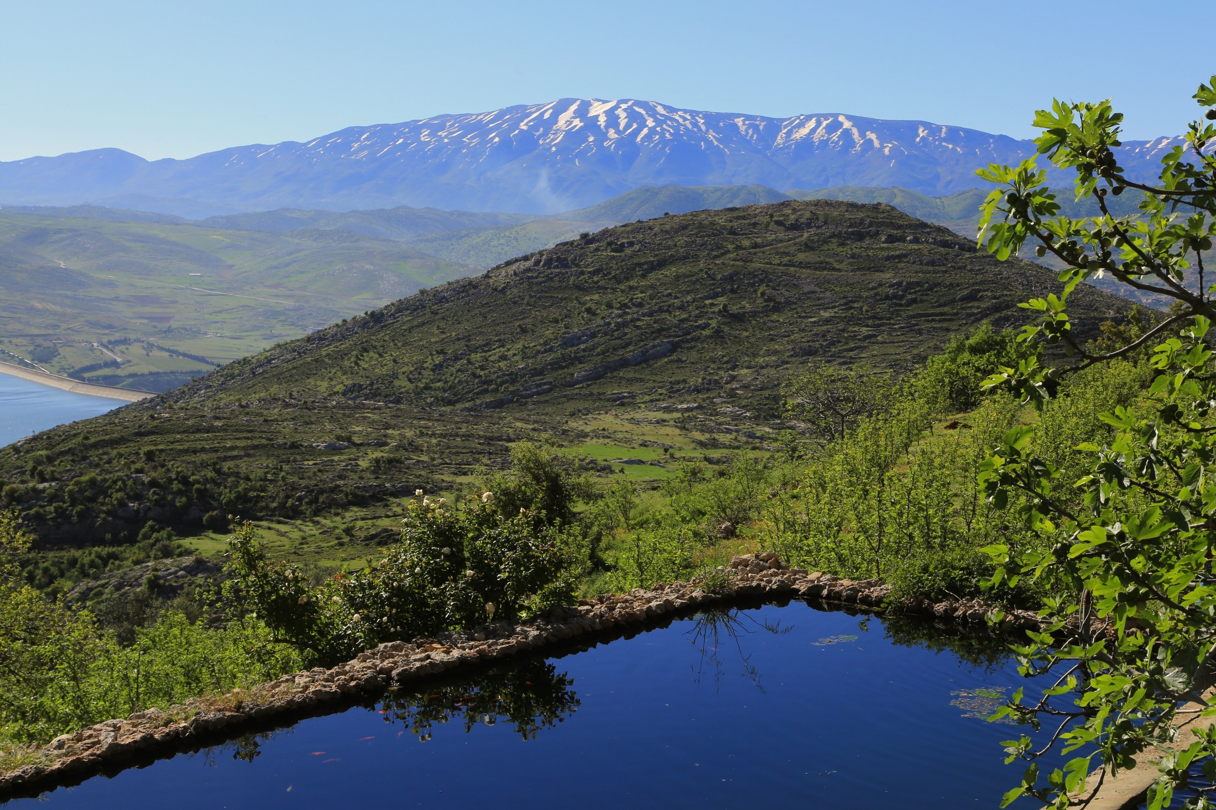
results by 2030
50% forest recovered by 2030
35% population have incomes from sustainable land management
Solid waste management system established by 2025
25% population have renewable energy option
Local construction code of conducts are formulated and socialyzed.
Monitoring and evaluation system of environmental risks implemented by 2030

Slide 24
supporting 2030 Agenda

Slide 25
THANKS FOR YOUR ATTENTION

