Slide 1
SYNOPSIS Landscape approach for enhancing mountain resilience
Danilo Godone, PhD
CNR-IRPI

Slide 2
Landscape…what other people see
https://www.facebook.com/trust.biologist/?tn-str=k%2AF

Slide 3
Landscape…what we’ve discovered!!!
https://www.facebook.com/trust.biologist/?tn-str=k%2AF

Slide 4
Landscape…what we’ve discovered!!!
Maybe with fewer details!!!
https://www.facebook.com/trust.biologist/?tn-str=k%2AF

Slide 5
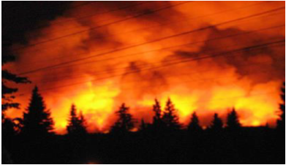
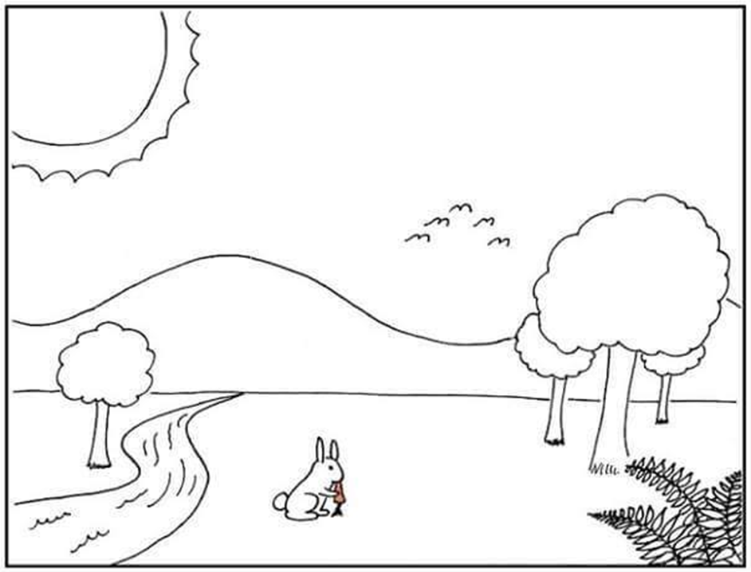
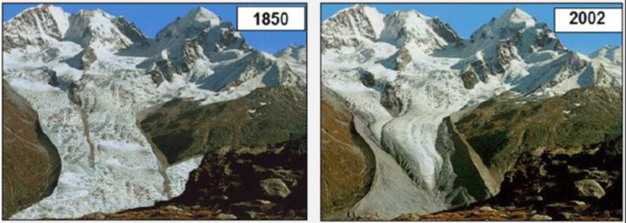
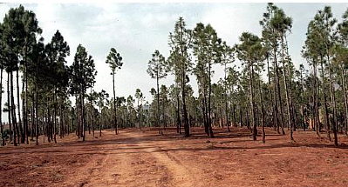
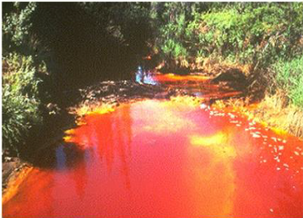
Landscape can be impacted by…
Global warming
Forest fires
Water pollution
Biodiversity loss

Slide 6
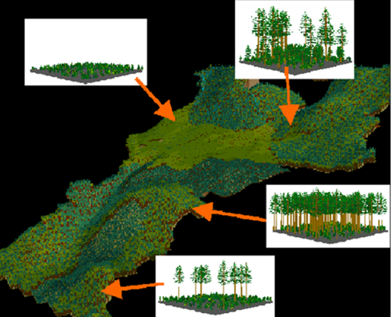
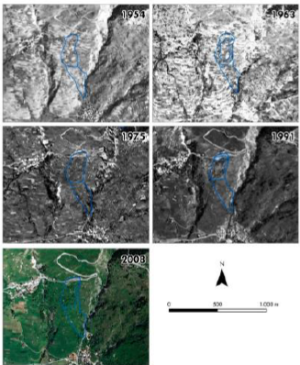
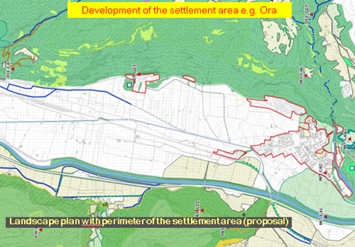
…but with appropriate tools…
Hazards assessment
Landscape ecology
Land planning
Water technology

Slide 7
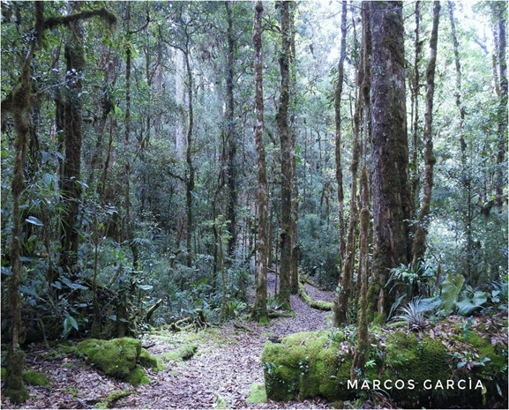
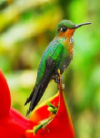
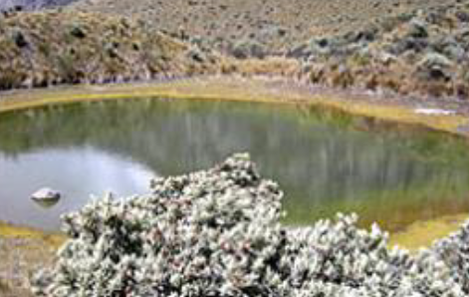
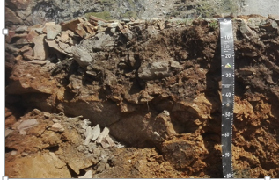
…and resources…
Forests
Biodiversity
CO₂ storage
Soil

Slide 8
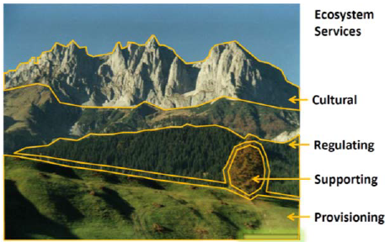
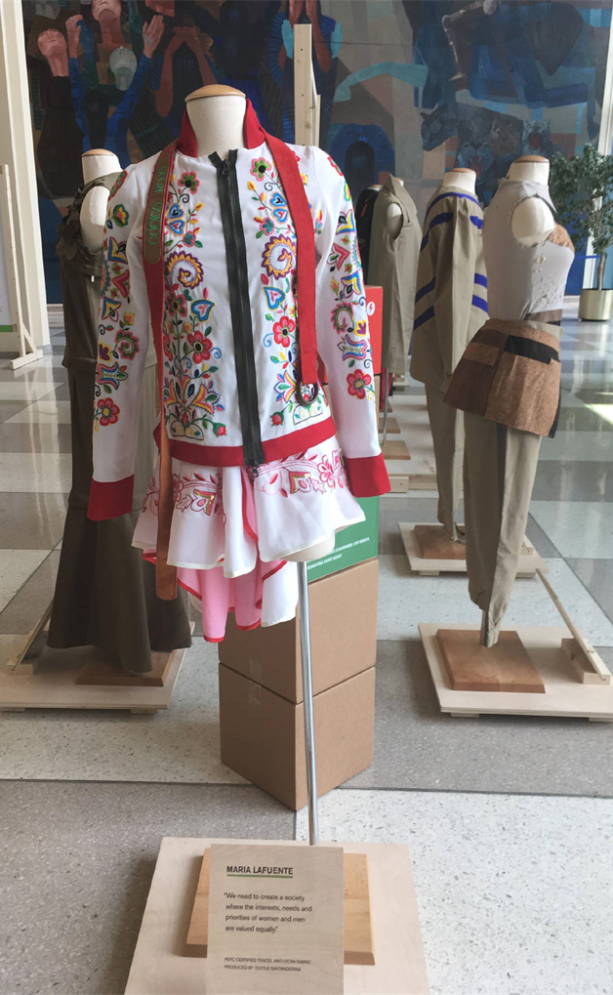
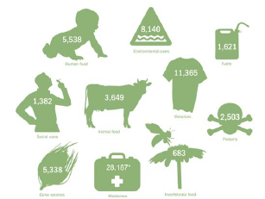
…can provide:
Ecosystem services
Clothes
Bio products
???

Slide 9
Working groups
Prepare a presentation showing how the landscape approach could be used to improve the local development.
0 minutes left
5 minutes left

Slide 10
Thank for your attention!
Adriano Oggiano
Hans Schreier
Mauricio Diazgranados
Giuseppe Scarascia Mugnozza
Sarah Cordero
René Castro
Hugh Pritchard
Maria de Cristofaro
Florian Zikeli,
Kai Lintunen
Mauro Bassignana
Enrico Pomatto
Alberto Cugnetto
Yuka Makino
Zenaida Willison
Ruijun Long
Matteo Garbarino
Donato Morresi
Michele Freppaz
Silvia Stanchi
Matteo Fasano
Matteo Morciano
Daniele Ganora
Daniele Giordan
Manuel Peralvo
Tommaso Chiti
Alberto Del Lungo
Danilo Godone, PhD – danilo.godone@irpi.cnr.it – d.godone@gmail.com
Disclaimer: images are extracted from lecturers’ presentations

