Slide 1
Personal Presentation
Dr. Apurva Rai
Sejahtera Fellow 2017, Republic of Korea
Former Programme Officer Centre for Environment Education
Consultant, Wildlife Coservation Society-India
apurvaraievs09@gmail.com
Ph No- +91-9919942590
IPROMO
Landscape approach for enhancing mountain resilience
Pieve Tesino /Ormea 02-18 July 2019

Slide 2
Education
Doctor of Philosophy -Banaras Hindu University, Varanasi in collaboration with CSIR-National Botanical Research Institute in Environmnetal Science. Studied the effect of elevated CO2 on leaf litter decompostion and Soil quality in Tropical Forest. 10 publication in internationla Journal.
https://scholar.google.co.in/citations?user=z9ufH5wAAAAJ&hl=en
Master of Philosophy (M.Phil) in Energy and Environmental Studies in DAVV, Indore, M.P. Studies based on Waste utlization and minimization techniques.
Master of Science ( M.Sc) in Environmental Science
Employment and Main Activities
Worked as a Programme Officer in Centre for Environment Education, Himalaya. Awareness and Training to train people on Disaster Risk Reduction (DRR), Climate Change, WASH and ODF to improve the quality of life in district of Uttar Pradesh funded by Give2Asia and ICIMOD.
Trained teachers and Pradhans and Involved in making of SDMPs of 234 schools and VCPs of 78 gram panchayats in Bahraich district. Total Direct Reach Out- Students- 626; Teachers- 660; Villagers-648; Media- 10
Total Indirect Recah Out- Villages- 121; Population- 2,18,222.
World environmnet day celebration 2018 on the theme Beat Plastic pollution in Mountains of Uttarakhand disrict of India and addressed and created awareness in more than 10 thousand people. A coffee table book was published and launched in Poland
Currently working as a Projcet Corodinator in TSA India. Conducting workshops on Biodiversity and wildlife conservation. Involved in Projects of community development.

Slide 3
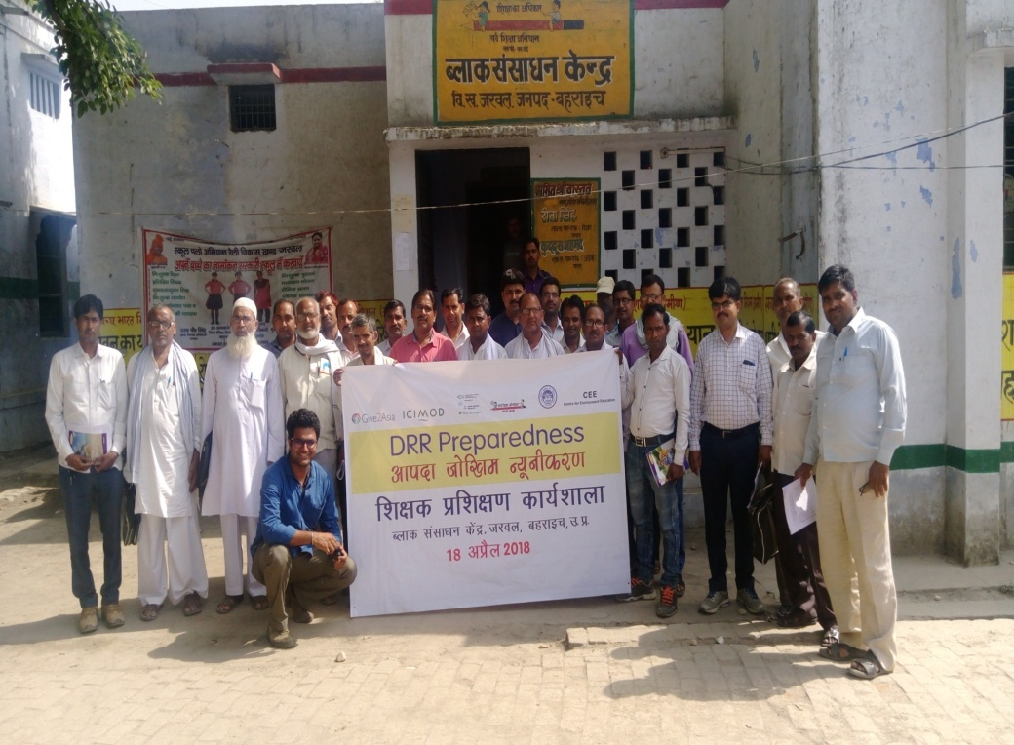
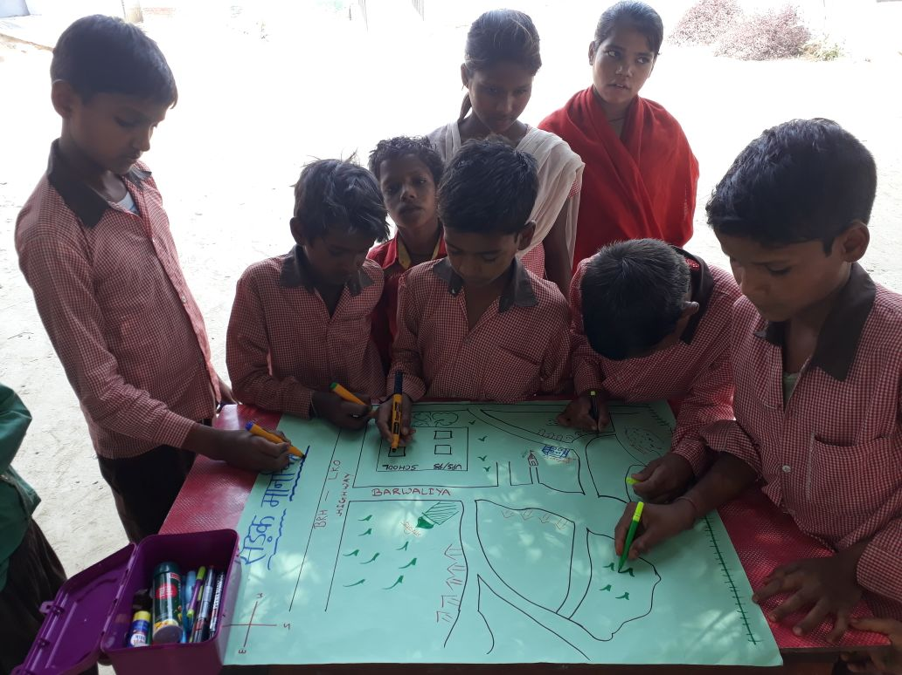
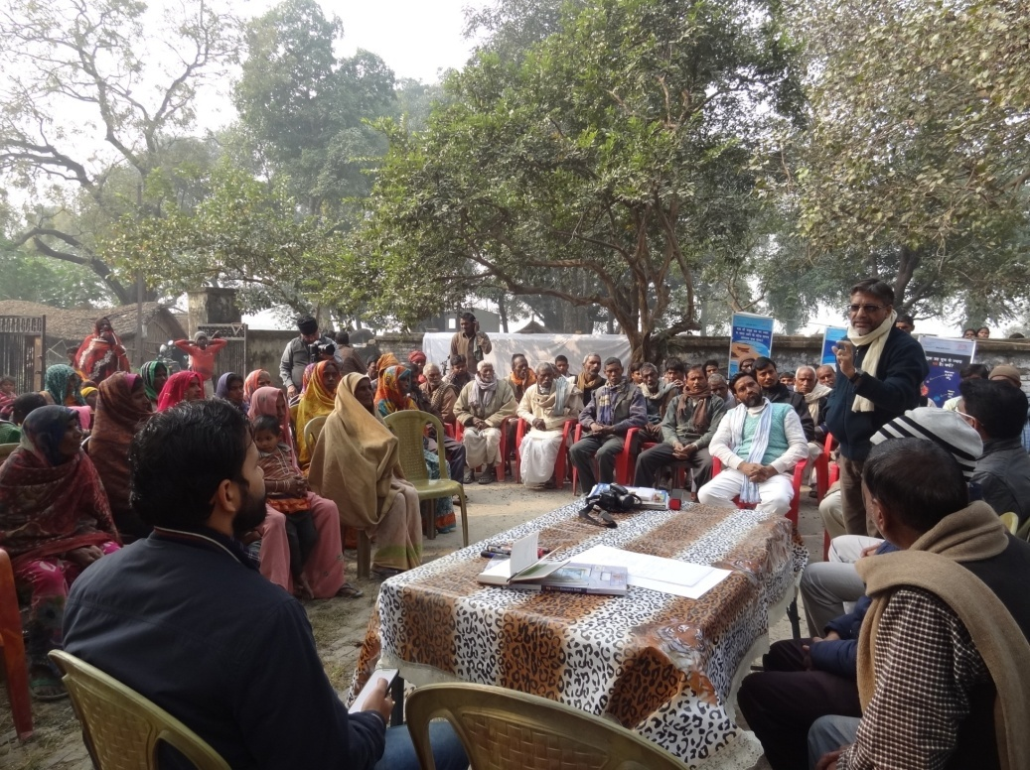
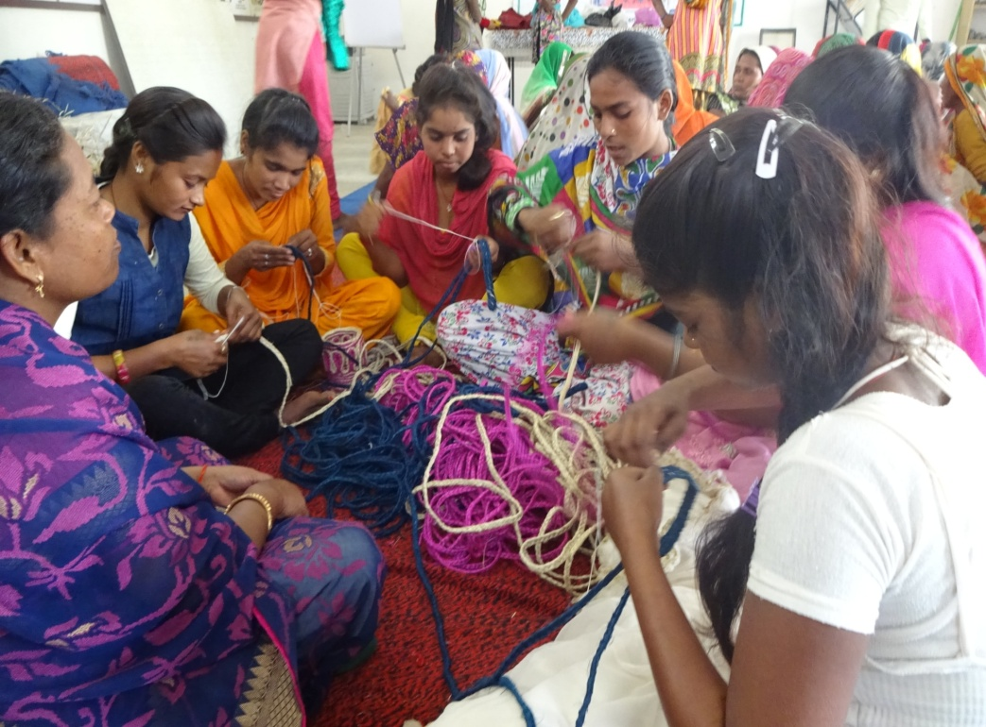

Slide 5
Other Interests (Volunteer work, hobbies etc.)
Selected as a Sejahtera Fellow 2017 from Asia Pacific region to work in South Korea to promote DRR and strengthening DRR network in whole Asia Pacific Region. The outcome of the project was the creation of DRR Netwotk in Asia Pacific Region.
Resource Person to Promote Popular Lecture Series on Climate Change & Sustainable Development in Mountain Areas funded by GIZ (Deutsche Gesellschaft für Internationale Zusammenarbeit), A Indo-German collaboration in five districts of Himachal Pradesh.
Celebrate World Environment Day, 2018 on the theme of Beat Plastic Pollution in Indian Himalayan Region (IHR) SDC-CEE Partnership in 15 states of India funded by Swiss Agency for Development and Corporation (SDC). Involved the larger group of stakeholders including Vendors, Bureaucrats and officials from Ministries.
Hobbies- Gardening, Swimming, Sports, Singing, Driving etc..

Slide 6
Presentation of a project you are working on 1/3
Project 1:
To curb illegal trade of animals by community development.
Objectives
Providing at least three livelihood options.
Capacity building of community four identified ongoing government schemes
Training to forest department on identification and triage of confiscated turtles.
Resource material development- raise awareness for communities, identification manuals, discourage turtle trade, info on how to continue government schemes

Slide 7
Presentation of a Project you are working on 2/3
Project 2:
Promoting Urban Ecology and Biodiversity in Lucknow city
Vision: Lucknow as a Green and Clean city.
Goal: By 2030 degraded habitats are restored increasing floral and faunal species diversity and richness.

Slide 8
Objectives | Activities
1. To prioritize Urban biodiversity rich habitats for conservation | 1.1 Study the current habitat status and ecological processes influencing faunal and floral species diversity and richness. 1.2 Identify major threats and assess their relative levels of intensity (high , medium , low)
2.Establish institutional and capacity building related to conservation of urban biodiversity conservation 3. To develop a framework for urban biodiversity conservation | 2.1 Identify stakeholders, Sensitize and Create awareness for urban biodiversity conservation. 2.2 Develop a multi-stakeholder forum for urban biodiversity conservation. 2.3 Enhance institutional and capacity issues of the multi-stakeholder forum. 3.1 Strengthening policies and governance

Slide 9
Thank for your attention!
(Increase your Handprint and decrease your Foot print)

