Slide 1
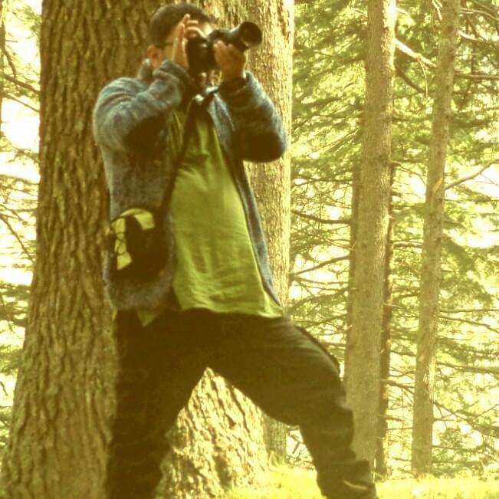

Name: Ghanshyam Pande
Affiliation: Central Himalayan Institute for Nature and Applied Research (CHINAR)
E-mail: gp.chinar@gmail.com
IPROMO
Landscape approach for enhancing mountain resilience
Pieve Tesino /Ormea 02-18 July 2019

Slide 2
Education
M.A (Sociology)| Kumaun University Nainital, Uttarakhand, India.
B.Sc. (Zoology, Botany and Chemistry)) | Kumaun University Nainital, Uttarakhand, India.
Employment and main activities
Currently working as-
Program Coordinator| Central Himalayan Institute for Nature and Applied Research (CHINAR) www.chinarindia.com
Responsibilities-
Leading Citizen science based environmental expeditions in Himalayas
Coordination with partners, donors and funders.
Develop new concepts, proposals and present them to funders.
Represent organization in national and international forums.
Documentation and print material designing.
Overall management of projects.
Survey’s related to mountain issues.

Slide 3
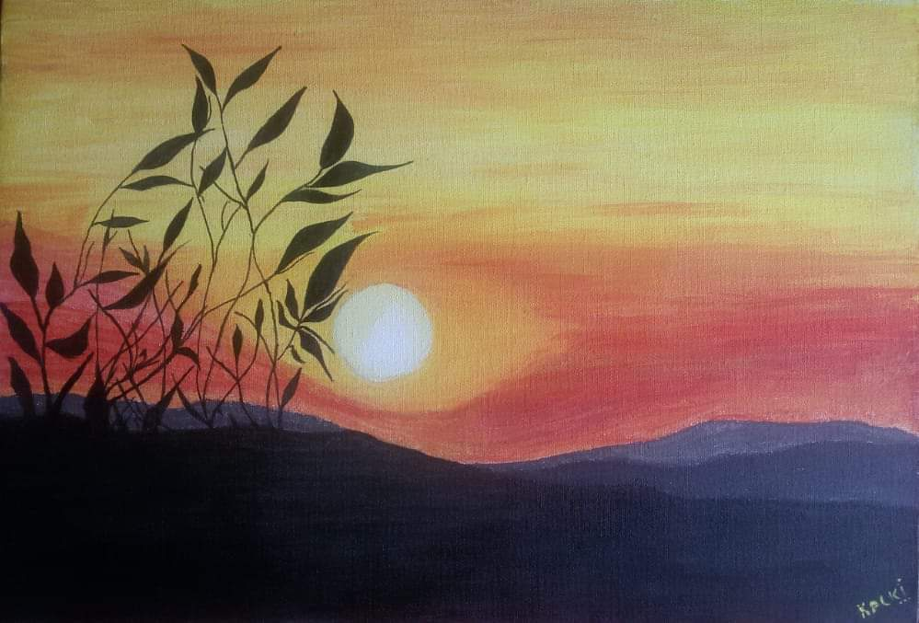
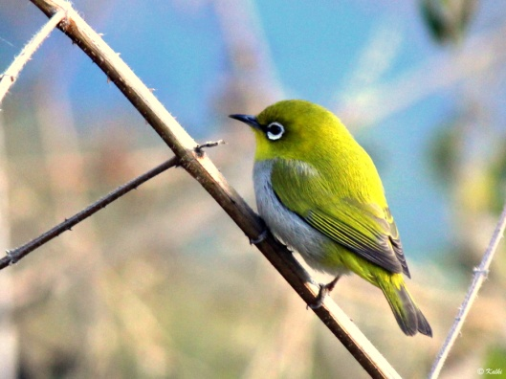
Other interests (volunteer work, hobbies etc.)
Conducts Birdwatching and Environment Awareness based workshops for students
Works as disaster management volunteer
Loves Photography and Painting
Loves Hiking and Birdwatching

Slide 4
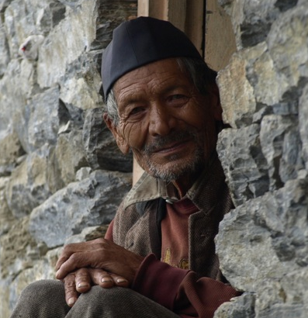
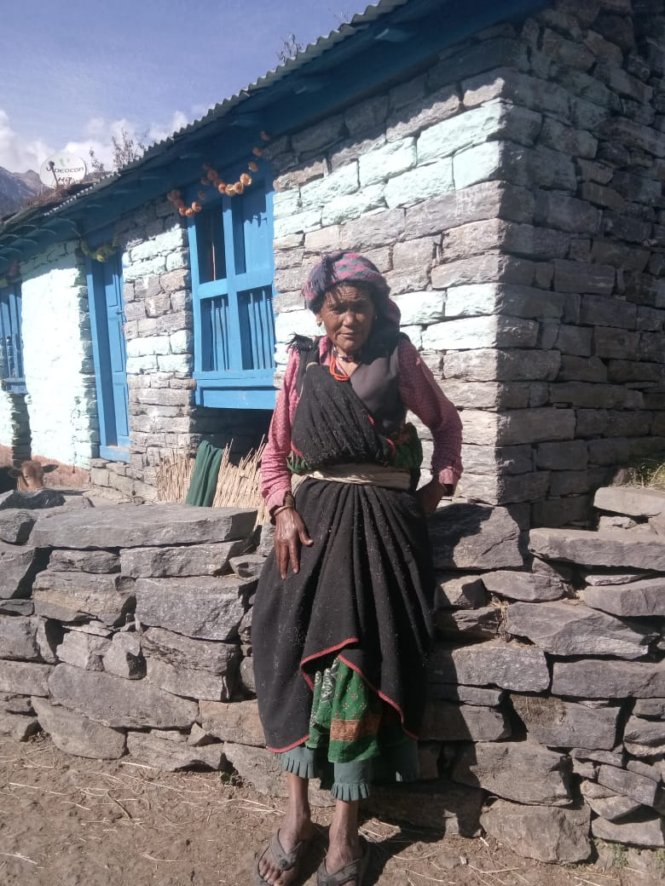
Current Projects Working On
Profiling of Indigenous Food Systems:
10 Food profiles done
globally by FAO
CHINAR did one of them in Namik Valley (India)
where Indigenous communities ,Bhotia
and Anwals reside.
The report is being peer reviewed
and published by FAO

Slide 5
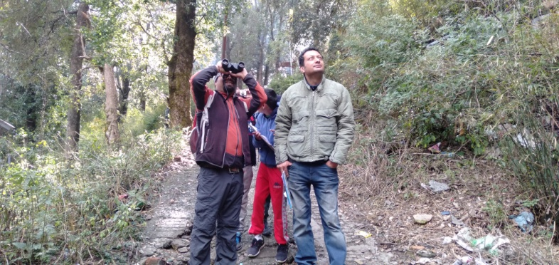
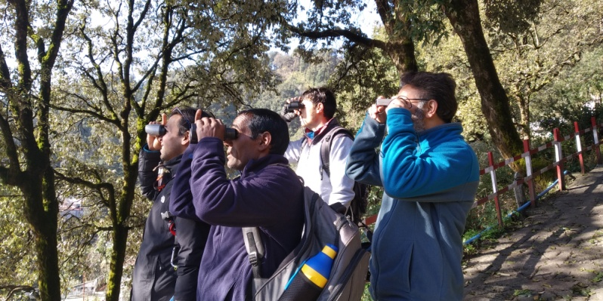
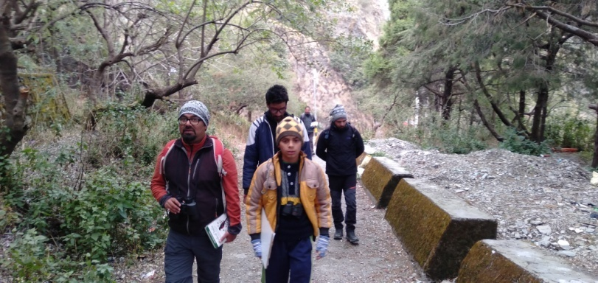
Current Projects Working On
Conneting people with
Nature-
Birds Identification Course
Nature Hikes
Environmental Expeditions

Slide 6
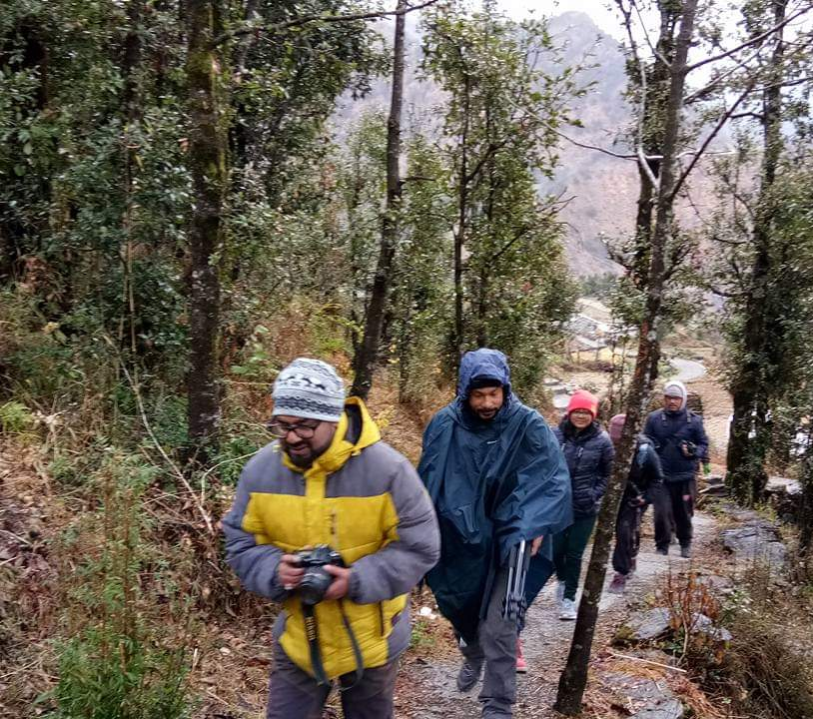
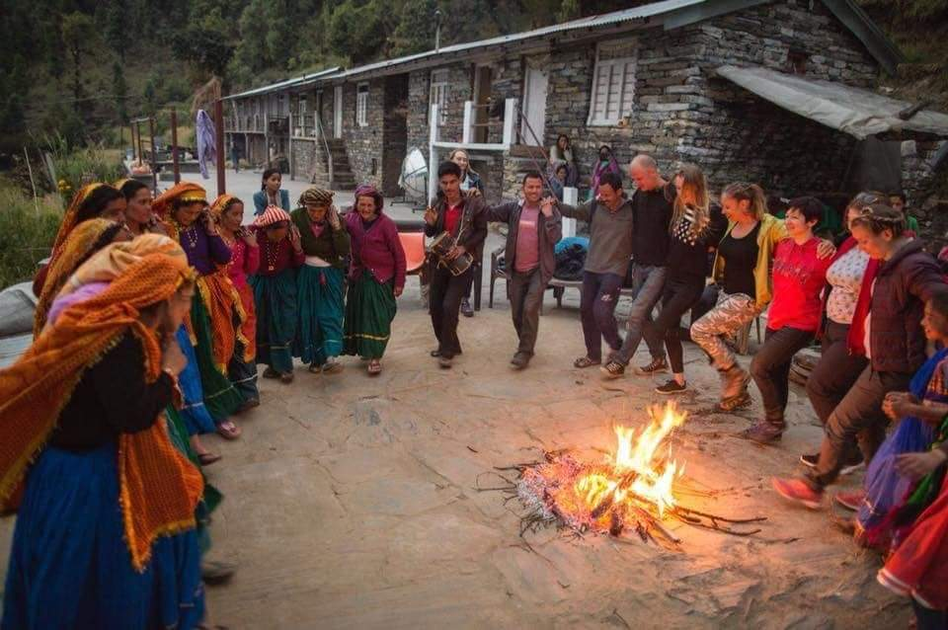
Current Projects Working On
Responsible Tourism
Developing Homestays and Campsites for rural communities
Capacity development of local youth as Birdwatching, Hiking/Trekking guides and Homestays/Camp site managenet

Slide 7
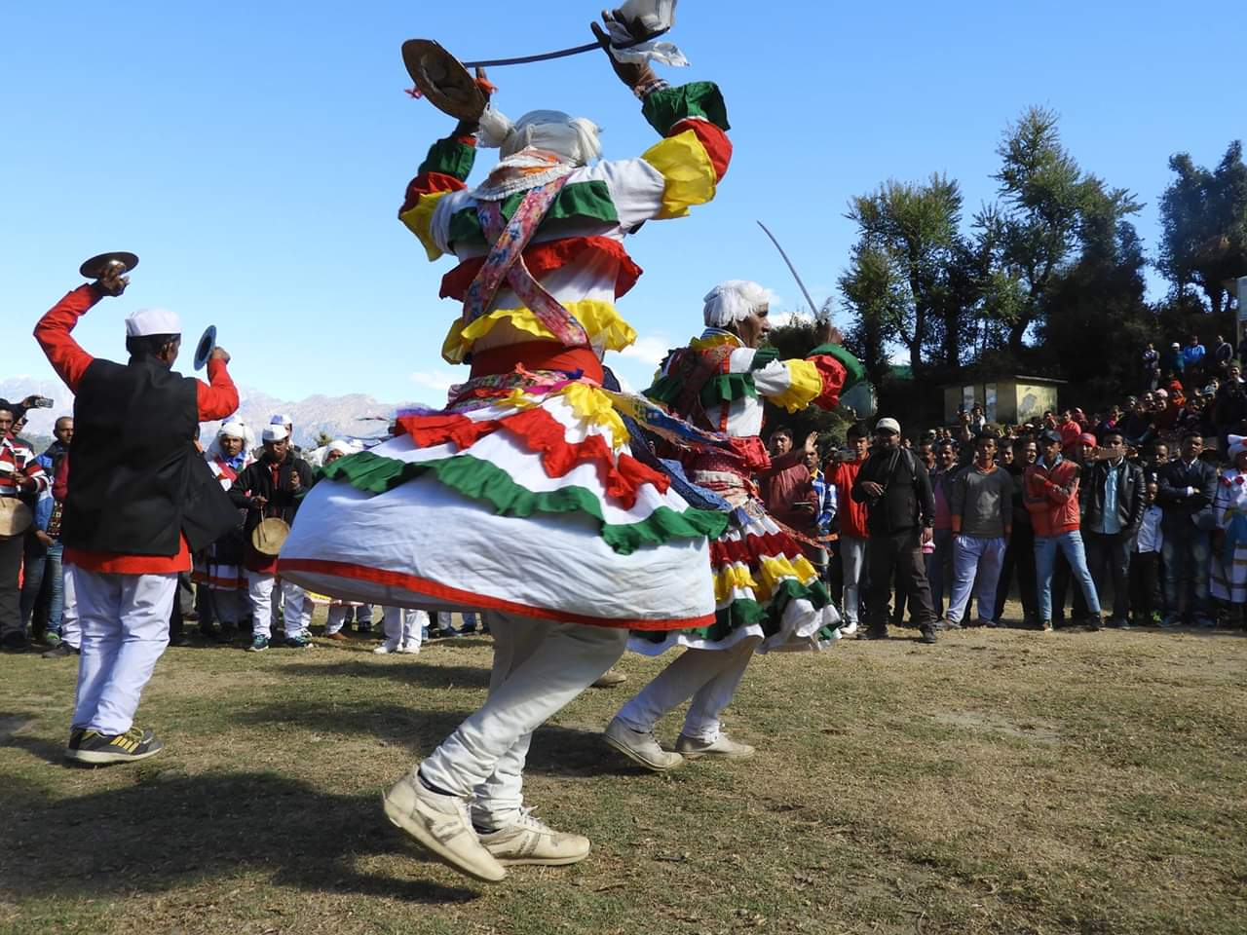
Thank You

