Slide 1
Mirlan Zholdoshbaev
BIO-KG Federation of Organic Development
E-mail: Mirtourkg@gmail.com
IPROMO
Landscape approach for enhancing mountain resilience
Pieve Tesino /Ormea 02-18 July 2019

Slide 2
Education
Academy of Management under
the President of Kyrgyz Republic
Faculty of Economics and Management
Employment and main activities
Federation of Organic Development BIO-KG
Provide assistance to the Operations team on financial, administrative, HR and procurement matters related to the mandated projects, when and as needed and in full compliance with FOD BIO-KG rules and procedures.

Slide 3
Other interests (volunteer work, hobbies etc.)
Hobbies:
Photographing
Travel Club Membership
Team Sports
Interests:
Green economy development projects
Member of social and environmental groups
Creation of eco village

Slide 4
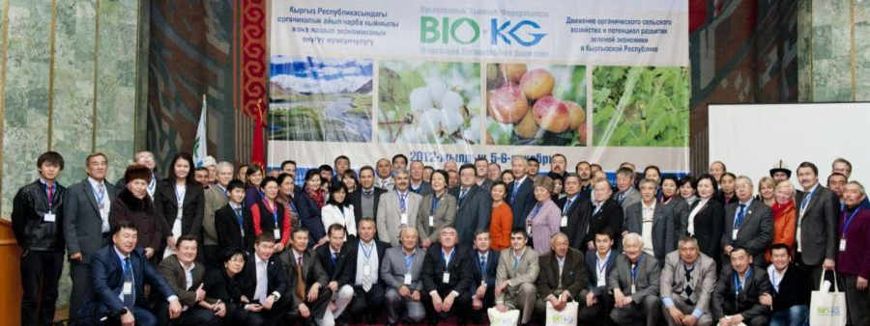
FOD BIO – KG – is an umbrella organization, which consolidates all stakeholders of organic agriculture, was created in 2012
Mission: Leadership by joint efforts of stepping up and support to organic movement in the Kyrgyz Republic and promotion of Organic Agriculture principles (health, ecology, fairness and care) as a beginning to shape agrarian policy in the country.
Vision: Organic agricultural products production system set up and runs in the Kyrgyz Republic, as the basis for food and nutrition security, retaining cultural heritage and development of ecosystems

Slide 5
Consolidation of stakeholders of organic movement, creation of atmosphere of active cooperation with civil society and partnership environment
The country work tour on informing and promotion of organic agriculture:
7 regions, more than 1500 participants (farmers and local government).
Annual Organic Congress and Fair-Exhibition:
2012-2018, more than 100 producers, more than 1100 farmers,
more than 2500 participants, 15000 visitors, 15 countries.
Cooperation with international organic movement, international organizations and stakeholders of organic agriculture in Kyrgyzstan:
Membership in IFOAM Global, IFOAM Asia, IFOAM Euro-Asia
Membership in The Sun Movement
Membership in the Civil Alliance for Food and Food Security
Strengthening partnership relations with FOD members and potential partners:
Data base of FOD members created
Data base of organic farmers created
Active cooperation with partners

Slide 6
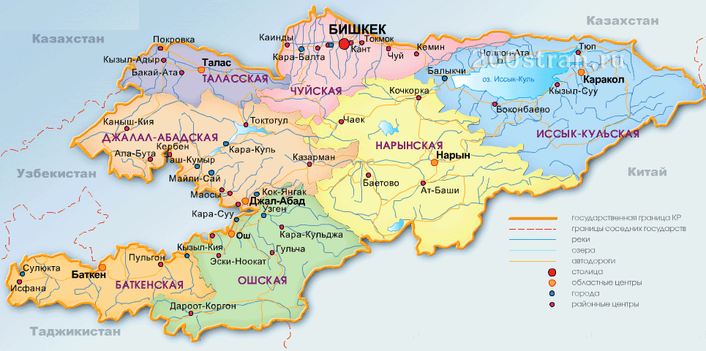
2020 – Kyrgyzstan is a country
of organic agriculture

