Slide 1


Personal presentation
Fabio Parisi
Mountain Partnership Secretariat
fabio.parisi@fao.org
IPROMO
Landscape approach for enhancing mountain resilience
Pieve Tesino /Ormea 02-18 July 2019

Slide 2
Education
2015 - 2016
Master of Science in Crisis and Security Management, Leiden University, The Hague, Netherlands
  Focus on crisis management / security studies / human rights law
2011 - 2014
Bachelor in Crisis and Security Management, Università degli Studi di Roma Tre, Rome, Italy
  Focus on international relations / international law / international economy
Employment and main activities
Mountain Partnership Secretariat, FAO, Rome, Italy
  Work on the SDG Indicator 15.4.2: the Mountain Green Cover Index
  Developement and update the indigenous mountain peoples database
Since 2017
2016 - 2017
Freelance Research, CLEVIS Research, Berlin, Germany
  Market research

Slide 3
Other interests (volunteer work, hobbies etc.)
Volunteer work:
Refugee Shelter ‘Baobab’, Rome, Italy
  Organization and coordination of the arrival of refugees to the shelter, assisting in travel arrangements
  organization of weekly events and activities for the integration of the refugees in the local community.
2015
Local committee ‘Miriam Mafai’, Rome, Italy
  Participation in several political campaigns at city and national level
  Coodination of the work carried out by the association.
  Organization of events for the local community
2012 - 2014
Personal Interests:
Rock climbing, hiking, cooking, performance art

Slide 4
SDG Indicator 15.4.2: The Mountain Green Cover Index
SDG 15 (Life on Land):
Protect, restore and promote sustainable use of terrestrial ecosystems, sustainably manage forests, combat desertification, halt and reverse land degradation, halt biodiversity loss
TARGET
15.4
By 2030, ensure the conservation of mountain ecosystems, including their biodiversity, to enhance their capacity to provide benefits essential for sustainable development
2016: Mountain Green Cover Index (SDG Indicator 15.4.2) adopted as one of the official indicators for target 15.4
Developed by FAO Mountain Partnership Secretariat in cooperation with other FAO teams
In 2017, the methodology is accepted internationally and a baseline is built

Slide 5
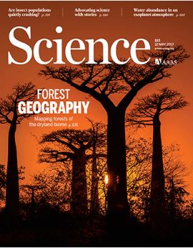
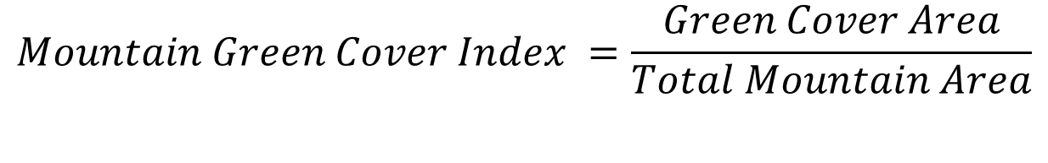
SDG Indicator 15.4.2: Definition, Rationale, Calculus
SDG Indicator 15.4.2 Mountain Green Cover Index: measures the changes of green vegetation and land cover in mountain areas - i.e. trees, shrubs, grassland, cropland, wetland, settlements, other land (IPCC) – to monitor progress on the mountain target.
There is a direct correlation between the green coverage of mountain areas and their state of health, and as a consequence their capacity of fulfilling their ecosystem roles.
$$Mountain Green Cover Index =\frac{Green Cover Area}{Total Mountain Area}$$
The index has a range from 0 to 1, where 0 indicates no green vegetation and 1 indicates that the entire area is covered by green vegetation.

Slide 6
SDG Indicator 15.4.2: Methodology
Mountains are classified according to the UNEP-WCMC Classification (Kapos)
Land Cover Classess follow the IPCC Classification
  Green Cover Classes = Forest Land; Cropland; Grassland-Shrubland
  Other = Other Land; Wetlands; Settlments
Data is collected and analyzed using Collect Earth, a software application developed by FAO and Google for land cover/use assessments
120,000 sampling plots have been collected and assessed in mountain areas
Global accuracy is 99%
  It decreases at country level

Slide 7
Thank for your attention!

