Slide 1
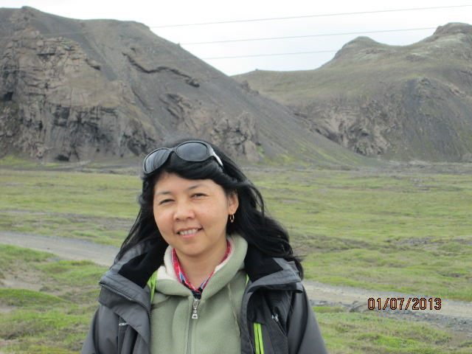
Personal presentation
Zhyldyz Shigaeva
Mountain Societies Research Institute (MSRI)/University of Central Asia
Zhyldyz.shigaeva@ucentralasia.org
IPROMO
Landscape approach for enhancing mountain resilience
Pieve Tesino /Ormea 02-18 July 2019

Slide 2
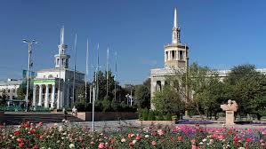
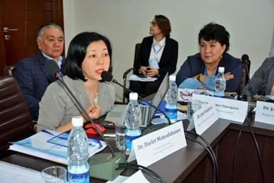
Education
International University of Kyrgyzstan, Bishkek, Faculty: Ecology and biotechnogy, Master in environmental science (2000)
PhD in ecology, topic: Assessment of ecological status of land resources and land use trasformation in Kyrgyzstan (2008)
Employment and main activities
Research Fellow in Mountain Societies Research Institute/UCA
Main research fields: natural resource management and governance (pasture and forest), rural livelihoods, sustainable mountain development

Slide 3
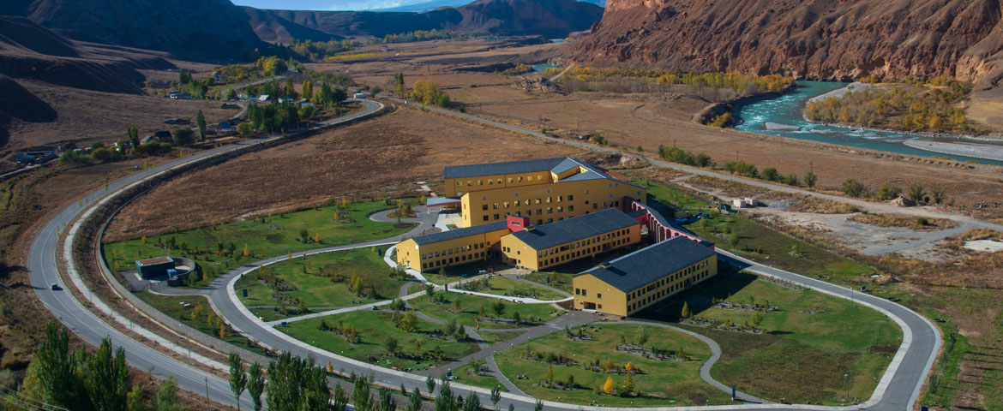
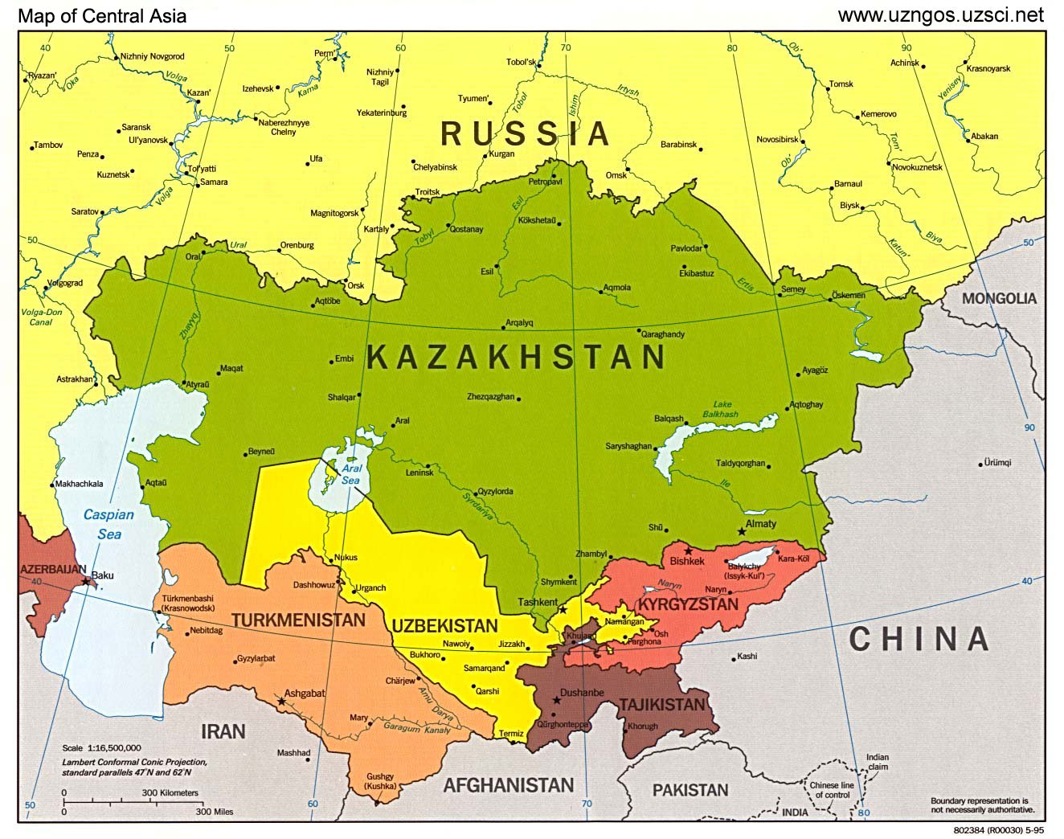
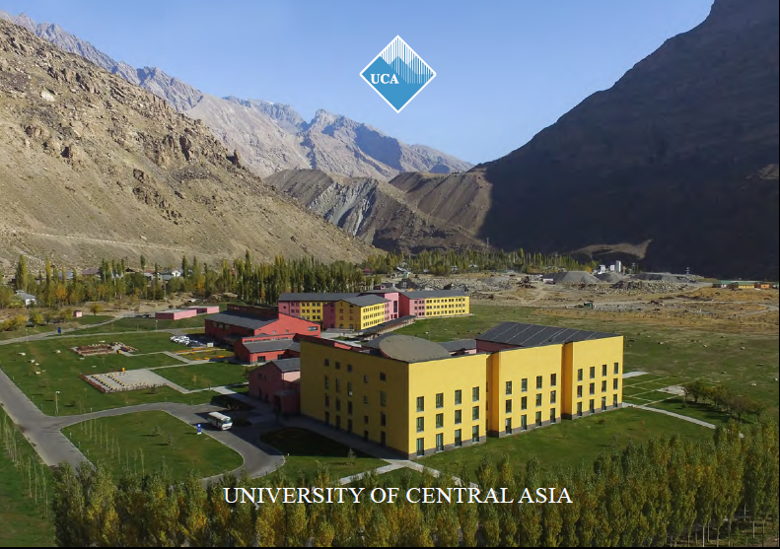
Kyrgyzstan, Naryn
Tajikistan, Khorog
https://www.ucentralasia.org/Research/MSRI/EN

Slide 4
Other interests (volunteer work, hobbies etc.)
Traveling, yoga, to read books and watch films

Slide 5
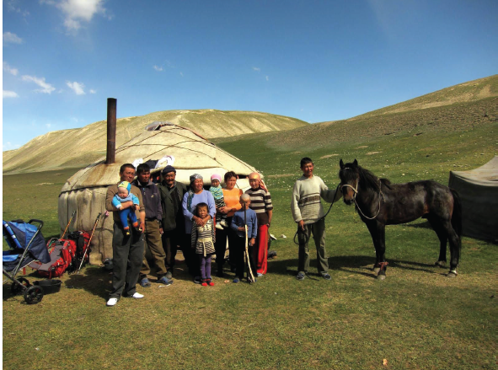
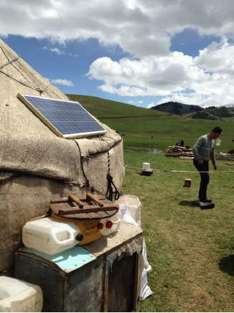

Slide 6
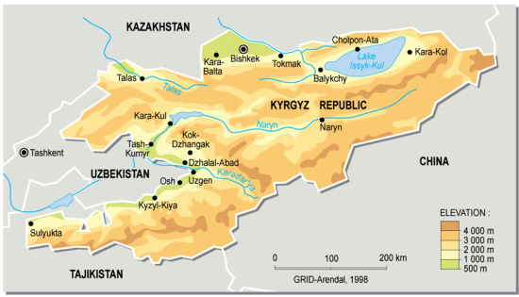
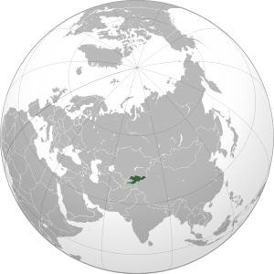
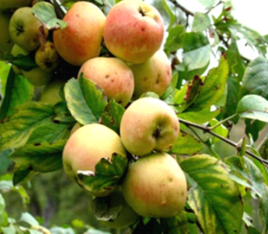
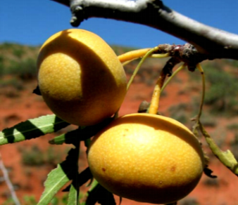
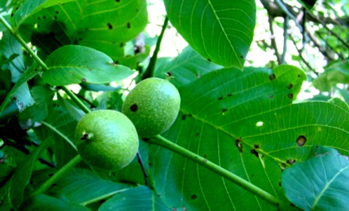
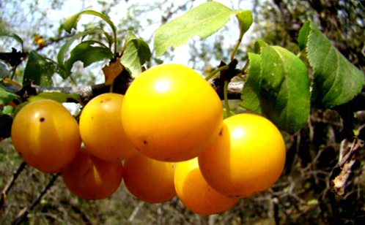
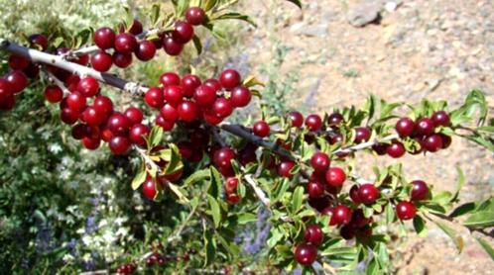
Project: The Contribution of the Underutilised Species in the Walnut-Fruit Forests to the Local Livelihoods in Kyrgyzstan
http://www.agrowebcee.net/awkg/forestry/forest-ecology-and-biodiversity-conservation/; last accessed: 27.05.2017

Slide 7
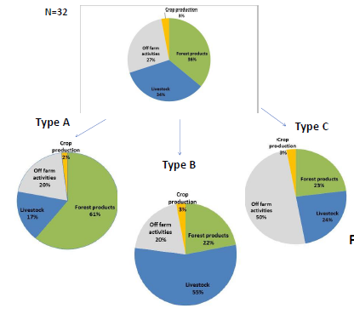
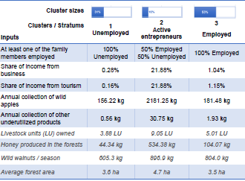
Some results
Species contributing to the local livelihoods

Slide 8
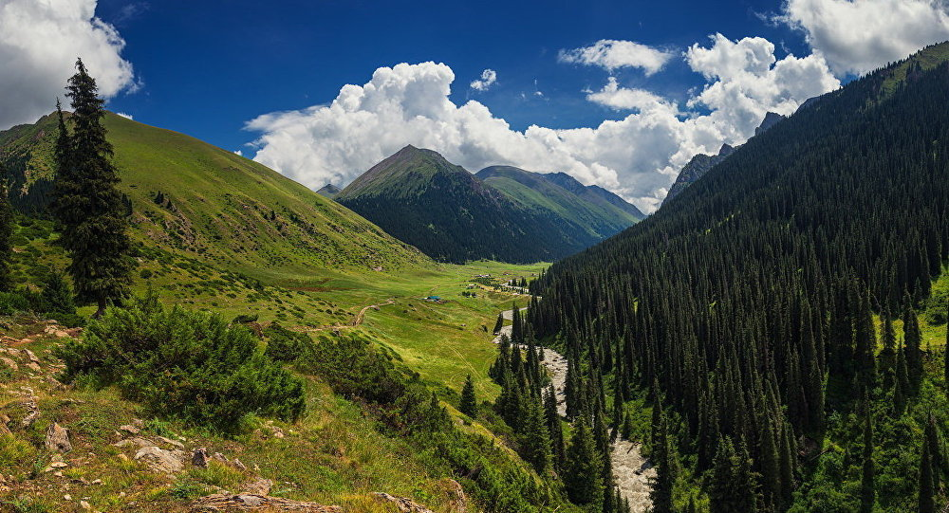
Thank for your attention!
Thank you for your attention!

