Slide 1

Personal Presentation
Name: Sonam Tashi
Department of Forests and Park Services, Bhutan
E-mail: stashi@moaf.gov.bt
IPROMO
Landscape approach for enhancing mountain resilience
Pieve Tesino /Ormea 02-18 July 2019

Slide 2
Education
M.Sc Forestry, Forest Research Institute, India
B.Sc Botany and Zoology from Royal Univeristy of Bhutan
Employment and main activities
Position title: Forestry Officer
Institution: Department of Forest and Park Services, Ministry of Agriculture and Forests, Royal Government of Bhutan.
Role: Section head of Resource A under Divisional Forest Office, Bumthang, Department of Forest and Park Services.
Duties:
Participates and helps in formulating forest plans, policies and programs in accordance with five year plan of the Country.
Develop forest management plans and operational plans for both Forest Management Unit and for Outside FMU.
Supervises and evaluates the work programs of FMU in Timber extraction from FMUs.
Current Project
  Involved in Local Forest Management Plan and Biological Corridor management
  Which is under the project “Enhancing sustainably and climate resilience of Forest and Agricultural landscape and community Livelihood” UNDP program funded by GEF/LDCF/SCCF trust fund

Slide 3
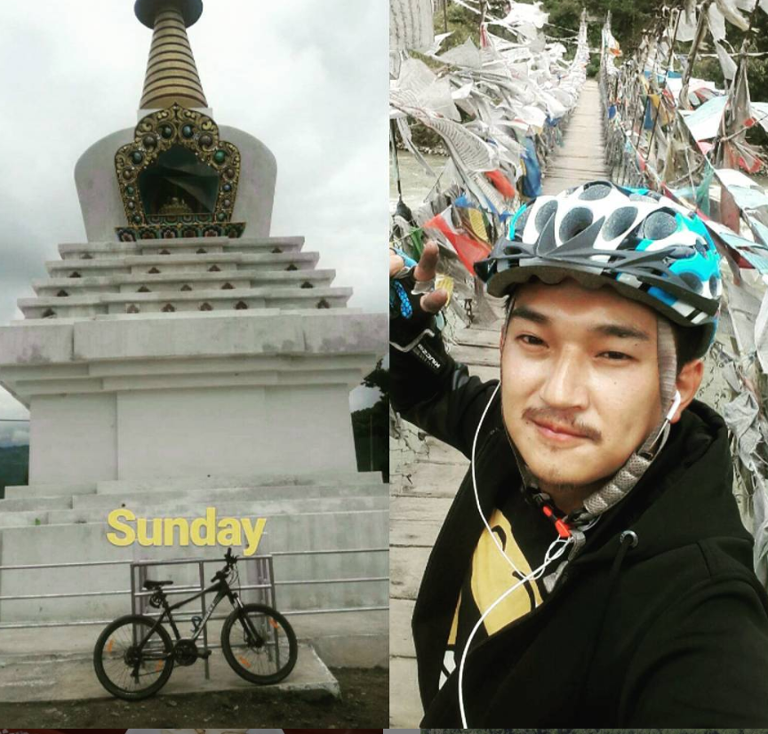



Other interests (volunteer work, hobbies etc.)
Hobbies :
Mountain biking
Reading
Travelling
Basketball
Volunter works
Plantation works
Cleaning campaigns
www.instagram.com/thefunnymind/
https://www.facebook.com/sompeltashi
+97517472207

Slide 4
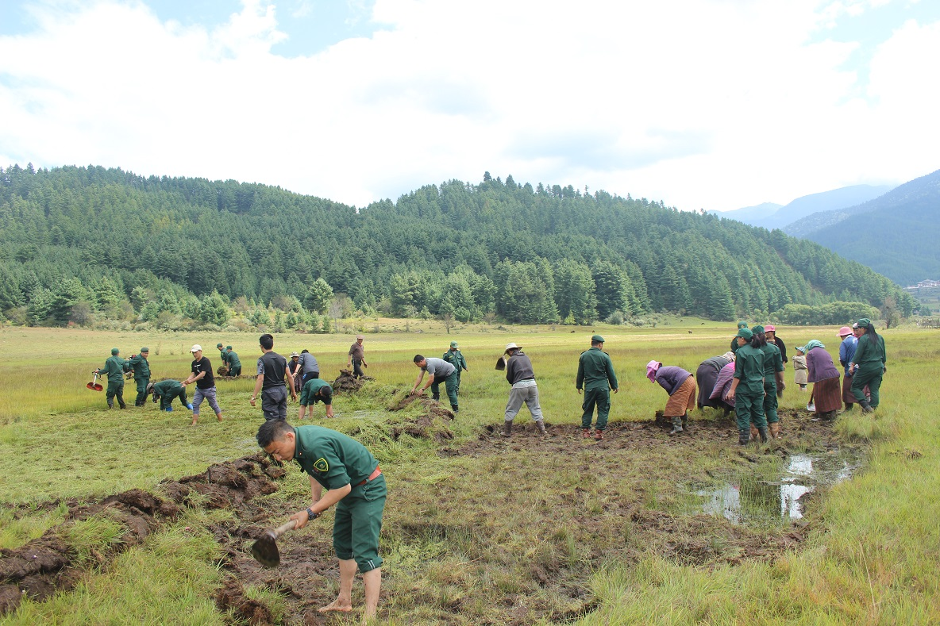
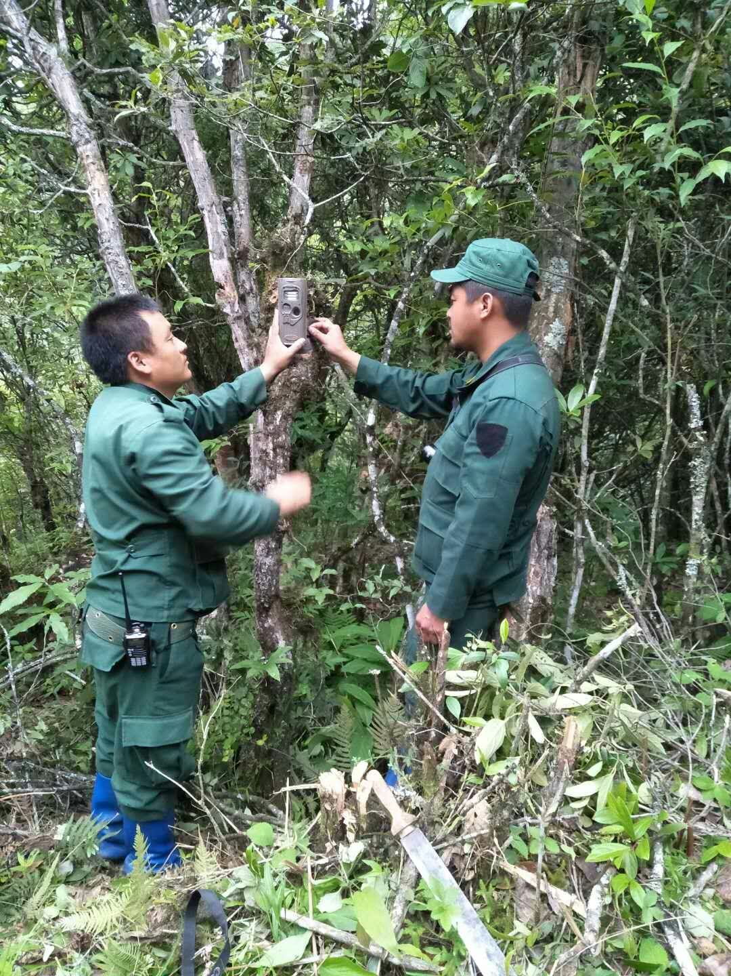
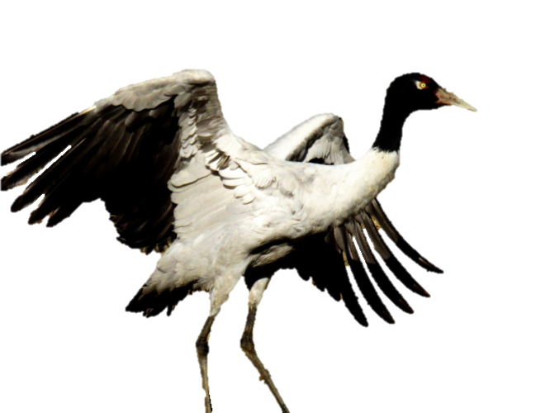
Project Involved

Slide 5
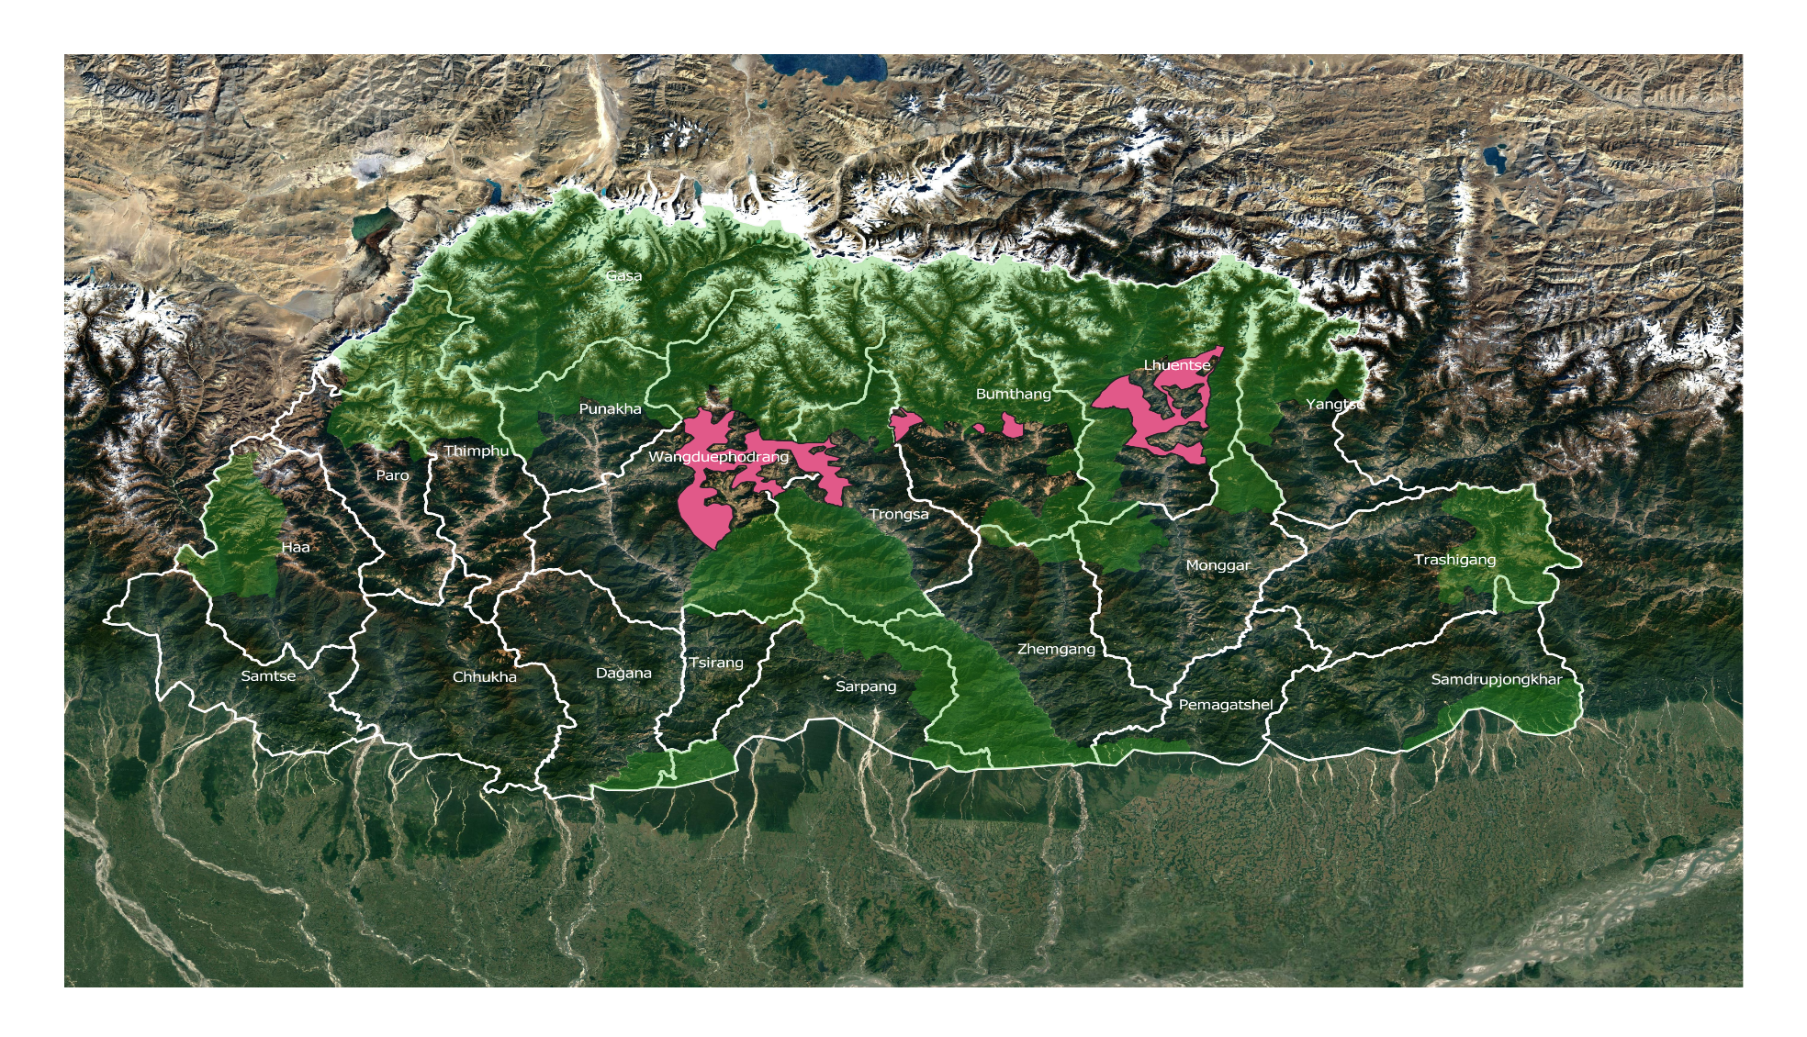
Projects involved
  Sustainable management of Forest through planning various management plans.
  I am also involved in management of Biological Corridor No. 8 which connects four national parks.

Slide 6
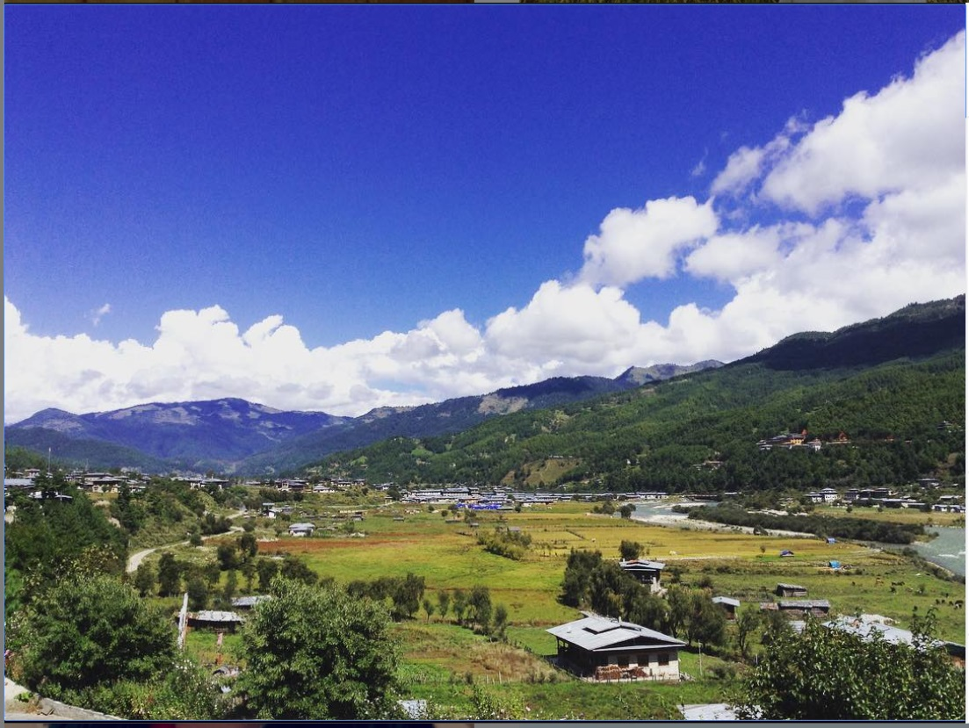
Thank for your attention!
Bumthang Valley where I work

