Slide 1
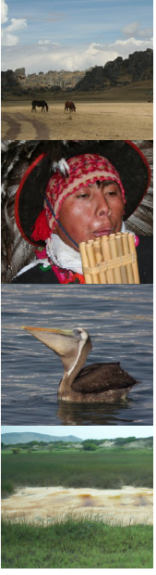
Personal Presentation
Name
Yumi Matsuno Remigio
Affiliation
OIKOS
E-mail
ymatsuno@oikos.pe
IPROMO
Landscape approach for enhancing mountain resilience
Pieve Tesino /Ormea 02-18 July 2019

Slide 2


Education
M.Sc. in Applied Ecology (A.B.D), 2017-2018.
National Agrarian University La Molina (UNALM), Graduate School.
Diploma in Wildlife Management, 2017.
OIKOS / UNMSM, Faculty of Veterinary Medicine.
Diploma in Biodiversity Management, 2017.
OIKOS / UNMSM, Faculty of Veterinary Medicine.
Bachelor of Veterinary Medicine (upper class), 2015.
National University of San Marcos (UNMSM), Faculty of Veterinary Medicine.

Slide 3



Employment and main activities
Academic coordinator
Environmental Diplomas 2019 in Wildlife Management and Biodiversity Management

Slide 4


Other interests
Organizer of the event
II Carnival for the Mountains
High-end cinema
Photographic exhibition
Children's area - workshops and games
Dialogues and talks
Music, adventure sports

Slide 5
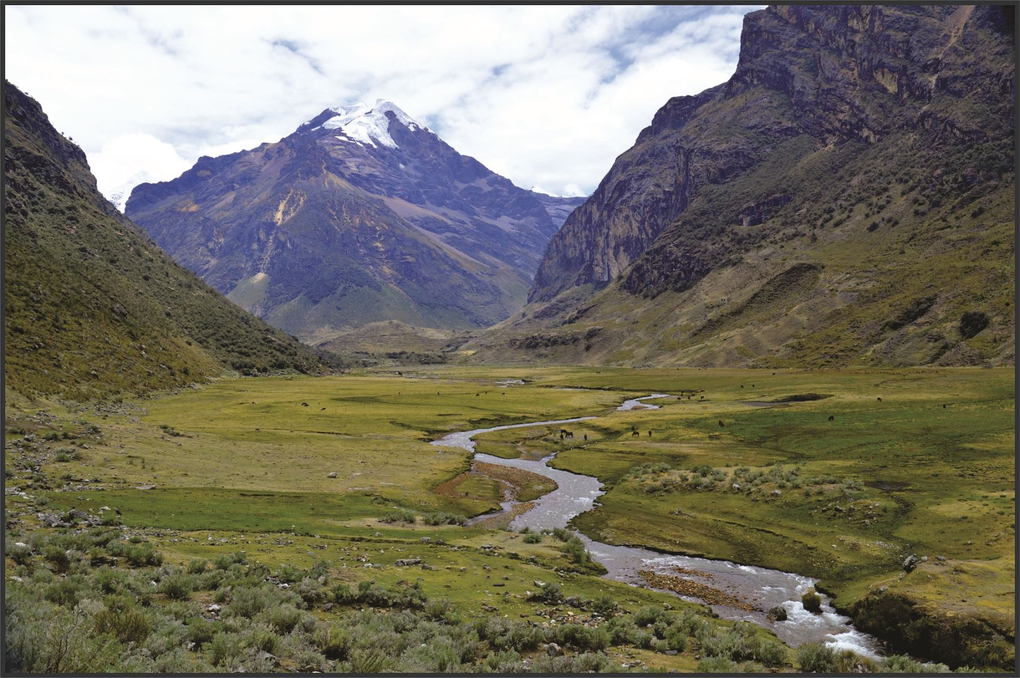
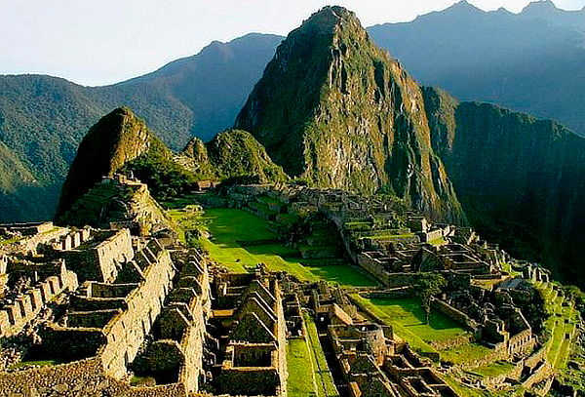
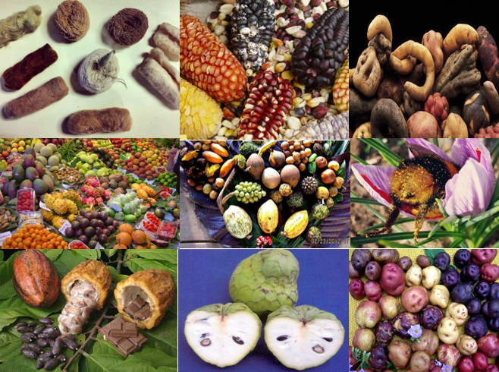
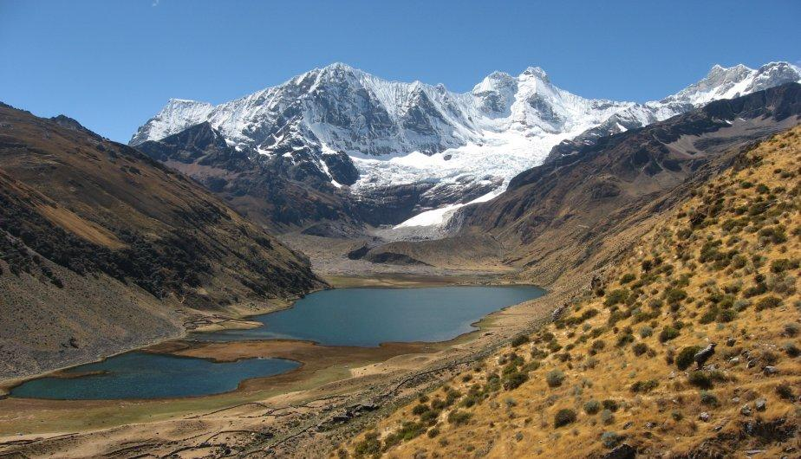


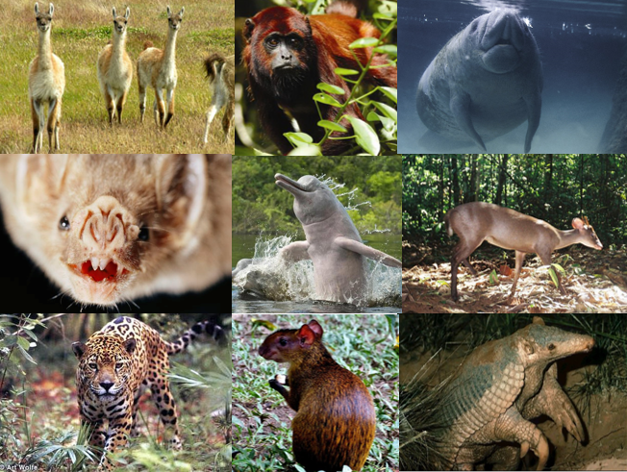
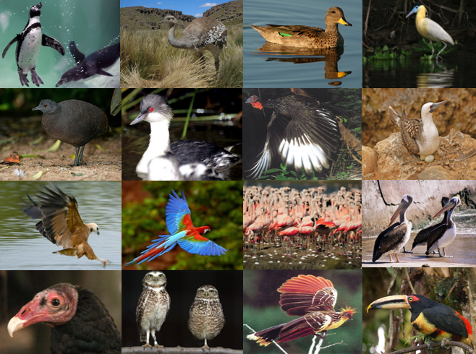

Slide 6



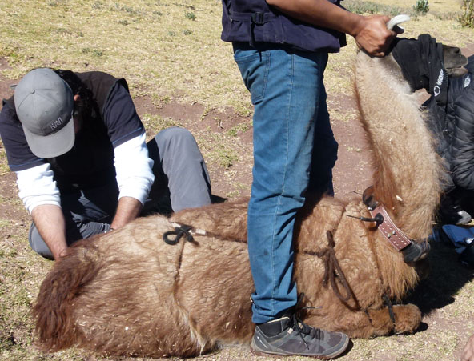
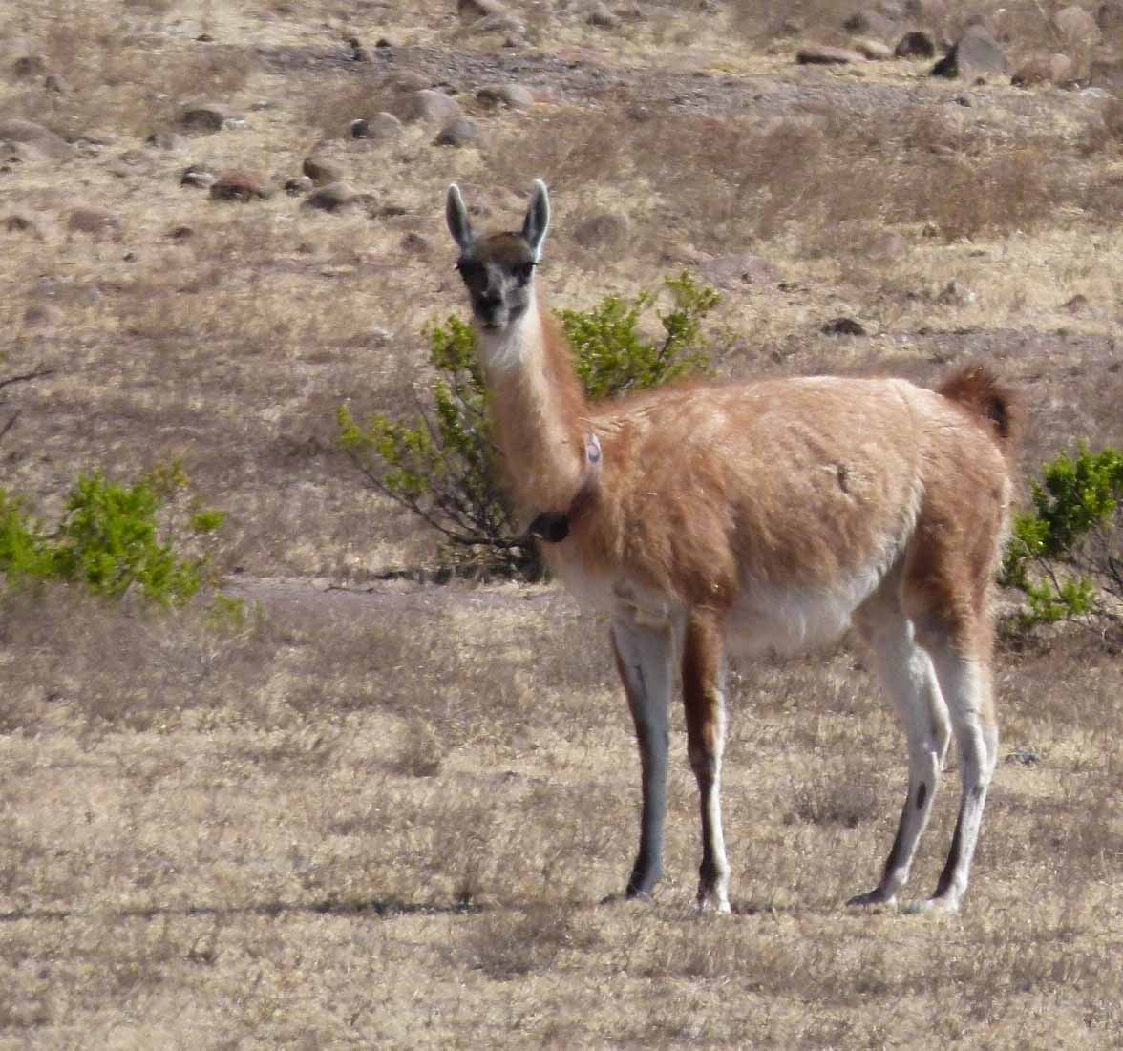
Research assistant of Project
"Genetic Variability and Spatial Ecology of Guanaco (Lama guanicoe cacsilensis) in Peru"

Slide 7
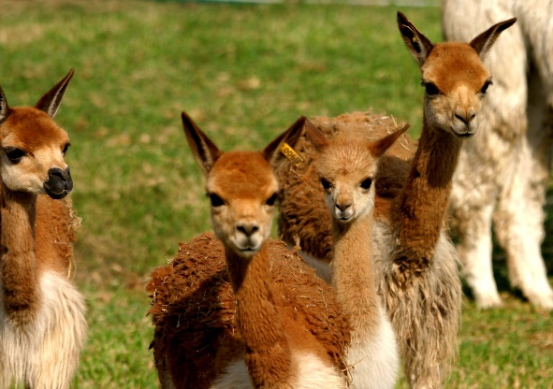

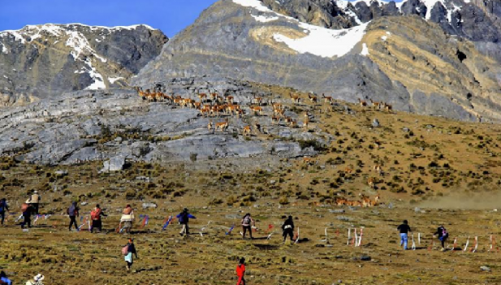
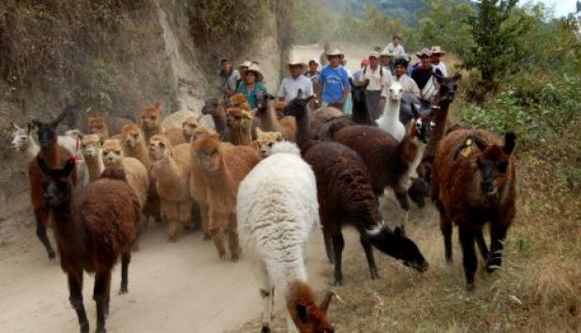

Technical specialist of Project
Ecosystem-based Adaptation and Financing for Alpacas Herders and Vicuña (AbE-FAV)
…In progress

