Slide 1
Personal presentation
Zahra Najarzadeh
parisanjarzadeh1982@gmail.com
IPROMO
Landscape approach for enhancing mountain resilience
Pieve Tesino /Ormea 02-18 July 2019

Slide 2
Education
B.S. Degree in Social Science
Mountain Climber with climbing degree
Official Sport Tourist Leader

Slide 4
Employment and main activities
An active member of the Mountain Environment Protection Society (MEPS) since 2011
Currently working at MEPS as a full time employee.
Collaborating with MEPS in its Projects as the facilitator and contact person with local women.
Mountain Environment Activist

Slide 5
Other interests (volunteer work, hobbies etc.)
Mountain Cyclist
A regular mountain climber
A permenant activist in mountain events such as clean up projects, workshops, seminars & gatherings and exhebitions.

Slide 6
The Land of Iran
Mountains cover more than %50 of the landscape.
Average height is 1000 meters asl.
Situated on the arid belt of the world, mountains provide more than %90 of the fresh water.
Mountains host a very rich biodiversity (Fauna & Flora), more than 8000 plant species have been identified up to now, 1700 endemic.
Majority of the urban and local dwellings are in or near the mountains.
Zagros and Alborz are the longest and highest ranges that consist of over a few hundred peaks above 3000 meter.
Mount Damavand, 5610 is the highest peak in Iran.

Slide 7
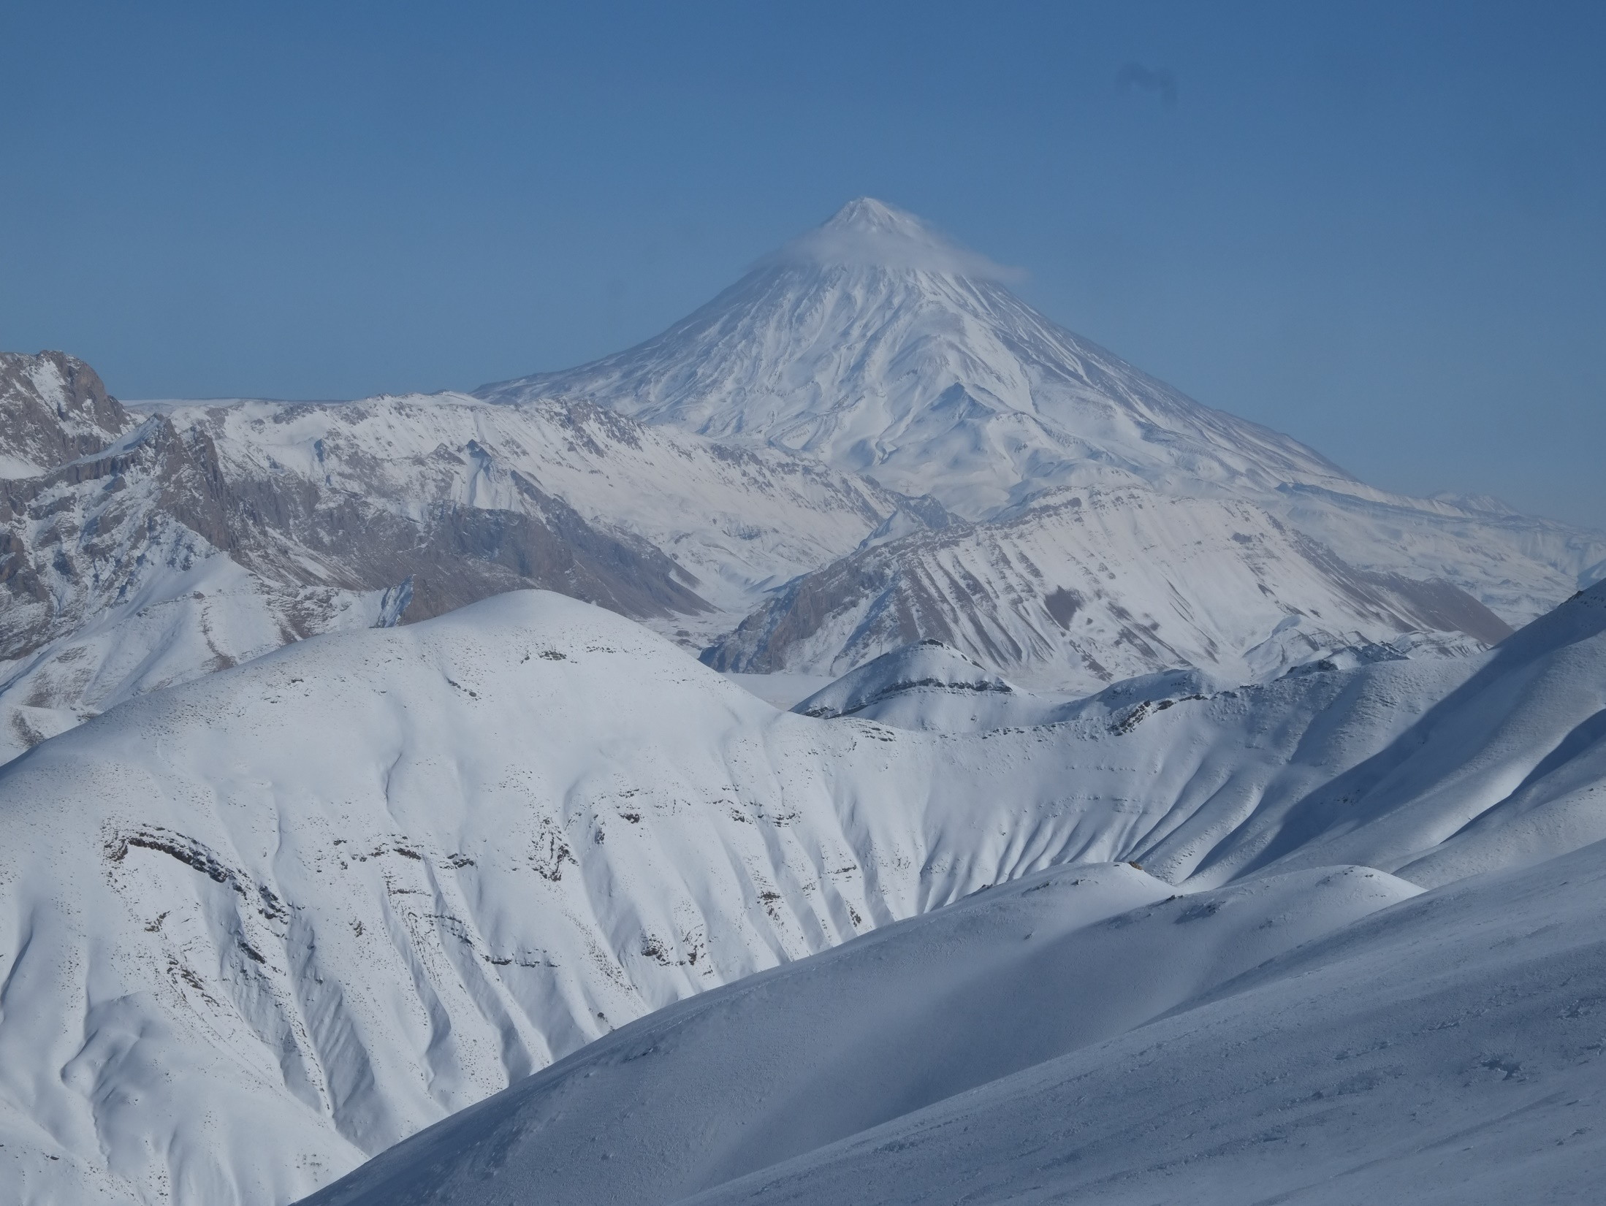

Slide 8
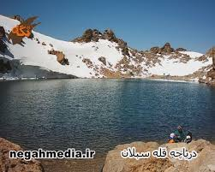
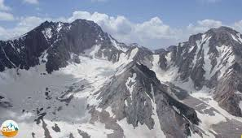

Slide 9
Thank for your attention!

