Slide 1
Key Messages from Bhutan+10 Climate Change, gender and Sustainable Development
Mountain Day 2:
COP 18, Doha Qatar
ICMOD, kathmandu, Nepal

Slide 2
BHUTAN 2002
CELEBRATING MOUNTAIN WOMEN!

Slide 3
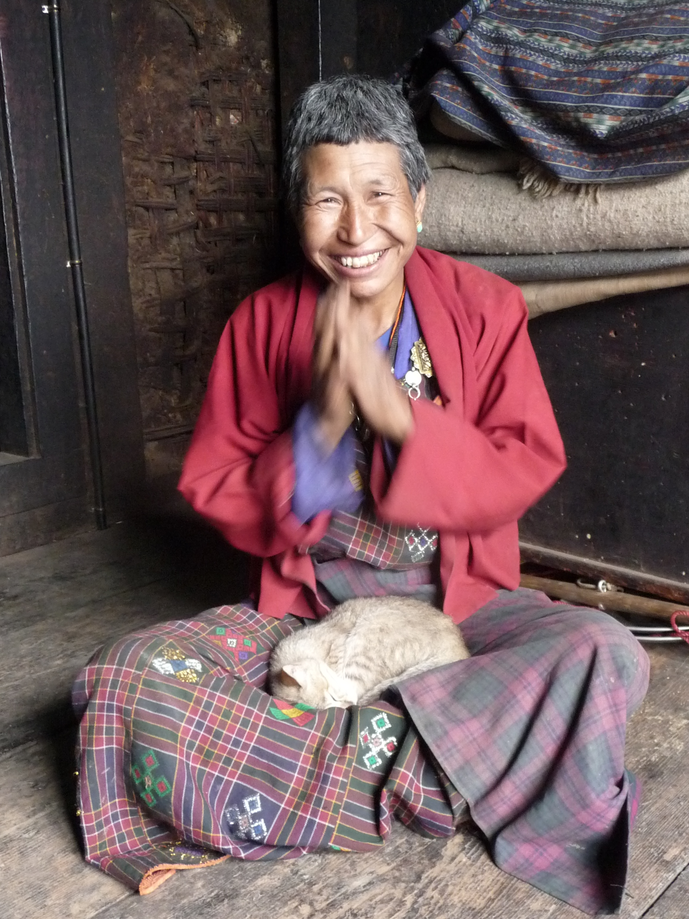
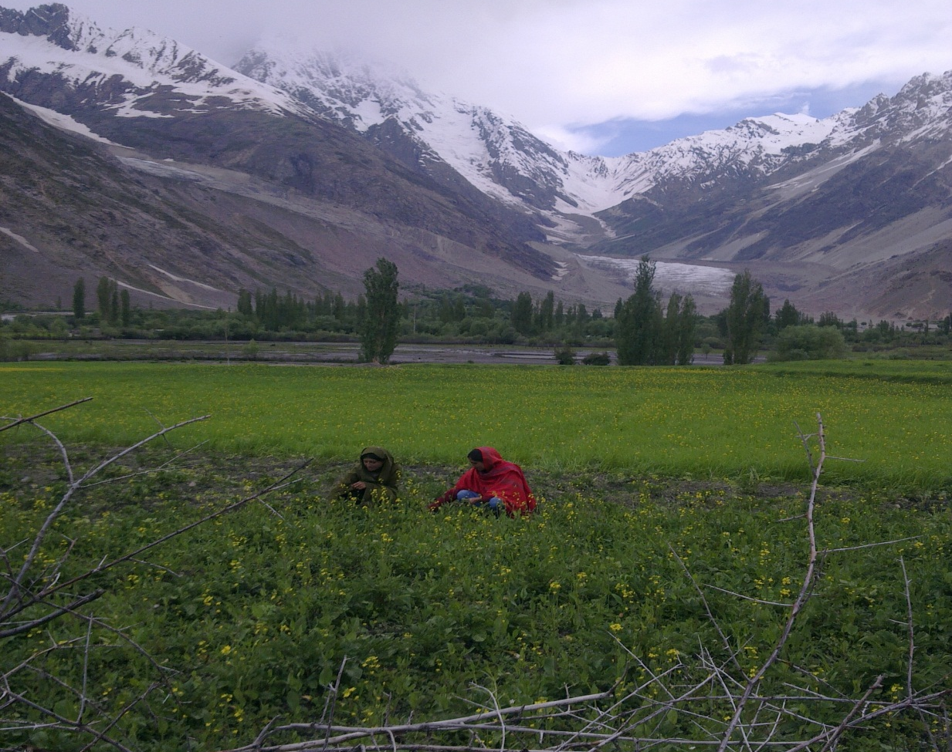
THE ‘SPECIFICITY’ OF MOUNTAIN WOMEN!

Slide 4
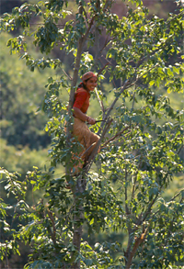
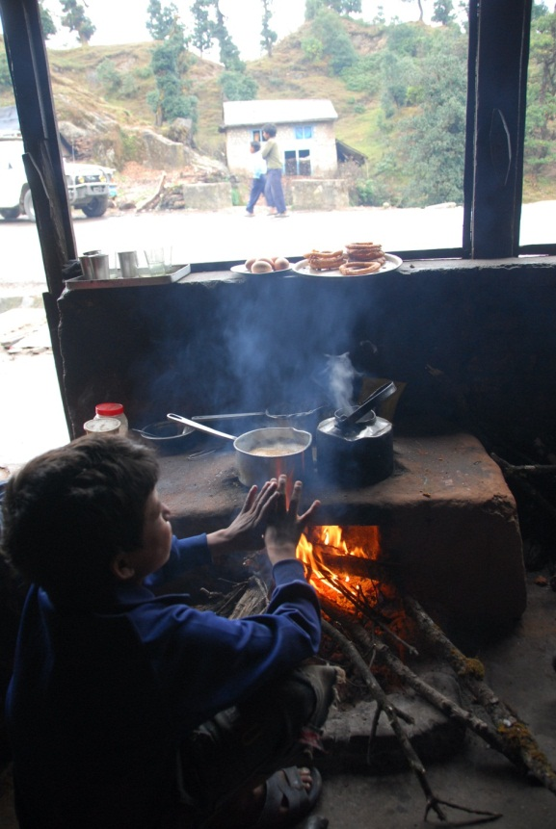
Greater physical labor Greater dependence on natural resources

Slide 5
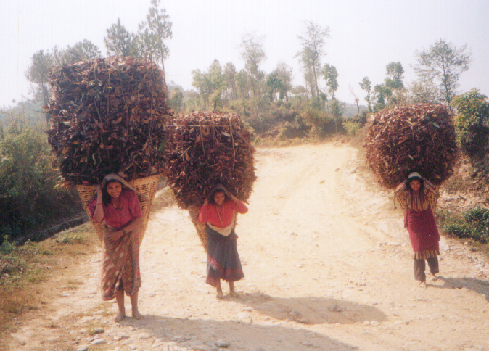
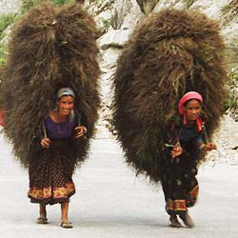

Slide 6
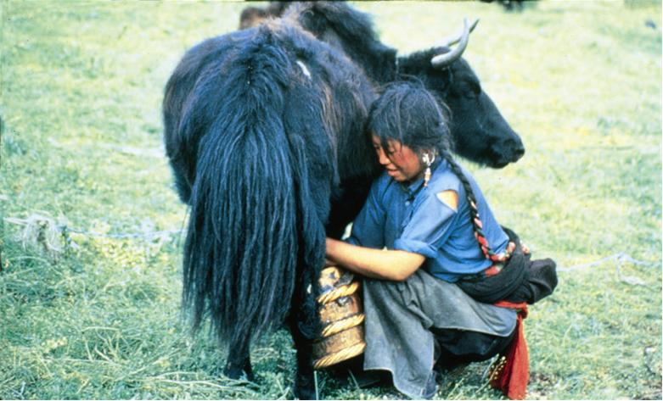
Limited exposure: Mkt, Tech, Communication Neglect by the State and development agencies

Slide 7
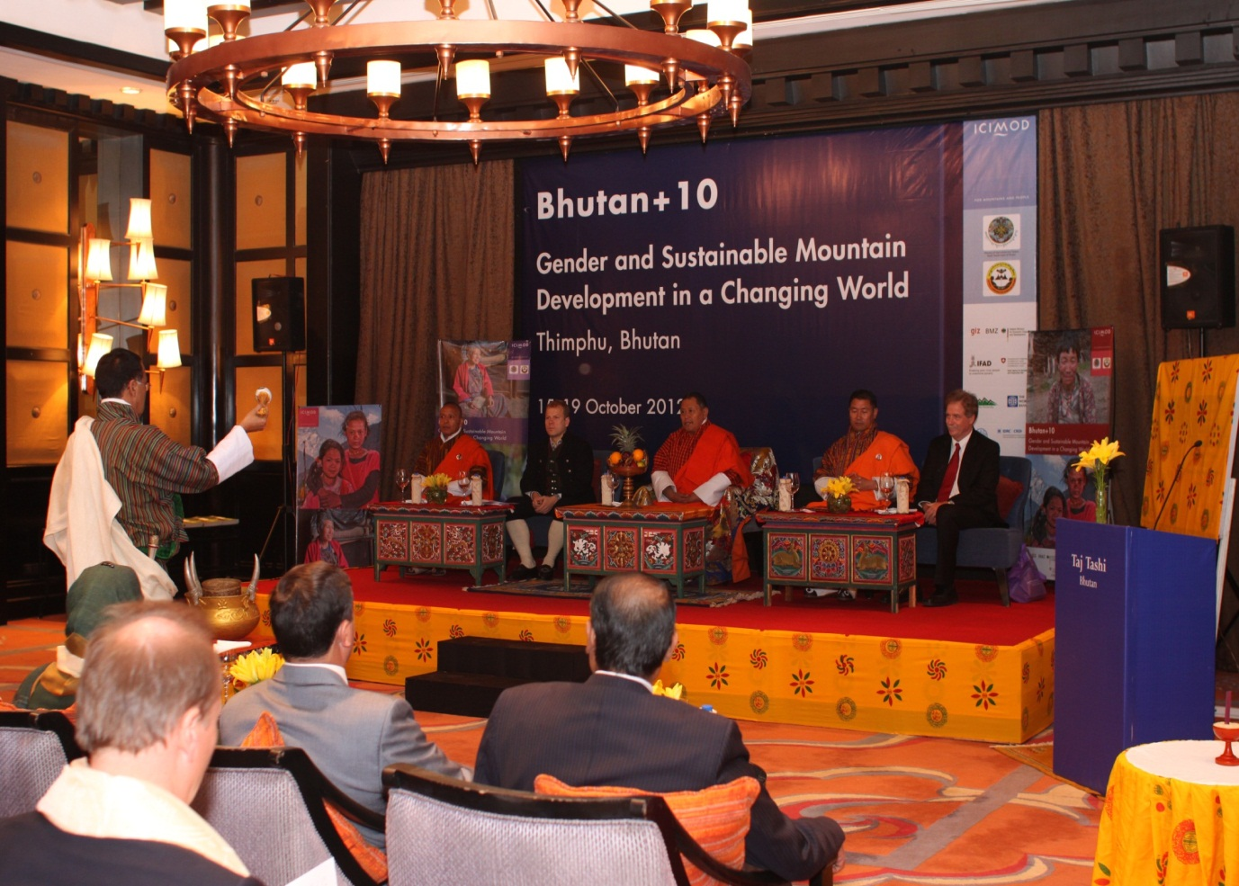
BHUTAN +10
GENDER AND SUSTAINABLE MOUNTAIN DEVELOPMENT IN A CHANGING WORLD

Slide 8
CONFERENCE THEMES
Livelihoods: Inclusive Sustainable Development
Governance: Gender responsive policies
Gender Positive Change
Water: Equitable Access, Control and benefits
Eco-systems: Benefit sharing, Access and Equity
Climate Change: Gender and Adaptation

Slide 9
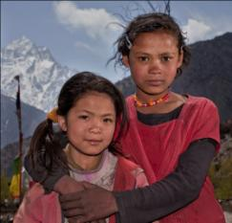
WOMEN AT THE FOREFRONT OF CC NRM, Food Security, Ecosystems, Water, vulnerability
OPPORTUNITIES
VULNERABILITIES

Slide 10
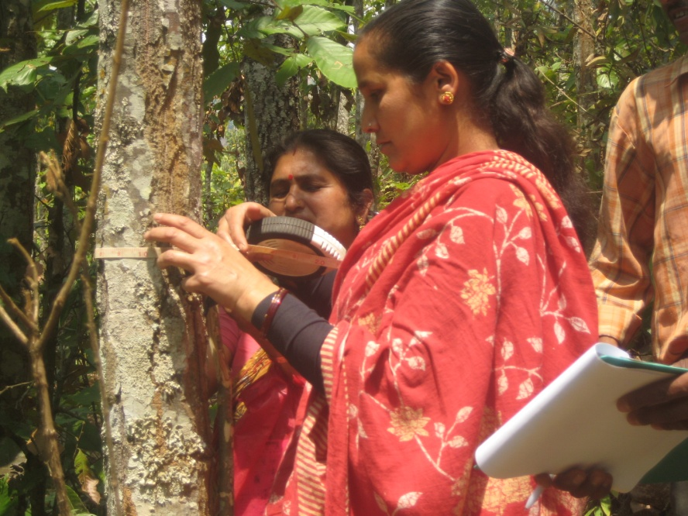
WOMEN AS GAME CHANGERS
Local knowledge
Acute perception of the situation

Slide 11
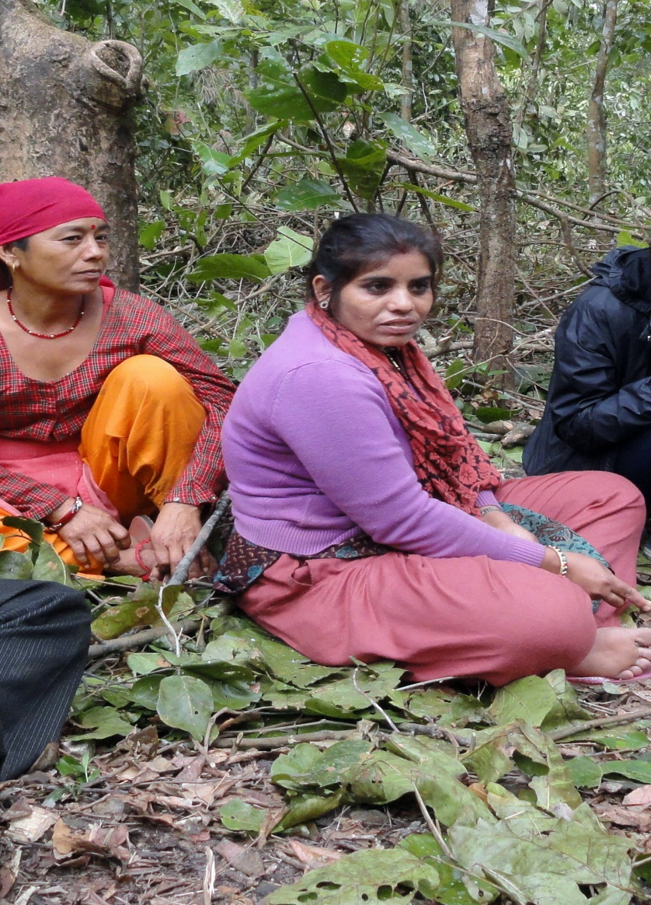
THE VULNERABILITY FACTOR
Representation Vs. Participation
Access to Resources
Disasters

Slide 12
Who are we talking about?

Slide 13
Climate Change and Migration
Climate Change
Decreased Agricultural production
Outmigration of Men
Other Drivers of Change
Feminization of Agriculture

Slide 14
Out Migration and Effect on Women’s Well Being
Psycho-social Changes
Increased social responsibility
Social Stress
Changes in Workload
Negotiating male labor
Taking on men’s work
Increased Market engagement
Negotiating with Men in Public Arena

Slide 15
The Big Debate
Women Centric Projects
Gender Transformative Change

Slide 16
What is Needed? Way Forward
Policy
Migration in the context of women’s role in the mountain economy
Labor rights and land rights!
Research and Evidence based research
More research to understand the mountain context.
Investment in mountain specific technology
Recognize women’s agency, knowledge and already existing adaptive capacities
Translation of results for different audiences
Target Women as Farmers and Agents of Adaptation
Documentation of ethnography and personal narratives
From anecdotal evidence to hard data.

Slide 17
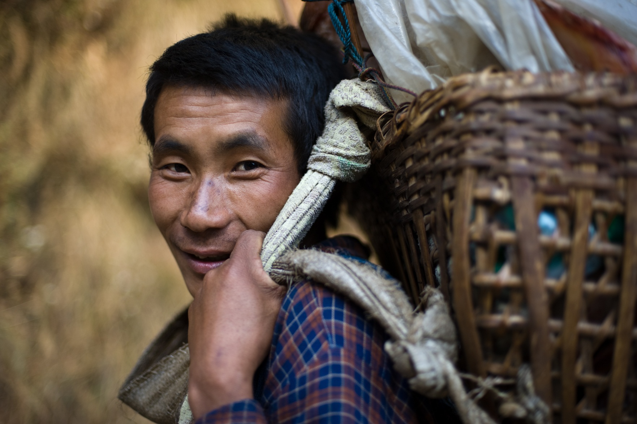

Slide 18
HICAP The Role of Women and Gender in Adaptation
Gender Research
Integrative Research
Common Questions on the Role of Women and Gender in Ecosystems, Food Security and Vulnerability (and components 1 & 2 where possible)
Capacity Strengthening
Networking and Policy
Gender Case Studies
Integrative gender analysis of new data
Cross-cutting Work
Focused Work
Capacity Strengthening on Gender Integration
Anti-evaporation strategy
Briefs
Partners
University
Researchers
NGOs
CBOs
Government
Policy
Regional
Programmatic
Gender Scoping Studies
RRAs on Gender and Climate Change
State of the art Literature Review on Gender and CC in the HKH
Papers/articles
Gender conceptual and methodological framework
Women’s Leadership
Networks
Roster of experts
Gender mapping
Interdisciplinary case studies
Women Environmental Leaders Video
Women’s groups
Needs and gaps assessment
Gender trainings
Influence

