Slide 1
Cutting the environmental cost of food production
Study Webcast

Slide 2
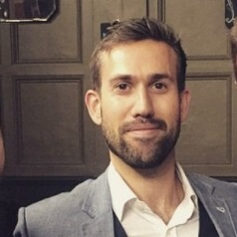
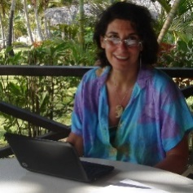
INTRODUCTION
Richie Hardwicke
Food and Agriculture sector lead –EMEA
Trucost
Nadia El-Hage Scialabba
Senior Natural Resources Officer
FAO, Rome
Libby Bernick
Senior Vice President
North America
Trucost
Chris Baldock
Senior Analyst
Trucost
United Nations agency specialized in food and agriculture and representing 194 member nations seeking to achieve food security for all.
Global leader in valuing natural capital and quantifying the economic consequences of natural capital dependency.

Slide 3
WEBCAST AGENDA
Why FAO commissioned this work?
What are the study findings?
Objectives, Scope, methods and data
What is the environmental cost of food production?
What are the opportunities for more sustainable food production?
What can you do?

Slide 4
Why FAO COMMISIONED THIS Work?

Slide 5
Why FAO commissioned the work – The study - What can you do
FAO Guidelines on Sustainability Assessment of Food and Agriculture systems (SAFA) include, among others:
Good Governance dimension (1/4 SAFA Dimensions)
Holistic Management (1/21 SAFA Themes)
Full-Cost Accounting (1/116 SAFA Indicators)
Sustainability Management Plan (1/2 Holistic Management indicators)
SAFA Stakeholders unanimously requested, in March 2013, that joint work be undertaken to develop practical ways for full-cost accounting for improving their triple bottom line assessments and reporting

Slide 6
Food Wastage Footprint: Full-Cost Accounting (FAO, 2014) quantified environmental externalities and social wellbeing lost due to environmental degradation:
Economic costs: USD 1055 billion (market value and subsidies)
Environmental costs: USD 696 billion (air, land, water, biodiversity)
Social costs: USD 882 billion (livelihoods, health, conflicts)
Methodological questions and uncertainties led to meeting the relatively small international community working on similar topics, such as TEEB, NCC and Trucost
FAO seeks to:
Raise enterprises awareness on the inter-dependency between production and natural resources (Nature’s free inputs)
Inform policy-makers in natural capital impacts, with a view to build synergies across agriculture and environmental constituencies
Improve data sets: UN System of Environmental and Economic Accounting since 2012 => towards SEEA Agriculture

Slide 7
The study Findings
OBJECTIVES, Approach, Methods, DATA

Slide 8
Why FAO commissioned the work – The study - What can you do
OBJECTIVES
Raise awareness of the invisible environmental costs of industrial food production
Present an indication of the magnitude, location specificity and source of these costs
Provide an example of a frameworks that can be used to measure the net environmental benefits associated with improvements in agricultural management practices

Slide 9
Why FAO commissioned the work – The study - What can you do
SCOPE
High –level materiality approach
Assessment covered
4 crops -wheat, maize, soy and rice
4 livestock commodities cow/beef, cow/dairy, pork and poultry
Covered industrial, large scale, intensive farming practices in over 40 countries
Included 80% of total production of each commodity
Accounted for the costs associated with both the cultivation phase as well as the supply chain associated with each individual commodity

Slide 10
Why FAO commissioned the work – The study - What can you do
IMPACTS
Crops
Livestock
Impact | Farming | Supply Chain
GHGs (from energy & non-energy sources) | ✓ | ✓
GHGs (from land clearing) | ✓ | ✓
Air pollutants | ✓ | ✓
Land pollutants | ✓ | ✓
Water pollutants | ✓ | ✓
Water consumption | ✓ | ✓
Land use change | ✓ | ✓
Impact | Farming | Supply Chain
GHGs (from energy & non-energy sources) | ✓ | ✓
GHGs (from land clearing) | ✓ | ✓
Air pollutants | ✓ | ✓
Land pollutants | - | ✓
Water pollutants | - | ✓
Water consumption | ✓ | ✓
Land use change | ✓ | ✓

Slide 11
Why FAO commissioned the work – The study - What can you do
METHODS -QUANTIFICATION
Farming
Supply Chain
Emissions are estimated by applying emissions factors that are:
Country-specific
Commodity specific
Emissions factor examples are:
tonnes CO2 per kg of meat
m3 water use per kg crop
Emissions factors are sourced from a variety of sources (see next slide)
Emissions are estimated by applying environmental intensities to financial transactions in Trucost’s input-output model
Environmental intensities
Emissions calculated per unit of revenue
Sources include FAO, IEA, EIA, USGS, LCA data…
Input-output model
Financial flows across 531 sectors
US Bureau of Economic Analysis

Slide 12
Why FAO commissioned the work – The study - What can you do
DATA
Non-energy related emissions
FAOSTAT emissions database – country-specific
Energy related emissions
Agri-footprint – country-specific
Ecoinvent – country-specific
Water consumption
Mekonnen and Hoekstra (2010) – country-specific
Land Use
Livestock: FAO SOL-model – country-specific
Crops: FAOSTAT

Slide 13
Why FAO commissioned the work – The study - What can you do
METHODS - VALUATION
A literature review was conducted in order to understand the magnitude of each environmental impact on receptors such as crops, ecosystems, human health and materials.
Secondary literature was used to estimate the social cost of these impacts – natural capital valuation
The valuations reflect the impact on ecosystems and the damage to human health.
Value transfer techniques were applied to make the valuations country-specific.

Slide 14
The study Findings
RESULTS

Slide 15
Study reveals $3 trillion environmental cost of industrial farming
Why FAO commissioned the work – The study - What can you do
On average:
68 percent of the impacts of livestock production can be attributed to operational activities taking place on the farm.
77 percent of the natural capital costs of crop production occur on the farm

Slide 16
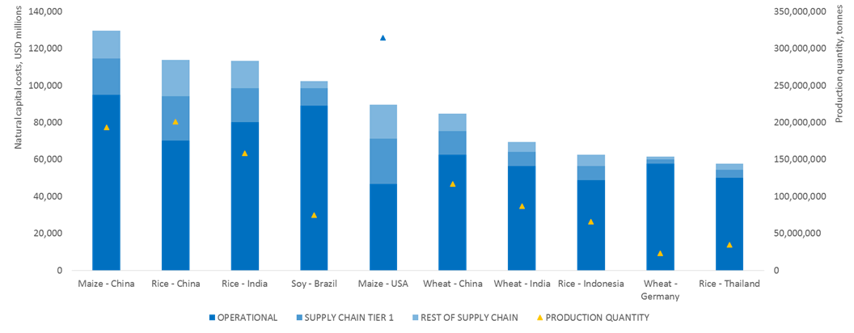
CROPS
Top 10 operational and supply chain natural capital costs of crop production by country

Slide 17
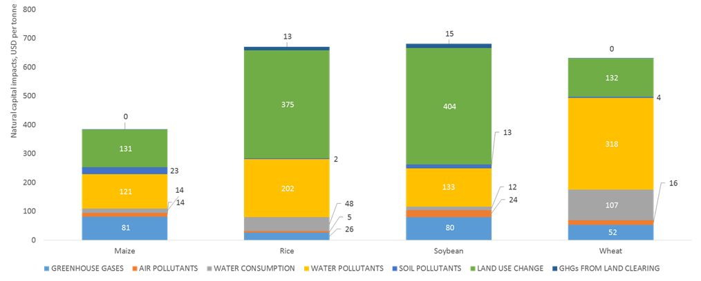
COMMODITY IMPACTS MATERIALITY
OPERATIONAL natural capital intensity of crop commodities (USD of impacts per tonne of production)

Slide 18
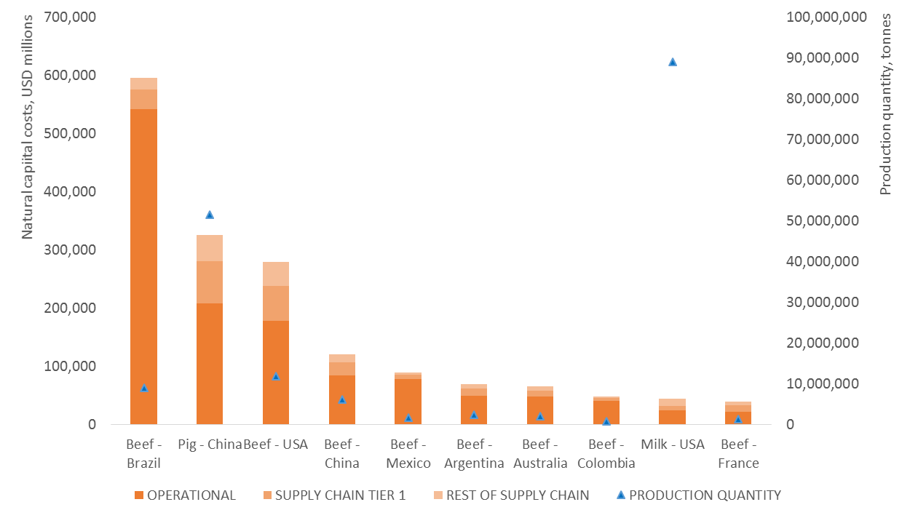
Why FAO commissioned the work – The study - What can you do
LIVESTOCK
Top 10 operational and supply chain natural capital costs of livestock production by country

Slide 19
Why FAO commissioned the work – The study - What can you do
IMPROVEMENT OPPORTUNITES EXIST
Beef: Holistic grazing management vs. conventional cattle grazing in Brazil
Rice: System of rice intensification (SRI) vs. conventional rice farming in India
Soy: Organic farming vs. conventional soybean farming in the USA
Wheat: Organic farming vs. conventional wheat farming in Germany

Slide 20
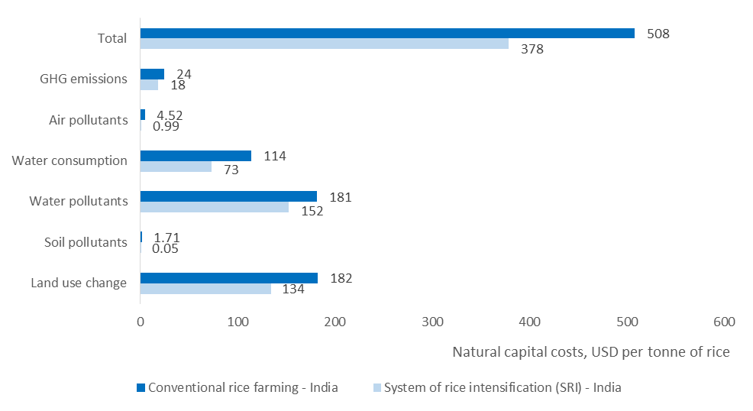
Why FAO commissioned the work – The study - What can you do
CASE STUDY SRI RICE IN INDIA
Monetary Value of the operational Impacts caused by producing one Tonne of RICE in INDIA

Slide 21
WHAT CAN you DO?

Slide 22
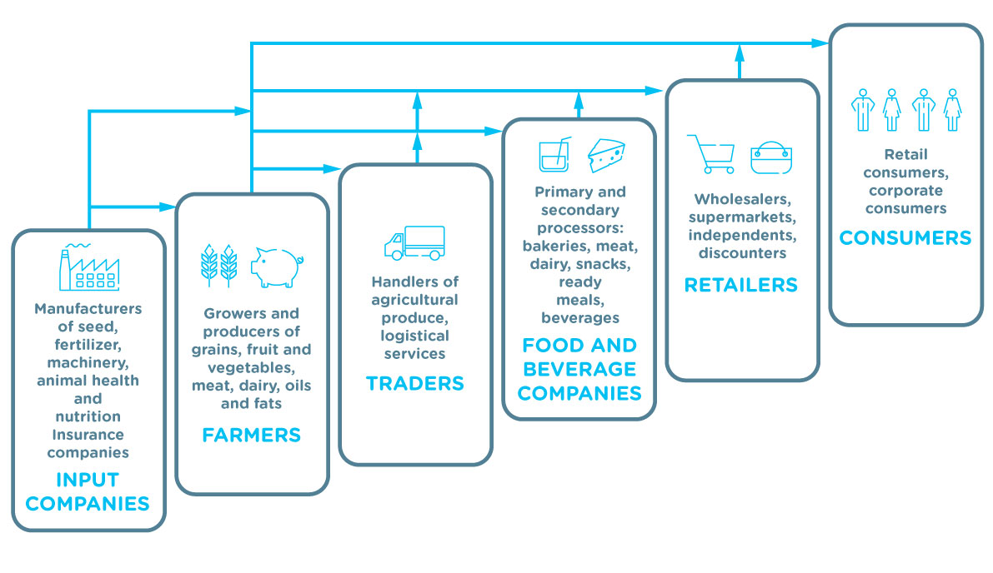
Why FAO commissioned the work – The study - What can you do
WE ALL HAVE A PART TO PLAY
Source: Natural Capital Coalition Food and Beverage Sector Guide: The Food and Beverage Value Chain

Slide 23
Why FAO commissioned the work – The study - What can you do
DECOUPLING ENVIRONMENTAL IMPACT

Slide 24
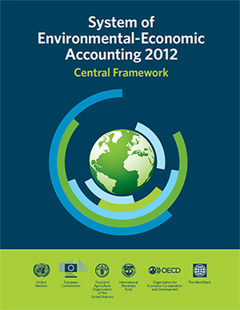
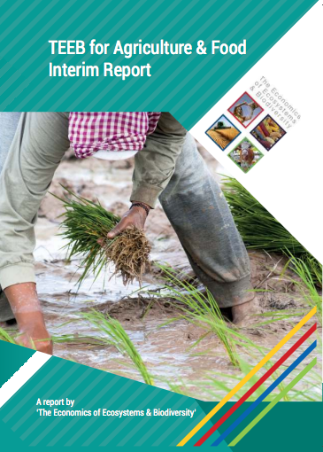
STANDARDISED FRAMEWORKS TO MEASURE IMPACT AND DEPENDENCY
Why FAO commissioned the work – The study - What can you do

Slide 25
THREE QUESTIONS
Why FAO commissioned the work – The study - What can you do
What is our interaction with Natural capital?
How do these impacts and dependencies drive risks and opportunities ?
How do these risks and opportunities effect the economics of our business or country

Slide 26
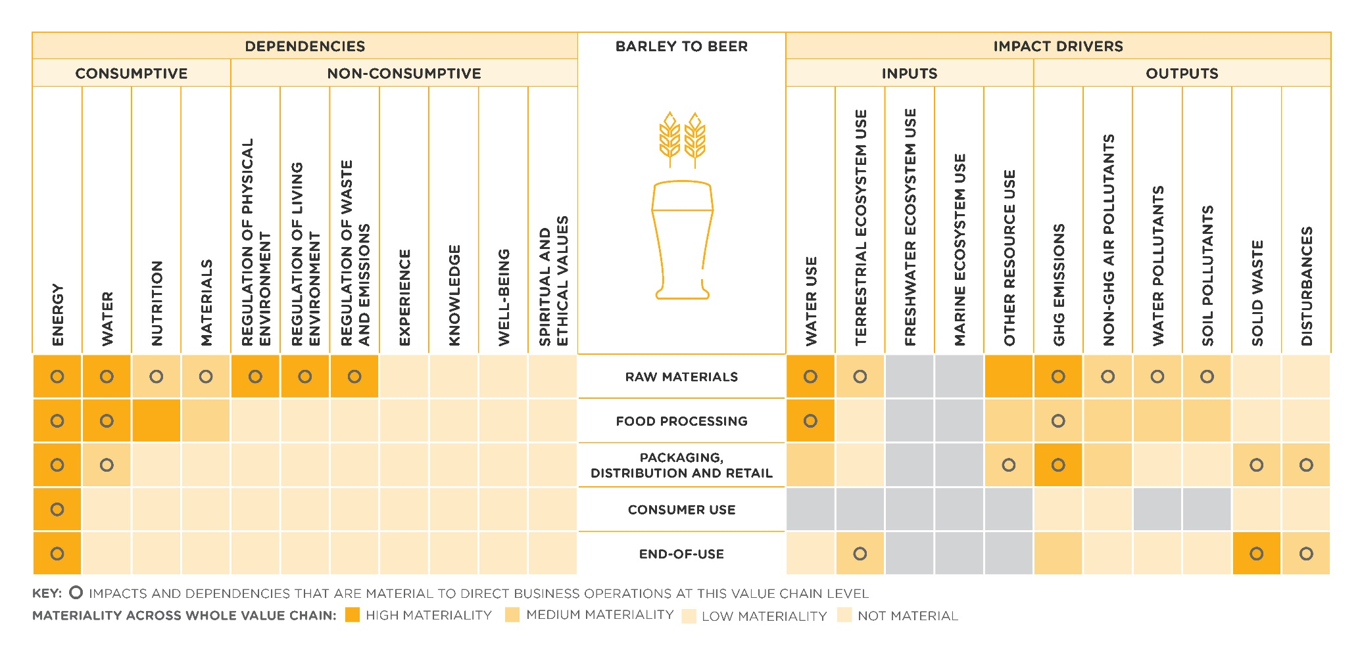
What is our interaction with Natural capital?
Why FAO commissioned the work – The study - What can you do
Source: Natural Capital Coalition Food and Beverage Sector Guide: Materiality Matrix for the value chain of barley used to produce beer

Slide 27
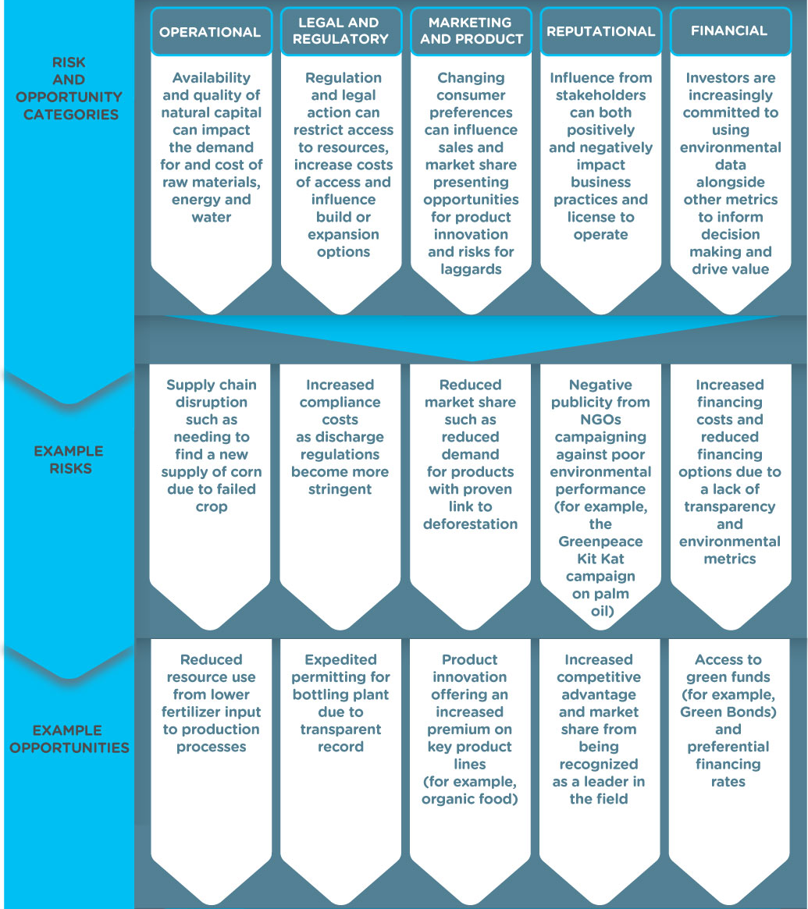
How do these impacts and dependencies drive risks and opportunities ?
Why FAO commissioned the work – The study - What can you do
RISK AND OPPORTUNITY CATAGORIES
Operational
Legal/ Regulatory
Marketing and product
Reputational
Financial

Slide 28
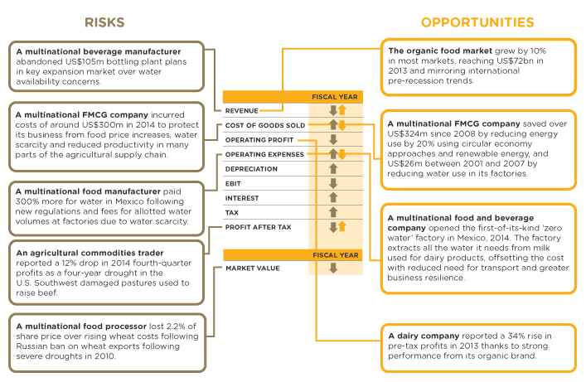
How do these risks and opportunities effect the economics of our business
Why FAO commissioned the work – The study - What can you do

Slide 29
QUESTIONS
Richie Hardwicke
Food and Agriculture sector lead –EMEA
Trucost
Nadia El-Hage Scialabba
Senior Natural Resources Officer
FAO, Rome
Libby Bernick
Senior Vice President
North America
Trucost
Chris Baldock
Senior Analyst
Trucost
Richie.hardwicke@trucost.com Nadia.Scialabba@fao.org
Libby.bernick@trucost.com Chris.baldock@trucost.com
United Nations agency specialized in food and agriculture and representing 194 member nations seeking to achieve food security for all.
Global leader in valuing natural capital and quantifying the economic consequences of natural capital dependency.

